Slide 1

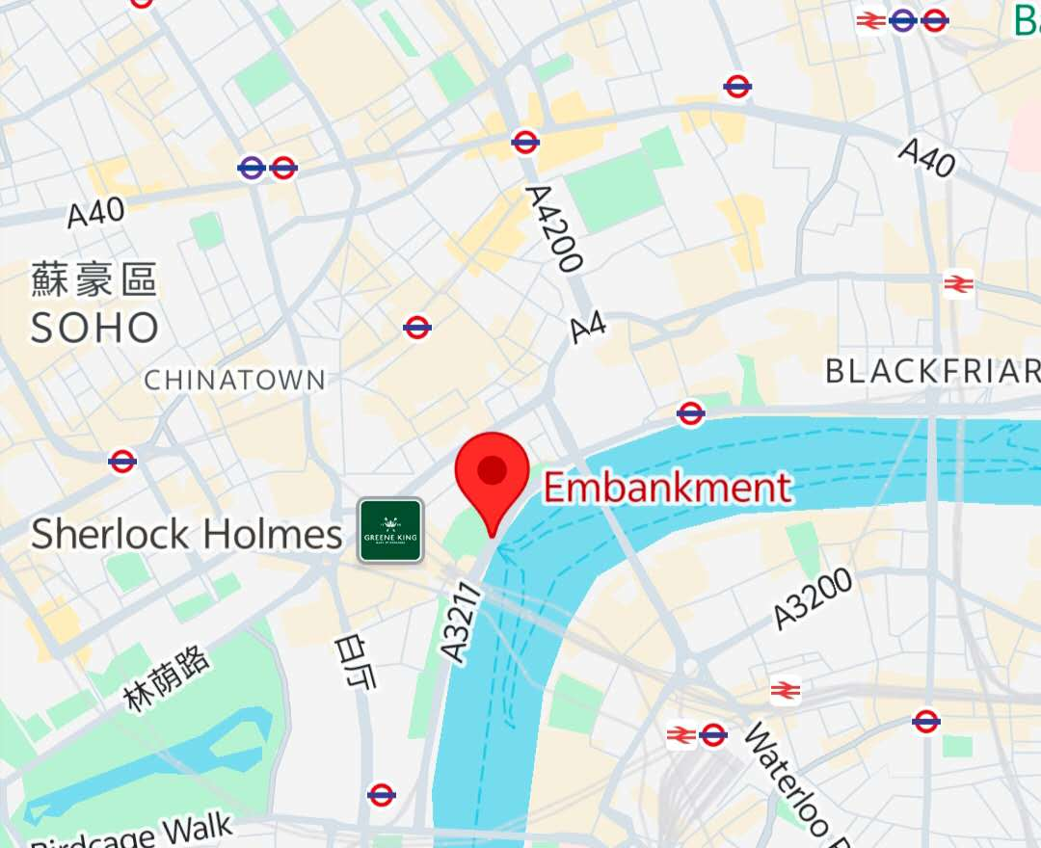
Cycle Counters and
Smart Digital Cycle Totem.
The image shows London's Smart Digital Cycle Totem, located along cycle superhighways and major cycling routes. It relies on piezoelectric sensors embedded beneath the lane surface, generating an electrical charge as bicycles pass by, which is then used to count them. An LED screen above displays the number of riders for the day and the cumulative total, making this data visible to the public.
Questions when visiting site?
What are the practical applications of such data?
Why should the annual number of cyclists be shown to pedestrians as shown in the picture?
Are there any ongoing operating costs associated with the project?
Location info:
Embankment Station, London WC2N 6PB
https://maps.app.goo.gl/PcKWJ6cSknWnTwBv8?g_st=awc
Submitted: Qingshan Luo Oct 2025
Notes:
A title and a couple of sentences describing the technology and possibly linking to further information online.
A photo of the technology in situ with a corresponding map showing where it is.
2 or 3 questions that you might ask when you are in situ at the site of the technology to engage others in a discussion about that technology
The following geographic data:
Lat Long
Street Address
Google maps link
What3words location
Also add in the names of those submitting this data.

