Slide 1
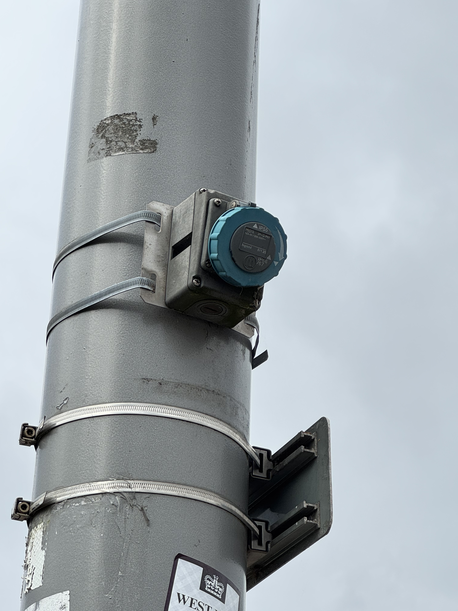
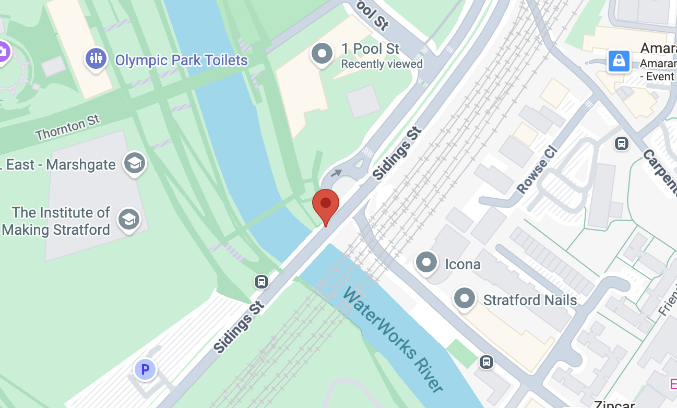
Smart Park Connectivity – SPARK® Wi-Fi.
This device is part of the digital infrastructure at Queen Elizabeth Olympic Park (QEOP). Using SPARK platform by WIFI SPARK, they provides free public WIFI.
Further info: GLA DATA CITY report (WiFi SPARK provides Smart Park connectivity)；SPARK TSL public-WiFi solution for QEOP；G-Cloud service definition.
Questions when visiting site?
What data do these SPARK Wi-Fi nodes collect?
What backhaul does this node use?
Who is this technology for?
Location info:
@51.537434, −0.009600
One Pool Street, London E20 2AF
https://maps.app.goo.gl/or1ck3rHRSqZwy3F8
what3words: ///raced.ranged.refuse
Submitted: Yidan Gao 2025
Notes:
A title and a couple of sentences describing the technology and possibly linking to further information online.
A photo of the technology in situ with a corresponding map showing where it is.
2 or 3 questions that you might ask when you are in situ at the site of the technology to engage others in a discussion about that technology
The following geographic data:
Lat Long
Street Address
Google maps link
What3words location
Also add in the names of those submitting this data.

