Slide 1
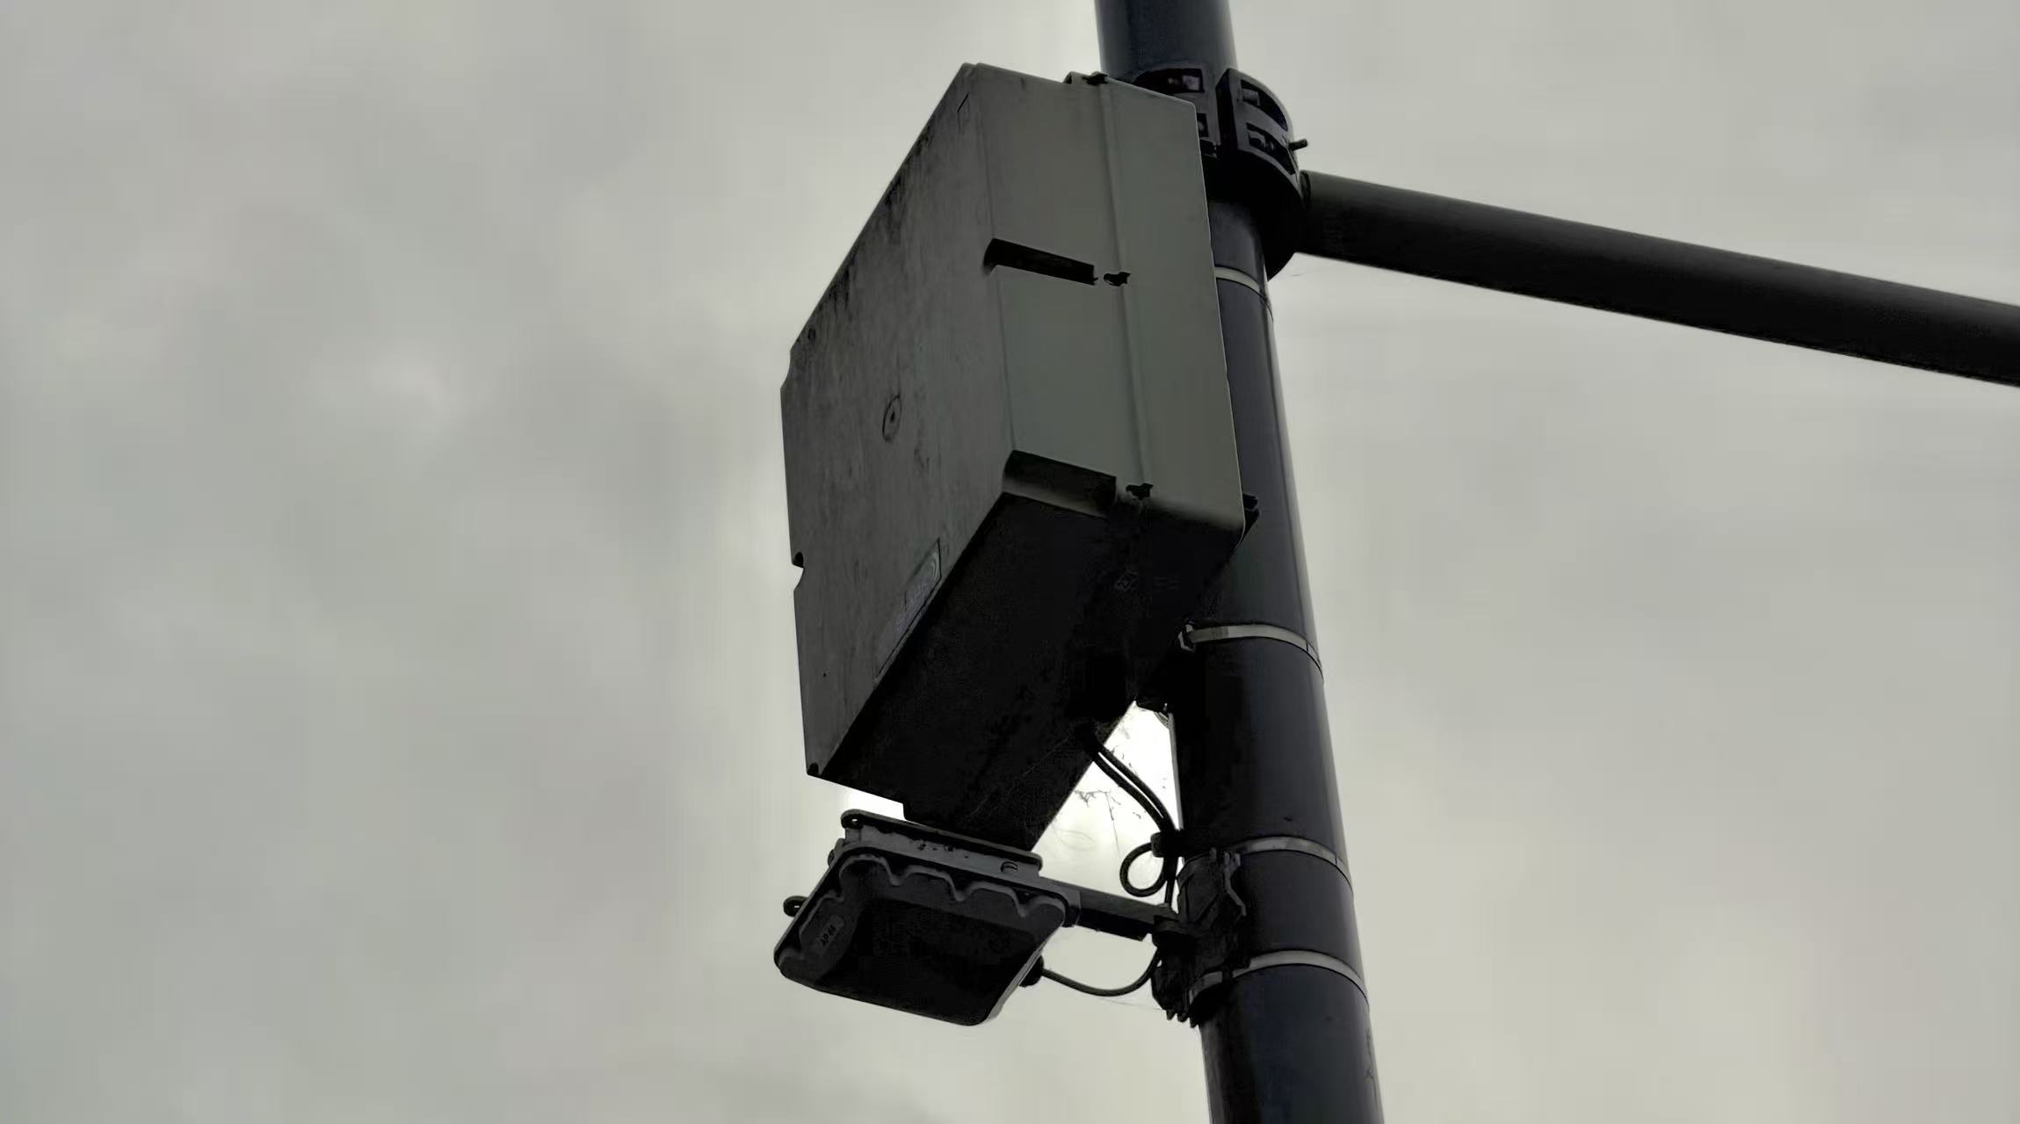
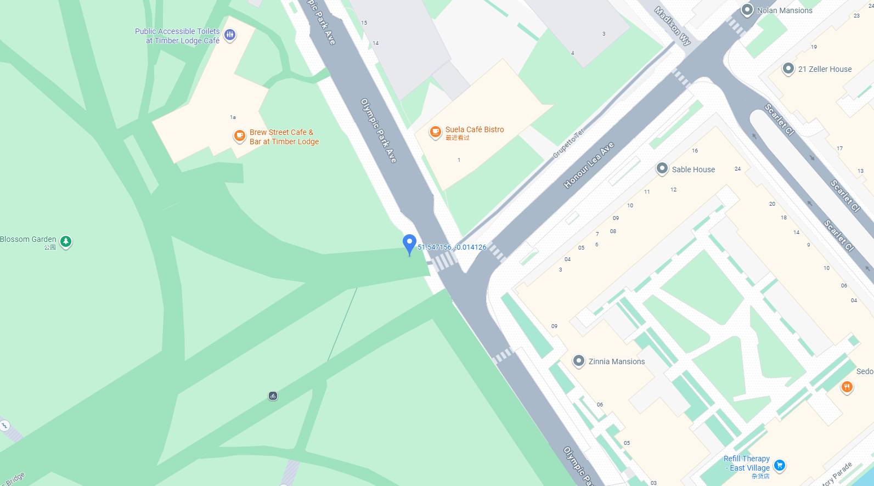
Traffic Monitoring and Smart City System.
This traffic monitoring station is part of a smart city network used to collect real-time traffic data.
It is measuring vehicle count, traffic flow rate, average speed, and vehicle type recognition through an AI-enabled camera system. The data is used for traffic management, congestion prediction, and improving road safety.
Questions when visiting site?
What time of day shows the highest traffic flow here?
How might a citizen check real-time traffic information?
Who benefits most from this technology (drivers, city planners, or pedestrians)?
Location info:
@51.547156,-0.014126
Celebration Avenue, Stratford, London, E20
https://maps.app.goo.gl/JKiWBB5um4mRTZmv9
what3words: ///remove.tolls.matter
Submitted: Ziyi Wang Oct 2025
Notes:
A title and a couple of sentences describing the technology and possibly linking to further information online.
A photo of the technology in situ with a corresponding map showing where it is.
2 or 3 questions that you might ask when you are in situ at the site of the technology to engage others in a discussion about that technology
The following geographic data:
Lat Long
Street Address
Google maps link
What3words location
Also add in the names of those submitting this data.

