Slide 1
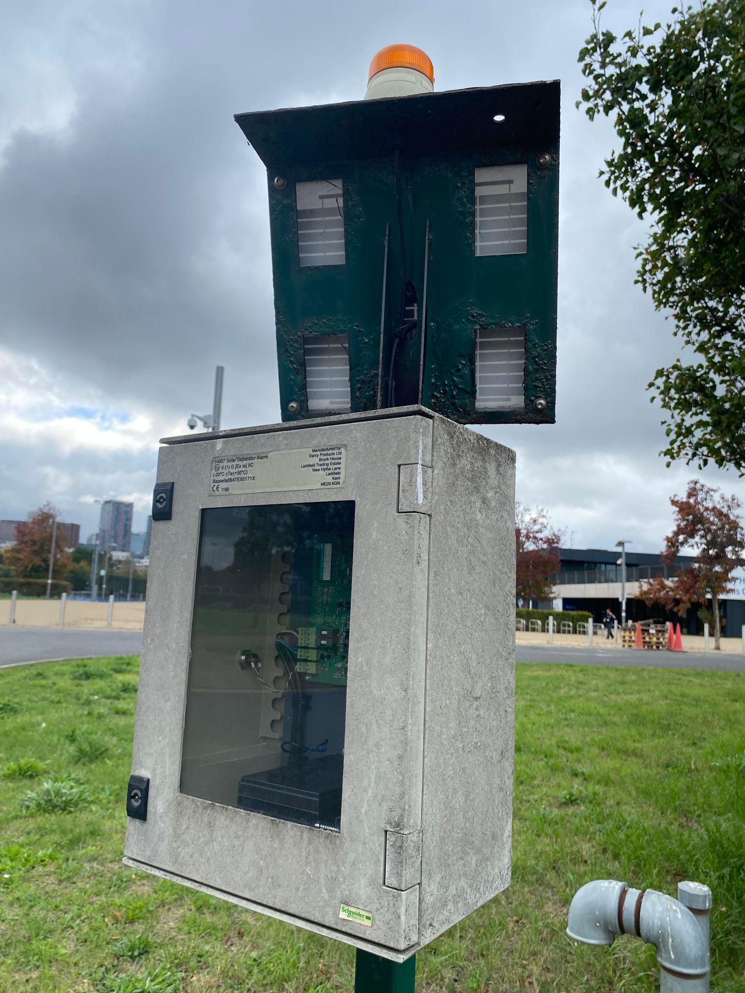
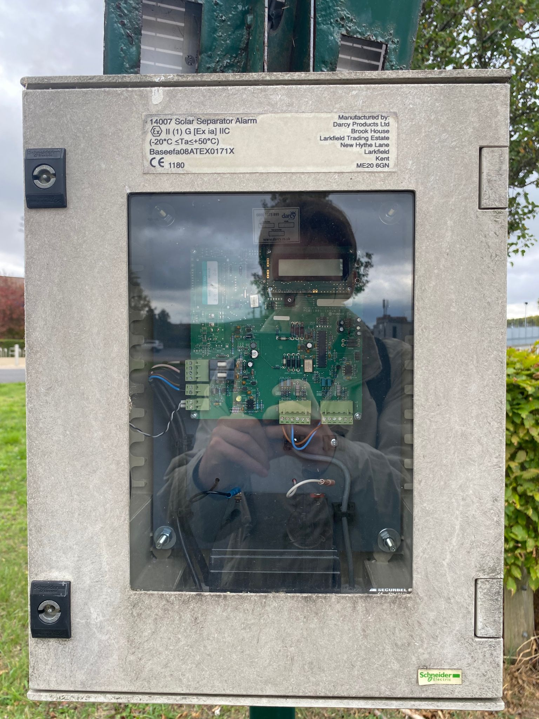
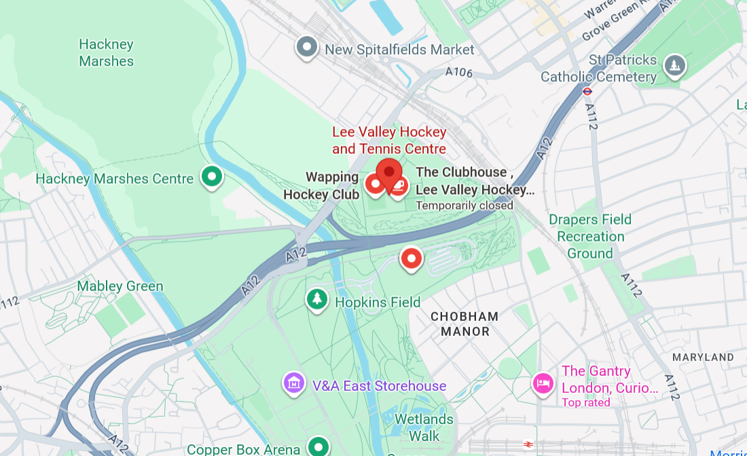
Solar-powered oil/water separator alarm
This device monitors the operation of an oil/water separator underground. When the separator fails, contaminants such as oil and suspended solids are not filtered out of the water, which could lead to a larger pollution incident.
Upon detecting abnormal levels of contaminants in the water, the device sends an SMS alert to authorised individuals and emits an orange flashing light.
Questions when visiting site?
Why is the box so big, compared to the hardware inside?
Why did they design the box so I can see the internals?
Who receives the data, and who is sent to fix the problem?
Location info:
@51.554017209709706, -0.01587127934155465
Eton Manor, Queen Elizabeth Olympic Park, Leadmill Ln, London E20 3AD
https://maps.app.goo.gl/pwBTZGeKLEKtQRAd7
what3words: ///mouse.allows.follow
Submitted: Ethan Taylor Oct 2025
Notes:
A title and a couple of sentences describing the technology and possibly linking to further information online.
A photo of the technology in situ with a corresponding map showing where it is.
2 or 3 questions that you might ask when you are in situ at the site of the technology to engage others in a discussion about that technology
The following geographic data:
Lat Long
Street Address
Google maps link
What3words location
Also add in the names of those submitting this data.

