Slide 1
The 5 Safes

Slide 2
Introduction
Provides a framework for managing access to data that is proportionate to the risk
5 simple to follow principles
First developed by staff at the Office for National Statistics
Now used throughout the UK and worldwide
Simple and effective way of understanding an ‘Information Governance Management System’

Slide 3
The 5 Safes
Valid statistical purpose
Trusted researchers
Anonymisation of data
Technical controls around access
Disclosure control of results
Safe Projects
+ Safe People
+ Safe Data
+ Safe Setting
+ Safe Outputs
= Safe Use
From VML, 2004; Desai, Ritchie & Welpton 2016
Notes:
The 5 Safes combined add up to the Safe Use of data – it is crucial to remember however that data is often not safe.
When it isn’t we have to make sure we are safe in the other areas.

Slide 4
The 5 Safes
MAY BE USED AS A HANDOUT
Safe Projects – What is the purpose of accessing the data?
Safe projects are those that have a valid statistical purpose. For example, using data to work out how people respond to new treatments, what causes ill health, the effects of policy interventions. Attempting to identify someone would not be a reason to access the data. There should be a ‘public benefit’ to the research; and it must not be possible to realise this benefit without access to the data.
Safe People – Who is going to be accessing the data?
Safe people should have the right motivations for accessing the data. They should also have sufficient experience to work with the data safely and credentials to allow them access. Ideally they should undergo additional training on using this type of data.
Notes:
The Five Safes is a way of thinking about how to access data. It was originally devised by Professor Felix Ritchie (now of University of West of England) during his time at the Office for National Statistics (around 2006).
The framework provides a decision-making process to enable ‘safe use’ of personal, confidential data. ‘Statistical purposes’ were what was in mind when the framework was drawn up.

Slide 5
The 5 Safes
MAY BE USED AS A HANDOUT
Safe Settings – Where will the data be used?
Confidential data should only be accessed in a suitable environment. This setting should have safeguards in place to minimise the risk that unauthorised people can access the data.
Safe Outputs – What will be produced from the data?
Outputs should be released if they report statistical findings but do not reveal the identity of a data subject nor associate confidential information to a data subject. Statistical Disclosure Control (SDC) is often used to minimise this risk of releasing confidential data. Researchers and/or the institution managing the use of the data can check outputs (apply SDC) before publication to unsure they do no present undue risk.
Notes:
The Five Safes is a way of thinking about how to access data. It was originally devised by Professor Felix Ritchie (now of University of West of England) during his time at the Office for National Statistics (around 2006).
The framework provides a decision-making process to enable ‘safe use’ of personal, confidential data. ‘Statistical purposes’ were what was in mind when the framework was drawn up.

Slide 6
The 5 Safes
MAY BE USED AS A HANDOUT
Safe Data – What does the data contain?
A safe dataset will present the minimal risk possible that any of the data subjects could be identified or confidential information be attributed to them. The minimisation of risk could be achieved by removing direct identifiers, aggregating values, banding variables or other statistical techniques that make re-identification more difficult.
However, this does limited the usefulness of the dataset.
Confidential or personal data should therefore not be considered to be safe – though it is often the most useful for research.

Slide 7
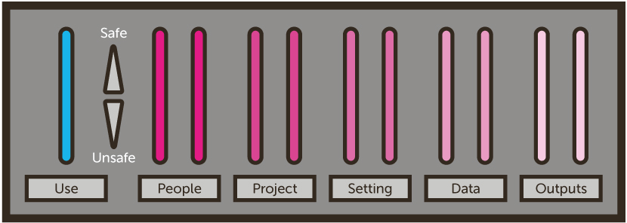
The 5 Safes
Adapted from Desai, Ritchie & Welpton 2016
Notes:
When data is safe, it doesn’t matter if people, projects, the setting, or outputs are unsafe. Because the data is safe, then ‘safe use’ can be achieved without the other aspects being safe.
However, the confidential data you will be using is unsafe. Even with names and direct IDs removed, the level of detail is such that it is possible to reidentify people. Therefore if we have unsafe data, and any of the other aspects are also unsafe, then when we would not be able to get to safe use.
When the data is unsafe, but we have safe people, safe projects, safe settings, and safe outputs, we can still have safe use

Slide 8
Public Use File
The data is safe. No other safes are required for Safe Use.
Scientific Use File
The data has some residual risk. We may need to have some additional safes in place to obtain Safe Use.
Secure Data Environment
The data is has significant residual risk. We need all of the other safes in place in order to have Safe Use.
Notes:
Public Use File – We don’t need any other safeguards. As the data is safe there shouldn’t be any way to misuse the data.
Scientific Use File – There is some residual risk in the data. It will have more detail than a public use file and it might be possible to use the data to reidentify someone, albeit a very small risk. As such you may have to register to access the data, have the proposed usage approved by the data owner, and the data may need to be stored in a restricted area.
Secure Data Environment – There is a high amount of residual risk because of the detail in the data, as such we have to make sure that we have the other safes are in place in order to get to safe use.

Slide 9

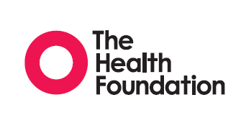
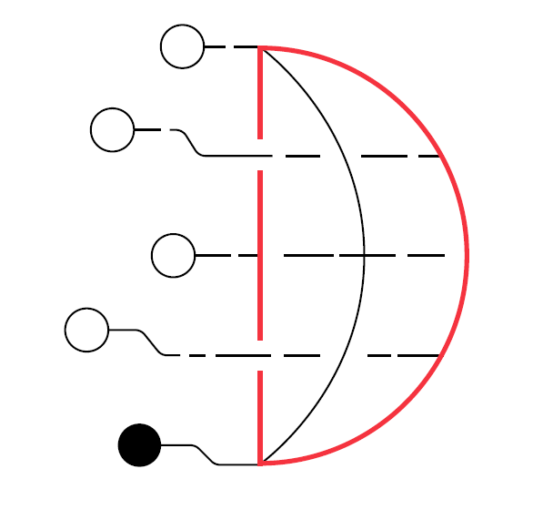
Assessments for this module
SDAP: Safe Analyst Training - The 5 Safes
Created by Cancer Research UK and The Health Foundation for the Safe Data Access Professionals Working Group

