Slide 1
Regressions

Slide 2
Regressions
A ‘regression’ refers to the set of models for estimating a statistical relationship between two or more variables.
Disclosure can occur if:
the regression is based on a single unit,
the regressions are performed sequentially in which the number of observations changes slightly but the coefficients show a significant change
the regression consists of only categorical variables.

Slide 3
SDC Considerations
The degrees of freedom should be at least the threshold of N.
Sequential regressions should not differ in counts of observations of less than N.
If a full model contains only categorical variables then at least one of the coefficients should be suppressed.
Generally, regression results can be released and they do not often present a disclosure risk.
Notes:
The degrees of freedom is the calculated by subtracting the number of independent variables from the number of observations used. N will be the threshold set by the organisation.
A full model would display the coefficients for every variable included in the regression as well as all possible interactions of those variables.

Slide 4
A Regression Output
Model Coefficients - GenHelf4
Predictor |  | Estimate |  | SE |  | t |  | p
Intercept |  | 1.2439 |  | 0.0792 |  | 15.7057 |  | 0.0000
Age35g |  | 0.0738 |  | 0.00203 |  | 36.3033 |  | 0.0000
JNTINC2 |  | -2.50e−5 |  | 2.63E-04 |  | -0.0953 |  | 0.9240
EducEnd |  | -0.0338 |  | 0.00332 |  | -10.1857 |  | 0.0000
Origin2:
2 – 1 |  | 0.0645 |  | 0.04719 |  | 1.367 |  | 0.1720
3 – 1 |  | 0.1896 |  | 0.03347 |  | 5.6651 |  | 0.0000
4 – 1 |  | 0.0483 |  | 0.05941 |  | 0.8134 |  | 0.4160
5 – 1 |  | 0.197 |  | 0.09112 |  | 2.162 |  | 0.0310
Are there any issues with this regression output?
Data: Health Survey for England, 2016
How many observations are included in the model?
What variables have been included in the model?
Notes:
We don’t know how many observations the regression model is based on.
We also don’t know what the variables included are, the variable names are likely to be meaningless to whoever is checking the output.

Slide 5
A Regression Output
Model Coefficients – Self reported health (Four categories) Number of observations: 10,067
Predictor |  | Estimate |  | SE |  | t |  | p
Intercept |  | 1.2439 |  | 0.0792 |  | 15.7057 |  | 0.0000
Banded age |  | 0.0738 |  | 0.00203 |  | 36.3033 |  | 0.0000
Banded household income |  | -2.50e−5 |  | 2.63E-04 |  | -0.0953 |  | 0.9240
Age finished FT education |  | -0.0338 |  | 0.00332 |  | -10.1857 |  | 0.0000
Ethnic categories:
Black compared to white |  | 0.0645 |  | 0.04719 |  | 1.367 |  | 0.1720
Asian compared to white |  | 0.1896 |  | 0.03347 |  | 5.6651 |  | 0.0000
Mixed compared to white |  | 0.0483 |  | 0.05941 |  | 0.8134 |  | 0.4160
Other compared to white |  | 0.197 |  | 0.09112 |  | 2.162 |  | 0.0310
Are there any issues with this regression output?
Data: Health Survey for England, 2016
Number of observations is shown
Variables included are clearly named
Not a full model
Notes:
Now we can see the number of observations and have an understanding of the variables included. We can now properly check if the potential problems with the models, it doesn’t appear so because it is not based on single observation, there isn’t any issues with nesting, nor is there only categorical.

Slide 6
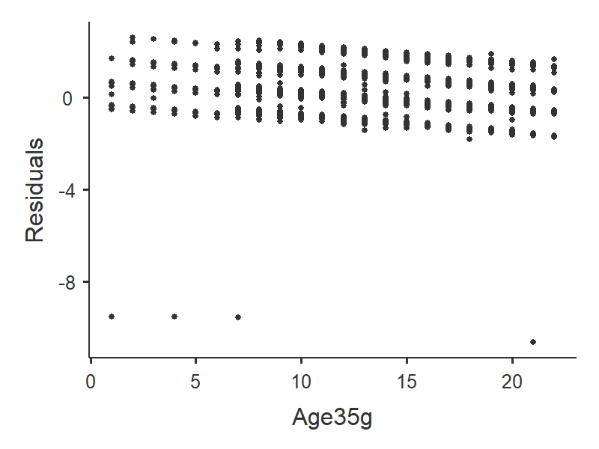
Residual Plots
Residuals plots are a graphical representation of residuals (or errors) following the estimation of a regression model. Residuals are often plotted against one of the covariates used in the model.
Residual plots will often represent a single observation and should be avoided.
It may be useful to describe the shape of the residual rather than plot it, or to remove the scale of the axes, or use a covariate on the a-axis that is difficult to observe outside of the data.
Residual plots should not normally be released

Slide 7


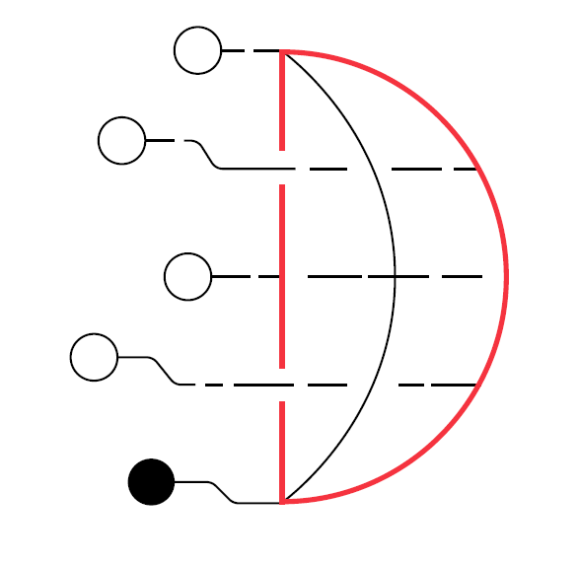
Assessments for this module
SDAP: Safe Analyst Training - Regressions
Created by Cancer Research UK and The Health Foundation for the Safe Data Access Professionals Working Group

