Slide 1
Introduction to Safe Outputs

Slide 2
Introduction to Safe Outputs
The aim of making outputs safe is to minimise the risk of an individual being identified, or assigning an attribute to someone, from a piece of analysis.
Statistical Disclosure Control is a key method of doing so. The Safe Access Data Professionals Handbook gives guidance for researchers, checkers, and organisations on what to look out for.
No system is 100% effective, the aim is to reduce the risk to an acceptable level.
Notes:
This training should be seen as an accompanying resource to the SDAP handbook.
Acceptable and reasonableness are important aspects to this. The aim is not to pour infinite resources into checking to ensure that there is no chance of reidentification, but to make it difficult for a reasonably well-equipped data misuser to breach the confidentiality.

Slide 3
How might a disclosure occur?
Suppose we collect some confidential information, income. The total income for observations in the data is £1000.
But, there are only two observations, including myself. I know my income (£400).
Therefore, it must be the case that the other person’s income is £600.
I meet the other person at an event to celebrate the data collection; and I know how much the other person earns (and they know how much I earn).
Would this still be the case if there were three observations?
Notes:
This is a simple example of how a statistical disclosure, and identification, could occur.
However, if there are three observations, then I cannot ascertain how the remaining income (after I’ve deducted my own from the total) is assigned between the other two individuals. So a disclosure has not occurred. This is the statistical reason why 3 is always the absolute minimum frequency published.

Slide 4
SDC and Outputs
SDC is often used to produce ‘safer’ versions of datasets.
However when working with potentially identifiable data it needs to be applied to results.
Why do you think it is important to preserve confidentiality?
Legal penalties
Reputational damage
Loss of confidence in data collection
Fewer observations
Notes:
SDC is used as guidance to convert data with a higher residual risk into less disclosive versions such as scientific use, or public use versions. Software such as the R package SDCMicro is often used to help guide the decisions taken by those processing the data.
Ask the attendees what their views are on preserving confidentiality then explain the highlighted points.

Slide 5
Rules-based vs Principles-based
Rules-based
Users are given a set of fixed rules about what can and cannot be released, if the statistical output presented by the user meets the criteria it is released.
Principles-based
An assessment of risk takes place, and a decision is made as to whether the statistical output presented ‘safe’ to release or not? (in accordance with the Five Safes ‘Safe Output’ element).
What are the benefits and limitations of these approaches?
Notes:
Rules-based
Pros: Easy to understand, data owners tend to prefer it as it reflects the way that official statistics are made, usually less resource intensive to enforce
Cons: Difficult to predict the techniques and outputs that researchers will use ahead of time and have appropriate rules in place, sometimes outputs can meet the rules but be unsafe, and outputs might not confirm to the rules but can be shown to be safe
Principles-based
Pros: Flexible as there are not strict rules, adaptable to new techniques
Cons: Takes longer to check, more resource intensive for checkers, potential for incorrect assessment of risk to be made (requires experienced checkers to be effective)

Slide 6
Types of Disclosure
Primary disclosure
Inferring the identity, and/or information about, a data subject from a single source of data.
Spontaneous recognition.
Secondary disclosure (‘attribute’)
Deriving the identity, and/or information of, a data subjecting by combining two or more sources of information together.
Notes:
Spontaneous recognition is where a researcher believes they have identified someone in the data, not because they are looking for them, but because the level of detail is such that it is possible to do so. They should immediately stop working with the data and contact the data owner. It may be that the observation needs to be removed. If a researcher continues to work with the data despite believing they have spontaneously recognised an individual, it will be considered an attempt to deliberately identify patients and therefore be in breach of the DPA.

Slide 7


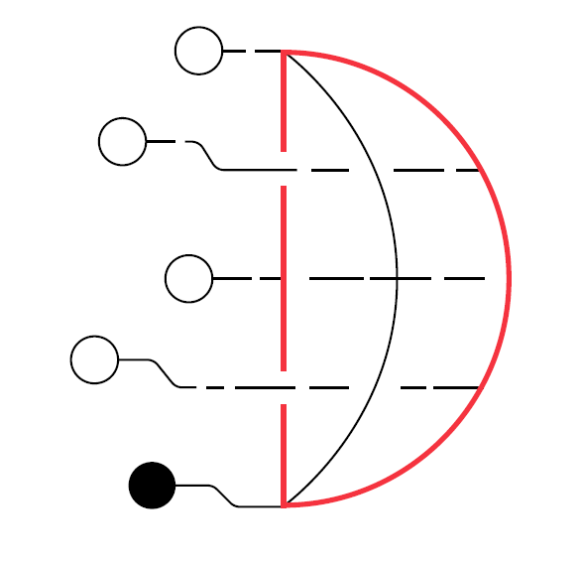
Assessments for this module
SDAP: Safe Analyst Training – Introduction to Safe Outputs
Created by Cancer Research UK and The Health Foundation for the Safe Data Access Professionals Working Group

