Slide 1
Graphs

Slide 2
Graphs
Graphs are subject to the same Statistical Disclosure Control methods as statistical tables.
As a minimum researchers should provide a table of the underlying frequencies and total counts, clear labels, and details about the data subjects.
Potential issues with graphs would include low counts being presented on the tails of histograms, plots displaying individual observations, or maxima and minima being shown.
Graphs should only be released from secure environments as fixed images such as png or jpeg.
Notes:
Researchers should not assume that the output checker will understand what they are looking at, and so explaining what a graph shows will speed up the process. It is very hard to ascertain if a graph is safe without the counts, and so these should be always be included.
Fixed images are preferred because graph objects produced by Stata and Excel may store the data that produced the graph within them, and this could be access outside of the secure setting
Whilst graphs will be presented in many different ways, the general SDC principles are that they be based on a sufficient number of observations, that they are clearly labelled, and that individual observations cannot be identified.

Slide 3
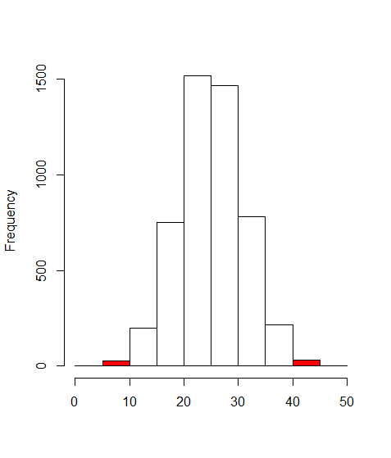
Histograms
What is the graph displaying?
How many observations are in each bin?
Histograms display the frequency distribution of a variable.
The foremost SDC concern for histograms is that there are often low counts in the tails of the distribution. The maximum and minimum values may also be shown.
In the example shown here, there would appear to be very few observations with a value below 10, or above 40. This could potentially be disclosive.
The example also lacks labels, and so it would be very difficult for anyone to judge if the graph is safe.

Slide 4
Scatterplots
Scatterplots could be problematic as often it will be individuals that are displayed.
In this example, it is easy to identify individual observations. We can that there is a 10 year old who consumes around 4 units of alcohol a week.
Scatterplots can potentially be made safe by grouping observations into clusters or other transformations.
Graph is easy to understand
The points appear to be individual observations
Notes:
What is good about this graph?
Good – It is clear and well labelled.
What might be problematic?
The dots appear to present individual observations, and therefore present a risk of re-identification.

Slide 5
Scatterplots Transformed
In this example we have transformed the graph seen on the previous slide.
Rather than present the actual values, this example shows the deviation from the means for age and units consumed.
The means were calculated for male and female respondents separately. Even if the means were published, because we do not know the gender of the observations from the graph we would not be able to work back to identify anyone.
Graph is easy to understand
Can we work back to the untransformed data?
Notes:
Notice that the trend line has remained very similar despite the transformation

Slide 6
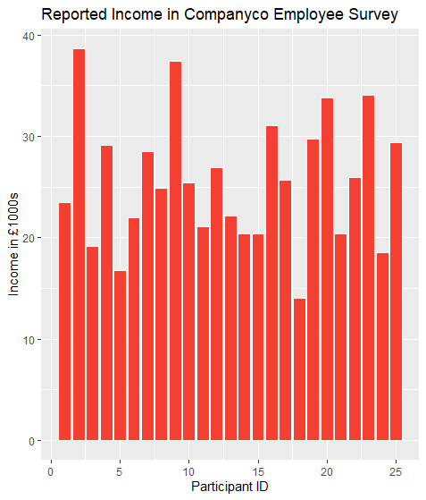
Bar Charts and Pie Charts
Are there a sufficient number of observations displayed?
Notes:
Are there any issues with these charts?
Bar Chart is a two way plot however the x-axis is just showing the Participant ID. This suggests that the bars are actually showing the income for individuals. As such this should not be released.
Pie chart is showing 160 staff but we don’t know the break down for each category. The Mixed Ethnicity category looks like it is quite small, and may well fall below the threshold.

Slide 7



Assessments for this module
SDAP: Safe Analyst Training - Graphs
Created by Cancer Research UK and The Health Foundation for the Safe Data Access Professionals Working Group

