Slide 1
Welcome to the UCLH learning data science course

Slide 2


Slide 3
Hello!
Course objectives
Introductions
Pre-requisites
Course schedule
What to expect from sessions

Slide 4
Course objectives (brief version)
make you (more) comfortable with R
introduce you to good-enough data practice
that after the 2 days you will know how (& be motivated) to find out more
Introductions
a few sentences each, start with instructors

Slide 5
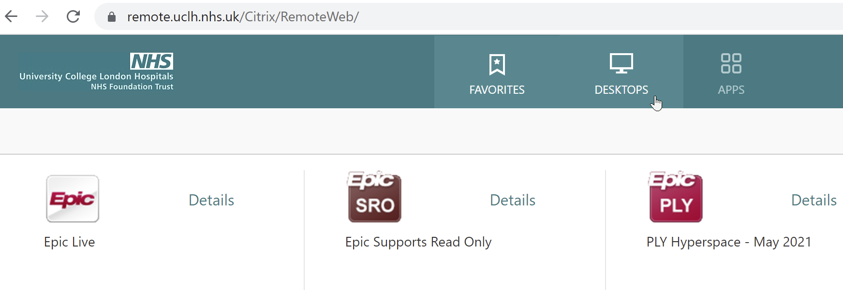

Slide 6
Pre-requisites
UCLH Data Science desktop. You should have received this link, let us know if you don’t have access.
https://github.com/uclh-criu/learning-datascience/blob/master/instructions/01-pre-course-instructions.md
Access Collaborative document for tracking progress, entering questions etc.
Backup plan : if need to run locally download R & RStudio
Course schedule
2 days of intensive learning link to schedule
we will be flexible & adapt as needed

Slide 7
What to expect from the sessions
we will follow a learning by doing approach
getting you interacting with R early
don’t worry if you don’t understand everything at the start
do feel free to ask us questions at any time
I expect to fail to avoid doing these at some point :
assume you know things that you don’t
patronise you by explaining things you already know
Please feel free to tell me.

Slide 8
Thank you. We hope you enjoy the course.

