Slide 1
session1: an R taster

Slide 2
Rationale
in this session we will give you a quick taste of R
to show you what you can do
we will get you to type commands in R and see what happens
we don’t expect you to understand completely at this stage
we will return to concepts later

Slide 3
Content
download a project from Github into RStudio
read in data from a file
look at the data
manipulate the data
plot the data

Slide 4
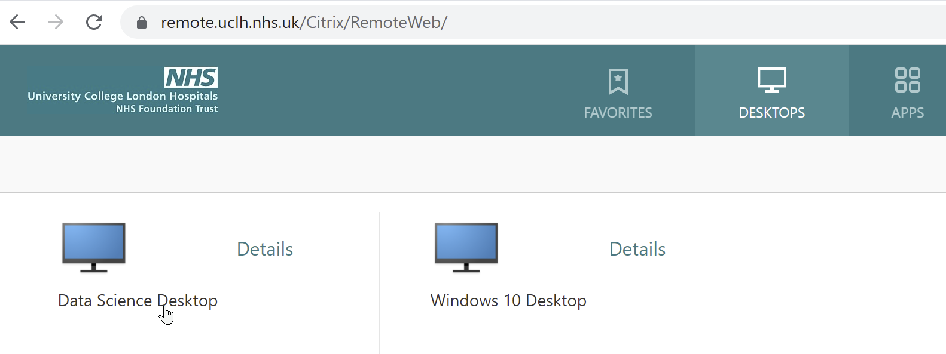
UCLH Data Science Desktop If you don’t see something like this, let us know and we’ll help

Slide 5
RStudio fom Data Science Desktop
To start RStudio type ‘rst’ in the search box at the lower left, an then double click on the RStudio desktop app.

Slide 6
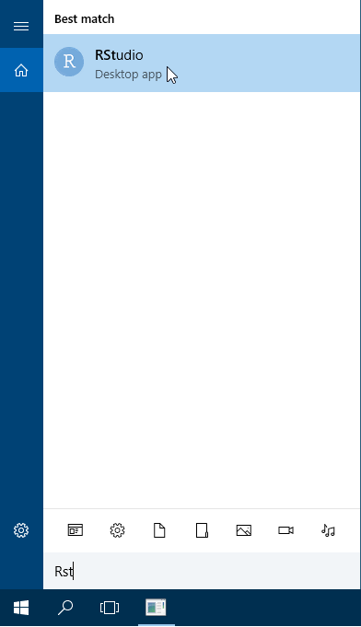

Slide 7
Working with RStudio
RStudio is an Integrated Development Environment (IDE). – (also the name of the company that develops it and a lot more)
Easier to work with than R on it’s own, since it it a bit more ‘point and clicky’
Allows
Code editing
Syntax highlighting
Plotting tools
Workspace management
Version control

Slide 8
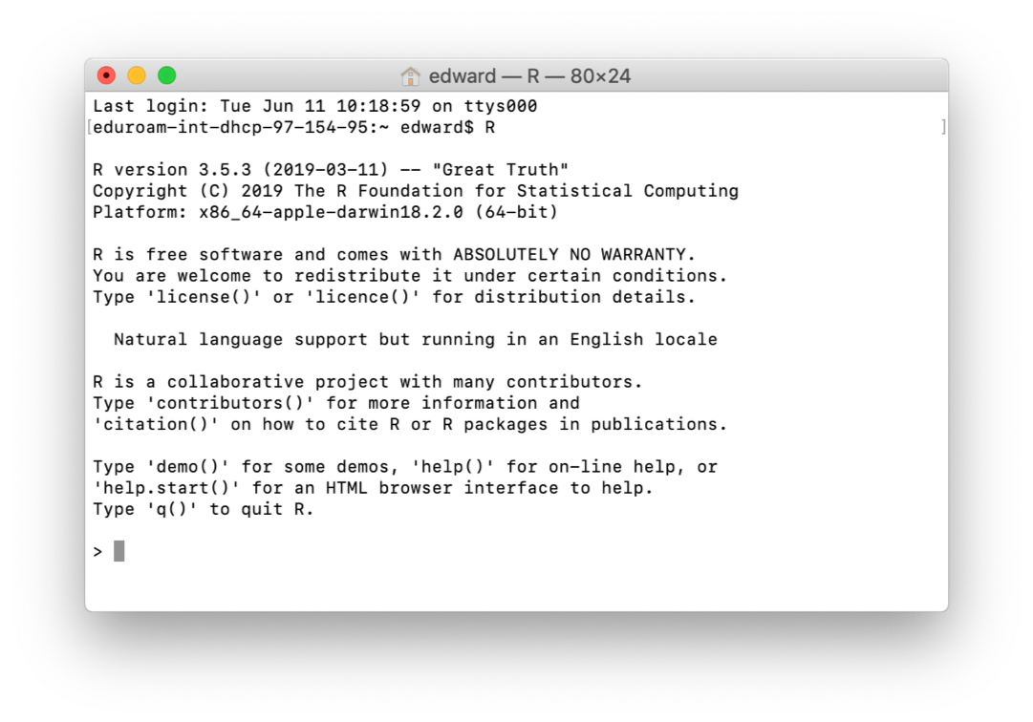
This is what R on it’s own looks like

Slide 9
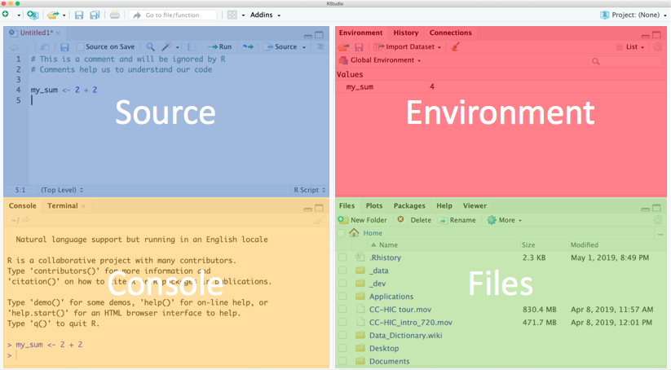
RStudio is much easier to work with & what we recommend
Notes:
Explain each window.
Console - this is where R is run. Commands executed but not saved.
Source - text files that contain commands.
Environment - tells you which R objects you are working with.
Files - actually a helper window. Gives you files, help, plots.

Slide 10
Using the Source/Text editor
Type 2 + 2 in top left, then Enter.
What happens?
To ask R to run code
Highlight the code and:
MacOS: Cmd + Enter
Windows: Ctrl + Enter
Notice the output in the console.

Slide 11
A warning about R warnings & errors
DON’T PANIC : they are common & expected
Warnings give you info that often you can ignore
Errors usually need to be fixed and are usually due to a typo
Errors check the first one - if it doesn’t make sense to you, google it

Slide 12
First time from UCLH PC
To enable RStudio to find internet
Create a small text file, paste some commands into it, save it as a file called .Renviron and then restart RStudio.
We can use a function called edit_r_environ() within a helper package called usethis.
Copy & paste the 3 lines below into the R console at the lower left:
install.packages("usethis") library(usethis) usethis::edit_r_environ()
This should open a tab called .Renviron in the editor at the top left.

Slide 13
Copy & paste these lines into a space below the .Renviron tab at top left
# Set-up proxies to allow RStudio & R to talk to internet # allows git cloning of RStudio projects & remotes::install_github # CRAN package installation works without proxies being set # file called .Renviron needs to be saved in your home folder http_proxy=http://www-cache-n.xuclh.nhs.uk:3128/ https_proxy=http://www-cache-n.xuclh.nhs.uk:3128/ HTTP_PROXY=http://www-cache-n.xuclh.nhs.uk:3128/ HTTPS_PROXY=http://www-cache-n.xuclh.nhs.uk:3128/
Then save that file by selecting File, Save (or Ctrl S). Close the .Renviron tab. Restart RStudio.

Slide 14
If you are an Instructor switch to live demo in RStudio
If you are learning independently follow the steps in these slides.

Slide 15
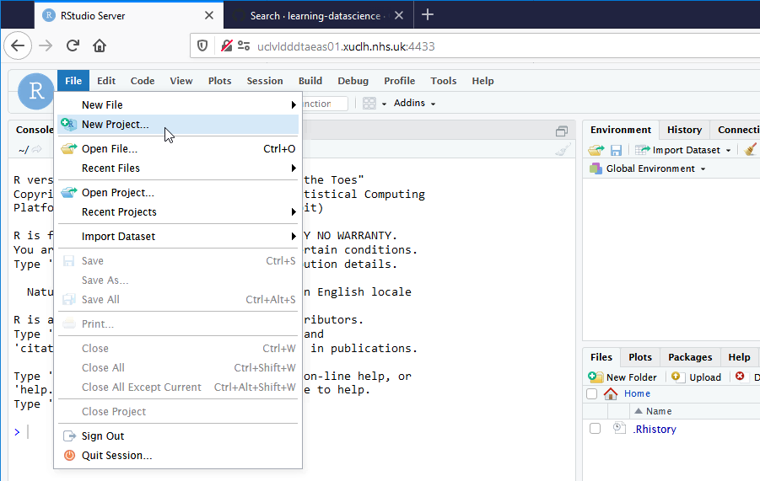
download a project from Github into RStudio

Slide 16
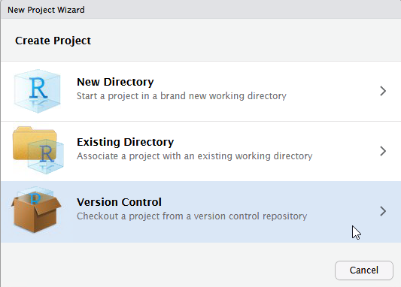

Slide 17
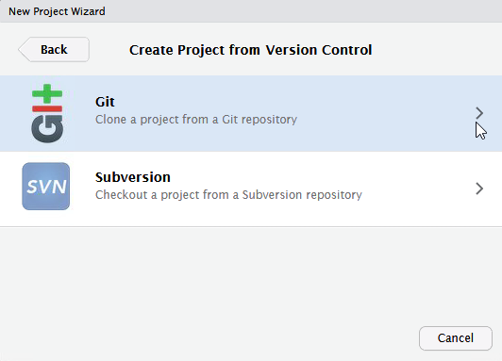

Slide 18
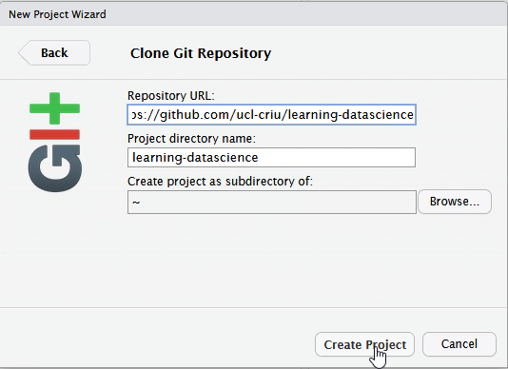
Copy into first box https://github.com/uclh-criu/learning-datascience

Slide 19
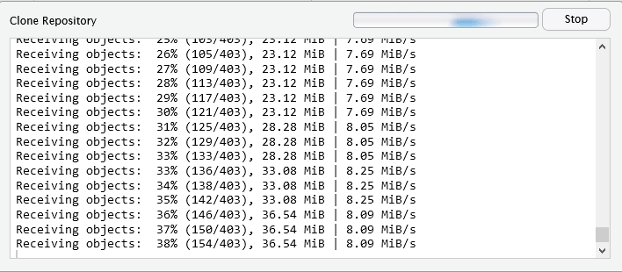
may take a while to copy files.

Slide 20
Intructor will step through sessions/1-R-taster-script.R

