Slide 1
session2: Intro to R

Slide 2
Content
Motivation for R: what and why?
R studio: a tour
R building blocks
Using/Writing functions

Slide 3
What is R?
Free software for statistical computing, plotting (and almost anything else you can think of)
Works on all platforms
Built around handling data
NOT just for statistics

Slide 4
Why use R?
Why?
You can do anything
Not limited to the pre-designed command process of an app.
Can record everything you do, so can be repeated with one click
Hurdles
Need to learn a new language
Little ‘point and click’
Need to describe to the computer the steps you want it to take

Slide 5
Really, why R?
Save time
Small upfront investment for long term gain
New data? - Easy
Repeat analysis? - Easy
Found an error? - Easy
Reproducible Science
Code makes your analysis explicit
Writing code = writing lab-book = good reproducible science

Slide 6
R versus Python
almost anything you can do in one you can also do in other
what are people around you using ?
R is commoner in Research, Python in software engineering
R for Research, Python for production

Slide 7
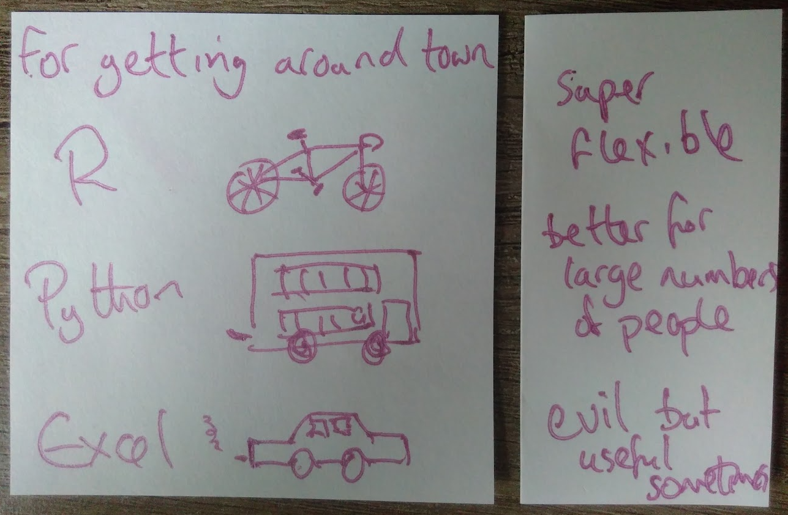
R versus Python - my imperfect analogy

Slide 8
R communities
big improvement over past 10 years
now much more beginner friendly
efforts to increase under-represented groups e.g. R-Ladies Global
Twitter e.g. #rstats hashtag, a tweet from yesterday

Slide 9
some R inspiration
amazing open-source covid graphics by Colin Angus & one of his covid apps (all made with R)
R/medicine conference starting tomorrow !
NHS R Community & conference
NHS R community datasets for learning(I only found this yesterday)

Slide 10
data & R in the NHS
“the NHS is failing to make the most of its data because there are not enough people with the right analytical skills to make sense of the information being collected”
“Communities need to share languages and common tools to work and grow together. R and Python are both free, open source, state of the art …”
“We need to create a culture of ‘build it once, share the methodology and learn with others’”
NHSX blog 2021

Slide 11
Return to looking at RStudio live (switch between slides & RStudio as needed)

Slide 12
3 Main R Building Blocks
Objects
named objects store data (& other things)
Functions
Little factories
Take an input (raw material) use function (factory) get an output (product)
Packages
collections of objects (data) and functions
provide additional functionality

Slide 13
Objects
You assign names to objects in R.
This is the assignment operator <-
Return the stored value by typing the name.
practice <- 2 + 2 practice
## [1] 4

Slide 14
Names
You can store any object under a name.
This example stores a string. You need to use quote marks to assign it.
say_hello <- "hello" say_hello
## [1] "hello"
Note that R does not like spaces in names.
say hello <- "hello"
## Error: <text>:1:5: unexpected symbol ## 1: say hello ## ^

Slide 15
Vectors
for R a vector is a container with elements of the same type.
A vector of integers - an example would be age
## [1] 50 25 32 67 46 19 48
A vector of real numbers - an example would be temperature.
## [1] 37.5 37.1 37.3 38.3 37.4 38.9
A vector of characters - an example would be name.
## [1] "Adam" "Sally" "Eve" "John" "James"
A vector of logicals - an example would be ‘are the blood results available?’
## [1] TRUE FALSE FALSE TRUE TRUE

Slide 16
Naming vectors.
The c() function combines individual values into a single vector.
# Storing several ages in one vector. age <- c(50, 25, 32, 67, 46, 19) age
## [1] 50 25 32 67 46 19
# Storing several names in one vector. name <- c("Adam", "Sally", "Eve", "John", "James", "Jennifer") name
## [1] "Adam" "Sally" "Eve" "John" "James" "Jennifer"

Slide 17
Accessing elements of a vector
R creates an index for each element of the vector.
It allocates a number to each element within the vector from left to right, starting with 1.
# The age of the second person. age[2]
## [1] 25
# The age of the fourth person. age[4]
## [1] 67
# The name of the fifth person. name[5]
## [1] "James"

Slide 18
Data Frames.
A data frame is a series of vectors aligned to form a table
Each vector becomes a column in the table
A properly formatted excel spreadsheet is essentially a data frame
Here we can create a new vector for gender
and combine the 3 vectors (name, age, gender) into a dataframe
## name age gender ## 1 Adam 50 male ## 2 Sally 25 female ## 3 Eve 32 female ## 4 John 67 male ## 5 James 46 male ## 6 Jennifer 19 female

Slide 19
Creating a data frame - excercise
Create and name vectors containing information about these 6 patients.
Name: "Adam", "Sally", "Eve", "John", "James", "Jennifer"
Age: 50, 25, 32, 67, 46, 19
Gender: "male", "female", "female", "male", "male", "female"
Quotation marks are not needed for names in R, but are when your data is a string e.g. “male”, “female”
As a rule:
Characters on the left side of the assignment operator. No quote marks.
Characters on the right side of the assignment operator. Use quote marks if storing letters.

Slide 20
Creating a data frame - exercise
Combine these vectors into a data frame using data.frame()
Hint, the vector names need to go inside the ()
Save the data frame under the name patients
Print the data frame called patients to your console

Slide 21
Creating a data frame - solution
# Creating individual vectors. name <- c("Adam", "Sally", "Eve", "John", "James", "Jennifer") age <- c(50, 25, 32, 67, 46, 19) gender <- c("male", "female", "female", "male", "male", "female") # Combining into a data frame. patients <- data.frame(name, age, gender)

Slide 22
This is the data frame.
patients
## name age gender ## 1 Adam 50 male ## 2 Sally 25 female ## 3 Eve 32 female ## 4 John 67 male ## 5 James 46 male ## 6 Jennifer 19 female
R arranges the vectors as columns in the data frame
R names the columns of the data frame after the names of the vectors
R numbers each row of the data frame

Slide 23
Recalling a vector in a data frame
Data frame columns are vectors.
$ can be used to extract a vector from a data frame.
We can get the age column from the data frame group
patients$age
## [1] 50 25 32 67 46 19

Slide 24
Vectors - other properties
Add a value of TRUE to a vector of integers
Give it a name
Recall the vector
Use str() to examine the structure of the vector.
What has happened?

Slide 25
Vectors - other properties
test <- c(1, 2, 3, 4, TRUE) test
## [1] 1 2 3 4 1
str(test)
## num [1:5] 1 2 3 4 1
The value of TRUE has been changed to 1.
The vector is still a numeric vector

Slide 26
Vectors - other properties
Add a string to a vector of integers
Recall the vector
What has happened?

Slide 27
Vectors - other properties
test2 <- c(1, 2, 3, 4, "hi") test2
## [1] "1" "2" "3" "4" "hi"
str(test2)
## chr [1:5] "1" "2" "3" "4" "hi"
The string has been added on to the end of the vector.
The vector is now a string vector.

Slide 28
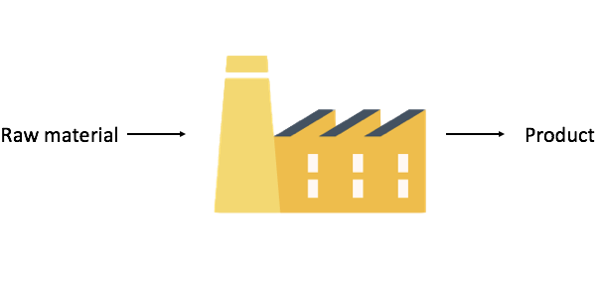
Functions as factories

Slide 29
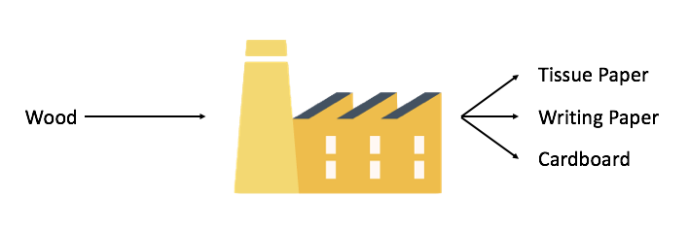
Functions as factories

Slide 30
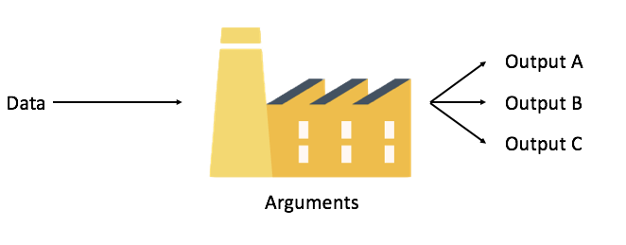
Functions as factories

Slide 31
Functions
You can think of them as a factory
Usually labelled as a verb (they are “doing” something)
Many come built into R
Sys.time()
mean(1:100)
You can also install ‘packages’ containing bundles of functions
View each function as a separate separate factory in a production line

Slide 32
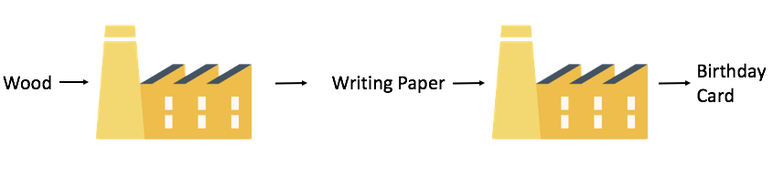
Functions in a line

Slide 33
Functions
You have been using functions already!
data.frame() is a function.
age, gender, weight are arguments.
data.frame(name, age, gender)
## name age gender ## 1 Adam 50 male ## 2 Sally 25 female ## 3 Eve 32 female ## 4 John 67 male ## 5 James 46 male ## 6 Jennifer 19 female
The data frame is the output

Slide 34
Try these functions yourself. What do they do?
Use the group data frame as the argument.
head()
tail()
summary()
mean()

Slide 35
Try these functions yourself.
head() Gives you the first 6 rows
tail() Gives you the last 6 rows
summary() Gives an overview of the object
mean() Gives the mean of a numeric vector

Slide 36
Warning note
Functions are carrying out pre-written instructions
They will fail if they are supplied with the wrong kind of data - they will return an error message instead
Try mean(group$gender)

Slide 37
Help with functions
How do you find out how to use a particular function?
Three ways:
Select the help tab in bottom right of RStudio, then type the function name into the search box, and read the help page.
Type ?function_name into the console.
If you can’t remember the exact function name try typing ??whatever_you_want_to_do into the console. It searches the whole database for matching terms.
Notes:
Get them to look up the help page for mean

Slide 38
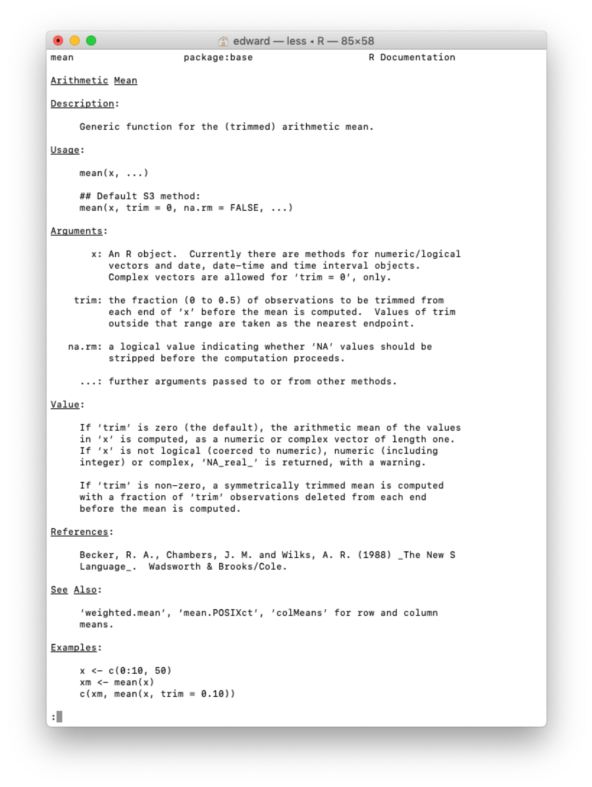
This is what a help page looks like.

Slide 39
Reading the help page
detailed & contains a lot of info you don’t need (I don’t understand all of it).
Usually a standard format:
Brief description
An example of use
The argument(s) that can be passed to the function - along with any default value it takes if there is no value provided.
Argument details
A reproducible example of use, that you can normally copy & paste

Slide 40
Explore functions yourself
Look up the function head
What are the arguments you can give the function?
How do you specify the argument for ‘n’? Try it
Try copy & pasting some of the examples

Slide 41
Packages - collections of functions
There are bunch of functions that come with R. They are ‘base R’ functions.
Extra functionality in packages.
Currently, the CRAN package repository features 18073 available packages.
Anyone can create & share packages.

Slide 42
To access a package, 2 step process
install.packages("[package name]")
library([package name])
Lightbulb analogy
install lightbulb - do once (update ~ yearly)
library - do every time you start R / enter room We have already installed required packages for you. Limitations to installing packages on some NHS systems.

Slide 43
Useful packages
These are some packages we will use in the course.
ggplot2 - plots graphs in R
readr - imports data into R
stringr - helps you manipulate strings
lubridate - helps you manipulate dates
These are all part of the tidyverse - you can load all of them with library(tidyverse)
tidyverse packages are designed to work with tidy data that we will talk about later.

