Slide 1
session4: read data into R

Slide 2
What will this workshop teach you?
Getting csv files into R
Initial exploration of your data set

Slide 3
Introduction
You have now learnt to input data into R manually
But what happens if you are given an Excel spreadsheet and told to analyse it?
How can you look at and work with that data in R?

Slide 4
The Data
We will use a synthetic dataset (5k rows) similar to the Critical Care Health Informatics Collaborative data.
Data look real, but aren’t.
Multicentre Adult ITU database
11 adult ICUs
5 UK teaching hospitals
Privacy ensured through “highest standards of data security”
18, 074 unique patients
Thankyou to the ClinicianCoders project who created the data (& many of these slides!)

Slide 5
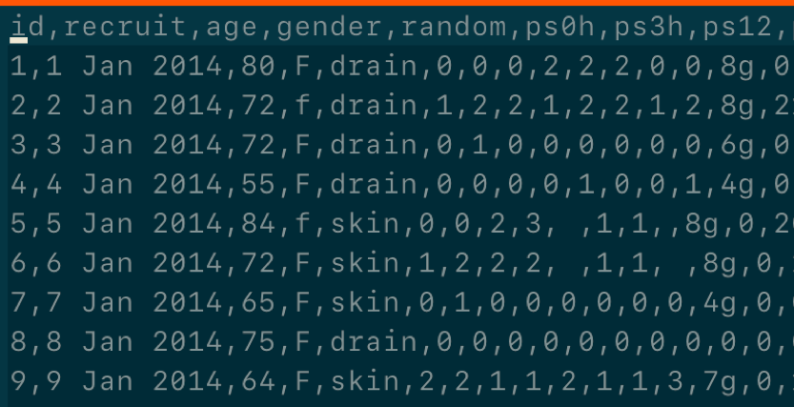
What is a CSV file?
Comma separated values file
You still have columns and rows
But data values on a single row are separated by commas instead of walls of a cell
Excel spreadsheets are easily converted into this format

Slide 6
::: ::::::::::::

Slide 7
Files, Directories and File Paths
R can not read your data if it does not know where it is stored
Your computer has a system for storing files within directories
Directories are also known as folders
The language used to instruct on the location of the file in known as the file path

Slide 8
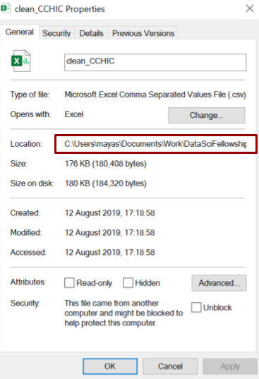
File Paths
Starts with a Root Directory and then Branches are specified
You can find out the file path name by right clicking on any file:
Properties in Windows
Get Info in Mac
Folders within directories are specified with:
/ in Mac & Unix
\\ in Windows

Slide 9
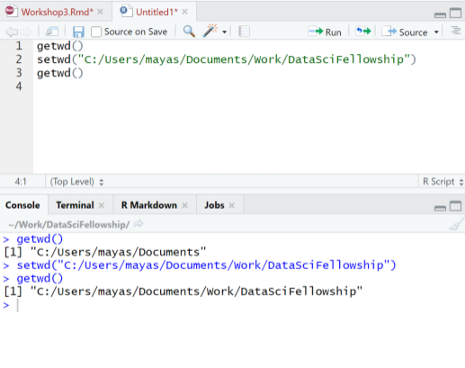
Finding and setting your Working Directory
R would have chosen a working directory for you
getwd()
Will display your working directory in your console
You can then reset it to your desired working directory using
setwd()
However using RStudio projects reduces the need to use setwd()
Remember. You need quotation marks ("") around your file path name

Slide 10
Getting your work into R
There are 3 main methods
Point and click
Less fiddly as no need to write code
But not reproducible
Using commands
Better for reproducibility
Someone else would just have to replace the source code to run the code on their own computer
Connecting to an online database or google spreadsheet (not covered here)

Slide 11
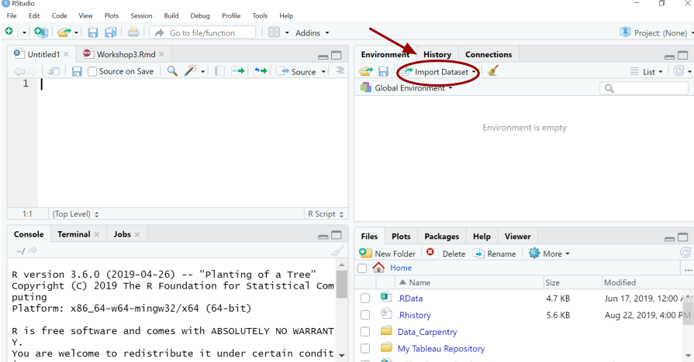
Method 1: Point and click
Click Import Dataset tab in the Environment pane

Slide 12
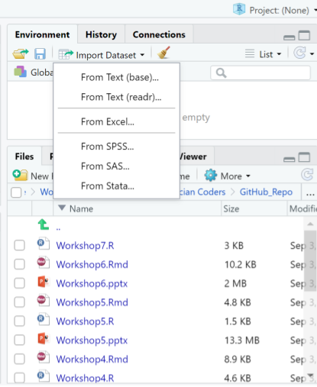
Choose From text (readr)

Slide 13
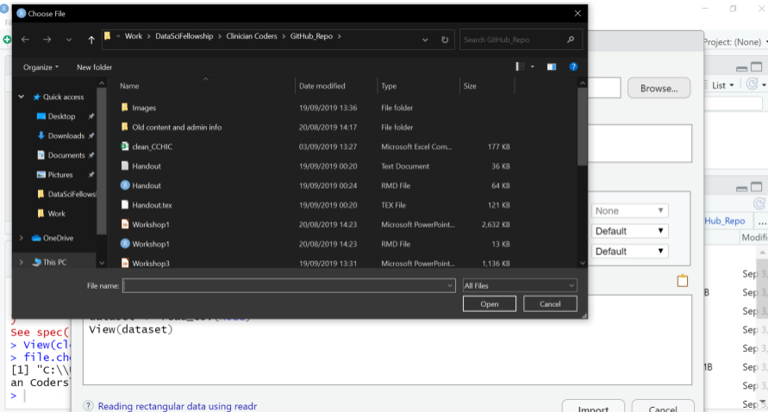
Browse Files
Now browse for your file
Click on the file you wish to select
Then select Import
IF you try this you will notice there is no text in the source pane. This method is not reproducible.

Slide 14
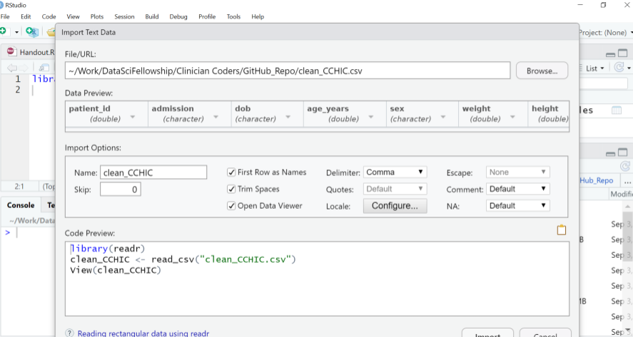
How can I make this reproducible?
Look for the code in the Code Preview
You can copy and paste this code into your source pane to make this step reproducible

Slide 15
Method 2: Commands
readr is a package containing functions to help R read your external files
It is automatically installed with tidyverse
Remember we have installed already so now load the packages with library()
library(tidyverse)

Slide 16
Read your file
You can then tell R to read a CSV file by writing the full file path name.
Because we are working in an RStudio project we can use a relative file path
# You creating an object called "cchic" to contain the data cchic <- read_csv("data/clean_CCHIC.csv")
(use double dot .. if you need to go above the current working directory)
Display the contents of the data frame cchic in R
cchic

Slide 17
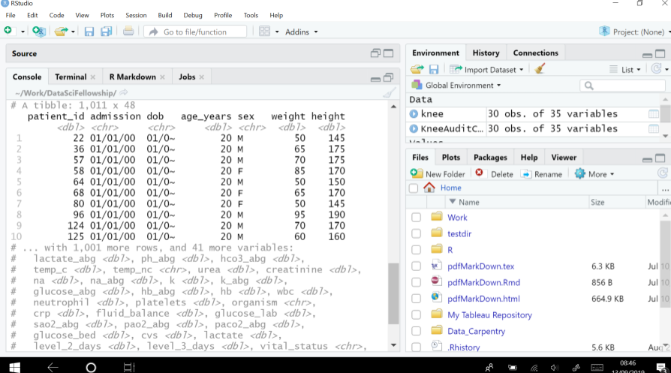
data is imported as a tibble - a special type of dataframe
A tibble is a tidyverse friendly dataframe - we don’t need to worry about that at this stage.

Slide 18
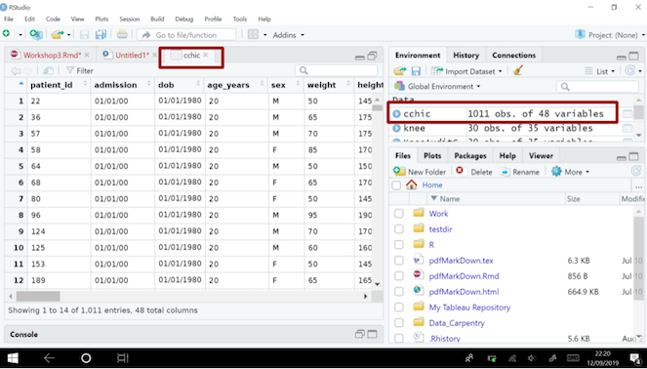
Viewing Your Data in R
You have imported your data into R.
You need a neat way of looking at it.
View(cchic)
The data is displayed in a familiar spreadsheet format.
This is a more human-legible table
You can also view the data via the environment pane

Slide 19
Reviewing your data in R
Spreadsheets in R are called data frames You can use these functions to investigate your data frame:
head(cchic)
tail(cchic)
names(cchic)
str(cchic)

Slide 20
head()
head(cchic)
Prints the first 6 rows of the data frame.

Slide 21
tail()
tail(cchic)
Prints the last 6 rows of the data frame.

Slide 22
names()
names(cchic)
Prints the names of the variables.

Slide 23
str()
str(cchic)
Prints the data type of each variable.

Slide 24
Look at specific items.
You can look at specific data points.
cchic[21, 5]
## # A tibble: 1 x 1 ## temp_nc ## <dbl> ## 1 36.1
This displays the the piece of data in the 21st row and 5th column.

Slide 25
Selecting variables using $ sign.
You can also use the $ function
Enter data_frame_name$variable_name
cchic$weight
This will list all of the data in the weight column

Slide 26
table() range() min() mean() & other tools to review data
Specific functions from other packages can help you describe datasets
e.g.
table() gives the number of unique values in a column
range() min() mean() work on numeric columns
BEWARE if a column contains any NA values these will return NA, unless you specify na.rm=TRUE
try with & without :
range(cchic2$urea, na.rm=TRUE)

Slide 27
Exercise
What types of variables do you have in cchic?
Display the discharge_dttm vector from cchic.
How many men and women are in the database?
How many survived and how many died?
What does the function ls() do?
Use it to see how many vectors contain information about “temp”

Slide 28
Answer 1.
What types of variables do you have in cchic?
str(cchic)

Slide 29
Answer 2
Display the discharge_dttm vector in cchic.
cchic$discharge_dttm

Slide 30
Answer 3
How many men and women are in the database?
table(cchic$sex)
## ## F M ## 2246 2754

Slide 31
Answer 4
How many survived and how many died?
table(cchic$vital_status)
## ## A D ## 4444 556

Slide 32
Answer 5
What does the function ls() do?
ls(cchic, pattern = "temp")
## [1] "temp_c" "temp_nc"
This lists all of the variables containing the word “temp”.

