Slide 1
session1: an R taster

Slide 2
Rationale
in this session we will give you a quick taste of R
to show you what you can do
we will get you to type commands in R and see what happens
we don’t expect you to understand completely at this stage
we will return to concepts later

Slide 3
Content
download a project from Github into RStudio
read in data from a file
look at the data
manipulate the data
plot the data

Slide 4
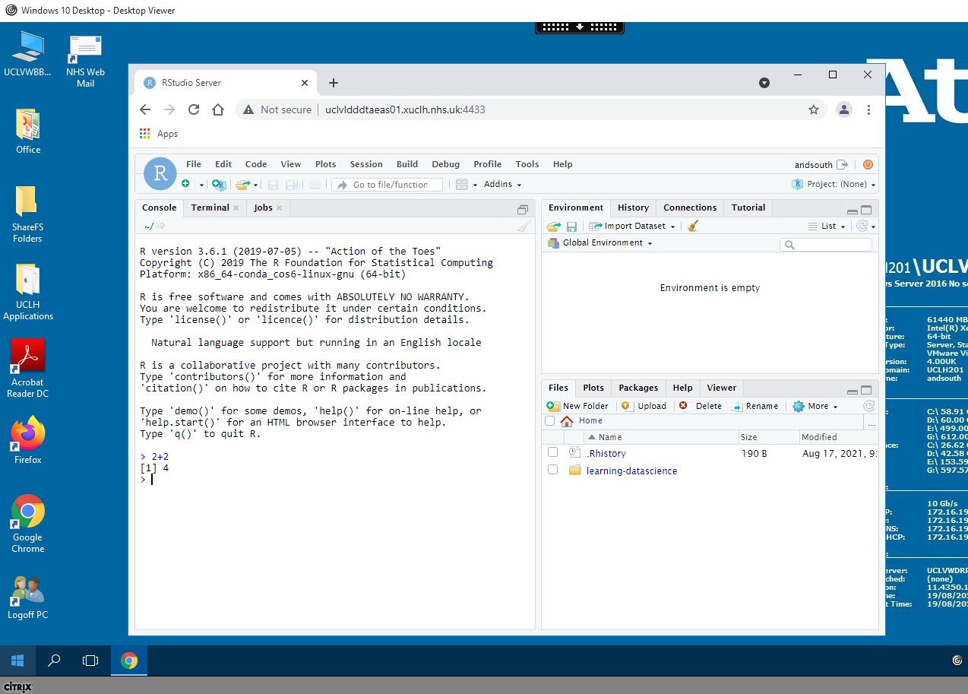
If you don’t see something like this, let us know and we’ll help

Slide 5
Working with RStudio
RStudio is an Integrated Development Environment (IDE). – (also the name of the company that develops it and a lot more)
Easier to work with than R on it’s own, since it it a bit more ‘point and clicky’
Allows
Code editing
Syntax highlighting
Plotting tools
Workspace management
Version control

Slide 6
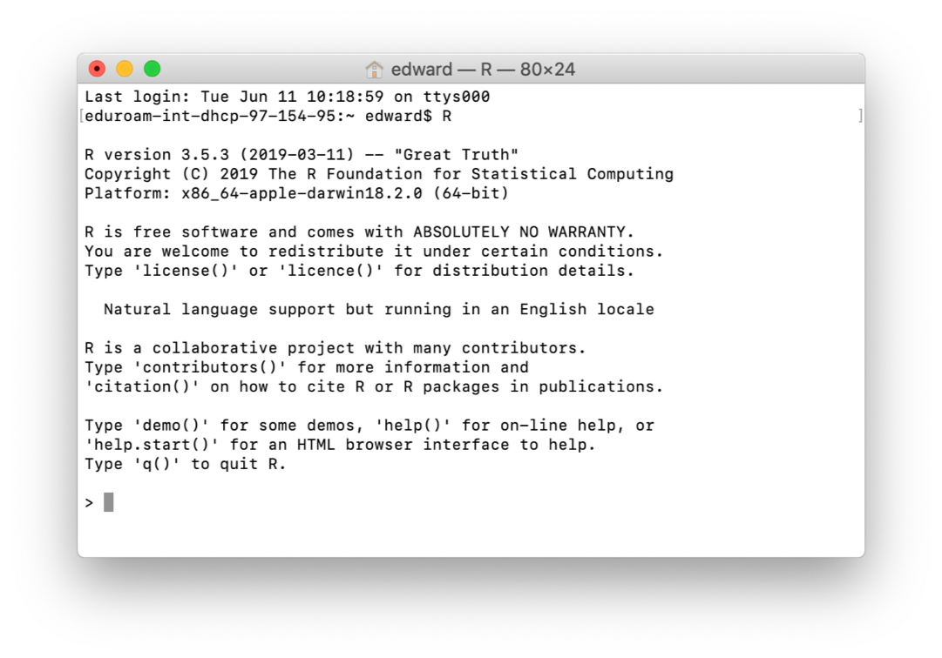
This is what R on it’s own looks like

Slide 7
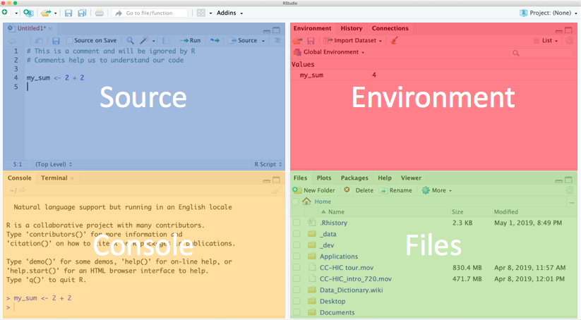
RStudio is much easier to work with & what we recommend
Notes:
Explain each window.
Console - this is where R is run. Commands executed but not saved.
Source - text files that contain commands.
Environment - tells you which R objects you are working with.
Files - actually a helper window. Gives you files, help, plots.

Slide 8
Using the Source/Text editor
Type 2 + 2 in top left, then Enter.
What happens?
To ask R to run code
Highlight the code and:
MacOS: Cmd + Enter
Windows: Ctrl + Enter
Notice the output in the console.

Slide 9
A warning about R warnings & errors
DON’T PANIC : they are common & expected
Warnings give you info that often you can ignore
Errors usually need to be fixed and are usually due to a typo
Errors check the first one - if it doesn’t make sense to you, google it

Slide 10
If you are an Instructor switch to live demo in RStudio
If you are learning independently follow the steps in these slides.

Slide 11
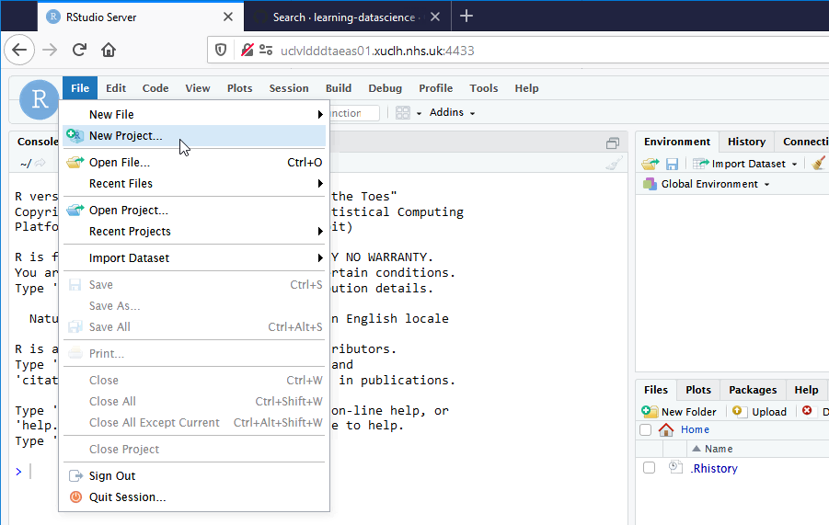
download a project from Github into RStudio

Slide 12
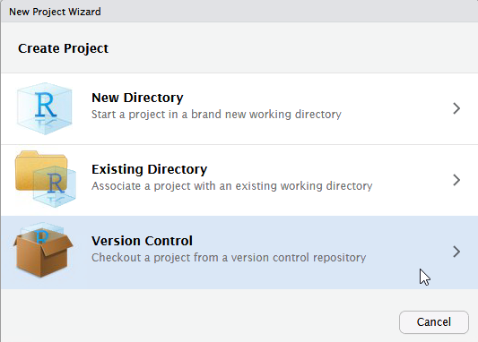

Slide 13
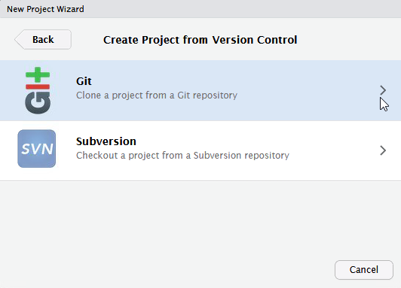

Slide 14
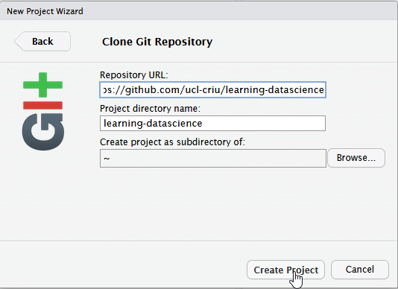
Copy into first box https://github.com/uclh-criu/learning-datascience

Slide 15
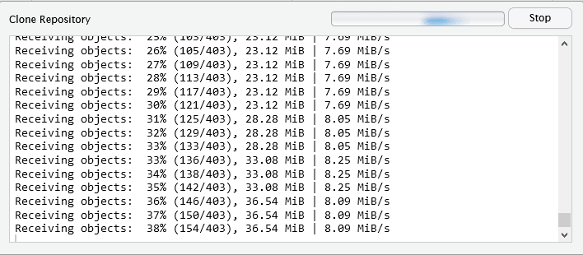
may take a while to copy files.

Slide 16
Intructor will step through sessions/1-R-taster-script.R

