Slide 1
MGMT298D
Science and Strategy of AI
Week 2
Tree-Based Models:
Decision Trees, Random Forests, XGBoost
UCLA Anderson School of Management
Auyon Siddiq

Slide 2
Case Handout
Algorithmic Pricing at Carvana and Zillow

Slide 3
Discussion
Q1
Q2
Q3

Slide 4
Limitations of Linear Regression
Assumption of Linearity
Prices don't move in straight lines
Price may jump based on mileage thresholds (e.g., >100k miles)
Feature Interactions
Luxury trim × high mileage has nonlinear effect on price
Linear models can't capture this
Limited Predictive Power
Typically explains 40–60% of variance in vehicle pricing
We need models that handle nonlinear relationships and interactions automatically

Slide 5
Decision Trees

Slide 6
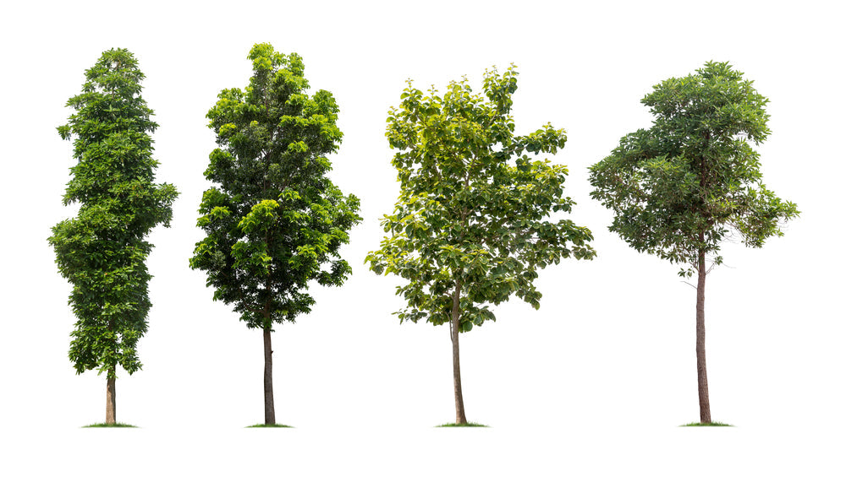
Decision Trees: The Core Idea
Recursive Partitioning
Split the data into regions using yes/no questions
Example: Is mileage > 80,000 miles?
Interpretability
Each path from root to leaf is a simple decision rule
Anyone can follow the logic
Handling Nonlinearity
Captures interactions through splits
No assumptions about functional form

Slide 7
How a Decision Tree Splits
Mileage ≤ 60,000?
Yes
No
Low mileage → avg $45,000
Year ≥ 2015?
Yes
No
Recent, high-mi → $35,000
Old, hi-mi → $18K
Each leaf = a prediction (average price of the vehicles in that region)
Trees automatically discover interactions — no feature engineering required

Slide 8
Decision Tree: Numerical Example
Predicting used Range Rover prices using the tree from the previous slide:
Vehicle | Mileage | Year | Actual Price | Tree Path | Predicted | Error
RR A | 45,000 | 2018 | $48,000 | ≤60k → Leaf 1 | $45,000 | +$3,000
RR B | 95,000 | 2016 | $32,000 | >60k, ≥2015 → Leaf 2 | $35,000 | -$3,000
RR C | 110,000 | 2008 | $19,000 | >60k, <2015 → Leaf 3 | $18,000 | +$1,000
RR D | 38,000 | 2019 | $52,000 | ≤60k → Leaf 1 | $45,000 | +$7,000
Tree captures nonlinear relationship: older + higher mileage = much lower price
Note: RR D and RR A both land in Leaf 1 — the tree can't distinguish them without a deeper split.

Slide 9
Depth & Overfitting in Trees
Shallow Trees (depth = 2–3)
High bias, low variance — underfitting
Too simple to capture price patterns
Deep Trees (depth = 10–15)
Low bias, high variance — overfitting
Memorizes training data; fails on new data
The Sweet Spot
Depth 5–7 typically balances accuracy & generalization
Same bias-variance trade-off from Week 1 — here controlled by tree depth instead of λ

Slide 10
Decision Tree Hyperparameters
Parameter | What It Controls | Typical Values | Effect / Trade-off
max_depth | Maximum levels in the tree | 5–7 (regression) | Deeper = more complex, risk overfitting
min_samples_split | Min samples to split a node | 2–20 | Higher = more conservative splits
min_samples_leaf | Min samples in leaf node | 1–10 | Higher = smoother predictions
max_features | Features considered per split | All or sqrt(n) | Fewer = more regularization
criterion | Split quality metric | mse, mae | MSE is standard; MAE more robust to outliers
Most important to tune: max_depth and min_samples_leaf — these have the biggest effect on overfitting.

Slide 11
When to Use Decision Trees
Strengths
Highly interpretable — you can show the tree to a stakeholder
No feature scaling needed
Handles nonlinearity and interactions naturally
Limitations
High variance — small data changes produce different trees
Overfits without depth limits
Lower accuracy than ensemble methods
Decision trees are the building block — ensembles (RF, XGBoost) fix their weaknesses

Slide 12
Random Forests

Slide 13
Jellybean Game

Slide 14
The Single Tree Problem
High Variance
Sensitive to which data they see
Different sample → completely different tree
The Intuition
One expert → risky
500 experts averaged → much more reliable
Random Forest = ensemble of 100–500 independent trees

Slide 15
Random Forests: The Algorithm
Bootstrap Aggregating (Bagging)
For each tree i = 1 to 500:
Sample N rows with replacement (bootstrap)
At each split, random subset of features
Grow a deep tree on this bootstrap sample
Prediction (Regression)
Average predictions from all 500 trees
Price = (Tree₁ + Tree₂ + ... + Tree₅₀₀) / 500
Feature randomness decorrelates trees → lower variance

Slide 16
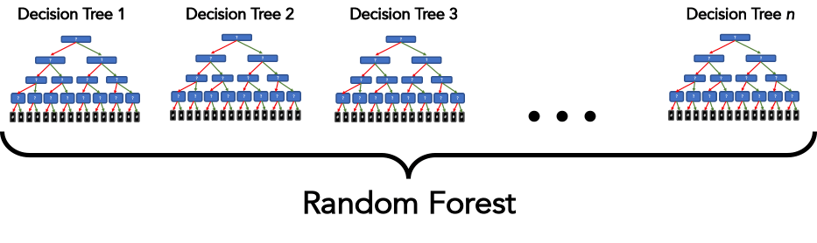
Random Forest: Parallel Tree Building
Full Training Data (N rows, P features)

Slide 17
Random Forest: Numerical Example
Each tree gives a slightly different prediction; the average is more stable:
Vehicle | Tree 1 | Tree 2 | Tree 3 | ... Tree 500 | RF Prediction | Actual
RR A | $46,500 | $44,200 | $45,100 | ... | $45,240 | $48,000
RR B | $34,800 | $35,200 | $35,600 | ... | $35,100 | $32,000
RR C | $17,900 | $18,200 | $17,800 | ... | $18,050 | $19,000
RR D | $46,000 | $44,500 | $45,800 | ... | $45,650 | $52,000
Averaging reduces noise & outlier influence — more stable than any single tree

Slide 18
Why Random Forests Work
Variance Reduction
Bootstrap + averaging = much lower variance
Better generalization
Bias-Variance Trade-off
Single deep tree: high variance, low bias
Random forest: similar bias, much lower variance
Robustness
Outliers in one tree get washed out
Interactions captured automatically

Slide 19
Random Forest Hyperparameters
Parameter | What It Controls | Typical Values | Effect / Trade-off
n_estimators | Number of trees in forest | 100–500 | More = lower variance; diminishing after ~200
max_depth | Depth of each tree | 10–15 or None | Deeper OK since bagging controls variance
min_samples_split | Min samples to split a node | 2–10 | Less aggressive than single trees
min_samples_leaf | Min samples in leaf node | 1–5 | Lower OK since ensemble averages out noise
max_features | Features per split | sqrt(n) or n/3 | Lower = more diverse trees, less correlated
Most important to tune: n_estimators (enough trees) and max_features (diversity of ensemble).

Slide 20
When to Use Random Forests
Strengths
Strong accuracy with minimal tuning
Resistant to overfitting
Built-in feature importance
Limitations
Less interpretable — no single path to show
Slower to train (500× more trees)
Trees don't learn from each other's mistakes
What if each tree could learn from the previous tree's errors? → Boosting

Slide 21
XGBoost

Slide 22
Boosting: Sequential Improvement
Random Forest: Parallel
Boosting: Sequential
Tree 1: Fit to original data
Tree 2: Focus on mistakes from Tree 1
Tree 3: Focus on mistakes from Trees 1+2
Each tree corrects the last
Build 500 trees independently
Then average all predictions
All trees are peers
Even weak learners combine into a strong predictor when each corrects the last

Slide 23

XGBoost: The Algorithm
Initialization
Start with mean price = $35,000
Iteration 1
Residuals = actual – $35,000
Tree 1 predicts these residuals
Update: Prediction = $35,000 + η × (Tree₁ prediction)
Iteration 2
New residuals from updated predictions
Tree 2 predicts new residuals
Learning rate (η) controls how much each tree contributes — typically 0.01–0.3

Slide 24
XGBoost: The Algorithm
Prediction = Base + η·Tree₁ + η·Tree₂ + η·Tree₃ + ...
Each tree is small (shallow)
η (learning rate) shrinks each tree's contribution to avoid overshooting
Lower η → more trees needed, but more accurate
Residuals shrink each iteration → predictions converge

Slide 25
XGBoost: Numerical Example
Step-by-step boosting with η = 0.1. Each tree fits the previous residuals:
 | RR A | RR B | RR C | RR D
Actual price | $48,000 | $32,000 | $19,000 | $52,000
Base prediction | $35,000 | $35,000 | $35,000 | $35,000
Residual 1 | +$13,000 | -$3,000 | -$16,000 | +$17,000
Tree 1 predicts | +$10,000 | -$2,500 | -$12,000 | +$13,000
Prediction after T1 | $36,000 | $34,750 | $33,800 | $36,300
Residual 2 | +$12,000 | -$2,750 | -$14,800 | +$15,700
Tree 2 predicts | +$9,200 | -$2,200 | -$11,500 | +$12,100
Prediction after T2 | $36,920 | $34,530 | $32,650 | $37,510
Residual 3 | +$11,080 | -$2,530 | -$13,650 | +$14,490
Tree 3 predicts | +$8,500 | -$2,000 | -$10,600 | +$11,200
Prediction after T3 | $37,770 | $34,330 | $31,590 | $38,630
Residuals shrink with each tree — predictions converge toward actual prices
After just 3 trees, RR C: $35K → $31,590 (toward $19K). With η = 0.1, convergence is slow but stable.

Slide 26
XGBoost Hyperparameters
Parameter | What It Controls | Typical Values | Effect / Trade-off
learning_rate (η) | Shrinkage per tree | 0.01–0.3 | Lower = slower learning, needs more trees, but more accurate
n_estimators | Number of boosting rounds | 100–1000 | More trees with low η; fewer with high η
max_depth | Depth of each tree | 3–6 | Shallower than RF — boosting is prone to overfitting
subsample | Fraction of rows per tree | 0.7–1.0 | < 1.0 adds randomness, reduces overfitting
colsample_bytree | Fraction of features per tree | 0.5–1.0 | Similar to RF's max_features — adds diversity
reg_alpha / reg_lambda | L1 / L2 regularization | 0–10 | Penalizes complex trees — just like LASSO/Ridge from Week 1
Most important to tune: learning_rate, n_estimators, and max_depth — these dominate model performance.

Slide 27
Trees vs. Forests vs. Boosting
Aspect | Decision Tree | Random Forest | XGBoost
Interpretability | Excellent | Good | Moderate
Predictive Accuracy | Moderate | High | Very High
Prone to Overfitting | Yes | No | Yes (if poorly tuned)
Speed (prediction) | Very Fast | Fast | Fast
Variance | High | Low | Low
Requires Tuning | Moderate | Low | High
XGBoost wins on accuracy but requires careful hyperparameter tuning

Slide 28
Hyperparameter Tuning

Slide 29
Why Tuning Matters
Default ≠ Optimal
Library defaults aren't tailored to your data
Range Rovers need different tuning than houses
Variance-Bias Trade-off
Too simple → high bias, underfits
Too complex → high variance, overfits
Tuning finds the sweet spot
Business Impact
10% accuracy improvement ≈ $1,000+ per vehicle
On 5,000 annual sales = $5M+ improvement

Slide 30
learning_rate (η): Deep Dive
Controls how much each tree contributes to the prediction
Prediction = Base + η×Tree₁ + η×Tree₂ + ...
η = 0.3 (High)
η = 0.1 (Medium)
η = 0.01 (Low)
Each tree contributes 30%
Fast learning, but risky
Can overfit quickly
Each tree contributes 10%
Balanced approach
Good default starting point
Each tree contributes 1%
Slow but stable
Needs many more trees
Rule of thumb: lower η + more trees = better accuracy but slower training

Slide 31
learning_rate: Numerical Example
Tracking RR A (actual = $48,000) across different learning rates:
Iteration | η = 0.3 | η = 0.1 | η = 0.01 | Actual
Initial | $35,000 | $35,000 | $35,000 | $48,000
After Tree 1 | $38,900 | $36,300 | $35,130 | $48,000
After Tree 2 | $41,230 | $36,700 | $35,240 | $48,000
After Tree 5 | $45,100 | $37,900 | $35,620 | $48,000
After Tree 20 | $47,600 | $42,300 | $40,100 | $48,000
After Tree 100 | OVERFIT | $47,800 | $47,300 | $48,000
η=0.3 overshoots & overfits; η=0.01 is slower but converges accurately

Slide 32
n_estimators: Deep Dive
Number of trees in Random Forest or boosting rounds in XGBoost
Random Forest Typical Range
100–500 trees; diminishing returns after ~200–300
XGBoost Typical Range
100–1000 trees (depends on learning rate)
High η → fewer trees (100–300)
Low η → more trees (500–1000)
Computational Trade-off
More trees = slower training but better accuracy

Slide 33
n_estimators: Impact on Accuracy
# Trees | RF Train RMSE | RF Test RMSE | XGB Train RMSE | XGB Test RMSE
10 | $3,200 | $5,400 | $2,900 | $6,100
50 | $2,100 | $3,800 | $1,500 | $3,200
100 | $1,800 | $3,100 | $900 | $2,800
200 | $1,700 | $3,050 | $600 | $2,750
500 | $1,650 | $3,020 | $400 | $2,850
1000 | $1,600 | $3,050 | $300 | $3,200
Test RMSE plateaus; XGB overfits at 1,000 trees — watch for train-test divergence
Adding trees after ~200 gives little benefit for RF. For XGB, too many trees can hurt.

Slide 34
max_depth: Deep Dive
Controls how deep each tree grows
Single Tree Perspective
Shallow (2–3): High bias, low variance
Deep (15+): Low bias, high variance
Sweet spot: 5–7 for single tree
In Ensembles
Random Forest: Deeper OK (10–15) — bagging controls variance
XGBoost: Keep shallow (3–6) — boosting overfits easily
RF trees are deep and independent; XGBoost trees are shallow and sequential

Slide 35
Grid Search: Systematic Tuning
What is Grid Search?
Try every combination of hyperparameters
Pick the combination with lowest validation error
Example: XGBoost Tuning Grid
learning_rate: [0.01, 0.05, 0.1, 0.2]
n_estimators: [100, 300, 500, 1000]
max_depth: [3, 5, 7]
= 4 × 4 × 3 = 48 models to train
Grid search takes hours for large datasets — but essential for optimal performance

Slide 36
Grid Search Results: learning_rate vs n_estimators
Test RMSE for max_depth = 5:
η \ Trees | 100 | 300 | 500 | 1000
0.01 | $3,200 | $2,850 | $2,680 | $2,620
0.05 | $2,900 | $2,620 | $2,480 | $2,550
0.1 | $2,750 | $2,550 | $2,520 | $2,680
0.2 | $2,850 | $2,680 | $2,750 | $3,100
Optimal: η=0.05, n_estimators=500 (RMSE=$2,480) — sweet spot of learning rate & complexity
Note: η=0.2 with 1000 trees overfits ($3,100). Higher learning rates need fewer trees.

Slide 37
Tuning in Action: Comparing Configurations
Range Rover pricing — comparing 4 XGBoost configurations:
Config | η | Trees | Depth | Train RMSE | Test RMSE | Gap
A (default) | 0.3 | 100 | 6 | $800 | $3,400 | $2,600
B (lower η) | 0.1 | 300 | 6 | $1,200 | $2,750 | $1,550
C (tuned) | 0.05 | 500 | 5 | $1,500 | $2,480 | $980
D (overfit) | 0.01 | 2000 | 8 | $200 | $2,900 | $2,700
Config C: Best test performance. Watch the train-test gap — large gap = overfitting
Config D has near-zero training error but worse test error — classic overfitting pattern.

Slide 38
Hyperparameter Tuning: Best Practices
1. Start with Defaults
Get baseline performance before tuning
2. Tune High-Impact Parameters First
learning_rate & n_estimators > max_depth > min_samples
3. Use Proper Validation
Train / Validation / Test split (60/20/20)
4. Coarse → Fine Search
Start with wide grid, then zoom into promising region
5. Monitor for Overfitting
Track train vs. test error — divergence = overfitting

Slide 39
Feature Importance
Tree-based models tell you which features drive predictions the most
Mileage
35%
Year
28%
Trim Level
18%
State
10%
Color
5%
Other
4%
Mileage and year dominate — same features a dealer would focus on intuitively
Feature importance is measured by how much each feature reduces error across all trees in the ensemble.

Slide 40
Which Model Should You Use?
Need interpretability for stakeholders?
→ Use Decision Tree (can show the tree to a dealer or executive)
Want strong performance with minimal tuning?
→ Use Random Forest (robust out-of-the-box)
Need maximum accuracy and have time to tune?
→ Use XGBoost (state-of-the-art on structured/tabular data)
Unsure?
→ Start with Random Forest as baseline, then try XGBoost if accuracy matters
XGBoost is the go-to algorithm for structured data in industry and Kaggle competitions

Slide 41
Live Demo
Building & Tuning Models in Google Colab

Slide 42
Assignment 2

Slide 43
Assignment 2: Model Comparison & Tuning
Your Task
Build Decision Tree, Random Forest, and XGBoost models
Use grid search to tune XGBoost hyperparameters
Compare performance across models
Deliverables
Python notebook with code & output
Table: model accuracy, train/test RMSE
Plot: feature importance (Random Forest & XGBoost)
1-page summary: which model & why?
Due
End of Week 2 (Friday 11:59 PM)

