Slide 1
MGMT298D
Science and Strategy of AI
Week 1
Course Introduction;
Regression with Feature Engineering
UCLA Anderson School of Management
Auyon Siddiq

Slide 2
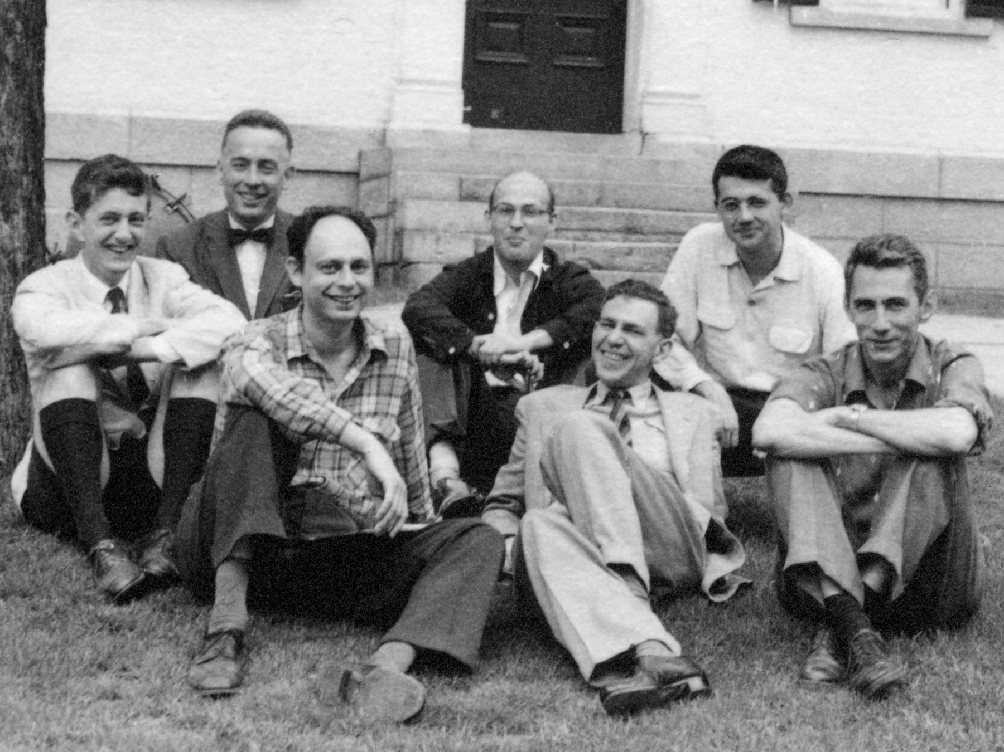
When Did "Artificial Intelligence" Begin?
1956: Dartmouth Conference — John McCarthy coins the term
A small group of researchers proposed that machines could simulate every aspect of learning
https://spectrum.ieee.org/dartmouth-ai-workshop

Slide 3
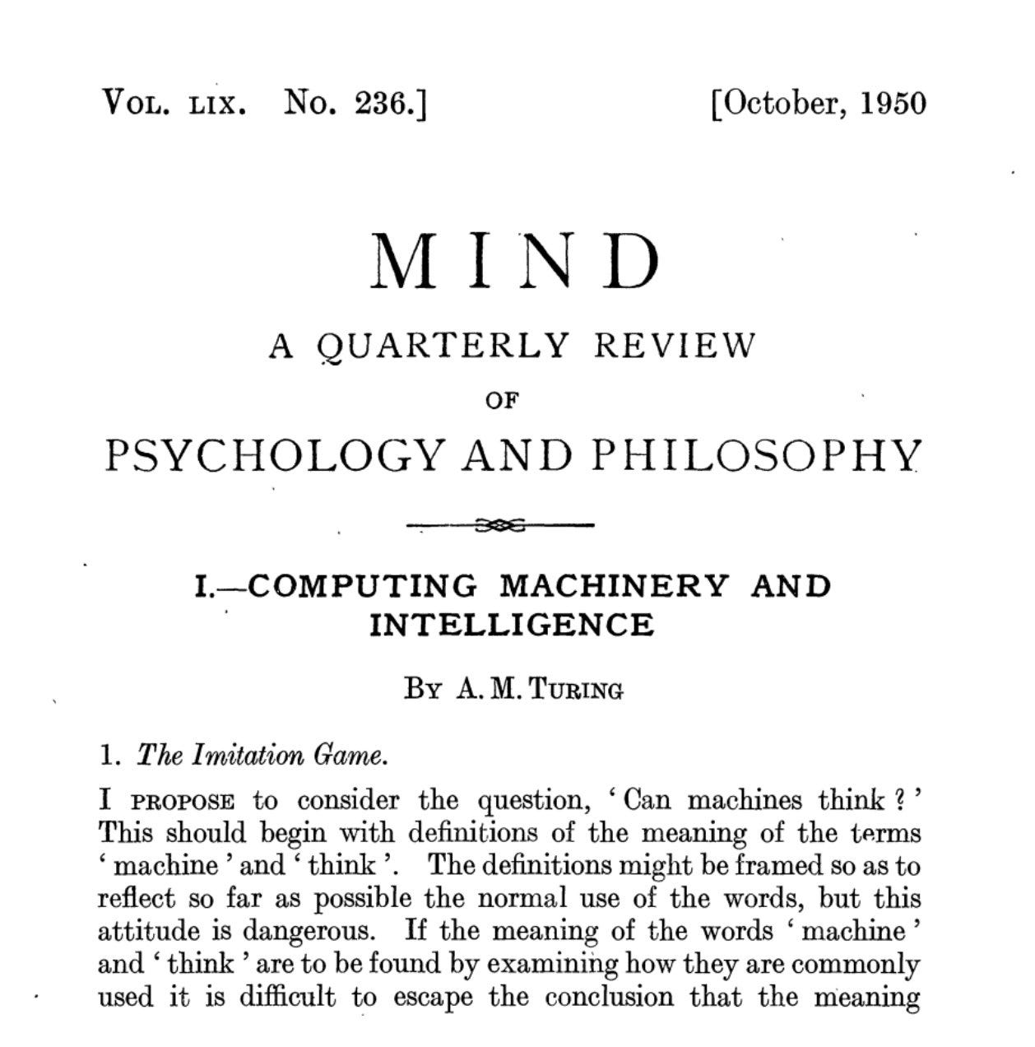


Slide 4
Confident Predictions!
"Machines will be capable of doing any work a man can do."
— Herbert Simon, 1965
"Within a generation... the problem of creating 'artificial intelligence' will substantially be solved."
— Marvin Minsky, 1967
"In 3 to 8 years we will have a machine with the general intelligence of an average human being."
— Marvin Minsky, 1970

Slide 5
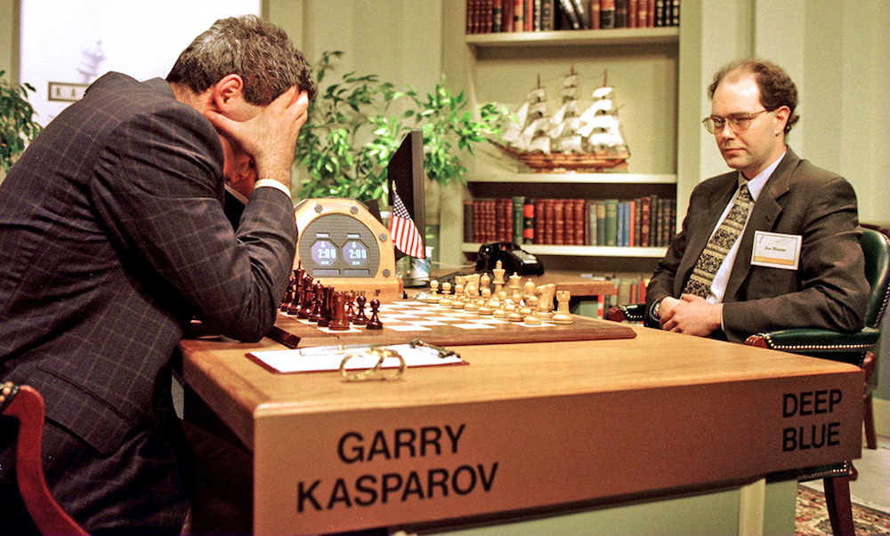
Deep Blue (1997)

Slide 6
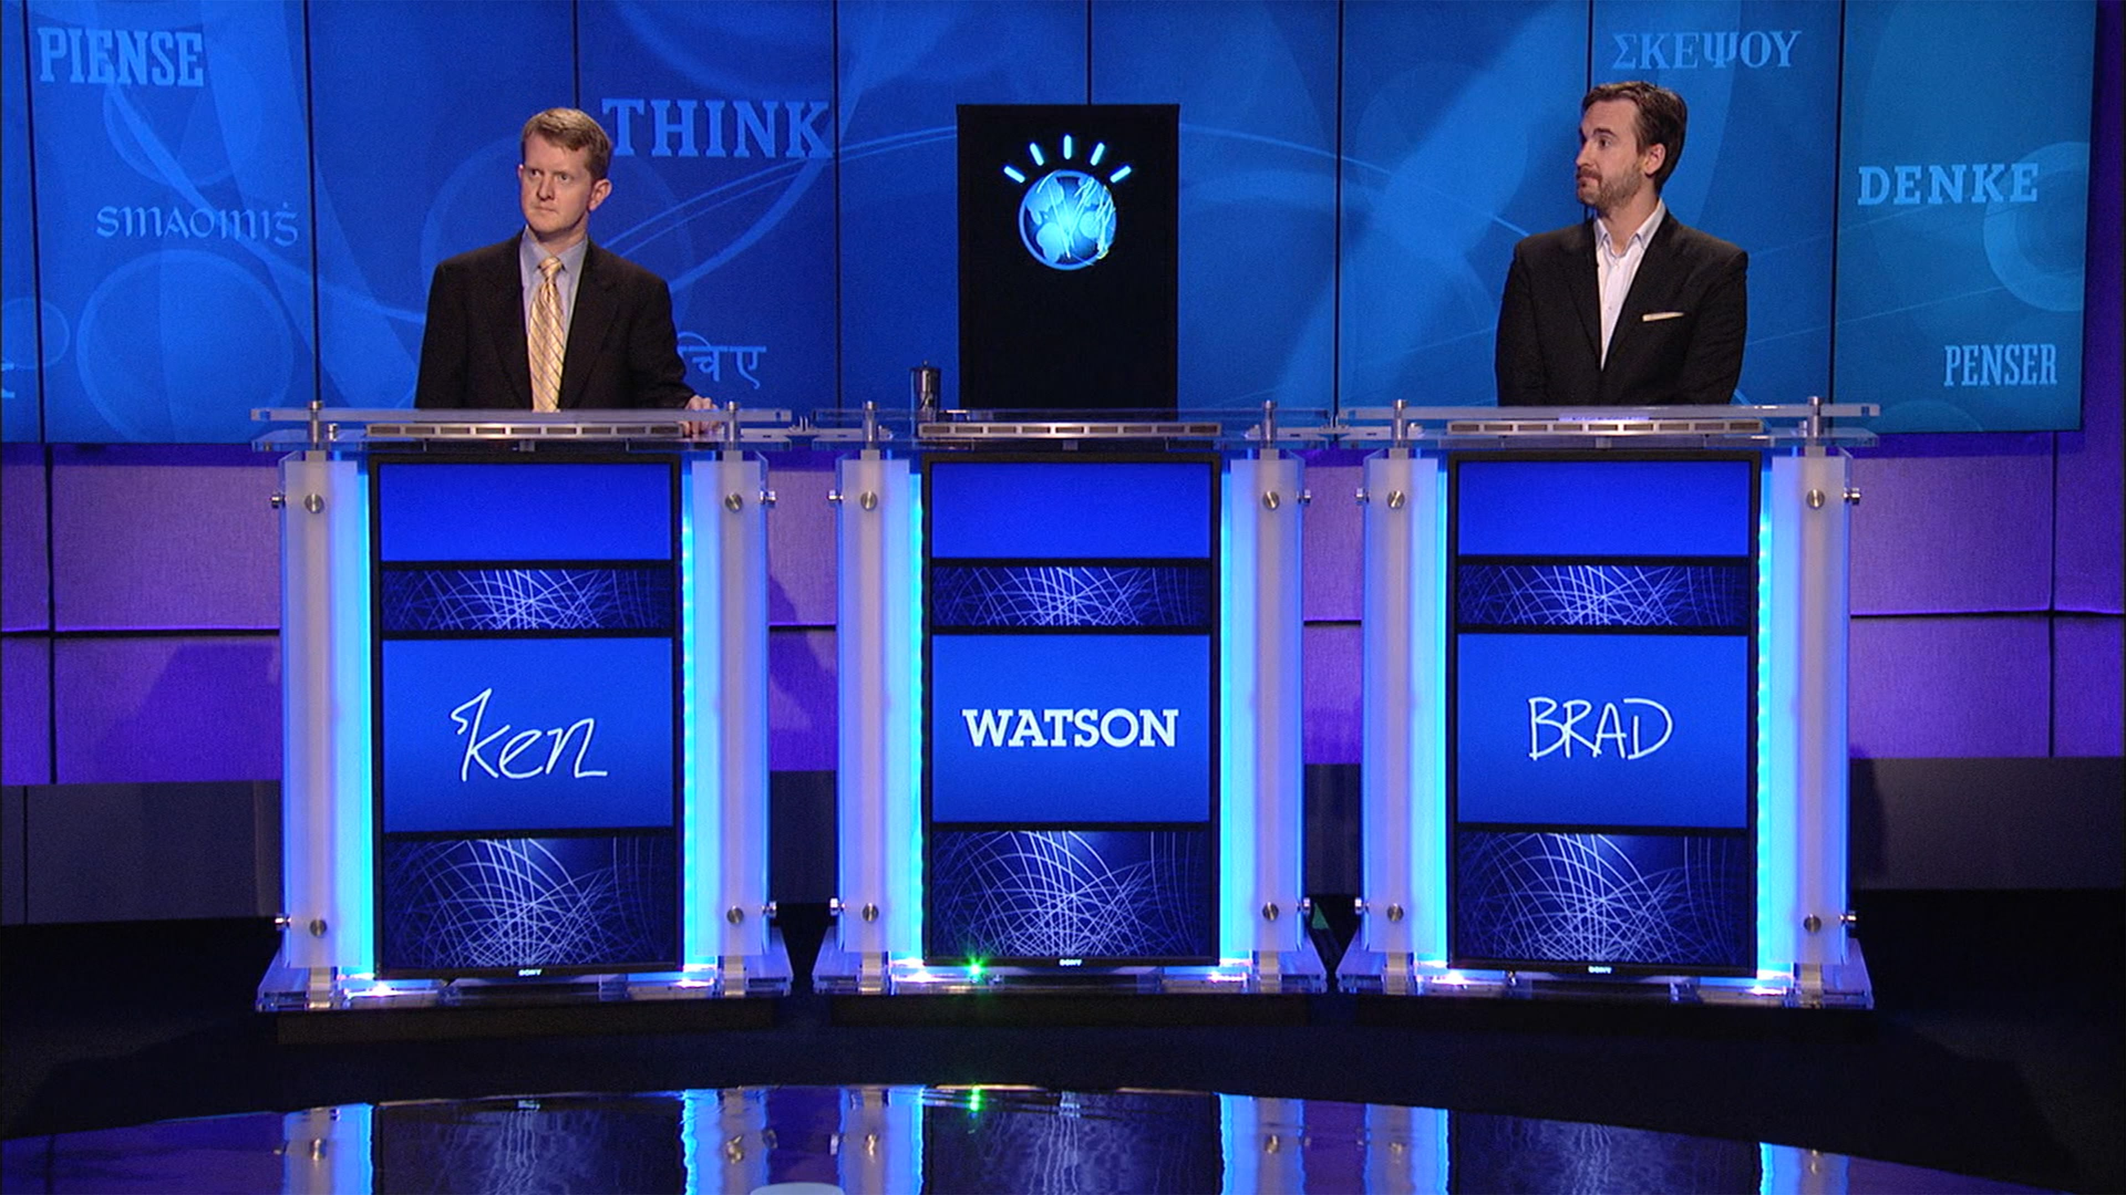
IBM Watson (2011)

Slide 7
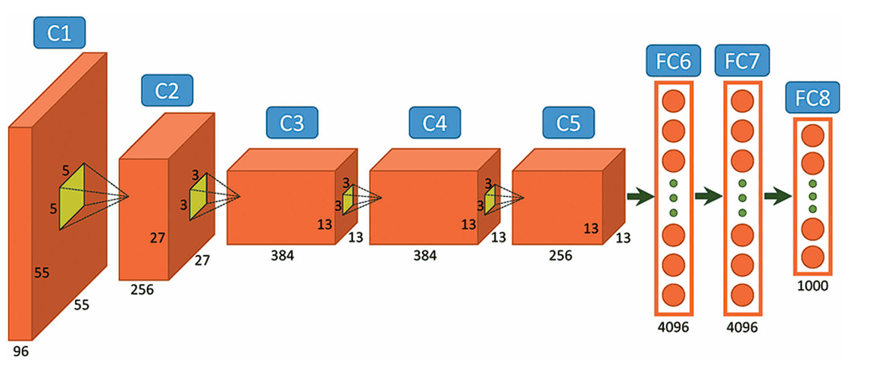
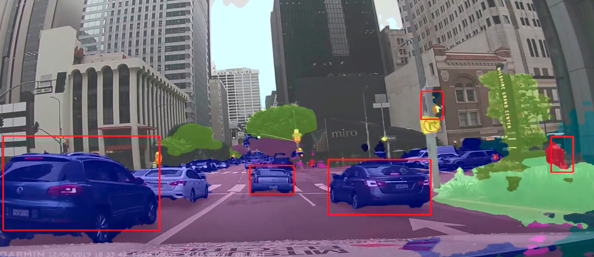
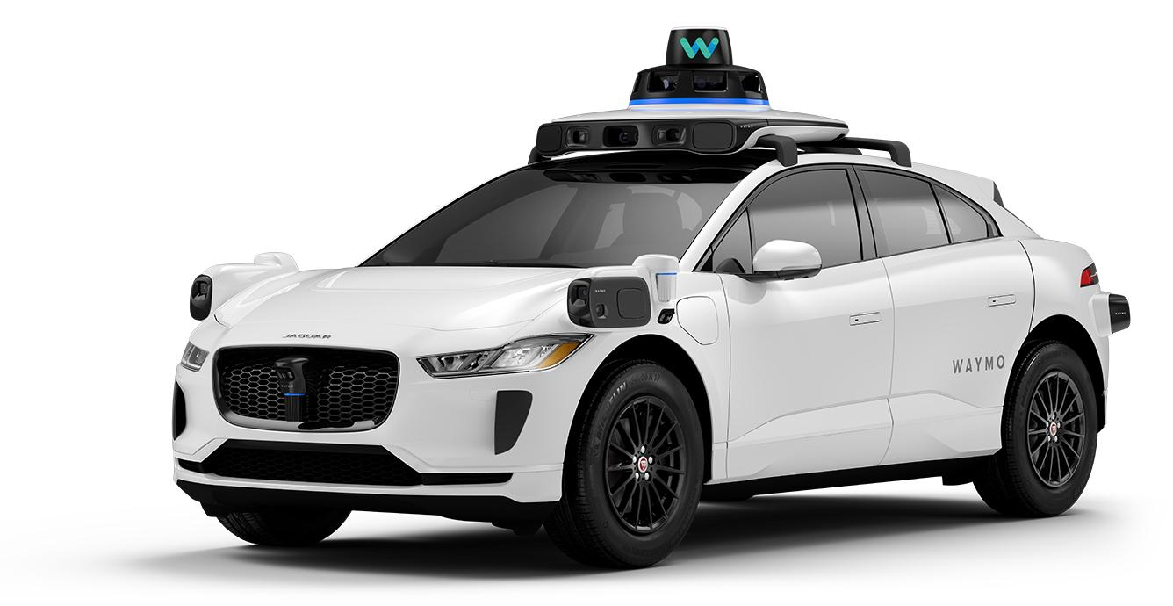
AlexNet (2012)

Slide 8

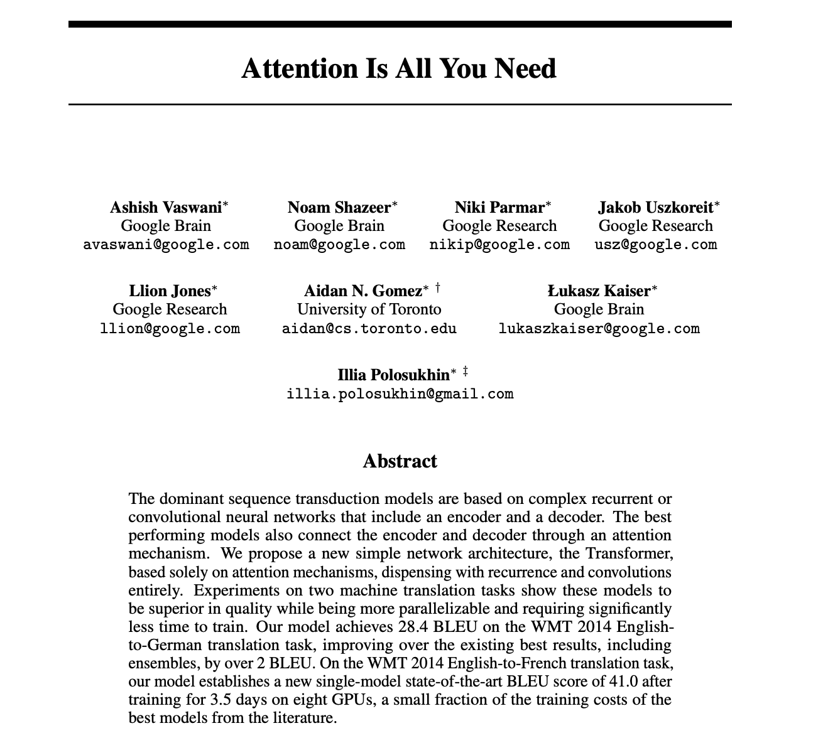
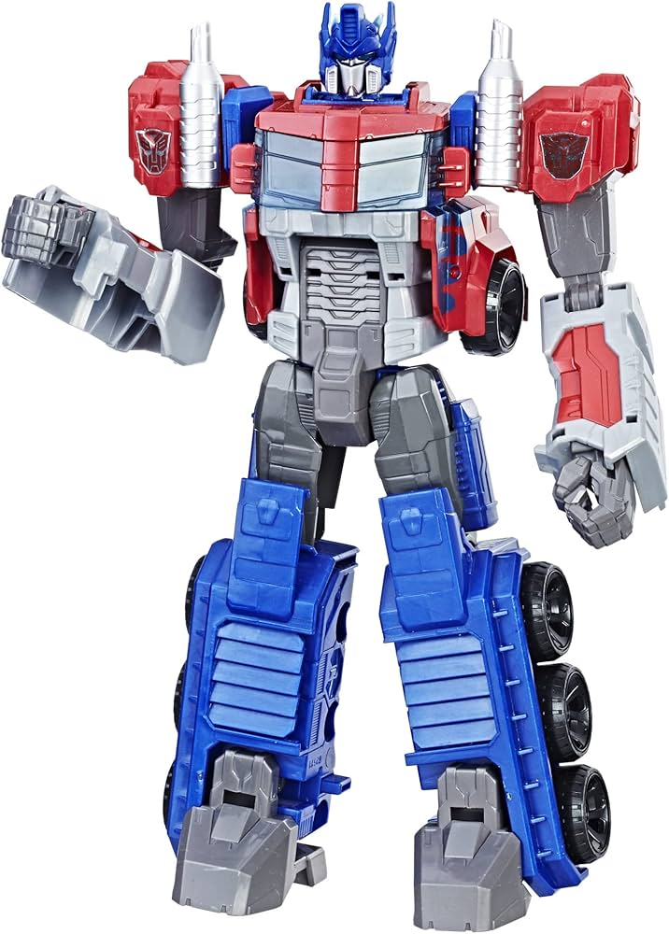
Transformers (2017)

Slide 9

ChatGPT (2022)

Slide 10
Milestones in AI
Year | Early Era (1956–1993) | Year | Modern Era (1997–2023)
1956 | Dartmouth Conference coins 'AI' | 1997 | Deep Blue defeats Kasparov at chess
1966 | ELIZA chatbot — early NLP | 2011 | IBM Watson wins Jeopardy!
1969 | Shakey the Robot — perception + reasoning | 2012 | AlexNet revolutionizes computer vision
1974–80 | First AI Winter — unmet expectations | 2016 | AlphaGo defeats Go champion Lee Sedol
1980s | Expert systems boom in enterprises | 2017 | Transformer architecture → modern LLMs
1987–93 | Second AI Winter — brittle systems | 2022–23 | ChatGPT / GPT-4 — generative AI

Slide 11
So What Is This Course About?
Survey of core machine learning and AI models
Tech-forward: understand how the technology and data drives value
Light on math, heavy on intuition
We will get technical to build genuine understanding

Slide 12
Who Is This Course For?
Non-technical leaders (consultants, PMs) who are genuinely curious about how ML/AI works
Why invest in this knowledge?
1. Confidence in AI topics — when to deploy, what it can/can't do
2. Credibility with AI teams, easier to lead and collaborate
3. Competitive advantage and differentiation in job market
4. Complementary to other Anderson courses
5. It is interesting

Slide 13
Course Structure
Machine Learning (Weeks 1-4)
Week 1: Linear Regression, Feature Engineering, Regularization
Week 2: Decision Trees, Random Forests, XGBoost
Week 3: Clustering, Recommendation Systems
Week 4: Reinforcement Learning, Dynamic Pricing
Deep Learning (Weeks 5-7)
Week 5: Neural Networks
Week 6: Convolutional Neural Networks (Computer Vision)
Week 7: Word Embeddings, Transformers, LLMs
Project (Week 8)
Week 8: LLM Parameters, Generative AI, Team Presentations

Slide 14
Case Handout
H&M Demand Forecasting

Slide 15

Discussion
Q1
Q2
Q3

Slide 16
Machine Learning

Slide 17

What is Machine Learning?
Branch of artificial intelligence
Standard ML models use tabular data

Slide 18
What is a Model?
Name of the game is prediction
Most standard setup: Take in some training examples (input and output data pairs), and produce a prediction
1) Regression (predict a number)
2) Classification (predict a category)

Slide 19
Data
H&M sales data: Each row = one week observation
product_id | price | lag_m1 | discount | sales
12345 | $42.50 | 125 | 0.15 | 110
12346 | $38.00 | 95 | 0.20 | 88
12347 | $55.00 | 200 | 0.00 | 185
12348 | $29.99 | 75 | 0.30 | 65
... | ... | ... | ... | ...

Slide 20
Terminology
Features (x): input variables the model uses to make predictions (e.g., price, discount, last month's sales)
Target / Label (y): the variable we want to predict (e.g., units sold)
Coefficients / Weights (beta): learned parameters that determine how much each feature matters
Training: the process of finding optimal weights by minimizing prediction error
Inference: using the trained model to make predictions on new data

Slide 21
Linear Regression

Slide 22
Linear Regression
ŷ = β₀ + β₁x₁ + β₂x₂ + ... + βₙxₙ

Slide 23
Example Regression Model
A model is an equation with learned parameters:
sales = β₀ + β₁(price) + β₂(lag_m1)
BEFORE Training
AFTER Training
β₀ = ?, β₁ = ?, β₂ = ?
(Unknown coefficients)
β₀ = 850, β₁ = -15.2, β₂ = 0.73
(Learned from 42K examples)
Example: price=$45, lag_m1=120 → sales = 850 - 684 + 87.6 = 253.6 units

Slide 24
Model Training: Finding “Best” Weights
Find β values that minimize a loss function
Result: β₀ = 850, β₁ = -15.2, β₂ = 0.73 (optimal coefficients found!)

Slide 25
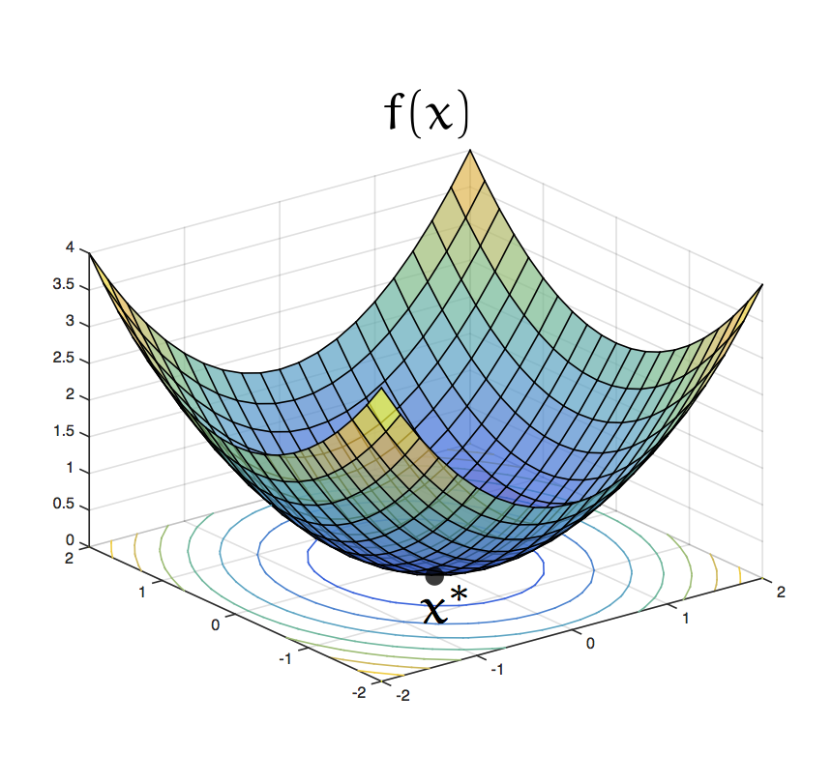

Slide 26
Making Predictions
With trained coefficients, prediction is simple arithmetic:
Trained Model:
sales = 850 - 15.2(price) + 0.73(lag_m1)
Example Calculation (from test set):
Given: price = $38, lag_m1 = 95
sales = 850 + (-15.2)(38) + (0.73)(95)
= 850 - 577.6 + 69.4
= 341.8 units

Slide 27
Evaluating Prediction Error
MAE (Mean Absolute Error): average of |actual - predicted| across all test observations. Easy to interpret: "on average, we're off by X units”
MSE (Mean Squared Error): average of (actual - predicted)².
Prediction error does not have to be the same as the loss function

Slide 28
Best Practices: Train/Test Split
Test set represents future, unseen data
Detects overfitting (memorization vs learning)
Test set is locked until final evaluation
Training Data (80%)
Test Data (20%)
↓
Find β coefficients
🔒
Evaluate once

Slide 29
Best Practices: Feature Standardization
Problem: Features have different scales
Feature | Range | Units
price | $10 – $150 | dollars
lag_m1 | 0 – 5,000 | units sold
discount | 0.0 – 0.8 | percentage
StandardScaler Formula:
z = (x - mean) / std_dev
Transformation Example:
Feature | Before (raw) | After (scaled)
price | 42.50 | 0.15
lag_m1 | 125 | -0.42
discount | 0.15 | 0.88
All features now have mean=0, std=1

Slide 30
Feature Engineering

Slide 31
Feature Engineering
Use existing features to create new features!
Capture more complex patterns (e.g., interaction terms between features)
What new features make sense for H&M?
product_id | price | lag_m1 | discount | sales
12345 | $42.50 | 125 | 0.15 | 110
12346 | $38.00 | 95 | 0.20 | 88
12347 | $55.00 | 200 | 0.00 | 185
12348 | $29.99 | 75 | 0.30 | 65
... | ... | ... | ... | ...

Slide 32
Overfitting
Overfitting: Model is too complex for available data, fits to random noise in data instead of extracting real signal
Increasing number of features through feature engineering can risk overfitting
Warning signs: training error very low, test error much higher

Slide 33
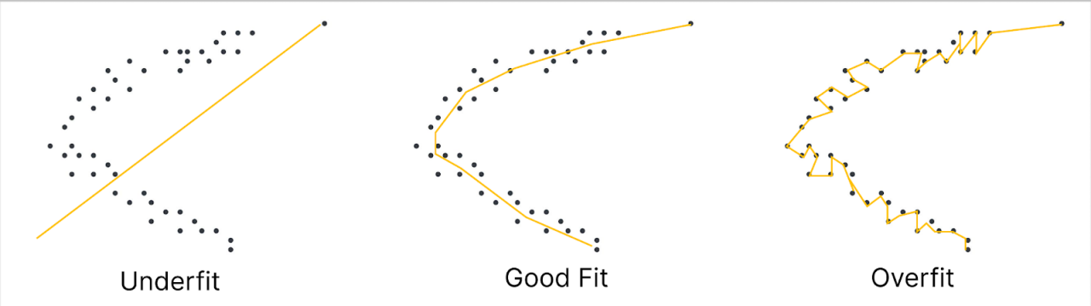

Slide 34
Regularization:
Preventing Overfitting

Slide 35
Regularization
Regularization refers to any method that decreases model complexity
Not just for linear regression, but other methods too (e.g., neural networks)

Slide 36
LASSO Regression
Loss = MSE + λ Σ|βᵢ|
How λ Affects Coefficients:
Feature | λ=0 | λ=1 | λ=10 | λ=100
price | -2.5 | -2.3 | -1.8 | -0.9
discount | +3.2 | +2.9 | +1.5 | 0
holiday | +45 | +42 | +30 | +12
color | +0.3 | +0.1 | 0 | 0
day_week | -0.8 | -0.2 | 0 | 0
Most predictive features survive

Slide 37
Ridge Regression
Loss = MSE + λ Σβᵢ²
Ridge vs LASSO (λ=10):
Feature | No Reg | LASSO | Ridge
price | -2.5 | -1.8 | -2.1
discount | +3.2 | +1.5 | +2.6
holiday | +45 | +30 | +39
color | +0.3 | 0 (removed) | +0.2 (kept)
day_week | -0.8 | 0 (removed) | -0.6 (kept)

Slide 38
ElasticNet: Best of Both Worlds
Loss = MSE + λ[(1-α)Σβ² + αΣ|β|]
└─Ridge─┘ └─LASSO─┘
α = 0 → Pure Ridge (L2 only)
α = 0.5 → 50/50 mix
α = 1 → Pure LASSO (L1 only)
Default choice when unsure — combines stability of Ridge with selection of LASSO

Slide 39
Regularization: Three Approaches
Problem: Too many features → model memorizes noise
Solution: Add penalty for model complexity to the loss function
Method | Penalty | Effect
LASSO (L1) | λ Σ|β| | Zeros out weak features
Ridge (L2) | λ Σβ² | Shrinks all, keeps all
ElasticNet | λ[(1-α)Σβ² + αΣ|β|] | Combination of L1 + L2
All three use cross-validation to find optimal λ (regularization strength)

Slide 40

Cross-Validation
We choose best penalty parameter through cross-validation

Slide 41
Which Regularization Should You Use?
 | LASSO (L1) | Ridge (L2) | ElasticNet
Feature Selection | ✓ Yes (zeros) | ✗ No | ✓ Partial
Correlated Features | Struggles | ✓ Excellent | ✓ Good
Best For | Feature selection | Correlated features | General purpose

Slide 42
Colab Demo

Slide 43
Assignment 1

