Slide 1
Peer Benchmarking Research and Recommendations
An evaluation of data services at R1 institutions and recommendations for UCLA
Presentation for the Research Data Working Group
Notes:
Quick introductions

Slide 2
Research Data Services Subgroup
Tim Dennis, Chair, Library Data Science Center, Director
Todd Grappone, Library, AUL Digital Initiatives & IT
Ibraheem Ali, Library, Sciences Data Librarian
Keith Chen, Anderson, Professor of Behavioral Economics
Yoh Kawano, OARC, Lead Computational Scientist
Eleanor Koehl, OARC, Senior Program Manager, Research Facilitation
Clifford Kravit, DGSOM, IT Program Manager of Research Informatics
Rose Rocchio, OARC, Mobile and Web Strategy, Education & Research

Slide 3
Process
Define | Research | Share
Identify Peer Institutions | Gather Benchmarking Data from University Websites | Narrative Summary of Research Findings
Define Criteria | Record Data in Worksheets | Group Presentation & Discussion
Define Recommendations |  | Two Page Executive Summary
Notes:
Follow peer benchmarking process used at NYU, Stanford & UC Berkeley, see full process here https://drive.google.com/drive/u/0/folders/1ceh-yAFNPrtGUKoaoaUomY2oV9Zub_XJ

Slide 4
Peer Institutions
Berkeley | MIT | OSU
Cornell | NYU | Penn
Stanford | Chicago | NWU
Harvard | Michigan | UCI
UCSD | Virginia | UCF
Notes:
We asked campus administrative or directors who they perceive as their competitors and exemplars when recruiting for talent. These included:
* Interim Dean of Molecular Biology Unit Hilary Coller
* Dean Darnell Hunt, Social Science Divison
* Jennie Brand, California Center for Pop Research & Soc Professor
* Vice Dean Boutros, David Geffen School Of Med
* Director of QCBio Collabatory, Dr. Matteo Pellegrini
We also added a couple ourselves

Slide 5
Benchmarking Criteria
Research Data Services (RDS) program
Cohesive RDS website & service catalog
Data, sharing, publishing and curation
Reproducible research & data integrity support
Education & Community
Data acquisition support
Data visualization support
Data analysis / Statistical Support
HPC Support
Storage services
Backup Services
Compliance services
Data Licensing/IP Support
Notes:
Cohesive RDS website & service catalog: information for researchers on research data services is available in one cohesive website.
Data, sharing, publishing and curation: The research data services include actual services a researcher can leverage to collect, share, publish, and store their data in repository services.
Reproducible research & data integrity support: The research data services is able to consult and evaluate the computational reproducibility of their research. This includes support and evaluation of their code, data and workflows. Can include support for FAIR data and transparency practices.
Education & Community: Campus has a community that provides research data and computing support services through workshops, course integrated instruction and other events to support computational and data literacy education and advocacy.
Data acquisition support: Research data can include publically available data sets, data sets that are purchased, data sets that are derived from other data and new data sets that are created via research instruments such as audio/video recordings, online surveys, web interfaces and mobile apps.
Data visualization support: Data visualization support may include providing feedback to researchers and participants via web or mobile apps to regarding study progress, also support for exploratory data analysis and research presentation.
Data analysis / Statistical Support: Consulting services for research data analysis and statistics are accessible and available for researchers and support staff
HPC Support: Consultation services on using HPC resources, including optimizing code, running jobs, and working with large datasets. Advanced topics may include code design and optimization, parallel computing, and research methods on high-performance computing platforms.
Storage services: Data services that include storage options, on-premise or cloud based
Backup Services: Data Backup services for a variety of data environments. This could include replication at other sites.
Compliance services
Data Licensing/IP Support: Consultation services that advise on licensing and copyright issues around aquisition, use, and sharing of data

Slide 6
Scoring strategy to evaluate peer institutions
Criteria were scored on a 1-4 scale
Campuses were ranked by individuals & discussed as a group
Scores were averaged for each campus
Tiers were established using numeric cut-off values
Notes:
Members of the committee split up the list of peers and ranked them for each criteria on a 1 to 4 numeric scale. Committee members ranked 2-4 institutions each and presented their findings to the group where further revisions to scale were made based on the collected information. To establish a finalized campus score, we averaged scores for all the criteria measured and established numeric cutoffs that resulted in a finalized tier structure.

Slide 7
Ranking results revealed gaps in services and support
Tier | Description | Institutions
1 | Robust across all bench-marking criteria | Cornell, UMichigan, Harvard
2 | Strong in most benchmarking criteria, very strong in some areas and weaker in others | Chicago, Northwestern, Stanford, UC Berkeley, UPenn, MIT, UVA
3 | Mixed assessment | UCLA, UCSD, OSU
4 | Weak assessment in all or most areas | UC Irvine
Notes:
Through our benchmarking we found a small handful of exemplars which helped inform our final recommendations. These exemplars included UMichigan, Harvard and Cornell. Some features from our exemplars will be described shortly. Using our ranking approach, UCLA ranked in Tier 3 the lowest score in the tier, alongside UCSD and Ohio State University.
While some of our scores were on par with some of our peers, like our score for education and community, and support for data analysis and visualization. We lagged behind our peers in a number of criteria. Among our peers, we had the lowest score for having a cohesive RDS website and service catalog. We also scored one tier less than the average score of peers in 8 out of 13 categories.

Slide 8
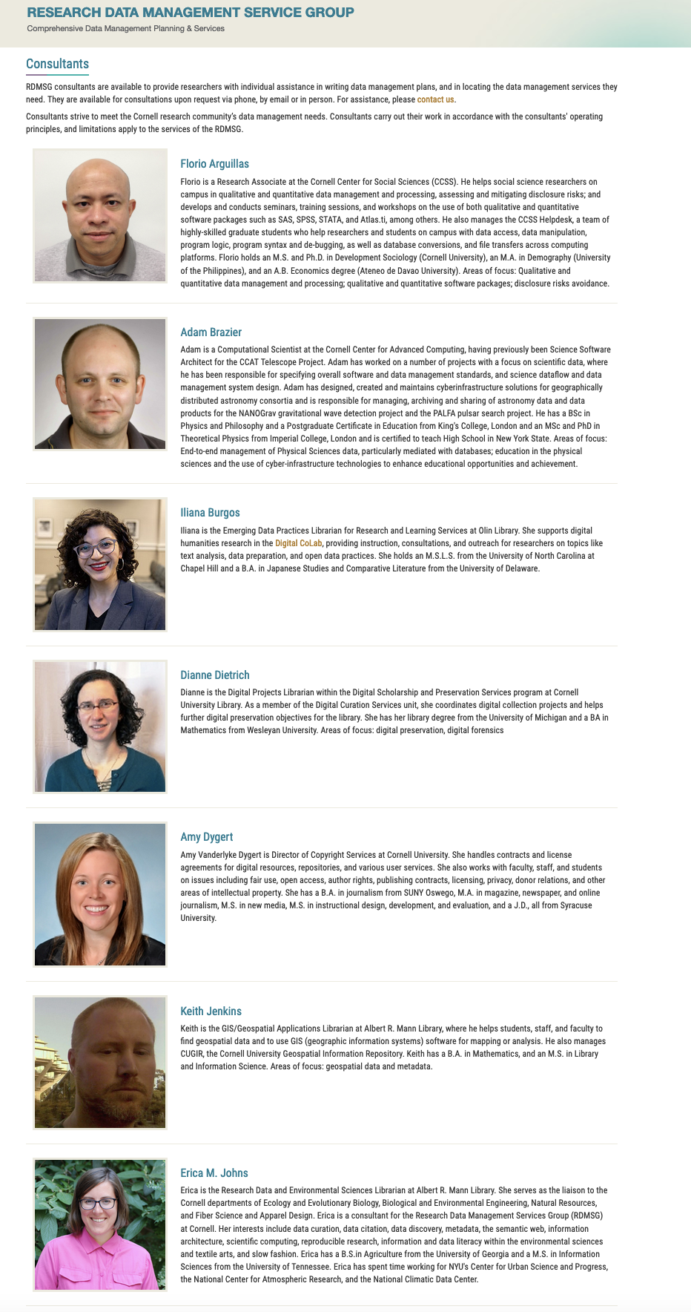
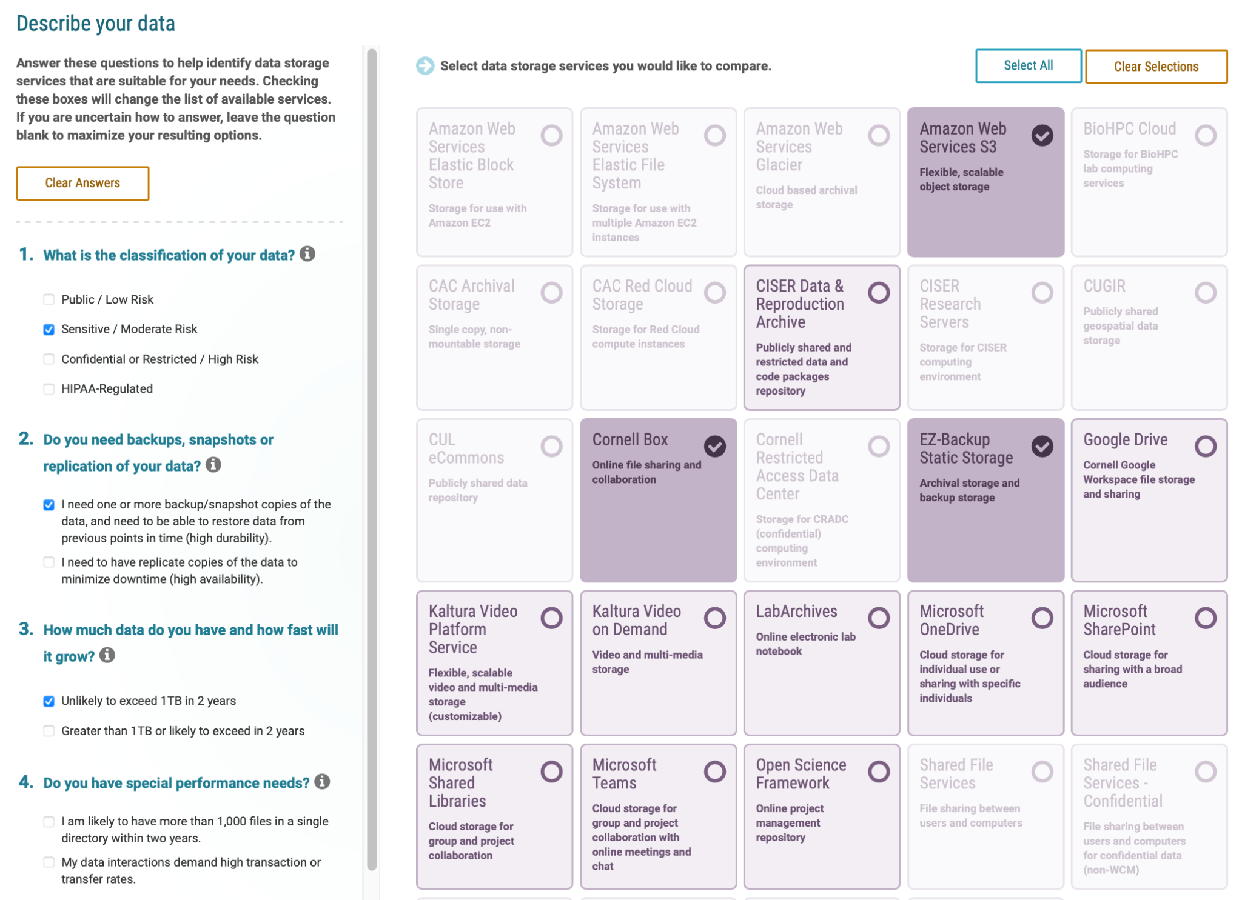
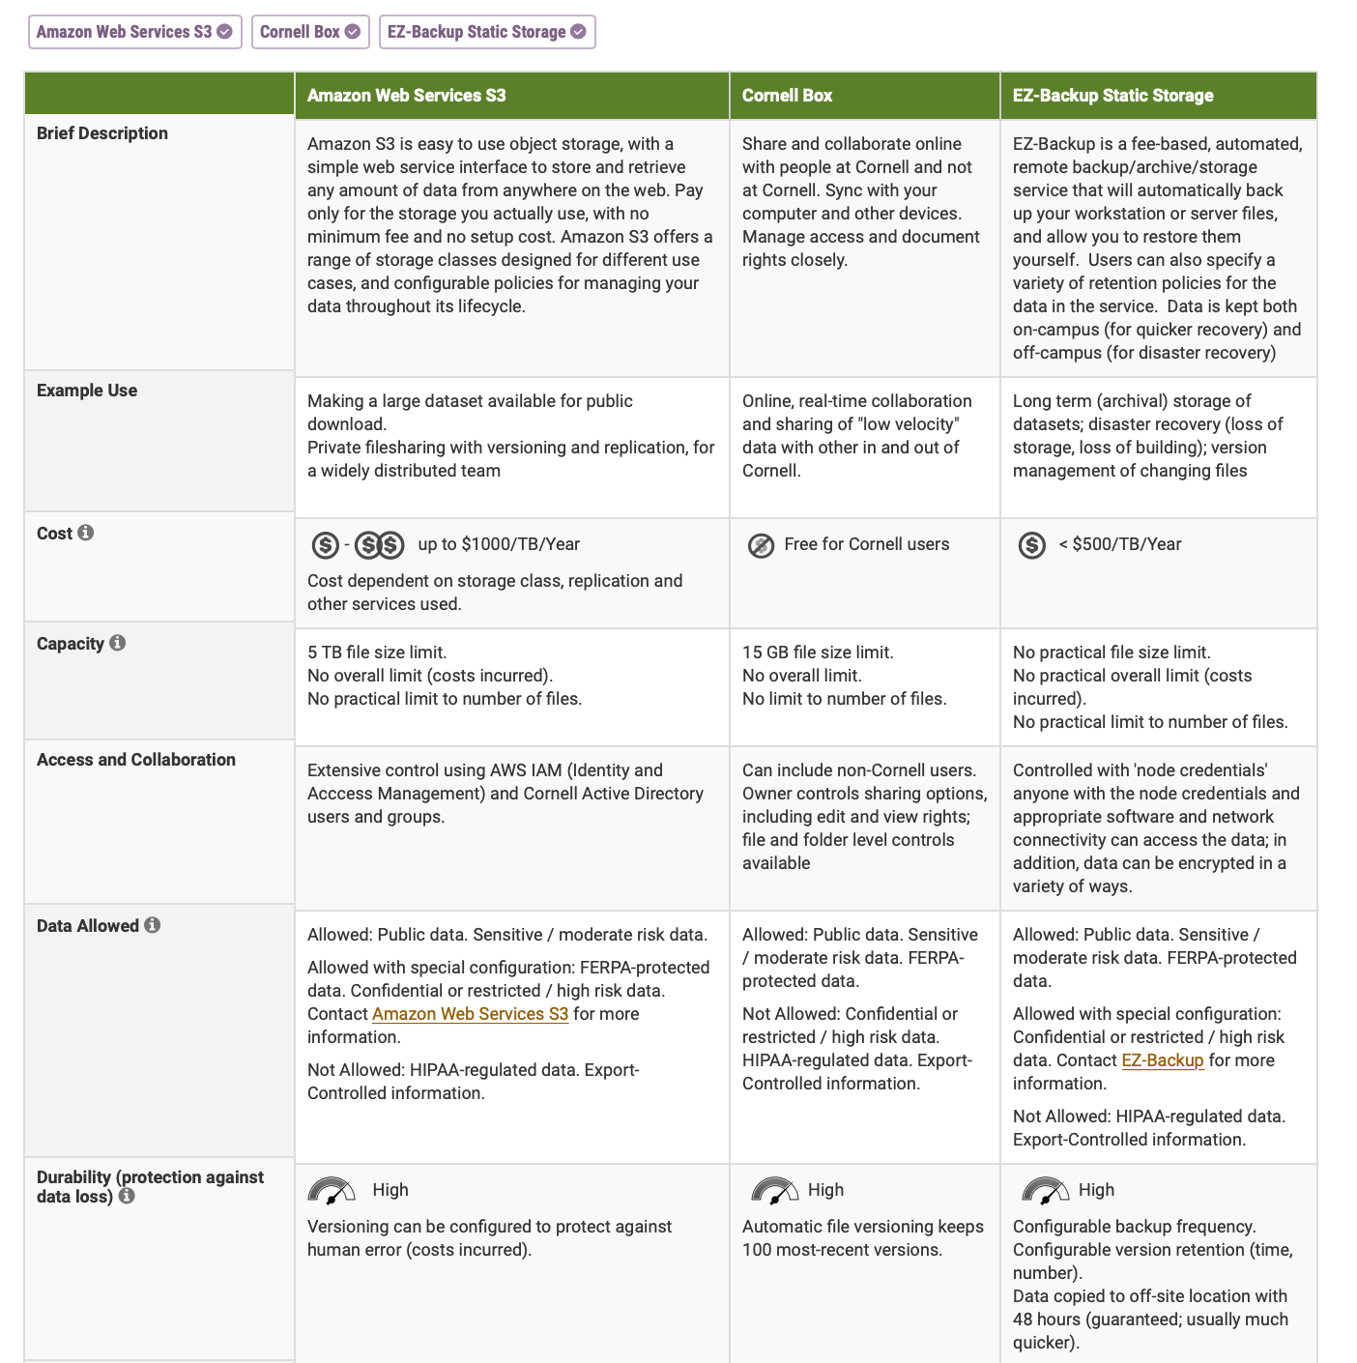
Tier 1 Example: Cornell
Notes:
Cornell Highlights – Research Data Management Service Group (centralized catalog):
Interactive Data Storage Finder
Results in a comparison matrix
Cross campus research consultant directory

Slide 9
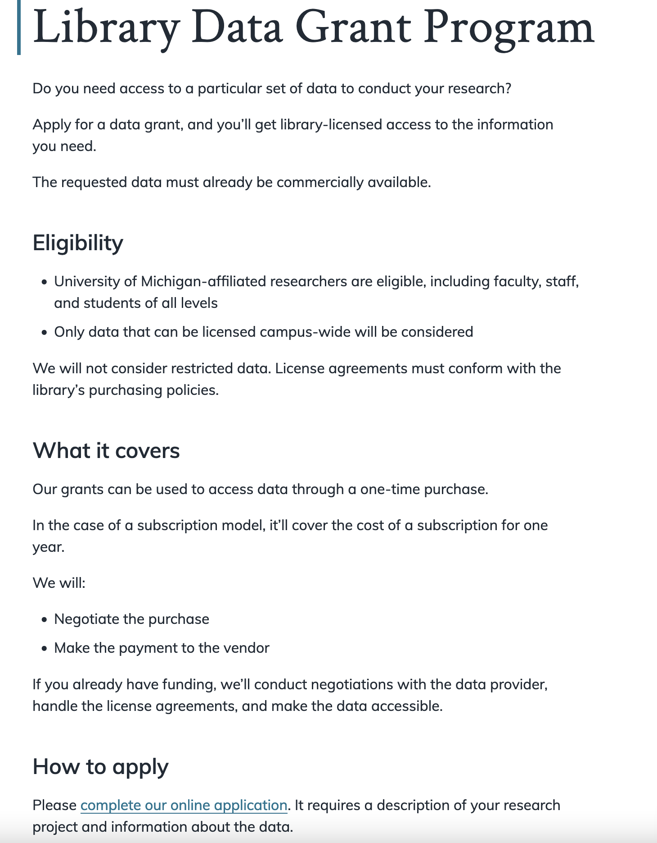
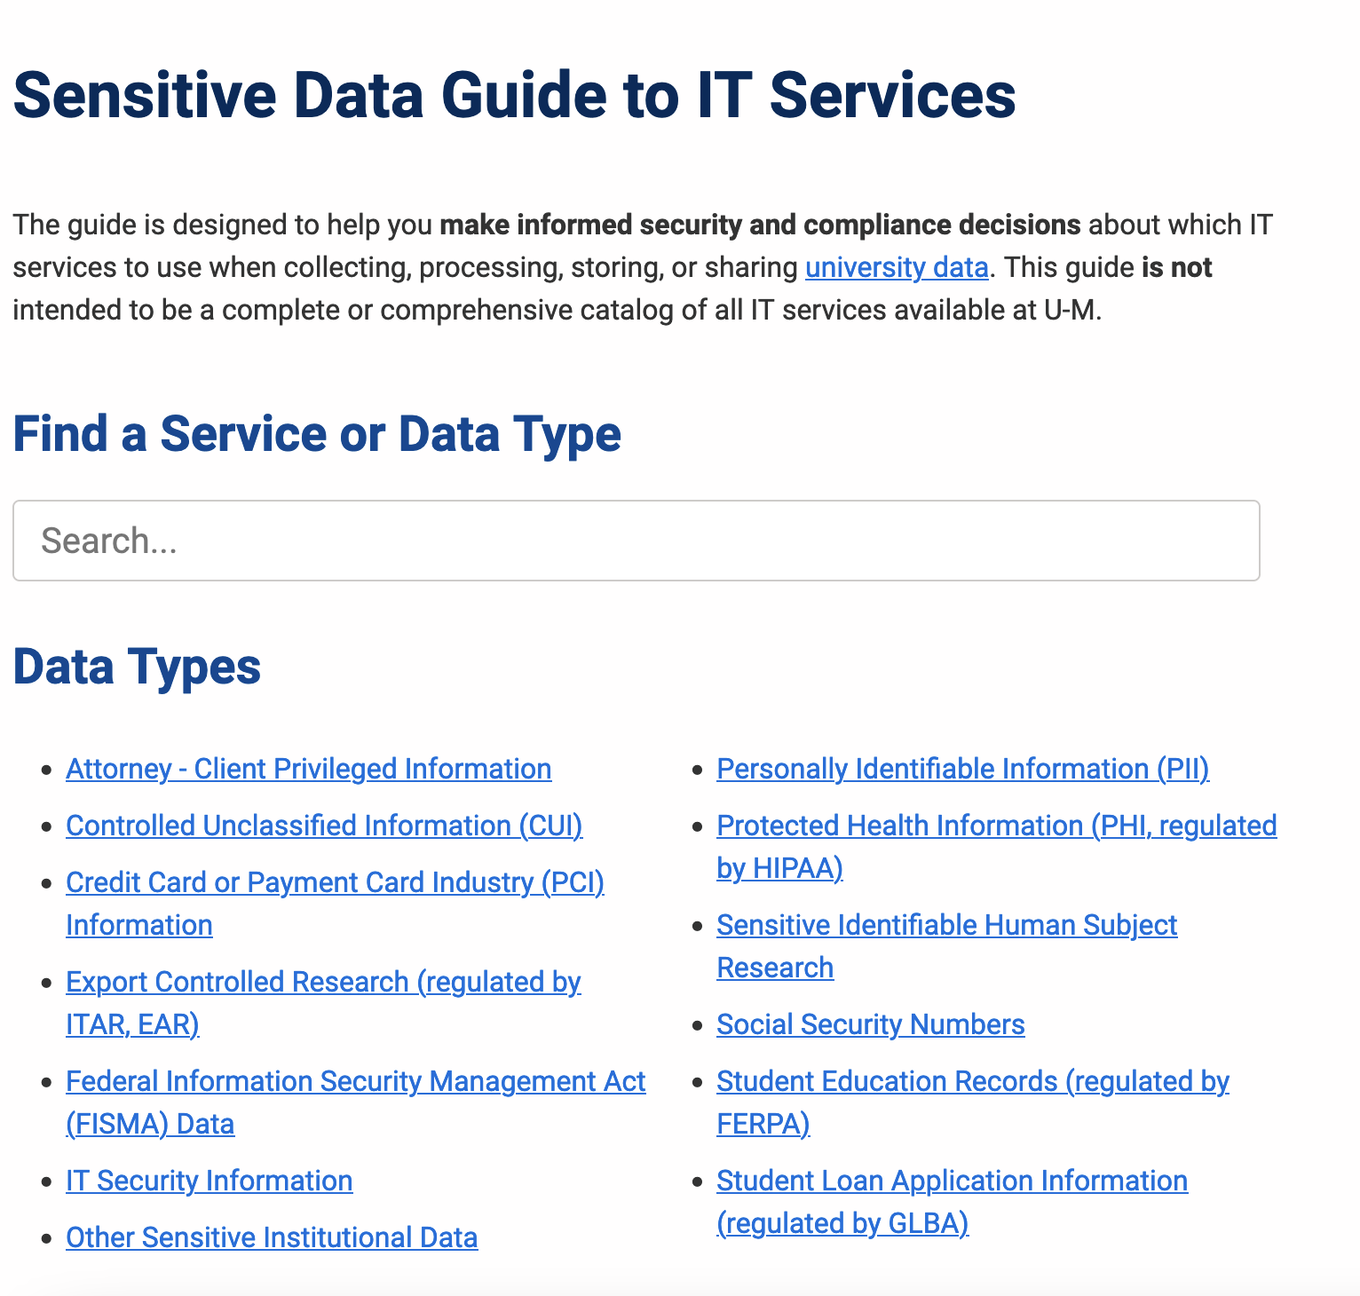
Tier 1 Example: University of Michigan
Notes:
UMich highlights:
Guidance for how to collect, process, store, and share various kinds of protected data
Library data grant/data purchase program

Slide 10
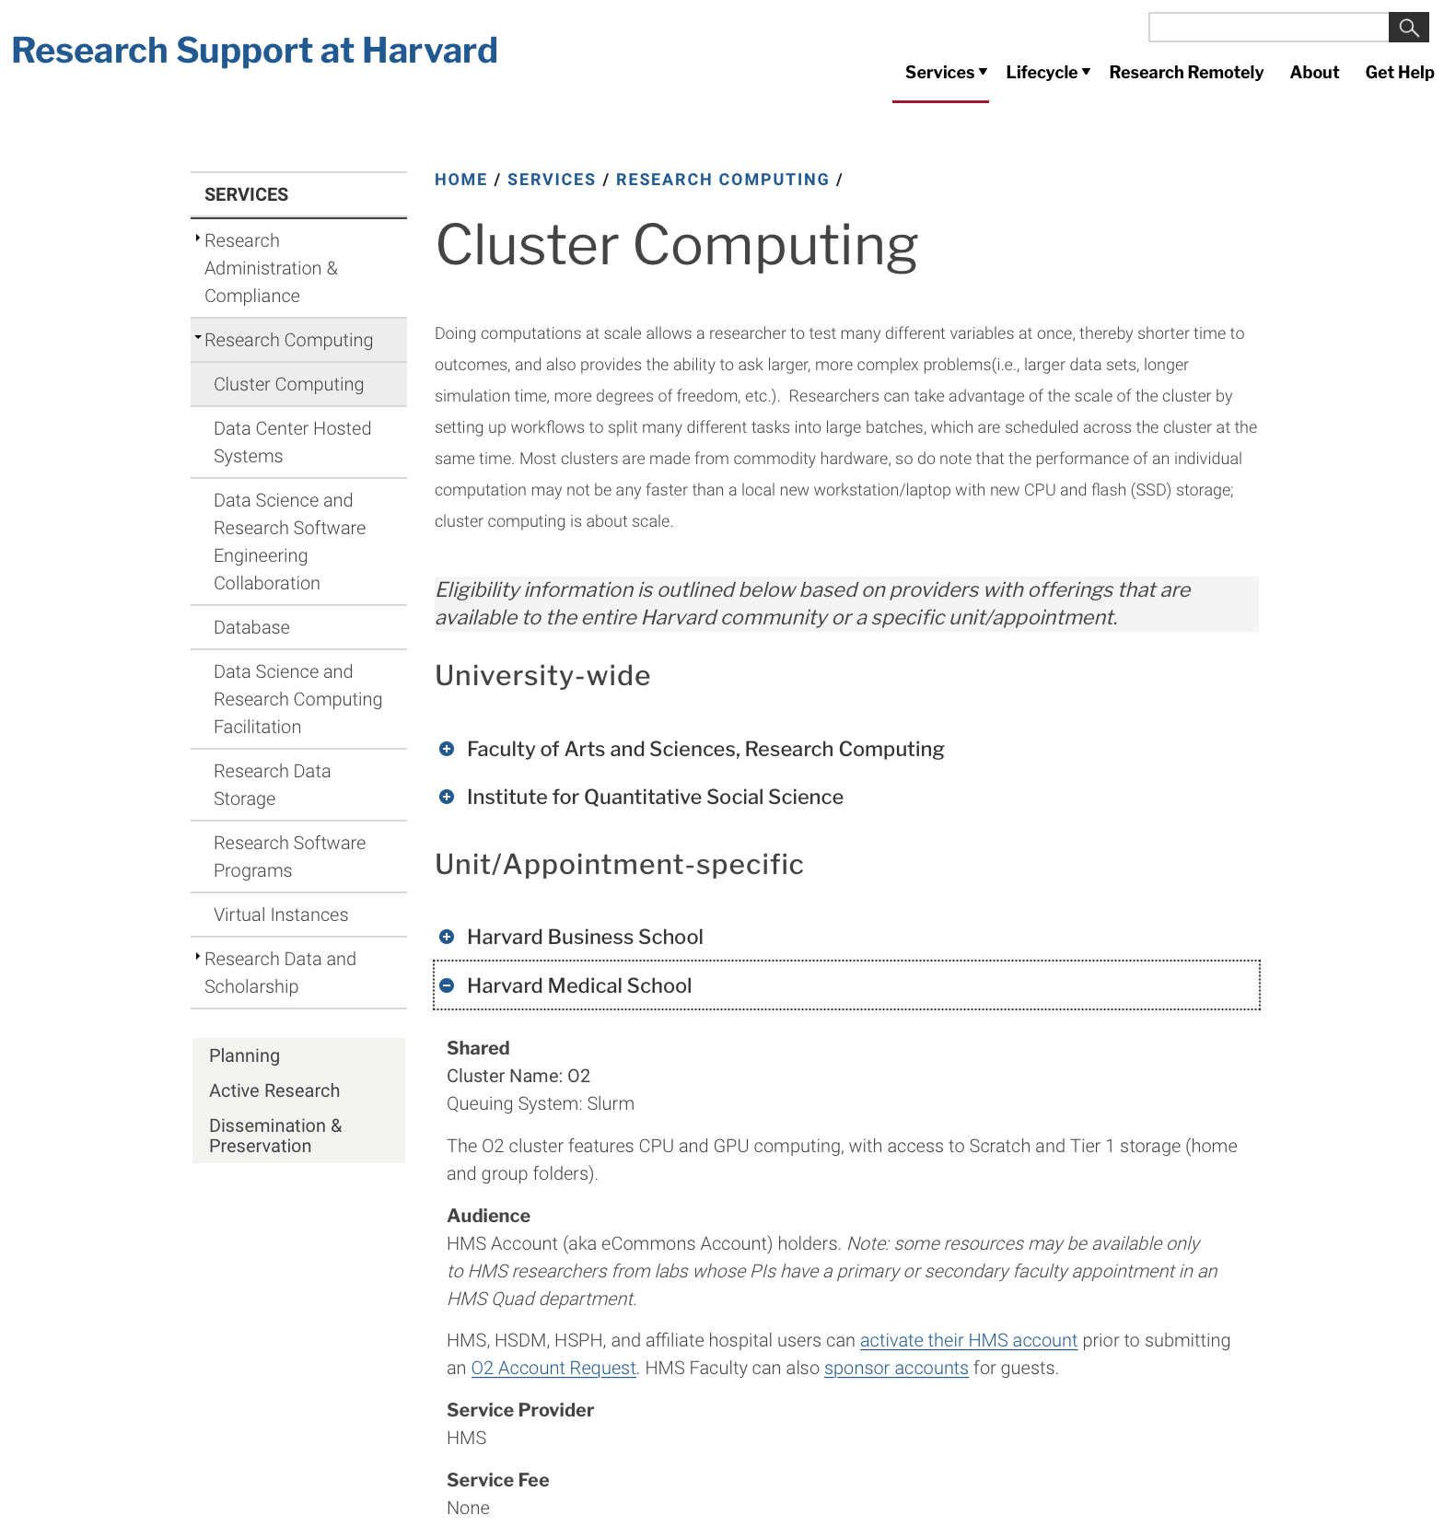
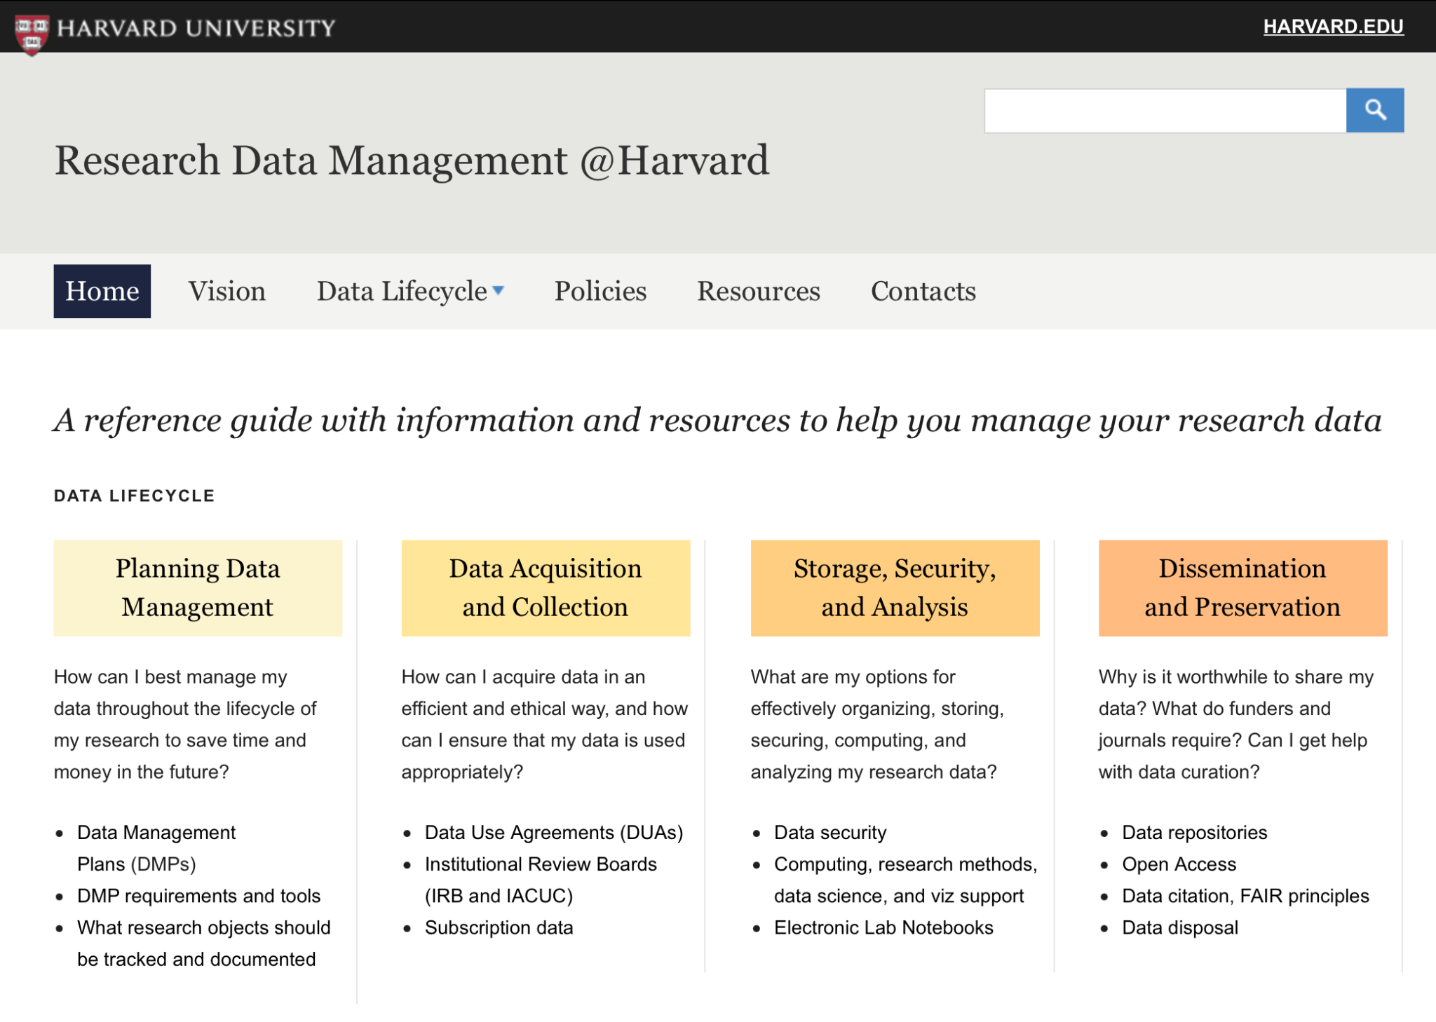
Tier 1 Example: Harvard
Notes:
Harvard Highlights:
Research Data Lifecycle reference guide
Research Support Services
Details about various services with

Slide 11
Draft Recommendations: Move from Tier 3 to 2
Hire 1 FTE (Research Data Management Coordinator (RDO)) to collect and describe research data infrastructure and services
Develop a plan to foster coordination with all campus partners to provide data services (e.g., Library, ORCA, ORA, ITS, UHIT, QC Bio)
Implement the research data lifecycle map and underlying service network and publish it on a high profile campus-level domain
Develop a workflow for referrals between data services providers
Establish a seminar series/committee to coordinate services across units
Hire or allocate 1 FTE to support data publishing and curation
Conduct a gap analysis to move from Tier 2 to Tier 1

Slide 12
Draft Recommendations: Move from Tier 2 to 1
Extend the research data lifecycle map filling gaps identified in Tier 2 in services and information about various aspects of research data management, support services, funding, and compliance information
Develop an interactive resource with guidance for appropriate repository selections (local, system, society, etc.), deposit guidelines (IP, copyright, etc.), and deposit assistance
Develop a complete and usable service catalog
Expand service offerings to include robust options/tiers of storage for research data as well as support for research data use of cloud resources as they become available
Present consolidated event information for data-related workshops across campus and offer more workshops specific to data management
Support data acquisition and licensing by including funds for purchasing data and support for licensing

Slide 13
Q & A

Slide 14
Resources & Documents
UCLA2022 Final Analysis Recommendations
  2 page analysis with recommendations
UCLA 2022 Benchmarking Summary Research Data Services
  Tiers across criteria with observations and notes by comparator

Slide 15
THANK
YOU

