Slide 1
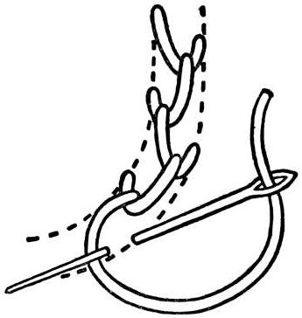
Generalized File System Dependencies
Christopher Frost* Mike Mammarella* Eddie Kohler*
Andrew de los Reyes† Shant Hovsepian*
Andrew Matsuoka‡ Lei Zhang†
*UCLA †Google ‡UT Austin
http://featherstitch.cs.ucla.edu/

Slide 2

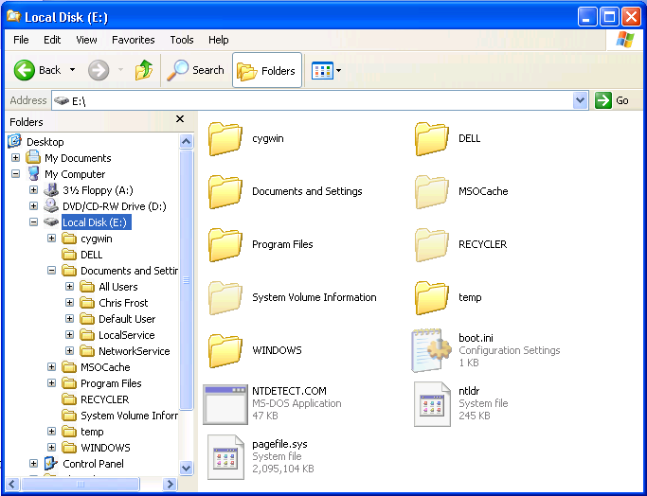

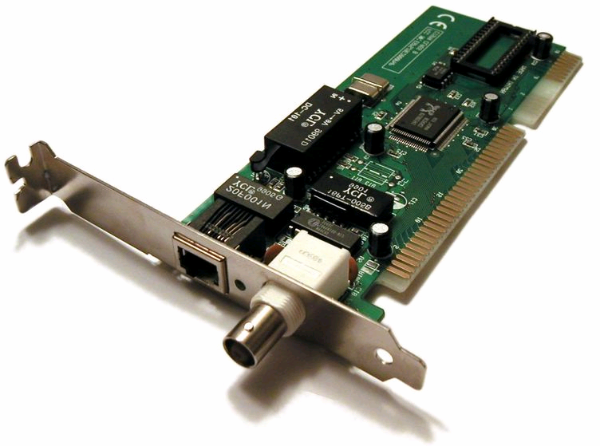
Persistent Storage Consistency
VFS
Persistent Storage

Slide 3
Persistent Storage Consistency
VFS
Persistent Storage

Slide 4
Consistency Models
Solution: ensure that stable storage is consistent after every write
Journaling
ACID transactions
Shadow paging
Soft Updates
Synchronous writes
Enforced through write-before relationships
Log Journal
Transaction
Commit Journal
Transaction
Update File
System Contents

Slide 5
Beyond Basic Consistency
Consistency and performance
  xsyncfs, SpecNFS
Application-specific consistency
  Asynchronous Write Graphs
  CAPFS
  Echo
Consistent file system extensions
  Snapshots

Slide 6
Consistency Mechanisms
Journaling developers
“Personally, it took me about 5 years to thoroughly understand soft updates and I haven't met anyone other than the authors who claimed to understand it well enough to implement it. The paper is pretty understandable up to about page 5, at which point your head will explode. Don't feel bad about this, it happens to everyone.” – Valerie Henson
Soft Updates developers
FreeBSD and NetBSD have each recently attempted to add journaling to UFS. Each declared failure.
Consistency mechanisms are hard to develop.

Slide 7
Consistency Mechanisms
Linux ext3’s has a “general” Journaling Block Device.
But only the ext3 and ocfs2 file systems use the JBD.
Consistency mechanisms are ad hoc.

Slide 8
The Problem
Can we build a consistency mechanism
that supports any consistency model?

Slide 9
Contributions
The patch abstraction makes write-before relationships explicit and file system agnostic
Patch-based ext2 implementation
Journaling and soft updates, implemented using just patch arrangements
Patch optimizations dramatically reduce patch overhead
Patchgroups support application-defined consistency policies
Evaluations of patch optimizations and patchgroups
Evaluation of a modular storage system, Featherstitch, designed around patches

Slide 10
Patch Model
A patch represents:
  a disk data change
  any dependencies on other disk data changes
Dependency
P
Q
Patch
A
B
Disk block
Undo data

Slide 11
Patch Example
asynchronous rename()
add
dirent
remove
dirent
target dir
source dir
Not safe.

Slide 12
Patch Example
rename() with soft updates
dec #refs
add
dirent
remove
dirent
inc #refs
inode table
target dir
source dir

Slide 13
Patch Example
rename() with soft updates
dec #refs
add
dirent
remove
dirent
inc #refs
inode table
target dir
source dir
inode table
source dir
target dir

Slide 14
Patch Example
dec #refs
rename() with soft updates
Undo data
add
dirent
remove
dirent
inc #refs
inode table
target dir
source dir

Slide 15
Patch Example
dec #refs
rename() with soft updates
Undo data
add
dirent
remove
dirent
inode table
target dir
source dir

Slide 16
Patch Example
rename() with soft updates
dec #refs
add
dirent
remove
dirent
inode table
target dir
source dir

Slide 17
Patch Example
rename() with journaling
Journal
commit
txn
complete
txn
add
dirent
remove
dirent
target dir
source dir
txn log
add
dirent
block copy
remove
dirent
block copy

Slide 18
Patch Optimizations
Patch manipulation is slow
Patches are memory hogs
Optimize:
  Undo memory usage
  Number of patches and dependencies
  Ready patch query time complexity

Slide 19
Patch Optimizations
PostMark: Featherstitch allocates 5.5 GB of RAM to write 2.2 GB to disk
Primary memory overhead: unused (!) undo data
Optimize away unused undo data allocations?
  Can’t detect “unused” until it’s too late
Restrict the patch API to reason about the future?

Slide 20
Patch Optimizations
A patch that must be reverted to make progress is
the head of a block-level cycle.
cycle head
R
Q
P
R
Block writeout:
Q
P
P
,
,

Slide 21
Hard Patches
Detect block-level cycle heads when allocating?
  Restrict the patch API: supply all dependencies
  at patch creation*
Now, any patch that will need to be reverted
will be the head of a block-level cycle when
the patch is created
We call a patch with undo data omitted a hard patch. A soft patch has its undo data.
R
Q
P
Soft patch
Hard patch

Slide 22
Detecting Hard Patches in Practice
Block-level cycle head detection is time intensive (dependency traversals)
Solution: approximate detection
  Detect when no external patch depends on its block
B
A
C
R
Q
P

Slide 23
Hard Patch Results
PostMark: 3.2 GB → 1.6 GB of undo data

Slide 24
Optimizations: Hard Patch Merging
PostMark: Featherstitch allocates 450 MB of patches
(4.6 M patches for 580 k block writes)
Represent patches written together with a single patch?
Notice: all hard patches on a given block must be written together
  Conservative, but commonly applicable merge rule
Effectively, add patch B’s dependencies to patch A
  Will not create block-level cycles: both patches are hard
A
B
A + B
Notes:
Delete Linux kernel source: create 300 k patches; 30 MB of the 39 MB of overhead
Example beneficiaries: multiple write()s to a file block; the inode block, when creating two files, is an example beneficiary

Slide 25
Hard Patch Results
PostMark: 4.6 M → 2.5 M patches

Slide 26
Hard Patch and Merging Results
PostMark
Undo data: 3.2 GB → 1.6 GB
Patches: 4.6 M → 2.5 M
CPU: 23.6 s → 18.6 s

Slide 27
Optimizations: Overlap Patch Merging
PostMark: Featherstitch allocates 250 MB of patches
(2.5 M patches for 580 k block writes)
Blocks tend to accumulate many overlapping patches
  Example: repeated creates and unlinks
Overlap merging can combine:
  new, soft patch
  existing, overlapped patch
Hard patch block-level cycle head logic,
but with different detection heuristics
inode block
u₁
c₁
u₀
B
A
A+B
c₀
Notes:
Delete Linux kernel source: create 300 k patches; 30 MB of the 39 MB of overhead

Slide 28
Overlap Merging Results
PostMark
Undo data: 3.2 GB → 1.6 GB
Patches: 4.6 M → 0.5 M
CPU: 23.6 s → 12.9 s

Slide 29
Optimizations: Ready Patch Lists
Buffer cache: which (if any) patches on block X are ready?
Even modest dependency traversals are
painfully slow, when executed for each patch
  Slow because of duplicate traversals
  Even after our second algorithm, traversals were a bottleneck beyond a 128 block (512 kB) buffer cache (!)
Simplify Featherstitch module design
Keep running dependency counts for each patch
Keep per-block list of ready patches
CAUTION

Slide 30
Patchgroups
Problem: application-defined consistency requirements
  Tell buffer cache when to write to disk (fsync and friends)
  Implicitly specify coarse write orderings (ordered journaling)

Slide 31
Patchgroups
Problem: application-defined consistency requirements
  Tell buffer cache when to write to disk (fsync and friends)
  Implicitly specify coarse write orderings (ordered journaling)
Extend patches to applications: patchgroups
  Specify write-before requirements among system calls
rename(a)
unlink(d)
write(b)
fork(e)
rename(c)

Slide 32
Patchgroup Case Studies
gzip
Subversion working copy
UW IMAP server

Slide 33
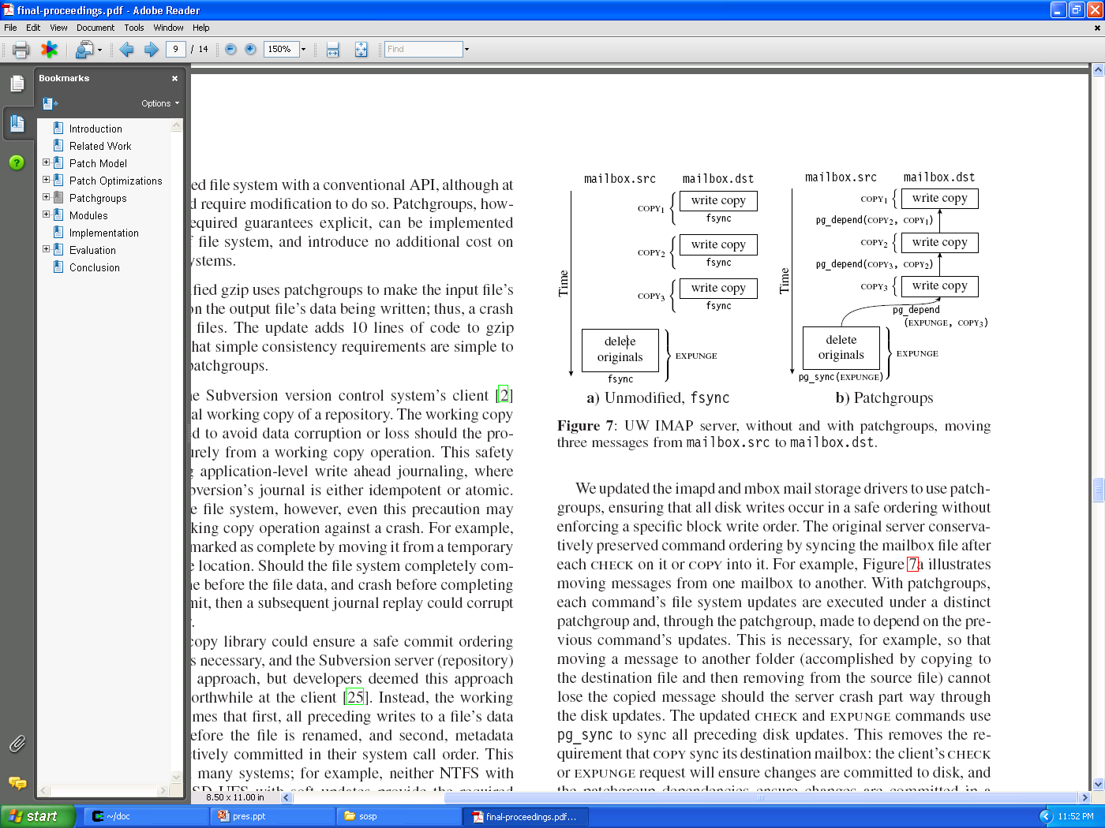
Patchgroups: UW IMAP
IMAP CHECK synchronizes a client’s changes
UW IMAP also synchronizes after each COPY, to enforce inter-command ordering
Patchgroup-enabled UW IMAP instead adds a dependency between each IMAP command
Unmodified, fsync
Patchgroups

Slide 34
Implementation
Linux 2.6 kernel module and FUSE server
In the Linux kernel, Featherstitch:
  exposes fstitch file systems
  uses generic block devices
Detecting when a block write becomes durable
  Use SCSI TCQ or SATA NCQ and FUA or WT drive cache
ext2, ufs, journal, buffer cache, and loopback modules

Slide 35
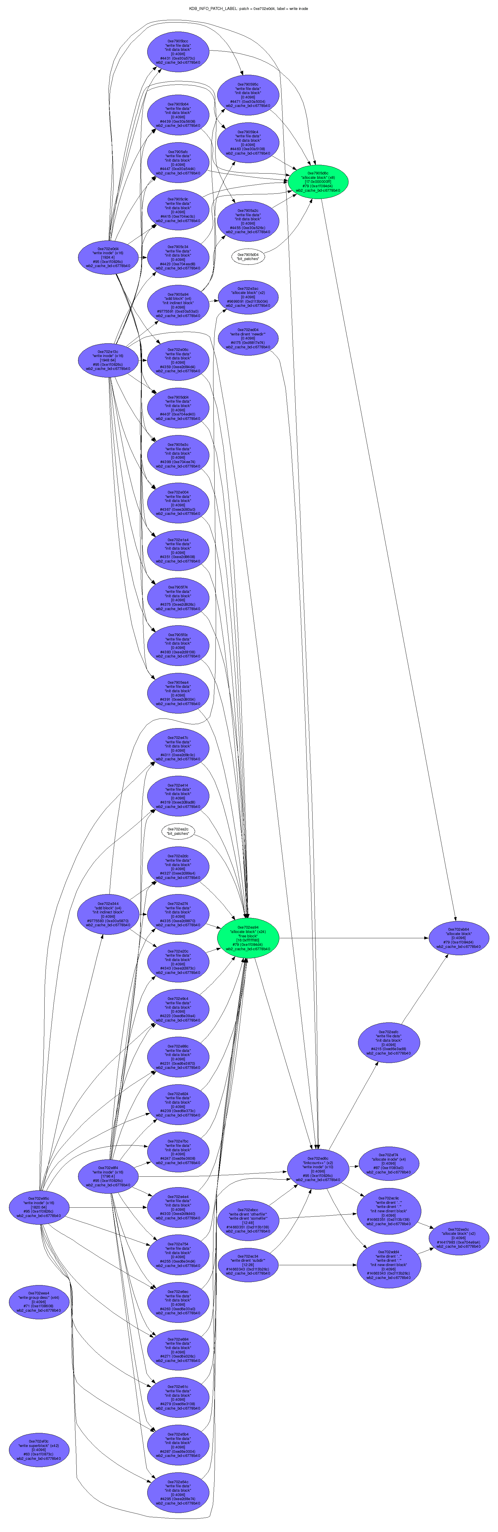
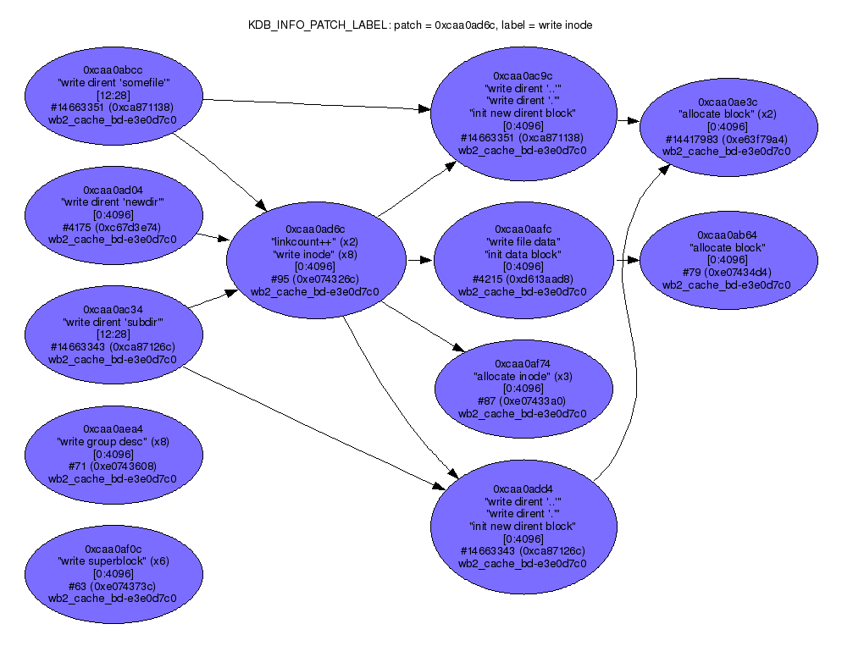
Implementation: Patch Debugger

Slide 36
Evaluation
Measure patch optimization effectiveness
Compare performance with Linux ext2/ext3
Benchmark patchgroup-enabled UW IMAP

Slide 37
Evaluation: Patch Optimizations
PostMark
Optimization | # Patches | Undo data | System time
None | 4.6 M | 3.2 GB | 23.6 sec
Hard Patches | 2.5 M | 1.6 GB | 18.6 sec
Overlap merging | 550 k | 1.6 GB | 12.9 sec
Both | 675 k | 0.1 MB | 11.0 sec

Slide 38
Evaluation: Linux Comparison
PostMark
System | Real time | System time
Featherstitch ext2
soft updates | 38.3 | 10.3
meta journal | 48.3 | 14.5
full journal | 82.8 | 19.3
Linux ext3
writeback | 38.2 | 3.7
full journal | 69.6 | 4.5

Slide 39
Evaluation: Patchgroups
Move 1,000 messages
Implementation | Real time | System time | # Writes
Featherstitch ext2
soft updates, fsync per operation | 65.2 | 0.3 | 8,083
full journal, fsync per operation | 52.3 | 0.4 | 7,114
soft updates, patchgroups | 28.0 | 1.2 | 3,015
full journal, patchgroups | 1.4 | 0.4 | 32
Linux ext3
writeback, fsync per operation | 19.9 | 0.3 | 2,531
full journal, fsync per durable operation | 1.3 | 0.3 | 26

Slide 40
Related Work
Soft Updates
Consistency research (journaling, shadow paging, …)
Echo Distributed File System
Burnett
xsyncfs

Slide 41
Conclusions
Patches provide new write-before abstraction
Thanks to optimizations, performance is comparable to production, ad hoc consistency mechanisms
Patches simplify the implementation of consistency protocols like journaling and soft updates
Patchgroups allow specification of precise application consistency needs

Slide 42
Undo Data Example
fsync()
P
R
Q
Buffer cache
Unused
Used
(required)
Unused
Block writes:
P
Q
P
R
,
,

Slide 43
Undo Data Example
P
R
Q
Required Undo Data
Block writes:
P
Q
P
R
,
,

Slide 44
Optimizations: Hard Patch Merging
Additionally, a new hard patch can be merged with the block’s existing soft patches
How this can occur:
  Patch r was created soft, because some set of patches depend on other patches on r’s block
  These other patches are written to disk, but r remains
Uncommon, but necessary to ensure that no hard patch has dependencies on its own block. This invariant simplifies ready block detection.
directory
inode
r
r
r + s
q
q
q
p
1) Create soft r
2) Commit p
3) Create s, by making r hard
and merging r and s

Slide 45
Optimizations: Overlap Merging
How to detect block-level cycles for overlaps?
Use a conservative heuristic here, too
Detect no block-level cycle for p₁ and p₂ if a limited dependency traversal OKs each dependency chain
But also use a dependency class white list to detect that many chains are OK without requiring an exhaustive traversal

Slide 46
Optimizations: Overlap Merging
But also use a dependency class white list to detect that many chains are OK without requiring an exhaustive traversal
  Example: p₂ and p₁ depend on x, and p₁ does not lie along the dependency path from p₂ to x
  Example: p₂ depends on a same-block hard
  patch
p₂
1)
p₁
x
2)
p₂
1 + 2 imply no block-level cycle for p₂ and p₁ through x
p₁
1)
p₀
1 implies no block-level cycle for p₂ and p₁ through p₀

Slide 47
Other Optimizations
Too many, or too strict, dependencies can non-trivially degrade performance
Avoid unnecessary implicit dependencies
  Example: updates to two inodes should generally be independent
s
r
q
p
s
r
q
p
inodes
inodes
i₂
i₁
i₂
i₁

Slide 48
Other Optimizations
File system implementations can generate better dependency arrangements, to reduce disk seeks, when they can detect that certain states will never appear on disk
  Example: in soft updates, an inode cannot be cleared until there are no referencing directory entries
Block allocation policies can have a dramatic effect on I/O requests
  Example: allocating indirect blocks contiguously, instead of among direct blocks, reduces the required number of seeks

