Slide 1
CS118 Dis 1C, Week 3
Yangchao
Slides credit to Xinyu Ma

Slide 2
Contents
Transport Layer Protocols
Project 1

Slide 3
Transport Protocol
Port numbers are used for multiplexing/demultiplexing
UDP = IP + Src Port + Dst Port + Checksum (very similar to bare IP packets)
Reliability:
Corrupted Bits -> checksum
This is very rare, since Ethernet already has a checksum
However, the design principle is Network Layer should not depend on lower layer’s reliability (will discuss this in CS217A)
Packet loss -> ??
Packet out-of-order -> ??

Slide 4
Transport Protocol
Port numbers are used for multiplexing/demultiplexing
4 tuple (Src IP, Src Port, Dst IP, Dst Port) decides a connection
Src Port
Src IP
Dst IP
Dst Port
Client
Server
Process
Process
…
…

Slide 5
Transport Protocol
Port numbers are used for multiplexing/demultiplexing
UDP = IP + Src Port + Dst Port + Checksum (very similar to bare IP packets)
TCP = IP + Ports + Reliabilities
Reliability:
Corrupted Bits -> checksum
This is very rare, since Ethernet already has a checksum
However, the design principle is Network Layer should not depend on lower layer’s reliability (will discuss this in CS217A)
Packet loss -> ACK
Packet out-of-order -> SEQ

Slide 6
TCP
TCP provides
End-to-end “pipe” connection
Bit stream
Reliability
TCP is built on IP
A graph of nodes identified by IP address
Packet
What TCP needs to do
Port number -> identify process
Connection -> Setup, shutdown
Pack bits into packets
Buffer -> flow control
Checksum -> Integrity
ACK, SEQ -> In order delivery, retransmission
Congestion control
TCP Model
Client
Server
A pipeline of bits
IP Model
A graph, that packets go through

Slide 7
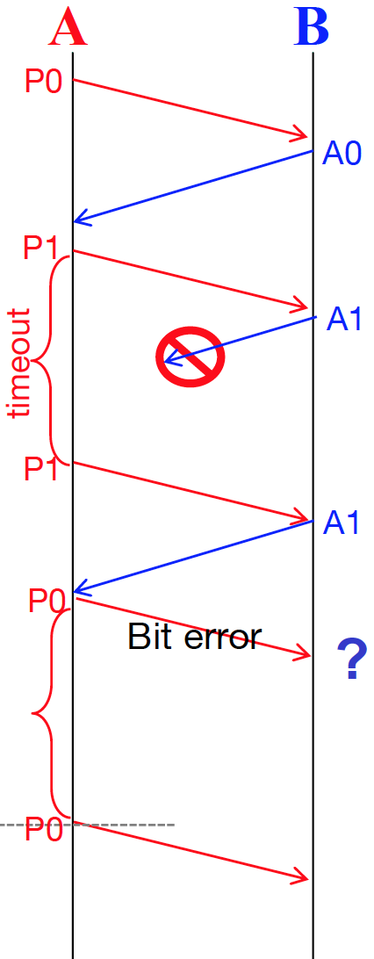
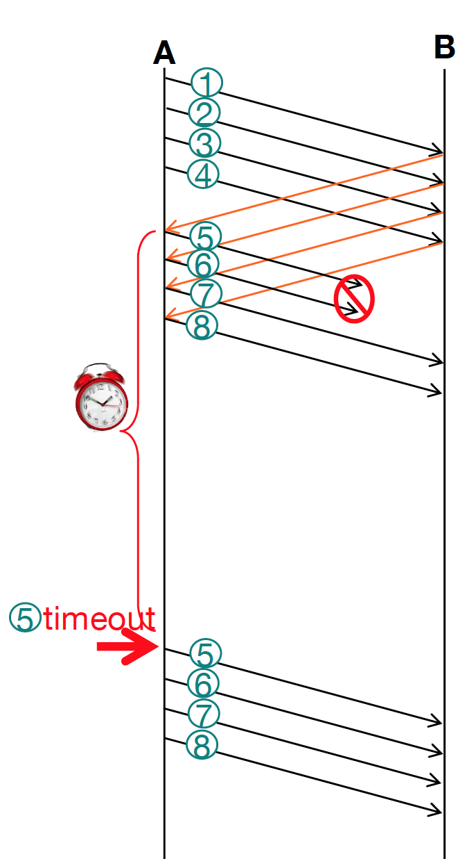
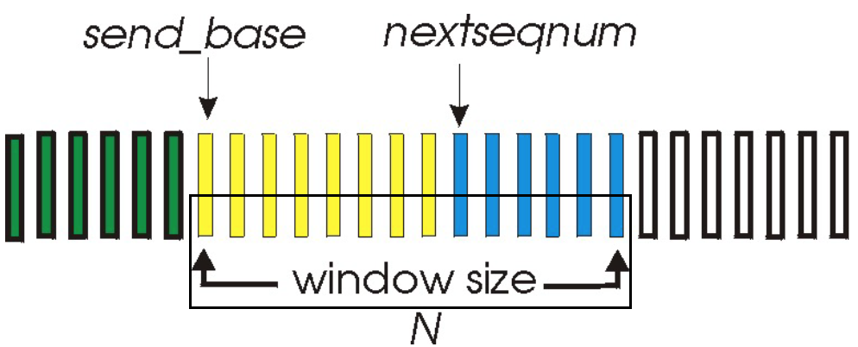
Different ACKs
Stop-and-Wait:
1 packet in-flight
Go-back-N (duplicate ACK may apply)
N packets in-flight
Multiple packets sent as long as window allows
If some packet is not ACKed, retransmit from that packet

Slide 8
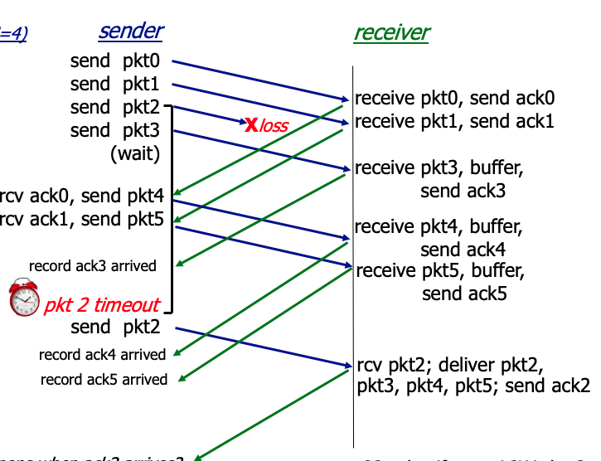
Selective Repeat
Go-back-N is inefficient:
Out-of-order packet gets tossed away
Selective repeat buffers out-of-order packets
Only retransmitting the lost packet

Slide 9
Cumulative ACK
Assuming we don’t use cumulative ACK but just ACK what we receive
What happens if an ACK is lost?
Sender won’t know receiver has received packet 3
Have to wait another time out and it will attempt to retransmit packet 3

Slide 10
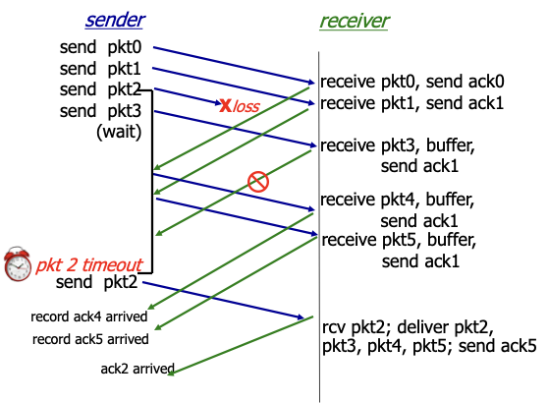
Cumulative ACK
Cumulative ACK allows an ACK to contain more information
It can ACK all packets smaller than the ACK number
The ACK for retransmitted packet 2 acknowledges 2,3,4,5 together

Slide 11
Questions?

Slide 12
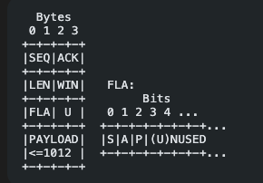
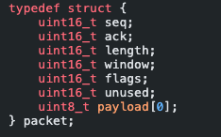
Project1: Parsing packets
Creating a buffer of the size right size and casting it to follow the packet structure
Then you can use the buffer to receive from socket

Slide 13
Project1: timer
Server/client only has 1 timer
Times the oldest unACKed packet
Reset the timer when:
The oldest unACKed packet got ACKed
A retransmission happens
No packet in-flight (i.e. sender has nothing in send buffer)

Slide 14
Project 1: server state machine
Entry point
AWAIT:
Received Packet with SYN flag
Project1 doesn’t test for closing connect, so connection state stay in Normal
NORMAL: process packet and sends ACK
START: Process packet and sends SYN/ACK
Received Packet with ACK flag

Slide 15
Project 1: client state machine
Entry point
START:
Send Packet with SYN flag
Project1 doesn’t test for closing connect, so connection state stay in Normal
NORMAL: process packet and sends ACK
AWAIT: Waiting for server to send back SYN/ACK
Received Packet with ACK flag

Slide 16
Project1: state machines
Client: active transition from START to AWAIT
By sending SYN to initiate connection
Server: passive transition from AWAIT to START
On receiving a packet with SYN
Regardless whether you are a client or server:
Always send a packet with SYN flag if you are in START state
Always expect a packet with SYN flag send to you if you are in AWAIT state
NORMAL state: normal transmission after hand-shake
ACK flag is always on
SYN flag is never on

Slide 17
Project1: loop structure
Receive packet and process packet
Process packet to be sent and send packet
Check whether we need to retransmit anything

Slide 18
Project1: loop structure
Receive packet and process packet
Check state and determine what kind of packet I should receive (SYN? SYN/ACK?)
Check parity bit
If ACK flag is set: see what is ACKed and process send buffer; restart timer if needed.
If there is data, we need to send ACK
Push packet into receiving buffer if the receiving window haven’t max out
Check receiving buffer: print out packet data if what we need is in the buffer
Advance ACK num
Remove printed packet in the buffer
Process packet to be sent and send packet
Check state
Determine how much data can be send through window size
Form a packet with the correct amount of data and sequence number
Push the packet into send buffer
Set ACK field if we need to ACK
Set parity bit
Send the packet

Slide 19
Project1: loop structure
Check whether we need to retransmit anything
Check if the timer has gone off if yes, we should retransmit the last unACKed packet
Check if we receive three consecutive ACK of the same seq
Reset the timer if retransmission happens
Reset the timer also if there is no packet in-flight

