Slide 1
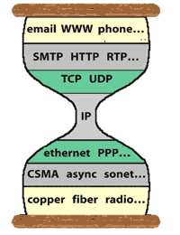
Lecture-2: HTTP
Non-persistent HTTP, persistent HTTP; pipelining
Web caching
A brief intro to HTTP/2 (FYI)
Notes:
FYI: wont show up in quizr exam; HTTP/2 aimed to address prev HTTP issues, which one should understand

Slide 2
What we covered in lecture-1
Concepts:
Internet: made of a huge number of hosts and routers, interconnected by physical and wireless links
Host: a computer running applications and bunch of protocols to let apps exchange data with each other
Router: a packet switch running bunch of protocols to move packets toward their destinations
Protocols are organized in layers:
Application protocols
Transport protocols
Network protocols
Link layer protocols
Physical layer
How to calculate packet delays as they move across one hop
Notes:
Today: first finish the discussion on delay calculation, then move on to socket programming

Slide 3

Encapsulation & Decapsulation
source
message
M
application
transport
network
link
physical
segment
H_{t}
M
H_{t}
datagram
H_{n}
H_{n}
H_{t}
M
frame
H_{l}
H_{n}
H_{t}
M
link
physical
switch
destination
H_{n}
H_{t}
M
network
link
physical
M
application
transport
network
link
physical
H_{l}
H_{n}
H_{t}
M
H_{n}
H_{t}
M
H_{t}
M
H_{n}
H_{t}
M
H_{l}
H_{n}
H_{t}
M
router
Notes:
Now we will how data packets are transferred up and down the protocol stack. We use this animation to explain two important concepts: encapsulation and decapsulation.
At the sender, the message is first passed from the application to the transport layer. When it arrives the transport layer, it will append additional information, which is called transport-layer header. (Ht), ….
It will be phyisically sent out.
Switch is a L2 equipment and the router is a L3 one.
It removes the L2 header and moves it to the network layer.
When it arrives at the destination, decapsulation is done in a reverse order.
Eventually, M arrives at the application layer in the destination end.
====
Application: message
Transport: segment
Network: datagram
Link: frame
Generally speaking: packet

Slide 4
Throughput
throughput: rate (bits/time unit) at which bits transferred between sender/receiver
instantaneous: rate at given point in time
average: rate over longer period of time
server, with
file of F bits
to send to client
link capacity
R_{s} bits/sec
link capacity
R_{c} bits/sec
server sends bits
(fluid) into pipe
pipe that can carry
fluid at rate
R_{s} bits/sec)
pipe that can carry
fluid at rate
R_{c} bits/sec)

Slide 5
Throughput (more)
R_{s} < R_{c} What is average end-end throughput?
R_{s} bits/sec
R_{c} bits/sec
R_{s} > R_{c} What is average end-end throughput?
R_{s} bits/sec
R_{c} bits/sec
The bottleneck link on end-end path that constrains end-end throughput

Slide 6
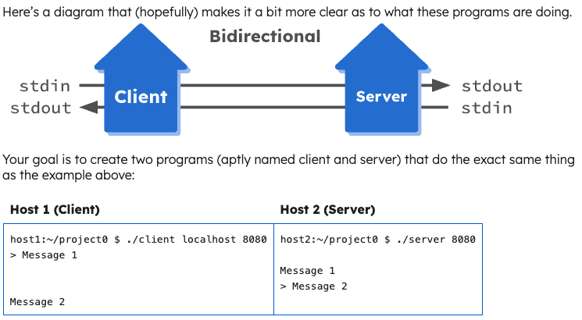
How to develop an Internet app?
3 basic concepts on Monday
Internet application processes
Internet sockets
Binding with address and port
What are the procedures to construct an Internet application?
3 main steps

Slide 7
Step 1: Application process
Create an Internet application process at two hosts/end systems
Each above process creates an Internet socket (via socket API)
As you create a socket, you need to select what transport service to use
application
socket
application
controlled by
app developer
process
process
transport
transport
network
network
controlled
by OS
link
Internet
link
physical
physical
Notes:
So, what is step 2? Apps run on top of transport layer

Slide 8
Step 2: Select from 2 Internet transport services
1. TCP service:
Connection-oriented: setup required between client and server processes
Reliable transfer between sending and receiving process
Control:
flow control: sender won’t overwhelm receiver
congestion control: throttle sender when network overloaded
does NOT provide: security
2. UDP service:
Connectionless: no connection setup
Unreliable data transfer between sending and receiving process
No control
You control the sending rate
does NOT provide: reliability, flow control, congestion control, security

Slide 9
What transport service to choose for your app?
Data integrity
some apps (e.g., file transfer, web transactions) require 100% reliable data transfer
other apps (e.g., audio/video) can tolerate some loss
Throughput
some apps (e.g., multimedia) require minimum amount of throughput to be “effective”
other apps (“elastic apps”) make use of whatever throughput they get
Timing
some apps (e.g., Internet telephony, interactive games) require low delay to be “effective”
Security
encryption, data integrity, …

Slide 10
Apps requirements on transport service
Application
File transfer
Email
Web page
Real-time
audio/video
Streaming
audio/video
Data loss
no loss
no loss
no loss
loss-tolerant
loss-tolerant
Throughput
elastic
elastic
elastic
audio: 5Kbps-1Mbps
video:10Kbps-5Mbps
same as above
Time sensitive?
no
no
no
yes, 10’s msec
yes, few secs

Slide 11
Choices of transport protocols services by apps
Application
File transfer
Email
Web page
Real-time
audio/video
Streaming
audio/video
Application layer protocol
FTP [RFC 959]
SMTP [RFC 5321]
HTTP 1.1 [RFC 7230]
SIP [RFC 3261], RTP [RFC 3550], or proprietary (e.g., Skype)
HTTP [RFC 7230], DASH
Transport protocol
TCP
TCP
TCP
TCP or UDP
TCP

Slide 12
Step 3: Define your application-layer protocol:
Types of messages exchanged,
e.g., request, response
Message syntax:
what fields in messages & how fields are delineated
Message semantics
meaning of information in fields
Rules for when and how processes send & respond to messages
Open protocols:
defined in RFCs, everyone has access to protocol definition
allows for interoperability
e.g., HTTP, SMTP
Proprietary protocols:
e.g., Skype

Slide 13
Choices of transport protocols services by apps
Application layer protocol
FTP [RFC 959]
SMTP [RFC 5321]
HTTP 1.1 [RFC 7230]
SIP [RFC 3261], RTP [RFC 3550], or proprietary (e.g., Skype)
HTTP [RFC 7230], DASH
Application
File transfer
Email
Web page
Real-time
audio/video
Streaming
audio/video
Transport protocol
TCP
TCP
TCP
TCP or UDP
TCP

Slide 14
Summary: How to develop an Internet app?
What are the procedures to construct an Internet application?
Create an application process (executing application program)
Which also needs to create an Internet socket
Select from 2 of the transport services offered by the Internet (via sockets)
Define your own application protocol for your Internet application
Let’s look at exactly what data is exchanged

Slide 15
Web and HTTP
Web page: normally consists of
base HTML-file, which includes
several referenced objects
An object can be another HTML file, JPEG image, Java applet, audio file,…
Each object is addressable by a URL (Universal Resource Locator )
http://www.someschool.edu:port#/someDept/pic.gif
host name
path name
Application protocol
Notes:
Port# is optional; use default if absent; explain 2 slides down
Path name:directory+file name

Slide 16
HTTP: HyperText Transfer Protocol
Web’s application layer protocol
Client/Server model
client: browser that requests, receives, “displays” Web objects
server: Web server sends objects in response to requests
HTTP/1.0: non-persistent connection
HTTP/1.1: persistent connection
May also pipelining
PC running
Explorer
HTTP request
HTTP response
HTTP request
Server
running
Apache Web
server
HTTP response
Mac running
Safari

Slide 17
HTTP runs over TCP
Client initiates TCP connection to server on port 80
creates socket
Server accepts TCP connection request from client
HTTP data exchanged between browser (HTTP client) and Web server (HTTP server)
When done: close the TCP connection
Which side initiates the close? Later

Slide 18
Now we got the big picture
HTTP request
Mac running
Safari
HTTP response
Server running
Apache Web server
Client (browser) speaks first
Set up a TCP connection (details later)
Send HTTP request
Server answers the request
HTTP is “stateless”: server maintains no information about past requests
Exactly how HTTP request & reply messages look like?
protocols that maintain “state” are complex!
past history (state) must be maintained
if server/client crashes, their views of “state” may be inconsistent, must be reconciled

Slide 19
HTTP request message example
FYI
Written in ASCII (human-readable)
http://www.httpforever.com:port#/some-dir/pic.gif
path name
host name
optional, default value: 80
carriage return character
method URL version
line-feed character
request line
GET /index.html HTTP/1.1\r\n
Host: www.httpforever.com\r\n
User-Agent: Chrome/131.0.0.0\r\n
Accept: text/html,application/xhtml+xml\r\n
Accept-Language: en-us,en;q=0.5\r\n
Accept-Encoding: gzip,deflate\r\n
Keep-Alive: 115\r\n
Connection: keep-alive\r\n
\r\n
header lines
A blank line
indicates end
of header
Optional message body
Notes:
Why there is a Host line
FYI: may appear in homework, but not in exam

Slide 20
Method types
FYI
HTTP/1.0
GET
POST
Web page often includes form input
User input sent from client to server in entity body of HTTP POST request message
HEAD
Requesting the header only (i.e. response does not include the requested object)
HTTP/1.1
GET, POST, HEAD
PUT
uploads (or completely replace) file in entity body to path specified in URL field
DELETE
deletes file specified in the URL field from the server
and a few others
See the protocol specification RFC2616
Notes:
How does the reply message look like?
Would it be the same/similar?

Slide 21
HTTP response message
FYI
status line
(status code,
status phrase)
HTTP/1.1 200 OK \r\n
Server: nginx/1.18.0 (Ubuntu)\r\n
Date: Wed, 08 Jan 2025 03:34:37 GMT\r\n
Content-Type: text/html\r\n
Content-Length: 5124\r\n
Last-Modified: Wed, 22 Mar 2023 14:54:48 GMT\r\n
Connection: keep-alive\r\n
ETag: "641b16b8-1404”\r\n
Accept-Ranges: bytes\r\n
\r\n
data data data data data ...
header
lines
A blank line
Data: e.g.,
requested
HTML file
Optional message body
Notes:
the connection will be closed after completion of the response (over-write persistent conn)

Slide 22
HTTP response status codes
important
Appears in the first line in server→client response message:
A few sample codes:
200 OK
request succeeded, requested object later in this message
301 Moved Permanently
requested object moved, new location specified later in this message (Location:)
400 Bad Request
request message not understood by server
404 Not Found
requested document not found on this server
505 HTTP Version Not Supported

Slide 23
Trying out HTTP request for yourself
1. Telnet to a Web server:
telnet www.httpforever.com 80
Opens TCP connection to port 80
(default HTTP server port) at www.httpforever.com
Anything typed in is sent
to port 80 at www.httpforever.com
2. Type in a GET HTTP request:
By typing this in (hit carriage
return twice), you send
this minimal (but complete)
GET request to HTTP server
GET /index.html HTTP/1.1
Host: www.httpforever.com
3. Look at response message from the HTTP server!

Slide 24
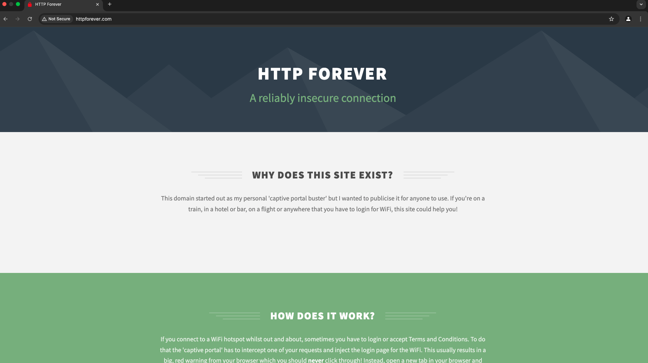
Notes:
Each picture is about 800KB

Slide 25
http://www.httpforever.com/index.html
<!DOCTYPE HTML>
<html>
<head>
<title>HTTP Forever</title>
<meta http-equiv="content-type" content="text/html; charset=utf-8" />
<meta name="description" content="A site that will always be available over HTTP!" />
<meta name="keywords" content="HTTP WiFi Captive Portal" />
<!--[if lte IE 8]><script src="css/ie/html5shiv.js"></script><![endif]-->
<script src="https://cdnjs.cloudflare.com/ajax/libs/jquery/3.3.1/jquery.min.js" integrity="sha256-FgpCb/KJQlLNfOu91ta32o/NMZxltwRo8QtmkMRdAu8=" crossorigin="anonymous"></script>
<script src="https://cdnjs.cloudflare.com/ajax/libs/skel/3.0.1/skel.min.js" integrity="sha256-3e+NvOq+D/yeJy1qrWpYkEUr6SlOCL5mHpc2nZfX74E=" crossorigin="anonymous"></script>
<script src="https://cdnjs.cloudflare.com/ajax/libs/skel-layers/2.2.1/skel.min.js" integrity="sha256-6xgf/CipbscdlAaUOAAlWVmpfPy9V5cQvZejxXSEfcw=" crossorigin="anonymous"></script>
<script src="js/init.min.js"></script>
<noscript>
<link rel="stylesheet" href="https://cdnjs.cloudflare.com/ajax/libs/skel-layers/2.2.1/skel.min.css" integrity="sha256-HoTbojxjAGIeiQMgAD2nqi6adFwcOUwoiPnr7mC7qBs=" crossorigin="anonymous" />
<link rel="stylesheet" href="css/style.min.css" />
<link rel="stylesheet" href="css/style-wide.min.css" />
</noscript>
<!--[if lte IE 8]><link rel="stylesheet" href="css/ie/v8.min.css" /><![endif]-->
</head>
<body class="landing">
<section id="banner">
<h2>HTTP FOREVER</h2>
<p>A reliably insecure connection</p>
</section>
<div class="wrapper style1">
<section class="container">
<header class="major">
<h2>Why does this site exist?</h2>
<p>This domain started out as my personal 'captive portal buster' but I wanted to publicise it for anyone to use. If you're on a train, in a hotel or bar, on a flight or anywhere that you have to login for WiFi, this site could help you!</p>
</header>
</section>
</div>
<div class="wrapper style2">
<section class="container">
<header class="major">
<h2>How does it work?</h2>
<p>If you connect to a WiFi hotspot whilst out and about, sometimes you have to login or accept Terms and Conditions. To do that the 'captive portal' has to intercept one of your requests and inject the login page for the WiFi. This usually results in a big, red warning from your browser which you should <b>never</b> click through! Instead, open a new tab in your browser and come here!</b></p>
</header>
</section>
</div>
<div class="wrapper style3">
<section class="container">
<header class="major">
<h2>Can I use it?</h2>
<p>Yes! Anyone is free to use or link to this site, just make sure you're always on the HTTP version: <a href="http://httpforever.com">http://httpforever.com</a></p>
</header>
</section>
</div>
<div class="wrapper style1">
<section class="container 75%">
<header class="major">
<h2>Who built this?</h2>
<p>This site was built by Scott Helme, a security researcher trying to help make the web more secure.</p>
</header>
<div id="contact" class="box">
<div class="row uniform">
<div class="6u">
<ul class="labeled-icons">
<li>
<h3 class="icon fa-twitter"><span class="label">Twitter</span></h3>
<a href="https://twitter.com/Scott_Helme" target="_blank">twitter.com/Scott_Helme</a>
</li>
<li>
<h3 class="icon fa-facebook"><span class="label">Facebook</span></h3>
<a href="https://www.facebook.com/scott.helme" target="_blank">facebook.com/scott.helme</a>
</li>
<li>
<h3 class="icon fa-linkedin"><span class="label">LinkedIn</span></h3>
<a href="https://www.linkedin.com/in/scotthelme/">linkedin.com/in/scotthelme</a>
</li>
</ul>
</div>
<div class="6u">
<ul class="labeled-icons">
<li>
<h3 class="icon fa-globe"><span class="label">Website</span></h3>
<a rel="author" href="https://scotthelme.co.uk">scotthelme.co.uk</a>
</li>
<li>
<h3 class="icon fa-github"><span class="label">GitHub</span></h3>
<a href="https://github.com/ScottHelme">github.com/ScottHelme</a>
</li>
<li>
<h3 class="icon fa-youtube"><span class="label">YouTube</span></h3>
<a href="https://www.youtube.com/user/ScottHelme">youtube.com/user/ScottHelme</a>
</li>
</ul>
</div>
</div>
</div>
</section>
</div>
<footer id="footer">
<div class="copyright">
Created By Scott Helme - License <a href="https://creativecommons.org/licenses/by-sa/4.0/">CC BY-SA 4.0</a> - <a href="https://scotthelme.co.uk/" rel="author">scotthelme.co.uk</a><br/>
Check out my other projects like <a href="https://report-uri.com">Report URI</a>, <a href="https://securityheaders.com">Security Headers</a> and <a href="https://crawler.ninja">Crawler.Ninja</a>.
</div>
</footer>
</body>
</html>

Slide 26
Non-Persistent HTTP (HTTP 1.0)
RTT: time between client sending a small packet to server and receiving the reply
Time needed to fetch a single web object:
one RTT to set up TCP connection
one RTT for HTTP request and first byte of HTTP response to reach the client
object transmission time
initiate TCP
connection
RTT
request
data
RTT
time to
transmit
data
data
received
time
time
Total = 2RTT + object transmission time

Slide 27
Total time to fetch a simple web page
User clicks URL www.httpforever.com/index.html
Host www.httpforever.com runs HTTP server process, waiting for incoming requests
2. HTTP server responds with "accept TCP connection”
4. HTTP server receives request message, forms a reply containing requested object, and sends it.
As soon as the server receives ACK for the reply (index.html), the server closes TCP connection.
1. HTTP client sends TCP connection open request to www.httpforever.com
3. HTTP client sends HTTP request message asking for index.html
5. HTTP client receives response message (index.html file), parsing the html file, finds 15 referenced objects
6. Steps 1-5 repeated for each of the 15 objects
Total time: 2 x (15 +1) = 32 RTTs, plus transmission time for the total 16 files
time

Slide 28
Q: How to improve?
At most one object is sent over one TCP connection
After opening a TCP connection, use it to fetch send multiple objects (Persistent HTTP)
open multiple TCP connections in parallel, one for each object

Slide 29
Persistent HTTP
Reuse the same TCP connection to transfer multiple objects
Server leaves connection open after sending response
Subsequent HTTP messages over the open connection
Client sends requests as soon as it encounters a referenced object
One RTT for each referenced object
Notes:
[The issues of non-P HTTP]
[Explain what is P-HTTP]
Keep the tcp connection on (reduce the TCP handshaking)..
….
…
Q: Do persistent HTTP overperform the non-persistent HTTP?
A: (depends on the file size… tx time vs. RTT ) (No, if non-persistent HTTP can be run in parallel) (Yes, if it is serial)
[Example: one web page with 10 objects)

Slide 30
Persistent HTTP (HTTP 1.1)
User clicks URL www.httpforever.com/index.html
Host www.httpforever.com runs HTTP server process, waiting for incoming requests
2. HTTP server responds with "accept TCP connection”
4. HTTP server receives request message, forms a reply containing requested object, and sends it.
1. HTTP client sends TCP connection open request to www.httpforever.com
3. HTTP client sends HTTP request message asking for object index.html
5. HTTP client receives response message (index.html file), parsing the html file, finds 15 referenced objects
After sending out first object, keep the connection open for a short time period, so if there is next request, it can use the same connection
At Step 5: use the established TCP connection to send 15 HTTP requests for the 15 referenced objects ⇨ total time needed: 17RTT + trans. Time for 16 objects
time

Slide 31
HTTP 1.0 vs 1.1 summary
Nonpersistent HTTP(1.0)
At most one object is fetched over a single TCP connection between client and server.
Described in RFC1945
http://tools.ietf.org/html/rfc1945
Can set up multiple TCP connections in parallel to speed up data fetching
Persistent HTTP (1.1)
Multiple objects can be fetched over a single TCP connection.
Described in RFC2616
Does HTTP 1.1 need to do the same?

Slide 32
Persistent HTTP: one more detail
Persistent without pipelining:
client issues next request after the previous response has been received
Total delay: one RTT for each object plus data transfer time (after TCP connection setup)
Persistent with pipelining:
client sends requests as soon as it sees a referenced object
Total delay: one RTT plus data transfer time for all objects (after TCP connection setup)

Slide 33
Three factors in HTTP fetching
1. Set up parallel connections, or not
2. Use persistent connection or not
3. Use, or not use, pipelining
Can do | No | No
Can do | Yes | Can do both
HTTP1.0
HTTP1.1

Slide 34
Example: Non-persistent HTTP vs. persistent HTTP
A web page (base html) with 10 (small) referenced objects. How long for client to receive all them all?
Ignore the object transmission time
Non-persistent HTTP (with 1 object one time)
2RTT + 2RTT* 10 = 22 RTT
Persistent HTTP
2RTT + 10 RTT = 12 RTT
Non-persistent HTTP (5 objects in parallel)
2RTT + 2RTT (1~5 objects) + 2RTT (6~10 objects) = 6RTT

Slide 35
HTTP/1.0 vs HTTP/1.1 with pipelining
Fetching one index.html file and 10 referenced jpeg files
HTTP/1.0
HTTP/1.1
Open TCP conn
Open TCP conn
Fetch index file
Fetch index file
Send 10 requests, get all objects
Repeat the above 2 steps 10 times to get all objects
Total time: 22RTT (plus data transfer time)
Total time: 3RTT (plus data transfer time)

Slide 36
How to scale web services?
Popular websites may receive thousands of requests per second
Each web server can only handle limited number of users at any given time
Popular web contents requested by many users
Cache popular
contents, serve
user requests
from caches

Slide 37

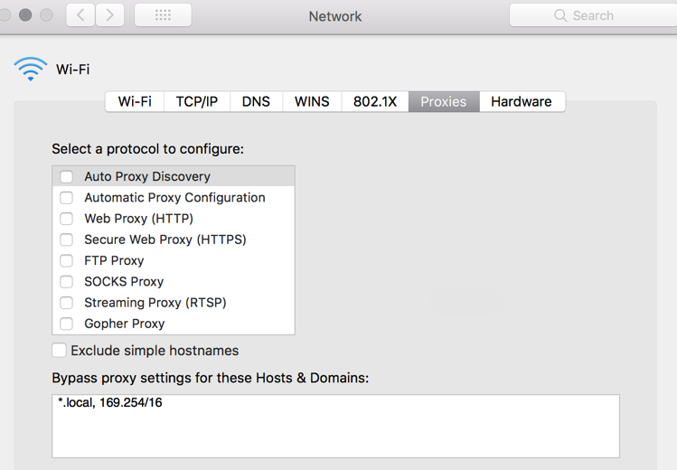
Web caching
origin
server
Configure each browser to send web requests to a proxy server (cache)
For each request: open a TCP connection with the cache
Cache:
If a requested object in cache: returns the object
else fetches the object from server, then returns object to client, and save a copy
Proxy
server
client
HTTP request
HTTP request
HTTP response
HTTP response
HTTP request
HTTP response
acts as both client and server
client
Notes:
Reduce load on the origin server; enables “poor” content providers to deliver content to large number of users
Reduce traffic on the content provider’s access link
Reduce response time for clients

Slide 38
Example: without caching
Assumptions
avg. web request rate = 10 reqs/sec
average object size = 100,000 bits
10 objects → 1M bits
RTT from institutional router to any web server and back = 500msec
Consequences
utilization on LAN = 1%
utilization on access link = 100%
Queuing delay at institutional router: may grow without bound
delay = 500msec + queuing delay
origin
servers
public
Internet
1 Mbps
access link
institutional
network
1 Gbps LAN
Notes:
100K/1M = 100msec,

Slide 39
Option-1: buy more bandwidth
Increase bandwidth of access link to 10 Mbps
Consequences
Can be costly
utilization on LAN = 1%
utilization on access link = 10%
delay for each request
≈ 500msec+queueing delay (negligible)
origin web
servers
public
Internet
10 Mbps
access link
institutional
network
1 Gbps LAN

Slide 40
Option-2: Adding a local cache
Consequences
assume hit rate = 40% requests will be satisfied by the data in the cache (delay ≈ 10msec)
Remaining 60% requests served by origin servers
utilization of access link reduced to 60% → much smaller queueing delay (say 30 msec)
avg delay for each object
= 0.6x(Internet delay + access delay) + 0.4x(LAN+cache delay)
= 0.6x(530 msec) + 0.4 x (1 msec)
= 313msec
origin
servers
public
Internet
1 Mbps
access link
institutional
network
1 Gbps LAN
Institutional cache
Notes:
3 remarks: (1) Reduce traffic on an institution’s access link, AND Reduce response time for client request. (2)popular file size: can be big; (3)what if content changed?

Slide 41
Having a local cache: there are issues
Configuring browsers to use a local cache:
What if the local cache fails?
What if the browser moves?
Two more questions
What if the cached contents are obsolete?
What about secured HTTP connections?
origin
servers
public
Internet
1 Mbps
access link
institutional
network
1 Gbps LAN
Institutional cache

Slide 42
Answer to Q1: use HTTP Conditional GET
Fetch content only if it has changed since previous fetch
Cache: specify date of cached copy in HTTP request
If-modified-since: <date>
server: response contains no object if cached copy is up-to-date:
HTTP/1.1 304 Not Modified
cache
server
HTTP request msg
If-modified-since: <date>
object
not
modified
HTTP response
HTTP/1.1
304 Not Modified
HTTP request msg
If-modified-since: <date>
object
modified
HTTP response
HTTP/1.1 200 OK
<data>
FYI: for http status code, see
https://datatracker.ietf.org/doc/html/rfc7231
Notes:
If-modified: header line in request, that we saw from the last lecture
Last-Modified: header line in HTTP response

Slide 43
Answer to Q2: HTTPS and HTTP Proxy
HTTPS:
Browser connects to, and authenticates web server
Encrypt all communications between the two ends
A cache by local ISP can run HTTPS with web server; your browser won’t run HTTPS with the cache
Web caching today: performed by Content Distribution Networks (CDNs)
CDN providers: Akamai, Fastly, CloudFlare, others
Your browser connects to a CDN server via HTTPs
Websites pay CDN providers and share crypto keys with them
How does your browser know which CDN box to connect to?
Notes:
Role of HTTP proxies today is diminishing, Access links are getting faster and cheaper
Lots CDNs, but how do CDNs make it work?
Now we finished a brief intro to HTTP/1.1, next explain 2.0

Slide 44

HTTP/3
2018
https://developer.mozilla.org/en-US/docs/Web/HTTP/Basics_of_HTTP/Evolution_of_HTTP
Sir Tim Berners-Lee 2016 ACM A.M. Turing Lecture, May 29, 2018
https://www.youtube.com/watch?v=BaMa4u4Fio4
Notes:
As of January 2022, the HTTP/3 protocol is still officially an Internet Draft, but is already supported by 73% of running web browsers, and 24% of the top 10 million websites.

Slide 45
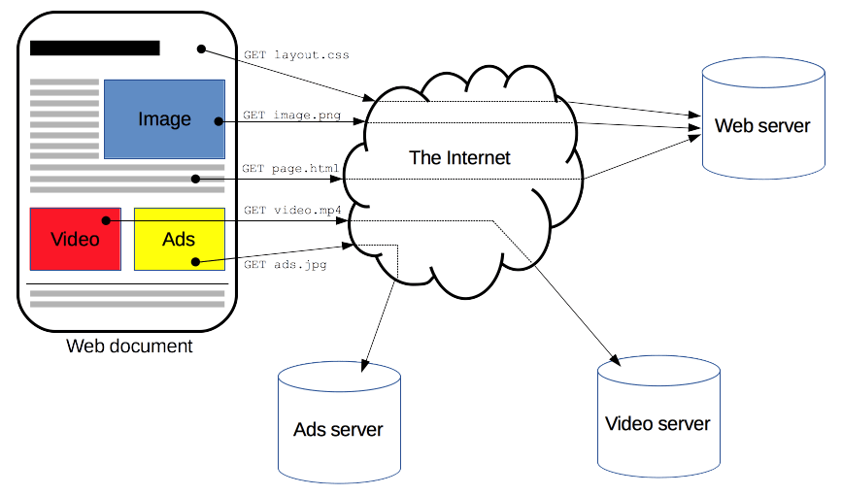
Why HTTP/2
HTTP/1.1 with pipelining: not good enough
Some measurement numbers: an average Web application is
composed of more than 90 objects
fetched from more than 15 distinct hosts
totaling more than 1.3MB of transferred data
On average each object <15KB
Some can be very big, e.g. large image files
That means some others can be very small
Notes:
The image files in my page: 800KB

Slide 46

HTTP/1.1’s performance issues
important
Head-of-line blocking: HTTP/1.1 handles all requests in strict sequential order
A request for a large file, or some dynamic computation, can take time, blocking all requests following it
Work-around: open multiple TCP connections
Big size HTTP header with repetitive information carried in queries
No work-around
Time consuming computation
Header-of-line blocking
Need to get answer ASAP
R4
R3
R2
R1
A1
A2
A3
A4
Notes:
bundling lots small objects into one: affect caching

Slide 47
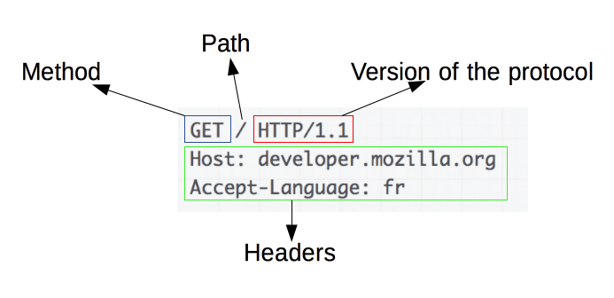
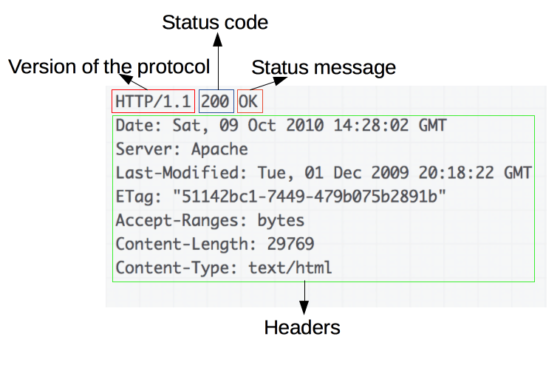
HTTP request and response message formats
HTTP headers are ASCII-encoded
Requests/response between the same 2 end nodes carry repeated information

Slide 48
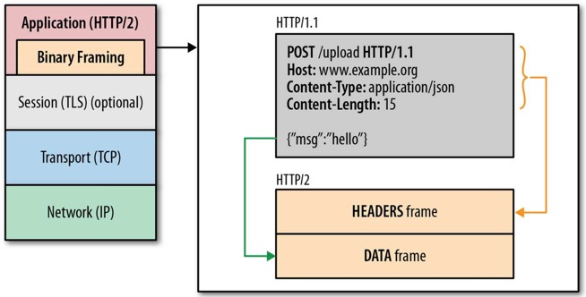
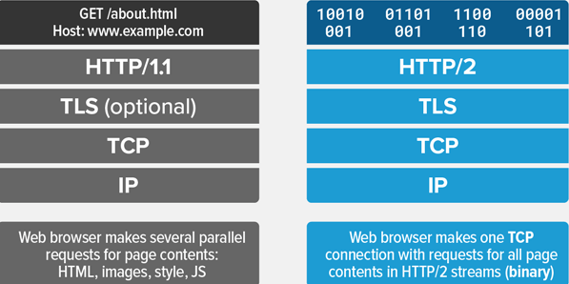
HTTP/2’s major new features
FYI
Binary encoding
Header compression
“frame” as the basic unit
Use a single TCP connection between browser—server
Each HTTP request → a stream
streams are multiplexed, in priority order
Server push

Slide 49
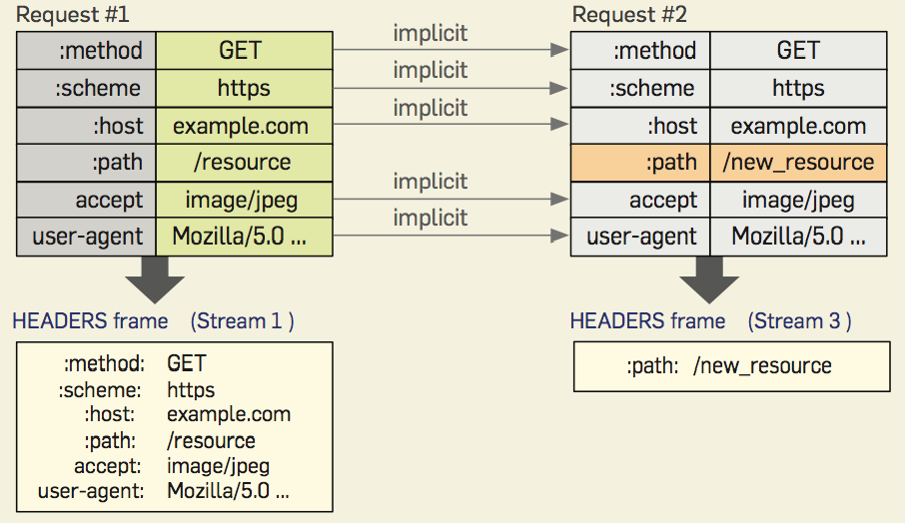
HTTP/2: Header Compression
Both browser & server keep a header table until the TCP connection closes
Notes:
Address the problem of Big HTTP header with repetitive information:

Slide 50
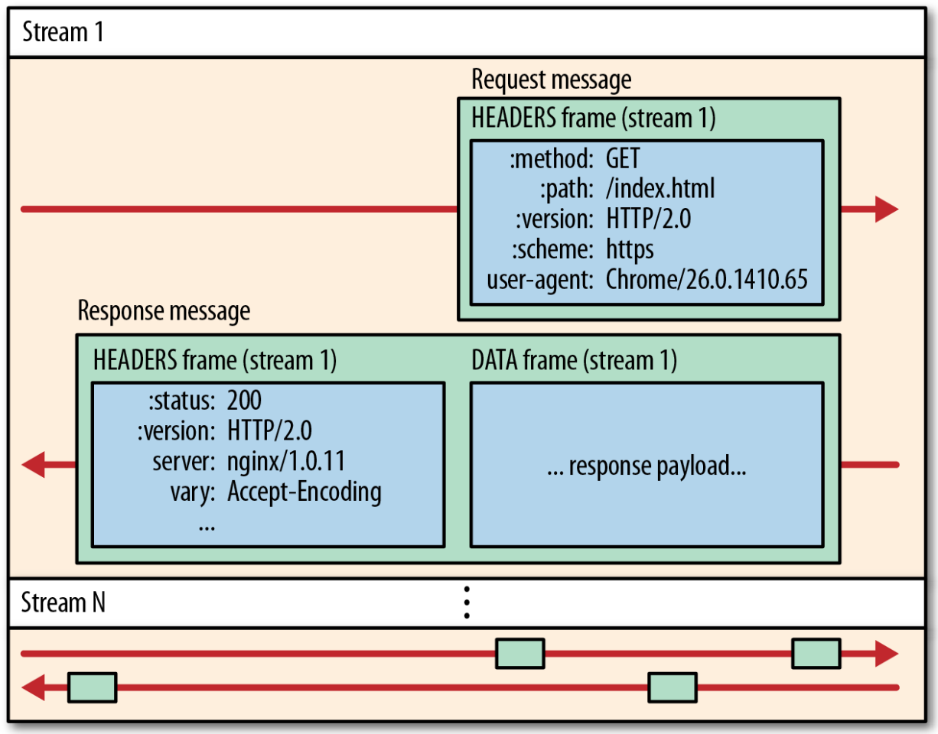
HTTP/2.0: Frame, Message, Stream
Frame: basic communication unit
Message: an HTTP request, or response
encoded in one or multiple frames
Stream: a virtual channel with priority, carrying frames in both directions
Notes:
Addresses Lack of pipelining support and Head-of-line blocking:

Slide 51
HTTP/2: Mitigating HOL blocking
HTTP 1.1: client requests 1 large object (e.g., video file) and 3 smaller objects
server
GET O₄
GET O₃
GET O₂
GET O₁
object data requested
client
O₁
O₂
O₁
O₃
O₂
O₄
O₃
O₄
objects delivered in order requested: O₂, O₃, O₄ wait behind O₁
Notes:
t’

Slide 52
HTTP/2: Mitigating HOL blocking
HTTP/2: objects divided into frames, frame transmission interleaved
server
GET O₄
GET O₃
GET O₂
object data requested
GET O₁
client
O₂
O₄
O₁
O₃
O₂
O₃
O₄
O₁
O₂, O₃, O₄ delivered quickly, O₁’s finish-time slightly delayed
What if 2nd frame of O₁ gets lost: can O₂, O₃, and O₄ be delivered to the browser app before the loss is recovered?
Notes:
shortest job first: decreased average delay!

Slide 53
HTTP/2 Performance Improvements
Reduced HTTP header overhead
Binary encoding
Header compression
Attempted to remove head-of-line blocking
Multiple streams, one for each http request/reply
Big messages are broken down to multiple frames
Frames from all streams can be interleaved
Above approaches avoids HOL at HTTP level
Single TCP connection between client-server → packet losses still lead to head-of-line blocking

Slide 54
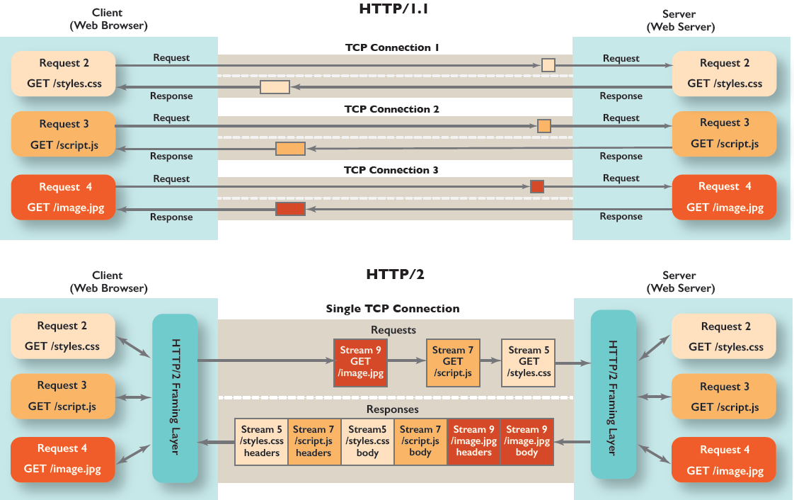
HTTP/2: a single TCP connection for multiple streams
Streams are prioritized
Notes:
Why can’t HTTP/1.1 do the same

Slide 55
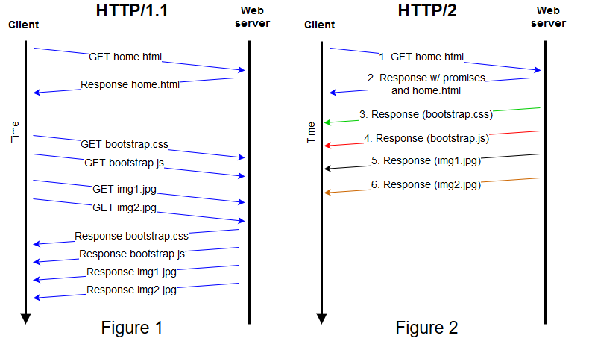
HTTP/2 server push
Notes:
To prevent servers from bombarding a client with data, the client can send a “rest stream” frame, informs the server to stop sending over that stream (i.e. refuse a push promise). if the user navigates to a new page on the same host, the existing connection can be re-used. The client simply needs to send a “rest stream” on all outstanding streams to avoid wasting bandwidth, and then send the new set of requests (over new streams). In HTTP/1, the only way to stop receiving already requested data was to drop the connection

Slide 56
HTTP/2 to HTTP/3
FYI
Decreased delay in multi-object HTTP requests
HTTP/2 over single TCP connection means:
Recovery from packet loss still stalls all object transmissions
as in HTTP 1.1, browsers have incentive to open multiple parallel TCP connections to reduce stalling, increase overall throughput
No security over vanilla TCP connection
HTTP/3: adds security , per object error and congestion-control (more pipelining) over UDP
more on HTTP/3 in transport layer
Notes:
t’

Slide 57
Tracking Web Clients via HTTP Cookies
FYI
Notes:
2nd topic of the da

Slide 58

Maintaining user/server state: cookies
Recall: HTTP GET/response interaction is stateless
no notion of multi-step exchanges of HTTP messages to complete a Web “transaction”
no need for client/server to track “state” of multi-step exchange
all HTTP requests are independent of each other
no need for client/server to “recover” from a partially-completed-but-never-completely-completed transaction
a stateful protocol: client makes two changes to X, or none at all
X
lock data record X
OK
X
update X X’
OK
X’
t’
update X X’’
OK
X’’
unlock X
OK
X’’
time
time
Q: what happens if network connection or client crashes at t’ ?
Notes:
t’

Slide 59
Maintaining user/server state: cookies
Web sites and client browser use cookies to maintain some state between transactions
four components:
1) cookie header line of HTTP response message
2) cookie header line in next HTTP request message
3) cookie file kept on user’s host, managed by user’s browser
4) back-end database at Web site
Example:
Alice uses browser on laptop, visits specific Amazon for first time
when initial HTTP requests arrives at site, site creates:
unique ID (aka “cookie”)
entry in backend database for ID
subsequent HTTP requests from Susan to this site will contain cookie ID value, allowing site to “identify” Amazon
Notes:
t’

Slide 60
User-server interaction: cookies
Client: has a cookie file
Web server
ebay 8734
usual http request msg
Amazon server
creates ID
1678 for user
usual http response
Set-cookie: 1678
create
entry
ebay 8734
amazon 1678
usual http request msg
cookie: 1678
cookie-
specific
action
access
one week later:
usual http response msg
backend
database
access
ebay 8734
amazon 1678
usual http request msg
cookie: 1678
cookie-
specific
action
usual http response msg

Slide 61
How Cookies Work
Web server:
If an HTTP request does not contain a “cookie” field: include a “set-cookie” header line in HTTP reply message
Store (in back-end database) the cookie with info about the user from the requests
Browser:
Save all received cookies in a local cookie file
Together with the website URL
When visiting a webpage: if a matching cookie found, include it in “cookie” header line in HTTP request

Slide 62
Cookies: usefulness vs privacy exposure
The use of cookies can
bring convenience to you
bring relevant recommendations
Permit a website to learn your online behavior
Advertising companies can obtain user info across multiple sites
Notes:
Web pages can feature content from third-party domains (such as banner ads), which opens up the potential for tracking the user's browsing history. Privacy setting options in most modern browsers allow the blocking of third-party tracking cookies.
Next, web caching

Slide 63

Third Party Cookies
Returned file includes a URL to Ad site
Site-1
Request URL
Request URL
Advertisement website
Return a cookie
Returned file includes a URL to Ad site
Site-2
When user visits the ad site the 2nd time, the request contains the cookie from the first visit

Slide 64
Third Party Cookie
A user visits www.example1.com, which contains an advert from ad.foxytracking.com, which, when downloaded, sets a cookie belonging to (ad.foxytracking.com).
When the same user visits another website, www.example2.com, which also contains an advert from ad.foxytracking.com → when the browser fetches this URL, it will include the cookie from (ad.foxytracking.com) in http request.
The advertiser can then use these cookies to build up a browsing history of the user across all websites hosting ads from this advertiser.
Notes:
As of 2014, some websites were setting cookies readable for over 100 third-party domains.[22] On average, a single website was setting 10 cookies, with maximum number of cookies (first- and third-party) reaching over 800.

