Slide 1
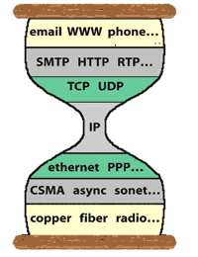
Lecture-3: HTTP and DNS
HTTP/2 and Cookie
(FYI)
Domain Name System
Why we need it
What it is
How it works
What it has been used for

Slide 2

HTTP/1.1’s performance issues
important
Head-of-line blocking: HTTP/1.1 handles all requests in strict sequential order
A request for a large file, or some dynamic computation, can take time, blocking all requests following it
Work-around: open multiple TCP connections
Big size HTTP header with repetitive information carried in queries
No work-around
Time consuming computation
Header-of-line blocking
Need to get answer ASAP
R4
R3
R2
R1
A1
A2
A3
A4
Notes:
bundling lots small objects into one: affect caching

Slide 3
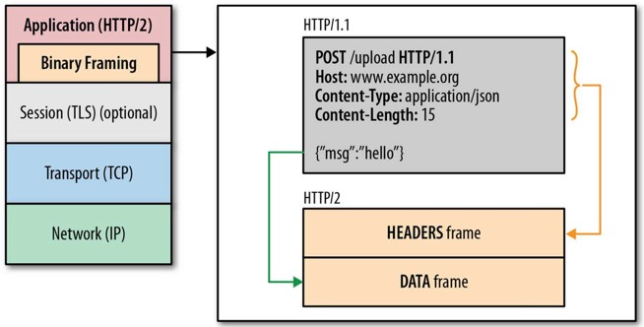
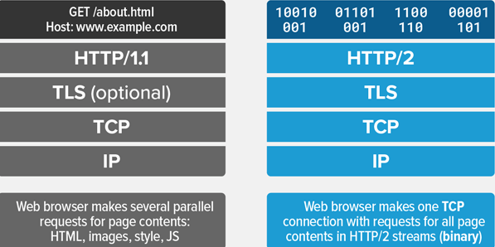
HTTP/2’s major new features
FYI
Binary encoding
Header compression
“frame” as the basic unit
Use a single TCP connection between browser—server
Each HTTP request → a stream
streams are multiplexed, in priority order
Server push

Slide 4
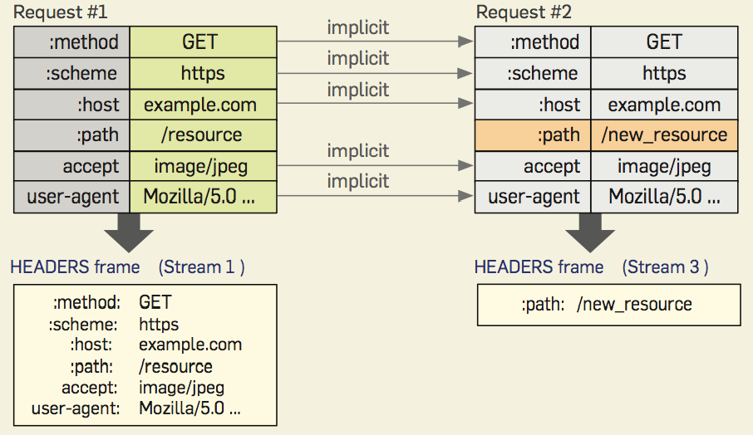
HTTP/2: Header Compression
Both browser & server keep a header table until the TCP connection closes
Notes:
Address the problem of Big HTTP header with repetitive information:

Slide 5
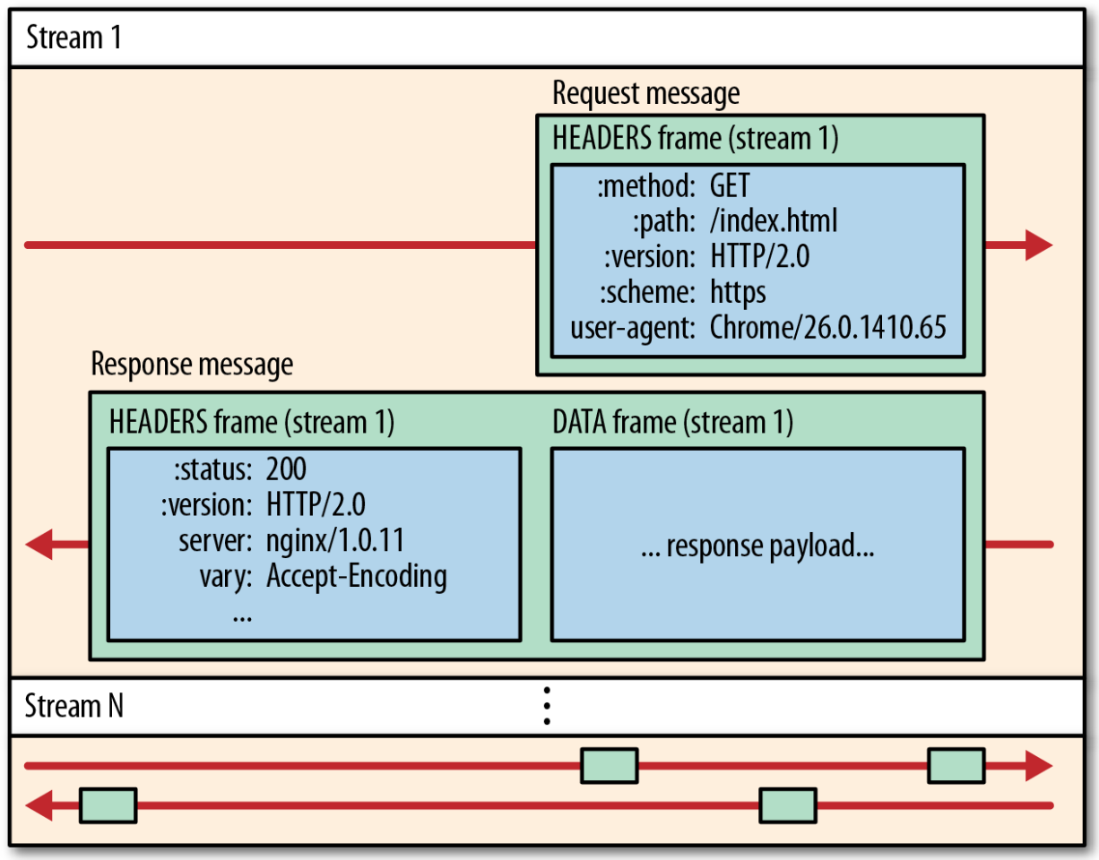
HTTP/2.0: Frame, Message, Stream
Frame: basic communication unit
Message: an HTTP request, or response
encoded in one or multiple frames
Stream: a virtual channel with priority, carrying frames in both directions
Notes:
Addresses Lack of pipelining support and Head-of-line blocking:

Slide 6

HTTP/2: Mitigating HOL blocking
HTTP 1.1: client requests 1 large object (e.g., video file) and 3 smaller objects
server
GET O₄
GET O₃
GET O₂
GET O₁
object data requested
client
O₁
O₂
O₁
O₃
O₂
O₄
O₃
O₄
objects delivered in order requested: O₂, O₃, O₄ wait behind O₁
Notes:
t’

Slide 7
HTTP/2: Mitigating HOL blocking
HTTP/2: objects divided into frames, frame transmission interleaved
server
GET O₄
GET O₃
GET O₂
object data requested
GET O₁
client
O₂
O₄
O₁
O₃
O₂
O₃
O₄
O₁
O₂, O₃, O₄ delivered quickly, O₁’s finish-time slightly delayed
What if 2nd frame of O₁ gets lost: can O₂, O₃, and O₄ be delivered to the browser app before the loss is recovered?
Notes:
shortest job first: decreased average delay!

Slide 8
HTTP/2 Performance Improvements
Reduced HTTP header overhead
Binary encoding
Header compression
Attempted to remove head-of-line blocking
Multiple streams, one for each http request/reply
Big messages are broken down to multiple frames
Frames from all streams can be interleaved
Above approaches avoids HOL at HTTP level
Single TCP connection between client-server → packet losses still lead to head-of-line blocking

Slide 9
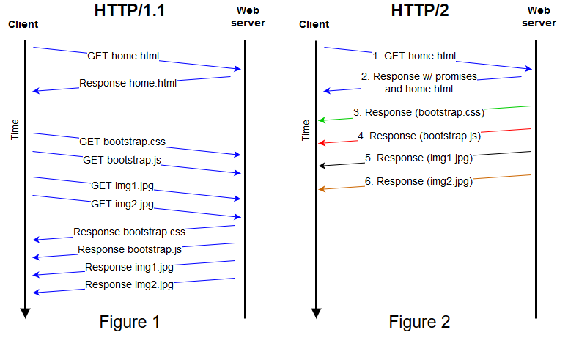
HTTP/2 server push
Notes:
To prevent servers from bombarding a client with data, the client can send a “rest stream” frame, informs the server to stop sending over that stream (i.e. refuse a push promise). if the user navigates to a new page on the same host, the existing connection can be re-used. The client simply needs to send a “rest stream” on all outstanding streams to avoid wasting bandwidth, and then send the new set of requests (over new streams). In HTTP/1, the only way to stop receiving already requested data was to drop the connection

Slide 10
HTTP/2 to HTTP/3
FYI
Decreased delay in multi-object HTTP requests
HTTP/2 over single TCP connection means:
Recovery from packet loss still stalls all object transmissions
as in HTTP 1.1, browsers have incentive to open multiple parallel TCP connections to reduce stalling, increase overall throughput
No security over vanilla TCP connection
HTTP/3: adds security , per object error and congestion-control (more pipelining) over UDP
more on HTTP/3 in transport layer
Notes:
t’

Slide 11
Tracking Web Clients via HTTP Cookies
FYI
Notes:
2nd topic of the da

Slide 12

Maintaining user/server state: cookies
Recall: HTTP GET/response interaction is stateless
No notion of multi-step exchanges of HTTP messages to complete a Web session
no need for client/server to track “state” of multi-step exchange
all HTTP requests are independent of each other
no need for client/server to “recover” from a partially-completed-but-never-completely-completed session
a stateful protocol: client makes two changes to X, or none at all
X
lock data record X
OK
X
update X X’
OK
X’
t’
update X X’’
OK
X’’
unlock X
OK
X’’
time
time
Q: what happens if network connection or client crashes at t’ ?

Slide 13
Maintaining user/server state: cookies
Websites and client browser use cookies to maintain some state between sessions
four components:
1) cookie header line of HTTP response message
2) cookie header line in next HTTP request message
3) cookie file kept on user’s host, managed by user’s browser
4) backend database at Web site
Example:
Alice uses browser on laptop, visits specific Amazon for first time
when initial HTTP requests arrives at site, site creates:
unique ID (aka “cookie”)
entry in backend database for ID
subsequent HTTP requests from Alice to this site will contain cookie ID value, Amazon “identifies” Alice
Notes:
t

Slide 14
User-server interaction: cookies
Client: has a cookie file
Web server
ebay 8734
usual http request msg
Amazon server
creates ID
1678 for user
usual http response
Set-cookie: 1678
create
entry
ebay 8734
amazon 1678
usual http request msg
cookie: 1678
cookie-
specific
action
access
one week later:
usual http response msg
backend
database
access
ebay 8734
amazon 1678
usual http request msg
cookie: 1678
cookie-
specific
action
usual http response msg

Slide 15
Cookies: usefulness vs privacy exposure
The use of cookies can
Bring convenience to you
Bring relevant recommendations
Permit a website to learn your online behavior
Advertising companies can obtain user info across multiple sites
Notes:
Web pages can feature content from third-party domains (such as banner ads), which opens up the potential for tracking the user's browsing history. Privacy setting options in most modern browsers allow the blocking of third-party tracking cookies.
Next, web caching

Slide 16

Third Party Cookies
Returned file includes a URL to Ad site
Site-1
Request URL
Request URL
Advertisement website
Return a cookie
Returned file includes a URL to Ad site
Site-2
When user visits the ad site the 2nd time, the request contains the cookie from the first visit

Slide 17
Why is DNS needed?
Application: host-to-host, process-to-process communication
Process identifier: IP address and port number
HTTP server-1: http://173.194.204.99:80
HTTP server-2: http://176.32.103.205:80
But, how can we know and remember the destination IP address?
Google?
Amazon?
Facebook?
how to map between IP address and name, and vice versa ?

Slide 18
What is DNS: services, structure
DNS services
hostname to IP address translation
host aliasing
canonical, alias names
mail server aliasing
load distribution
replicated Web servers: many IP addresses correspond to one name
Q: Why not centralize DNS?
single point of failure
traffic volume
distant centralized database
maintenance
A: doesn‘t scale!
Comcast DNS servers alone: 600B DNS queries per day

Slide 19
What is Domain Name System (DNS)?
Internet distributed database implemented in hierarchy of many name servers
application-layer DNS protocol: hosts, name servers communicate to resolve names (address/name translation)
note: core Internet function, implemented as application-layer protocol
complexity at network’s “edge”

Slide 20
Domain Name System
Why Internet needs DNS:
apps use name, IP needs address to deliver packets
name → IP address translation
One can also map IP address → name
DNS: works in the query-reply pattern (like HTTP)
Your browser sends a DNS query with a name:
DNS server sends back a reply:
web.cs.ucla.edu → 131.179.128.29
DNS runs over UDP (unreliable transport) by default
DNS handles packet losses
DNS can also run over TCP
Q: Does DNS need to do anything different if running over TCP?
Notes:
One of the most successful designs
People: many identifiers (name, SSN, passport #)
Internet hosts, routers: also multiple IDs: IP address to delivery packets, Name (e.g., www.google.com) - used by humans

Slide 21
Domain Names
A domain name is the sequence of labels from a node to the root, separated by dots (“.”s), read left to right
Domain names are limited to 255 characters in length
A node’s domain name identifies its position in the name space
ucla
cs
ee
tomado.east.nominum.com

Slide 22

DNS system: 4 parts
root
1
net
edu
com
gov
...
MIT
ucla
root
.
.....
cs seas cad
Foo Bar
com.
edu.
3
4
Caching resolver
ucla.edu.
2
Authoritative servers
John
cs.ucla.edu.
Alice
Bob
Notes:
The DNS has a hierarchical structure, composed by multiple administrative domains.
Each domain is called zone: On the very top there is the root zone, and below that the top level domains, such as com, net, edu…
Each zone is served by more servers, called name-servers. Each server stores all the names that belong to the zone in resource record
Each resource record, apart from name and value, has a certain type and a TTL value.
For example NS records are used to give the names of the name-servers and A records give the IP address
Finally the name-server information of a zone is stored at the parent zone also in order to connect the DNS tree

Slide 23
DNS: 4 Major Parts
important
A hierarchically structured name space
A distributed (federated) database, maintained by a hierarchy of authoritative servers
provided by individual domain owners
Local DNS servers (also called caching resolvers)
Each host runs a resolver routine (stub resolver), which talks to caching resolver provided by the host’s Internet service provider
Used to be the case, being changed now
DNS query protocol used by local caching resolvers to query authoritative servers
also used for stub to caching resolver communication

Slide 24
DNS: defines a hierarchical name space
root:
com.
org.
edu.
google.com
amazon.com
pbs.org
mitre.org
ucla.edu
umass.edu
cs.ucla.edu
ee.ucla.edu
remap.ucla.edu
starting from the root, growing downward, variable depth
Each leaf node is a (DNS) name
each non-leaf node in the tree is a domain
Each domain belongs to an administrative authority
delegated domain can set up sub-domains, the tree depth limit: 127
DNS name hierarchy: independent from topological connectivity

Slide 25
DNS Namespace Governance
Internet Corporation for Assigned Names and Numbers (ICANN, https://www.icann.org/) oversees the management of
Assignment of Top Level Domains (TLDs)
Delegation of TLD managements
Operation of the root name servers
TLD operators
Running TLD name servers
allocate 2nd level domain names
e.g.: edu allocates the name ucla.edu to UCLA
2nd level domain owners assign 3rd level names
ucla.edu allocates cs.ucla.edu to the CS dept
Notes:
Root zone file lists the names and numeric IP addresses of the authoritative DNS servers for all top-level domains (TLDs)

Slide 26
Top-Level Domains
Generic TLDs (gTLD)
Old ones: .com, .org, .net, .mil, .gov, .edu, .arpa
New ones: .kim, .bar, .coffee, .dance, .lol, and more (1000+ and counting)
Country code TLDs (ccTLD)
e.g.: .us, .kr, .ru, .cn
Internationalization ccTLDs (I18n ccTLD)
.한국 (South Korea), .рф (Russia), .中国 (China), …
https://en.wikipedia.org/wiki/List_of_Internet_top-level_domains

Slide 27
Second-level Domains
FYI
Example 2nd-level domain names under gTLDs
ucla.edu, mit.edu
google.com, apple.com
ca.gov, mass.gov
Examples under ccTLDs
.ac.uk, gov.uk
edu.cn, gov.cn
DNS names of additional levels:
3rd level: cs.ucla.edu
4th level: sec.cs.ucla.edu
No defined limit on the level of DNS names
Practical limit: the max length of a DNS name: 255 bytes

Slide 28
DNS Name Servers
Authoritative servers: serving queries for a given domain
A domain has multiple authoritative name servers
Master – maintaining the master zone file
Slave – replicated copies of the master file
These servers should be placed in different networks
Caching resolvers ( “local DNS servers”)
query authoritative servers on users behalf
cache the data from DNS replies
Stub resolvers: inside each host
configured with the IP address of (local) caching resolver(s)
send DNS queries to the caching resolver
Notes:
BIND: Berkeley Internet Name Domain

Slide 29
The Root Nameservers
https://root-servers.org/
The root domain file: contains the names and IP addresses of the authoritative DNS servers for all the top-level domains (TLDs)
This root domain file is published on 13 root DNS servers, named “A” through “M”, provided by volunteer efforts of diverse organizations

Slide 30
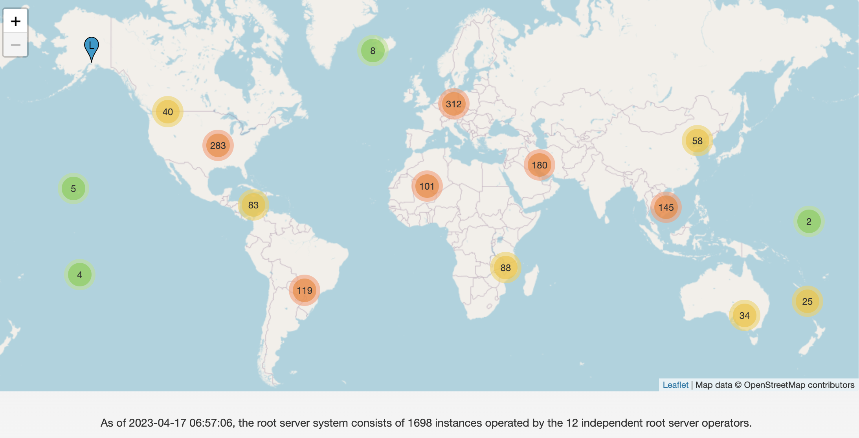
DNS Root Name Servers
13 root name servers operated by various parties on a coordinated, volunteering basis, all have multiple instances via anycast
http://root-servers.org

Slide 31
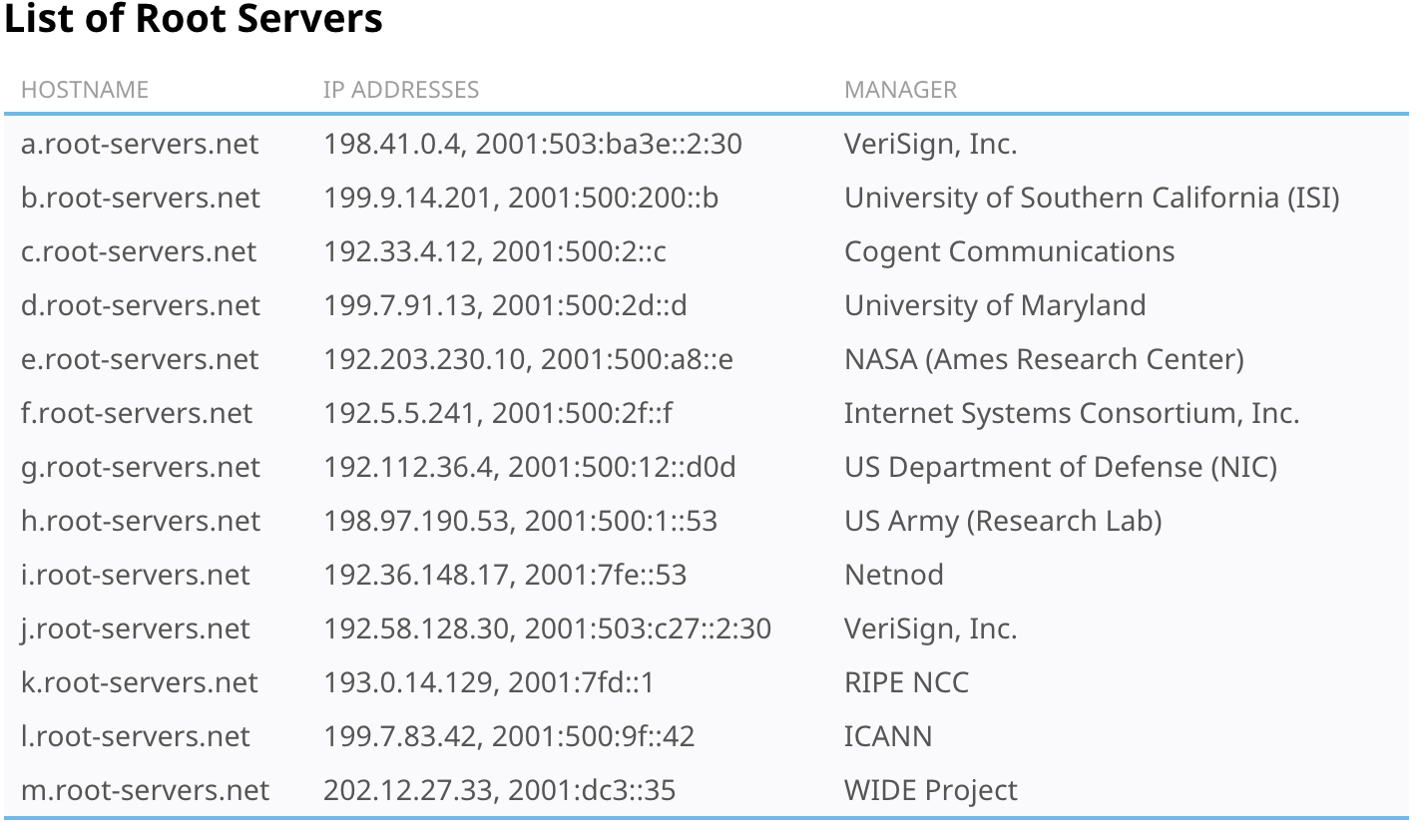
IPv4 address IPv6 address
Notes:
In 1997, j.root-servers.net was added as the 10th root name server. Operated by Network Solutions, it was initially co-located with A-root and used the IP address 198.41.0.10.
In 2000, Network Solutions, Inc. was acquired by Verisign.
The names and addresses of all these servers do not change.

