Slide 1
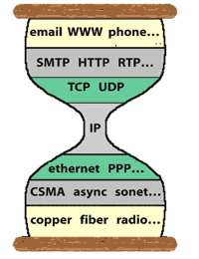
CS118 Lecture-5: Continue with DNS
Brief intro to DNS protocol
DNS performance and resiliency
DNS and CDN
DNS and network security

Slide 2

DNS system: 4 parts
root
1
net
edu
com
gov
...
MIT
ucla
root
.
.....
cs seas cad
Foo Bar
com.
edu.
3
4
Caching resolver
ucla.edu.
2
Authoritative servers
John
cs.ucla.edu.
Alice
Bob
Notes:
The DNS has a hierarchical structure, composed by multiple administrative domains.
Each domain is called zone: On the very top there is the root zone, and below that the top level domains, such as com, net, edu…
Each zone is served by more servers, called name-servers. Each server stores all the names that belong to the zone in resource record
Each resource record, apart from name and value, has a certain type and a TTL value.
For example NS records are used to give the names of the name-servers and A records give the IP address
Finally the name-server information of a zone is stored at the parent zone also in order to connect the DNS tree

Slide 3
DNS Namespace Governance
Internet Corporation for Assigned Names and Numbers (ICANN, https://www.icann.org/) oversees the management of
Assignment of Top Level Domains (TLDs)
Delegation of TLD managements
Operation of the root name servers
TLD operators
Running TLD name servers
allocate 2nd level domain names
e.g.: edu allocates the name ucla.edu to UCLA
2nd level domain owners assign 3rd level names
ucla.edu allocates cs.ucla.edu to the CS dept
Notes:
Root zone file lists the names and numeric IP addresses of the authoritative DNS servers for all top-level domains (TLDs)

Slide 4
Example: Verisign
FYI
ICANN delegates the management of .com to Verisign
Verisign operates authoritative name servers for .com domain
Verisign contracts registrars to sell domain names to public
Example registrars
GoDaddy (US)
CoolOcean (India)
There exist a very large number of registrars
Nowadays cloud providers also join the market…
Amazon, Cloudflare…
Notes:
Verisign contract for .com 2018-2024; .com had 135.6 million domain names by 6/30/2018 (3-4% growth/year)

Slide 5
Registries, registrars, registrants
FYI
Registry updates
Master updated
Registry
Domain DB
Registrar submits
add/modify/delete
to registry
Slaves
updated
Registrar
Registrar
Registrar
End user requests
add/modify/delete
Registrants

Slide 6
Registries, registrars, registrants
FYI
Registry (e.g., Public Interest Registry)
An organization that manages a DNS namespace
Allocate names, or work with a registrar for name allocations
Run TLD name servers
Registrar (e.g., Cloudflare)
An organization that sells domain names to the public
Submits change requests to the registry on behalf of the registrant
Registrant (e.g., cs118.org -- us!)
Person or company who registers a domain name
A registrant can manage its domain name’s settings through its own registrar.
Notes:
A classification of roles in the operation of a domain name space

Slide 7
Glue together DNS authoritative servers
net. NS a.net.
net. NS b.net.
a.net A 12.2.2.2
b.net A 14.3.4.5
edu. NS a.edu.
edu. NS b.edu.
a.edu A 2.2.3.4
b.edu A 2.2.4.4
Each NS RR of zone Z and the corresponding glue RR is stored in both Z’s own and its parent’s zone files
.
root
NAME TYPE TTL VALUE
ucla.edu NS 824 a.ucla.edu
ucla.edu NS 824 b.ucla.edu
a.ucla.edu A 600 3.3.4.5
b.ucla.edu A 900 3.4.4.5
www.ucla.edu A 1700 3.2.2.2
mail.ucla.edu A 3100 3.3.3.3
….
TTL field omitted
net.
edu.
ucla.edu.
edu. NS a.edu.
edu. NS b.edu.
a.edu A 2.2.3.4
b.edu A 2.2.4.4
ucla.edu. NS a.ucla.edu.
ucla.edu. NS b.ucla.edu.
a.ucla.edu. A 3.3.4.5
b.ucla.edu. A 3.4.4.5
All DNS data stored in a data structure called “resource record” (RR)
An RR contains 5 fields: name, type, class, TTL, value
Notes:
The DNS has a hierarchical structure, composed by multiple administrative domains.
Each domain is called zone: On the very top there is the root zone, and below that the top level domains, such as com, net, edu…
Zones are served by one or more servers, called name-servers.
Each server stores all the names that belong to the zone in a data-structure called resource record
Each resource record, apart from each name and each value, has a certain type and a TTL value.
For example NS records are used to give the names of the name-servers and A records give the IP address
Finally the name-server information of a zone is stored at the parent zone also in order to connect the DNS tree

Slide 8
Bootstrapping DNS lookup
Stub resolvers
must know the IP address for a caching resolver
Caching resolver (local DNS server)
must know the IP address for root server
Authoritative server
.
root
net.
Caching Resolver
edu.
Stub Resolver
ucla.edu.
John
cs.ucla.edu.
Alice
Bob

Slide 9
DNS Resolution
Whenever an app needs to communicates: first call DNS to translate the name to IP address, then open socket with the destination address
System call getaddrinfo(), gethostbyname()
Stub resolver
Configured with the IP address of the caching resolver(s)
Send DNS queries to local caching resolvers
Caching resolver (local DNS server)
Has the IP address of root servers, hard-coded in
Query authoritative servers, cache the data from replies

Slide 10
Steps of Actions in Resolving a Name
important
Cache
edu NS a.edu
edu NS b.edu
a.edu A 1.1.1.1
b.edu A 1.1.1.2
.
1
net.
edu.
ucla.edu.
John
Alice
Bob
www.ucla.edu ?
Notes:
Essentially the clients of the DNS system are the caching servers, which get request from the stub-resolvers
A stub-resolver is implemented in every operating system and they only forward requests from the applications to the caching servers.
For example assuming that…
Later on if another stub-resolver asks the same question the caching server can reply directly with the cached record without querying the name-servers.

Slide 11
Steps of Actions in Resolving a Name
important
Cache
edu NS a.edu
edu NS b.edu
a.edu A 1.1.1.1
b.edu A 1.1.1.2
.
1
ucla.edu NS a.ucla.edu
ucla.edu NS b.ucla.edu
a.ucla.edu A 2.2.2.1
b.ucla.edu A 2.2.2.2
net.
edu.
2
ucla.edu.
John
Alice
Bob
www.ucla.edu ?
Notes:
Essentially the clients of the DNS system are the caching servers, which get request from the stub-resolvers
A stub-resolver is implemented in every operating system and they only forward requests from the applications to the caching servers.
For example assuming that…
Later on if another stub-resolver asks the same question the caching server can reply directly with the cached record without querying the name-servers.

Slide 12
Steps of Actions in Resolving a Name
important
Cache
edu NS a.edu
edu NS b.edu
a.edu A 1.1.1.1
b.edu A 1.1.1.2
.
1
ucla.edu NS a.ucla.edu
ucla.edu NS b.ucla.edu
a.ucla.edu A 2.2.2.1
b.ucla.edu A 2.2.2.2
net.
edu.
www.ucla.edu A 2.2.2.3
2
www.ucla.edu ?
3
ucla.edu.
Other possibilities
Caching resolver may know the IP address for .edu server already
John
Alice
Bob
www.ucla.edu ?
Notes:
Essentially the clients of the DNS system are the caching servers, which get request from the stub-resolvers
A stub-resolver is implemented in every operating system and they only forward requests from the applications to the caching servers.
For example assuming that…
Later on if another stub-resolver asks the same question the caching server can reply directly with the cached record without querying the name-servers.

Slide 13
Summary: How a DNS name gets resolved?
A user host sends a query for www.ucla.edu (asking for its IP address) to a local DNS caching resolver
provided by your ISP
In recent years: provided by Google (8.8.8.8), CloudFlare (1.1.1.1), etc
The caching resolver either finds a relevant answer in its cache,
any of the following are relevant to www.ucla.edu
An exact match: www.ucla.edu’s IP address
ucla.edu DNS server IP address: go to step-5
.edu DNS server IP address: go to step-4
otherwise sends the query to one of the root servers
The root server replies with pointers to .edu servers
The caching resolver queries .edu DNS server, which replies with pointers to ucla.edu DNS servers
The caching resolver queries ucla.edu DNS server to get the IP address for www.ucla.edu, and sends the answer back to user host

Slide 14
Exploring DNS
dig
Should be available by default on macOS
Part of “bind” package on Linux (and if brave enough, on Windows)
https://www.digwebinterface.com/

Slide 15
tianyuan% dig . NS
; <<>> DiG 9.10.6 <<>> . NS
;; global options: +cmd
;; Got answer:
;; ->>HEADER<<- opcode: QUERY, status: NOERROR, id: 38900
;; flags: qr rd ra; QUERY: 1, ANSWER: 13, AUTHORITY: 0, ADDITIONAL: 0
;; QUESTION SECTION:
;. IN NS
;; ANSWER SECTION:
. 16232 IN NS e.root-servers.net.
. 16232 IN NS h.root-servers.net.
. 16232 IN NS l.root-servers.net.
. 16232 IN NS i.root-servers.net.
. 16232 IN NS a.root-servers.net.
. 16232 IN NS d.root-servers.net.
. 16232 IN NS c.root-servers.net.
. 16232 IN NS b.root-servers.net.
. 16232 IN NS j.root-servers.net.
. 16232 IN NS k.root-servers.net.
. 16232 IN NS g.root-servers.net.
. 16232 IN NS m.root-servers.net.
. 16232 IN NS f.root-servers.net.
tianyuan% dig a.root-servers.net (A)
; <<>> DiG 9.10.6 <<>> a.root-servers.net
;; global options: +cmd
;; Got answer:
;; ->>HEADER<<- opcode: QUERY, status: NOERROR, id: 30471
;; flags: qr rd ra; QUERY: 1, ANSWER: 1, AUTHORITY: 0, ADDITIONAL: 0
;; QUESTION SECTION:
;a.root-servers.net. IN A
;; ANSWER SECTION:
a.root-servers.net. 604800 IN A 198.41.0.4
tianyuan% dig a.root-servers.net aaaa
......
;; QUESTION SECTION:
;a.root-servers.net. IN AAAA
;; ANSWER SECTION:
a.root-servers.net. 604800 IN AAAA 2001:503:ba3e::2:30

Slide 16
2nd level domains:
UCLA runs its own DNS servers
3rd level domains: CS dept runs its own DNS servers
tianyuan% dig ucla.edu ns
.......
;; QUESTION SECTION:
;ucla.edu. IN NS
;; ANSWER SECTION:
ucla.edu. 917 IN NS ns2.dns.ucla.edu.
ucla.edu. 917 IN NS ns3.dns.ucla.edu.
ucla.edu. 917 IN NS ns4.dns.ucla.edu.
ucla.edu. 917 IN NS ns1.dns.ucla.edu.
;; ADDITIONAL SECTION:
ns1.dns.ucla.edu. 10093 IN A 192.35.225.7
ns2.dns.ucla.edu. 17620 IN A 54.201.38.106
ns2.dns.ucla.edu. 19766 IN AAAA 2600:1f14:793:a600::53
ns3.dns.ucla.edu. 11775 IN A 54.236.209.157
ns4.dns.ucla.edu. 21258 IN A 3.104.50.254
tianyuan% dig cs.ucla.edu ns
;; QUESTION SECTION:
;cs.ucla.edu. IN NS
;; ANSWER SECTION:
cs.ucla.edu. 14400 IN NS NS0.cs.ucla.edu.
cs.ucla.edu. 14400 IN NS NS3.cs.ucla.edu.
cs.ucla.edu. 14400 IN NS NS2.DNS.ucla.edu.
cs.ucla.edu. 14400 IN NS NS2.cs.ucla.edu.
cs.ucla.edu. 14400 IN NS NS3.DNS.ucla.edu.
cs.ucla.edu. 14400 IN NS NS1.cs.ucla.edu.
cs.ucla.edu. 14400 IN NS NS1.DNS.ucla.edu.
?

Slide 17
Namespace Allocation vs. Delegation
Administrator of a domain can allocate names under its own namespace to other organizations or individuals, creating a subdomain
The administrator can delegate the management responsibility of a subdomain, creating an administration unit called zone
The parent and subdomain zones can now be administered independently
Delegation: the key to DNS system’s scalability

Slide 18
Domain vs. Zone
Domain (from allocation)
Determined by the namespace structure
Zone (from delegation)
Determined by administration
ns1.dns.ucla.edu
ns1.dns.ucla.edu
domain
domain
domain
zone
zone
Namespace hierarchy != Administration hierarchy

Slide 19
DNS data is coded in Resource Record (RR)
RR format
+--------------+-----+-----+---------+-----+---------------+
+ name |type |class| TTL | RL | RDATA |
+--------------+-----+-----+---------+-----+---------------+
# of bytes <variable length> 2 2 4 2 <variable length>
Name: a list of labels
label: 1-byte length value, followed by n char's
Type: A, AAAA, NS, CNAME, MX, TXT, ...
a number of new types added in recent years
Class: protocol family (IN = Internet)
TTL: cache lifetime measured in second
DNS operators set the TTL value for data in master file
RDLENGTH: Resource Data length

Slide 20
RDATA: A function of RR type
Some commonly used DNS RR types
A: IPv4 address; AAAA: IPv6 address
Name = a DNS name,
RDATA = IP address
NS: an authoritative DNS name server for the named domain
Name = a domain name,
RDATA = DNS server’s name
CNAME: canonical name
Name = a canonical name
RDATA = the real DNS name
MX: mail server
Name = a domain name
RDATA = 2-byte preference value + DNS name for mail server
TXT: any value in text format
Notes:
MX preference specifies the preference given to this RR among others at the same owner. Lower values are preferred.
NS RR and associated A RR are infrastructure RRs, not user data; used solely by the DNS system itself
Talked 7 types here

Slide 21
DNS protocol
FYI
Client-server based: DNS query and reply over UDP/TCP
2 bytes
2 bytes
Message header:
Identification: 16 bit # for query, reply to query uses same #
Flags:
Query or reply
Recursion desired
Recursion available
Reply is authoritative
Identification
Flags
# Questions
# Answer RRs
# Authority RRs
# Additional RRs
Questions (variable # of questions)
Answers (variable # of RRs)
Authority (variable # of RRs)
Additional info (variable # of RRs)

Slide 22
DNS protocol (contd.)
FYI
Client-server based: DNS query and reply over UDP/TCP
2 bytes
2 bytes
Identification
Flags
# Questions
# Answer RRs
# Authority RRs
# Additional RRs
Name, type fields for a query
Questions (variable # of questions)
RRs in response to query
Answers (variable # of RRs)
Records for authoritative servers
Authority (variable # of RRs)
Additional “ helpful” info that may be used
Additional info (variable # of RRs)

Slide 23
RRset: a set of resource recodes
DNS stores multiple values of the same name, class, & type in multiple RRs
An RRset: made of all the RRs with the same name, class, and type
the basic DNS response unit
tianyuan% dig ucla.edu ns
; <<>> DiG 9.10.6 <<>> ucla.edu ns
;; global options: +cmd
;; Got answer:
;; ->>HEADER<<- opcode: QUERY, status: NOERROR, id: 13378
;; flags: qr rd ra; QUERY: 1, ANSWER: 4, AUTHORITY: 0, ADDITIONAL: 0
;; QUESTION SECTION:
;ucla.edu. IN NS
;; ANSWER SECTION:
ucla.edu. 1077 IN NS ns3.dns.ucla.edu.
ucla.edu. 1077 IN NS ns4.dns.ucla.edu.
ucla.edu. 1077 IN NS ns1.dns.ucla.edu.
ucla.edu. 1077 IN NS ns2.dns.ucla.edu.
an RRset
Notes:
labels 63 octets or less
names 255 octets or less
TTL positive values of a signed 32 bit number.
UDP messages 512 octets or less

Slide 24
Performance of the DNS System

Slide 25
DNS caching
Each resolver saves a copy of all query replies
Both caching resolvers and stub resolvers keep a cache
Stale cache entries removed from cache when their TTL expires
A caching resolver is most likely to have in its cache
the DNS server info (both names & IP addresses) for popular TLDs (e.g. .com, .edu)
the DNS server information for popular sites (e.g. google, apple, amazon, cnn, etc.)
2 major advantages from caching
reduce authoritative server load and network traffic
shorten response delay

Slide 26


How a caching resolver makes query decisions: an example
Your browser needs IP address for www.ucla.edu: the caching resolver CR doesn’t have it
Where will CR send its first query to?
Depending on what other info CR may have in its cache
ucla.edu authoritative server info?
.edu authoritative server info?
If none of the above: go to one of the root servers
Root Servers
Caching Resolver
.edu Servers
ucla.edu Servers
Stub Resolver

Slide 27
Scale the DNS system
Scale the namespace e.g. how many names the Internet can have
Hierarchical namespace, with variable name length
Scale the management by delegation
Each delegated domain manages its own namespace, provides its own authoritative DNS servers
Scale the DNS service by pervasive caching
tianyuan% dig edu. ns
......
;; QUESTION SECTION:
;edu. IN NS
;; ANSWER SECTION:
edu. 172800 IN NS j.edu-servers.net.
edu. 172800 IN NS m.edu-servers.net.
edu. 172800 IN NS g.edu-servers.net.
edu. 172800 IN NS l.edu-servers.net.
edu. 172800 IN NS k.edu-servers.net.
edu. 172800 IN NS i.edu-servers.net.
edu. 172800 IN NS b.edu-servers.net.
edu. 172800 IN NS c.edu-servers.net.
edu. 172800 IN NS d.edu-servers.net.
edu. 172800 IN NS a.edu-servers.net.
......
172800 sec = 2 days

Slide 28
Providing Resilient DNS Service
important
Resilient service = high availability in face of network and/or server failures
Basic means for resiliency: redundancy
Redundancy: replicating authoritative servers
Caching: as opportunistic replication
Root domain has 13 replicate authoritative server names and corresponding IP addresses
https://root-servers.org/: “As of 2025-01-15T04:40:06Z, the root server system consists of 1921 instances operated by the 12 independent root server operators.”
Notes:
What’s T and Z in timestamp? When “Z” (Zulu) is tacked on the end of a time: that time is UTC, so really the literal Z is part of the time. The T is just a literal to separate the date from the time, and the Z means “zero hour offset” also known as “Zulu time” (UTC).

Slide 29
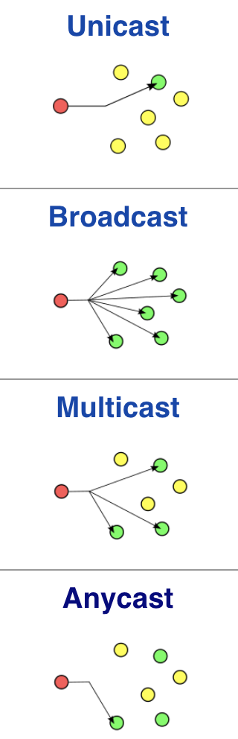
Anycast delivery
FYI
Focus
https://en.wikipedia.org/wiki/Anycast
Unicast: A given IP address block A is announced from a single location
Broadcast: if a packet’s destination IP is broadcast, send it everywhere
Multicast: an IP multicast address represents a group of recipients
need fundamental changes to IP forwarding
need multicast routing protocol support
Anycast: A given IP address block A is announced from multiple locations
a route receives reachability to A from multiple neighbors, pick the shortest path to forward packets
Notes:
It is NOT routing

Slide 30
(ab)Using DNS for Content Distribution Networks (CDN)
tianyuan% dig @ns1.dns.ucla.edu www.ucla.edu
...
;; QUESTION SECTION:
;www.ucla.edu. IN A
;; ANSWER SECTION:
www.ucla.edu. 60 IN CNAME d1zev4mn1zpfbc.cloudfront.net.
d1zev4mn1zpfbc.cloudfront.net. 56 IN A 18.154.132.29
d1zev4mn1zpfbc.cloudfront.net. 56 IN A 18.154.132.63
d1zev4mn1zpfbc.cloudfront.net. 56 IN A 18.154.132.13
d1zev4mn1zpfbc.cloudfront.net. 56 IN A 18.154.132.92
???

Slide 31
Where contents can be cached
and who provide the caches
Lecture-2 on HTTP caching:
Caches provided by end user sites, located near users
Caches can also be provided/ arranged by content owners
CDN providers offer caching service
with caches widely distributed
Content owners pay for service
origin
servers
public
Internet
1 Mbps
access link
institutional
network
10 Mbps LAN
Institutional cache
proxy
server
clients
Proxy
User cache
proxy
Notes:
Why called proxy

Slide 32
How to get user HTTP requests to nearby CDN server
without changing user host or application:
A user queries DNS to get web server www.ucla.edu IP address, then sets up TCP connection to it
One can make the DNS server return the IP address of nearest CDN server
When UCLA pays for CDN service: outsource www.ucla.edu hosting to the CDN provider
www.ucla.edu. 60 IN CNAME d1zev4mn1zpfbc.cloudfront.net
AWS CDN Product

Slide 33
Getting user’s HTTP requests to a nearby CDN server
AWS CDN servers
D
Origin of “www.ucla.edu”
C
F
A
2
5
E
B
1
3
AWS DNS server running as authoritative DNS server for www.ucla.edu based on service contract
4
1-4: user host queries for www.ucla.edu’s IP address, gets back IP address for AWS server-A
5: user host connects to AWS server-A to fetch the page

Slide 34
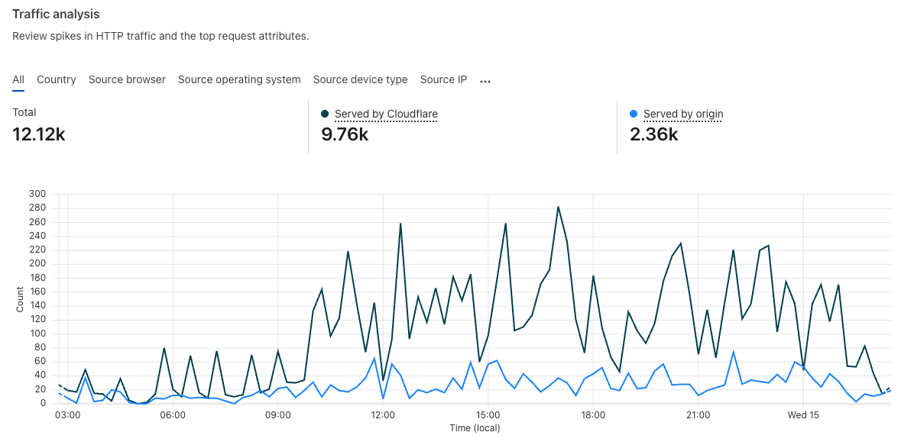
Another example: cs118.org
cs118.org buys Cloudflare service (domain and CDN)
Cloudflare provides authoritative DNS servers for cs118.org
When Cloudflare DNS server receives a DNS query:
Get the source IP address from the query message
Use the address to estimate the user location, then return the IP address of a nearby CDN box
cs118.org turns on HTTPS?
Share the crypto key with Cloudflare to make a browser believe it’s connected to cs118.org
What if some CDN box is overloaded? Or crashed?

Slide 35
Using DNS for load balancing
Common practice by CDN servers
Assign a very short TTL for the final (DNS lookup) result, to avoid it being cached for long
tianyuan% dig cs118.org a
;; QUESTION SECTION:
;cs118.org. IN A
;; ANSWER SECTION:
cs118.org. 75 IN A 104.21.48.1
cs118.org. 75 IN A 104.21.64.1
cs118.org. 75 IN A 104.21.96.1
cs118.org. 75 IN A 104.21.112.1
cs118.org. 75 IN A 104.21.16.1
cs118.org. 75 IN A 104.21.80.1
cs118.org. 75 IN A 104.21.32.1

Slide 36
DNS and security

Slide 37
Attacks to DNS
Brute force DDoS attacks
flood root servers with queries (so far: not successful)
flood specific lower level DNS servers
some of them not well provisioned
Man-in-middle attacks
Intercept queries, then send bogus relies to caching resolvers
resulting in cache poisoning
Other means to achieve cache poisoning

Slide 38

DNS cache poisoning
Response www.attacker.com A 128.9.128.127
attacker.com NS ns.attacker.com
attacker.com NS www.google.com
ns.attacker.com A 128.9.128.2
www.google.com A 128.9.128.127
UCLA Cache Resolver
www.google.com
= 128.9.128.127
ns.attacker.com
Query www.attacker.com
Query www.google.com
Remote attacker
Notes:
These vulnerabilities identified early

Slide 39
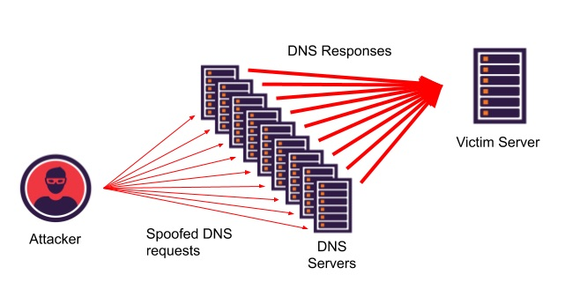
Abusing DNS as attack tool
Exploiting DNS for DDoS
Send queries with spoofed source address = victim IP
Using large number of compromised devices to amplify attack
One way to mitigate: DNS over TCP instead of UDP
victim

Slide 40
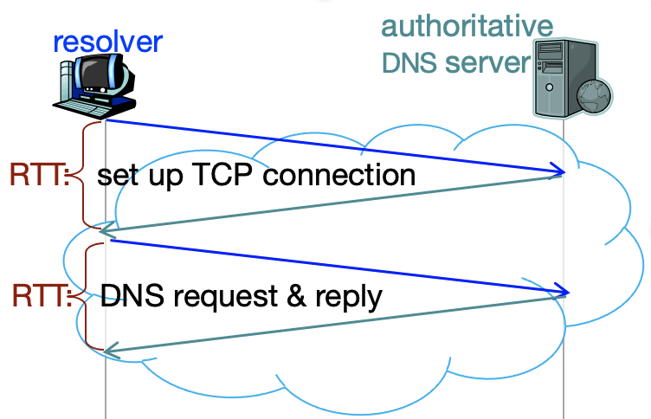
Running DNS over TCP versus UDP
DNS protocol: an application protocol
Running over TCP
Take minimum 2 RTTs to get reply
Running over UDP: the resolver detects packet loss and retries
When sending a query, resolver sets a retransmission timer
If no loss: receives reply in one RTT
If no reply received when the timer expires: retry with another authoritative server in the same RRset

Slide 41
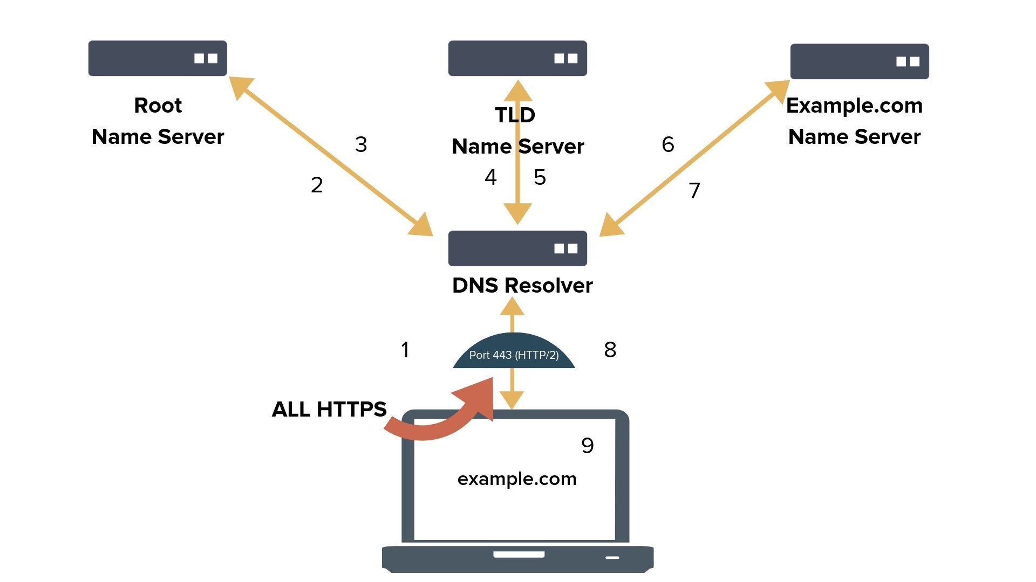
Latest change: DNS over HTTPS (DoH)
FYI
Caching resolver

Slide 42
DNS: Not a fully automated system
DNS defines the following
standard formats for storing DNS data (RR)
standard protocol for querying the database
Tuning knobs of DNS service configurations
Operators do the following
define domain boundaries and child-domain delegations
define desired operation policies
Cache validation period (TTL)
Master → secondary server synchronization period
manually update the master file of each domain
For ns RR and glue RR updates: contact the parent zone's operator

Slide 43
Inserting records into DNS
Example: assume creating a “W25 CS118” zone
Register name w25 at cs118.org
Need to provide with names and IP addresses of your authoritative name servers (primary and secondary)
Registrar inserts two RRs into the cs118.org name server:
w25.cs118.org, NS, ns1.w25.cs118.org
ns1.w25.cs118.org, A, 1.1.1.1
Put in authoritative server Type A record for www.w25.cs118.org
How do people get the IP address of www.w25.cs118.org?

Slide 44
Example Configuration
…
w25.cs118.org NS ns1.w25.cs118.org
w25.cs118.org NS ns2.w25.cs118.org
ns1.w25.cs118.org A 1.1.1.1
ns2.w25.cs118.org A 1.1.1.2
cs118.org
New
Delegation
Want to create:
1. a new zone
2. with two servers
Parent domain Configuration
Secondary
Master
Domain Configuration
w25.cs118.org
w25.cs118.org NS ns1.w25.cs118.org
w25.cs118.org NS ns2.w25.cs118.org
ns1.w25.cs118.org A 1.1.1.1
ns2.w25.cs118.org A 1.1.1.2
Authoritative Server
Notes:
Let’s see with a simple example how to configure a new DNS zone.
Later on I will use the same example in order to illustrate 4 types of configuration errors that can happen:
Let’s assume that we want to create a new zone: foo.edu, with a redundancy of two servers
First we have to configure the name-servers one primary and one secondary (i.e. one know the presence of the other)
Then we have to add the name-server information into the zone, and also add any other records we want
Finally we have to copy the name-server information to the parent zone
After all that the new delegation is complete.
So, the configuration of a new zone is an easy 3-Step process. But can something go wrong?

Slide 45


The failure of a popular DNS domain
Global Internet
replicated DNS servers
A popular domain → lots queries for DNS names under this domain
If the domain’s authoritative servers no longer reachable: all cached entries time-out eventually
When caching resolvers tried to look up a name: what happens when all the authoritative servers for that domain become unreachable?

Slide 46
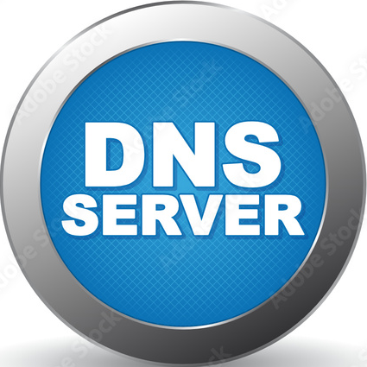
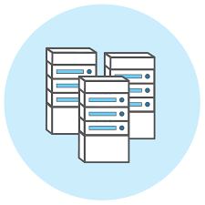
Understanding the Facebook Failure
During a regular internet maintenance, an error caused all the datacenters unreachable
Audit tool designed to prevent such mistakes had a bug
Facebook DNS servers became unreachable
Facebook, WhatsApp, Instagram names became unresolvable
The loss of DNS broke many internal tools normally used to investigate and resolve outages
Engineers sent to datacenters were delayed access by strict security measures
the global Internet

Slide 47
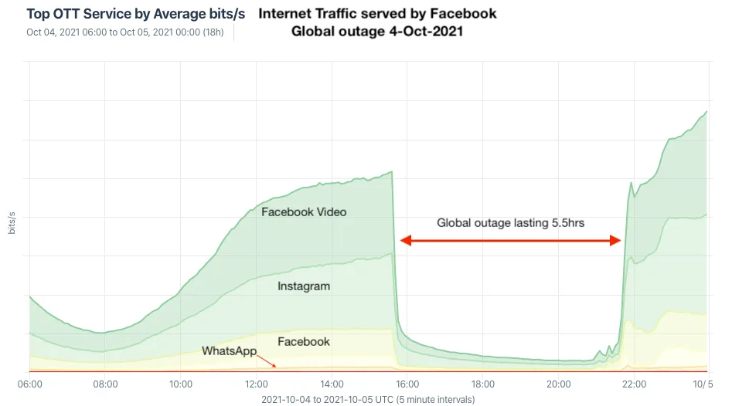
The Facebook failures impacted others
SERVFAIL: caching resolver times out, cache negative results
A tsunami of additional DNS traffic follows
apps won't accept an error for an answer and start retrying
end-users also won't take an error for an answer and start reloading the pages, or killing and relaunching their apps, sometimes aggressively.
30x increase of DNS traffic caused latency and timeout issues to other platforms

Slide 48
Encoding Domain Names in DNS
Examples:
foo.bar.example.
\032br.example. (\032 = space in ASCII decimal)
each name is encoded as a sequence of labels
Label = string between two "." (unless the dot is prefixed by “\”)
e.g. foo.bar is 2 labels; foo\.bar is 1 label
Each label is encoded as
Length (1 byte), followed by Name ([1..63] bytes)
Example: ogud.com → 04ogud03com00
00 also represents the root (.)
Notes:
7 types as defined in 1035 (more types now, some for DNSSEC); 00 = \0 = NULL

Slide 49
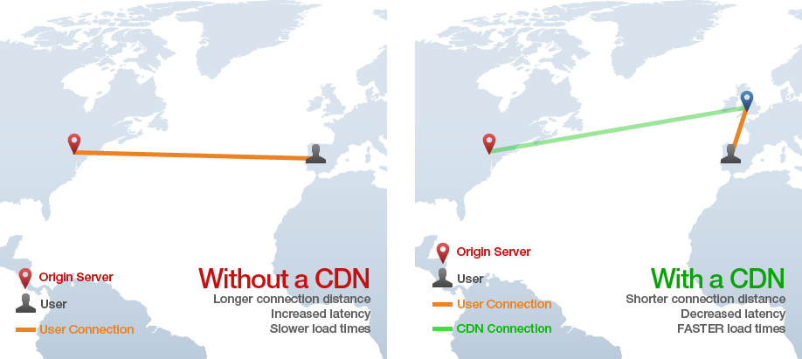
With And Without CDNs
Populating contents to CDN servers
Source: https://gtmetrix.com/why-use-a- cdn.html
CDN server
How to make a user send HTTP request to the nearest CDN server?

