Slide 1
CS118 Dis 1C, Week 4
Yangchao Wu
Slides credit to Xinyu Ma

Slide 2
Contents
Project 1
tips
TCP
Retransmission
Congestion Control
Some old problems

Slide 3
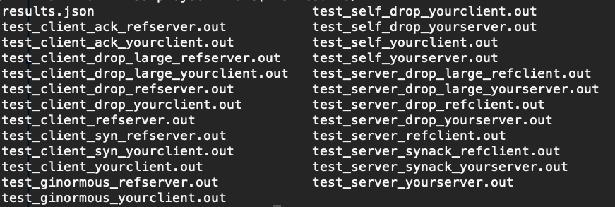
Project1 Debugging
Under results folder there are .out files
Contains messages printed to stderr

Slide 4

Project1 window
How much to send?
How much can be received - how is in our send window, capped by MAX_PAYLOAD
How much can we receive?
We have a max receiving window
If packet’s data has more than we can receive, we drop the packet as if it is corrupted
Increment the max receiving window by 500 bytes each time you receive data

Slide 5
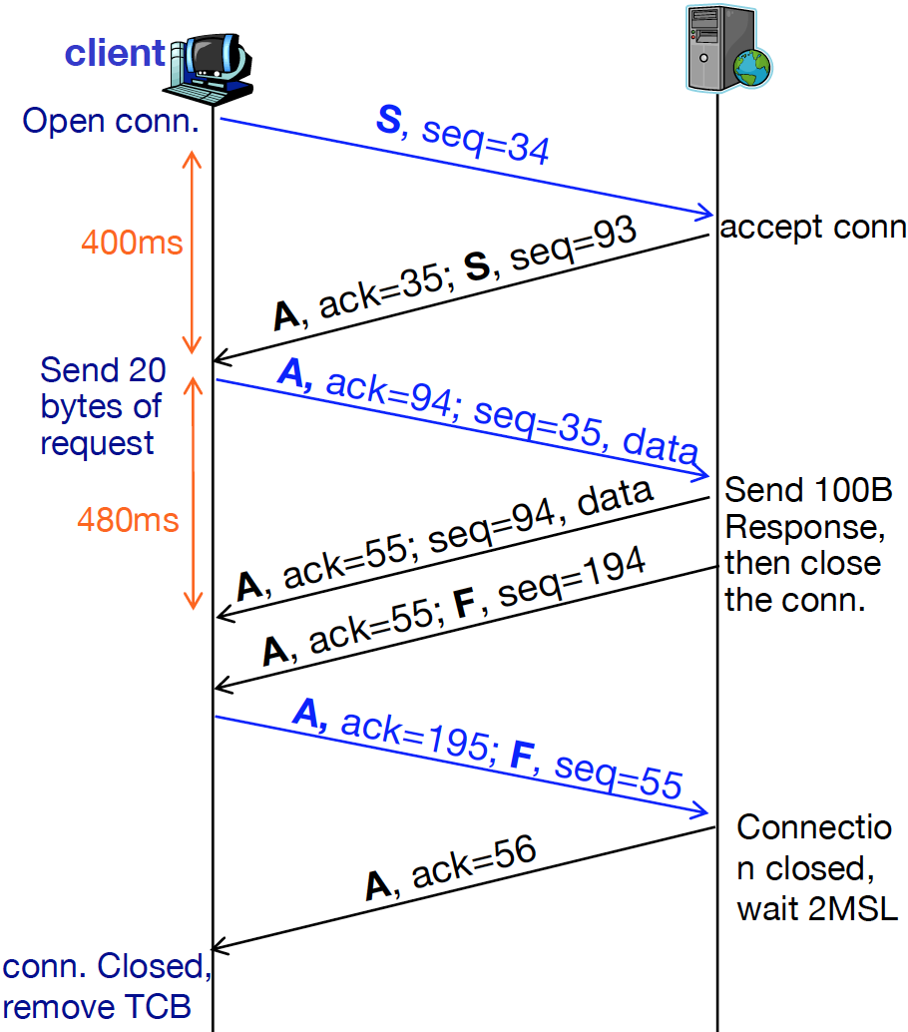

Retransmission
ACK
SEQ of the first desired byte (recved SEQ + data size)
Add 1 after SYN / FIN without data
Retransmission timer (RTO)
Too early -> Unnecessary traffic
Too late -> Wait longer
Adjusted based on estimated RTT
Typically set to a long value
Fast retransmission
Upon 3rd duplicate ACK
NOT including the original one

Slide 6
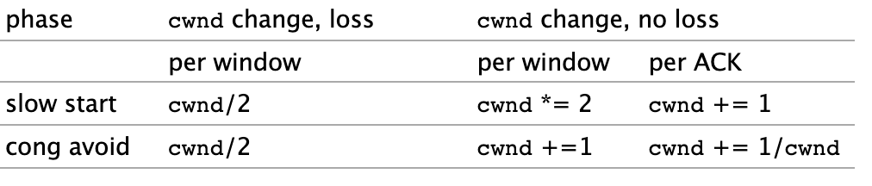
Congestion Control (slow start w/ cong. avoidance)
AIMD (cwnd >= ssthresh)
cwnd += 1MSS when all data in last RTT are ACKed
cwnd += 1/cwnd ( (1MSS)^2/cwnd in Byte)
Retransmission timer (RTO)
ssthresh = cwnd / 2
cwnd = 1MSS
Go back to Slow Start
Fast retransmission & recovery (3 dup ack)
ssthresh = cwnd / 2
cwnd = cwnd / 2
Stay in Congestion Avoidance
Slow Start (cwnd < ssthresh)
cwnd += 1 for every ACK
This doubles the cwnd per RTT

Slide 7
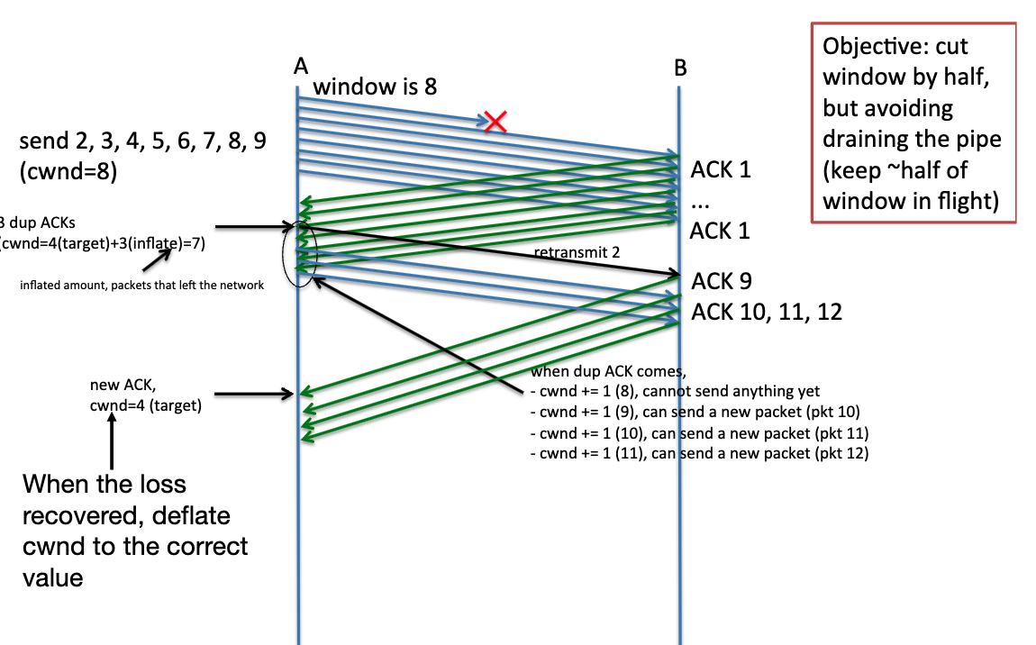
Fast recovery phase
After we see 3 dup ack
ssthresh = cwnd / 2
cwnd = cwnd / 2
Retransmit the lost packet
Enters fast recovery phase
Idea: want cwnd to reflect number of in-flight packets
dup-ACK: packets arrived
Can’t move lower bound of cwnd up
Increase the upper bound instead
Once we receive a new ACK
Cwnd is set to the cwnd before fast recovery
Send 1, 2, 3, 4, 5, 6, 7, 8

Slide 8
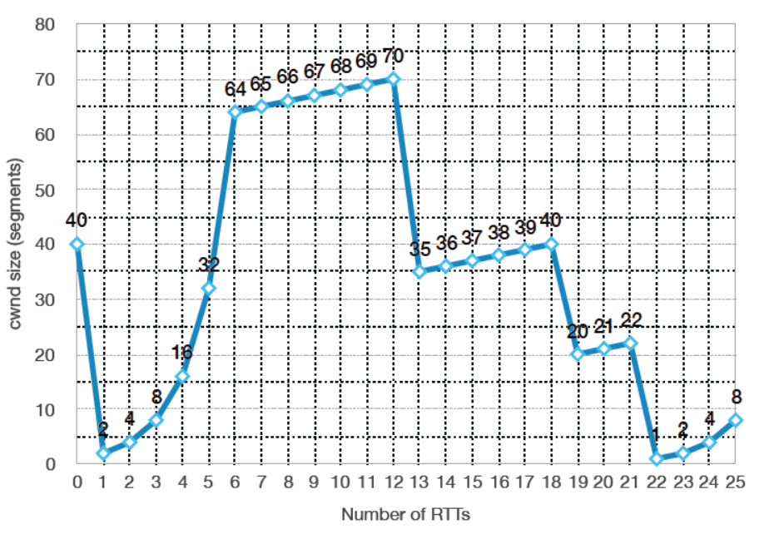
Old Homework
The time periods of Slow Start?
The time periods of AIMD?
Which losses were detected by RTO?
Which losses were detected by Fast Ret.?
For each loss, identify the ssthresh

Slide 9
Old Homework
The time periods of Slow Start?
1-6, 22-25
The time periods of AIMD?
6-22
Which losses were detected by RTO?
Which losses were detected by Fast Ret.?
For each loss, identify the ssthresh

Slide 10
Old Homework
The time periods of Slow Start?
1-6, 22-25
The time periods of AIMD?
6-22
Which losses were detected by RTO?
0, 21
Which losses were detected by Fast Ret.?
12, 18
For each loss, identify the ssthresh

Slide 11
Old Homework
The time periods of Slow Start?
1-6, 22-25
The time periods of AIMD?
6-22
Which losses were detected by RTO?
0, 21
Which losses were detected by Fast Ret.?
12, 18
For each loss, identify the ssthresh
t=0, ssthresh=40/2=20
t=12, ssthresh=70/2=35
t=18, ssthresh=40/2=20
t=21, ssthresh=22/2=11

Slide 12
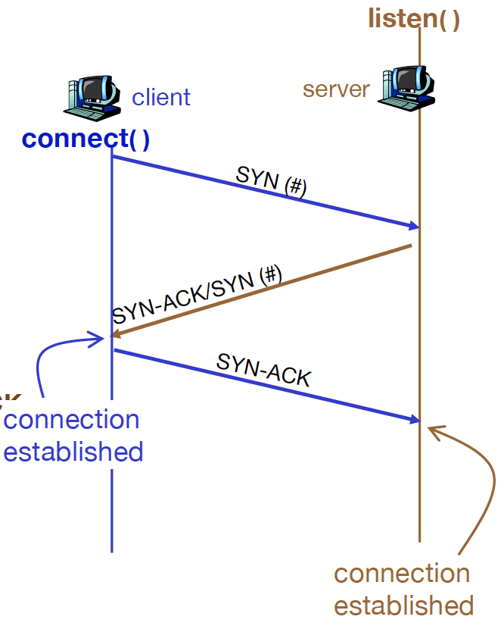
Connection Setup
Client: SYN
SYN
SEQ = random number r_{c}
No data
Server: SYN-ACK/SYN
SYN, ACK = r_{c} + 1
SEQ = random number r_{s}
No data
Client: SYN-ACK
ACK = r_{s} + 1
SEQ = r_{c} + 1
May carry data
FYI
Every packet that needs to be ACKed will take a SEQ.

Slide 13
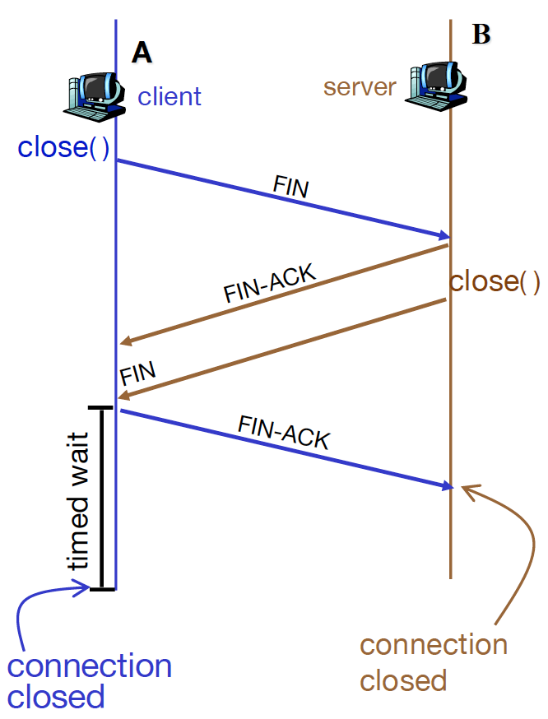
Connection Close
Does not distinguish client & server
A sends FIN
FIN (may have ACK)
SEQ = a
Cannot contain data
B sends ACK
ACK = a+1 (may have FIN)
SEQ = ? (maybe b, maybe not)
May carry data
B sends FIN
may be combined with FIN-ACK
SEQ = b
A sends ACK
ACK = b+1
SEQ = a+1

Slide 14
Simultaneous Close (FYI)
If two sides both send FIN, both sides need to wait
FIN
FIN
FIN-ACK
FIN-ACK
wait
wait

Slide 15
Old Homework
True or False?
A is sending B a large file over a TCP connection. B has no data to send A. B will not send ACKs to A because B cannot piggyback the ACK on data.
The size of rwnd never changes throughout the duration of connection
A is sending B a large file over a TCP connection. UnACKed bytes A sends cannot exceed the size of the recv buffer.

Slide 16
Old Homework
True or False?
A is sending B a large file over a TCP connection. B has no data to send A. B will not send ACKs to A because B cannot piggyback the ACK on data.
The size of rwnd never changes throughout the duration of connection
A is sending B a large file over a TCP connection. UnACKed bytes A sends cannot exceed the size of the recv buffer.
False
B always need to acknowledge
False
True

Slide 17
Old Homework
True or False?
A is sending B a large file over a TCP connection. If SEQ=m for one segment, then the next segment’s SEQ will be m+1.
TCP header has a field for rwnd
Suppose last SampleRTT=1ms, then the current RTO will necessarily be >= 1ms
A sends segment of 4B with SEQ=38. Then B’s ACK for the same segment will necessarily be 42.

Slide 18
Old Homework
True or False?
A is sending B a large file over a TCP connection. If SEQ=m for one segment, then the next segment’s SEQ will be m+1.
TCP header has a field for rwnd
Suppose last SampleRTT=1ms, then the current RTO will necessarily be >= 1ms
A sends segment of 4B with SEQ=38. Then B’s ACK for the same segment will necessarily be 42.
False
m + size of this segment
True
False
SRTT != SampleRTT
False
There may be unacked segments before

Slide 19
Old Homework
Client A (port: 34679) sends data to server B (port: 2000)
A picks SYN SEQ 1234, B 5678
Host A then sends 3 segments: 500B & 500B & 500B.
No packet loss
(SrcPort, DstPort) of B’s ACK?
SEQ and ACK of the 2nd data segment
SEQ and ACK in B’s FIN?

Slide 20
Old Homework
34679
2000
A
B
S, seq=1234
Client A (port: 34679) sends data to server B (port: 2000)
A picks SYN SEQ 1234, B 5678
Host A then sends 3 segments: 500B & 500B & 500B.
No packet loss
(SrcPort, DstPort) of B’s ACK?
(2000, 34679)
SEQ and ACK of the 2nd data segment
(1735, 5679)
SEQ and ACK in B’s FIN?
(5679, 2736)
SA, seq=5678, ack=1235
A, seq=1235, ack=5679
A, seq=1735, ack=5679
A, seq=2235, ack=5679
A, seq=5679, ack=2735
FA, seq=2735, ack=5679
A, seq=5679, ack=2736
FA, seq=5679, ack=2736
A, seq=2736, ack=5680

Slide 21
Old Homework
34679
2000
A
B
S, seq=1234
Client A (port: 34679) sends data to server B (port: 2000)
A picks SYN SEQ 1234, B 5678
Host A then sends 3 segments: 500B & 500B & 500B.
B’s FIN segment gets lost, there is only this lost packet. What happens next?
B will resend its FIN segment.
SA, seq=5678, ack=1235
A, seq=1235, ack=5679
A, seq=1735, ack=5679
A, seq=2235, ack=5679
A, seq=5679, ack=2735
FA, seq=2735, ack=5679
A, seq=5679, ack=2736
FA, seq=5679, ack=2736
X

Slide 22
Old Homework
34679
2000
A
B
S, seq=1234
Client A (port: 34679) sends data to server B (port: 2000)
A picks SYN SEQ 1234, B 5678
Host A then sends 3 segments: 500B & 500B & 500B.
B’s FIN segment gets lost, there is only this lost packet. What happens next?
SA, seq=5678, ack=1235
A, seq=1235, ack=5679
A, seq=1735, ack=5679
A, seq=2235, ack=5679
A, seq=5679, ack=2735
FA, seq=2735, ack=5679
A, seq=5679, ack=2736
FA, seq=5679, ack=2736
X

Slide 23
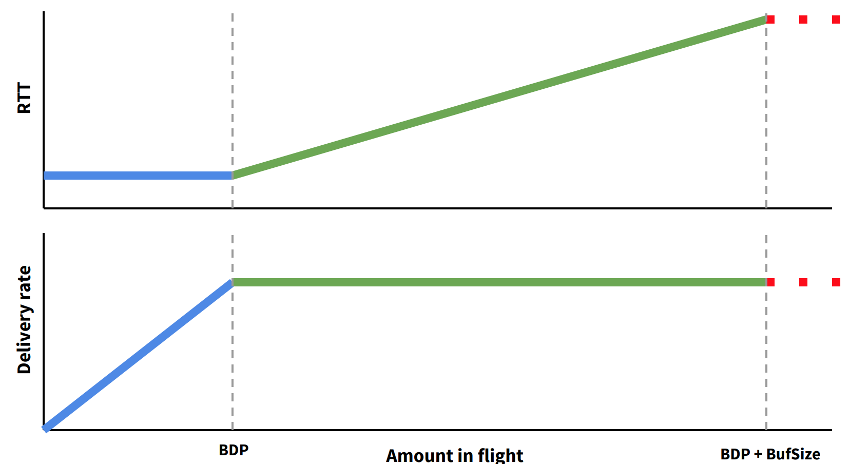
Two stages of congestion
An extra scenario to the “How network congestion happens” slide
A packet sends at t=0 will be ACKed by B at t=8ms
A received this ACK at t=14ms
14ms / (1000bits / 1Mbps) = 14
cwnd = 14 is the best option
R1-R2 is always full
If cwnd < 14, throughput < 1Mbps
If cwnd >= 14, throughput = 1Mbps (max)
If cwnd <= 14, RTT = 14ms
If cwnd > 14, RTT > 14ms (congestion@R1)
A
R1
R2
B
2Mbps 2ms
1Mbps 2ms
2Mbps 2ms
1000b
1000b
1000b
1000b

