Slide 1
CS118 Dis 1C, Week 2
Yangchao Wu
Slides credit to Xinyu Ma

Slide 2
Introduction
Yangchao Wu, 3rd year Ph.D. in CS
LA: Pranav Puranam
Discussion Session: Friday 2-4PM, Kaplan 169
Office Hours: Thursday 10-12PM, Boelter 3286S
Slides (if used) will be available on Bruinlearns
Homework and projects should be submitted via Gradescope

Slide 3
Contents
Project 0
Examples of HTTP
1.0 vs. 1.1
Web Caching: Content Delivery/Distribution Network
HOL blocking
HTTP cookie
DNS

Slide 4
Project 0
https://cs118.org/misc/sockets/
Server
Set up socket
Set socket and stdin non-blocking
Bind socket to port
While:
Receive from any clients
If connected and there is message send, print to stdout
If connected and there is message in stdin, send to client
Client
Set up socket
Set socket and stdin non-blocking
Set up server address and port
While:
Receive from server
If received anything from server, print to stdout
If there is message in stdin, send to client

Slide 5
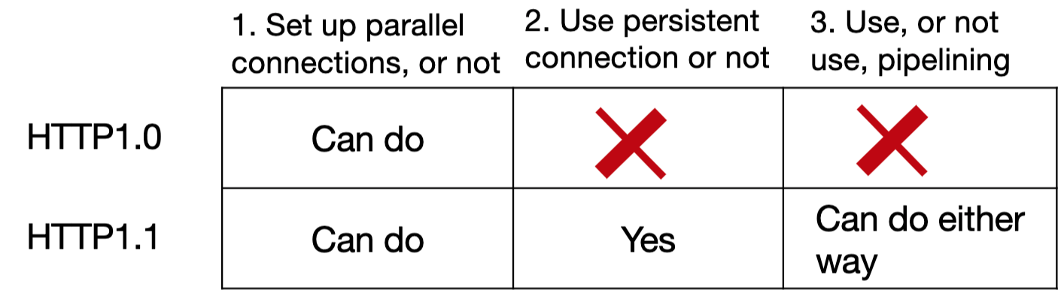
HTTP 1.0 vs 1.1
Copied from old lecture

Slide 6
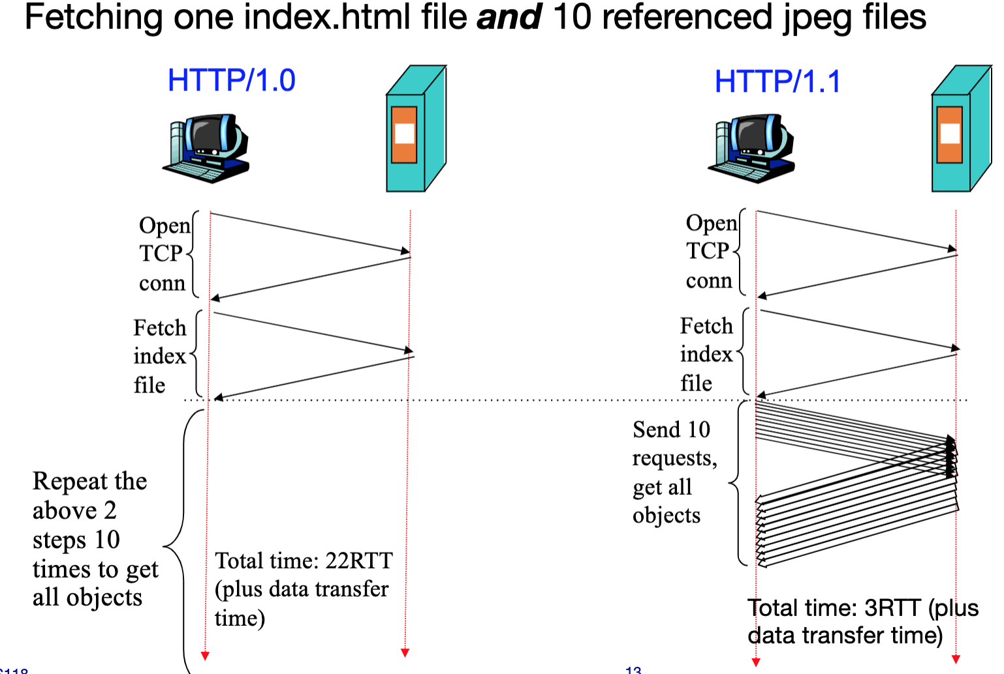
HTTP 1.0 vs 1.1
RTT is a property of network:
The time it takes for a small packet to travel from client to server and then back to the client.
≈ Sum of non-transmission delays on the round-trip path
Irrelevant of what you transmit
Time to fetch a file in an open connection = 1 RTT + Transmission time (bottleneck)
FYI: However, since RTT includes queuing delay, it is not a fixed number in real world.

Slide 7
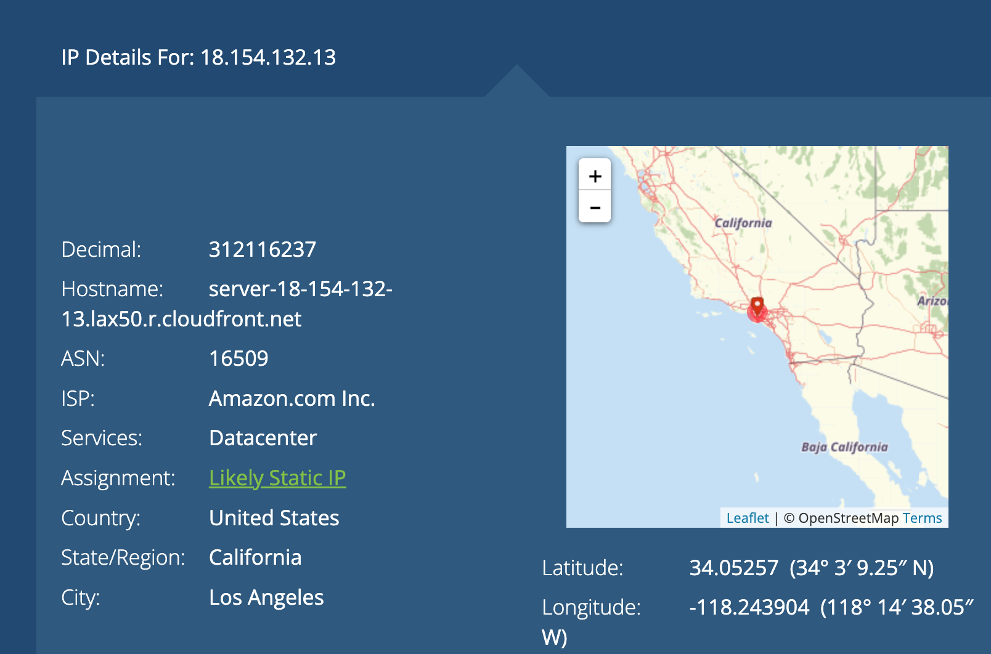
Web caching: CDN Case 1
Exploit DNS to direct your connection to a nearby CDN server
Examples:
www.ucla.edu. 60 IN CNAME d1zev4mn1zpfbc.cloudfront.net.
d2qnx9mnmqbxo6.cloudfront.net. 60 IN A 18.154.132.13

Slide 8
Web caching: CDN Case 1
CloudFront is Amazon’s CDN cache service
Serve the file directly until is expires
After the expiration, use conditional GET to check with the original web server.
CloudFront also has its own setting for caching.
age: 2185
cache-control: public
content-encoding: gzip
content-length: 16495
date: Fri, 14 Apr 2023 03:50:58 GMT
set-cookie: expires=Fri, 14-Apr-2023 05:50:58 GMT; Max-Age=7200;
Browser requested the CDN node at 21:26:23
The CDN node got the file at 20:50:58
The content expired at 22:50:58
The content could stay in any cache for at most 2 hours.

Slide 9
Web caching: CDN Case 2
Example 2: Directly embeds CDN links in HTML files
<link rel="stylesheet" type="text/css" href="https://cdnjs.cloudflare.com/ajax/libs/fancybox/3.5.6/jquery.fancybox.min.css"/>
Copied from www.ucla.edu

Slide 10
HOL blocking
Imagine a web page has a very large background image bg.png and several embedded images 1.png, …, 10.png
The browser sends requests in the order of: bg.png, 1.png, …, 10.png
HTTP/1.1 server has to responds in the order of requests: bg.png, 1.png, …, 10.png
The page does not show anything for a long time
HTTP/2.0 server could push the files before the requests come
Also, fulfill the requests in arbitrary order.
The page loads without bg.png for a short time.

Slide 11
HTTP cookie
A method for the server to identify a client
Able to provide customized service to client
Exposes client behavior to server as well
Example: Hawker center
Client send request
Server respond with ‘set-cookie’ header
Client request again with ‘cookie’ sent by server
Server is able to identify the client and do customized things

Slide 12
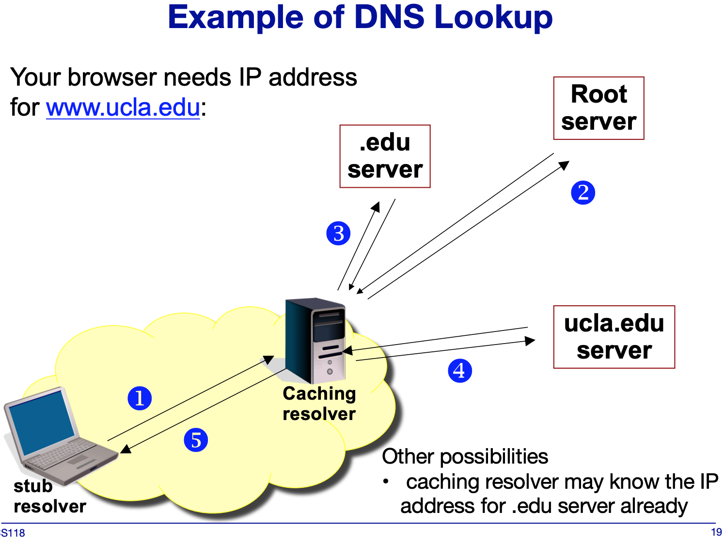
DNS
Hierarchical name space
Scalability design:
Decentralized database
Caching
Availability design
Redundancy
Caching
Note that name assignment is decentralized

Slide 13
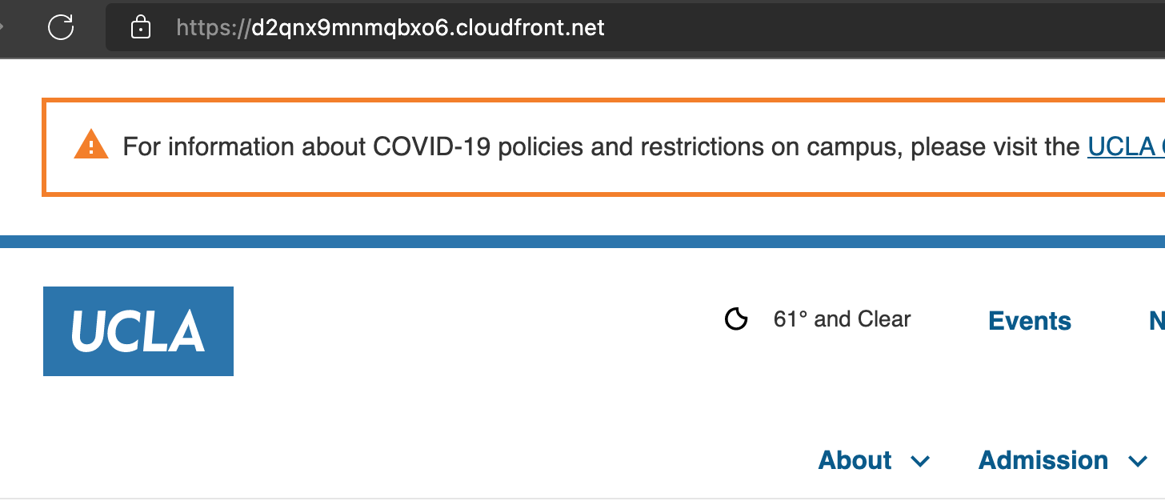
DNS
DIG experiment
dig .
dig a.root-servers.net
dig edu @198.41.0.4 (a.root-servers.net.)
dig ucla.edu @2001:503:231d::2:30 (b.edu-servers.net.)
dig www.ucla.edu @2607:f010:3fe:12:0:ff:fe01:35 (ns1.dns.ucla.edu.)
At last I get CNAME d2qnx9mnmqbxo6.cloudfront.net.
That’s how UCLA makes use of CDN

Slide 14
DNS Problem
All caches are empty
TTL values for all records is 1 hour
RTT between stub resolvers (A,B,C) and the caching resolver is 20 ms
RTT between the caching resolver and any of the authoritative name servers is 150 ms
No packet losses
No processing delays
Every organization maintains their own servers. No CNAME aliases used here.
T=0min, A sends a request for aws.amazon.com, and then for www.amazon.com. How long did it take?

Slide 15
DNS Problem
All caches are empty
TTL values for all records is 1 hour
RTT between stub resolvers (A,B,C) and the caching resolver is 20 ms
RTT between the caching resolver and any of the authoritative name servers is 150 ms
No packet losses
No processing delays
Every organization maintains their own servers. No CNAME aliases used here.
T=0min, A sends a request for aws.amazon.com, and then for www.amazon.com. How long did it take?
aws.amazon.com: 150x3+20
www.amazon.com: 150x1+20
Total: 640ms

Slide 16
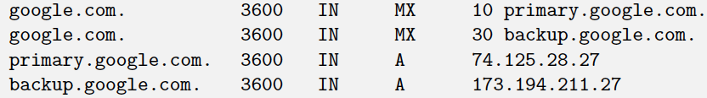
DNS Problem
All caches are empty
TTL values for all records is 1 hour
RTT between stub resolvers (A,B,C) and the caching resolver is 20 ms
RTT between the caching resolver and any of the authoritative name servers is 150 ms
No packet losses
No processing delays
Every organization maintains their own servers. No CNAME aliases used here.
T=0min, A sends a request for aws.amazon.com, and then for www.amazon.com. How long did it take?
T=40min, B queries MX for google.com and returns:
How long does it take?

Slide 17
DNS Problem
All caches are empty
TTL values for all records is 1 hour
RTT between stub resolvers (A,B,C) and the caching resolver is 20 ms
RTT between the caching resolver and any of the authoritative name servers is 150 ms
No packet losses
No processing delays
Every organization maintains their own servers. No CNAME aliases used here.
T=0min, A sends a request for aws.amazon.com, and then for www.amazon.com. How long did it take?
T=40min, B queries MX for google.com and returns:
How long does it take?
20+150x2 = 320ms

Slide 18
DNS Problem
All caches are empty
TTL values for all records is 1 hour
RTT between stub resolvers (A,B,C) and the caching resolver is 20 ms
RTT between the caching resolver and any of the authoritative name servers is 150 ms
No packet losses
No processing delays
Every organization maintains their own servers. No CNAME aliases used here.
T=0min,A queries www.amazon.com
T=40min, B queries MX for google.com
T=70min, C queries AAAA for mail.google.com; T=75min, C queries AAAA for meet.google.com. How long does each take?

Slide 19
DNS Problem
All caches are empty
TTL values for all records is 1 hour
RTT between stub resolvers (A,B,C) and the caching resolver is 20 ms
RTT between the caching resolver and any of the authoritative name servers is 150 ms
No packet losses
No processing delays
Every organization maintains their own servers. No CNAME aliases used here.
T=0min,A queries www.amazon.com
T=40min, B queries MX for google.com
T=70min, C queries AAAA for mail.google.com; T=75min, C queries AAAA for meet.google.com. How long does each take?
20+150x1 = 170ms
Note: Query for AAAA does not mean it has to connect to an IPv6 DNS server!

Slide 20
DNS Problem
All caches are empty
TTL values for all records is 1 hour
RTT between stub resolvers (A,B,C) and the caching resolver is 20 ms
RTT between the caching resolver and any of the authoritative name servers is 150 ms
No packet losses
No processing delays
Every organization maintains their own servers. No CNAME aliases used here.
T=0min,A queries www.amazon.com
T=40min, B queries MX for google.com
T=70min, C queries mail.google.com
T=75min, C queries meet.google.com
T=90min, all entries in the caching resolver:

Slide 21
DNS Problem
All caches are empty
TTL values for all records is 1 hour
RTT between stub resolvers (A,B,C) and the caching resolver is 20 ms
RTT between the caching resolver and any of the authoritative name servers is 150 ms
No packet losses
No processing delays
Every organization maintains their own servers. No CNAME aliases used here.
T=0min,A queries www.amazon.com
T=40min, B queries MX for google.com
T=70min, C queries mail.google.com
T=75min, C queries meet.google.com
T=90min, all entries in the caching resolver:
google.com/NS
google.com/MX (x2)
primary.google.com/A
backup.google.com/A
mail.google.com/AAAA
meet.google.com/AAAA

