Slide 1
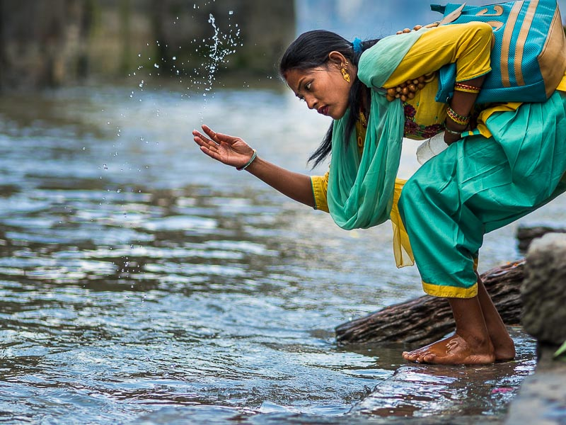


Lighting Up Nepal
An Initiative by UCL LITE
Mission Statement
Contact Us
Reducing inequalities and exclusions through, supporting people at a foundation level to, reduce poverty; promote health and well-being; improve academically; access sustainable energy and gender equality. Global development is the big picture
– UCL LITE
2016 How To Change The World Energy 2 Group 1 IEP UCL Gower Street London WC1E 6BT
Website: http://uclhenry.github.io
Email address:
zcbemak@ucl.ac.uk
zcemyqi@ucl.ac.uk
zcechsh@ucl.ac.uk
zcabyxu@ucl.ac.uk
zceensu@ucl.ac.uk
If you would like to donate skills, resources or finances please contact us through the provided details.

Slide 2
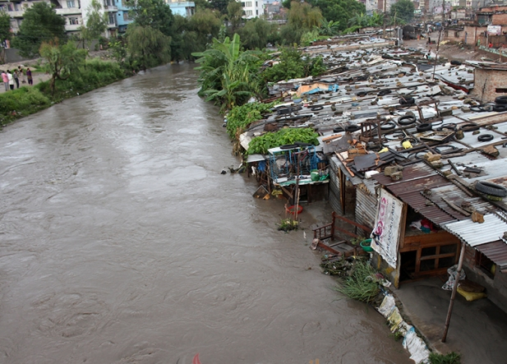
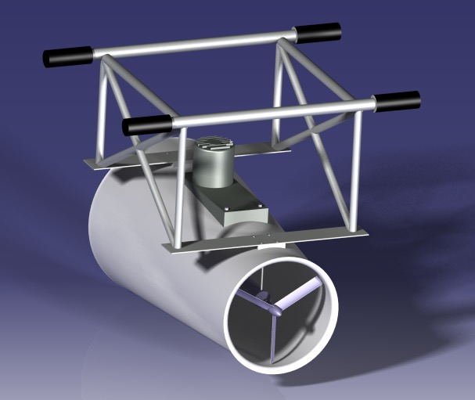
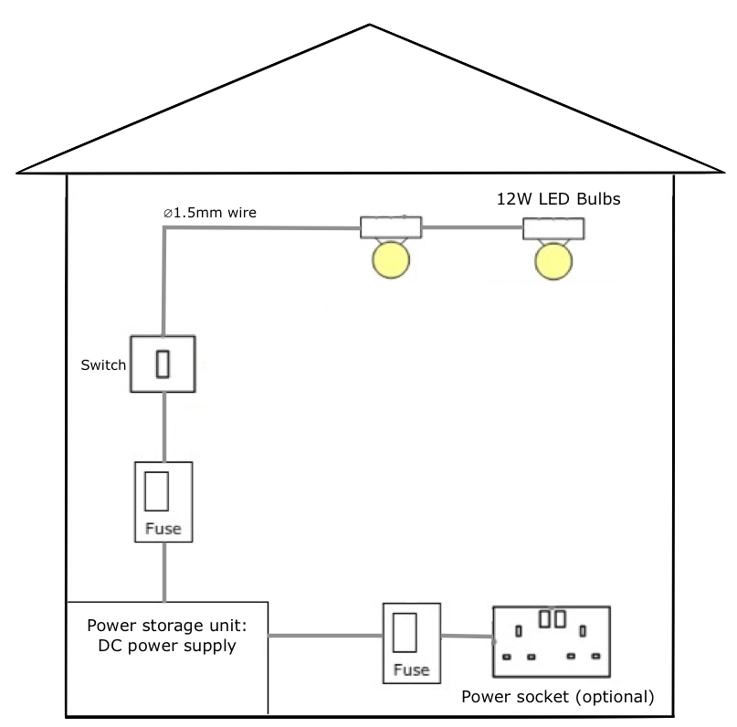
Hydroelectric Generator:
Rotor diameter = 0.5m
Big diameter = 0.7m
Small diameter = 0.55m
Length: 2m
3-blade configuration (optimum balance between the solidity, cost, efficiency and power extraction)
Fixed Pitch Blade 22º
Weight: 30kg
24 magnets poles
DC power supply:
Battery capacity: 2.5kWh
Weight: 15kg
Operating time: 5 days per 2 households
Change for IDP of Bagmati River, Katmandu
Social Sustainability: We aim to deliver symbiotic solutions with the Bagmati local culture. Implemented effectively we can deliver long term.
Reliable Lighting: Sub-par light sources has insufficient for social and educational activities, resulted in a low quality of life. We hope to promote an better home environment; and aid women and children in academic study pursuits.
Robust & Portable: Afflicted by seasonal natural disasters, settlement relocate is common. The portability and robust build of our generators helps to facilitate relocation and allow normality to recommence in a shorter time than previously possible.
Energy & Lighting Solution
Lifespan:
20 years
The ‘Lighting Up Nepal’ initiative by UCL Lite seeks to provide pragmatic solutions for energy generation that can be used for lighting the homes of internally displaced people around the Bagmati river.
Our proposed solution harnesses the kinetic energy of the already culturally important river with a locally available materials. The hydro generator will charger interchangeable batteries that will connect to dwellings to provide lighting, with hopes in the future to power other home devices in Bagmati and beyond. The project should cost £300,000 and take 6 months to implement.
Less income devoted to Lighting: Approximately 18% of each household’s income is spent on energy. We provide lighting partially subsidized, lowering their energy expenditure.
Average household area 15.75m²
4.5 people per household
3.5m² per person
2350 Lumen required
➔ sufficient for reading 400 Lumen/m²
Environmentally Safe: Current lighting methods include kerosene lamps and firewood. These pose significant risk to health from direct contact; emissions and; fire hazards. We aim to promote healthier and safer environments.
Bagmati River characteristics:
Length:196 km
Elevation: 2630m
Average width: 37m
Depth: 0.5m to 1.5m
Max. discharge: 15.28m³/s
Timely: No time wasted. We project manage to deliver fast safely and sustainably.
Energy usage per household:
6 hours of lighting per day
2x12W LED bulbs
Energy required: 0.144 kWh/day

