Slide 1

Note: The data and information in this document is reflective of a hypothetical situation and client. This document is to be used for KPMG Virtual Internship purposes only.
Sprocket Central Pty Ltd
Data analytics approach
[Division Name] - [Engagement Manager], [Senior Consultant], [Junior Consultant]

Slide 2
Note: The data and information in this document is reflective of a hypothetical situation and client. This document is to be used for KPMG Virtual Internship purposes only.
Agenda
Introduction
Data Exploration
Model Development
Interpretation

Slide 3
Note: The data and information in this document is reflective of a hypothetical situation and client. This document is to be used for KPMG Virtual Internship purposes only.
Introduction
Recommendation for Top 1000 Customers to Target from Datasets
Problem Outline
Sprocket Central marketing team is looking to boost business by analyzing their existing customer dataset to determine customer trends and behavior.
Using existing 3 datasets (Customer demographic, customer address and transactions) to recommend which of the 1000 new customers should be targeted to drive the most value for the company.
Data Analysis Contents
New and Old Customer Age Distributions
Bike related purchases over the last 3 years by gender
Job industry distributions
Wealth segmentation by age category
Number of cars owned and not owned by state
RFM analysis and customer classification
Phases
Data Exploration
Model Development
Interpretation

Slide 4
Note: The data and information in this document is reflective of a hypothetical situation and client. This document is to be used for KPMG Virtual Internship purposes only.
Data Exploration
Data Assessment and Cleaning
Key Issues
Accuracy
Completeness
Consistency
Currency
Relevancy
Validity
Uniqueness

Slide 5
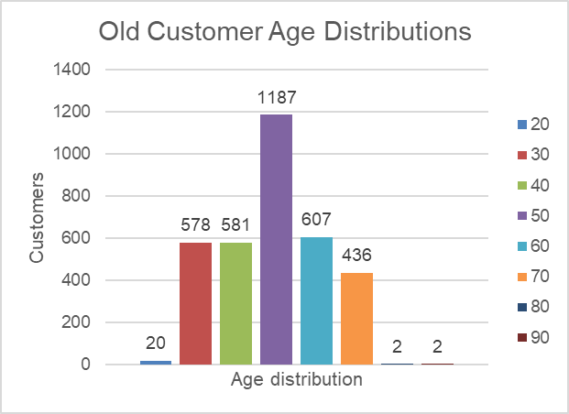
Note: The data and information in this document is reflective of a hypothetical situation and client. This document is to be used for KPMG Virtual Internship purposes only.
Data Exploration
“New” and “Old” Customer Age Distributions
Most Sprocket customers fall between age 40-49
The lowest age groups are under 20 and 80+ for both “New and “Old” customer lists
The old customer list indicates that age 20-69 are the most populated
The new customer list shows that age groups 20-29 and 40-69 are the most populated.

Slide 6
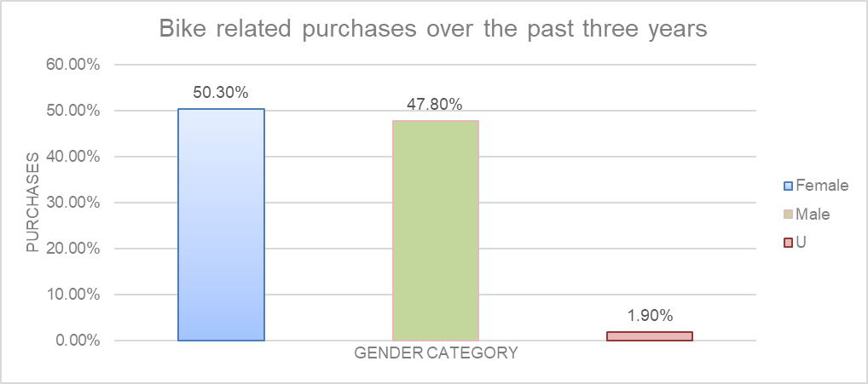
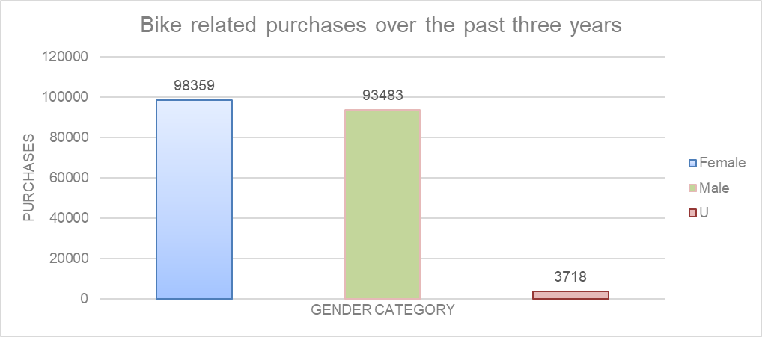
Note: The data and information in this document is reflective of a hypothetical situation and client. This document is to be used for KPMG Virtual Internship purposes only.
Data Exploration
Bike related purchases over last 3 years by gender
The bike related sales are quite close between males and females
Majority of the purchase are from females with over 50 percent of the purchase.

Slide 7
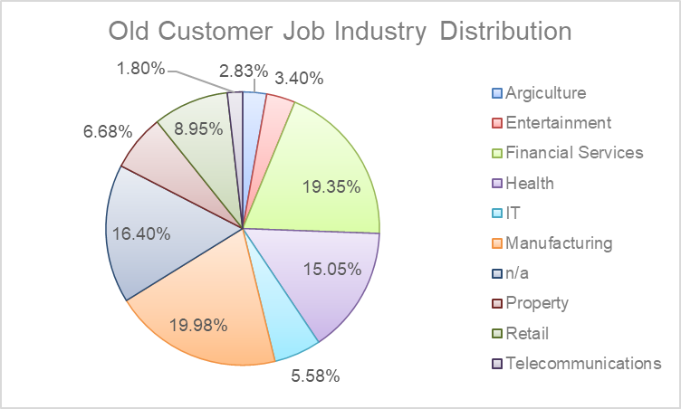
Note: The data and information in this document is reflective of a hypothetical situation and client. This document is to be used for KPMG Virtual Internship purposes only.
Data Exploration
Job Industry Distribution
Financial Services Health and Manufacturing industry account for most of the customers with over 50% old list.
The smallest number of customers come from Agriculture and Telecommunications at about 3% each.

Slide 8
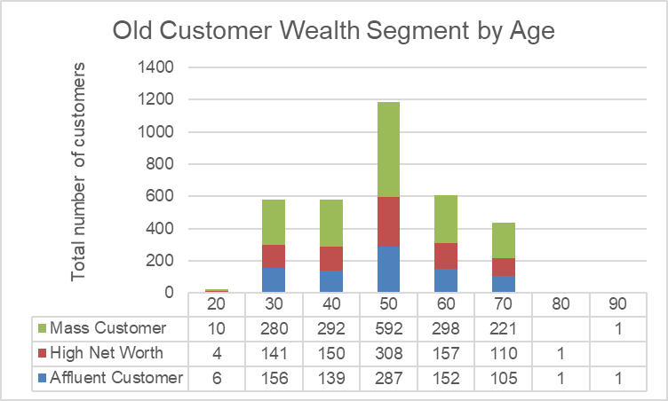
Note: The data and information in this document is reflective of a hypothetical situation and client. This document is to be used for KPMG Virtual Internship purposes only.
Data Exploration
Wealth Segmentation by age category
The largest number of customers are classified as “mass customer”
The next largest category is the “High Net Worth” customers
The age group 40-49 are the most in this group.

Slide 9
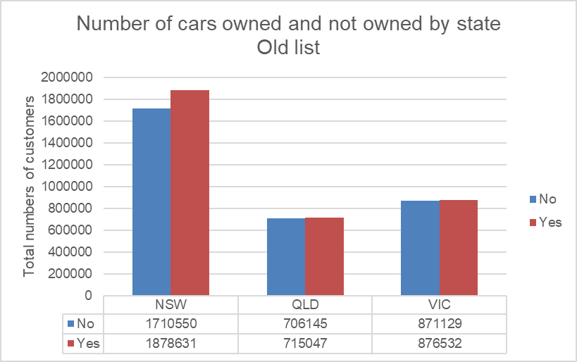
Note: The data and information in this document is reflective of a hypothetical situation and client. This document is to be used for KPMG Virtual Internship purposes only.
Data Exploration
Number of cars owned and not owned by state
Majority of the customers come from NSW.
There doesn’t seem to be a correlation between not owning a car and bike related purchases.
Majority of purchases come from people with cars.

Slide 10
Note: The data and information in this document is reflective of a hypothetical situation and client. This document is to be used for KPMG Virtual Internship purposes only.
Model Development
Customer Classification – Targeting High Value Customers
These are the high values customers that should be targeted in the new list
Most of the value came from females compared to male
Customers from Financial Services Health and Manufacturing industry
Customers aged 40-49
Customers living in NSW, VIC

Slide 11
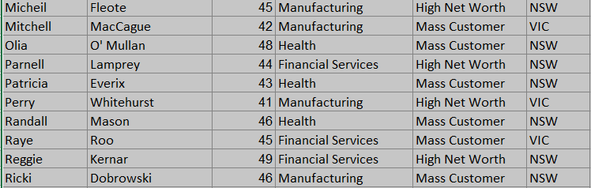
Note: The data and information in this document is reflective of a hypothetical situation and client. This document is to be used for KPMG Virtual Internship purposes only.
Interpretation
Summary Table for High Value Customers
Here is a screen shot of some customers that should be targeted based on our observation

Slide 12
Note: The data and information in this document is reflective of a hypothetical situation and client. This document is to be used for KPMG Virtual Internship purposes only.
Appendix

