Slide 1



powerbi_insight
View in Power BI
Last data refresh:
7/2/2021 12:43:45 PM UTC
Downloaded at:
7/2/2021 12:51:47 PM UTC

Slide 2
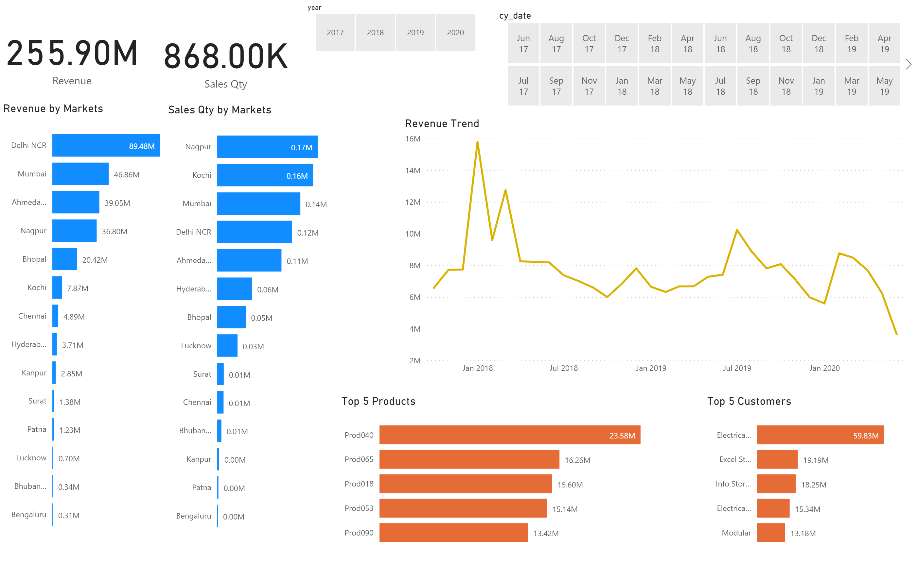
Page 1
Notes:
card
No alt text provided.
card
No alt text provided.
Top 5 Customers
No alt text provided.
slicer
No alt text provided.
slicer
No alt text provided.
Revenue by Markets
No alt text provided.
Sales Qty by Markets
No alt text provided.
Top 5 Products
No alt text provided.
Revenue Trend
No alt text provided.

