Slide 1
UCM Upsilon Pi Epsilon
Workshop Pre-Work
University of Central Missouri, Fall 2024

Slide 2
Workshop Pre-Work
Make sure you have Git installed on your machine.
Details on following slides.
Make sure you have a Github account. If you don’t you can create one here: https://github.com/signup .

Slide 3
Getting git
Mac’s have it installed.
Windows:
https://git-scm.com/download/win
Linux
Use Package Manager for your distro.
Ubuntu: $ sudo apt install git

Slide 4
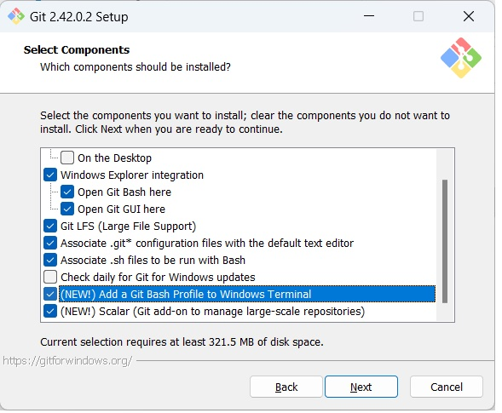
Getting git
Windows Git Installation Options
Use default, except:

