Slide 1


BLAZOR
Notes:
Hello everyone. Welcome to Aitrich Academy. Today we are discussing about Blazor.

Slide 2
Contents
01
How we develop web applications today?
06
Blazor WebAssembly
02
07
Blazor
Server side hosting Model
03
How can a browser execute C# code?
08
Razor project structure
04
09
How Create a Blazor App?
ASP.NET Core razor components
05
Blazor Hosting Models
Notes:
Contents :
This session includes the following contents :

Slide 3
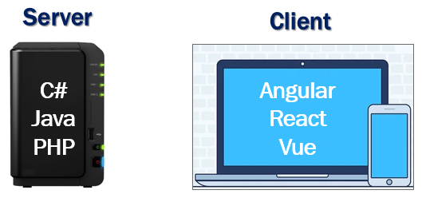
How we develop web applications today?
For server-side development, we use programming languages like C#, Java, PHP etc.
For the client-side development we use JavaScript frameworks like Angular, React, Vue etc.
To stay in the business as a developer and remain competitive, it's inevitable we learn both a server-side programming language and a client-side programming language.
But the question is, why should we learn and use 2 different sets of programming languages and frameworks.
Notes:
How we develop web applications today?
The integration of server-side development languages such as C#, Java, and PHP, alongside client-side JavaScript frameworks like Angular, React, and Vue, constitutes the backbone of our full-stack approach. As developers, the imperative to learn both sets of programming languages arises not just from industry trends but from the inherent advantages it brings to our skill set. By mastering both server and client-side languages, we ensure a diverse and adaptable proficiency that positions us competitively in the dynamic landscape of software development. This comprehensive understanding enables us to conceive, implement, and maintain end-to-end solutions, fostering efficient collaboration, effective problem-solving, and future-proofing our capabilities to navigate the ever-evolving technological terrain.

Slide 4
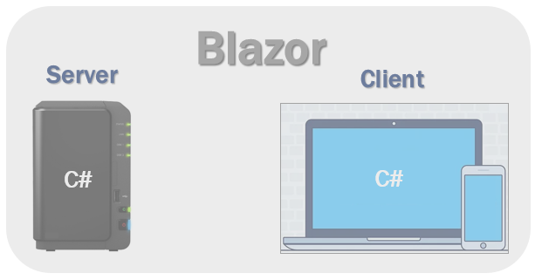
Blazor
Blazor is one of the frameworks for the .Net family for web development.
With Blazor we can now build interactive web UIs using C# instead of JavaScript
C# code can be executed both on the server and in the client browser.
Notes:
Blazor :
Imagine you want to create a website, like the ones you visit every day. Usually, people use languages like JavaScript to make these websites interactive. However, there's a framework called Blazor that lets developers use a language called C# instead of JavaScript. It's like having the option to build a website using a different set of tools. What's interesting is that with Blazor, the C# code can work not only on the server (where the website is hosted) but also directly in your web browser. It's like using a versatile tool that works in different places, making it more flexible for developers. This way, even if you're not deeply into IT, you can understand that Blazor is a cool tool that helps make websites more interactive using a language called C#.

Slide 5

How can a browser execute C# code?
Blazor can run C# code directly in the browser, using WebAssembly.
WebAssembly is based on open web standards. So it is a native part of all modern browsers including mobile browsers.
Notes:
How can a browser execute c# code?
Blazor's magic lies in its ability to run C# code directly in your web browser, thanks to something called WebAssembly. Now, don't get bogged down by the tech jargon – think of WebAssembly as a universal language understood by all modern browsers, whether on your computer or even on your mobile phone. It's like having a secret code that works everywhere, making sure that the cool interactive features developers create using C# with Blazor can be enjoyed seamlessly on any device without any extra effort. So, when you see a website doing something impressive, it might just be Blazor and WebAssembly working together to make it happen!

Slide 6

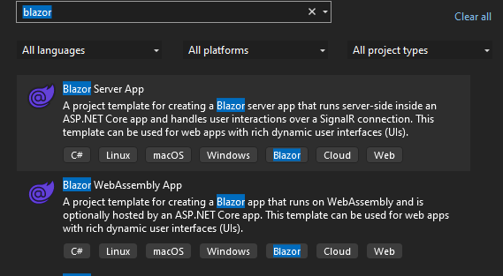
How Create a Blazor App?
The IDE Used for creating Blazor App is Visual Studio.
Notes:
How create a blazor app?
Creating a Blazor app is like setting up your own digital canvas. Begin by ensuring you have Visual Studio installed, your virtual workshop. Open it, create a new project, and choose the "Blazor App" template, providing the basic structure for your web creation. Configure the project details, decide on the hosting model (server or client), and explore the project folders, much like navigating rooms in your creative space. Finally, hit 'Run,' and witness your app come to life in your web browser. It's a fascinating journey of turning ideas into interactive web experiences using the power of C# and Blazor.

Slide 7

Blazor Hosting Models
Blazor offers 2 hosting models:
Blazor WebAssembly
( client-side hosting model)
Blazor Server
(Server-side Hosting model)
Notes:
Blazor Hosting Models :
Blazor offers two hosting models, each catering to different needs in web development. The first is Blazor WebAssembly, akin to a client-side hosting model. Picture this as your app's intelligence traveling with it, executing directly in the user's browser. On the flip side, there's Blazor Server, representing a server-side hosting model. Here, the app's logic resides on the server, communicating the results to the client. It's like choosing between sending the brain with the message (WebAssembly) or letting the server do the thinking (Server). Both models have their strengths, and the choice depends on the specific requirements of your project.

Slide 8
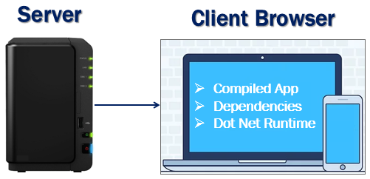
Blazor WebAssembly
Application runs directly in the browser on WebAssembly.
Everything the application needs i.e the compiled application code itself, it's dependencies and the .NET runtime are downloaded to the browser
A Blazor WebAssembly app can run entirely on the client without a connection to the server
Notes:
Blazor WebAssembly:
Blazor WebAssembly, the client-side maestro, allows applications to execute directly in your web browser using WebAssembly magic. Imagine this as delivering the entire intelligence of your application - the compiled code, its dependencies, and the .NET runtime - straight to the user's browser. It's like the app carrying its own toolkit, capable of running entirely on the client's machine without the need for a constant connection to the server. This independence brings a responsive and seamless experience, as if the application is a self-sufficient entity on the user's device.

Slide 9


Advantages and disadvantages
Active server connection is not required.
Client Resources and Capablities is used.
Full blown asp.net core web server is not required.
Can be hosted on our own webserver,cloud azure or CDN
The very First request usually takes longer.
Restricted to the capablities of the browser.
Capable client hadware and software is required
Notes:
Advantages and disadvantages :
Advantages :
No Active Server Connection Required:
One of the major perks is the independence from constant server connection. Once the app is loaded, it can operate on the client's machine without the need for a persistent server link.
Utilizes Client Resources and Capabilities:
Blazor WebAssembly maximizes the capabilities of the client's device. It harnesses the processing power and resources available on the user's browser, contributing to a responsive and dynamic user experience.
No Full ASP.NET Core Web Server Necessary:
Unlike traditional server-side applications, Blazor WebAssembly doesn't mandate a full-blown ASP.NET Core web server. This means a lighter server footprint, offering flexibility in deployment.
Versatile Hosting Options:
Blazor WebAssembly apps can be hosted in various environments, whether it's on your own web server, in the cloud using services like Azure, or even distributed globally through Content Delivery Networks (CDN).
Disadvantages :
Longer Initial Request Time:
The very first request to load a Blazor WebAssembly app typically takes longer compared to subsequent interactions. This delay is due to the need to download and initialize the application and its dependencies.
Restricted to Browser Capabilities:
The capabilities of the Blazor WebAssembly app are constrained by the capabilities of the user's browser. This might limit certain advanced features that could be available in more powerful server-side scenarios.
Client Hardware and Software Requirements:
For optimal performance, Blazor WebAssembly requires capable client hardware and software. Older browsers or devices may not provide the best experience, necessitating a certain level of client-side capability.

Slide 10
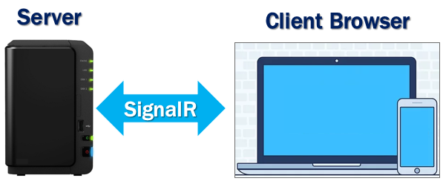
Server side hosting Model
Application is executed on the server.
Between the client and the server a SignalR connection is established.
When an event occurs on the client such as a button click for example, the information about the event is sent to the server over the SignalR connection. The server handles the event and for the generated HTML a diff (difference) is calculated. The entire HTML is not sent again to the client, it's only the diff that is sent to the client over the SignalR connection. The browser then updates the UI. Since only the diff is applied to update the UI, the application feels faster and more responsive to the user.
Notes:
Server side hosting Model :
In the Server-Side Hosting Model of Blazor, the application orchestrates its performance dance on the server. Here's the play-by-play: A dynamic SignalR connection forms the communication bridge between the client and server. When a user-triggered event, say a button click, occurs on the client, this event information is swiftly dispatched to the server via SignalR. Here's the brilliance - the server then takes charge, handling the event and calculating only the difference (diff) in the generated HTML. Instead of sending the entire HTML back, it sends just the changes to the client over the SignalR connection. Think of it like sending only the script changes for a movie rather than the entire film. This selective update makes the application feel faster and more responsive to users, enhancing their overall experience. It's a smart, behind-the-scenes choreography that keeps the user engaged without unnecessary data transfer.

Slide 11
Advantages and disadvantages
Application loads much faster.
can take full advantages of server capablities.
All the client needs,to use the app is browser.
More secure as the app code is not sent to the client
Asp.Net core web server is required.
An active connection t the server is required.
Higher latency due to the round trip to the server.
Scalablity can be challenge
Notes:
Advantages and disadvantages :
Advantages :
Faster Initial Load:
The application loads faster initially since the client only needs to download the essential UI components, and the heavy lifting happens on the server.
Leverages Server Capabilities:
Takes full advantage of server-side capabilities, utilizing server resources for processing and executing application logic.
Minimal Client Requirements:
Users only need a browser to access the application, as most of the processing is handled on the server side.
Enhanced Security:
Security is bolstered as the application code remains on the server, reducing the risk of exposing sensitive information to the client.
Disadvantages :
Dependence on ASP.NET Core Web Server:
Requires a full ASP.NET Core web server to host the application, limiting deployment options compared to more versatile hosting in Blazor WebAssembly.
Active Connection Requirement:
Relies on an active connection to the server, meaning users need to be online for the application to function.
Higher Latency:
Involves a round trip to the server for each user interaction, leading to higher latency compared to client-side models, potentially impacting real-time responsiveness.
Scalability Challenges:
Scaling server-side hosted applications can be challenging, as increased user load directly impacts server resources. This might require additional measures for efficient scaling.

Slide 12

Blazor project structure
Program.cs:contains the Main() method which is the entry point for both the project types
wwwroot:For both the project types, this folder contains the static files like images, stylesheets etc.
App.razor:This is the root component of the application. It uses the built-in Router component and sets up client-side routing.
Notes:
Blazor Project structure :
1.Program.cs - The Entry Point:
Picture Program.cs as the backstage manager of our Blazor show. It holds the Main() method, the entry point for both types of Blazor projects – WebAssembly and Server. It's where the curtain lifts and our application begins.
2. wwwroot - The Asset Repository:
Now, let's step into wwwroot – the storage room for all things static. This is where images, stylesheets, and other static files reside. It's like the dressing room for our application's visual elements.
3. App.razor - The Maestro Component:
App.razor is the conductor of our application symphony. As the root component, it orchestrates everything. It utilizes the built-in Router component, setting the stage for client-side routing. Think of it as the musical score determining how our application's scenes unfold.

Slide 13

Pages folder:This folder contains the _Host razor page and the routable components that make up the Blazor app. The components have the .razor extension.
Shared folder:As the name implies, contains the shared components(MainLayout componen(MainLayout.razor),NavMenu component (NavMenu.razor))
_Imports.razor:contains the common namespaces so we do not have to include them in every razor component.
Notes:
4.Pages Folder - The Storytelling Arena:
Head over to the Pages folder – this is where our application's story unfolds. It houses the _Host razor page, a crucial starting point for our app, and various routable components (.razor files). Each of these components represents a scene or functionality in our Blazor app, bringing our narrative to life.
5. Shared Folder - Collaboration Space:
Now, let's peek into the Shared folder – a collaborative space for shared components. Here, we find the MainLayout component (MainLayout.razor), acting as the visual template for our app's layout. Additionally, we have the NavMenu component (NavMenu.razor), serving as the navigator for our app's users. It's like the shared props and set design that make each scene seamless and cohesive.
6. _Imports.razor - The Efficiency Booster:
Finally, meet _Imports.razor – the efficiency booster. It's like a backstage pass that contains common namespaces shared by our razor components. By having them here, we avoid the need to include them in every single razor component file. It streamlines our code, making it cleaner and more maintainable.

Slide 14

wwwroot/index.html:This is the root page in a Blazor WebAssembly project and is implemented as an html page.
Pages/_Host.cshtml:This is the root page of the application and is specified by calling MapFallbackToPage("/_Host") method. It is implemented as a razor page.
Notes:
7. wwwroot/index.html - The WebAssembly Welcome Mat:
Step into wwwroot, and you'll find index.html, the heart of a Blazor WebAssembly project. This is where the journey begins, serving as the root page. It's like the welcoming doormat of our WebAssembly-powered app, inviting users to step into the Blazor experience.
8. Startup.cs - Crafting the App's Genesis:
Enter Startup.cs, the mastermind behind our app's startup logic. It wears two hats - ConfigureServices configures the application's Dependency Injection (DI) services, ensuring components talk seamlessly. Meanwhile, Configure sets up the app's request processing pipeline, orchestrating how it handles incoming requests. It's like the architect laying the groundwork for our app's structure and functionality.
9. Pages/_Host.cshtml - The Razor Root Page:
Lastly, open the Pages folder to discover _Host.cshtml – the razor root page of our application. It's specified by calling MapFallbackToPage("/_Host") method, acting as the home base. Implemented as a razor page, it sets the stage for our Blazor WebAssembly project, providing the foundation for the user interface.

Slide 15

Data folder (Blazor Server):Contains code files related to the sample WeatherForecast service
appsettings.json (Blazor Server):uses this file to store the Configuration settings.
Notes:
10. Data Folder - The WeatherForecast Warehouse:
Dive into the Data folder within a Blazor Server project, and you'll discover a treasure trove of code files related to the WeatherForecast service. Think of this folder as the warehouse where our application stores and manages data related to weather forecasts. It's where the magic happens behind the scenes to keep users updated on the latest weather conditions.
11. appsettings.json - The Configuration Keeper:
Now, let's explore appsettings.json – the keeper of configuration settings in a Blazor Server project. It's like a control panel where we store various configurations needed for our application to run smoothly. Whether it's database connections, API keys, or any other settings, appsettings.json is the go-to file for managing them.

Slide 16

ASP.NET Core razor components
Components are the fundamental building blocks of a Blazor application.
They can be nested, reused, and if implemented properly, can even be shared across multiple projects.
Component files have the extension .razor
Component names cannot start with a lowercase character
Notes:
ASP.NET Core razor components:
Components - The Blueprint of Blazor:
Components are the heart and soul of a Blazor application. Picture them as the building blocks that define the structure, behavior, and appearance of various parts of your app. Whether it's a button, a form, or an entire section, components are the architects that bring your app to life.
Nesting and Reusability:
What's fascinating is that components can be nested within each other. It's like having smaller Lego pieces fitting perfectly into a larger structure. This nesting capability allows for creating complex and modular designs. Additionally, components can be reused across different parts of the app, enhancing efficiency in development.
Extension: .razor - The Signature File Format:
Recognizing a component is easy – just look for the .razor extension. This extension signifies that you're dealing with a special kind of file that defines a Blazor component. It's like the signature that tells you, "This is where the magic happens.“
Naming Conventions:
One little quirk to remember – when naming components, they cannot start with a lowercase character. It's like a naming rule that ensures clarity and consistency in your code.
. Share the Wealth - Cross-Project Component Sharing:
Perhaps the most exciting part is that if you design your components wisely, they can be shared not just within a single project but across multiple projects. It's like having a set of universal building blocks that architects can use in various constructions.

Slide 17
Componet is combination of two things:
01
HTML markup which defines the user interface of the component i.e the look and feel.
02
C# code which defines the processing logic
Component is rendered by giving path in the @page directive
Notes:
Component is combination of two things :
Component Composition:
At its core, a Blazor component is a harmonious blend of two essential elements. First, we have the HTML markup, serving as the visual identity that defines how the component looks and feels. This is where we design the user interface, specifying buttons, forms, and other visual elements.
The Brain Behind - C# Code:
Complementing the HTML markup is the C# code, which acts as the processing logic for the component. It's the brain behind the beauty, defining how the component behaves, handles user interactions, and processes data. This dynamic duo of HTML and C# creates a powerful synergy within each component.
Rendering Magic - @page Directive:
Now, let's talk about how these components come to life. A component is rendered by specifying its path in the @page directive. It's like providing the GPS coordinates for where your component should appear in the grand stage of your Blazor application

Slide 18

Notes:
Thank you for joining this session.

