Slide 1

HEARTBIT

Slide 2
Who we are
Sergi Sales Jové
Guillem Felis
Joan Martí
Àiax Faura

Slide 3
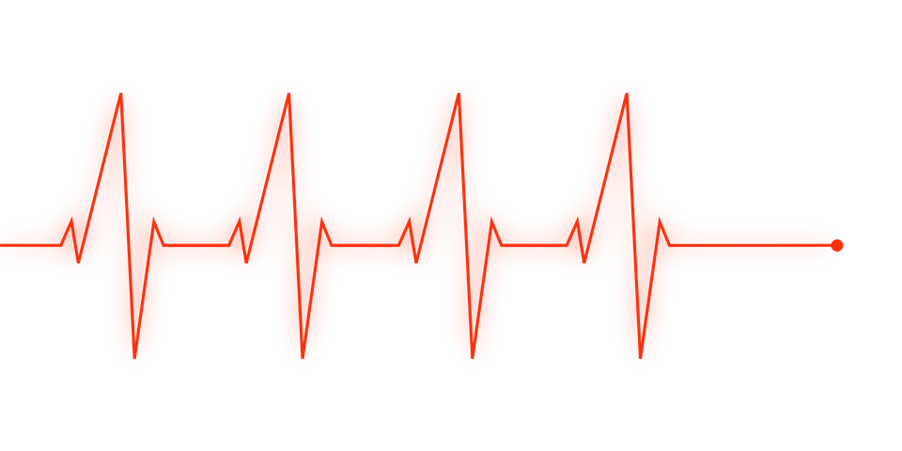
What is this?
?

Slide 4
Beat vs. Rhythm
Beat
It’s a steady and REGULAR PULSE we hear in music.
Rhythm
The actual FLOW of the music through time.

Slide 5
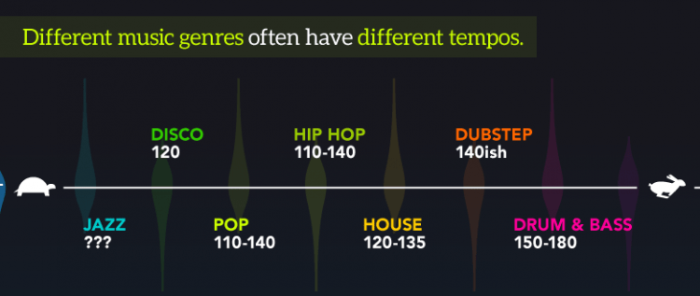

Slide 6
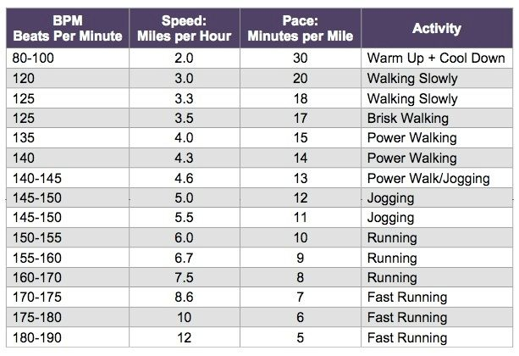

Slide 7
Why Music?
We can think of music as “a type of legal performance-enchanting drug”.
Dr. Costas Karageorghis
(world-leading resercher on music performance)

Slide 8

Our idea
Using music as a reenforcement to sports, not only a distraction.
Constant beats that follows (and lead) your heartbeats.

Slide 9
How does it work?
Recording your heartbeats with an smartwatch.
With a constant pulse and some tracks to build on top of that.
And a lot of rhythm!

Slide 10

After the first 36 hours….
Where’s the next step?

Slide 11
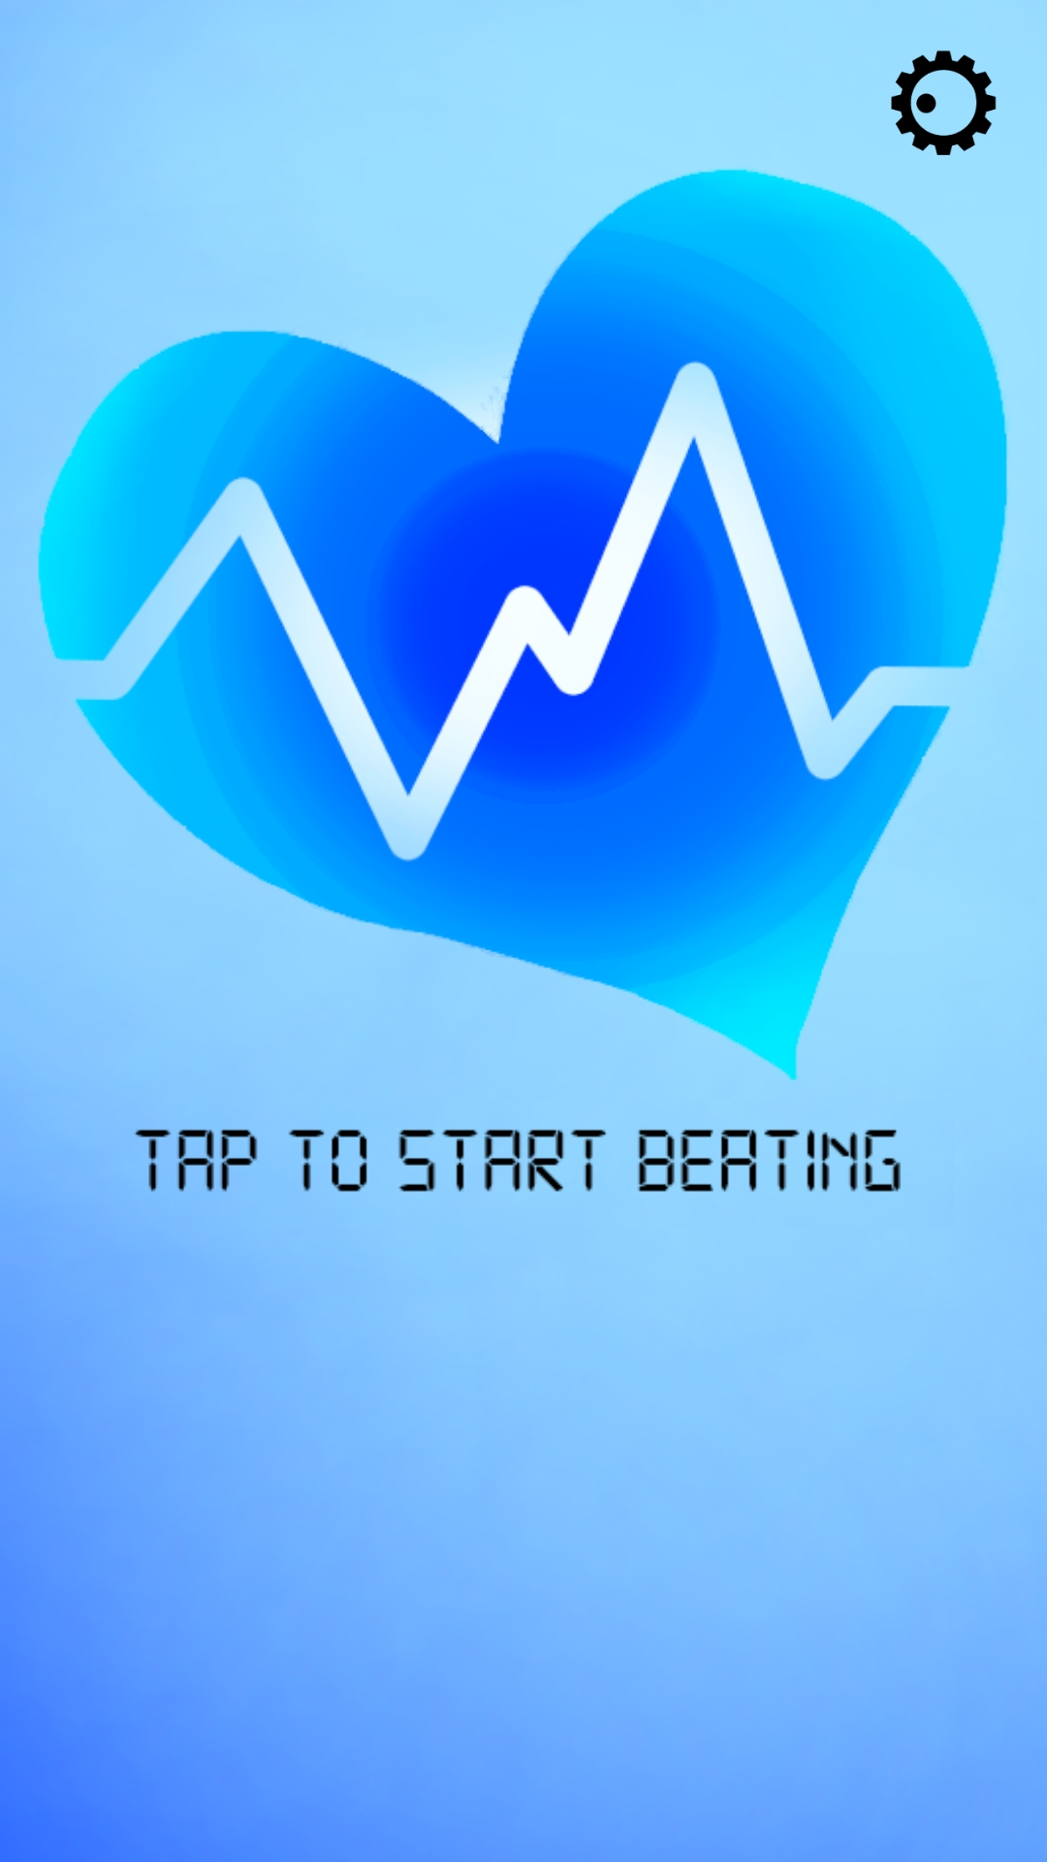
What is the final product?
A mobile app, working with your smartwatch, offering music, consistance and improvement.

Slide 12
Thanks!
Any questions?

