Slide 1
Runapong
A Ucode 2019 project

Slide 2
What we have planned…
A little bit of motivation
What is Runapong?
How does it work?
The future
Monetization

Slide 3
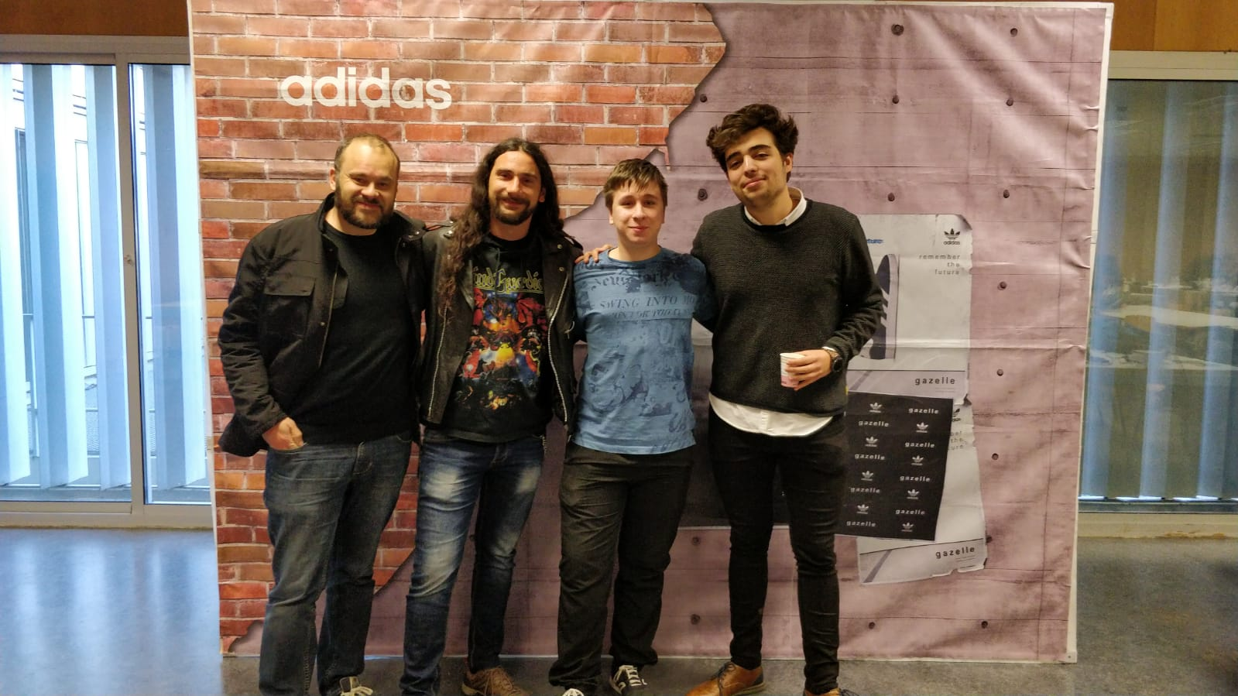
Who are we?
David Manero
Víctor M.
Lafuente
Enrique Torres
Pedro Malo

Slide 4
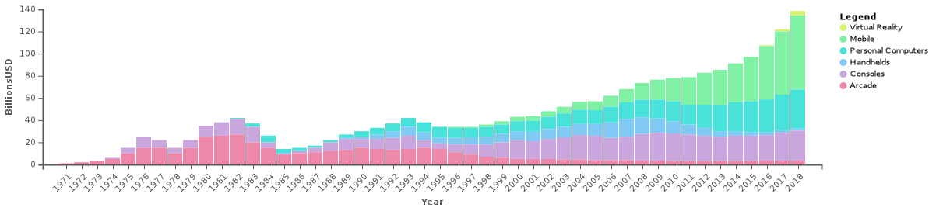
A Little bit of motivation…

Slide 5
A Little bit of motivation…
The gaming industry is growing exponentially.
It doesn’t only attract young people. Many games and gaming products have attracted many people from very varied ages.
It brings people together.
It brings joy to those who play.

Slide 6
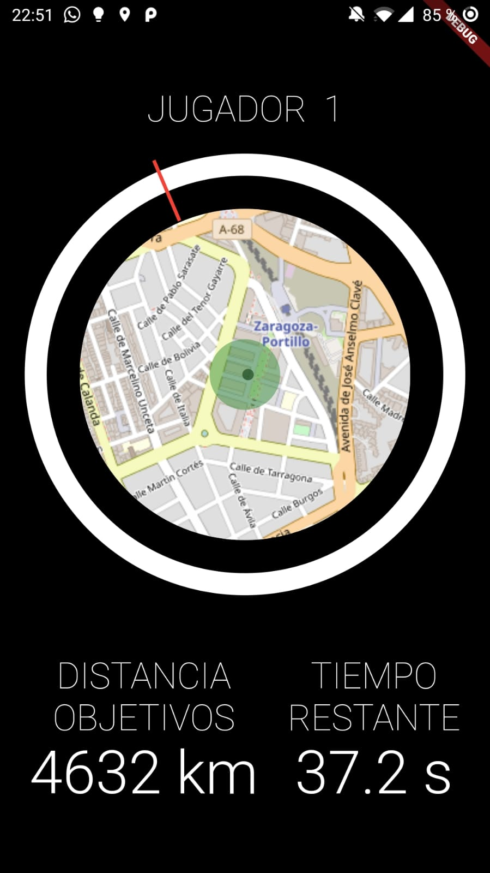
What is Runapong?
Fast paced, augmented reality / virtual sport.
Train your body and your mind.
Meet new people and make friends.
Have fun not only competing against others, but also improving your abilities, everything while getting in shape.

Slide 7
What is Runapong… and how it came to be
We thought about the idea of integrating sports and gamification.
We wanted to make people move and get fit, all while having fun and thinking outside the box.
We thought about competition, adventure and fitness, with a touch of social networking.

Slide 8
What is Runapong… The rules
Shoot a virtual ball, make your opponent run far and fast.
If your opponent reaches the ball and hits it, search for the ball, run for it and repeat the process.
If you don’t reach the ball under the specified time, you lose! So remember to go fast, to be smart and to shoot strong and well!
Last and most important rule: have fun and practice an outdoor sport, meet new people and make friends.

Slide 9
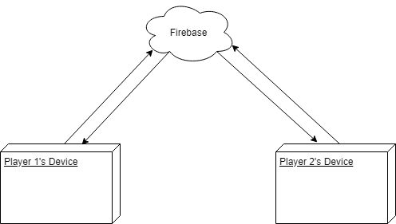
How does it work?
Matchmaking through Firebase
Calculation of acceleration and distance traveled by the ball with sensors (currently the cellphone’s accelerometer).

Slide 10
How does it work?
Let’s demo it.

Slide 11
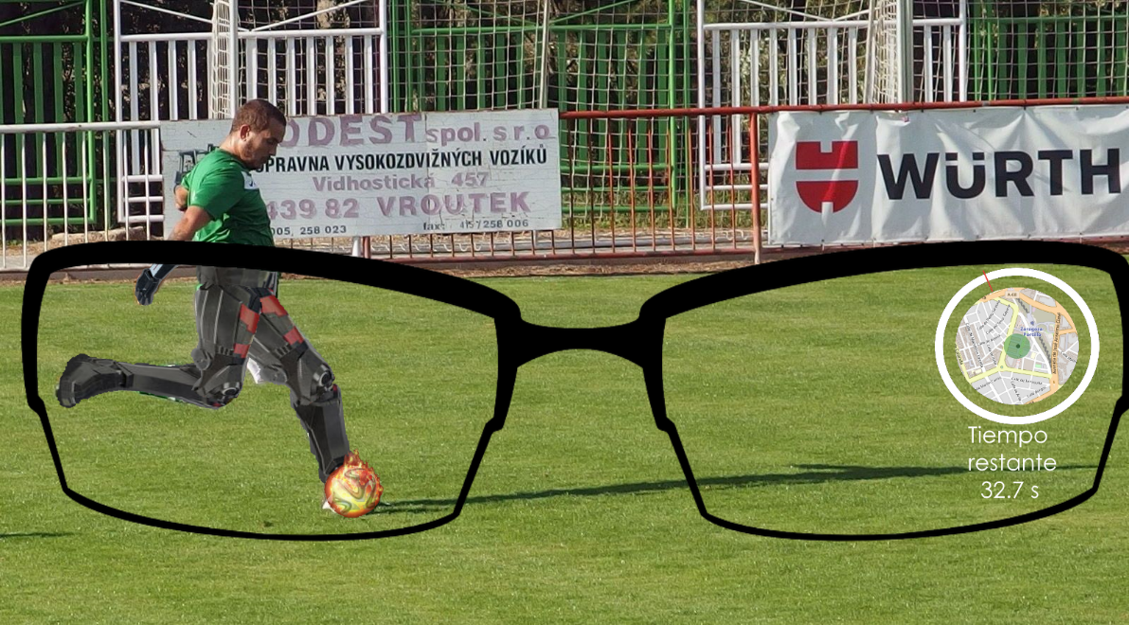
The future
This project is aimed at augmented reality.
Seeing the compass on the lens of an AR pair of glasses.
Seeing the ball superposed on the real world and being able to interact with it.
Visual effects and superimposing clothes and suits on other players with AR.
Using sensors to read more accurate data and transform the game into several sports depending on where you place the sensors.

Slide 12
The future
Check the movements of the player against a huge database of recorded movements of professional players, and evaluating whether the shot was good or bad depending on the results.
More game modes, like dodgeball or finding a ball every once in a while you’re running outside, which you can shoot, and that has information of all the places around the world that it’s been in.

Slide 13
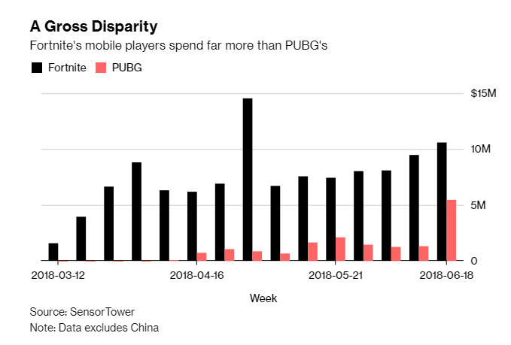
Monetization

Slide 14
Monetization
Skins!
Visual effects.
Products from sponsorships with companies like Adidas, that give you special effects or power ups.
Products from sponsorships that give you more statistics about your shots, with more precision (like sneakers with sensors, for example).

Slide 15
Why is this different?
It’s a project that really looks into the future of sports and lifestyle in general.
It’s a new spin to gamification, as well as to virtual fitness.
Endless possibilities of expansion. The imagination is the only limitation.
There’s nothing like this out in the current market.

