Slide 1


The Big Picture:
Beyond Connecticut’s
Borders
Michael Willig
Director of the Center for Environmental Sciences & Engineering
Distinguished Professor of Ecology & Evolutionary Biology
John Volin
Vice Provost for Academic Affairs
Professor of Natural Resources & the Environment

Slide 2
In Your Students’ Lifetimes
Global climate change with warming of at least 2ºC; high variability in weather patterns (temperature and precipitation)
More than 2 billion people, mostly poor, added to world population
Massive migration, as well as widespread food and water shortages
The loss of one of every five species

Slide 3
Climate
Change
Land Use
Change
Water
Dynamics
Sustainability

Slide 4
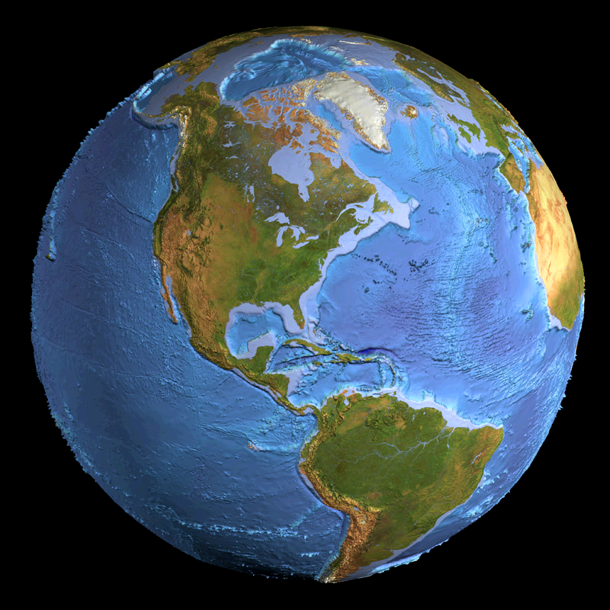
Global Connections
Atmosphere
Hydrosphere
Biosphere

Slide 5
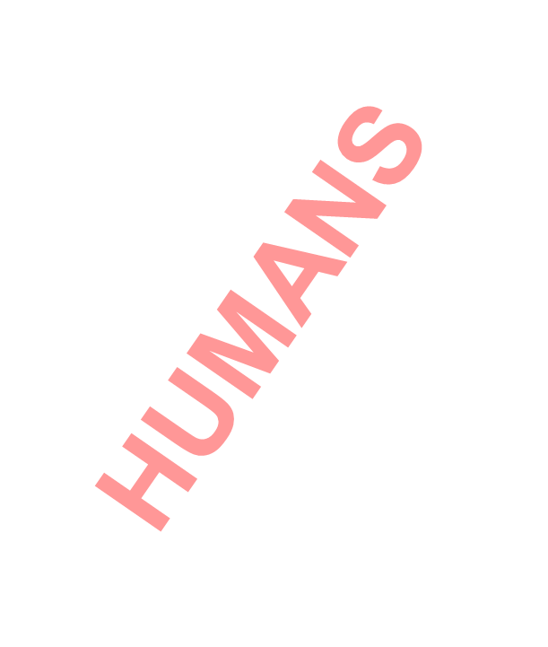
Global Connections
Atmosphere
Hydrosphere
Biosphere

Slide 6
Global Connections
Atmosphere
Hydrosphere
Biosphere
Global Responsibility

Slide 7
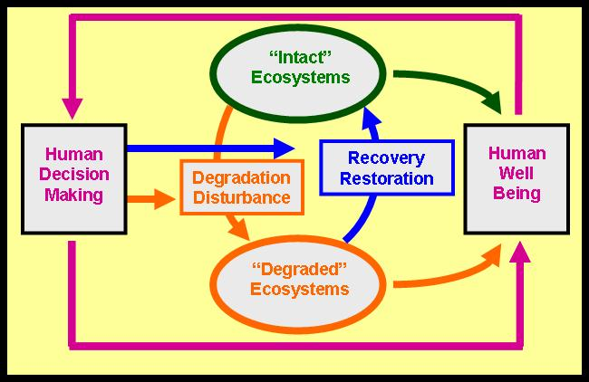
Social Ecological System
Conceptual Model (Willig & Scheiner, 2011) identifies key linkages between human and natural systems that together constitute dynamic social ecological systems and represent the basis for sustainability.

Slide 8

Sustainable Water Resources
“Intact” Water Resources
Degradation & Disturbance
Recovery & Restoration
Human Decision-making & Action
Human Well-being
Impaired Water Resources

Slide 9
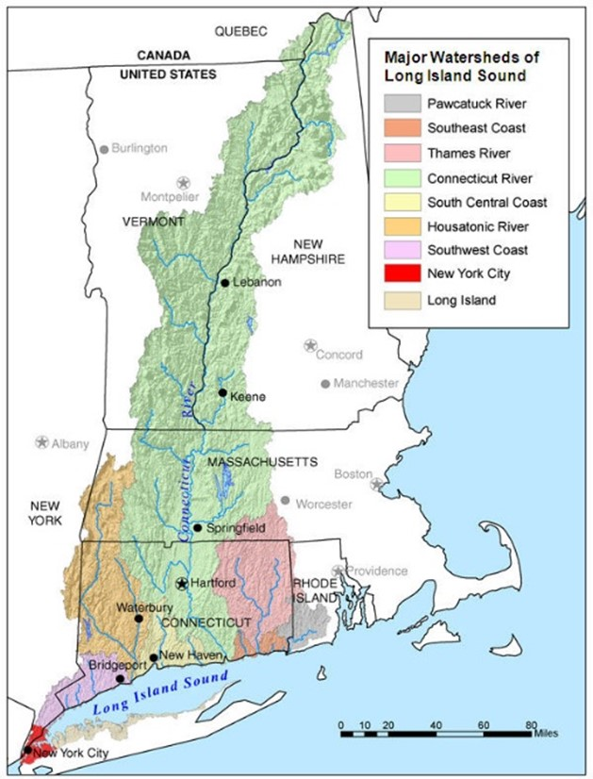
Long Island Sound
Watersheds

Slide 10
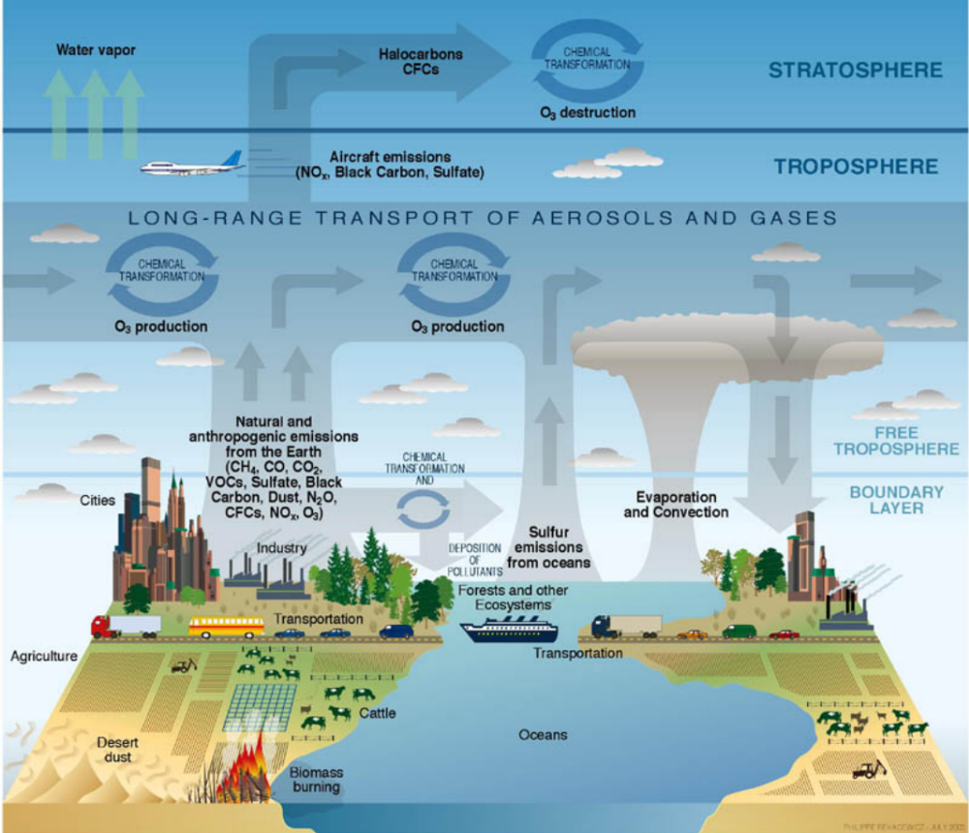
All Things Are Connected

Slide 11
Focal
Question
1. What will happen to water resources as population and development continue to expand?

Slide 12
Focal
Question
2. What (legal, cultural, technological, etc.) need to occur if water resources are to be protected?

Slide 13
Focal
Question
3. What role can geospatial technology play in regard to the two previous questions?

Slide 14
What is Sustainability?

Slide 15
What Is the Relationship Between
Desirability
and
Sustainability?

Slide 16
Pillars of Sustainability
Understand the System
Live on the Interest
Values Determining Use

Slide 17
Societal Values
Declaration of Sustainability
We hold these truths to be self-evident, that all people are equal, and that they are endowed … with certain inalienable rights including clean air, clean water, food, living space, and access to nature. Moreover, future generations are empowered by an equivalent suite of rights, leading to long-term sustainability.

Slide 18
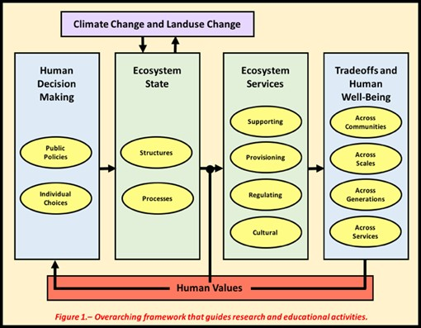
Social Ecological System
Ecosystem Services

