Slide 1
CE100 Algorithms and Programming II
Introduction to Analysis of Algorithms Author: Asst. Prof. Dr. Uğur CORUH

Slide 2
CE100 Algorithms and Programming II

Slide 3
Week-1 (Introduction to Analysis of Algorithms)
Spring Semester, 2021-2022
Download DOC, SLIDE, PPTX

Slide 4
Brief Description of Course and Rules
We will first talk about,
Course Plan and Communication
Grading System, Homeworks, and Exams
please read the syllabus carefully.

Slide 5
We Need Mathematical Proofs
Direct proof
Proof by mathematical induction
Proof by contraposition
Proof by contradiction
Proof by construction
Proof by exhaustion
Probabilistic proof
Combinatorial proof
Nonconstructive proof
Statistical proofs in pure mathematics
Computer-assisted proofs
Mathematical proof - Wikipedia

Slide 6
Introduction to Analysis of Algorithms

Slide 7
Outline
Study two sorting algorithms as examples
Insertion sort: Incremental algorithm
Merge sort: Divide-and-conquer
Introduction to runtime analysis
Best vs. worst vs. average case
Asymptotic analysis

Slide 8
What is Algorithm
Algorithm: A sequence of computational steps that transform the input to the desired output
Procedure vs. algorithm An algorithm must halt within finite time with the right output
We Need to Measure Performance Metrics
Processing Time
Allocated Memory
Network Congestion
Power Usage etc.

Slide 9
Example Sorting Algorithms
Input: a sequence of n numbers
$$⟨a_{1},a_{2},...,a_{n}⟩$$
Algorithm: Sorting / Permutation
∏=⟨1​,2​,...,n​⟩
Output: sorted permutation of the input sequence
$$⟨a_{\underset{\left(1\right)}{∏}}≤a_{\underset{\left(2\right)}{∏}}≤,...,a_{\underset{\left(n\right)}{∏}}⟩$$

Slide 10
Pseudo-code notation
We can use Flowgorithm - Flowchart Programming Language
Objective: Express algorithms to humans in a clear and concise way
Liberal use of English
Indentation for block structures
Omission of error handling and other details (needed in real programs)

Slide 11
Pseudocode Links to Visit
Pseudocode - Wikipedia
Pseudocode Examples
How to write a Pseudo Code? - GeeksforGeeks

Slide 12
What is the processing time ?
alt:“processing time map” height:550px center

Slide 13
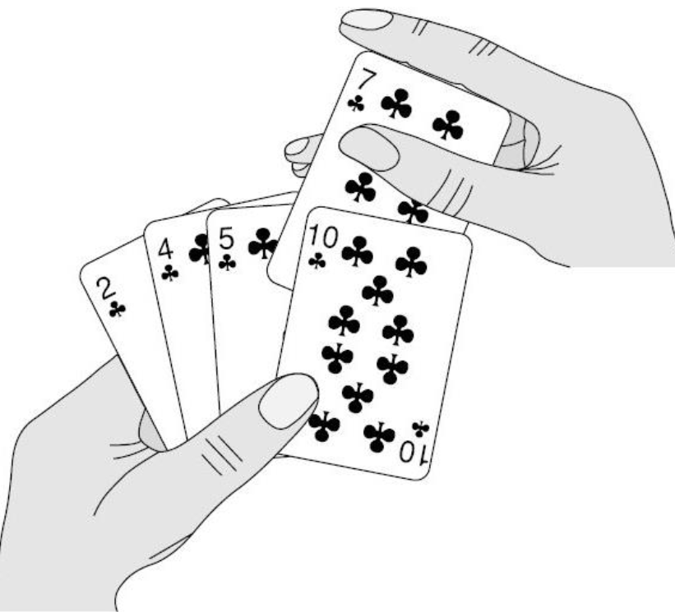
Insertion Sort
Insertion sort is a simple sorting algorithm that works similar to the way you sort playing cards in your hands
The array is virtually split into a sorted and an unsorted part
Values from the unsorted part are picked and placed at the correct position in the sorted part.
alt:“playing cards” height:300px center

Slide 14
Assume input array : $A\left[1..n\right]$
Iterate $j$ from $2$ to $n$
alt:“insertion sort movement” height:450px center

Slide 15
Insertion Sort Algorithm
alt:“insertion sort algorithm” height:550px center

Slide 16
Insertion Sort Algorithm (inline)
Insertion-Sort(A) 1. for j=2 to A.length 2. key = A[j] 3. //insert A[j] into the sorted sequence A[1...j-1] 4. i = j - 1 5. while i>0 and A[i]>key 6. A[i+1] = A[i] 7. i = i - 1 8. A[i+1] = key

Slide 17
Insertion Sort Step-By-Step Description (1)
alt:“insertion sort description-1” height:550px center

Slide 18
Insertion Sort Step-By-Step Description (2)
alt:“insertion sort description-2” height:550px center

Slide 19
Insertion Sort Step-By-Step Description (3)
alt:“insertion sort description-3” height:500px center

Slide 20
Insertion Sort Example
Insertion Sort Step-1 (initial)
alt:“insertion sort step-1” height:450px center

Slide 21
Insertion Sort Step-2 (j=2)
alt:“insertion sort step-2” height:450px center

Slide 22
Insertion Sort Step-3 (j=3)
alt:“insertion sort step-3” height:450px center

Slide 23
Insertion Sort Step-4 (j=3)
alt:“insertion sort step-4” height:450px center

Slide 24
Insertion Sort Step-5 (j=4)
alt:“insertion sort step-5” height:450px center

Slide 25
Insertion Sort Step-6 (j=5)
alt:“insertion sort step-6” height:450px center

Slide 26
Insertion Sort Step-7 (j=5)
alt:“insertion sort step-7” height:450px center

Slide 27
Insertion Sort Step-8 (j=6)
alt:“insertion sort step-8” height:450px center

Slide 28
Insertion Sort Review (1)
Items sorted in-place
Elements are rearranged within the array.
At a most constant number of items stored outside the array at any time (e.,g. the variable key)
Input array $A$ contains a sorted output sequence when the algorithm ends

Slide 29
Insertion Sort Review (2)
Incremental approach
Having sorted $A\left[1..j−1\right]$ , place $A\left[j\right]$ correctly so that $A\left[1..j\right]$ is sorted
Running Time
It depends on Input Size (5 elements or 5 billion elements) and Input Itself (partially sorted)
Algorithm approach to upper bound of overall performance analysis

Slide 30
Visualization of Insertion Sort
Sorting (Bubble, Selection, Insertion, Merge, Quick, Counting, Radix) - VisuAlgo
https://www.cs.usfca.edu/~galles/visualization/ComparisonSort.html
https://algorithm-visualizer.org/
HMvHTs - Online C++ Compiler & Debugging Tool - Ideone.com

Slide 31
Kinds of Running Time Analysis (Time Complexity)
Worst Case (Big-O Notation)
$T\left(n\right)$ = maximum processing time of any input $n$
Presentation of Big-O : $O\left(n\right)$
Average Case (Teta Notation)
$T\left(n\right)$ = average time over all inputs of size $n$, inputs can have a uniform distribution
Presentation of Big-Theta : $Θ\left(n\right)$
Best Case (Omega Notation)
$T\left(n\right)$ = min time on any input of size $n$, for example sorted array
Presentation of Big-Omega : $Ω\left(n\right)$

Slide 32
Array Sorting Algorithms Time and Space Complexity
alt:“array sorting algorithms” height:550px center

Slide 33
Comparison of Time Analysis Cases
For insertion sort, worst-case time depends on the speed of primitive operations such as
Relative Speed (on the same machine)
Absolute Speed (on different machines)
Asymptotic Analysis
Ignore machine-dependent constants
Look at the growth of $T\left(n\right)|n→∞$

Slide 34
Asymptotic Analysis (1)
alt:“algorithm analysis comparisons” height:450px center

Slide 35
Asymptotic Analysis (2)

Slide 36
Theta-Notation (Average-Case)
Drop low order terms
Ignore leading constants
e.g
$$2n^{2}+5n+3=Θ\left(n^{2}\right)$$
$$3n^{3}+90n^{2}−2n+5=Θ\left(n^{3}\right)$$
As $n$ gets large, a $Θ\left(n^{2}\right)$ algorithm runs faster than a $Θ\left(n^{3}\right)$ algorithm

Slide 37
Asymptotic Analysis (3)
For both algorithms, we can see a minimum item size in the following chart. After this point, we can see performance differences. Some algorithms for small item size can be run faster than others but if you increase item size you will see a reference point that notation proof performance metrics.
alt:“T(n) and n change graph” height:350px center

Slide 38
Insertion Sort - Runtime Analysis (1)
Cost Times Insertion-Sort(A) ---- ----- --------------------- c1 n 1. for j=2 to A.length c2 n-1 2. key = A[j] c3 n-1 3. //insert A[j] into the sorted sequence A[1...j-1] c4 n-1 4. i = j - 1 c5 k5 5. while i>0 and A[i]>key do c6 k6 6. A[i+1] = A[i] c7 k6 7. i = i - 1 c8 n-1 8. A[i+1] = key
we have two loops here, if we sum up costs as follow we can see big-O worst case notation.
$k_{5}=\sum_{j=2}^{n}{t_{j}}$ and $k_{6}=\sum_{j=2}^{n}{t_{i}−1}$
for operation counts

Slide 39
Insertion Sort - Runtime Analysis (2)
cost function can be evaluated as follow;
$T\left(n\right)=c_{1}n+c_{2}\left(n−1\right)+0\left(n−1\right)+c_{4}\left(n−1\right)+c_{5}\sum_{j=2}^{n}{t_{j}}+c_{6}\sum_{j=2}^{n}{t_{i}−1}+c_{7}\sum_{j=2}^{n}{t_{i}−1}+c_{8}\left(n−1\right)$

Slide 40
Insertion Sort - Runtime Analysis (3)
$\sum_{j=2}^{n}{j}=\left(n\left(n+1\right)/2\right)−1$ and $\sum_{j=2}^{n}{j−1}=n\left(n−1\right)/2$

Slide 41
Insertion Sort - Runtime Analysis (4)
$T\left(n\right)=\left(c_{5}/2+c_{6}/2+c_{7}/2\right)n^{2}+\left(c_{1}+c_{2}+c_{4}+c_{5}/2−c_{6}/2−c_{7}/2+c_{8}\right)n−\left(c_{2}+c_{4}+c_{5}+c_{6}\right)$

Slide 42
Insertion Sort - Runtime Analysis (5)
$T\left(n\right)=an^{2}+bn+c$

Slide 43
Insertion Sort - Runtime Analysis (6)
$O\left(n^{2}\right)$

Slide 44
Best-Case Scenario (Sorted Array) (1)
Problem-1, If $A\left[1...j\right]$ is already sorted, what will be $t_{j}=?$
alt:“Insertion Sort Best-Case Scenario (Sorted Array)” height:400px center

Slide 45
$t_{j}=1$

Slide 46
Best-Case Scenario (Sorted Array) (2)
Parameters are taken from image
$T\left(n\right)=c_{1}n+c_{2}\left(n−1\right)+c_{3}\left(n−1\right)+c_{4}\sum_{j=2}^{n}{t_{j}}+c_{5}\sum_{j=2}^{n}{\left(t_{j}−1\right)}+c_{6}\sum_{j=2}^{n}{\left(t_{j}−1\right)}+c_{7}\left(n−1\right)$
$t_{j}=1$ for all $j$
$T\left(n\right)=\left(c_{1}+c_{2}+c_{3}+c_{4}+c_{7}\right)n−\left(c_{2}+c_{3}+c_{4}+c_{7}\right)$
$T\left(n\right)=an−b$
$Ω\left(n\right)$

Slide 47
Worst-Case Scenario (Reversed Array) (1)
Problem-2 If $A\left[j\right]$ is smaller than every entry in $A\left[1...j−1\right]$, what will be $t_{j}=?$
alt:“Insertion Sort Worst-Case Scenario (Reversed Array)” height:400px center

Slide 48
$t_{j}=?$

Slide 49
Worst-Case Scenario (Reversed Array) (2)
The input array is reverse sorted $t_{j}=j$ for all $j$ after calculation worst case runtime will be
$T\left(n\right)=1/2\left(c_{4}+c_{5}+c_{6}\right)n^{2}+\left(c_{1}+c_{2}+c_{3}+1/2\left(c_{4}−c_{5}−c_{6}\right)+c_{7}\right)n−\left(c_{2}+c_{3}+c_{4}+c_{7}\right)$
$T\left(n\right)=1/2an^{2}+bn−c$
$O\left(n^{2}\right)$

Slide 50
Asymptotic Runtime Analysis of Insertion-Sort
alt:“Asymptotic Runtime Analysis of Insertion-Sort” height:450px center

Slide 51
Insertion-Sort Worst-case (input reverse sorted)
Inner Loop is $Θ\left(j\right)$
$T\left(n\right)=\sum_{j=2}^{n}{Θ}\left(j\right)=Θ\left(\sum_{j=2}^{n}{j}\right)=Θ\left(n^{2}\right)$

Slide 52
Insertion-Sort Average-case (all permutations uniformly distributed)
Inner Loop is $Θ\left(j/2\right)$
$T\left(n\right)=\sum_{j=2}^{n}{Θ}\left(j/2\right)=\sum_{j=2}^{n}{Θ}\left(j\right)=Θ\left(n^{2}\right)$

Slide 53
Array Sorting Algorithms Time/Space Complexities
To compare this sorting algorithm please check the following map again.
alt:“array sorting algorithms” height:450px center

Slide 54
Merge Sort : Divide / Conquer / Combine (1)
alt:“Merge Sort : Divide / Conquer / Combine” height:450px center

Slide 55
Merge Sort : Divide / Conquer / Combine (2)
Divide: we divide the problem into a number of subproblems
Conquer: We solve the subproblems recursively
Base-Case: Solve by Brute-Force
Combine: Subproblem solutions to the original problem

Slide 56
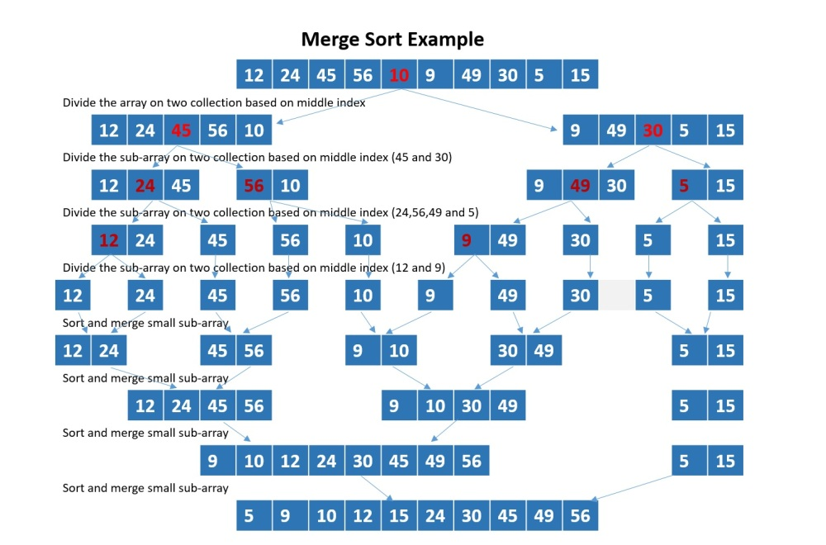
Merge Sort Example (TODO : update image)
alt:“Merge Sort Example” height:450px center

Slide 57
Merge Sort Algorithm (initial setup)
Merge Sort is a recursive sorting algorithm, for initial case we need to call Merge-Sort(A,1,n) for sorting $A\left[1..n\right]$
initial case
A : Array p : 1 (offset) r : n (length) Merge-Sort(A,1,n)

Slide 58
Merge Sort Algorithm (internal iterations)
internal iterations
A : Array p : offset r : length Merge-Sort(A,p,r) if p=r then (CHECK FOR BASE-CASE) return else q = floor((p+r)/2) (DIVIDE) Merge-Sort(A,p,q) (CONQUER) Merge-Sort(A,q+1,r) (CONQUER) Merge(A,p,q,r) (COMBINE) endif

Slide 59
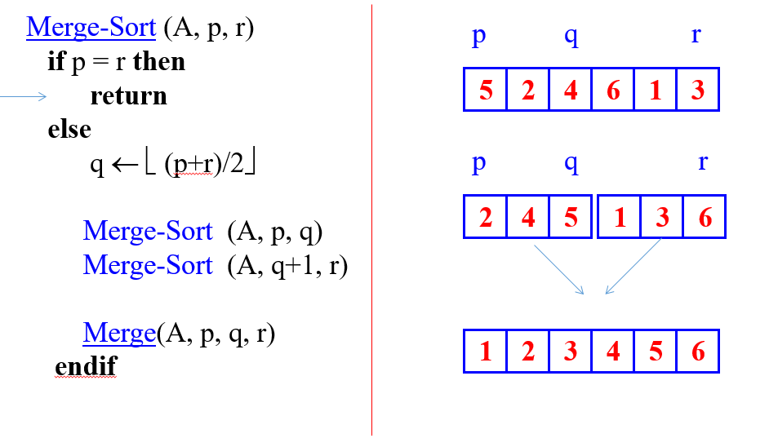
Merge Sort Algorithm (Combine-1)
$p=start−point$ $q=mid−point$ $r=end−point$
alt:“Merge Sort Algorithm (Combine-1)” height:450px center

Slide 60
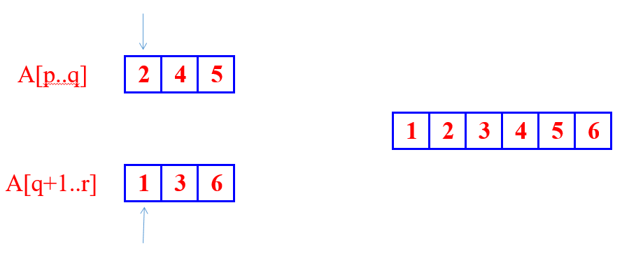
Merge Sort Algorithm (Combine-2)
brute-force task, merging two sorted subarrays
The pseudo-code in the textbook (Sec. 2.3.1)
alt:“Merge Sort Algorithm (Combine-2)” height:350px center

Slide 61
Merge Sort Combine Algorithm (1)
Merge(A,p,q,r) n1 = q-p+1 n2 = r-q //allocate left and right arrays //increment will be from left to right //left part will be bigger than right part L[1...n1+1] //left array R[1...n2+1] //right array //copy left part of array for i=1 to n1 L[i]=A[p+i-1] //copy right part of array for j=1 to n2 R[j]=A[q+j] //put end items maximum values for termination L[n1+1]=inf R[n2+1]=inf i=1,j=1 for k=p to r if L[i]<=R[j] A[k]=L[i] i=i+1 else A[k]=R[j] j=j+1

Slide 62
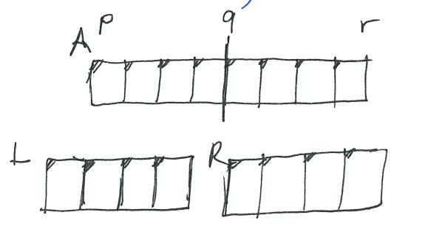
Merge Sort Combine Algorithm (2)
alt:“p,q,r” height:450px center

Slide 63
What is the complexity of merge operation?
You can find by counting loops will provide you base constant nested level will provide you exponent of this constant, if you drop constants you will have complexity
we have 3 for loops
it will look like $3n$ and $Θ\left(n\right)$ will be merge complexity

Slide 64
Merge Sort Correctness
Base case
$p=r$ (Trivially correct)
Inductive hypothesis
MERGE-SORT is correct for any subarray that is a strict (smaller) subset of $A\left[p,q\right]$.
General Case
MERGE-SORT is correct for $A\left[p,q\right]$. From inductive hypothesis and correctness of Merge.

Slide 65
Merge Sort Algorithm (Pseudo-Code)
A : Array p : offset r : length Merge-Sort(A,p,r) if p=r then (CHECK FOR BASE-CASE) return else q = floor((p+r)/2) (DIVIDE) Merge-Sort(A,p,q) (CONQUER) Merge-Sort(A,q+1,r) (CONQUER) Merge(A,p,q,r) (COMBINE) endif

Slide 66
Merge Sort Algorithm Complexity
A : Array p : offset r : length Merge-Sort(A,p,r)-------------> T(n) if p=r then--------------->Theta(1) return else q = floor((p+r)/2)---->Theta(1) Merge-Sort(A,p,q)-----> T(n/2) Merge-Sort(A,q+1,r)---> T(n/2) Merge(A,p,q,r)-------->Theta(n) endif

Slide 67
Merge Sort Algorithm Recurrence
We can describe a function recursively in terms of itself, to analyze the performance of recursive algorithms
$$T\left(n\right)=\left\{\begin{matrix}Θ\left(1\right) & \text{if n=1} \\ 2T\left(n/2\right)+Θ\left(n\right) & otherwise\end{matrix}\right.$$

Slide 68
How To Solve Recurrence (1)
$$T\left(n\right)=\left\{\begin{matrix}Θ\left(1\right) & \text{if n=1} \\ 2T\left(n/2\right)+Θ\left(n\right) & otherwise\end{matrix}\right.$$

Slide 69
How To Solve Recurrence (2)
We will assume $T\left(n\right)=Θ\left(1\right)$ for sufficiently small $n$ to rewrite equation as
$$T\left(n\right)=2T\left(n/2\right)+Θ\left(n\right)$$
Solution for this equation will be $Θ\left(nlgn\right)$ with following recursion tree.

Slide 70
How To Solve Recurrence (3)
Multiply by height $Θ\left(lgn\right)$ with each level cost $Θ\left(n\right)$ we can found $Θ\left(nlgn\right)$

Slide 71
How To Solve Recurrence (4)
This tree is binary-tree and binary-tree height is related with item size.
alt:“Merge Sort Recursive Tree” height:500px center

Slide 72
How Height of a Binary Tree is Equal to $logn$ ? (1)
Merge-Sort recursion tree is a perfect binary tree, a binary tree is a tree which every node has at most two children, A perfect binary tree is binary tree in which all internal nodes have exactly two children and all leaves are at the same level.

Slide 73
How Height of a Binary Tree is Equal to $logn$ ? (2)
Let $n$ be the number of nodes in the tree and let $l_{k}$ denote the number of nodes on level k. According to this;
$l_{k}=2l_{k−1}$ i.e. each level has exactly twice as many nodes as the previous level
$l_{0}=1$ , i.e. on the first level we have only one node (the root node)
The leaves are at the last level, $l_{h}$ where $h$ is the height of the tree.

Slide 74
How Height of a Binary Tree is Equal to $logn$ ? (3)
The total number of nodes in the tree is equal to the sum of the nodes on all the levels: nodes $n$
$$1+2^{1}+2^{2}+2^{3}+...+2^{h}=n$$
$$1+2^{1}+2^{2}+2^{3}+...+2^{h}=2^{h+1}−1$$
$$2^{h+1}−1=n$$
$$2^{h+1}=n+1$$
$$log_{2}2^{h+1}=log_{2}\left(n+1\right)$$
$$h+1=log_{2}\left(n+1\right)$$
$$h=log_{2}\left(n+1\right)−1$$

Slide 75
How Height of a Binary Tree is Equal to $logn$ ? (3)
If we write it as asymptotic approach, we will have the following result
$$\text{height of tree is }h=log_{2}\left(n+1\right)−1=O\left(logn\right)$$
also
$$\text{number of leaves is }l_{h}=\left(n+1\right)/2$$
nearly half of the nodes are at the leaves

Slide 76
Review
$Θ\left(nlgn\right)$ grows more slowly than $Θ\left(n^{2}\right)$
Therefore Merge-Sort beats Insertion-Sort in the worst case
In practice Merge-Sort beats Insertion-Sort for $n>30$ or so

Slide 77
Asymptotic Notations

Slide 78
Big-O / $O$- Notation : Asymptotic Upper Bound (Worst-Case) (1)
$f\left(n\right)=O\left(g\left(n\right)\right)$ if $∃$ positive constants $c$, $n_{0}$ such that
$$0≤f\left(n\right)≤cg\left(n\right),∀n≥n_{0}$$

Slide 79
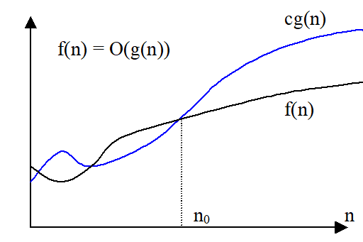
Big-O / $O$- Notation : Asymptotic Upper Bound (Worst-Case) (2)
alt:“Big-O Function-1” height:450px center

Slide 80
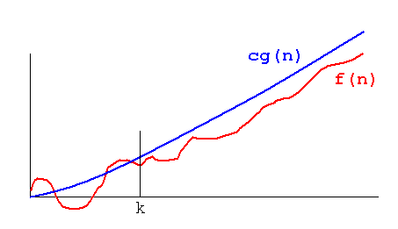
Big-O / $O$- Notation : Asymptotic Upper Bound (Worst-Case) (3)
alt:“Big-O Function-2” height:450px center

Slide 81
Big-O / $O$- Notation : Asymptotic Upper Bound (Worst-Case) (4)
Asymptotic running times of algorithms are usually defined by functions whose domain are $N=0,1,2,…$ (natural numbers)

Slide 82
Big-O / $O$- Notation : Asymptotic Upper Bound (Worst-Case) (5)
Example-1
Show that $2n^{2}=O\left(n^{3}\right)$
we need to find two positive constant $c$ and $n_{0}$ such that:
$$0≤2n^{2}≤cn^{3}\text{ for all }n≥n_{0}$$
Choose $c=2$ and $n_{0}=1$
$$2n^{2}≤2n^{3}\text{ for all }n≥1$$
Or, choose $c=1$ and $n_{0}=2$
$$2n^{2}≤n^{3}\text{ for all }n≥2$$

Slide 83
Big-O / $O$- Notation : Asymptotic Upper Bound (Worst-Case) (6)
Example-2
Show that $2n^{2}+n=O\left(n^{2}\right)$
We need to find two positive constant $c$ and $n_{0}$ such that:
$$0≤2n^{2}+n≤cn^{2}\text{ for all }n≥n_{0}$$
$$2+\left(1/n\right)≤c\text{ for all }n≥n_{0}$$
Choose $c=3$ and $n_{0}=1$
$$2n^{2}+n≤3n^{2}\text{ for all }n≥1$$

Slide 84
Big-O / $O$- Notation : Asymptotic Upper Bound (Worst-Case) (7)
We can say the followings about $f\left(n\right)=O\left(g\left(n\right)\right)$ equation
The notation is a little sloppy
One-way equation, e.q. $n^{2}=O\left(n^{3}\right)$ but we cannot say $O\left(n^{3}\right)=n^{2}$

Slide 85
Big-O / $O$- Notation : Asymptotic Upper Bound (Worst-Case) (8)
$O\left(g\left(n\right)\right)$ is in fact a set of functions as follow
$O\left(g\left(n\right)\right)=\{f\left(n\right):∃\text{ positive constant }c,n_{0}\text{ such that }0≤f\left(n\right)≤cg\left(n\right),∀n≥n_{0}\}$

Slide 86
Big-O / $O$- Notation : Asymptotic Upper Bound (Worst-Case) (9)
In other words $O\left(g\left(n\right)\right)$ is in fact, the set of functions that have asymptotic upper bound $g\left(n\right)$
e.q $2n^{2}=O\left(n^{3}\right)$ means $2n^{2}∈O\left(n^{3}\right)$

Slide 87
Big-O / $O$- Notation : Asymptotic Upper Bound (Worst-Case) (10)
Example-1
${10}^{9}n^{2}=O\left(n^{2}\right)$
$0≤{10}^{9}n^{2}≤cn^{2}\text{ for }n≥n_{0}$
choose $c={10}^{9}$ and $n_{0}=1$
$0≤{10}^{9}n^{2}≤{10}^{9}n^{2}\text{ for }n≥1$
CORRECT

Slide 88
Big-O / $O$- Notation : Asymptotic Upper Bound (Worst-Case) (11)
Example-2
$100n^{1.9999}=O\left(n^{2}\right)$
$0≤100n^{1.9999}≤cn^{2}\text{ for }n≥n_{0}$
choose $c=100$ and $n_{0}=1$
$0≤100n^{1.9999}≤100n^{2}\text{ for }n≥1$
CORRECT

Slide 89
Big-O / $O$- Notation : Asymptotic Upper Bound (Worst-Case) (12)
Example-3
${10}^{−9}n^{2.0001}=O\left(n^{2}\right)$
$0≤{10}^{−9}n^{2.0001}≤cn^{2}\text{ for }n≥n_{0}$
${10}^{−9}n^{0.0001}≤c\text{ for }n≥n_{0}$
INCORRECT (Contradiction)

Slide 90
Big-O / $O$- Notation : Asymptotic Upper Bound (Worst-Case) (13)
If we analysis $O\left(n^{2}\right)$ case, $O$-notation is an upper bound notation and the runtime $T\left(n\right)$ of algorithm A is at least $O\left(n^{2}\right)$.
$O\left(n^{2}\right)$: The set of functions with asymptotic upper bound $n^{2}$
$T\left(n\right)≥O\left(n^{2}\right)$ means $T\left(n\right)≥h\left(n\right)$ for some $h\left(n\right)∈O\left(n^{2}\right)$
$h\left(n\right)=0$ function is also in $O\left(n^{2}\right)$. Hence : $T\left(n\right)≥0$ , runtime must be nonnegative.

Slide 91
Big-Omega / $Ω$-Notation : Asymptotic Lower Bound (Best-Case) (1)
$f\left(n\right)=Ω\left(g\left(n\right)\right)$ if $∃$ positive constants $c,n_{0}$ such that $0≤cg\left(n\right)≤f\left(n\right),∀n≥n_{0}$

Slide 92
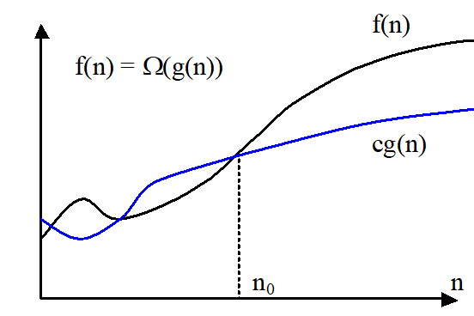
Big-Omega / $Ω$-Notation : Asymptotic Lower Bound (Best-Case) (2)
alt:“Big-Omega Function-1” height:450px center

Slide 93
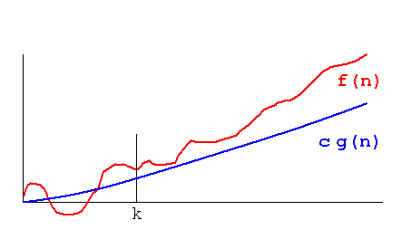
Big-Omega / $Ω$-Notation : Asymptotic Lower Bound (Best-Case) (3)
alt:“Big-Omega Function-2” height:450px center

Slide 94
Big-Omega / $Ω$-Notation : Asymptotic Lower Bound (Best-Case) (4)
Example-1
Show that $2n^{3}=Ω\left(n^{2}\right)$
We need to find two positive constants $c$ and $n_{0}$ such that:
$$0≤cn^{2}≤2n^{3}\text{ for all }n≥n_{0}$$
Choose $c=1$ and $n_{0}=1$
$$n^{2}≤2n^{3}\text{ for all }n≥1$$

Slide 95
Big-Omega / $Ω$-Notation : Asymptotic Lower Bound (Best-Case) (5)
Example-4
Show that $\sqrt{n}=Ω\left(lgn\right)$
We need to find two positive constants $c$ and $n_{0}$ such that:
$$clgn≤\sqrt{n}\text{ for all }n≥n_{0}$$
Choose $c=1$ and $n_{0}=16$
$$lgn≤\sqrt{n}\text{ for all }n≥16$$

Slide 96
Big-Omega / $Ω$-Notation : Asymptotic Lower Bound (Best-Case) (6)
$Ω\left(g\left(n\right)\right)$ is the set of functions that have asymptotic lower bound $g\left(n\right)$
$$Ω\left(g\left(n\right)\right)=\{f\left(n\right):∃\text{ positive constants }c,n_{0}\text{ such that }0≤cg\left(n\right)≤f\left(n\right),∀n≥n_{0}\}$$

Slide 97
Big-Omega / $Ω$-Notation : Asymptotic Lower Bound (Best-Case) (7)
Example-1
${10}^{9}n^{2}=Ω\left(n^{2}\right)$
$0≤cn^{2}≤{10}^{9}n^{2}\text{ for }n≥n_{0}$
Choose $c={10}^{9}$ and $n_{0}=1$
$0≤{10}^{9}n^{2}≤{10}^{9}n^{2}\text{ for }n≥1$
CORRECT

Slide 98
Big-Omega / $Ω$-Notation : Asymptotic Lower Bound (Best-Case) (8)
Example-2
$100n^{1.9999}=Ω\left(n^{2}\right)$
$0≤cn^{2}≤100n^{1.9999}\text{ for }n≥n_{0}$
$n^{0.0001}≤\left(100/c\right)\text{ for }n≥n_{0}$
INCORRECT(Contradiction)

Slide 99
Big-Omega / $Ω$-Notation : Asymptotic Lower Bound (Best-Case) (9)
Example-3
${10}^{−9}n^{2.0001}=Ω\left(n^{2}\right)$
$0≤cn^{2}≤{10}^{−9}n^{2.0001}\text{ for }n≥n_{0}$
Choose $c={10}^{−9}$ and $n_{0}=1$
$0≤{10}^{−9}n^{2}≤{10}^{−9}n^{2.0001}\text{ for }n≥1$
CORRECT

Slide 100
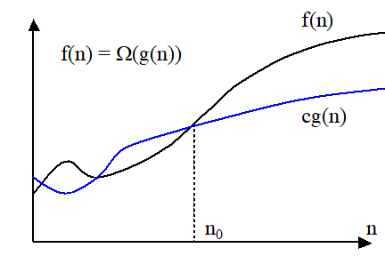
Comparison of Notations (1)
alt:“Big-Omega Function for Comparison” height:250px center

Slide 101
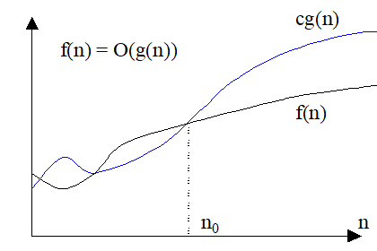
alt:“Big-O Function for Comparison” height:250px center

Slide 102
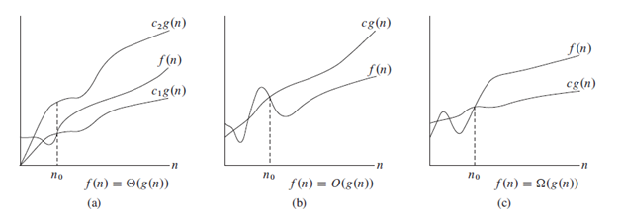
Comparison of Notations (2)
alt:“Comparison of Notations” height:450px center

Slide 103
Big-Theta /$Θ$-Notation : Asymptotically tight bound (Average Case) (1)
$f\left(n\right)=Θ\left(g\left(n\right)\right)$ if $∃$ positive constants $c_{1},c_{2},n_{0}$ such that $0≤c_{1}g\left(n\right)≤f\left(n\right)≤c_{2}g\left(n\right),∀n≥n_{0}$

Slide 104
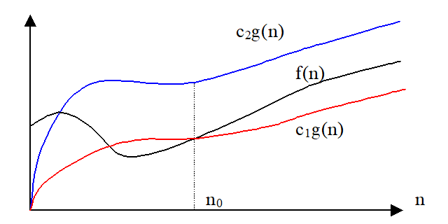
Big-Theta /$Θ$-Notation : Asymptotically tight bound (Average Case) (2)
alt:“Big-Theta Function” height:450px center

Slide 105
Big-Theta /$Θ$-Notation : Asymptotically tight bound (Average Case) (3)
Example-1
Show that $2n^{2}+n=Θ\left(n^{2}\right)$
We need to find 3 positive constants $c_{1},c_{2}$ and $n_{0}$ such that:
$0≤c_{1}n^{2}≤2n^{2}+n≤c_{2}n^{2}$ for all $n≥n_{0}$
$c_{1}≤2+\left(1/n\right)≤c_{2}$ for all $n≥n_{0}$
Choose $c_{1}=2,c_{2}=3$ and $n_{0}=1$
$2n^{2}≤2n^{2}+n≤3n^{2}$ for all $n≥1$

Slide 106
Big-Theta /$Θ$-Notation : Asymptotically tight bound (Average Case) (4)
Example-2.1
Show that $1/2n^{2}−2n=Θ\left(n^{2}\right)$
We need to find 3 positive constants $c_{1},c_{2}$ and $n_{0}$ such that:
$0≤c_{1}n^{2}≤1/2n^{2}−2n≤c_{2}n^{2}\text{ for all }n≥n_{0}$
$c_{1}≤1/2−2/n≤c_{2}\text{ for all }n≥n_{0}$
Choose 3 positive constants $c_{1},c_{2},n_{0}$ that satisfy $c_{1}≤1/2−2/n≤c_{2}$ for all $n≥n_{0}$

Slide 107
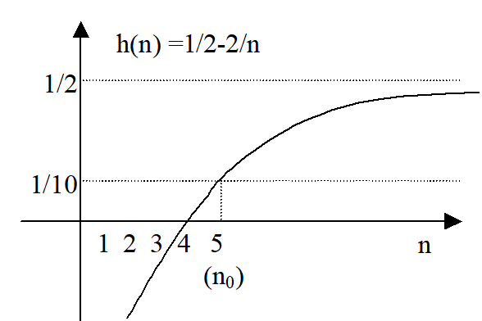
Big-Theta /$Θ$-Notation : Asymptotically tight bound (Average Case) (5)
Example-2.2
alt:“Big-Theta Example” height:450px center

Slide 108
Big-Theta /$Θ$-Notation : Asymptotically tight bound (Average Case) (6)
Example-2.3
$$1/10≤1/2−2/n\text{ for }n≥5$$
$$1/2−2/n≤1/2\text{ for }n≥0$$
Therefore we can choose $c_{1}=1/10,c_{2}=1/2,n_{0}=5$

Slide 109
Big-Theta /$Θ$-Notation : Asymptotically tight bound (Average Case) (7)
Theorem: leading constants & low-order terms don’t matter
Justification: can choose the leading constant large enough to make high-order term dominate other terms

Slide 110
Big-Theta /$Θ$-Notation : Asymptotically tight bound (Average Case) (8)
Example-1
${10}^{9}n^{2}=Θ\left(n^{2}\right)$ CORRECT
$100n^{1.9999}=Θ\left(n^{2}\right)$ INCORRECT
${10}^{9}n^{2.0001}=Θ\left(n^{2}\right)$ INCORRECT

Slide 111
Big-Theta /$Θ$-Notation : Asymptotically tight bound (Average Case) (9)
$Θ\left(g\left(n\right)\right)$ is the set of functions that have asymptotically tight bound $g\left(n\right)$
$Θ\left(g\left(n\right)\right)=\{f\left(n\right):∃\text{ positive constants }c_{1},c_{2},n_{0}\text{ such that }0≤c_{1}g\left(n\right)≤f\left(n\right)≤c_{2}g\left(n\right),∀n≥n_{0}\}$

Slide 112
Big-Theta /$Θ$-Notation : Asymptotically tight bound (Average Case) (10)
Theorem:
$f\left(n\right)=Θ\left(g\left(n\right)\right)$ if and only if $f\left(n\right)=O\left(g\left(n\right)\right)$ and $f\left(n\right)=Ω\left(g\left(n\right)\right)$
$Θ$ is stronger than both $O$ and $Ω$
$Θ\left(g\left(n\right)\right)⊆O\left(g\left(n\right)\right)\text{ and }Θ\left(g\left(n\right)\right)⊆Ω\left(g\left(n\right)\right)$

Slide 113
Big-Theta /$Θ$-Notation : Asymptotically tight bound (Average Case) (11)
Example-1.1
Prove that ${10}^{−8}n^{2}≠Θ\left(n\right)$
We can check that ${10}^{−8}n^{2}=Ω\left(n\right)$ and ${10}^{−8}n^{2}≠O\left(n\right)$
Proof by contradiction for $O\left(n\right)$ notation
$$O\left(g\left(n\right)\right)=\{f\left(n\right):∃\text{ positive constant }c,n_{0}\text{ such that }0≤f\left(n\right)≤cg\left(n\right),∀n≥n_{0}\}$$

Slide 114
Big-Theta /$Θ$-Notation : Asymptotically tight bound (Average Case) (12)
Example-1.2
Suppose positive constants $c_{2}$ and $n_{0}$ exist such that:
${10}^{−8}n^{2}≤c_{2}n,∀n≥n_{0}$
${10}^{−8}n≤c_{2},∀n≥n_{0}$
Contradiction: $c_{2}$ is a constant

Slide 115
Summary of $O,Ω$ and $Θ$ notations (1)
$O\left(g\left(n\right)\right)$ : The set of functions with asymptotic upper bound $g\left(n\right)$
$Ω\left(g\left(n\right)\right)$ : The set of functions with asymptotic lower bound $g\left(n\right)$
$Θ\left(n\right)$: The set of functions with asymptotically tight bound $g\left(n\right)$
$f\left(n\right)=Θ\left(g\left(n\right)\right)⇔f\left(n\right)=O\left(g\left(n\right)\right)\text{ and }f\left(n\right)=Ω\left(g\left(n\right)\right)$

Slide 116
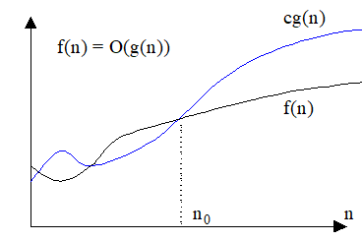
Summary of $O,Ω$ and $Θ$ notations (2)
alt:“Summary Big-O” height:200px center

Slide 117
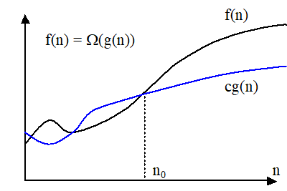
alt:“Summary Big-Omega” height:200px center

Slide 118
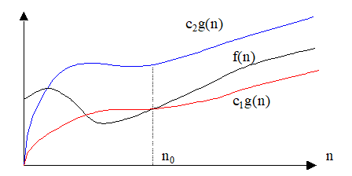
alt:“Summary Big-Theta” height:200px center

Slide 119
Small-o / $o$-Notation : Asymptotic upper bound that is not tight (1)
Remember, upper bound provided by big- $O$ notation can be tight or not tight
Tight mean values are close the original function
e.g. followings are true
$2n^{2}=O\left(n^{2}\right)$ is asymptotically tight
$2n=O\left(n^{2}\right)$ is not asymptotically tight
According to this small-$o$ notation is an upper bound that is not asymptotically tight

Slide 120
Small-o / $o$-Notation : Asymptotic upper bound that is not tight (2)
Note that in equations equality is removed in small notations
$o\left(g\left(n\right)\right)=\{f\left(n\right):\text{ for any constant}c>0,∃\text{ a constant }n_{0}>0,\text{ such that }0≤f\left(n\right)<cg\left(n\right),∀n≥n_{0}\}$
$$\lim_{n→∞}\frac{f\left(n\right)}{g\left(n\right)}=0$$
e.g $2n=o\left(n^{2}\right)$ any positive $c$ satisfies but $2n^{2}≠o\left(n^{2}\right)$ $c=2$ does not satisfy

Slide 121
Small-omega / $ω$-Notation: Asymptotic lower bound that is not tight (1)
$ω\left(g\left(n\right)\right)=\{f\left(n\right):\text{ for any constant }c>0,∃\text{ a constant }n_{0}>0,\text{ such that }0≤cg\left(n\right)<f\left(n\right),∀n≥n_{0}$
$$\lim_{n→∞}\frac{f\left(n\right)}{g\left(n\right)}=∞$$
e.g. $n^{2}/2=ω\left(n\right)$, any positive $c$ satisfies but $n^{2}/2≠ω\left(n^{2}\right)$, $c=1/2$ does not satisfy

Slide 122
(Important) Analogy to compare of two real numbers
$$f\left(n\right)=O\left(g\left(n\right)\right)↔a≤b$$
$$f\left(n\right)=Ω\left(g\left(n\right)\right)↔a≥b$$
$$f\left(n\right)=Θ\left(g\left(n\right)\right)↔a=b$$
$$f\left(n\right)=o\left(g\left(n\right)\right)↔a<b$$
$$f\left(n\right)=ω\left(g\left(n\right)\right)↔a>b$$

Slide 123
(Important) Trichotomy property for real numbers
For any two real numbers $a$ and $b$, we have either
$a<b$, or $a=b$, or $a>b$
Trichotomy property does not hold for asymptotic notation, for two functions $f\left(n\right)$ and $g\left(n\right)$, it may be the case that neither $f\left(n\right)=O\left(g\left(n\right)\right)$ nor $f\left(n\right)=Ω\left(g\left(n\right)\right)$ holds.
e.g. $n$ and $n^{1+sin\left(n\right)}$ cannot be compared asymptotically

Slide 124
$5n^{2}=O\left(n^{2}\right)$ | TRUE | $n^{2}lgn=O\left(n^{2}\right)$ | FALSE
$5n^{2}=Ω\left(n^{2}\right)$ | TRUE | $n^{2}lgn=Ω\left(n^{2}\right)$ | TRUE
$5n^{2}=Θ\left(n^{2}\right)$ | TRUE | $n^{2}lgn=Θ\left(n^{2}\right)$ | FALSE
$5n^{2}=o\left(n^{2}\right)$ | FALSE | $n^{2}lgn=o\left(n^{2}\right)$ | FALSE
$5n^{2}=ω\left(n^{2}\right)$ | FALSE | $n^{2}lgn=ω\left(n^{2}\right)$ | TRUE
$2^{n}=O\left(3^{n}\right)$ | TRUE
$2^{n}=Ω\left(3^{n}\right)$ | FALSE | $2^{n}=o\left(3^{n}\right)$ | TRUE
$2^{n}=Θ\left(3^{n}\right)$ | FALSE | $2^{n}=ω\left(3^{n}\right)$ | FALSE
Examples

Slide 125
Asymptotic Function Properties
Transitivity: holds for all
e.g. $f\left(n\right)=Θ\left(g\left(n\right)\right)\&g\left(n\right)=Θ\left(h\left(n\right)\right)⇒f\left(n\right)=Θ\left(h\left(n\right)\right)$
Reflexivity: holds for $Θ,O,Ω$
e.g. $f\left(n\right)=O\left(f\left(n\right)\right)$
Symmetry: hold only for $Θ$
e.g. $f\left(n\right)=Θ\left(g\left(n\right)\right)⇔g\left(n\right)=Θ\left(f\left(n\right)\right)$
Transpose Symmetry: holds for $\left(O↔Ω\right)$ and $\left(o↔ω\right)$
e.g. $f\left(n\right)=O\left(g\left(n\right)\right)⇔g\left(n\right)=Ω\left(f\left(n\right)\right)$

Slide 126
Using $O$-Notation to Describe Running Times (1)
Used to bound worst-case running times, Implies an upper bound runtime for arbitrary inputs as well
Example:
Insertion sort has worst-case runtime of $O\left(n^{2}\right)$
Note:
This $O\left(n^{2}\right)$ upper bound also applies to its running time on every input
Abuse to say “running time of insertion sort is $O\left(n^{2}\right)$”
For a given $n$, the actual running time depends on the particular input of size $n$
i.e., running time is not only a function of $n$
However, worst-case running time is only a function of $n$

Slide 127
Using $O$-Notation to Describe Running Times (2)
When we say:
Running time of insertion sort is $O\left(n^{2}\right)$
What we really mean is
Worst-case running time of insertion sort is $O\left(n^{2}\right)$
or equivalently
No matter what particular input of size n is chosen, the running time on that set of inputs is $O\left(n^{2}\right)$

Slide 128
Using $Ω$-Notation to Describe Running Times (1)
Used to bound best-case running times, Implies a lower bound runtime for arbitrary inputs as well
Example:
Insertion sort has best-case runtime of $Ω\left(n\right)$
Note:
This $Ω\left(n\right)$ lower bound also applies to its running time on every input

Slide 129
Using $Ω$-Notation to Describe Running Times (2)
When we say
Running time of algorithm A is $Ω\left(g\left(n\right)\right)$
What we mean is
For any input of size $n$, the runtime of A is at least a constant times $g\left(n\right)$ for sufficiently large $n$
It’s not contradictory to say
worst-case running time of insertion sort is $Ω\left(n^{2}\right)$
Because there exists an input that causes the algorithm to take $Ω\left(n^{2}\right)$

Slide 130
Using $Θ$-Notation to Describe Running Times (1)
Consider 2 cases about the runtime of an algorithm
Case 1: Worst-case and best-case not asymptotically equal
Use $Θ$-notation to bound worst-case and best-case runtimes separately
Case 2: Worst-case and best-case asymptotically equal
Use $Θ$-notation to bound the runtime for any input

Slide 131
Using $Θ$-Notation to Describe Running Times (2)
Case 1: Worst-case and best-case not asymptotically equal
Use $Θ$-notation to bound the worst-case and best-case runtimes separately
We can say:
“The worst-case runtime of insertion sort is $Θ\left(n^{2}\right)$”
“The best-case runtime of insertion sort is $Θ\left(n\right)$”
But, we can’t say:
“The runtime of insertion sort is $Θ\left(n^{2}\right)$ for every input”
A $Θ$-bound on worst/best-case running time does not apply to its running time on arbitrary inputs

Slide 132
Worst-Case and Best-Case Equation for Merge-Sort
e.g. for merge-sort, we have:
$$T\left(n\right)=Θ\left(nlgn\right)\left\{\begin{matrix}T\left(n\right)=O\left(nlgn\right) \\ T\left(n\right)=Ω\left(nlgn\right)\end{matrix}\right.$$

Slide 133
Using Asymptotic Notation to Describe Runtimes Summary (1)
“The worst case runtime of Insertion Sort is $O\left(n^{2}\right)$”
Also implies: “The runtime of Insertion Sort is $O\left(n^{2}\right)$”
“The best-case runtime of Insertion Sort is $Ω\left(n\right)$”
Also implies: “The runtime of Insertion Sort is $Ω\left(n\right)$”

Slide 134
Using Asymptotic Notation to Describe Runtimes Summary (2)
“The worst case runtime of Insertion Sort is $Θ\left(n^{2}\right)$”
But: “The runtime of Insertion Sort is not $Θ\left(n^{2}\right)$”
“The best case runtime of Insertion Sort is $Θ\left(n\right)$”
But: “The runtime of Insertion Sort is not $Θ\left(n\right)$”

Slide 135
Using Asymptotic Notation to Describe Runtimes Summary (3)
Which one is true?
FALSE “The worst case runtime of Merge Sort is $Θ\left(nlgn\right)$”
FALSE “The best case runtime of Merge Sort is $Θ\left(nlgn\right)$”
TRUE “The runtime of Merge Sort is $Θ\left(nlgn\right)$”
This is true, because the best and worst case runtimes have asymptotically the same tight bound $Θ\left(nlgn\right)$

Slide 136
Asymptotic Notation in Equations (RHS)
Asymptotic notation appears alone on the RHS of an equation:
implies set membership
e.g., $n=O\left(n^{2}\right)$ means $n∈O\left(n^{2}\right)$
Asymptotic notation appears on the RHS of an equation stands for some anonymous function in the set
e.g., $2n^{2}+3n+1=2n^{2}+Θ\left(n\right)$ means:
$2n^{2}+3n+1=2n^{2}+h\left(n\right)$, for some $h\left(n\right)∈Θ\left(n\right)$
i.e., $h\left(n\right)=3n+1$

Slide 137
Asymptotic Notation in Equations (LHS)
Asymptotic notation appears on the LHS of an equation:
stands for any anonymous function in the set
e.g., $2n^{2}+Θ\left(n\right)=Θ\left(n^{2}\right)$ means:
for any function $g\left(n\right)∈Θ\left(n\right)$
$∃$ some function $h\left(n\right)∈Θ\left(n^{2}\right)$
such that $2n^{2}+g\left(n\right)=h\left(n\right)$
RHS provides coarser level of detail than LHS

Slide 138
References
Introduction to Algorithms, Third Edition | The MIT Press
http://nabil.abubaker.bilkent.edu.tr/473/
Insertion Sort - GeeksforGeeks
http://www.cs.gettysburg.edu/~ilinkin/courses/Fall-2012/cs216/notes/bintree.pdf
Dictionary of Algorithms and Data Structures
big-O notation
Omega

