Slide 1
CE100 Algorithms and Programming II
Introduction to Analysis of Algorithms Author: Asst. Prof. Dr. Uğur CORUH

Slide 2
CE100 Algorithms and Programming II

Slide 3
Week-1 (Introduction to Analysis of Algorithms)
Spring Semester, 2021-2022
Download DOC, SLIDE, PPTX

Slide 4
Brief Description of Course and Rules
We will first talk about,
Course Plan and Communication
Grading System, Homeworks, and Exams
please read the syllabus carefully.

Slide 5
TODO : Brief Proof Methods

Slide 6
Introduction to Analysis of Algorithms

Slide 7
Outline
Study two sorting algorithms as examples
Insertion sort: Incremental algorithm
Merge sort: Divide-and-conquer
Introduction to runtime analysis
Best vs. worst vs. average case
Asymptotic analysis

Slide 8
What is Algorithm
Algorithm: A sequence of computational steps that transform the input to the desired output
Procedure vs. algorithm An algorithm must halt within finite time with the right output
We Need to Measure Performance Metrics
Processing Time
Allocated Memory
Network Congestion
Power Usage etc.

Slide 9
Example Sorting Algorithms
Input: a sequence of n numbers
$$⟨a_{1},a_{2},...,a_{n}⟩$$
Algorithm: Sorting / Permutation
∏=⟨1​,2​,...,n​⟩
Output: sorted permutation of the input sequence
$$⟨a_{\underset{\left(1\right)}{∏}}≤a_{\underset{\left(2\right)}{∏}}≤,...,a_{\underset{\left(n\right)}{∏}}⟩$$

Slide 10
Pseudo-code notation
We can use Flowgorithm - Flowchart Programming Language
Objective: Express algorithms to humans in a clear and concise way
Liberal use of English
Indentation for block structures
Omission of error handling and other details (needed in real programs)

Slide 11
Pseudocode Links to Visit
Pseudocode - Wikipedia
Pseudocode Examples
How to write a Pseudo Code? - GeeksforGeeks

Slide 12
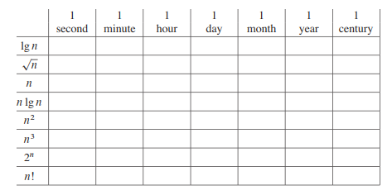
What is the processing time ?
alt:“processing time map” height:450px center

Slide 13
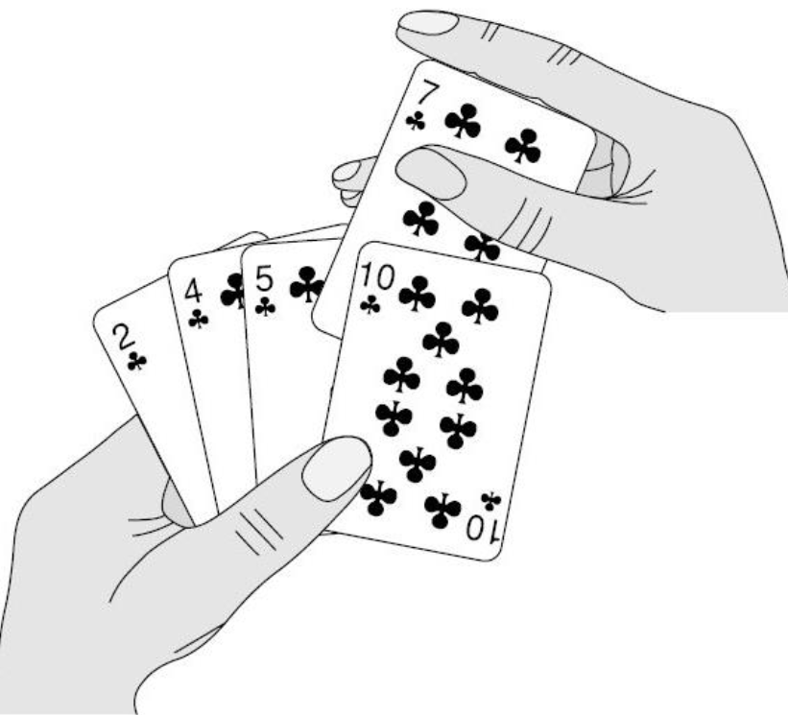
Insertion Sort
Insertion sort is a simple sorting algorithm that works similar to the way you sort playing cards in your hands
The array is virtually split into a sorted and an unsorted part
Values from the unsorted part are picked and placed at the correct position in the sorted part.
alt:“playing cards” height:300px center

Slide 14
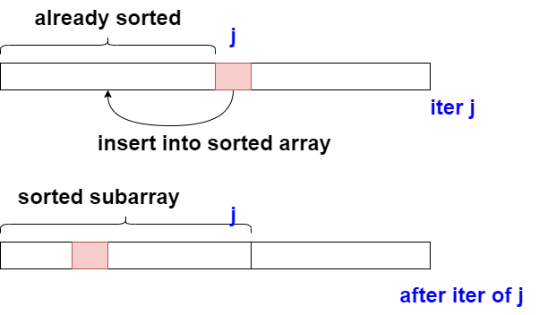
Assume input array : $A\left[1..n\right]$
Iterate $j$ from $2$ to $n$
alt:“insertion sort movement” height:450px center

Slide 15
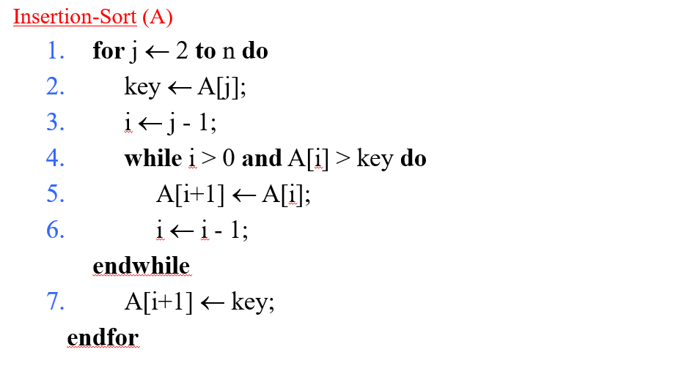
Insertion Sort Algorithm
alt:“insertion sort algorithm” height:450px center

Slide 16
Insertion Sort Algorithm (inline)
Insertion-Sort(A) 1. for j=2 to A.length 2. key = A[j] 3. //insert A[j] into the sorted sequence A[1...j-1] 4. i = j - 1 5. while i>0 and A[i]>key 6. A[i+1] = A[i] 7. i = i - 1 8. A[i+1] = key

Slide 17
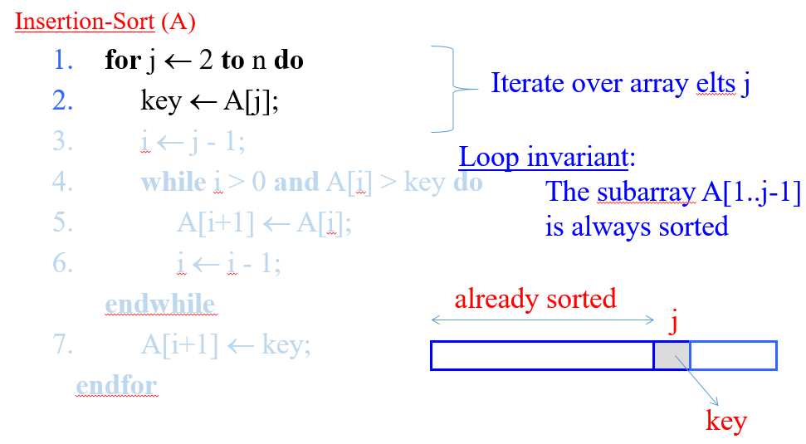
Insertion Sort Step-By-Step Description (1)
alt:“insertion sort description-1” height:450px center

Slide 18
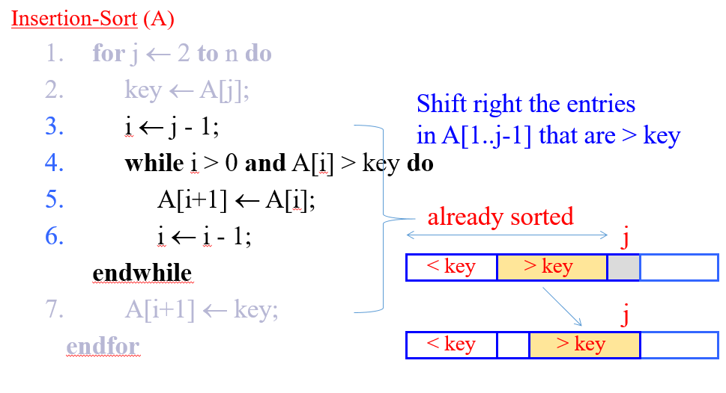
Insertion Sort Step-By-Step Description (2)
alt:“insertion sort description-2” height:450px center

Slide 19
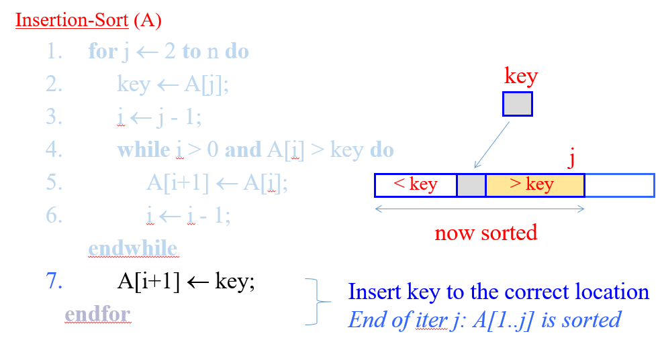
Insertion Sort Step-By-Step Description (3)
alt:“insertion sort description-3” height:450px center

Slide 20
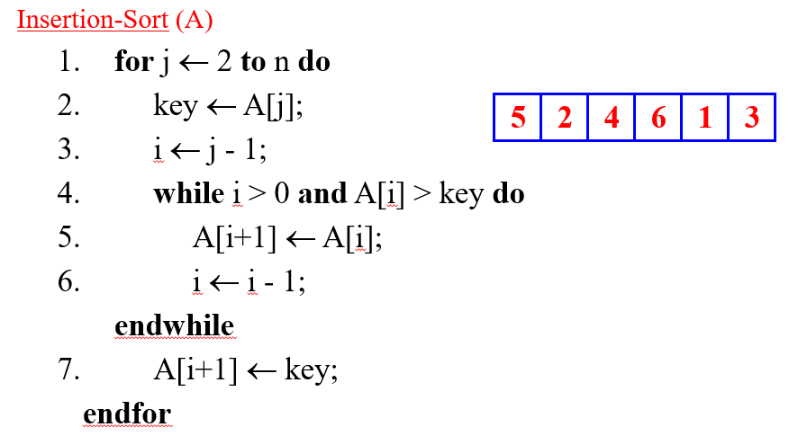
Insertion Sort Example
Insertion Sort Step-1 (initial)
alt:“insertion sort step-1” height:450px center

Slide 21
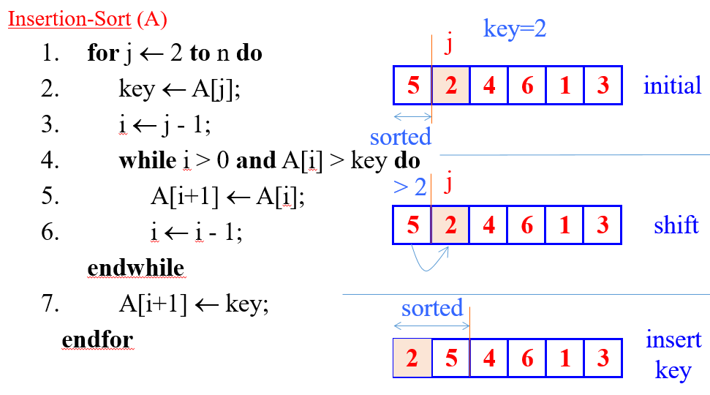
Insertion Sort Step-2 (j=2)
alt:“insertion sort step-2” height:450px center

Slide 22
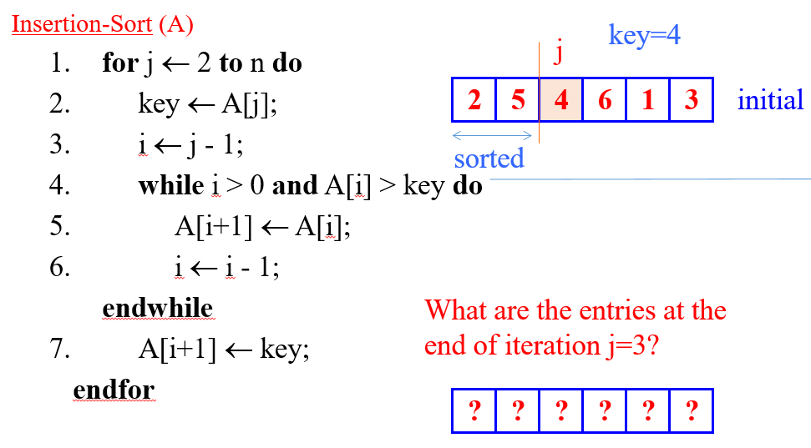
Insertion Sort Step-3 (j=3)
alt:“insertion sort step-3” height:450px center

Slide 23
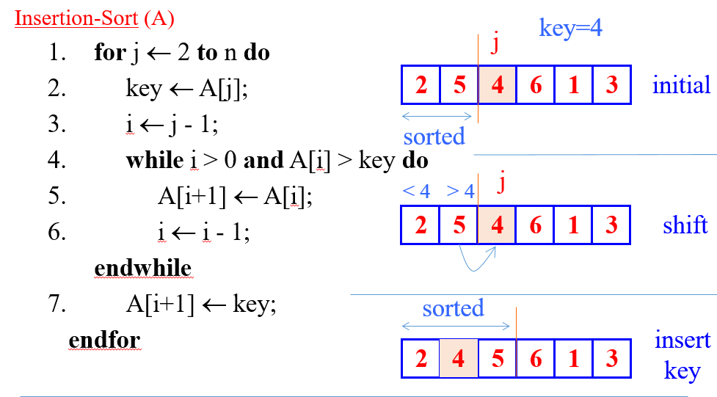
Insertion Sort Step-4 (j=3)
alt:“insertion sort step-4” height:450px center

Slide 24
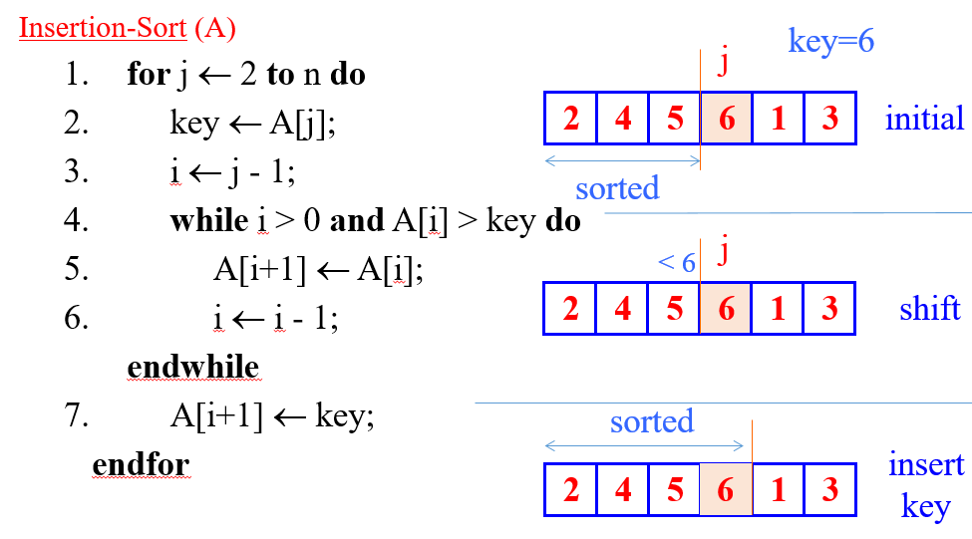
Insertion Sort Step-5 (j=4)
alt:“insertion sort step-5” height:450px center

Slide 25
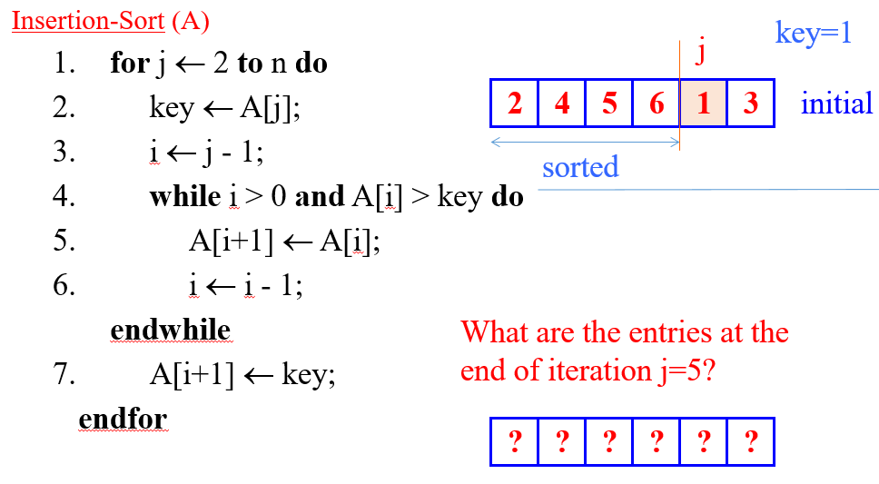
Insertion Sort Step-6 (j=5)
alt:“insertion sort step-6” height:450px center

Slide 26
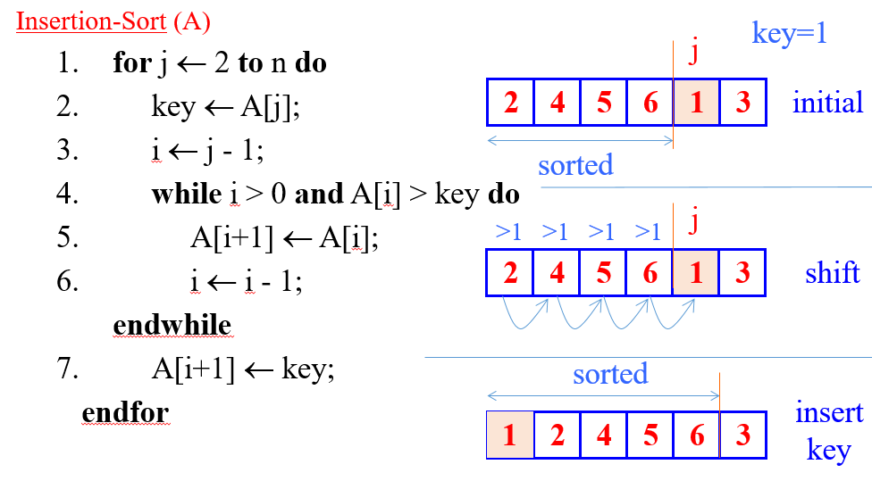
Insertion Sort Step-7 (j=5)
alt:“insertion sort step-7” height:450px center

Slide 27
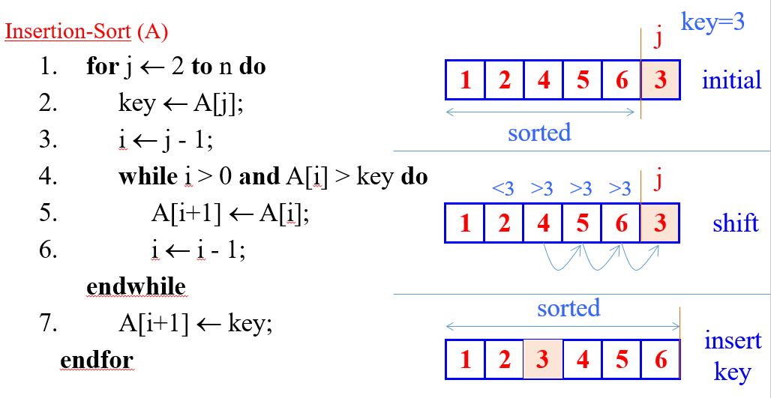
Insertion Sort Step-8 (j=6)
alt:“insertion sort step-8” height:450px center

Slide 28
Insertion Sort Review (1)
Items sorted in-place
Elements are rearranged within the array.
At a most constant number of items stored outside the array at any time (e.,g. the variable key)
Input array $A$ contains a sorted output sequence when the algorithm ends

Slide 29
Insertion Sort Review (2)
Incremental approach
Having sorted $A\left[1..j−1\right]$ , place $A\left[j\right]$ correctly so that $A\left[1..j\right]$ is sorted
Running Time
It depends on Input Size (5 elements or 5 billion elements) and Input Itself (partially sorted)
Algorithm approach to upper bound of overall performance analysis

Slide 30
Visualization of Insertion Sort
Sorting (Bubble, Selection, Insertion, Merge, Quick, Counting, Radix) - VisuAlgo
https://www.cs.usfca.edu/~galles/visualization/ComparisonSort.html
https://algorithm-visualizer.org/
HMvHTs - Online C++ Compiler & Debugging Tool - Ideone.com

Slide 31
Kinds of Running Time Analysis (Time Complexity)
Worst Case (Big-O Notation)
$T\left(n\right)$ = maximum processing time of any input $n$
Presentation of Big-O : $O\left(n\right)$
Average Case (Teta Notation)
$T\left(n\right)$ = average time over all inputs of size $n$, inputs can have a uniform distribution
Presentation of Big-Theta : $Θ\left(n\right)$
Best Case (Omega Notation)
$T\left(n\right)$ = min time on any input of size $n$, for example sorted array
Presentation of Big-Omega : $Ω\left(n\right)$

Slide 32
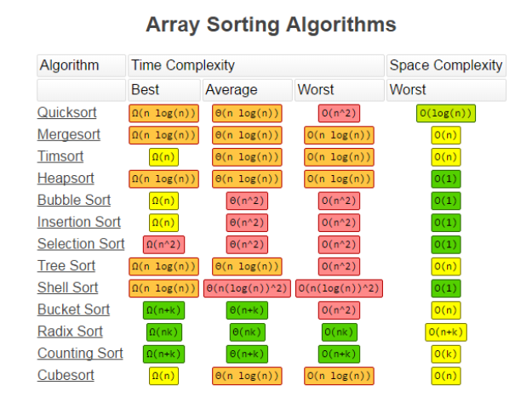
alt:“array sorting algorithms” height:550px center

Slide 33
Comparison of Time Analysis Cases
For insertion sort, worst-case time depends on the speed of primitive operations such as
Relative Speed (on the same machine)
Absolute Speed (on different machines)
Asymptotic Analysis
Ignore machine-dependent constants
Look at the growth of $T\left(n\right)|n→∞$

Slide 34
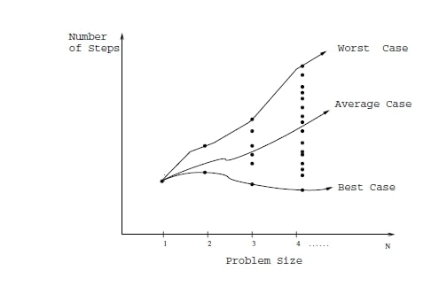
Asymptotic Analysis (1)
alt:“algorithm analysis comparisons” height:550px center

Slide 35
Asymptotic Analysis (2)

Slide 36
Theta-Notation (Average-Case)
Drop low order terms
Ignore leading constants
e.g
$$2n^{2}+5n+3=Θ\left(n^{2}\right)$$
$$3n^{3}+90n^{2}−2n+5=Θ\left(n^{3}\right)$$
As $n$ gets large, a $Θ\left(n^{2}\right)$ algorithm runs faster than a $Θ\left(n^{3}\right)$ algorithm

Slide 37
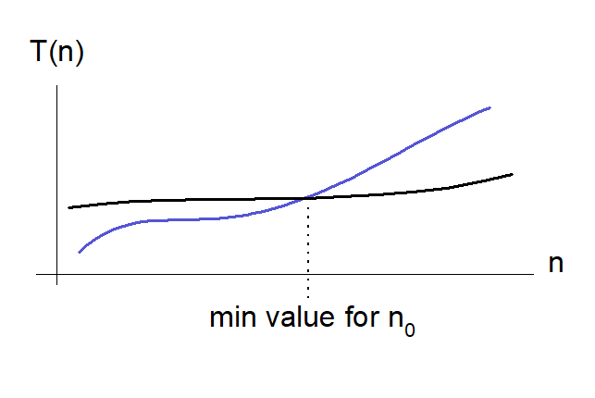
Asymptotic Analysis (3)
For both algorithms, we can see a minimum item size in the following chart. After this point, we can see performance differences. Some algorithms for small item size can be run faster than others but if you increase item size you will see a reference point that notation proof performance metrics.
alt:“T(n) and n change graph” height:350px center

Slide 38
Insertion Sort - Runtime Analysis (1)
Cost Times Insertion-Sort(A) c1 n 1. for j=2 to A.length c2 n-1 2. key = A[j] c3 n-1 3. //insert A[j] into the sorted sequence A[1...j-1] c4 n-1 4. i = j - 1 c5 k5 5. while i>0 and A[i]>key do c6 k6 6. A[i+1] = A[i] c7 k6 7. i = i - 1 c8 n-1 8. A[i+1] = key
we have two loops here, if we sum up costs as follow we can see big-O worst case notation.
$k_{5}=\sum_{j=2}^{n}{t_{j}}$ and $k_{6}=\sum_{j=2}^{n}{t_{i}−1}$ for operation counts

Slide 39
Insertion Sort - Runtime Analysis (2)
cost function can be evaluated as follow;
$T\left(n\right)=c_{1}n+c_{2}\left(n−1\right)+0\left(n−1\right)+c_{4}\left(n−1\right)+c_{5}\sum_{j=2}^{n}{t_{j}}+c_{6}\sum_{j=2}^{n}{t_{i}−1}+c_{7}\sum_{j=2}^{n}{t_{i}−1}+c_{8}\left(n−1\right)$

Slide 40
Insertion Sort - Runtime Analysis (3)
$\sum_{j=2}^{n}{j}=\left(n\left(n+1\right)/2\right)−1$ and $\sum_{j=2}^{n}{j−1}=n\left(n−1\right)/2$

Slide 41
Insertion Sort - Runtime Analysis (4)
$T\left(n\right)=\left(c_{5}/2+c_{6}/2+c_{7}/2\right)n^{2}+\left(c_{1}+c_{2}+c_{4}+c_{5}/2−c_{6}/2−c_{7}/2+c_{8}\right)n−\left(c_{2}+c_{4}+c_{5}+c_{6}\right)$

Slide 42
Insertion Sort - Runtime Analysis (5)
$T\left(n\right)=an^{2}+bn+c$

Slide 43
Insertion Sort - Runtime Analysis (6)
$O\left(n^{2}\right)$

Slide 44
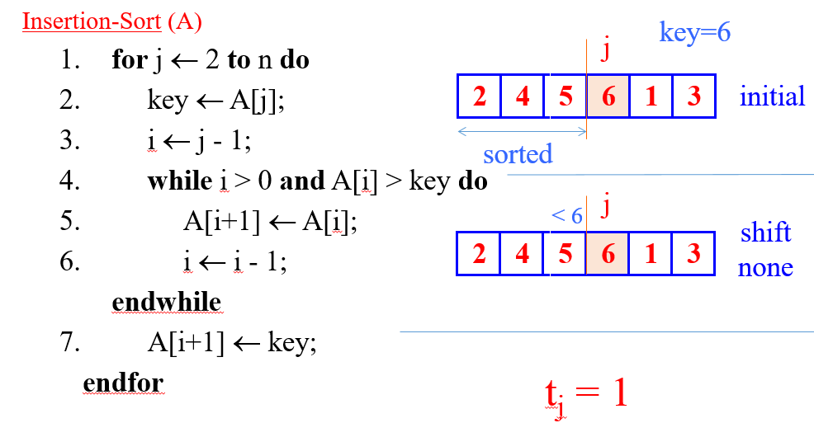
Best-Case Scenario (Sorted Array) (1)
Problem-1, If $A\left[1...j\right]$ is already sorted, what will be $t_{j}=?$
alt:“Insertion Sort Best-Case Scenario (Sorted Array)” height:400px center

Slide 45
Best-Case Scenario (Sorted Array) (2)
Parameters are taken from image
$T\left(n\right)=c_{1}n+c_{2}\left(n−1\right)+c_{3}\left(n−1\right)+c_{4}\sum_{j=2}^{n}{t_{j}}+c_{5}\sum_{j=2}^{n}{\left(t_{j}−1\right)}+c_{6}\sum_{j=2}^{n}{\left(t_{j}−1\right)}+c_{7}\left(n−1\right)$
$t_{j}=1$ for all $j$
$T\left(n\right)=\left(c_{1}+c_{2}+c_{3}+c_{4}+c_{7}\right)n−\left(c_{2}+c_{3}+c_{4}+c_{7}\right)$
$T\left(n\right)=an−b$
$Ω\left(n\right)$

Slide 46
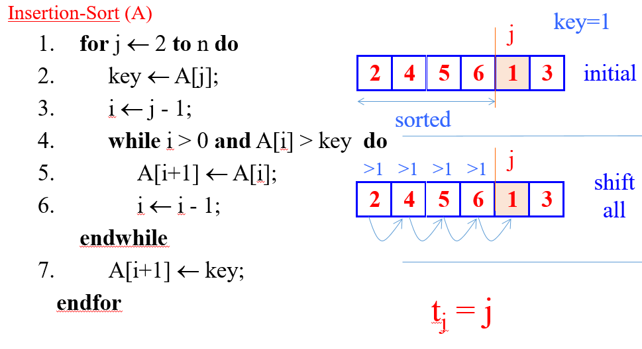
Worst-Case Scenario (Reversed Array) (1)
Problem-2 If $A\left[j\right]$ is smaller than every entry in $A\left[1...j−1\right]$, what will be $t_{j}=?$
alt:“Insertion Sort Worst-Case Scenario (Reversed Array)” height:400px center

Slide 47
Worst-Case Scenario (Reversed Array) (2)
The input array is reverse sorted $t_{j}=j$ for all $j$ after calculation worst case runtime will be
$T\left(n\right)=1/2\left(c_{4}+c_{5}+c_{6}\right)n^{2}+\left(c_{1}+c_{2}+c_{3}+1/2\left(c_{4}−c_{5}−c_{6}\right)+c_{7}\right)n−\left(c_{2}+c_{3}+c_{4}+c_{7}\right)$
$T\left(n\right)=1/2an^{2}+bn−c$
$O\left(n^{2}\right)$

Slide 48
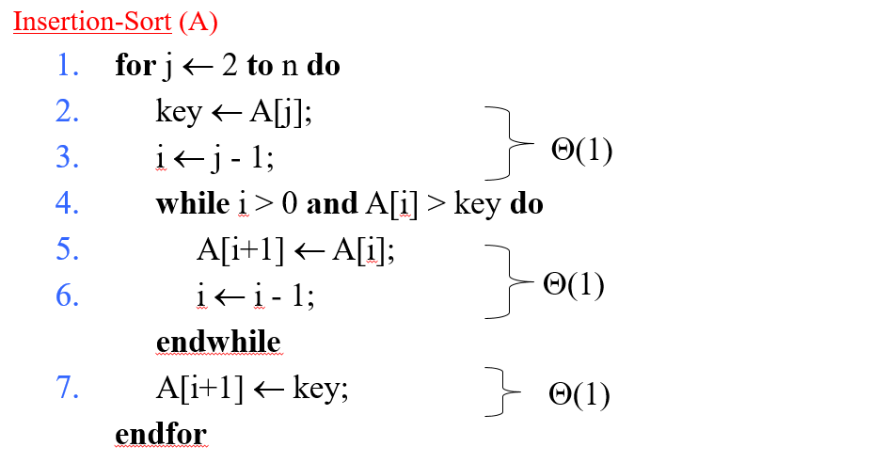
Asymptotic Runtime Analysis of Insertion-Sort
alt:“Asymptotic Runtime Analysis of Insertion-Sort” height:450px center

Slide 49
Insertion-Sort Worst-case (input reverse sorted)
Inner Loop is $Θ\left(j\right)$
$T\left(n\right)=\sum_{j=2}^{n}{Θ}\left(j\right)=Θ\left(\sum_{j=2}^{n}{j}\right)=Θ\left(n^{2}\right)$

Slide 50
Insertion-Sort Average-case (all permutations uniformly distributed)
Inner Loop is $Θ\left(j/2\right)$
$T\left(n\right)=\sum_{j=2}^{n}{Θ}\left(j/2\right)=\sum_{j=2}^{n}{Θ}\left(j\right)=Θ\left(n^{2}\right)$

Slide 51
Array Sorting Algorithms Time/Space Complexities
To compare this sorting algorithm please check the following map again.
alt:“Array Sorting Algorithms Time/Space Complexities” height:450px center

Slide 52
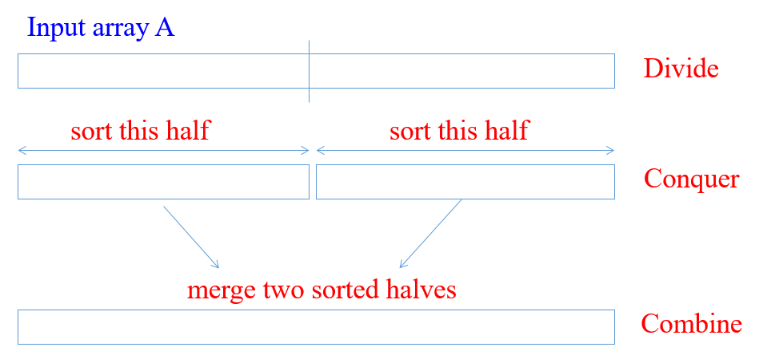
Merge Sort : Divide / Conquer / Combine (1)
alt:“Merge Sort : Divide / Conquer / Combine” height:450px center

Slide 53
Merge Sort : Divide / Conquer / Combine (2)
Divide: we divide the problem into a number of subproblems
Conquer: We solve the subproblems recursively
Base-Case: Solve by Brute-Force
Combine: Subproblem solutions to the original problem

Slide 54
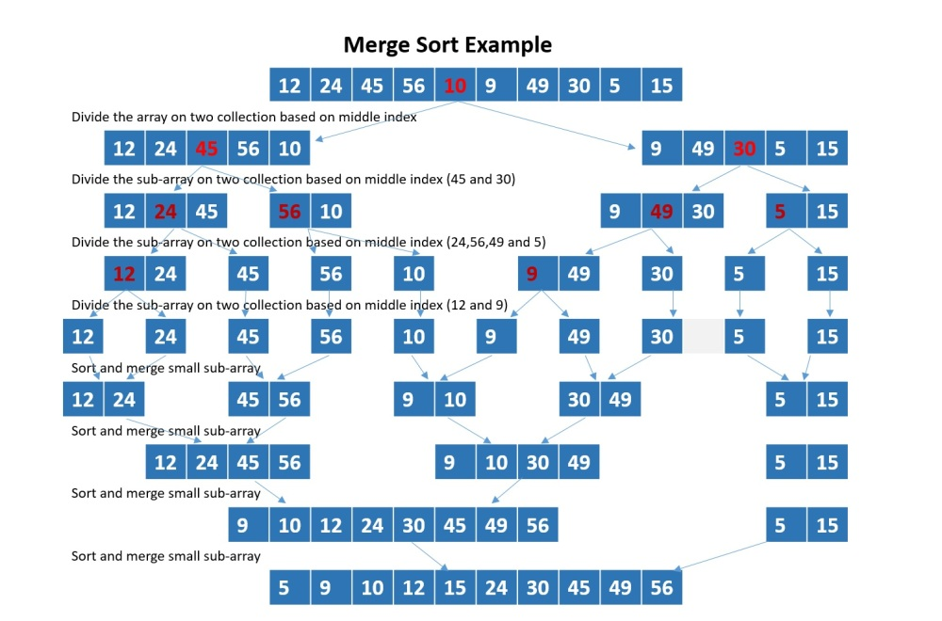
Merge Sort Example
alt:“Merge Sort Example” height:450px center

Slide 55
Merge Sort Algorithm (initial setup)
Merge Sort is a recursive sorting algorithm, for initial case we need to call Merge-Sort(A,1,n) for sorting $A\left[1..n\right]$
initial case
A : Array p : 1 (offset) r : n (length) Merge-Sort(A,1,n)

Slide 56
Merge Sort Algorithm (internal iterations)
internal iterations
A : Array p : offset r : length Merge-Sort(A,p,r) if p=r then (CHECK FOR BASE-CASE) return else q = floor((p+r)/2) (DIVIDE) Merge-Sort(A,p,q) (CONQUER) Merge-Sort(A,q+1,r) (CONQUER) Merge(A,p,q,r) (COMBINE) endif

Slide 57
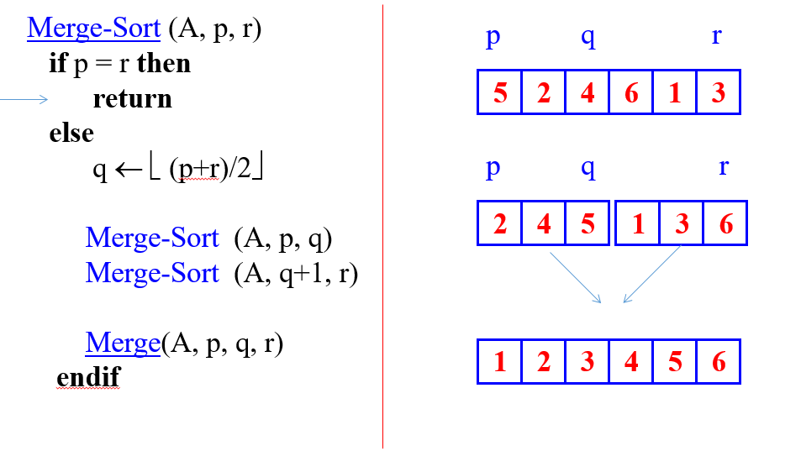
Merge Sort Algorithm (Combine-1)
$p=start−point$ $q=mid−point$ $r=end−point$
alt:“Merge Sort Algorithm (Combine-1)” height:450px center

Slide 58
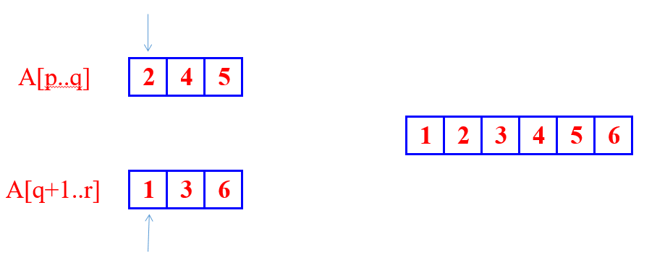
Merge Sort Algorithm (Combine-2)
brute-force task, merging two sorted subarrays
The pseudo-code in the textbook (Sec. 2.3.1)
alt:“Merge Sort Algorithm (Combine-2)” height:350px center

Slide 59
Merge Sort Combine Algorithm (1)
Merge(A,p,q,r) n1 = q-p+1 n2 = r-q //allocate left and right arrays //increment will be from left to right //left part will be bigger than right part L[1...n1+1] //left array R[1...n2+1] //right array //copy left part of array for i=1 to n1 L[i]=A[p+i-1] //copy right part of array for j=1 to n2 R[j]=A[q+j] //put end items maximum values for termination L[n1+1]=inf R[n2+1]=inf i=1,j=1 for k=p to r if L[i]<=R[j] A[k]=L[i] i=i+1 else A[k]=R[j] j=j+1

Slide 60
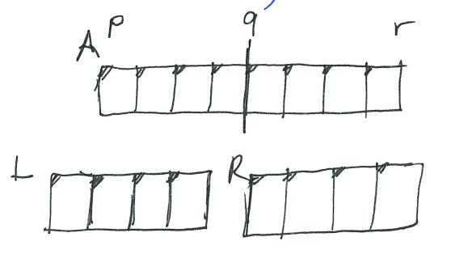
Merge Sort Combine Algorithm (2)
alt:“p,q,r” height:450px center

Slide 61
What is the complexity of merge operation?
You can find by counting loops will provide you base constant nested level will provide you exponent of this constant, if you drop constants you will have complexity
we have 3 for loops
it will look like $3n$ and $Θ\left(n\right)$ will be merge complexity

Slide 62
Merge Sort Correctness
Base case
$p=r$ (Trivially correct)
Inductive hypothesis
MERGE-SORT is correct for any subarray that is a strict (smaller) subset of $A\left[p,q\right]$.
General Case
MERGE-SORT is correct for $A\left[p,q\right]$. From inductive hypothesis and correctness of Merge.

Slide 63
Merge Sort Algorithm (Pseudo-Code)
A : Array p : offset r : length Merge-Sort(A,p,r) if p=r then (CHECK FOR BASE-CASE) return else q = floor((p+r)/2) (DIVIDE) Merge-Sort(A,p,q) (CONQUER) Merge-Sort(A,q+1,r) (CONQUER) Merge(A,p,q,r) (COMBINE) endif

Slide 64
Merge Sort Algorithm Complexity
A : Array p : offset r : length Merge-Sort(A,p,r)-------------> T(n) if p=r then--------------->Theta(1) return else q = floor((p+r)/2)---->Theta(1) Merge-Sort(A,p,q)-----> T(n/2) Merge-Sort(A,q+1,r)---> T(n/2) Merge(A,p,q,r)-------->Theta(n) endif

Slide 65
Merge Sort Algorithm Recurrence
We can describe a function recursively in terms of itself, to analyze the performance of recursive algorithms
$$T\left(n\right)=\left\{\begin{matrix}Θ\left(1\right) & \text{if n=1} \\ 2T\left(n/2\right)+Θ\left(n\right) & otherwise\end{matrix}\right.$$

Slide 66
How To Solve Recurrence (1)
$$T\left(n\right)=\left\{\begin{matrix}Θ\left(1\right) & \text{if n=1} \\ 2T\left(n/2\right)+Θ\left(n\right) & otherwise\end{matrix}\right.$$

Slide 67
How To Solve Recurrence (2)
We will assume $T\left(n\right)=Θ\left(1\right)$ for sufficiently small $n$ to rewrite equation as
$$T\left(n\right)=2T\left(n/2\right)+Θ\left(n\right)$$
Solution for this equation will be $Θ\left(nlgn\right)$ with following recursion tree.

Slide 68
How To Solve Recurrence (3)
Multiply by height $Θ\left(lgn\right)$ with each level cost $Θ\left(n\right)$ we can found $Θ\left(nlgn\right)$

Slide 69
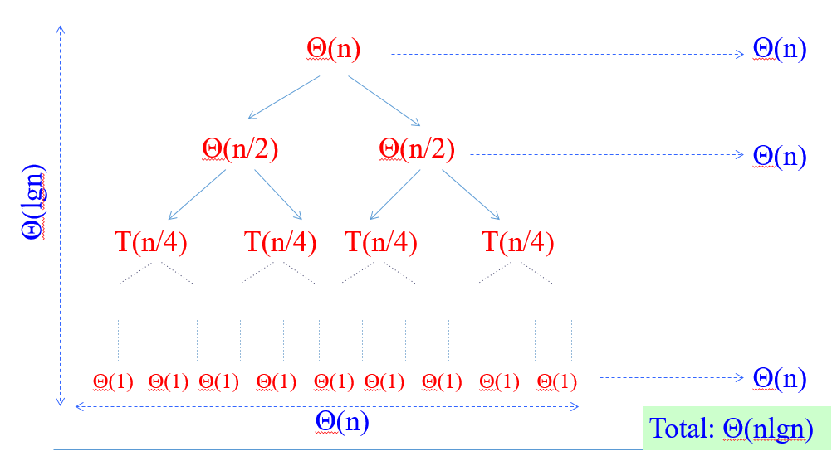
How To Solve Recurrence (4)
This tree is binary-tree and binary-tree height is related with item size.
alt:“Merge Sort Recursive Tree” height:450px center

Slide 70
How Height of a Binary Tree is Equal to $logn$ ? (1)
Merge-Sort recursion tree is a perfect binary tree, a binary tree is a tree which every node has at most two children, A perfect binary tree is binary tree in which all internal nodes have exactly two children and all leaves are at the same level.

Slide 71
How Height of a Binary Tree is Equal to $logn$ ? (2)
Let $n$ be the number of nodes in the tree and let $l_{k}$ denote the number of nodes on level k. According to this;
$l_{k}=2l_{k−1}$ i.e. each level has exactly twice as many nodes as the previous level
$l_{0}=1$ , i.e. on the first level we have only one node (the root node)
The leaves are at the last level, $l_{h}$ where $h$ is the height of the tree.

Slide 72
How Height of a Binary Tree is Equal to $logn$ ? (3)
The total number of nodes in the tree is equal to the sum of the nodes on all the levels: nodes $n$
$$1+2^{1}+2^{2}+2^{3}+...+2^{h}=n$$
$$1+2^{1}+2^{2}+2^{3}+...+2^{h}=2^{h+1}−1$$
$$2^{h+1}−1=n$$
$$2^{h+1}=n+1$$
$$log_{2}2^{h+1}=log_{2}\left(n+1\right)$$
$$h+1=log_{2}\left(n+1\right)$$
$$h=log_{2}\left(n+1\right)−1$$

Slide 73
How Height of a Binary Tree is Equal to $logn$ ? (3)
If we write it as asymptotic approach, we will have the following result
$$\text{height of tree is }h=log_{2}\left(n+1\right)−1=O\left(logn\right)$$
also
$$\text{number of leaves is }l_{h}=\left(n+1\right)/2$$
nearly half of the nodes are at the leaves

Slide 74
Review
$Θ\left(nlgn\right)$ grows more slowly than $Θ\left(n^{2}\right)$
Therefore Merge-Sort beats Insertion-Sort in the worst case
In practice Merge-Sort beats Insertion-Sort for $n>30$ or so

Slide 75
Asymptotic Notations

Slide 76
Big-O / $O$- Notation : Asymptotic Upper Bound (Worst-Case) (1)
$f\left(n\right)=O\left(g\left(n\right)\right)$ if $∃$ positive constants $c$, $n_{0}$ such that
$$0≤f\left(n\right)≤cg\left(n\right),∀n≥n_{0}$$

Slide 77
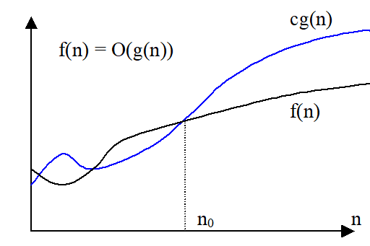
Big-O / $O$- Notation : Asymptotic Upper Bound (Worst-Case) (2)
alt:“Big-O Function-1” height:450px center

Slide 78
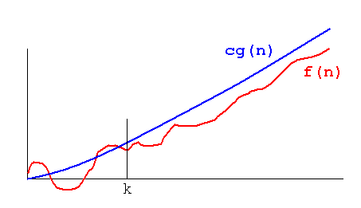
Big-O / $O$- Notation : Asymptotic Upper Bound (Worst-Case) (3)
alt:“Big-O Function-2” height:450px center

Slide 79
Big-O / $O$- Notation : Asymptotic Upper Bound (Worst-Case) (4)
Asymptotic running times of algorithms are usually defined by functions whose domain are $N=0,1,2,…$ (natural numbers)

Slide 80
Big-O / $O$- Notation : Asymptotic Upper Bound (Worst-Case) (5)
Example-1
Show that $2n^{2}=O\left(n^{3}\right)$
we need to find two positive constant $c$ and $n_{0}$ such that:
$$0≤2n^{2}≤cn^{3}\text{ for all }n≥n_{0}$$
Choose $c=2$ and $n_{0}=1$
$$2n^{2}≤2n^{3}\text{ for all }n≥1$$
Or, choose $c=1$ and $n_{0}=2$
$$2n^{2}≤n^{3}\text{ for all }n≥2$$

Slide 81
Big-O / $O$- Notation : Asymptotic Upper Bound (Worst-Case) (6)
Example-2
Show that $2n^{2}+n=O\left(n^{2}\right)$
We need to find two positive constant $c$ and $n_{0}$ such that:
$$0≤2n^{2}+n≤cn^{2}\text{ for all }n≥n_{0}$$
$$2+\left(1/n\right)≤c\text{ for all }n≥n_{0}$$
Choose $c=3$ and $n_{0}=1$
$$2n^{2}+n≤3n^{2}\text{ for all }n≥1$$

Slide 82
Big-O / $O$- Notation : Asymptotic Upper Bound (Worst-Case) (7)
We can say the followings about $f\left(n\right)=O\left(g\left(n\right)\right)$ equation
The notation is a little sloppy
One-way equation, e.q. $n^{2}=O\left(n^{3}\right)$ but we cannot say $O\left(n^{3}\right)=n^{2}$

Slide 83
Big-O / $O$- Notation : Asymptotic Upper Bound (Worst-Case) (8)
$O\left(g\left(n\right)\right)$ is in fact a set of functions as follow
$O\left(g\left(n\right)\right)=\{f\left(n\right):∃\text{ positive constant }c,n_{0}\text{ such that }0≤f\left(n\right)≤cg\left(n\right),∀n≥n_{0}\}$

Slide 84
Big-O / $O$- Notation : Asymptotic Upper Bound (Worst-Case) (9)
In other words $O\left(g\left(n\right)\right)$ is in fact, the set of functions that have asymptotic upper bound $g\left(n\right)$
e.q $2n^{2}=O\left(n^{3}\right)$ means $2n^{2}∈O\left(n^{3}\right)$

Slide 85
Big-O / $O$- Notation : Asymptotic Upper Bound (Worst-Case) (10)
Example-1
${10}^{9}n^{2}=O\left(n^{2}\right)$
$0≤{10}^{9}n^{2}≤cn^{2}\text{ for }n≥n_{0}$
choose $c={10}^{9}$ and $n_{0}=1$
$0≤{10}^{9}n^{2}≤{10}^{9}n^{2}\text{ for }n≥1$
CORRECT

Slide 86
Big-O / $O$- Notation : Asymptotic Upper Bound (Worst-Case) (11)
Example-2
$100n^{1.9999}=O\left(n^{2}\right)$
$0≤100n^{1.9999}≤cn^{2}\text{ for }n≥n_{0}$
choose $c=100$ and $n_{0}=1$
$0≤100n^{1.9999}≤100n^{2}\text{ for }n≥1$
CORRECT

Slide 87
Big-O / $O$- Notation : Asymptotic Upper Bound (Worst-Case) (12)
Example-3
${10}^{−9}n^{2.0001}=O\left(n^{2}\right)$
$0≤{10}^{−9}n^{2.0001}≤cn^{2}\text{ for }n≥n_{0}$
${10}^{−9}n^{0.0001}≤c\text{ for }n≥n_{0}$
INCORRECT (Contradiction)

Slide 88
Big-O / $O$- Notation : Asymptotic Upper Bound (Worst-Case) (13)
If we analysis $O\left(n^{2}\right)$ case, $O$-notation is an upper bound notation and the runtime $T\left(n\right)$ of algorithm A is at least $O\left(n^{2}\right)$.
$O\left(n^{2}\right)$: The set of functions with asymptotic upper bound $n^{2}$
$T\left(n\right)≥O\left(n^{2}\right)$ means $T\left(n\right)≥h\left(n\right)$ for some $h\left(n\right)∈O\left(n^{2}\right)$
$h\left(n\right)=0$ function is also in $O\left(n^{2}\right)$. Hence : $T\left(n\right)≥0$ , runtime must be nonnegative.

Slide 89
Big-Omega / $Ω$-Notation : Asymptotic Lower Bound (Best-Case) (1)
$f\left(n\right)=Ω\left(g\left(n\right)\right)$ if $∃$ positive constants $c,n_{0}$ such that $0≤cg\left(n\right)≤f\left(n\right),∀n≥n_{0}$

Slide 90
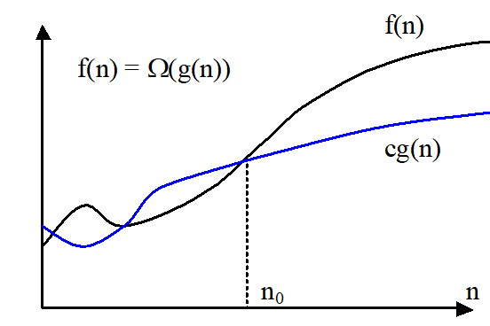
Big-Omega / $Ω$-Notation : Asymptotic Lower Bound (Best-Case) (2)
alt:“Big-Omega Function-1” height:450px center

Slide 91
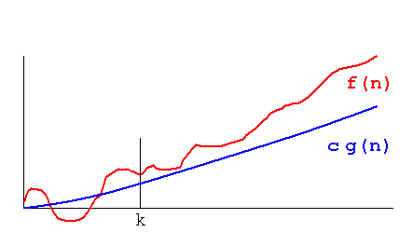
Big-Omega / $Ω$-Notation : Asymptotic Lower Bound (Best-Case) (3)
alt:“Big-Omega Function-2” height:450px center

Slide 92
Big-Omega / $Ω$-Notation : Asymptotic Lower Bound (Best-Case) (4)
Example-1
Show that $2n^{3}=Ω\left(n^{2}\right)$
We need to find two positive constants $c$ and $n_{0}$ such that:
$$0≤cn^{2}≤2n^{3}\text{ for all }n≥n_{0}$$
Choose $c=1$ and $n_{0}=1$
$$n^{2}≤2n^{3}\text{ for all }n≥1$$

Slide 93
Big-Omega / $Ω$-Notation : Asymptotic Lower Bound (Best-Case) (5)
Example-4
Show that $\sqrt{n}=Ω\left(lgn\right)$
We need to find two positive constants $c$ and $n_{0}$ such that:
$$clgn≤\sqrt{n}\text{ for all }n≥n_{0}$$
Choose $c=1$ and $n_{0}=16$
$$lgn≤\sqrt{n}\text{ for all }n≥16$$

Slide 94
Big-Omega / $Ω$-Notation : Asymptotic Lower Bound (Best-Case) (6)
$Ω\left(g\left(n\right)\right)$ is the set of functions that have asymptotic lower bound $g\left(n\right)$
$$Ω\left(g\left(n\right)\right)=\{f\left(n\right):∃\text{ positive constants }c,n_{0}\text{ such that }0≤cg\left(n\right)≤f\left(n\right),∀n≥n_{0}\}$$

Slide 95
Big-Omega / $Ω$-Notation : Asymptotic Lower Bound (Best-Case) (7)
Example-1
${10}^{9}n^{2}=Ω\left(n^{2}\right)$
$0≤cn^{2}≤{10}^{9}n^{2}\text{ for }n≥n_{0}$
Choose $c={10}^{9}$ and $n_{0}=1$
$0≤{10}^{9}n^{2}≤{10}^{9}n^{2}\text{ for }n≥1$
CORRECT

Slide 96
Big-Omega / $Ω$-Notation : Asymptotic Lower Bound (Best-Case) (8)
Example-2
$100n^{1.9999}=Ω\left(n^{2}\right)$
$0≤cn^{2}≤100n^{1.9999}\text{ for }n≥n_{0}$
$n^{0.0001}≤\left(100/c\right)\text{ for }n≥n_{0}$
INCORRECT(Contradiction)

Slide 97
Big-Omega / $Ω$-Notation : Asymptotic Lower Bound (Best-Case) (9)
Example-3
${10}^{−9}n^{2.0001}=Ω\left(n^{2}\right)$
$0≤cn^{2}≤{10}^{−9}n^{2.0001}\text{ for }n≥n_{0}$
Choose $c={10}^{−9}$ and $n_{0}=1$
$0≤{10}^{−9}n^{2}≤{10}^{−9}n^{2.0001}\text{ for }n≥1$
CORRECT

Slide 98
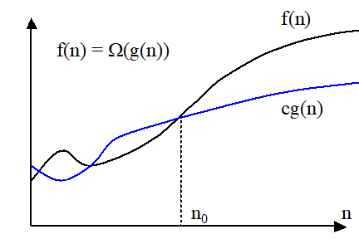
Comparison of Notations (1)
alt:“Big-Omega Function for Comparison” height:250px center

Slide 99
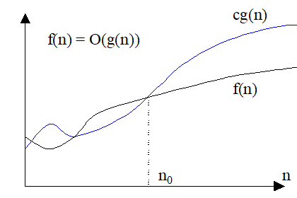
alt:“Big-O Function for Comparison” height:250px center

Slide 100
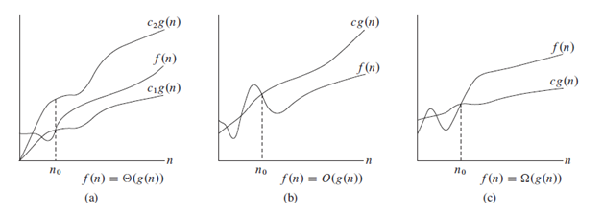
Comparison of Notations (2)
alt:“Comparison of Notations” height:450px center

Slide 101
Big-Theta /$Θ$-Notation : Asymptotically tight bound (Average Case) (1)
$f\left(n\right)=Θ\left(g\left(n\right)\right)$ if $∃$ positive constants $c_{1},c_{2},n_{0}$ such that $0≤c_{1}g\left(n\right)≤f\left(n\right)≤c_{2}g\left(n\right),∀n≥n_{0}$

Slide 102
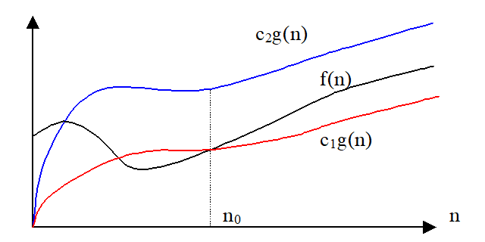
Big-Theta /$Θ$-Notation : Asymptotically tight bound (Average Case) (2)
alt:“Big-Theta Function” height:450px center

Slide 103
Big-Theta /$Θ$-Notation : Asymptotically tight bound (Average Case) (3)
Example-1
Show that $2n^{2}+n=Θ\left(n^{2}\right)$
We need to find 3 positive constants $c_{1},c_{2}$ and $n_{0}$ such that:
$0≤c_{1}n^{2}≤2n^{2}+n≤c_{2}n^{2}$ for all $n≥n_{0}$
$c_{1}≤2+\left(1/n\right)≤c_{2}$ for all $n≥n_{0}$
Choose $c_{1}=2,c_{2}=3$ and $n_{0}=1$
$2n^{2}≤2n^{2}+n≤3n^{2}$ for all $n≥1$

Slide 104
Big-Theta /$Θ$-Notation : Asymptotically tight bound (Average Case) (4)
Example-2.1
Show that $1/2n^{2}−2n=Θ\left(n^{2}\right)$
We need to find 3 positive constants $c_{1},c_{2}$ and $n_{0}$ such that:
$0≤c_{1}n^{2}≤1/2n^{2}−2n≤c_{2}n^{2}\text{ for all }n≥n_{0}$
$c_{1}≤1/2−2/n≤c_{2}\text{ for all }n≥n_{0}$
Choose 3 positive constants $c_{1},c_{2},n_{0}$ that satisfy $c_{1}≤1/2−2/n≤c_{2}$ for all $n≥n_{0}$

Slide 105
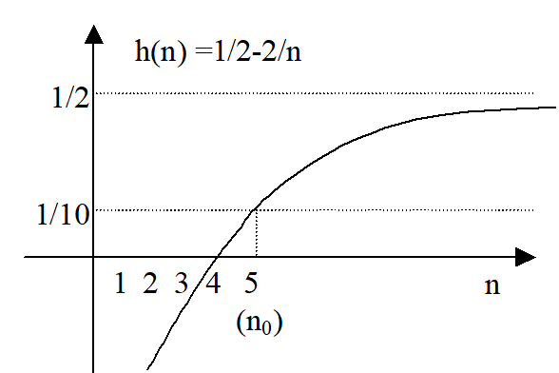
Big-Theta /$Θ$-Notation : Asymptotically tight bound (Average Case) (5)
Example-2.2
alt:“Big-Theta Example” height:450px center

Slide 106
Big-Theta /$Θ$-Notation : Asymptotically tight bound (Average Case) (6)
Example-2.3
$$1/10≤1/2−2/n\text{ for }n≥5$$
$$1/2−2/n≤1/2\text{ for }n≥0$$
Therefore we can choose $c_{1}=1/10,c_{2}=1/2,n_{0}=5$

Slide 107
Big-Theta /$Θ$-Notation : Asymptotically tight bound (Average Case) (7)
Theorem: leading constants & low-order terms don’t matter
Justification: can choose the leading constant large enough to make high-order term dominate other terms

Slide 108
Big-Theta /$Θ$-Notation : Asymptotically tight bound (Average Case) (8)
Example-1
${10}^{9}n^{2}=Θ\left(n^{2}\right)$ CORRECT
$100n^{1.9999}=Θ\left(n^{2}\right)$ INCORRECT
${10}^{9}n^{2.0001}=Θ\left(n^{2}\right)$ INCORRECT

Slide 109
Big-Theta /$Θ$-Notation : Asymptotically tight bound (Average Case) (9)
$Θ\left(g\left(n\right)\right)$ is the set of functions that have asymptotically tight bound $g\left(n\right)$
$Θ\left(g\left(n\right)\right)=\{f\left(n\right):∃\text{ positive constants }c_{1},c_{2},n_{0}\text{ such that }0≤c_{1}g\left(n\right)≤f\left(n\right)≤c_{2}g\left(n\right),∀n≥n_{0}\}$

Slide 110
Big-Theta /$Θ$-Notation : Asymptotically tight bound (Average Case) (10)
Theorem:
$f\left(n\right)=Θ\left(g\left(n\right)\right)$ if and only if $f\left(n\right)=O\left(g\left(n\right)\right)$ and $f\left(n\right)=Ω\left(g\left(n\right)\right)$
$Θ$ is stronger than both $O$ and $Ω$
$Θ\left(g\left(n\right)\right)⊆O\left(g\left(n\right)\right)\text{ and }Θ\left(g\left(n\right)\right)⊆Ω\left(g\left(n\right)\right)$

Slide 111
Big-Theta /$Θ$-Notation : Asymptotically tight bound (Average Case) (11)
Example-1.1
Prove that ${10}^{−8}n^{2}≠Θ\left(n\right)$
We can check that ${10}^{−8}n^{2}=Ω\left(n\right)$ and ${10}^{−8}n^{2}≠O\left(n\right)$
Proof by contradiction for $O\left(n\right)$ notation
$$O\left(g\left(n\right)\right)=\{f\left(n\right):∃\text{ positive constant }c,n_{0}\text{ such that }0≤f\left(n\right)≤cg\left(n\right),∀n≥n_{0}\}$$

Slide 112
Big-Theta /$Θ$-Notation : Asymptotically tight bound (Average Case) (12)
Example-1.2
Suppose positive constants $c_{2}$ and $n_{0}$ exist such that:
${10}^{−8}n^{2}≤c_{2}n,∀n≥n_{0}$
${10}^{−8}n≤c_{2},∀n≥n_{0}$
Contradiction: $c_{2}$ is a constant

Slide 113
Summary of $O,Ω$ and $Θ$ notations (1)
$O\left(g\left(n\right)\right)$ : The set of functions with asymptotic upper bound $g\left(n\right)$
$Ω\left(g\left(n\right)\right)$ : The set of functions with asymptotic lower bound $g\left(n\right)$
$Θ\left(n\right)$: The set of functions with asymptotically tight bound $g\left(n\right)$
$f\left(n\right)=Θ\left(g\left(n\right)\right)⇔f\left(n\right)=O\left(g\left(n\right)\right)\text{ and }f\left(n\right)=Ω\left(g\left(n\right)\right)$

Slide 114
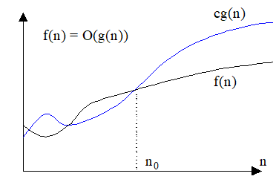
Summary of $O,Ω$ and $Θ$ notations (2)
alt:“Summary Big-O” height:200px center

Slide 115
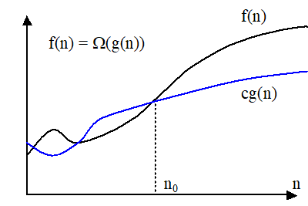
alt:“Summary Big-Omega” height:200px center

Slide 116
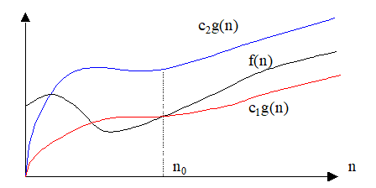
alt:“Summary Big-Theta” height:200px center

Slide 117
Small-o / $o$-Notation : Asymptotic upper bound that is not tight (1)
Remember, upper bound provided by big- $O$ notation can be tight or not tight
Tight mean values are close the original function
e.g. followings are true
$2n^{2}=O\left(n^{2}\right)$ is asymptotically tight
$2n=O\left(n^{2}\right)$ is not asymptotically tight
According to this small-$o$ notation is an upper bound that is not asymptotically tight

Slide 118
Small-o / $o$-Notation : Asymptotic upper bound that is not tight (2)
Note that in equations equality is removed in small notations
$o\left(g\left(n\right)\right)=\{f\left(n\right):\text{ for any constant}c>0,∃\text{ a constant }n_{0}>0,\text{ such that }0≤f\left(n\right)<cg\left(n\right),∀n≥n_{0}\}$
$$\lim_{n→∞}\frac{f\left(n\right)}{g\left(n\right)}=0$$
e.g $2n=o\left(n^{2}\right)$ any positive $c$ satisfies but $2n^{2}≠o\left(n^{2}\right)$ $c=2$ does not satisfy

Slide 119
Small-omega / $ω$-Notation: Asymptotic lower bound that is not tight (1)
$ω\left(g\left(n\right)\right)=\{f\left(n\right):\text{ for any constant }c>0,∃\text{ a constant }n_{0}>0,\text{ such that }0≤cg\left(n\right)<f\left(n\right),∀n≥n_{0}$
$$\lim_{n→∞}\frac{f\left(n\right)}{g\left(n\right)}=∞$$
e.g. $n^{2}/2=ω\left(n\right)$, any positive $c$ satisfies but $n^{2}/2≠ω\left(n^{2}\right)$, $c=1/2$ does not satisfy

Slide 120
(Important) Analogy to compare of two real numbers
$$f\left(n\right)=O\left(g\left(n\right)\right)↔a≤b$$
$$f\left(n\right)=Ω\left(g\left(n\right)\right)↔a≥b$$
$$f\left(n\right)=Θ\left(g\left(n\right)\right)↔a=b$$
$$f\left(n\right)=o\left(g\left(n\right)\right)↔a<b$$
$$f\left(n\right)=ω\left(g\left(n\right)\right)↔a>b$$

Slide 121
(Important) Trichotomy property for real numbers
For any two real numbers $a$ and $b$, we have either
$a<b$, or $a=b$, or $a>b$
Trichotomy property does not hold for asymptotic notation, for two functions $f\left(n\right)$ and $g\left(n\right)$, it may be the case that neither $f\left(n\right)=O\left(g\left(n\right)\right)$ nor $f\left(n\right)=Ω\left(g\left(n\right)\right)$ holds.
e.g. $n$ and $n^{1+sin\left(n\right)}$ cannot be compared asymptotically

Slide 122
$5n^{2}=O\left(n^{2}\right)$ | TRUE | $n^{2}lgn=O\left(n^{2}\right)$ | FALSE
$5n^{2}=Ω\left(n^{2}\right)$ | TRUE | $n^{2}lgn=Ω\left(n^{2}\right)$ | TRUE
$5n^{2}=Θ\left(n^{2}\right)$ | TRUE | $n^{2}lgn=Θ\left(n^{2}\right)$ | FALSE
$5n^{2}=o\left(n^{2}\right)$ | FALSE | $n^{2}lgn=o\left(n^{2}\right)$ | FALSE
$5n^{2}=ω\left(n^{2}\right)$ | FALSE | $n^{2}lgn=ω\left(n^{2}\right)$ | TRUE
$2^{n}=O\left(3^{n}\right)$ | TRUE
$2^{n}=Ω\left(3^{n}\right)$ | FALSE | $2^{n}=o\left(3^{n}\right)$ | TRUE
$2^{n}=Θ\left(3^{n}\right)$ | FALSE | $2^{n}=ω\left(3^{n}\right)$ | FALSE
Examples

Slide 123
Asymptotic Function Properties
Transitivity: holds for all
e.g. $f\left(n\right)=Θ\left(g\left(n\right)\right)\&g\left(n\right)=Θ\left(h\left(n\right)\right)⇒f\left(n\right)=Θ\left(h\left(n\right)\right)$
Reflexivity: holds for $Θ,O,Ω$
e.g. $f\left(n\right)=O\left(f\left(n\right)\right)$
Symmetry: hold only for $Θ$
e.g. $f\left(n\right)=Θ\left(g\left(n\right)\right)⇔g\left(n\right)=Θ\left(f\left(n\right)\right)$
Transpose Symmetry: holds for $\left(O↔Ω\right)$ and $\left(o↔ω\right)$
e.g. $f\left(n\right)=O\left(g\left(n\right)\right)⇔g\left(n\right)=Ω\left(f\left(n\right)\right)$

Slide 124
Using $O$-Notation to Describe Running Times (1)
Used to bound worst-case running times, Implies an upper bound runtime for arbitrary inputs as well
Example:
Insertion sort has worst-case runtime of $O\left(n^{2}\right)$
Note:
This $O\left(n^{2}\right)$ upper bound also applies to its running time on every input
Abuse to say “running time of insertion sort is $O\left(n^{2}\right)$”
For a given $n$, the actual running time depends on the particular input of size $n$
i.e., running time is not only a function of $n$
However, worst-case running time is only a function of $n$

Slide 125
Using $O$-Notation to Describe Running Times (2)
When we say:
Running time of insertion sort is $O\left(n^{2}\right)$
What we really mean is
Worst-case running time of insertion sort is $O\left(n^{2}\right)$
or equivalently
No matter what particular input of size n is chosen, the running time on that set of inputs is $O\left(n^{2}\right)$

Slide 126
Using $Ω$-Notation to Describe Running Times (1)
Used to bound best-case running times, Implies a lower bound runtime for arbitrary inputs as well
Example:
Insertion sort has best-case runtime of $Ω\left(n\right)$
Note:
This $Ω\left(n\right)$ lower bound also applies to its running time on every input

Slide 127
Using $Ω$-Notation to Describe Running Times (2)
When we say
Running time of algorithm A is $Ω\left(g\left(n\right)\right)$
What we mean is
For any input of size $n$, the runtime of A is at least a constant times $g\left(n\right)$ for sufficiently large $n$
It’s not contradictory to say
worst-case running time of insertion sort is $Ω\left(n^{2}\right)$
Because there exists an input that causes the algorithm to take $Ω\left(n^{2}\right)$

Slide 128
Using $Θ$-Notation to Describe Running Times (1)
Consider 2 cases about the runtime of an algorithm
Case 1: Worst-case and best-case not asymptotically equal
Use $Θ$-notation to bound worst-case and best-case runtimes separately
Case 2: Worst-case and best-case asymptotically equal
Use $Θ$-notation to bound the runtime for any input

Slide 129
Using $Θ$-Notation to Describe Running Times (2)
Case 1: Worst-case and best-case not asymptotically equal
Use $Θ$-notation to bound the worst-case and best-case runtimes separately
We can say:
“The worst-case runtime of insertion sort is $Θ\left(n^{2}\right)$”
“The best-case runtime of insertion sort is $Θ\left(n\right)$”
But, we can’t say:
“The runtime of insertion sort is $Θ\left(n^{2}\right)$ for every input”
A $Θ$-bound on worst/best-case running time does not apply to its running time on arbitrary inputs

Slide 130
Worst-Case and Best-Case Equation for Merge-Sort
e.g. for merge-sort, we have:
$$T\left(n\right)=Θ\left(nlgn\right)\left\{\begin{matrix}T\left(n\right)=O\left(nlgn\right) \\ T\left(n\right)=Ω\left(nlgn\right)\end{matrix}\right.$$

Slide 131
Using Asymptotic Notation to Describe Runtimes Summary (1)
“The worst case runtime of Insertion Sort is $O\left(n^{2}\right)$”
Also implies: “The runtime of Insertion Sort is $O\left(n^{2}\right)$”
“The best-case runtime of Insertion Sort is $Ω\left(n\right)$”
Also implies: “The runtime of Insertion Sort is $Ω\left(n\right)$”

Slide 132
Using Asymptotic Notation to Describe Runtimes Summary (2)
“The worst case runtime of Insertion Sort is $Θ\left(n^{2}\right)$”
But: “The runtime of Insertion Sort is not $Θ\left(n^{2}\right)$”
“The best case runtime of Insertion Sort is $Θ\left(n\right)$”
But: “The runtime of Insertion Sort is not $Θ\left(n\right)$”

Slide 133
Using Asymptotic Notation to Describe Runtimes Summary (3)
Which one is true?
FALSE “The worst case runtime of Merge Sort is $Θ\left(nlgn\right)$”
FALSE “The best case runtime of Merge Sort is $Θ\left(nlgn\right)$”
TRUE “The runtime of Merge Sort is $Θ\left(nlgn\right)$”
This is true, because the best and worst case runtimes have asymptotically the same tight bound $Θ\left(nlgn\right)$

Slide 134
Asymptotic Notation in Equations (RHS)
Asymptotic notation appears alone on the RHS of an equation:
implies set membership
e.g., $n=O\left(n^{2}\right)$ means $n∈O\left(n^{2}\right)$
Asymptotic notation appears on the RHS of an equation stands for some anonymous function in the set
e.g., $2n^{2}+3n+1=2n^{2}+Θ\left(n\right)$ means:
$2n^{2}+3n+1=2n^{2}+h\left(n\right)$, for some $h\left(n\right)∈Θ\left(n\right)$
i.e., $h\left(n\right)=3n+1$

Slide 135
Asymptotic Notation in Equations (LHS)
Asymptotic notation appears on the LHS of an equation:
stands for any anonymous function in the set
e.g., $2n^{2}+Θ\left(n\right)=Θ\left(n^{2}\right)$ means:
for any function $g\left(n\right)∈Θ\left(n\right)$
$∃$ some function $h\left(n\right)∈Θ\left(n^{2}\right)$
such that $2n^{2}+g\left(n\right)=h\left(n\right)$
RHS provides coarser level of detail than LHS

Slide 136
References
Introduction to Algorithms, Third Edition | The MIT Press
http://nabil.abubaker.bilkent.edu.tr/473/
Insertion Sort - GeeksforGeeks
http://www.cs.gettysburg.edu/~ilinkin/courses/Fall-2012/cs216/notes/bintree.pdf
Dictionary of Algorithms and Data Structures
big-O notation
Omega

