Slide 1
CE103 Algorithms and Programming I
C/Cpp GUI Programming Author: Asst. Prof. Dr. Uğur CORUH

Slide 2
CE103 Algorithms and Programming I

Slide 3
Week-12 (C/Cpp GUI Programming)
Fall Semester, 2021-2022
Download DOC, SLIDE, PPTX

Slide 4
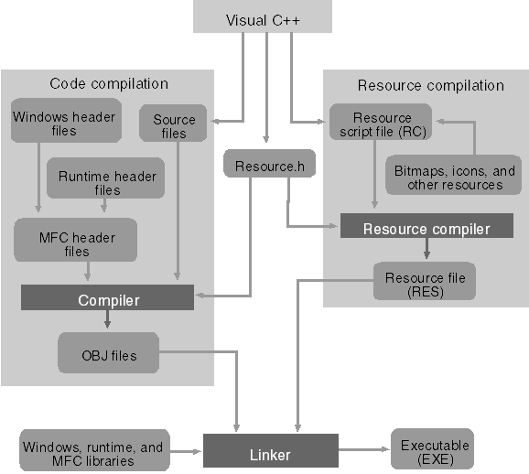
C/Cpp GUI Programming
The Microsoft Foundation Class
MFC Tutorial
Visual C++ / MFC Calculator 3 - YouTube
MFC C++ : My videos source code download available now to members - YouTube
The Windows GUI interface programming using Microsoft Foundation Classes (MFC) with Visual C++ and .Net hands-on approach tutorials
Module 1: Using Visual C++ 6.0, .Net and Windows MFC Graphic User Interface (GUI) programming hands-on tutorial-Module1
The Visual C++ application build process

Slide 5
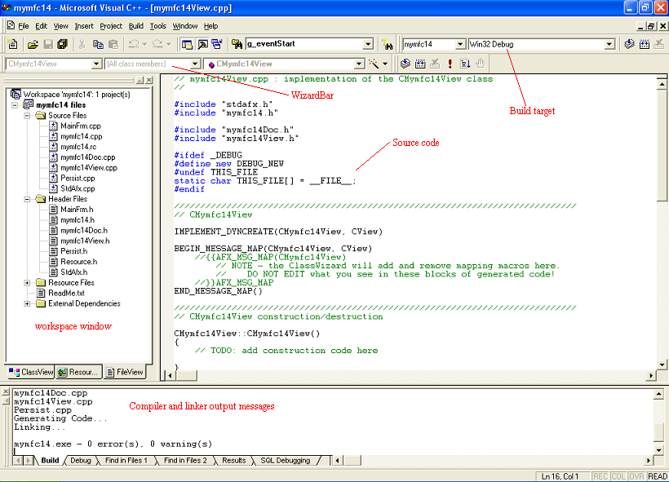
Visual C++ 6.0 windows with main components displayed

Slide 6
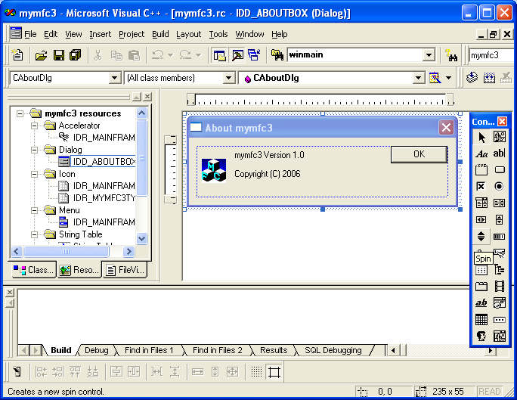
Visual C++ ResourceView

Slide 7
GTK 4
https://www.msys2.org/
https://www.msys2.org/
Programming with gtkmm 4
Build and run GTK 4 applications with Visual Studio
https://www.gtk.org/
The Meson Build system
The GTK Project - A free and open-source cross-platform widget toolkit
// Include gtk #include <gtk/gtk.h> static void on_activate (GtkApplication *app) { // Create a new window GtkWidget *window = gtk_application_window_new (app); // Create a new button GtkWidget *button = gtk_button_new_with_label ("Hello, World!"); // When the button is clicked, close the window passed as an argument g_signal_connect_swapped (button, "clicked", G_CALLBACK (gtk_window_close), window); gtk_window_set_child (GTK_WINDOW (window), button); gtk_window_present (GTK_WINDOW (window)); } int main (int argc, char *argv[]) { // Create a new application GtkApplication *app = gtk_application_new ("com.example.GtkApplication", G_APPLICATION_FLAGS_NONE); g_signal_connect (app, "activate", G_CALLBACK (on_activate), NULL); return g_application_run (G_APPLICATION (app), argc, argv); }

Slide 8
eBooks by Tags | RIP Tutorial

