Slide 1
CSci 6971: Image Registration
Lecture 11b: CMake Tutorial
February 20, 2004
Brad King
Kitware, Inc.

Slide 2
Build-System Generator
Provides single-sourcing for build systems
Knowledge of many platforms and tools
Users configure builds through a GUI
CMakeLists.txt
CMake
Native Build System
Executables
Libraries
Native Build Tools

Slide 3
Source and Build Trees
The Source Tree contains:
  CMake input files (CMakeLists.txt)
  Program source files (hello.cxx)
The Binary Tree (build tree) contains:
  Native build system files (hello.dsp)
  Program libraries and executables (hello.exe)
Source and Binary trees may be:
  In the same directory (in-source build)
  In different directories (out-of-source build)

Slide 4
The CMake Cache
Represents build configuration
Populated by CMake code
Stored in CMakeCache.txt at top of build
Entries have a type to help the GUI
Holds global information for CMake code
Updated by CMake configuration phase

Slide 5
Command Line Usage
Can be used from scripts
Set current-working-directory to binary tree
Pass path to source tree as first argument
Use -G to select build system generator
Use -D to set cache variables
$ cd Foo-msvc-6
$ cmake ../Foo –G“Visual Studio 6” –DBAR:BOOL=1

Slide 6
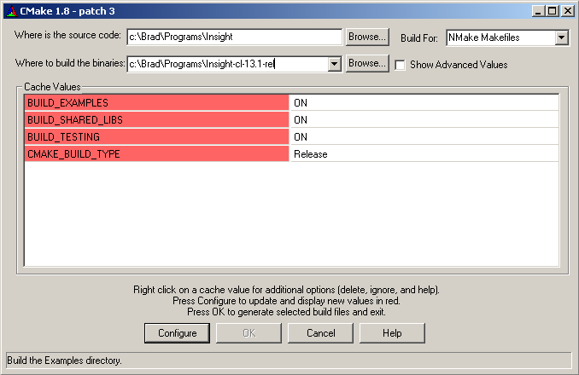
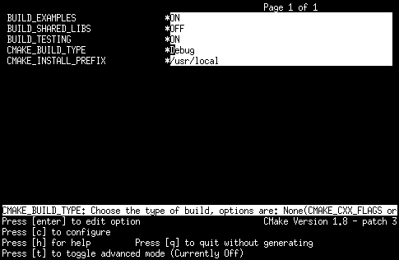
GUI Usage
Edit cache entries to configure the build
Use configure button after a change
Use OK (generate) button when finished
CMakeSetup
ccmake

Slide 7
Source Tree Structure
Every directory has a CMakeLists.txt file
Subdirectories specified by SUBDIRS
Directories depend only on parents
A subset of commands are inherited
Dir1/CMakeLists.txt
CMakeLists.txt
SUBDIRS(Dir1 Dir2)
Dir2/CMakeLists.txt

Slide 8
Writing CMakeLists.txt Files
CMake language evolved while in use
Scripting language with simple syntax
  Comments
  Commands
  Lists
  Variables
  Control structures
Processed during CMake configure phase
# Comment ends at a newline
COMMAND(arg1 arg2 ...)
A;B;C # Semicolon-separated
${VAR}
IF(CONDITION)

Slide 9
Commands
COMMAND(ARG “ARG WITH SPACES”
${A_LIST} “${A_STRING}”)
Simple syntax:
Each command must start on its own line
Variable references are replaced by values
Lists in unquoted arguments are expanded
Argument meanings defined by command
Both positional and keyword arguments used
TARGET_LINK_LIBRARIES(myTarget lib1 lib2)
FIND_LIBRARY(MY_LIB NAMES my1 my2
PATHS /foo /bar)

Slide 10
Variables
Named by C-style identifier
Value is always a string
No associated type
Initialized by CMake cache entries
Assigned through commands like SET
Referenced by ${VAR} (only one level)
SET(A_LIST ${A_LIST} foo)
SET(A_STRING “${A_STRING} bar”)

Slide 11
Control Structures
IF(CONDITION)
MESSAGE(“Yes”)
ELSE(CONDITION)
MESSAGE(“No”)
ENDIF(CONDITION)
IF
FOREACH
MACRO
FOREACH(c A B C)
MESSAGE(“${c}: ${${c}}”)
ENDFOREACH(c)
MACRO(MY_MACRO arg1 arg2)
SET(${arg1} “${${arg2}}”)
ENDMACRO(MY_MACRO)
MY_MACRO(A B)

Slide 12
A Typical Project
CMakeLists.txt
PROJECT(FOO)
SUBDIRS(Foo Bar Executable)
Foo/CMakeLists.txt
ADD_LIBRARY(foo foo1.cxx foo2.cxx)
Bar/CMakeLists.txt
ADD_LIBRARY(bar bar1.cxx bar2.cxx)
TARGET_LINK_LIBRARIES(bar foo)
Executable/CMakeLists.txt
ADD_EXECUTABLE(zot zot1.cxx zot2.cxx)
TARGET_LINK_LIBRARIES(zot bar)

Slide 13
Developer Documentation
Command-line documentation:
  Run “cmake --help” for summary
  Run “cmake --help COMMAND” for detailed help with a specific listfile command
  Try “cmake --help IF”
Online documentation:
  http://www.cmake.org/HTML/Documentation.html
Mastering CMake
  Published by Kitware, Inc.
  ISBN 1-930934-09-2

Slide 14
Editing CMake Code
EMACS mode for CMake
  cmake-mode.el located in CMake/Docs directory
  Provides highlighting and indentation
  Use this code in your .emacs file:
VIM mode is also available
(setq load-path (cons “/path/to/cmake-mode” load-path))
(require 'cmake-mode)
(setq auto-mode-alist
(append '(("CMakeLists.txt" . cmake-mode)
("\\.cmake$" . cmake-mode))
auto-mode-alist))

Slide 15
Building ITK & VXL Together
Build VXL using any configuration
Run CMakeSetup to build ITK
Click “Configure”
Turn on “Show Advanced Values”
Set ITK_USE_SYSTEM_VXL to ON
Click “Configure”
Set VXL_DIR to point at VXL build tree

Slide 16
Using ITK & VXL Together
Import ITK using code like this:
FIND_PACKAGE(ITK)
IF(ITK_FOUND)
INCLUDE(${ITK_USE_FILE})
IF(NOT ITK_USE_SYSTEM_VXL)
MESSAGE(“Need an ITK with ITK_USE_SYSTEM_VXL ON.”)
ENDIF(NOT ITK_USE_SYSTEM_VXL)
ELSE(ITK_FOUND)
MESSAGE(FATAL_ERROR “Set ITK_DIR”)
ENDIF(ITK_FOUND)

Slide 17
Using ITK & VXL Together
Create your application like this:
C++ code is straightforward:
ADD_EXECUTABLE(myapp myapp.cxx)
TARGET_LINK_LIBRARIES(myapp ITKIO vil)
#include “itkImage.h”
#include <vil/vil_transform.h>
// ...

