Slide 1
CE103 Algorithms and Programming I
Java GUI Programming Author: Asst. Prof. Dr. Uğur CORUH

Slide 2
CE103 Algorithms and Programming I

Slide 3
Week-15 (Java GUI Programming)

Slide 4
Fall Semester, 2021-2022
Download DOC, SLIDE, PPTX

Slide 5
Java GUI Programming

Slide 6
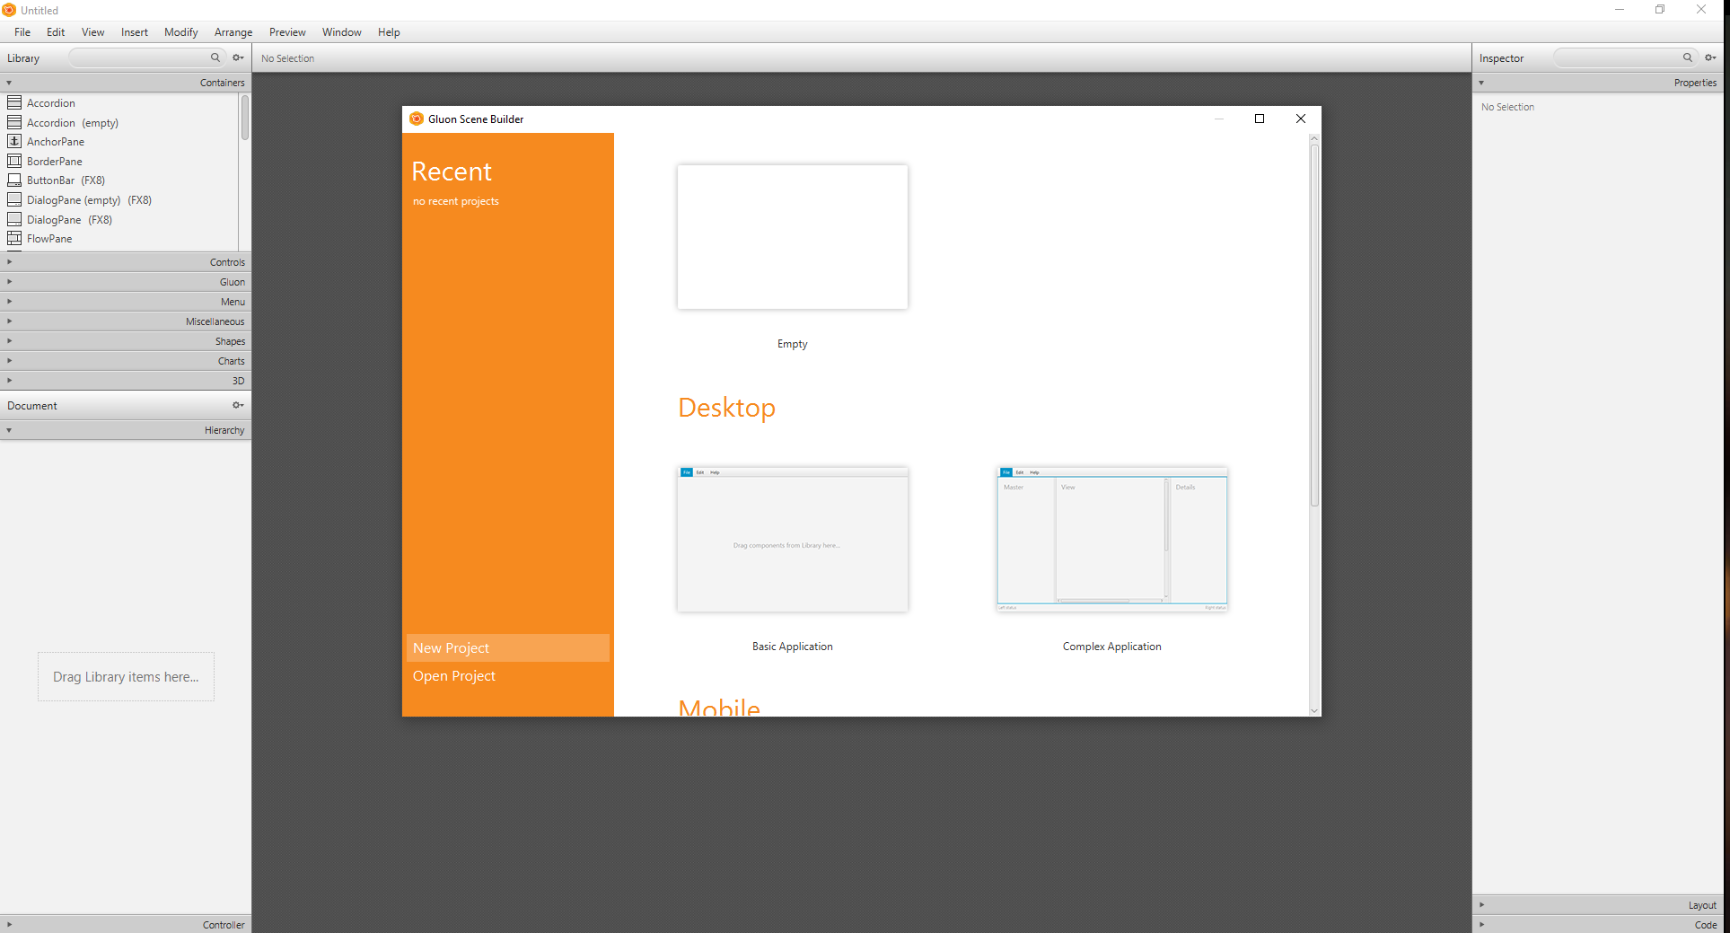
JavaFX GUI Programming
1-Install Gluon Scene Builder
Download and Install Gluon Scene Builder from URL
Scene Builder - Gluon
We will use gluon scene builder as an external designer for NetBeans, Eclipse, and IntelliJ idea tools.

Slide 7
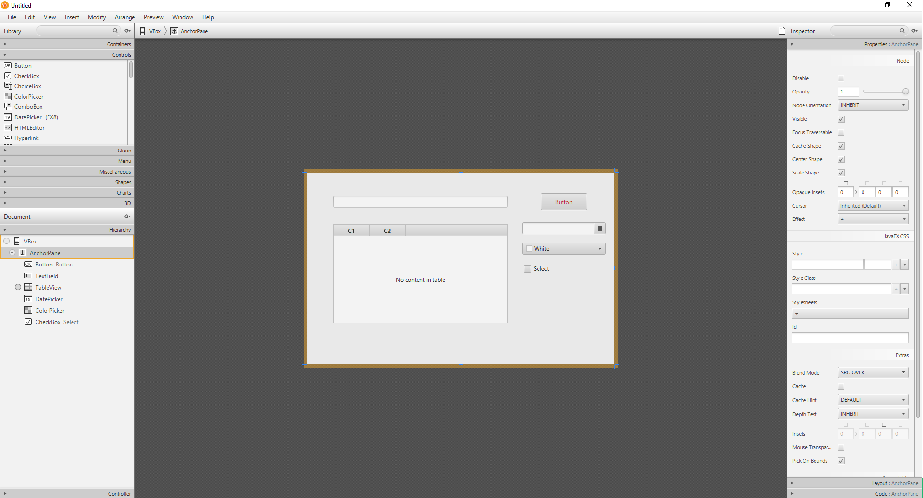

Slide 8
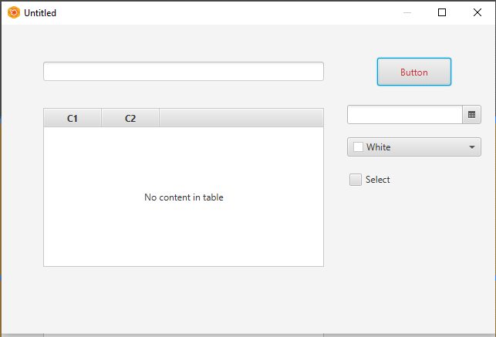

Slide 9
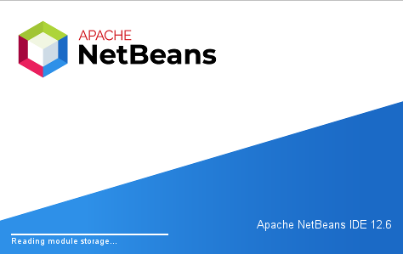
you can save this design as an FXML file from File->Save As
2-Install Apache Netbeans
Download and install apache Netbeans
https://netbeans.apache.org/

Slide 10
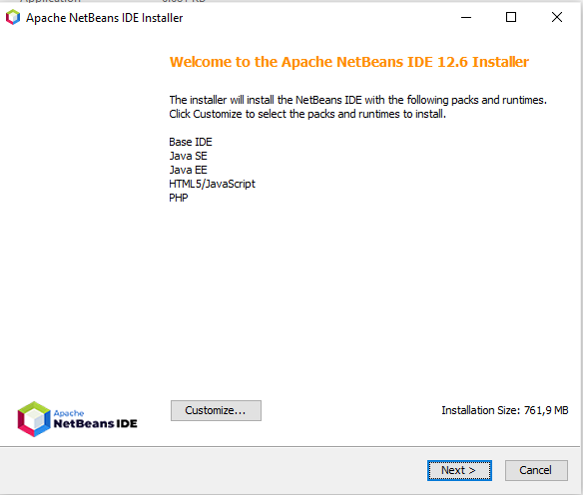

Slide 11
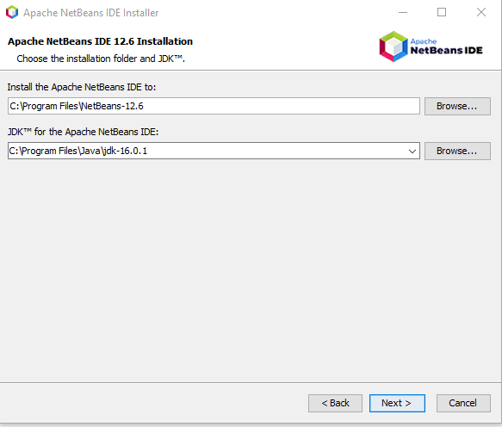

Slide 12
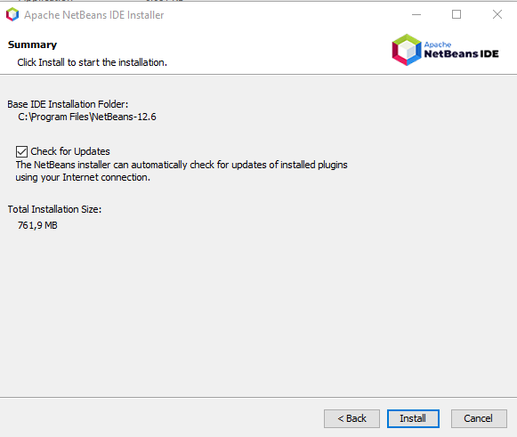

Slide 13
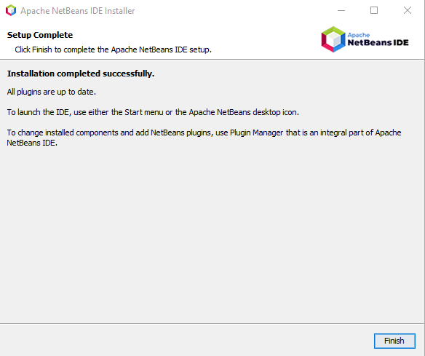

Slide 14
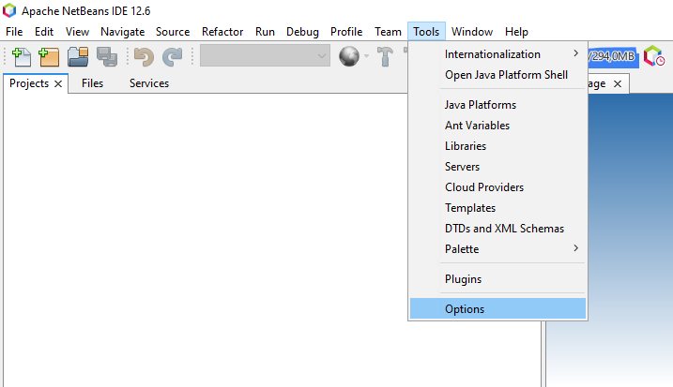
3- Configure JavaFX Scene Builder for Apache Netbeans
Open Tools->Options->Java->JavaFX

Slide 15
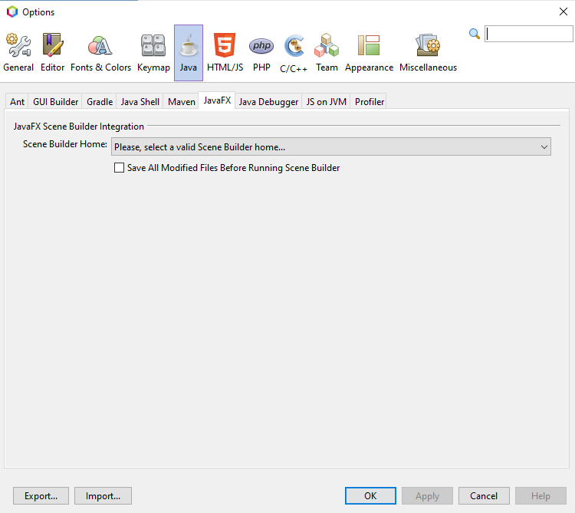

Slide 16
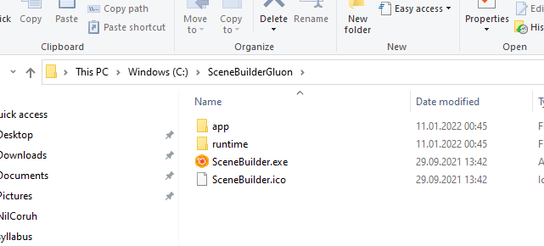
Select builder home

Slide 17
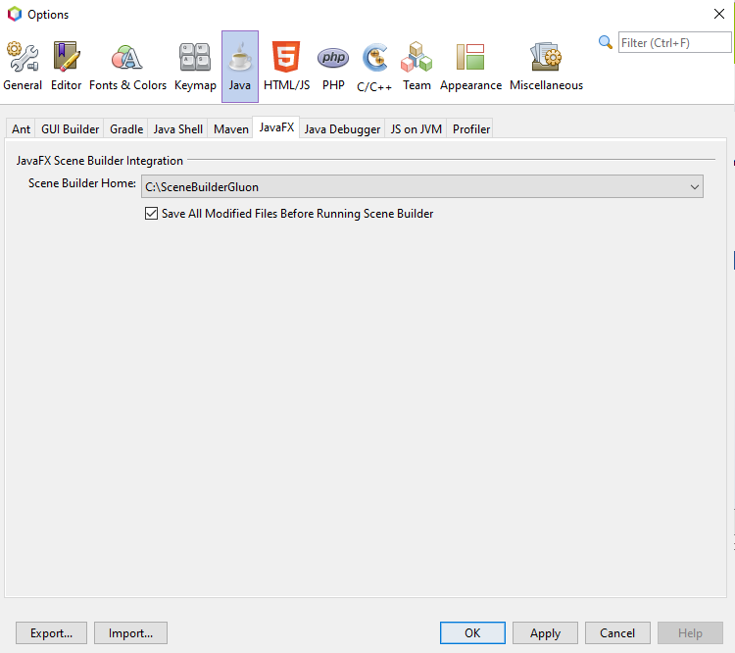

Slide 18
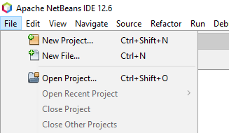
you can find old integration documentation here
Using JavaFX Scene Builder with Java IDEs: Using Scene Builder with NetBeans IDE | JavaFX 2 Tutorials and Documentation
4-Create First Application
Select File->New Project

Slide 19
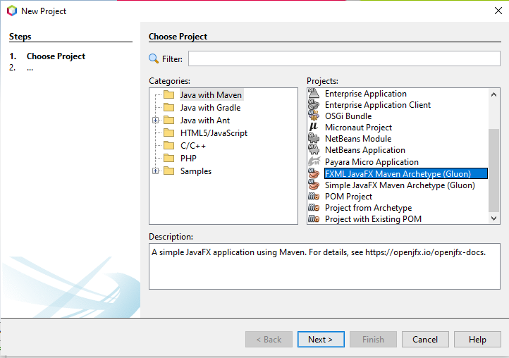
Select Java With Maven Types
FXML JavaFX Maven Archetype (Gluon)

Slide 20
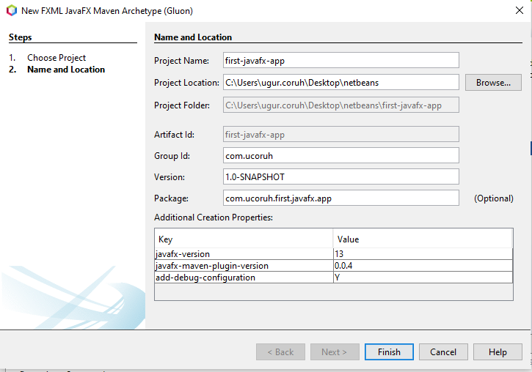
Set project properties

Slide 21
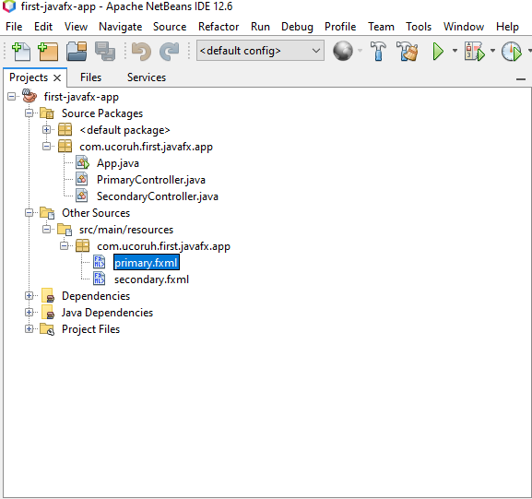
Open Project Resources and Click FXML files to run Scene Builder

Slide 22
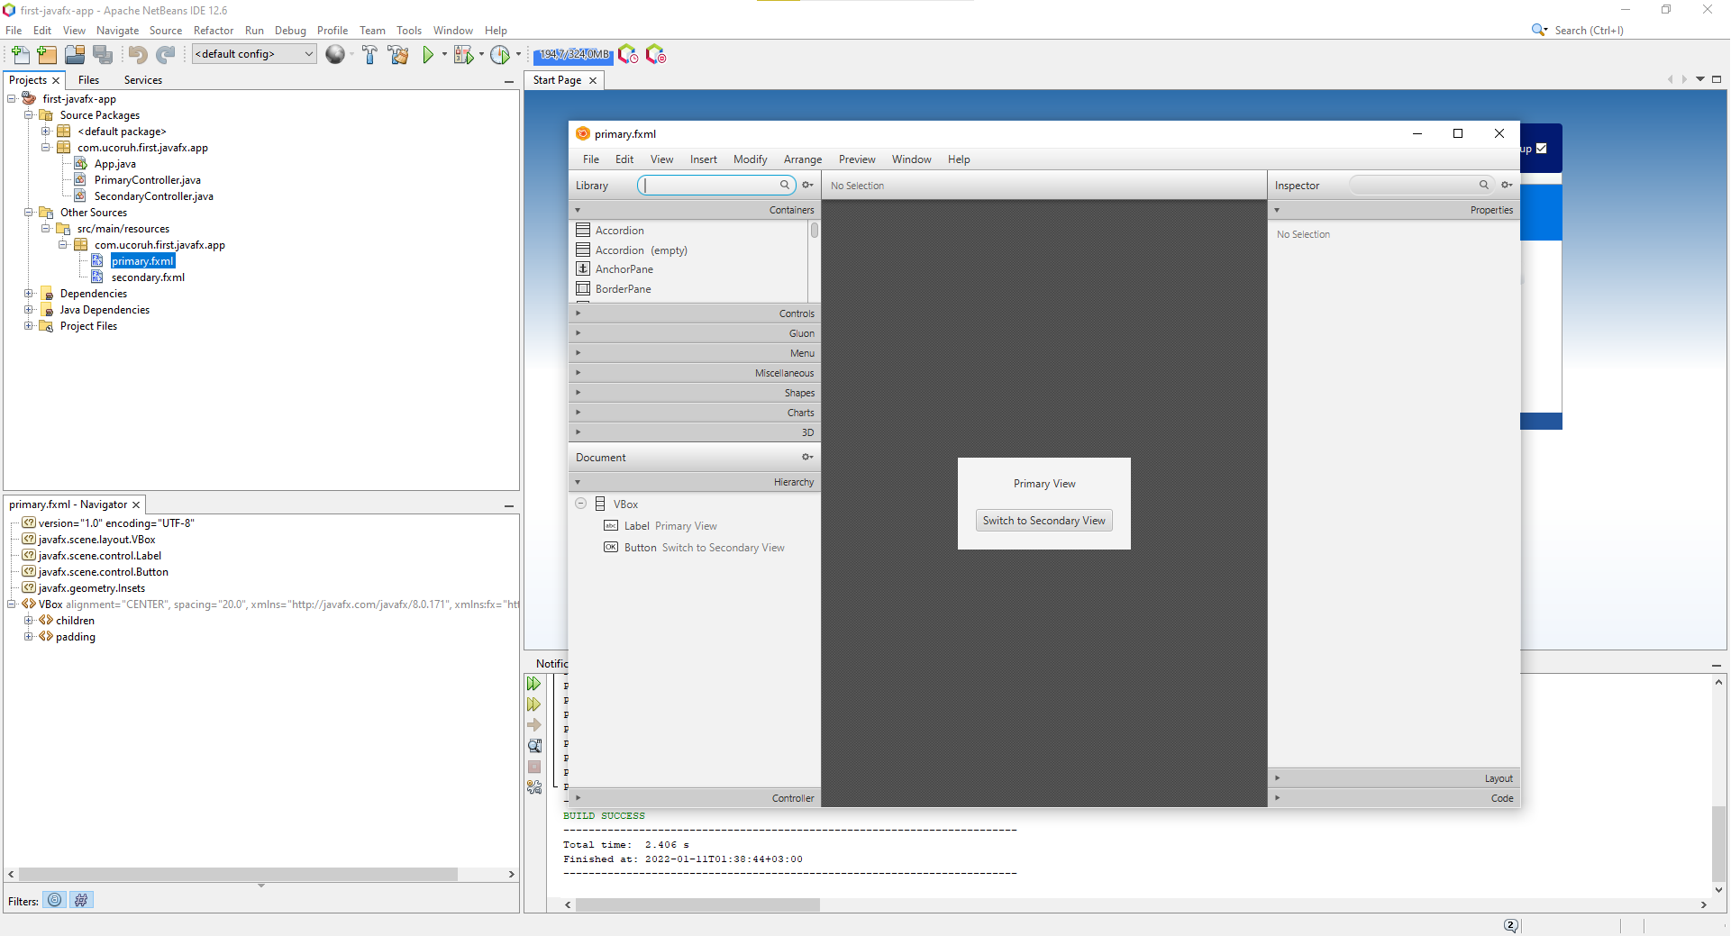

Slide 23
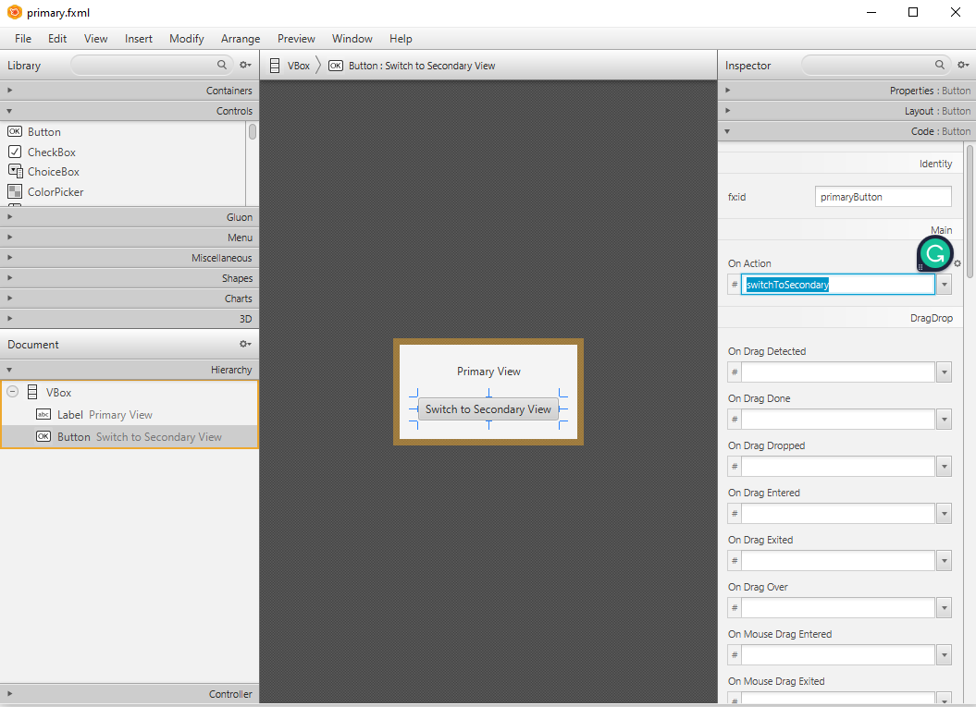
In designer properties tab will show control properties, code tab will show action bindings

Slide 24
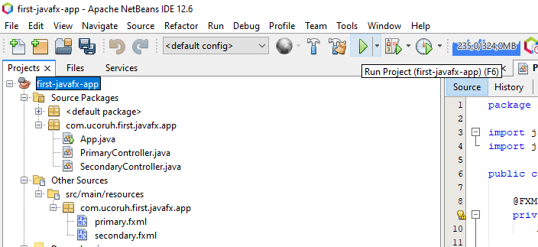
Then you can run applications from Netbeans.

Slide 25
for introduction level information please check the following examples
JavaFX Simple Calculator - Design and Code - YouTube
JavaFX Library Management System Development #0: Introduction - YouTube
for more information about JavaFX please check the following
JavaFX Tutorial - javatpoint

Slide 26
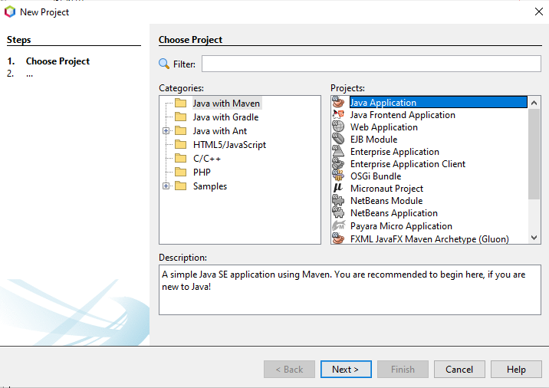
Java Swing GUI Programming
Select File->New Project -> Java with Maven -> Java Application

Slide 27
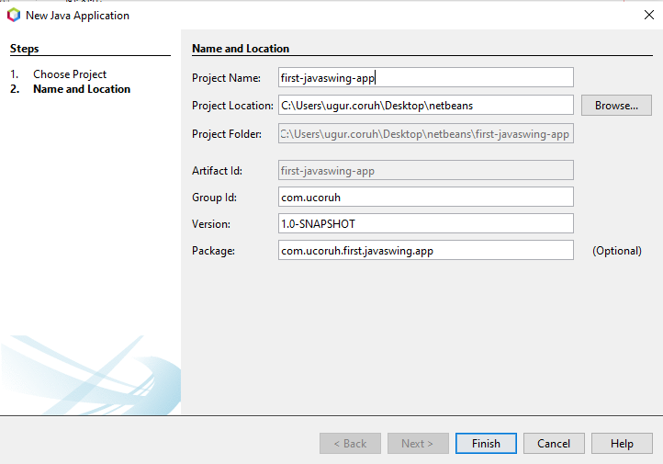
Configure Project

Slide 28
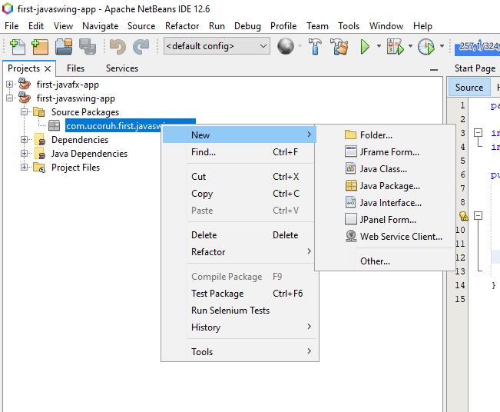
Open project and select package then select right-click -> New -> JFrame Form

Slide 29
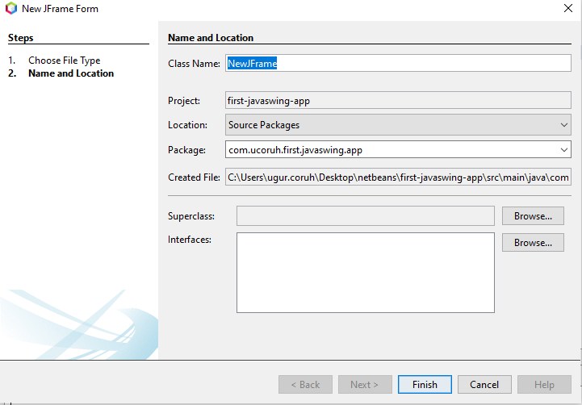
Give a name to your frame

Slide 30
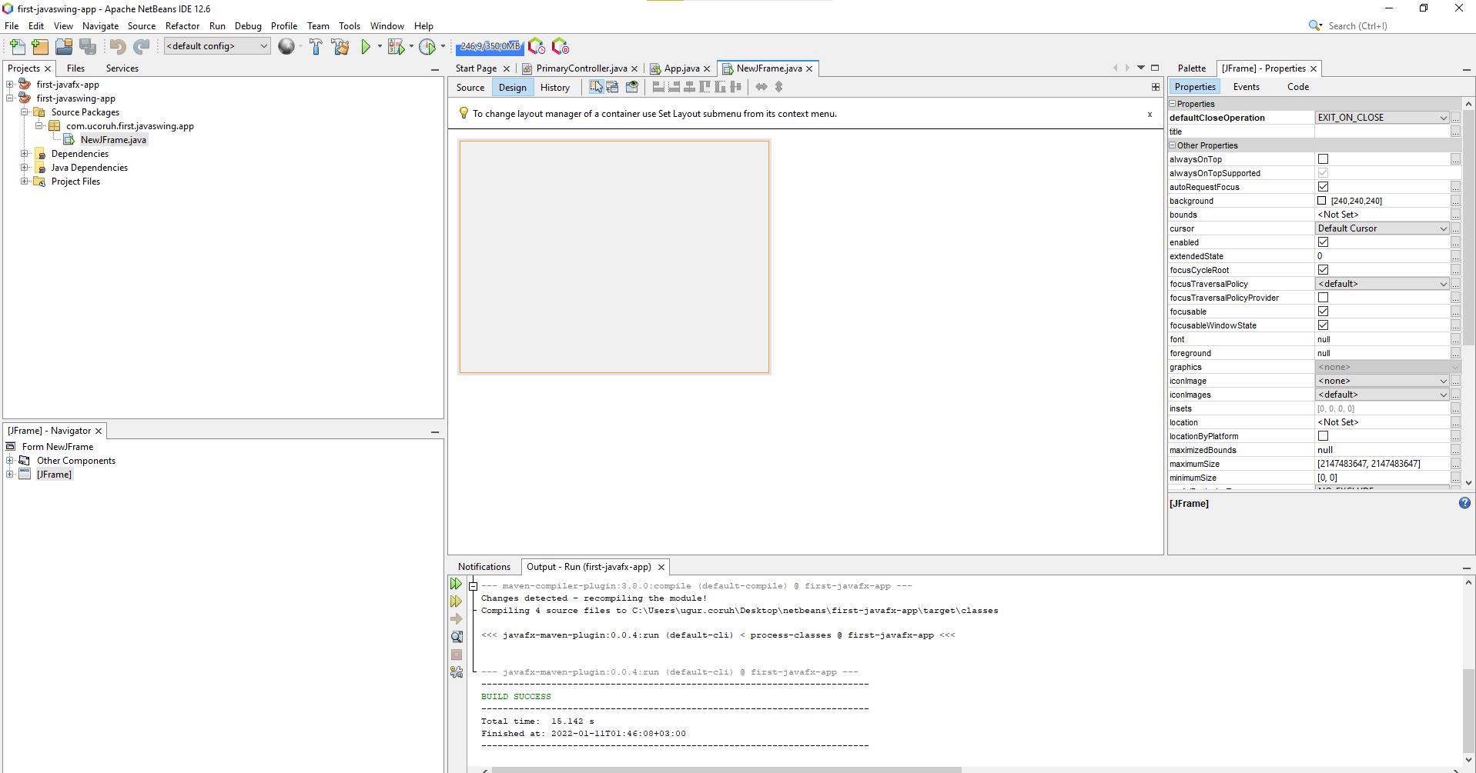
Swing GUI Builder is integrated with Netbeans

Slide 31
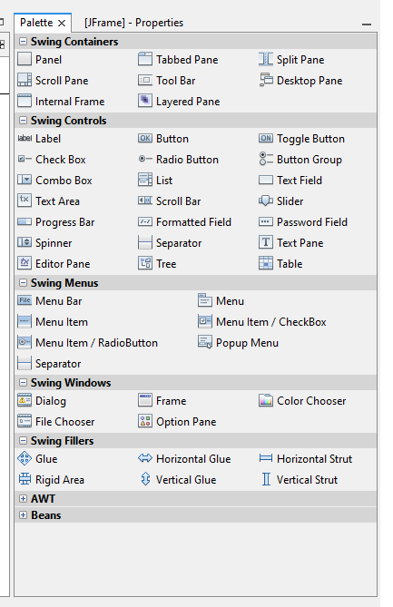
Drag-and-drop controls to panel from the palette

Slide 32
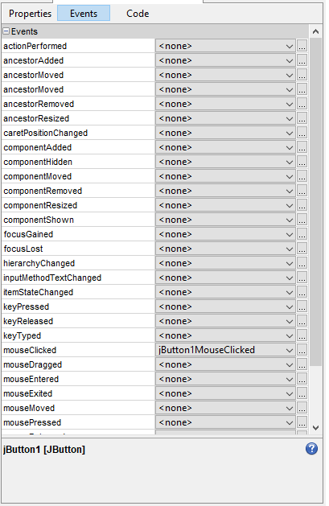
And from the events tab, add custom actions.

Slide 33
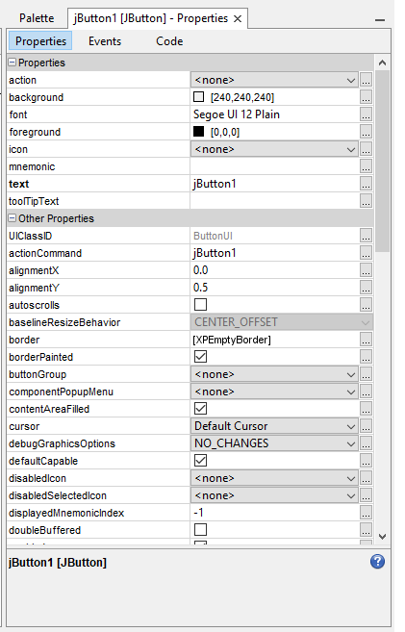
you can configure control properties from the properties screen

Slide 34
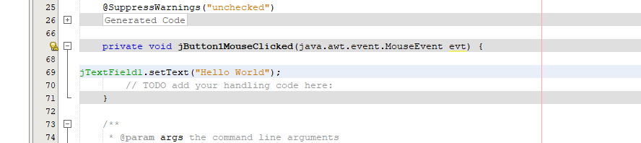
We can add simple events such as when the moclickscked to button write text on the text field
“Hello World”

Slide 35
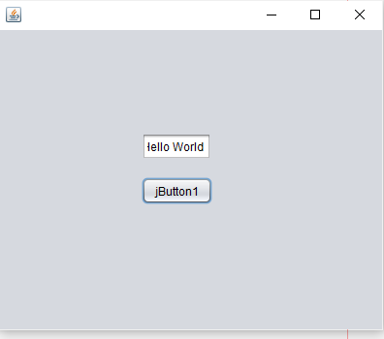
When you run application, you will see the following screen

Slide 36
References
…
..

