Slide 1
CE103 Algorithms and Programming I
Intro Author: Asst. Prof. Dr. Uğur CORUH

Slide 2
CE103 Algorithms and Programming I

Slide 3
Week-1 (Intro)
Fall Semester, 2021-2022
Download DOC, SLIDE, PPTX

Slide 4
Brief Description of Course and Rules
We will first talk about,
Course Plan and Communication
Grading System, Homework,s and Exams
please read the syllabus carefully.

Slide 5
Computer Engineering Roles
Software Development
Hardware Development
Network Organization and Management
Database Organization and Management
Hardware and Software Testing
Audit (Cyber Security, Policy etc.)
Etc.

Slide 6
Computer Engineering Areas
Computer Vision
Social
Analytics
Mobility

Slide 7
IoT
Security
Web-Scale IT
Cloud

Slide 8
Smart Machines
Pervasive
Fintech
Etc.

Slide 9
Our focus is Software Development
for this reason, we will focus on software-based road-maps
we can use common developer road maps from
https://roadmap.sh/

Slide 10
What will you see in the roadmap?
Frontend
Backend
DevOps
DBA
and more

Slide 11
Also, you need soft skills
Excellent written and oral communication skills, including public speaking and presenting
Decisiveness under pressure and strong critical thinking skills
Willingness to work off-core-hours, when necessary, to deploy software or upgrade hardware

Slide 12
If you need more information about your profession
Visit Job Search Web Portals and Look at Requirements to Understand What is Real Life Need
https://www.kariyer.net/
https://www.yenibiris.com/
https://www.secretcv.com/
https://www.linkedin.com/
Etc.

Slide 13
Using Google

Slide 14
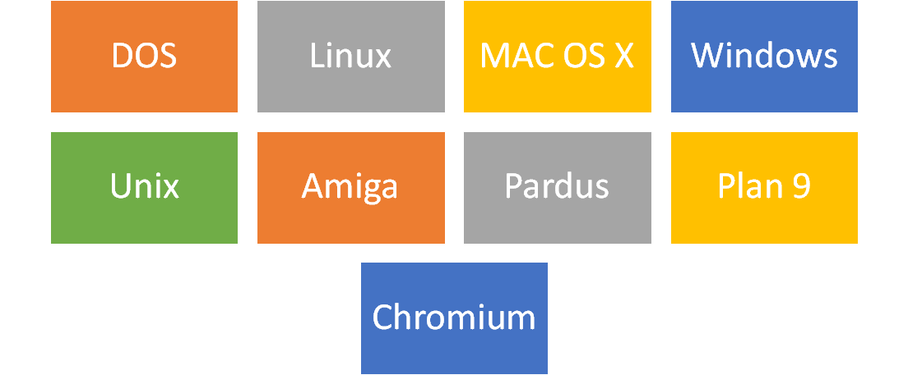
Operating System List
alt:“alt” height:450px center

Slide 15
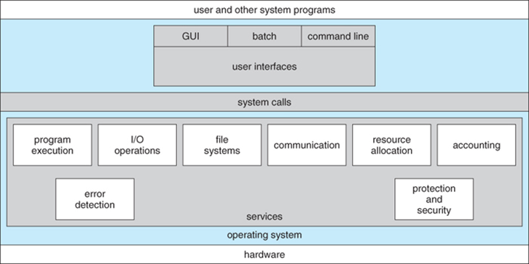
Operating System Architecture

Slide 16
reference

Slide 17
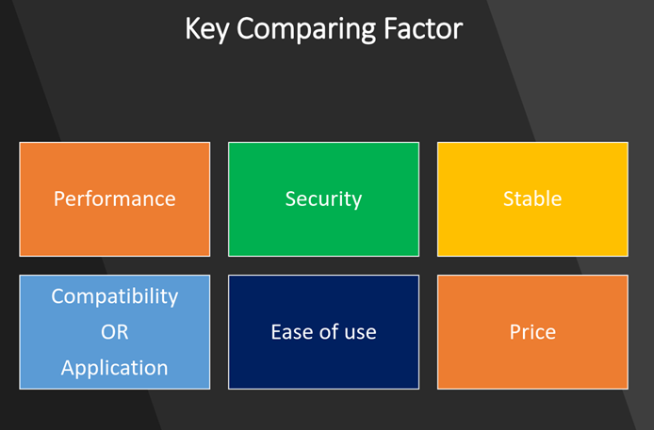
Operating Systems Key Comparing Factor
alt:“alt” height:450px center

Slide 18
reference

Slide 19

Operating System Comparisons
alt:“alt” height:450px center

Slide 20
reference

Slide 21
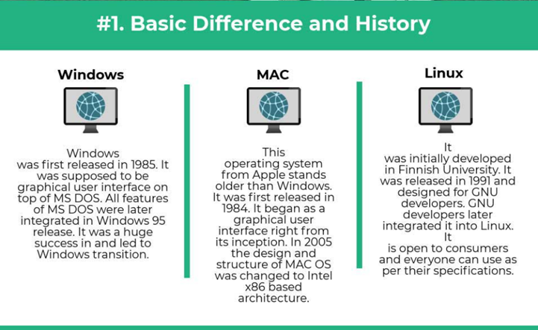
alt:“alt” height:450px center

Slide 22
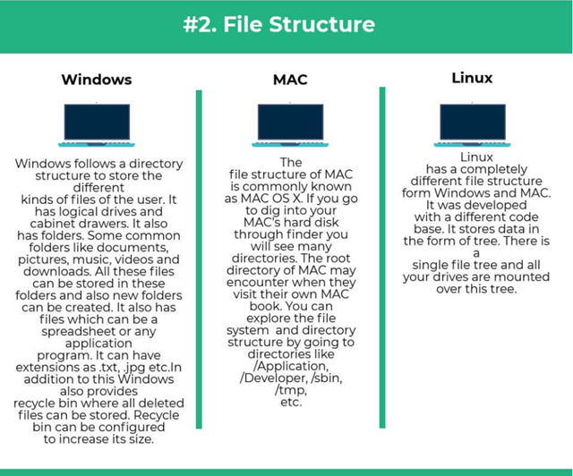
alt:“alt” height:450px center

Slide 23
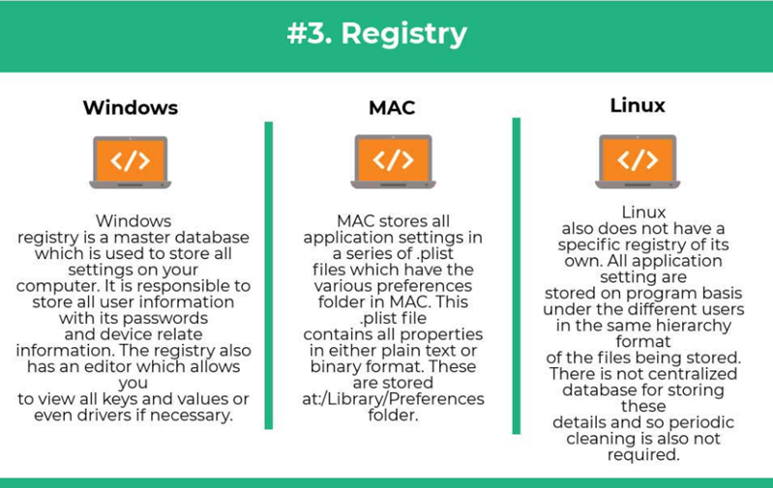
alt:“alt” height:450px center

Slide 24
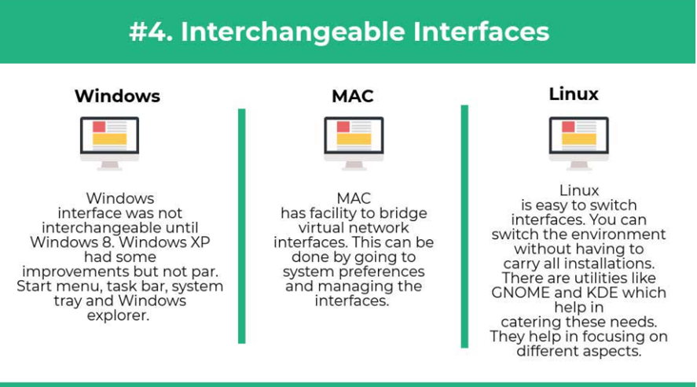
alt:“alt” height:450px center

Slide 25
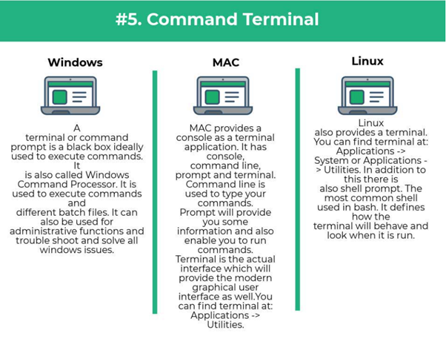
alt:“alt” height:450px center

Slide 26
Intro to the Internet

Slide 27
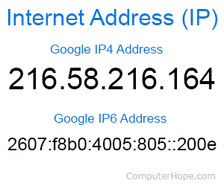
What is IP Address?
alt:“alt” height:450px center

Slide 28
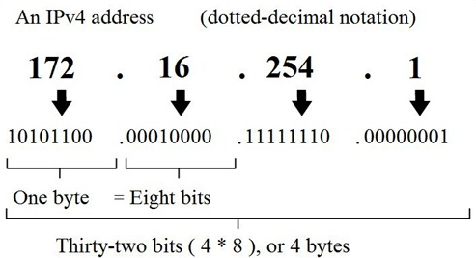
alt:“alt” height:450px center

Slide 29
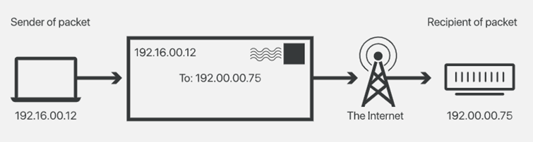
alt:“alt” height:450px center

Slide 30
What is Port?
In computer networking, a port is a communication endpoint. At the software level, within an operating system, a port is a logical construct that identifies a specific process or a type of network service. A port is identified for each transport protocol and address combination by a 16-bit unsigned number, known as the port number. The most common transport protocols that use port numbers are the Transmission Control Protocol (TCP) and the User Datagram Protocol (UDP).
reference

Slide 31
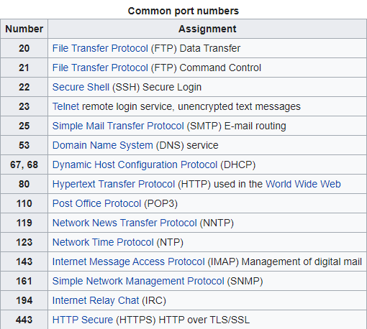
alt:“alt” height:450px center

Slide 32
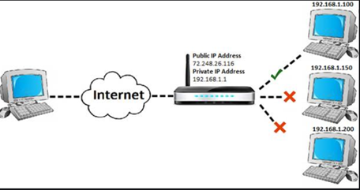
What is Port Forwarding and NAT
alt:“alt” height:450px center

Slide 33
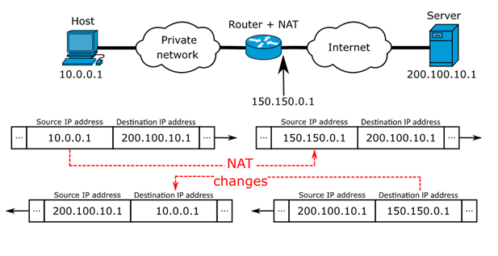
alt:“alt” height:450px center

Slide 34
https://www.networkantics.com/sonicwall-port-forwarding/
https://en.wikipedia.org/wiki/Network_address_translation

Slide 35
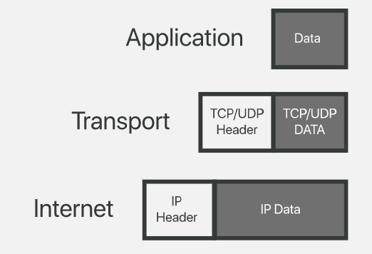
What is Internet Packet (IP)
alt:“alt” height:450px center

Slide 36
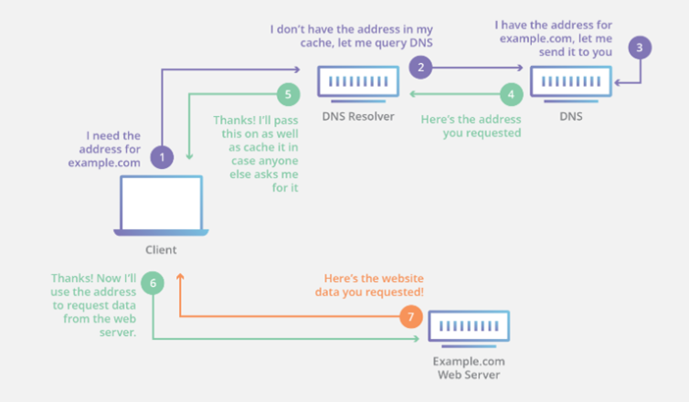
What is Domain Name Server (DNS)?
alt:“alt” height:450px center

Slide 37
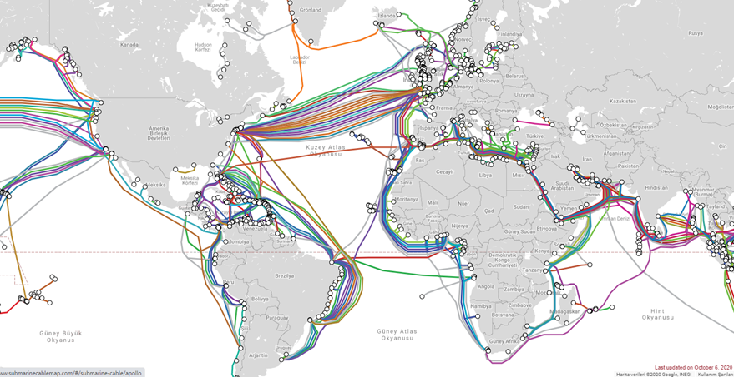
The Submarine Cable Map
alt:“alt” height:450px center

Slide 38
https://www.submarinecablemap.com/

Slide 39
Introduction to the command line interface
Reference Books
Bash Notes For Professionals Linux Notes For Professionals PowerShell Notes For Professionals

Slide 40
What is the command line?
The window, which is usually called the command line or command-line interface, is a text-based application for viewing, handling, and manipulating files on your computer. It’s much like Windows Explorer or Finder on the Mac, but without the graphical interface. Other names for the command line are:
cmd, CLI, prompt, console or terminal
While there are many commands you can use with CLI, they all fall into two categories:
The commands that handle the processes
The commands that handle the files
reference

Slide 41
Why Would You Use CLI over GUI?

Slide 42
Less Resource It is not a secret that the text-based program needs very little resources of your computer. This means that with CLI you can do similar tasks with minimum resources.

Slide 43
High Precision You can use a specific command to target specific destinations with ease. As long as you don’t type the wrong command, it will work like a charm. Once you learn the basics, writing syntax is not as hard as you might think.

Slide 44
Repetitive Tasks Friendly GUI has developed well over the years. But, the operating system may not give you all the menus and buttons to perform all tasks. One of the reasons is safety. This leaves you overwhelmed if you have to do repetitive tasks. For example, when you have to handle hundreds of files within a folder, CLI enables you to use a single command to do automate the repetition easily.

Slide 45
Powerful Most operating systems today prevent you from messing up the system’s core process. Windows has system protection and MacOS has SIP (System Integrity Protection). You won’t be able to perform certain tasks which are system protected. However, with CLI, you will have full control over your system.

Slide 46
Open the command-line interface (Windows)
Go to the Start menu or screen, and enter “Command Prompt” in the search field.
Go to Start menu → Windows System → Command Prompt.
Go to Start menu → All Programs → Accessories → Command Prompt.
Go to the Start screen, hover your mouse in the lower-left corner of the screen, and click the down arrow that appears (on a touch screen, instead flick up from the bottom of the screen). The Apps page should open. Click on Command Prompt in the Windows System section.
Hold the special Windows key on your keyboard and press the “X” key. Choose “Command Prompt” from the pop-up menu.
Hold the Windows key and press the “R” key to get a “Run” window. Type “cmd” in the box, and click the OK key.

Slide 47
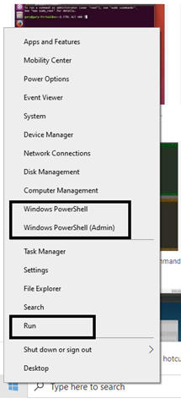
alt:“alt” height:450px center

Slide 48
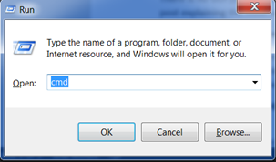
alt:“alt” height:450px center

Slide 49
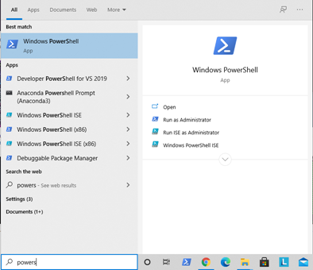
alt:“alt” height:450px center

Slide 50
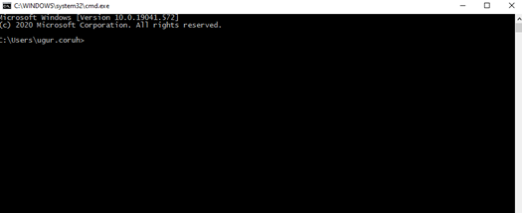
alt:“alt” height:450px center

Slide 51
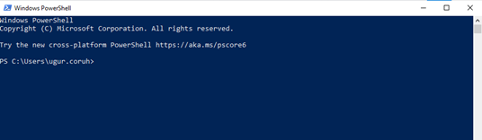
alt:“alt” height:450px center

Slide 52
Open the command-line interface (Linux)
It’s probably under
Applications → Accessories → Terminal, or
Applications → System → Terminal, but that may depend on your system. If it’s not there, you can try to Google it. :)

Slide 53
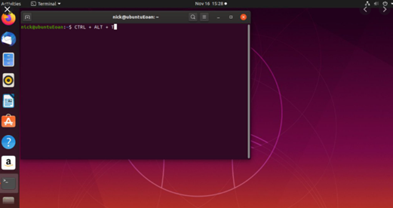
alt:“alt” height:450px center

Slide 54
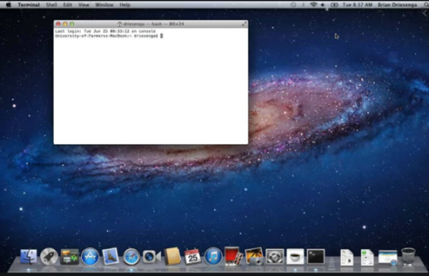
Open the command-line interface (MacOS)
Go to Applications → Utilities → Terminal
alt:“alt” height:450px center

Slide 55
Reference
Network_address_translation
GitHub - kamranahmedse/developer-roadmap: Roadmap to becoming a web developer in 2021
GitHub - jwasham/coding-interview-university: A complete computer science study plan to become a software engineer.
GitHub - sindresorhus/awesome: 😎 Awesome lists about all kinds of interesting topics

