Slide 1
CE103 Algorithms and Programming I
Development Environments and Algorithm Basics Author: Asst. Prof. Dr. Uğur CORUH

Slide 2
CE103 Algorithms and Programming I
Week-2
Fall Semester, 2021-2022
Download DOC, SLIDE, PPTX

Slide 3
Algorithm Basics

Slide 4
Flowgorithm
http://www.flowgorithm.org/

Slide 5
Pseudocode
Pseudocode - Wikipedia
Pseudocode Examples
How to write a Pseudo Code? - GeeksforGeeks

Slide 6
Introduction to Analysis of Algorithms
In this course we will learn how to code with several development environments and next term we will see analysis of algorithms in details.
This topic is covered in the following link : CE100 Introduction to Analysis of Algorithms

Slide 7
Programming Environment Setup and Configuration
Programming life is not about only learning how to code. Mostly you need to use several code development environments and you need to learn how to use them efficiently.

Slide 8
C / C++ Environment and Development

Slide 9
DevCpp (Install / Compile / Run / Debug) (1)
Download DevC++ IDE from following link
https://www.bloodshed.net/

Slide 10
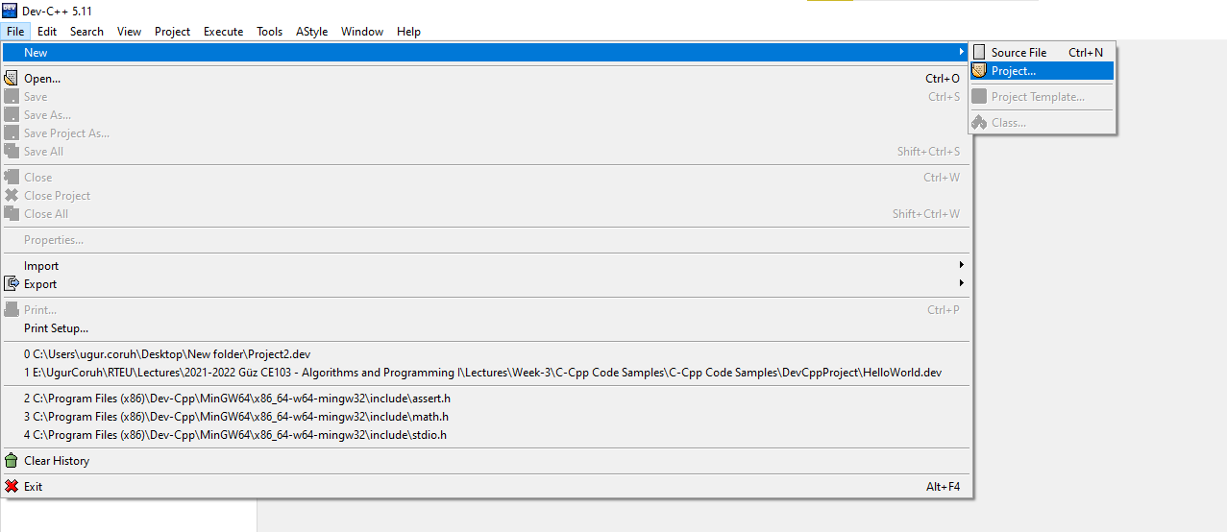
DevCpp (Install / Compile / Run / Debug) (2)
Open DevC++ IDE for C Project Generation
Open File->New->Project
alt:“alt” height:400px center

Slide 11
DevCpp (Install / Compile / Run / Debug) (3)
Select Console Application from Basic tab and with C Project Option and write a project name such as “Hello” then press OK
Select a folder and save Hello.dev project file.

Slide 12
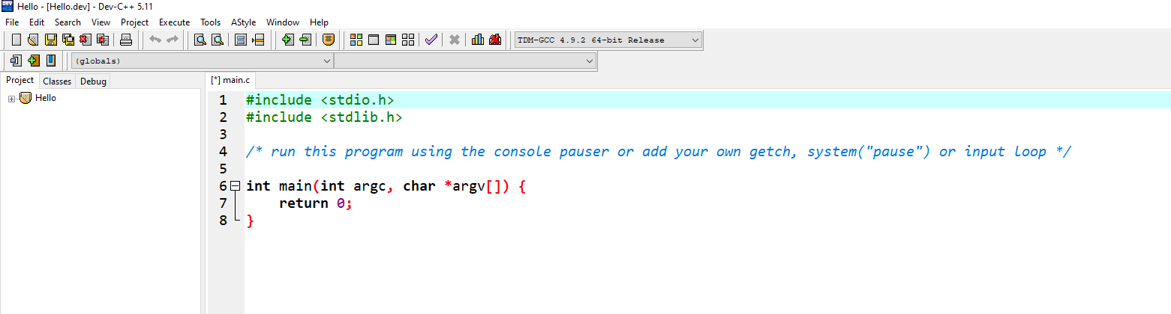
DevCpp (Install / Compile / Run / Debug) (4)
You will see a sample main with empty body
alt:“alt” height:450px center

Slide 13
DevCpp (Install / Compile / Run / Debug) (5)
#include <stdio.h> #include <stdlib.h> /* run this program using the console pauser or add your own getch, s,ystem("pause") or input loop */ int main(int argc, char *argv[]) { retAdd 0; }

Slide 14
DevCpp (Install / Compile / Run / Debug) (6)
add the following line in main function. This will write “Hello, World!” on the screen and then wait a keypress to exit from application
#include <stdio.h> #include <stdlib.h> /* run this program using the console pauser or add your own getch, system("pause") or input loop */ int main(int argc, char *argv[]) { printf("Hello, World!"); getchar(); return 0; }

Slide 15
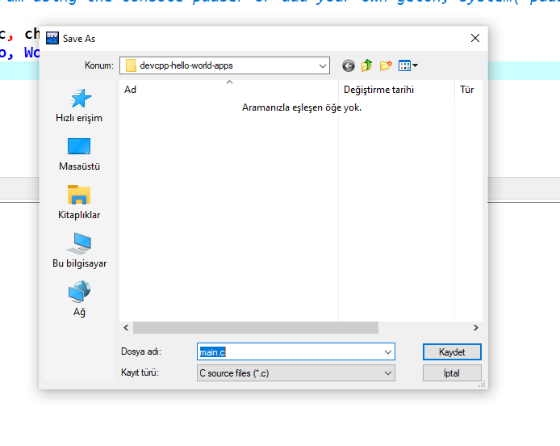
DevCpp (Install / Compile / Run / Debug) (7)
Then save the file
alt:“alt” height:450px center

Slide 16
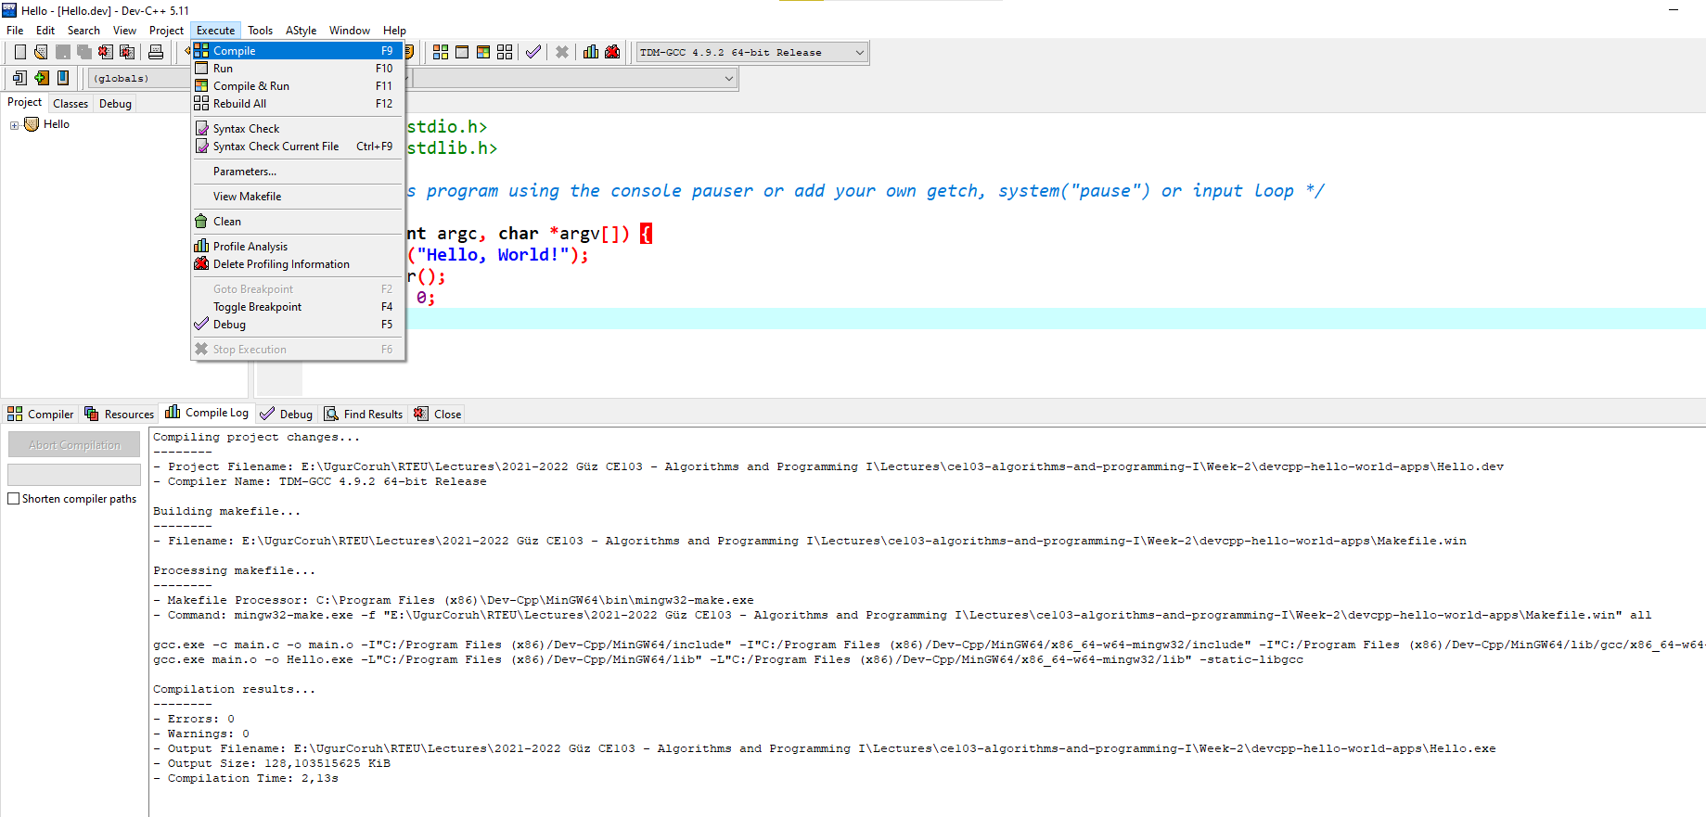
DevCpp (Install / Compile / Run / Debug) (8)
Use from menu Execute->Compile F5 to generate Hello.exe
alt:“alt” height:450px center

Slide 17
DevCpp (Install / Compile / Run / Debug) (9)
You can find the generated Hello.exe path from Compile.log as follow. Check the Output Filename
Compiling project changes... -------- - Project Filename: E:\UgurCoruh\RTEU\Lectures\2021-2022 Güz CE103 - Algorithms and Programming I\Lectures\ce103-algorithms-and-programming-I\Week-2\devcpp-hello-world-apps\Hello.dev - Compiler Name: TDM-GCC 4.9.2 64-bit Release Building makefile... -------- - Filename: E:\UgurCoruh\RTEU\Lectures\2021-2022 Güz CE103 - Algorithms and Programming I\Lectures\ce103-algorithms-and-programming-I\Week-2\devcpp-hello-world-apps\Makefile.win Processing makefile... -------- - Makefile Processor: C:\Program Files (x86)\Dev-Cpp\MinGW64\bin\mingw32-make.exe - Command: mingw32-make.exe -f "E:\UgurCoruh\RTEU\Lectures\2021-2022 Güz CE103 - Algorithms and Programming I\Lectures\ce103-algorithms-and-programming-I\Week-2\devcpp-hello-world-apps\Makefile.win" all gcc.exe -c main.c -o main.o -I"C:/Program Files (x86)/Dev-Cpp/MinGW64/include" -I"C:/Program Files (x86)/Dev-Cpp/MinGW64/x86_64-w64-mingw32/include" -I"C:/Program Files (x86)/Dev-Cpp/MinGW64/lib/gcc/x86_64-w64-mingw32/4.9.2/include" gcc.exe main.o -o Hello.exe -L"C:/Program Files (x86)/Dev-Cpp/MinGW64/lib" -L"C:/Program Files (x86)/Dev-Cpp/MinGW64/x86_64-w64-mingw32/lib" -static-libgcc Compilation results... -------- - Errors: 0 - Warnings: 0 - Output Filename: E:\UgurCoruh\RTEU\Lectures\2021-2022 Güz CE103 - Algorithms and Programming I\Lectures\ce103-algorithms-and-programming-I\Week-2\devcpp-hello-world-apps\Hello.exe - Output Size: 128,103515625 KiB - Compilation Time: 2,13s

Slide 18
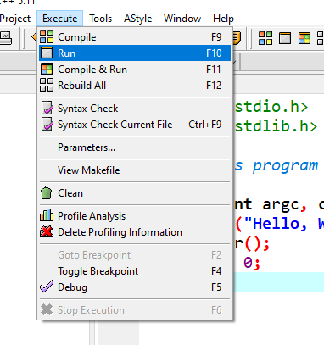
DevCpp (Install / Compile / Run / Debug) (10)
Then you can run with Execute->Run F10 or Directly Compile&Run F11
alt:“alt” height:450px center

Slide 19
DevCpp (Install / Compile / Run / Debug) (11)
for debugging operations, just change the code and add more statements as follow
#include <stdio.h> #include <stdlib.h> /* run this program using the console pauser or add your getch, system(",pause") or input loop */ int main(int argc, char *argv[]) { printf("Hello, World! Step-1\n"); printf("Hello, World! Step-2\n"); printf("Hello, World! Step-3\n"); printf("Hello, World! Step-4\n"); printf("Hello, World! Step-5\n"); printf("Hello, World! Step-6\n"); getchar(); return 0; }

Slide 20
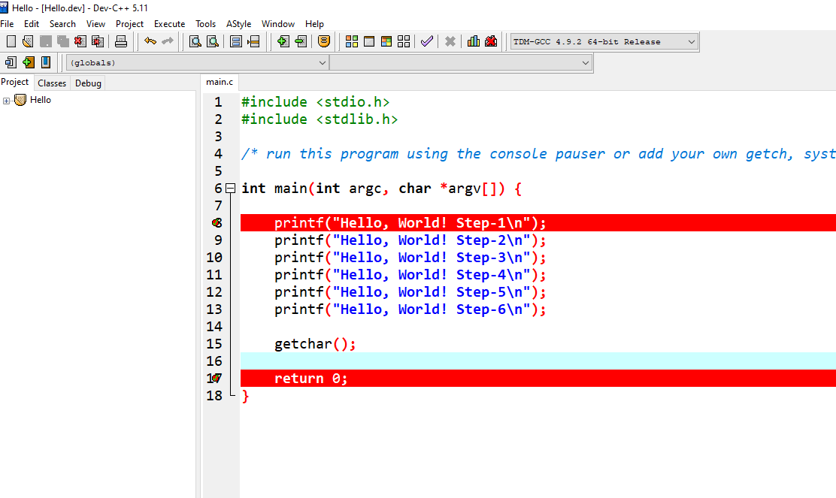
DevCpp (Install / Compile / Run / Debug) (12)
Click on line numbers and add breakpoints for debugger. This red point will be debugger stop points
alt:“alt” height:450px center

Slide 21
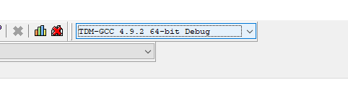
DevCpp (Install / Compile / Run / Debug) (13)
In the ,menu section select compiler with debug option
alt:“alt” height:450px center

Slide 22
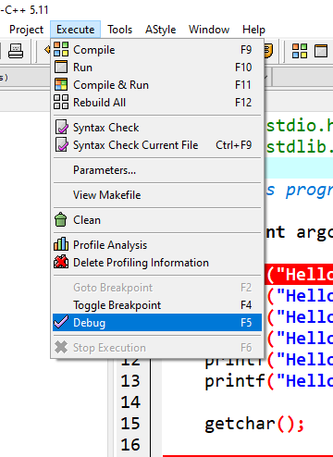
DevCpp (Install / Compile / Run / Debug) (14)
Compile application with debug setting and in Execute Section use Debug F5 to start debugging
alt:“alt” height:450px center

Slide 23
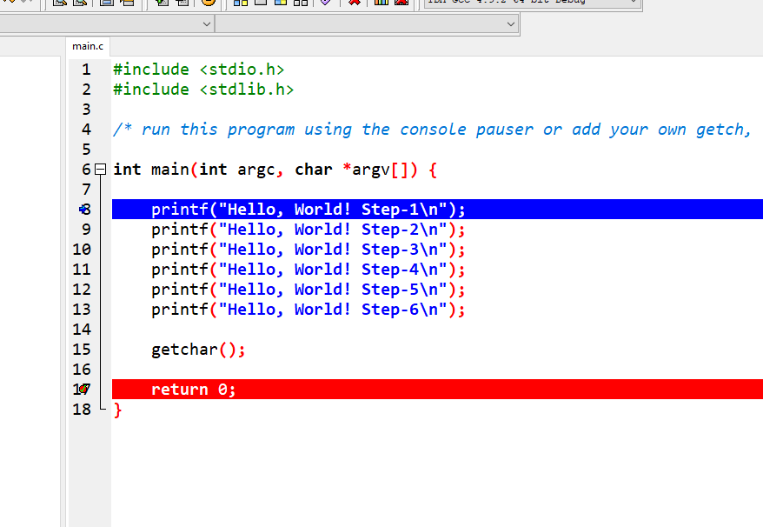
DevCpp (Install / Compile / Run / Debug) (15)
Debugger will stop at breakpoint at the debug point (blue line)
alt:“alt” height:450px center

Slide 24
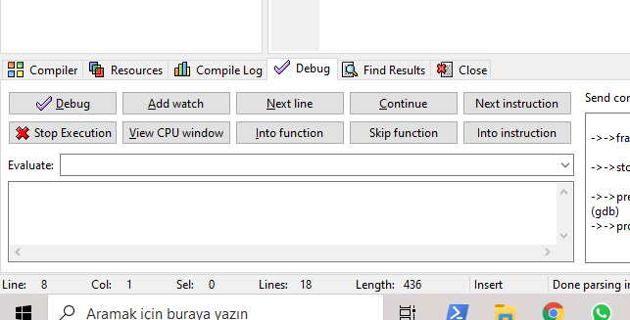
DevCpp (Install / Compile / Run / Debug) (16)
Moving to next statement can be done via control buttons or shortcuts
alt:“alt” height:450px center

Slide 25
DevCpp (Install / Compile / Run / Debug) (17)
Press F8 to step-by-step continue
Then go to Project Options - Compiler - Linker and set Generate debugging information to “yes”, and make sure you are not using any optimization options (they’re not good for debug mode). Also check the Parameters tab, make sure you don’t have any optimization options (like -O2 or -O3, but -O0 is ok because it means no optimization) or strip option (-s).

Slide 26
DevCpp (Install / Compile / Run / Debug) (18)
After that, do a full rebuild (Ctrl-F11), then set breakpoint(s) where you want the debugger to stop (otherwise it will just run the program). To set a breakpoint on a line, just click on the gutter (the gray band on the left), or press Ctrl-F5.

Slide 27
DevCpp (Install / Compile / Run / Debug) (19)
Now you are ready to launch the debugger, by pressing F8 or clicking the debug button. If everything goes well, the program will start, and then stop at the first breakpoint. Then you can step through the code, entering function calls, by pressing Shift-F7 or the “step into” button, or stepping over the function calls, by pressing F7 or the “next step” button. You can press Ctrl-F7 or the “continue” button to continue execution till the next breakpoint. At any time, you can add or remove breakpoints.

Slide 28
DevCpp (Install / Compile / Run / Debug) (20)
When the program stopped at a breakpoint and you are stepping through the code, you can display the values of various variables in your program by putting your mouse over them, or you can display variables and expressions by pressing F4 or the “add watch” button and typing the expression.

Slide 29
DevCpp (Install / Compile / Run / Debug) (21)
How do I debug using Dev-C++

Slide 30
Code Blocks (Install / Compile / Run / Debug) (1)
Download Code Blocks from the following link
Binary releases - Code::Blocks

Slide 31
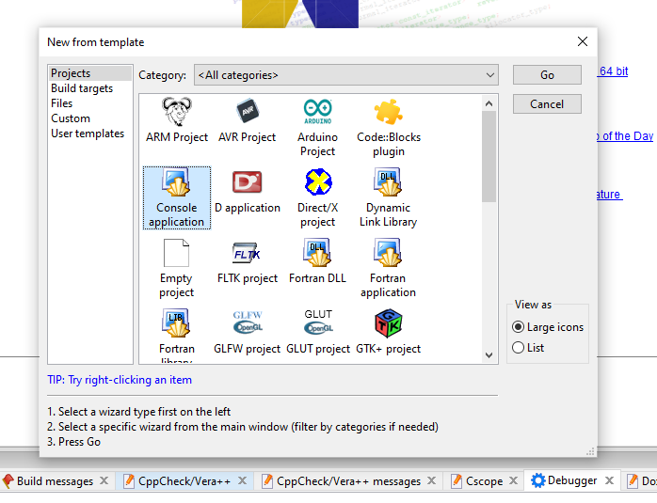
Code Blocks (Install / Compile / Run / Debug) (2)
Open Code Blocks and
Select File->New->Project
alt:“alt” height:450px center

Slide 32
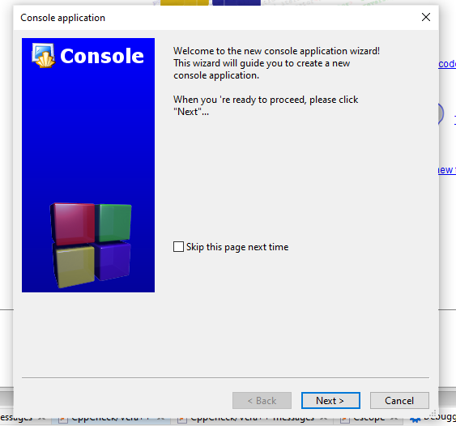
Code Blocks (Install / Compile / Run / Debug) (3)
Select Console Application
Click Next from Opening Window
alt:“alt” height:450px center

Slide 33
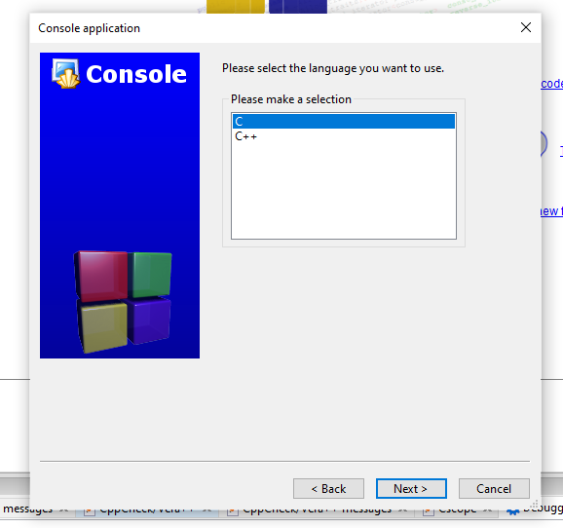
Code Blocks (Install / Compile / Run / Debug) (4)
Select C for Sample Project
alt:“alt” height:450px center

Slide 34
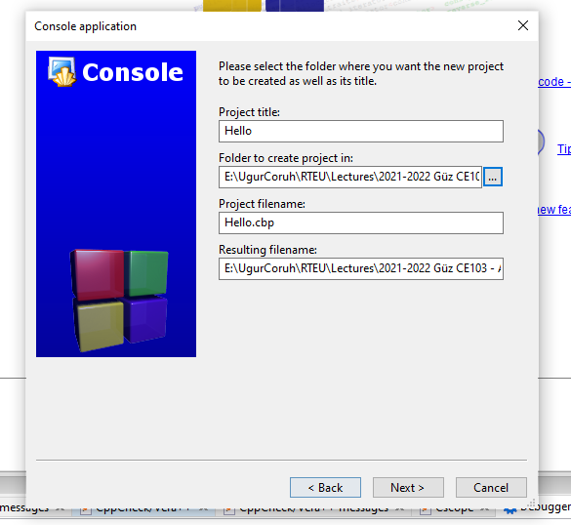
Code Blocks (Install / Compile / Run / Debug) (5)
Write a project name and title also set a project folder
alt:“alt” height:450px center

Slide 35
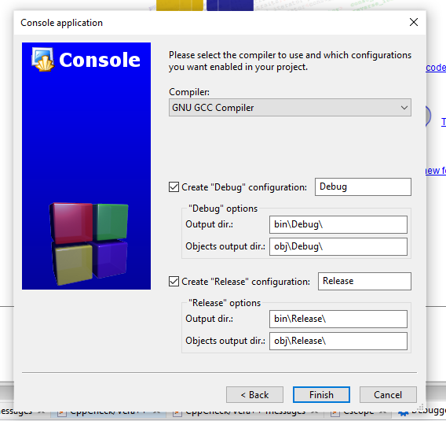
Code Blocks (Install / Compile / Run / Debug) (6)
Select complier for this project we selected GCC but you can select C compliers from list. Set Debug and Release executable output folders.
alt:“alt” height:450px center

Slide 36
Code Blocks (Install / Compile / Run / Debug) (7)
After this wizard you will have the following code
#include <stdio.h> #include <stdlib.h> int main() { printf("Hello world!\n"); return 0; }

Slide 37
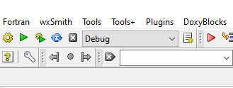
Code Blocks (Install / Compile / Run / Debug) (8)
Select Debug Build from menu
alt:“alt” height:450px center

Slide 38
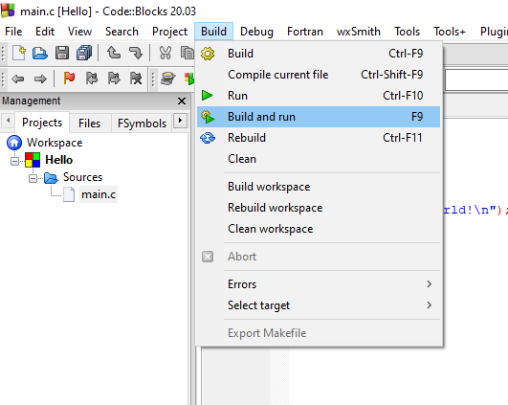
Code Blocks (Install / Compile / Run / Debug) (9)
Run with Build and Run F9
alt:“alt” height:450px center

Slide 39
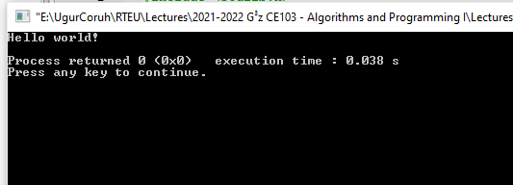
Code Blocks (Install / Compile / Run / Debug) (10)
You should see the following output
alt:“alt” height:450px center

Slide 40
Code Blocks (Install / Compile / Run / Debug) (11)
Add the following lines to your source code for debugging
#include <stdio.h> #include <stdlib.h> int main() { printf("Hello world! Step-1\n"); printf("Hello world! Step-2\n"); printf("Hello world! Step-3\n"); printf("Hello world! Step-4\n"); printf("Hello world! Step-5\n"); printf("Hello world! Step-6\n"); return 0; }

Slide 41
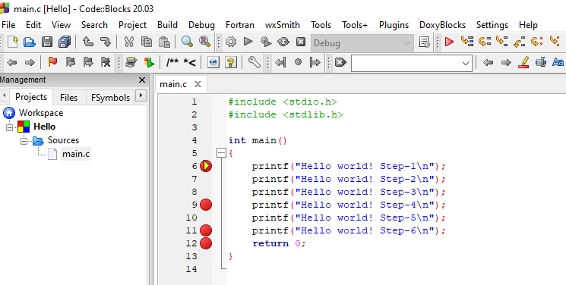
Code Blocks (Install / Compile / Run / Debug) (12)
and add break points with F5 or mouse click
alt:“alt” height:450px center

Slide 42
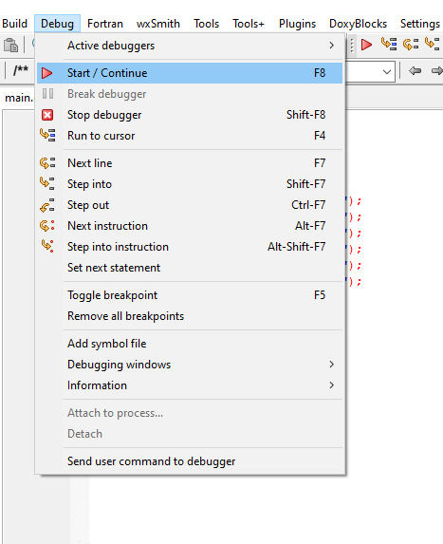
Code Blocks (Install / Compile / Run / Debug) (13)
select Debug->Start/Continue to start debugger
alt:“alt” height:450px center

Slide 43
Code Blocks (Install / Compile / Run / Debug) (14)
If you see the following error this is related with long or turkish character including path. Just move project to a shorter path and try again
Setting breakpoints Debugger name and version: GNU gdb (GDB) 8.1 Starting the debuggee failed: No executable specified, use `target exec'. Debugger finished with status 0

Slide 44
Code Blocks (Install / Compile / Run / Debug) (15)
You will see the following yellow pointer for debugger
alt:“alt” height:450px center

Slide 45
Code Blocks (Install / Compile / Run / Debug) (16)
You can use the following menu or shortcuts for step-by-step debugging.
alt:“alt” height:100px center

Slide 46
GCC/G++ Complier (MinGW) / Clang-cl (LLVM) (1)
Download and install MinGW or LLVM compiler (if you downloded then skip this step)
MinGW installer (clang)
Download MinGW-w64 - for 32 and 64 bit Windows from SourceForge.net
LLVM installer (gcc / g++)
Download LLVM releases
Also use the following notes
https://llvm.org/devmtg/2014-04/PDFs/Talks/clang-cl.pdf

Slide 47
GCC/G++ Complier (MinGW) / Clang-cl (LLVM) (2)
Open a console with “cmd” and test the following commands if commands are not recognized then set the system environment variable add gcc and g++ exe paths to path variable (add to both system and user path variable)
gcc --version g++ --version
C:\Users\ugur.coruh>gcc --version gcc (x86_64-win32-seh-rev0, Built by MinGW-W64 project) 8.1.0 Copyright (C) 2018 Free Software Foundation, Inc. This is free software; see the source for copying conditions. There is NO warranty; not even for MERCHANTABILITY or FITNESS FOR A PARTICULAR PURPOSE.
clang --version

Slide 48
GCC/G++ Complier (MinGW) / Clang-cl (LLVM) (3)
for gcc.exe, g++.exe and gdb.exe
C:\Program Files\mingw-w64\x86_64-8.1.0-win32-seh-rt_v6-rev0\mingw64\bin
for clang.exe , lldb.exe
C:\Program Files\LLVM\bin
This folder paths changes according to your setup

Slide 49
VSCode (Install / Compile / Run / Debug) (1)
Download Visual Studio Code from the following link
Download Visual Studio Code - Mac, Linux, Windows

Slide 50
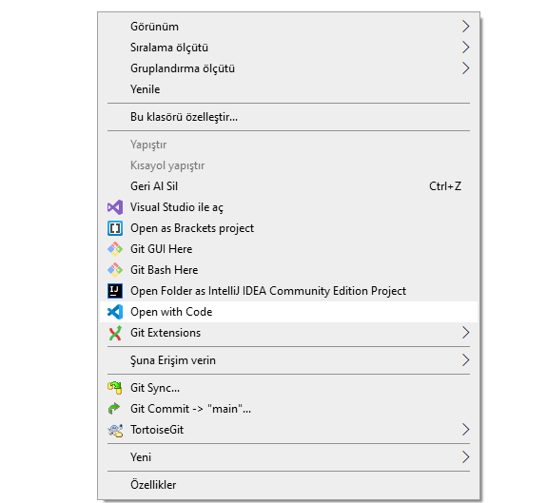
VSCode (Install / Compile / Run / Debug) (2)
In this sample you will find MinGW and LLVM compiler combinations for C and C++
Create a folder and enter this folder then open this folder with vscode by right click
alt:“alt” height:450px center

Slide 51
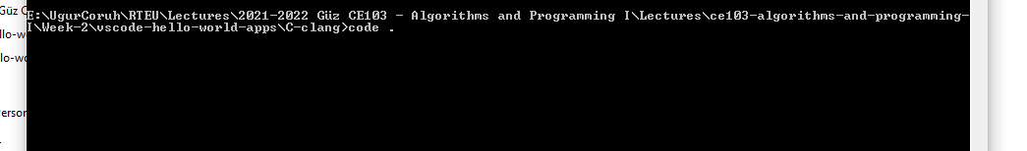
VSCode (Install / Compile / Run / Debug) (3)
or enter the folder via console
alt:“alt” height:300px center

Slide 52
write
code .

Slide 53
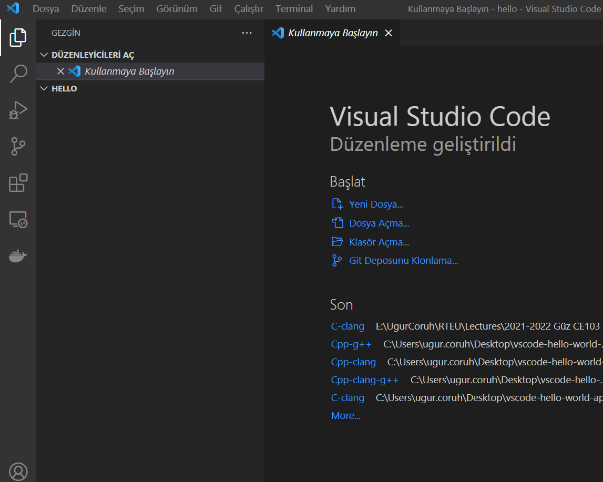
VSCode (Install / Compile / Run / Debug) (4)
This will open vscode for current folder . dot present current folder.
You will see a empty folder in the right window
alt:“alt” height:400px center

Slide 54
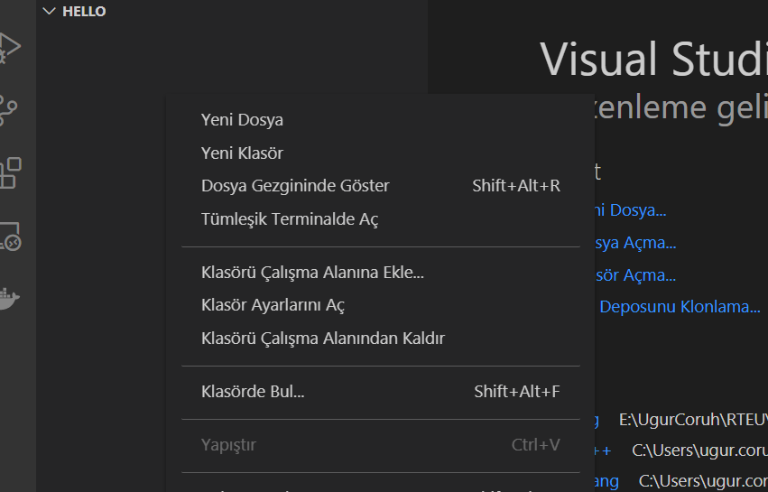
VSCode (Install / Compile / Run / Debug) (5)
alt:“alt” height:400px center

Slide 55
VSCode (Install / Compile / Run / Debug) (6)
Create a hello.c file and write following content
#include <stdio.h> int main() { // printf() displays the string inside quotation printf("Hello, World!"); return 0; }

Slide 56
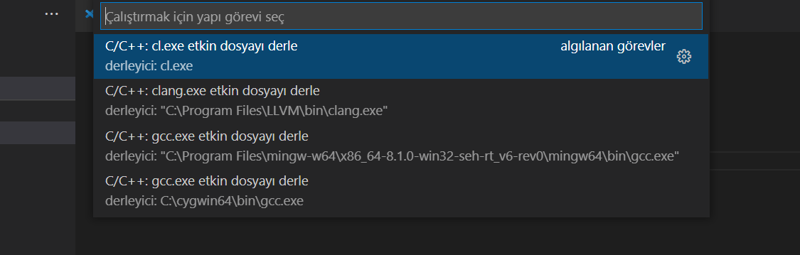
VSCode (Install / Compile / Run / Debug) (7)
use CTRL+SHIFT+B (you should be on source code section) to build file
alt:“alt” height:400px center

Slide 57
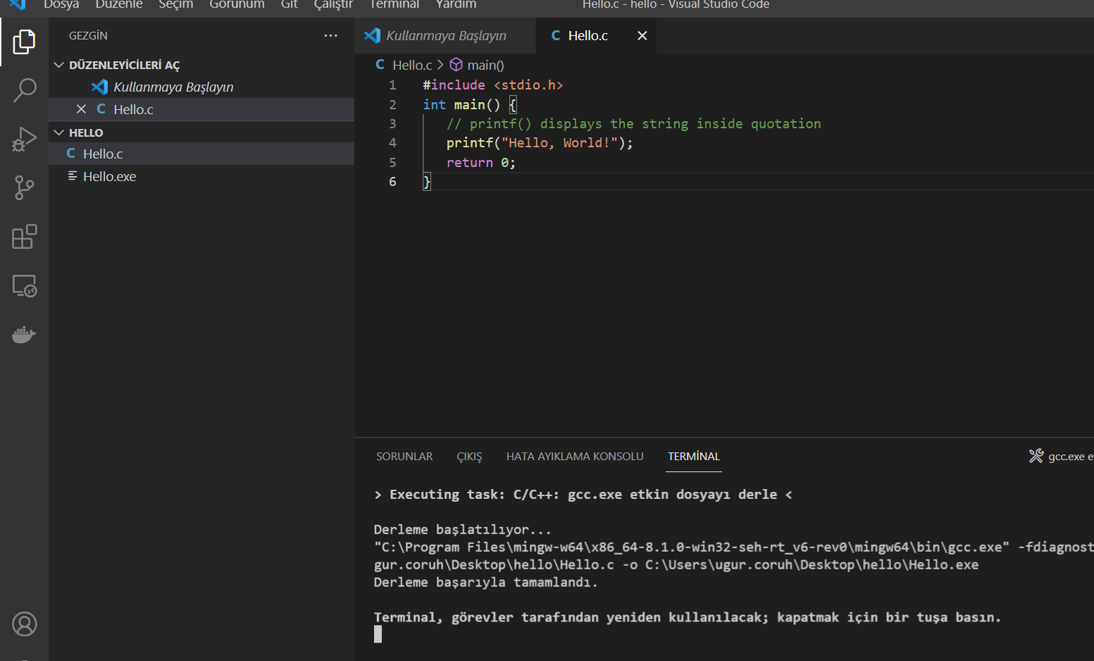
VSCode (Install / Compile / Run / Debug) (8)
Select GCC or CLANG for this sample we can use GCC
You will see output generated Hello.exe
alt:“alt” height:450px center

Slide 58
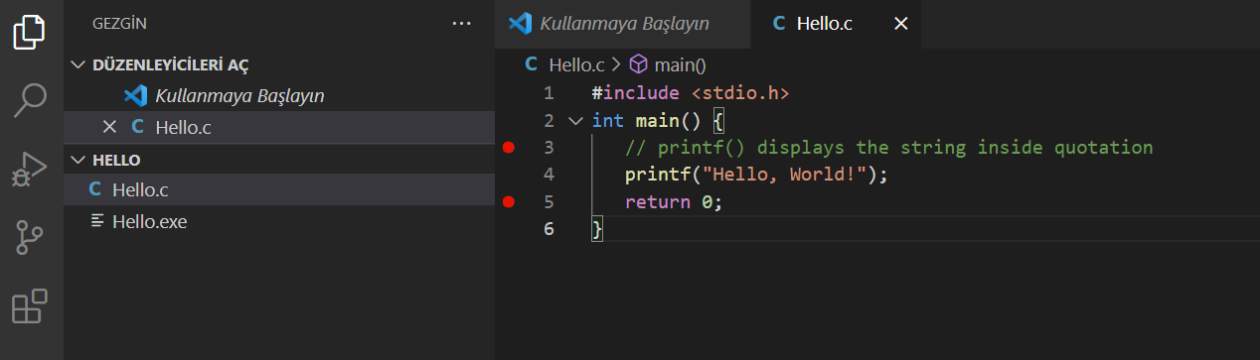
VSCode (Install / Compile / Run / Debug) (9)
for debugging just put breakpoint and build again
alt:“alt” height:450px center

Slide 59
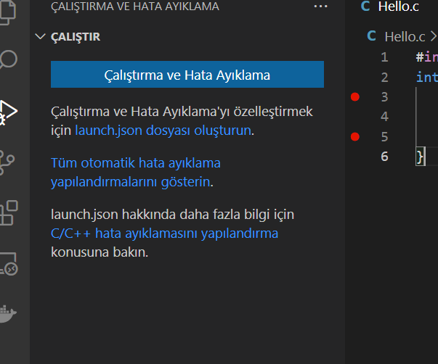
VSCode (Install / Compile / Run / Debug) (10)
after build for debug press CTRL+SHIFT+D (you should be on source code section)and in the right window select create launch.json
alt:“alt” height:450px center

Slide 60
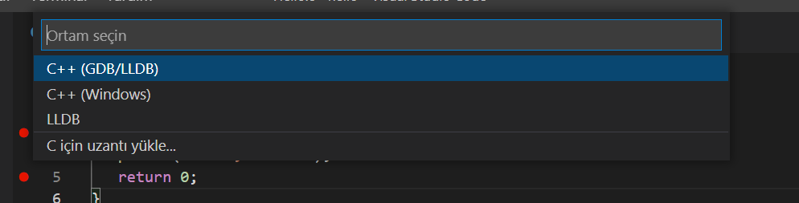
VSCode (Install / Compile / Run / Debug) (11)
from opening window select C++ GDB/LLDB
alt:“alt” height:300px center

Slide 61
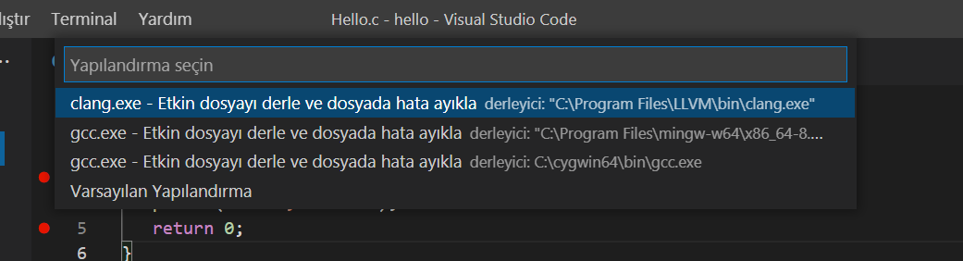
VSCode (Install / Compile / Run / Debug) (12)
from next opening menu select mingw-w64 gcc.exe
alt:“alt” height:350px center

Slide 62
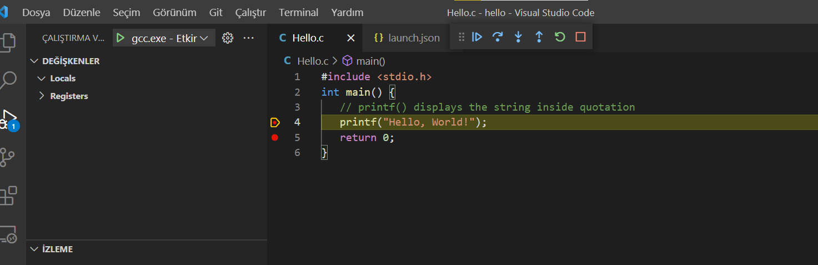
VSCode (Install / Compile / Run / Debug) (13)
this will run debugger and you will see debug points activated
alt:“alt” height:400px center

Slide 63
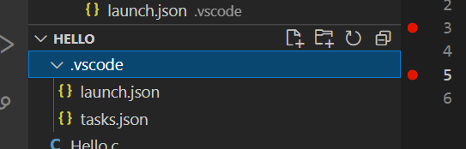
VSCode (Install / Compile / Run / Debug) (14)
then you can step-by-step debug your code.
the following task.json and launch.json automatically generated with your selections
alt:“alt” height:250px center

Slide 64
VSCode (Install / Compile / Run / Debug) (15)
launch.json
{ // Olası öznitelikler hakkında bilgi edinmek için IntelliSense kullanın. // Mevcut özniteliklerin açıklamalarını görüntülemek için üzerine gelin. // Daha fazla bilgi için şu adresi ziyaret edin: https://go.microsoft.com/fwlink/?linkid=830387 "version": "0.2.0", "configurations": [ { "name": "gcc.exe - Etkin dosyayı derle ve dosyada hata ayıkla", "type": "cppdbg", "request": "launch", "program": "${fileDirname}\\${fileBasenameNoExtension}.exe", "args": [], "stopAtEntry": false, "cwd": "${fileDirname}", "environment": [], "externalConsole": false, "MIMode": "gdb", "miDebuggerPath": "C:\\Program Files\\mingw-w64\\x86_64-8.1.0-win32-seh-rt_v6-rev0\\mingw64\\bin\\gdb.exe", "setupCommands": [ { "description": "gdb için düzgün yazdırmayı etkinleştir", "text": "-enable-pretty-printing", "ignoreFailures": true } ], "preLaunchTask": "C/C++: gcc.exe etkin dosyayı derle" } ] }

Slide 65
VSCode (Install / Compile / Run / Debug) (16)
task.json
{ "tasks": [ { "type": "cppbuild", "label": "C/C++: gcc.exe etkin dosyayı derle", "command": "C:\\Program Files\\mingw-w64\\x86_64-8.1.0-win32-seh-rt_v6-rev0\\mingw64\\bin\\gcc.exe", "args": [ "-fdiagnostics-color=always", "-g", "${file}", "-o", "${fileDirname}\\${fileBasenameNoExtension}.exe" ], "options": { "cwd": "${fileDirname}" }, "problemMatcher": [ "$gcc" ], "group": { "kind": "build", "isDefault": true }, "detail": "Hata Ayıklayıcısı tarafından oluşturulan görev." } ], "version": "2.0.0" }

Slide 66
VSCode (Install / Compile / Run / Debug) (17)
you can do the same thing for other compilers and c++ source codes. LLVM do not support debug on vscode now.
for C++ VsCode you can check the following links
for Windows
https://code.visualstudio.com/docs/cpp/config-mingw
for Linux
https://code.visualstudio.com/docs/cpp/config-linux
for WSL
https://code.visualstudio.com/docs/cpp/config-wsl

Slide 67
VSCode (Install / Compile / Run / Debug) (18)
in the launch file if you start debugging with F5
(you can select debugger with CTRL+SHIFT+P and then writing Debug and Selecting Configure Debugger Option)

Slide 68
VSCode (Install / Compile / Run / Debug) (19)
following line will be your debugging application path
if you start debugging with F5 in Hello.c file this will set <Hello.c base path>/Hello.exe

Slide 69
VSCode (Install / Compile / Run / Debug) (20)
You should set this correct for both LLVM and GCC configuration in launch.json
"program": "${fileDirname}\\${fileBasenameNoExtension}.exe",
Also you should set your installed debugger paths
for GCC
"miDebuggerPath": "C:\\Program Files\\mingw-w64\\x86_64-8.1.0-win32-seh-rt_v6-rev0\\mingw64\\bin\\gdb.exe",
for LLVM
"miDebuggerPath": "C:\\Program Files\\LLVM\\bin\\lldb.exe",
for more details please check the sample source codes.

Slide 70

Visual Studio Community Edition (Install / Compile / Run / Debug)
//TODO//
alt:“alt” height:200px center

Slide 71
Notepad++ (Install / Compile ) (1)
Please download Notepad++ from the following link
Downloads | Notepad++

Slide 72
Notepad++ (Install / Compile ) (2)
Download and install MinGW or LLVM compiler (if you downloded then skip this step)
MinGW installer (clang)
Download MinGW-w64 - for 32 and 64 bit Windows from SourceForge.net
LLVM installer (gcc / g++)
Download LLVM releases
Also use the following notes
https://llvm.org/devmtg/2014-04/PDFs/Talks/clang-cl.pdf

Slide 73
Notepad++ (Install / Compile ) (3)
Open a console with “cmd” and test the following commands if commands are not recognized then set the system environment variable add gcc and g++ exe paths to path variable (add to both system and user path variable)
gcc --version g++ --version
C:\Users\ugur.coruh>gcc --version gcc (x86_64-win32-seh-rev0, Built by MinGW-W64 project) 8.1.0 Copyright (C) 2018 Free Software Foundation, Inc. This is free software; see the source for copying conditions. There is NO warranty; not even for MERCHANTABILITY or FITNESS FOR A PARTICULAR PURPOSE.

Slide 74
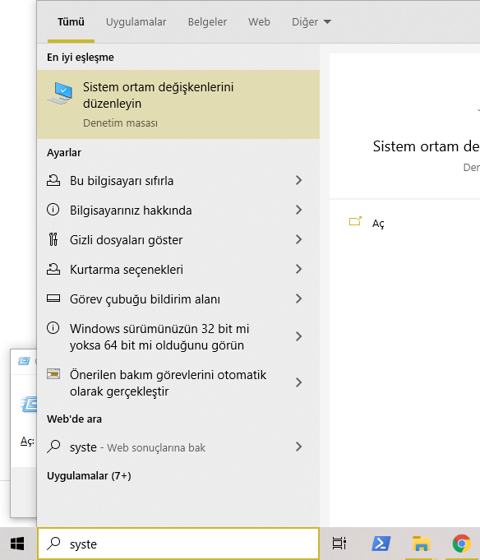
Notepad++ (Install / Compile ) (4)
alt:“alt” height:450px center

Slide 75
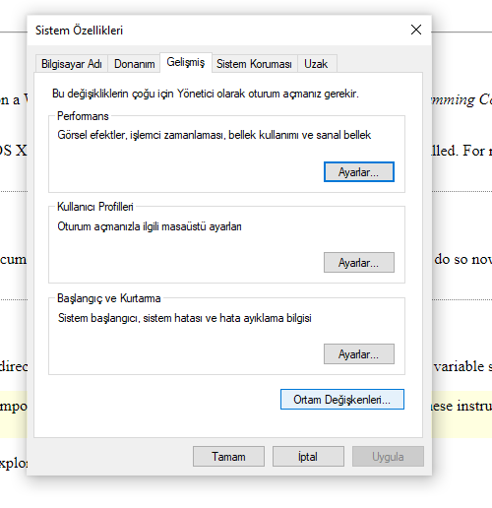
Notepad++ (Install / Compile ) (5)
alt:“alt” height:450px center

Slide 76
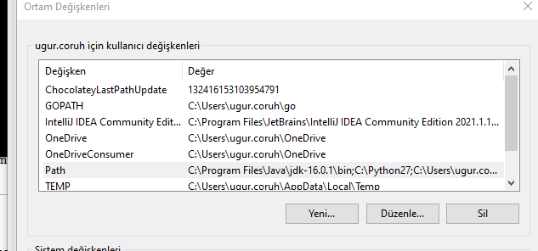
Notepad++ (Install / Compile ) (6)
alt:“alt” height:450px center

Slide 77
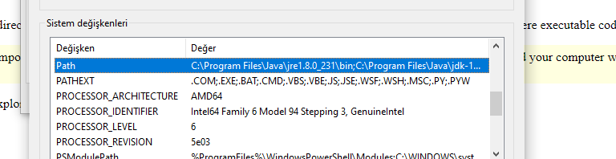
Notepad++ (Install / Compile ) (7)
alt:“alt” height:450px center

Slide 78

Notepad++ (Install / Compile ) (8)
alt:“alt” height:450px center

Slide 79
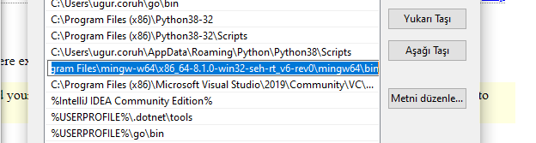
Notepad++ (Install / Compile ) (9)
alt:“alt” height:450px center

Slide 80
Notepad++ (Install / Compile ) (10)
for gcc.exe, g++.exe and gdb.exe
C:\Program Files\mingw-w64\x86_64-8.1.0-win32-seh-rt_v6-rev0\mingw64\bin

Slide 81
Notepad++ (Install / Compile ) (11)
for clang.exe , lldb.exe
C:\Program Files\LLVM\bin

Slide 82
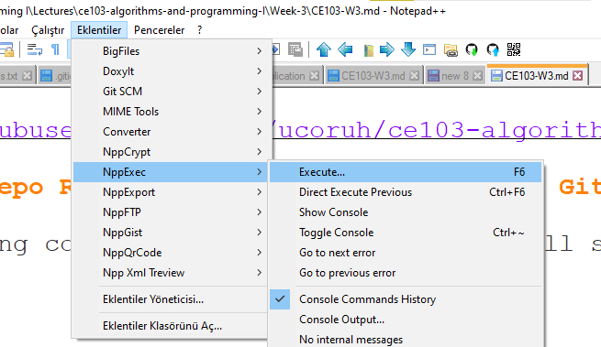
Notepad++ (Install / Compile ) (12)
This folder paths changes according to your setup
Open NppExec extension (install from extension manager if not exist)
alt:“alt” height:450px center

Slide 83
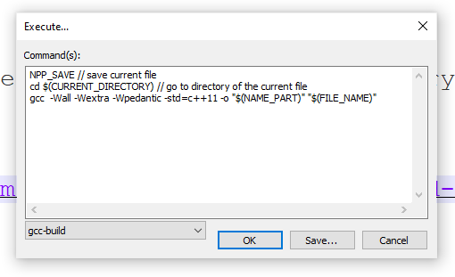
Notepad++ (Install / Compile ) (13)
write the following commands in box
NPP_SAVE // save current file cd $(CURRENT_DIRECTORY) // go to directory of the current file gcc -Wall -Wextra -Wpedantic -std=c++11 -o "$(NAME_PART)" "$(FILE_NAME)"
alt:“alt” height:300px center

Slide 84
Notepad++ (Install / Compile ) (14)
save script as gcc-build and for more information check the following link
How To Setup Notepad for Writing C++ Programs
You can modify or add multiple scripts for another tasks.

Slide 85
Vi/Vim (C/C++)
//TODO//
alt:“alt” height:200px center

Slide 86
Eclipse (C/C++)
//TODO//
alt:“alt” height:200px center

Slide 87
Netbeans (C/C++)
//TODO//
alt:“alt” height:200px center

Slide 88
Turbo C++/C
//TODO//
alt:“alt” height:200px center

Slide 89
Cmake (C++/C) (1)
CMake (http://www.cmake.org/) is a program which generates the Makefiles used by Make.

Slide 90
Cmake (C++/C) (2)
Why use CMake ?
Eases Make use
but the same way of thinking
generate the Makefile
Separate the compilation from the sources
Multi-platfoms
Very flexible

Slide 91
Cmake (C++/C) (3)
Check if the libraries/programs are available on your system
File generator (configure_file)
Calling programs or scripts (doxygen)
One of the new standards

Slide 92
Cmake (C++/C) (4) (Download and Install)
use the following link for download
Download | CMake

Slide 93
Cmake (C++/C) (5) (WSL and Linux Environment)
Hello world with CMake

Slide 94
Cmake (C++/C) (6) (Windows Environment)
main.c
#include <stdio.h> int main() { char name[20]; printf("Enter name: "); scanf("%s", name); printf("Your name is %s.", name); return 0; }
CMakeLists.txt
cmake_minimum_required(VERSION 3.7.2) project(scanf-sample) add_executable(scanf-sample main.c)

Slide 95
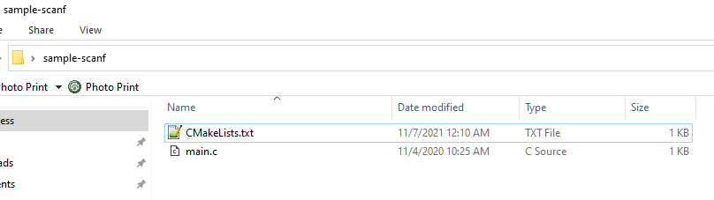
Cmake (C++/C) (7) (Windows Environment)
put main.c and CMakeLists.txt file in sample-scanf folder and from command line
alt:“alt” height:450px center

Slide 96
run the following cmake command with dot (.) to create solution file for c project
C:\Users\ugur.coruh\Desktop\sample-scanf>cmake .

Slide 97
Cmake (C++/C) (8) (Windows Environment)
I have Visual Studio 2022 Community Edition Installed on My Computer, for these reason build tools are selected for visual studio environment and the following outputs are generated
C:\Users\ugur.coruh\Desktop\sample-scanf>cmake . -- Building for: Visual Studio 17 2022 -- Selecting Windows SDK version 10.0.22000.0 to target Windows 10.0.19043. -- The C compiler identification is MSVC 19.30.30704.0 -- The CXX compiler identification is MSVC 19.30.30704.0 -- Detecting C compiler ABI info -- Detecting C compiler ABI info - done -- Check for working C compiler: C:/Program Files/Microsoft Visual Studio/2022/Community/VC/Tools/MSVC/14.30.30704/bin/Hostx64/x64/cl.exe - skipped -- Detecting C compile features -- Detecting C compile features - done -- Detecting CXX compiler ABI info -- Detecting CXX compiler ABI info - done -- Check for working CXX compiler: C:/Program Files/Microsoft Visual Studio/2022/Community/VC/Tools/MSVC/14.30.30704/bin/Hostx64/x64/cl.exe - skipped -- Detecting CXX compile features -- Detecting CXX compile features - done -- Configuring done -- Generating done -- Build files have been written to: C:/Users/ugur.coruh/Desktop/sample-scanf C:\Users\ugur.coruh\Desktop\sample-scanf>

Slide 98
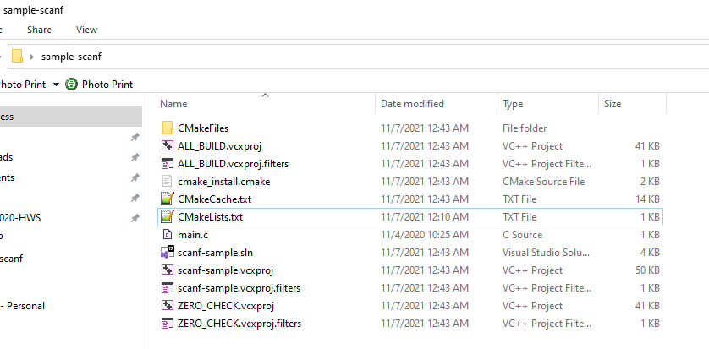
Cmake (C++/C) (9) (Windows Environment)
also following files are generated
alt:“alt” height:450px center

Slide 99
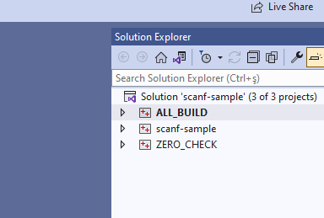
Cmake (C++/C) (10) (Windows Environment)
if we open scanf-sample.sln file we will have automated generated project files
alt:“alt” height:450px center

Slide 100

Cmake (C++/C) (11) (Windows Environment)
you can make scanf-sample with startup project with right click and then run on visual studio.
if you want to configure for another build tool you can use Cmake-GUI installed with setup on your computer
alt:“alt” height:150px center

Slide 101
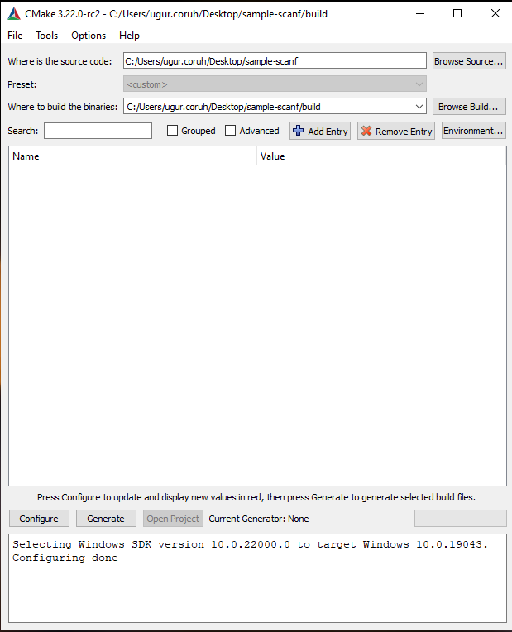
Cmake (C++/C) (12) (Windows Environment)
Open GUI and Select File-> Delete Cache
alt:“alt” height:450px center

Slide 102
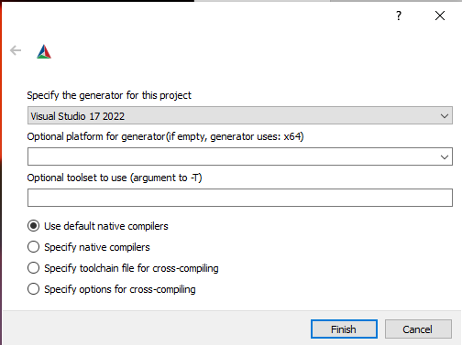
Cmake (C++/C) (13) (Windows Environment)
then you can click “Configure” to select build tool
alt:“alt” height:450px center

Slide 103
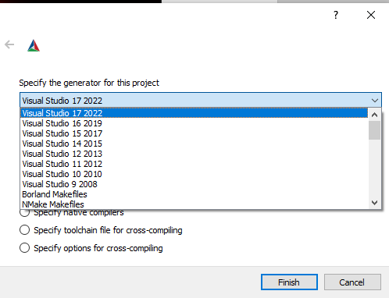
Cmake (C++/C) (14) (Windows Environment)
alt:“alt” height:400px center

Slide 104
Cmake (C++/C) (15) (Windows Environment)
if you click “Configure” twice it will generate the visual studio solution in build folder
for more detailed examples that include also docker and travis-ci sample you can check the following repo
GitHub - ttroy50/cmake-examples: Useful CMake Examples

Slide 105
Make (1)
Sample
hello.c
#include <stdio.h> int main(void) { printf("hello, world\n"); }

Slide 106
Make (2)
Makefile
# This is the default target, which will be built when # you invoke make .PHONY: all all: hello # This rule tells make how to build hello from hello.cpp hello: hello.c g++ -o hello hello.c # This rule tells make to copy hello to the binaries subdirectory, # creating it if necessary .PHONY: install install: mkdir -p binaries cp -p hello binaries # This rule tells make to delete hello and hello.o .PHONY: clean clean: rm -f hello

Slide 107
Make (3)
compile.bat
make all .
will create hello.exe
check hello-make sample

Slide 108
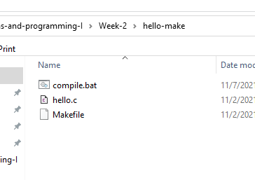
alt:“alt” height:450px center

Slide 109
JAVA Environment and Development
//TODO//
alt:“alt” height:200px center

Slide 110
JDK and JRE Setup
//TODO//
alt:“alt” height:200px center

Slide 111
System Environments and Paths for Java
//TODO//
alt:“alt” height:200px center

Slide 112
Netbeans (Java)
//TODO//
alt:“alt” height:200px center

Slide 113
Eclipse (Java)
//TODO//
alt:“alt” height:200px center

Slide 114
Intellij Idea (Jet Brains) (Java)
//TODO//
alt:“alt” height:200px center

Slide 115
VSCode (Java)
//TODO//
alt:“alt” height:200px center

Slide 116
Notepad++ (Java)
//TODO//
alt:“alt” height:200px center

Slide 117
Cmake (Java)
ASTERICS_HPC

Slide 118
C# Environment and Development

Slide 119
Visual Studio Community Edition (C#)
//TODO//
alt:“alt” height:200px center

Slide 120
Notepad++ (C#)
//TODO//
alt:“alt” height:200px center

Slide 121
Cmake (C#)
Outline

Slide 122
Common Tools and Platforms

Slide 123

Fatih Kalem

Slide 124
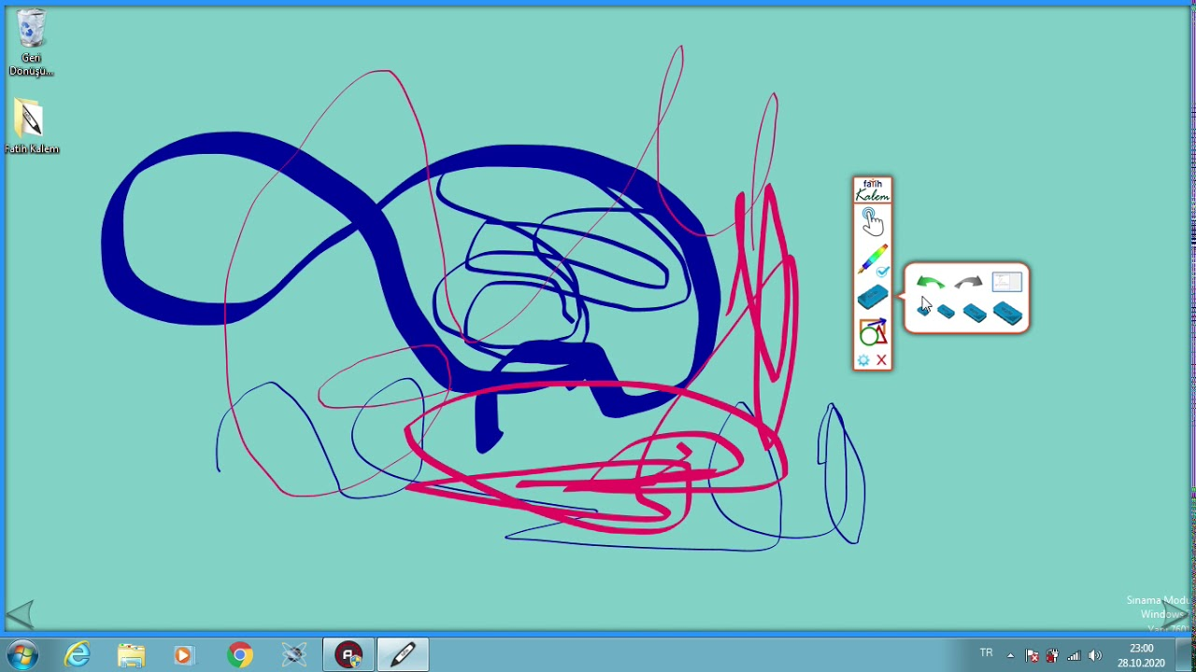
https://cdnvideo.eba.gov.tr/fatihkalem/fatihkalem_portable.zip
https://cdnvideo.eba.gov.tr/fatihkalem/fatihkalem_setup.exe
Fatih Kalem indir - Akıllı Tahta için

Slide 125

Notepad++ (Notepad for Source Code)

Slide 126
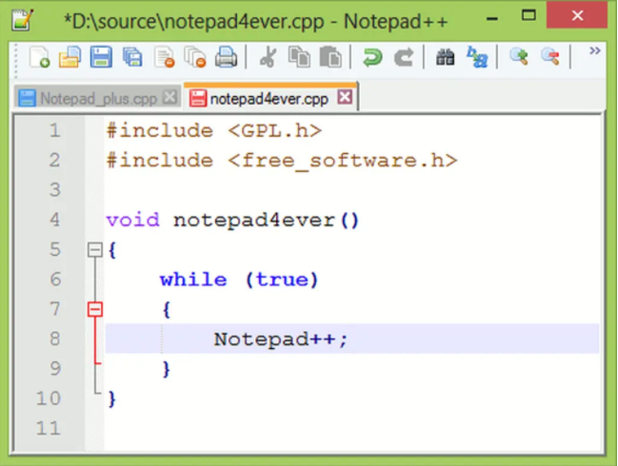
Downloads | Notepad++

Slide 127

HxD (Hex Editor)

Slide 128
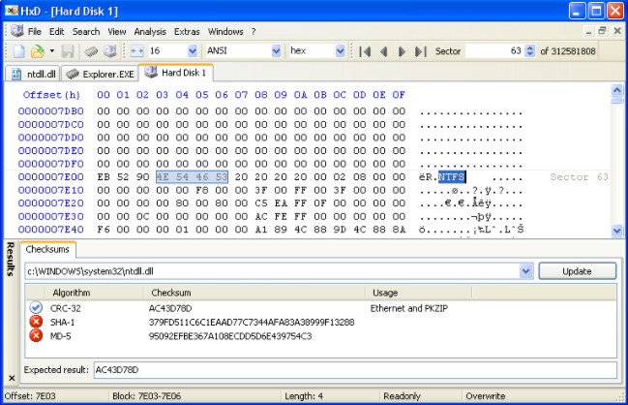
HxD - Freeware Hex Editor and Disk Editor | mh-nexus

Slide 129

Marktext (Markdown Syntax Editor)

Slide 130
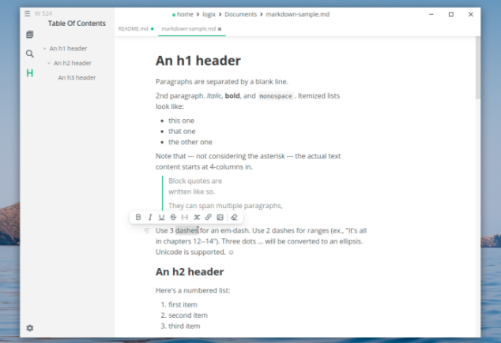
https://marktext.app/

Slide 131

Cygwin (Linux environment for Windows)

Slide 132

https://www.cygwin.com/

Slide 133

Dependency Walker (32-bit or 64-bit Windows module dependency checker)

Slide 134

https://www.dependencywalker.com/

Slide 135

Doxygen (Code Documentation)

Slide 136

Doxygen: Doxygen

Slide 137

Sonarlint (Code Quality and Code Security Extension)

Slide 138
https://www.sonarlint.org/

Slide 139

Codepen.io (online code sharing)

Slide 140

https://codepen.io/

Slide 141
Credit Card Sample
https://codepen.io/quinlo/pen/YONMEa

Slide 142

Codeshare.io (real time code sharing)

Slide 143

https://codeshare.io/

Slide 144

Codebeautify.org (online data conversion tools)

Slide 145
https://codebeautify.org/

Slide 146
AsciiFlow.com (ASCII drawing tool)
//TODO//
alt:“alt” height:200px center

Slide 147
Freemind (opensource mindmap application)
//TODO//
alt:“alt” height:200px center

Slide 148
Wireflow (user flow designer)
//TODO//
alt:“alt” height:200px center

Slide 149
PlantUML (software designer)
//TODO//
alt:“alt” height:200px center

Slide 150
Drawio (drawing tool)
//TODO//
alt:“alt” height:200px center

Slide 151
Putty (Remote Connection)
//TODO//
alt:“alt” height:200px center

Slide 152
MobaXterm (Remote Connection)
//TODO//
alt:“alt” height:200px center

Slide 153
Teamviewer (Remote Connection)
//TODO//
alt:“alt” height:200px center

Slide 154
Paletton.com (Color Chooser)
//TODO//
alt:“alt” height:200px center
Understand (Static Code Analysis)
//TODO//
alt:“alt” height:200px center

Slide 155
JD Project (Java Decompiler)
//TODO//
alt:“alt” height:200px center

Slide 156
Cutter (Multi-Platform Reverse Engineering Tool)
//TODO//
alt:“alt” height:200px center

Slide 157
IDA Pro / Freeware (Native Reverse Engineering Tool)
//TODO//
alt:“alt” height:200px center

Slide 158
Code Visualization (Python, C , C++ , Java)
https://pythontutor.com/
//TODO//
alt:“alt” height:200px center

Slide 159
Assembly of C Code
https://godbolt.org/
//TODO//
alt:“alt” height:200px center

Slide 160
Mobile Device Screen Sharing for Demo
GitHub - Genymobile/scrcpy: Display and control your Android device

Slide 161
Travis-CI
Travis.yml
//TODO//
alt:“alt” height:200px center

Slide 162
Jenkins
//TODO//
alt:“alt” height:200px center

Slide 163
Valgrind
//TODO//
alt:“alt” height:200px center

Slide 164
Docker
- https://www.youtube.com/watch?v=nBwJm0onzeo&ab_channel=GaryExplains Dockerfile
DockerHub
Docker Compose Yaml
Dockerrun.aws.json (AWS)
//TODO//
alt:“alt” height:200px center

Slide 165
Nuget Packages
//TODO//
alt:“alt” height:200px center

Slide 166
Vim for Windows
vim/vim-wim32-installer (windows vim installer)
//TODO//
alt:“alt” height:200px center

Slide 167
SCV Cryptomanager
//TODO//
alt:“alt” height:200px center

Slide 168
Addario CryptoBench
//TODO//
alt:“alt” height:200px center

Slide 169
Raymond’s MD5 & SHA Checksum Utility
//TODO//
alt:“alt” height:200px center

Slide 170
SlavaSoft HashCalc
//TODO//
alt:“alt” height:200px center

Slide 171
Portable PGP
//TODO//
alt:“alt” height:200px center

Slide 172
Online Programming Envoriments
Hackerrank
CS50 Sandbox
Programiz C Online Complier
//TODO//
alt:“alt” height:200px center

