Slide 1
CEN206 Object-Oriented Programming
Software Engineering, Java Introduction and Fundamental Structures Author: Asst. Prof. Dr. Ugur CORUH

Slide 2
CEN206 Object-Oriented Programming

Slide 3
Week-1 (Software Engineering, Java Introduction and Fundamental Structures)
Spring Semester, 2025-2026
Download DOC-PDF, DOC-DOCX, SLIDE

Slide 4
Module A: Course Introduction

Slide 5
Course Plan and Communication
Introduction to the course
Course objectives and learning outcomes
Grading system
Assignments and exams
Communication channels (Microsoft Teams Code: 42ttevp)
Office hours and consultation

Slide 6
Takeaway: Course Introduction
CEN206 covers OOP concepts, UML, Design Patterns, and Java implementation
Growth track: Java OOP -> UML -> PlantUML/UMPLE -> Design Patterns
One semester-long project with midterm and final checkpoints
Two quizzes (Week 7 and Week 13) to assess theoretical understanding

Slide 7
Module B: Software and Software Engineering

Slide 8
Module Outline
Software and Software Engineering
The Project Construction Cycle - The Tree Swing Example
Software Quality and Metrics
Software Engineering Projects and Life Cycle
Unified Process (UP)

Slide 9
Software and Software Engineering

Slide 10
Software
Computer Software is the product that software engineers design and build.
It encompasses
programs that execute within a computer of any size and architecture,
documents that encompass hard-copy and virtual forms,
data that combine numbers and text but also includes representations of pictorial, video, and audio information.

Slide 11
The Nature of Software… (1)
Software is intangible Hard to understand development effort
Software is easy to reproduce
Cost is in its development
in other engineering products, manufacturing is the costly stage
The industry is labor-intensive
Hard to automate
Untrained people can hack something together
Quality problems are hard to notice

Slide 12
The Nature of Software… (2)
Software is easy to modify
People make changes without fully understanding it
Software does not “wear out”
It deteriorates by having its design changed:
erroneously, or
in ways that were not anticipated, thus making it complex
Conclusions
Much software has poor design and is getting worse
We have to learn to ‘engineer’ software

Slide 13
Some types of Software
Real time embedded software
E.g. control and monitoring systems
Must react immediately
Safety often a concern
Data processing software
Used to run businesses
Accuracy and security of data are key
Game software
Mobile device software
Web-based software
Etc.

Slide 14
Single Chance
Most of the clients use applications to ease their tasks to make money. For this reason, you do not have a chance to try your application development in real system. Before this deployment you have to use
Theory
Experimentation
Guesses
Feedback

Slide 15
Lets talk about.

Slide 16
The Project Construction Cycle - The Tree Swing Example

Slide 17
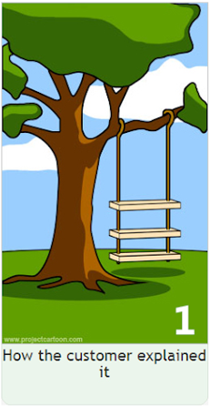
1-How the customer explained it
center h:500px

Slide 18
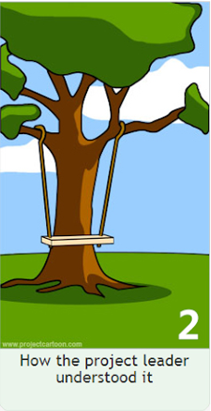
2-How the project leader understood it.
center h:500px

Slide 19
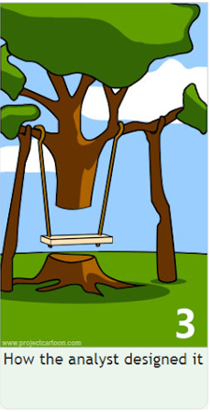
3- How the analyst designed it
center h:500px

Slide 20
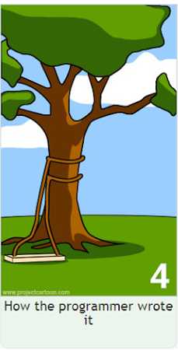
4-How the programmer wrote it
center h:500px

Slide 21
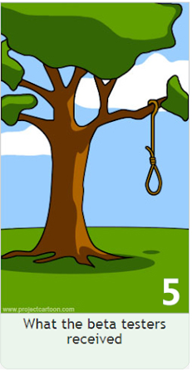
5-What the beta testers received
center h:500px

Slide 22

6-How the business consultant described it
center h:500px

Slide 23

7- How the project was documented
center h:500px

Slide 24
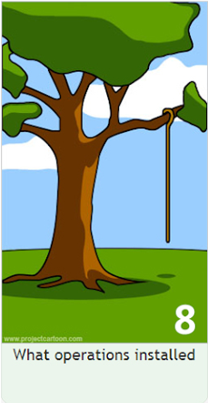
8-What operations installed
center h:500px

Slide 25
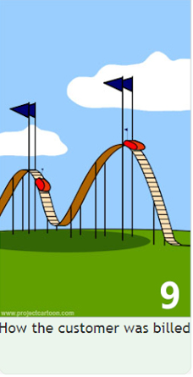
9-How the customer was billed
center h:500px

Slide 26

10-How it was supported
center h:500px

Slide 27

11-What marketing advertised
center h:500px

Slide 28
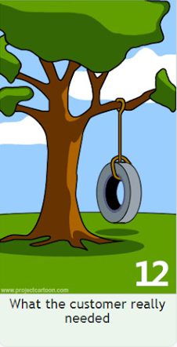
12-What the customer really needed
center h:500px

Slide 29

13-The disaster recover plan
center h:500px

Slide 30

14- What the digg effect can do to your site
center h:500px

Slide 31

15- (Finally) When it was delivered
center h:500px

Slide 32
Need for a good programming method
Common problems
Why does it take so long?
Why are development costs so high?
Why can’t find all faults before delivery?
Why can’t we measure development?
NIST reported that even though 50 percent of software development budgets go to testing, flaws in software still cost the U.S. economy $59.5 billion annually.*
Updated NIST Software Uses Combination Testing to Catch Bugs Fast and Easy | NIST

Slide 33
What is Software Engineering? (1)
The process of solving customers’ problems by the
systematic development and evolution of large,
high-quality software systems within
cost,
time and
other constraints

Slide 34
What is Software Engineering? (2)
Solving customers’ problems
The goal
Sometimes the solution is to buy, not build
Adding unnecessary features often makes software worse
Software engineers must communicate effectively to identify and understand the problem

Slide 35
What is Software Engineering? (3)
Systematic development and evolution
An engineering process involves applying well understood techniques in a organized and disciplined way
Many well-accepted practices have been formally standardized
e.g. by the IEEE or ISO
Most development work is evolution

Slide 36
What is Software Engineering? (4)
Large, high quality software systems
Software engineering techniques are needed because large systems cannot be completely understood by one person
Teamwork and co-ordination are required
Key challenge: Dividing up the work and ensuring that the parts of the system work properly together
The end-product must be of sufficient quality

Slide 37
What is Software Engineering? (5)
Cost, time and other constraints
Finite resources
The benefit must outweigh the cost
Others are competing to do the job cheaper and faster
Inaccurate estimates of cost and time have caused many project failures

Slide 38
The Software Engineering Profession
The term Software Engineering was coined in 1968
People began to realize that the principles of engineering should be applied to software development
Engineering is a licensed profession
In order to protect the public
Engineers design artifacts following well accepted practices which involve the application of science, mathematics and economics
Ethical practice is also a key tenet of the profession
In many countries, much software engineering does not require an engineering licence, but is still engineering

Slide 39
Software Engineering Code of Ethics
Software engineers shall
Act consistently with public interest
Act in the best interests of their clients
Develop and maintain with the highest standards possible
Maintain integrity and independence
Promote an ethical approach in management
Advance the integrity and reputation of the profession
Be fair and supportive to colleagues
Participate in lifelong learning

Slide 40
Software Quality
Usability
Users can learn it and fast and get their job done easily
Efficiency
It doesn’t waste resources such as CPU time and memory
Reliability
It does what it is required to do without failing
Maintainability
It can be easily changed
Reusability
Its parts can be used in other projects, so reprogramming is not needed

Slide 41
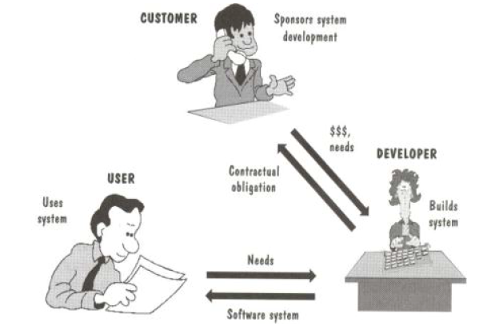
Software Quality and Stakeholders
center h:500px

Slide 42
Software Quality and Stakeholders
Customer (those who pay):
solves problems at an acceptable cost in terms of money paid and resources used
User
easy to learn; efficient to use; helps get work done
Developer
easy to design; easy to maintain; easy to reuse its parts
Development manager
sells more and pleases customers while costing less to develop and maintain

Slide 43
Software Quality Metrics – User
A program must do its job correctly. It must be useful and - usable
A program must run as fast as necessary (Real-time constraints)
A program must not waste system resources(processor time, - memory, disk capacity, network capacity) too much
It must be reliable
It must be easily updated
A good software must have sufficient documentation (users manual)

Slide 44
Software Quality Metrics – SW Developer
Source code must be readable and understandable
It must be easy to maintain and update the program
A program must consist of independent modules
An error may not affect other parts of a program (Locality of errors)
Modules of the program must be reusable in other projects
A software project must meet its deadline
Good software must have sufficient documentation

Slide 45
Software Quality Metrics - OOP
OOP techniques ensure high-quality programs
While designing and coding a program, these quality metrics must always be considered

Slide 46
Software Quality: Conflicts and Objectives
The different qualities can conflict
Increasing efficiency can reduce maintainability or reusability
Increasing usability can reduce efficiency
Setting objectives for quality is a key engineering activity
You then design to meet the objectives
Avoids “over-engineering” which wastes money

Slide 47
Software Engineering Projects
Most projects are evolutionary or maintenance projects, involving work on legacy systems
Corrective projects: fixing defects
Adaptive projects: changing the system in response to changes in
Operating system
Database
Rules and regulations
Enhancement projects: adding new features for users
Reengineering or perfective projects: changing the system internally so it is more maintainable

Slide 48
Software Engineering Projects Start Points
Green Field Development | Brownfield Development
Start afresh | Build on existing code
Choose your technology | Technology already chosen
Use your best ideas, patterns, techniques | Understand previous developers’ code
Learn from mistakes | Live with mistakes

Slide 49
Software Engineering Projects Start Points
 | Requirements must be determined | Clients have produced requirements
New development, Green Field Project | A | B
Evolution of Existing System, Brown Field Project | C | D

Slide 50
Activities Common to Software Projects
Requirements and specification
Includes
Domain analysis
Defining the problem
Requirements gathering
Obtaining input from as many sources as possible
Requirements analysis
Organizing the information
Requirements specification
Writing detailed instructions about how the software should behave

Slide 51
Activities Common to Software Projects
Design
Deciding how the requirements should be implemented, using the available technology
Includes:
Systems engineering: Deciding what should be in hardware and what in software
Software architecture: Dividing the system into subsystems and deciding how the subsystems will interact
Detailed design of the internals of a subsystem
User interface design
Design of databases

Slide 52
Activities Common to Software Projects
Modeling
Creating representations of the domain or the software
Use case modeling
Structural modeling
Dynamic and behavioural modeling
Programming
Quality assurance
Reviews and inspections
Testing
Deployment
Managing the process

Slide 53
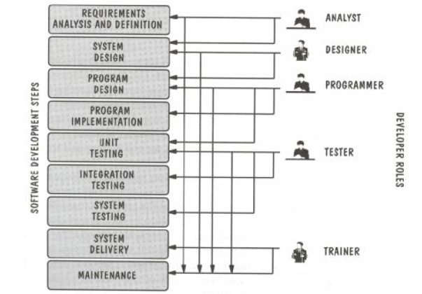
Software Projects Development Team
center h:500px

Slide 54
Software Life Cycle
Requirements Phase
Specification Phase
Design Phase
Implementation Phase
Integration Phase
Maintenance Phase
Retirement Phase

Slide 55
Requirements Phase
Defining constraints
Functions
Due dates
Costs
Reliability
Size
Types
Functional
Non-Functional

Slide 56
Specification Phase
Documentation of requirements
Inputs & Outputs
Formal
Understandable for user & developer
Usually functional requirements (what to do)
Base for testing & maintenance
The contract between customer & developer

Slide 57
Design Phase
Defining Internal structure (how to do)
Has some levels (or types of docs)
Architectural design
Detailed design
Important
To backtrack the aims of decisions
To easily maintain

Slide 58
Implementation and Integration Phases
Implementation phase: Simply coding
Unit tests
For verification
Combining modules
System tests
For validation
Quality tests

Slide 59
Maintenance Phase
Corrective
Enhancement
Perfective
Adaptive
Usually maintainers are not the same people with developers.
The only input is (in general) the source code of the software

Slide 60
Retirement Phase
When the cost of maintenance is not effective.
Changes are so drastic, that the software should be redesigned.
So many changes may have been made.
The update frequency of docs is not enough.
The hardware (or OS) will be changed.

Slide 61
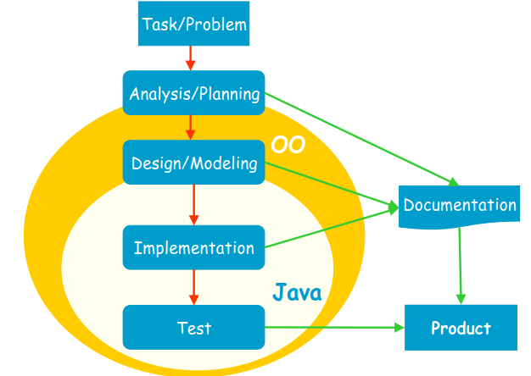
Software Development Process
center h:500px

Slide 62
Software Development Process
Analysis: Understanding requirements. They may change during (or after) development of the system! Building the programming team.
Design: Identifying the key concepts involved in a solution and creation of the models.
This stage has a strong effect on the quality of the software. Therefore, before the coding, verification of the created model must be done.
Design process is connected with the programming scheme. Here, our design style is object-oriented.

Slide 63
Software Development Process
Coding: The solution (model) is expressed in a program. In this course we will use Java.
Documentation: Each phase of a software project must be clearly explained. A users manual should also be written.
Test: the behavior of the program for possible inputs must be examined.
These steps are important design principles and design patterns, which help us developing high-quality software. The Unified Modeling Language (UML) is useful to express the model.

Slide 64
Unified Process (UP)
The UP promotes several best practices.
Iterative
Incremental
Risk-driven

Slide 65
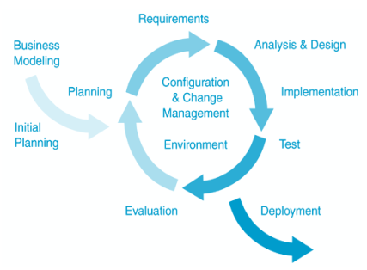
Unified Process (UP)
center h:500px

Slide 66
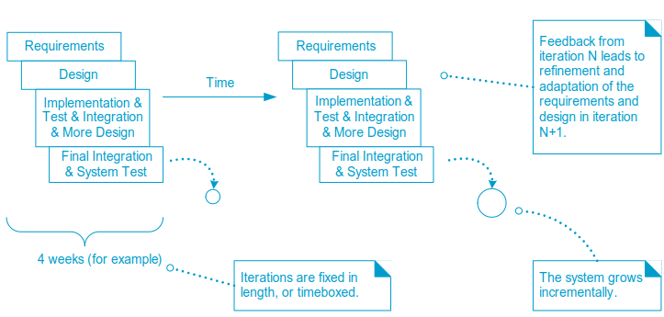
Unified Process (UP)
center h:500px

Slide 67
Takeaway: Software and Software Engineering
Software is intangible, easy to modify but hard to engineer correctly
The Tree Swing example shows why communication matters in SE projects
Software quality has multiple stakeholders with potentially conflicting needs
Software Life Cycle: Requirements -> Specification -> Design -> Implementation -> Maintenance -> Retirement
Unified Process (UP) provides an iterative, incremental development framework

Slide 68
Module C: What is Object-Oriented Programming?

Slide 69
Module Outline
OOP Concepts and the Four Pillars
Procedural Programming and Its Problems
OOP vs Procedural Programming: Side-by-Side Comparison
Object Model and Paradigm Views
Key Terminology

Slide 70
Object Orientation Part-1

Slide 71
OOP Concepts in Java
OOP stands for Object-Oriented Programming. OOP is a programming paradigm in which every program is follows the concept of object. In other words, OOP is a way of writing programs based on the object concept.
The object-oriented programming paradigm has the following core concepts.
Encapsulation
Inheritance
Polymorphism
Abstraction
The popular object-oriented programming languages are Smalltalk, C++, Java, PHP, C#, Python, etc.

Slide 72
Encapsulation
Encapsulation is the process of combining data and code into a single unit (object / class). In OOP, every object is associated with its data and code. In programming, data is defined as variables and code is defined as methods. The java programming language uses the class concept to implement encapsulation.

Slide 73
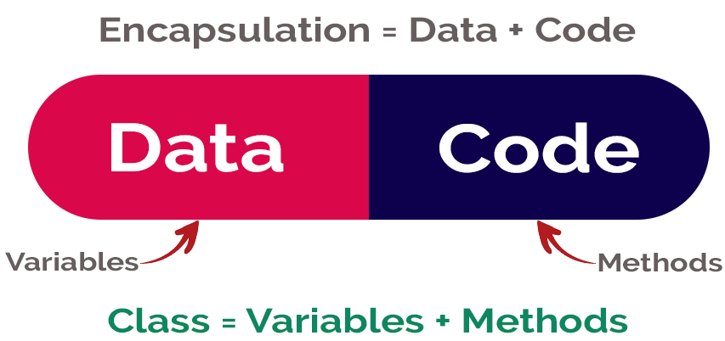
Encapsulation
center h:400px

Slide 74
Inheritance
Inheritance is the process of acquiring properties and behaviors from one object to another object or one class to another class. In inheritance, we derive a new class from the existing class. Here, the new class acquires the properties and behaviors from the existing class. In the inheritance concept, the class which provides properties is called as parent class and the class which receives the properties is called as child class. The parent class is also known as base class or super class. The child class is also known as derived class or sub class.
In the inheritance, the properties and behaviors of base class extended to its derived class, but the base class never receive properties or behaviors from its derived class.
In java programming language the keyword extends is used to implement inheritance.

Slide 75
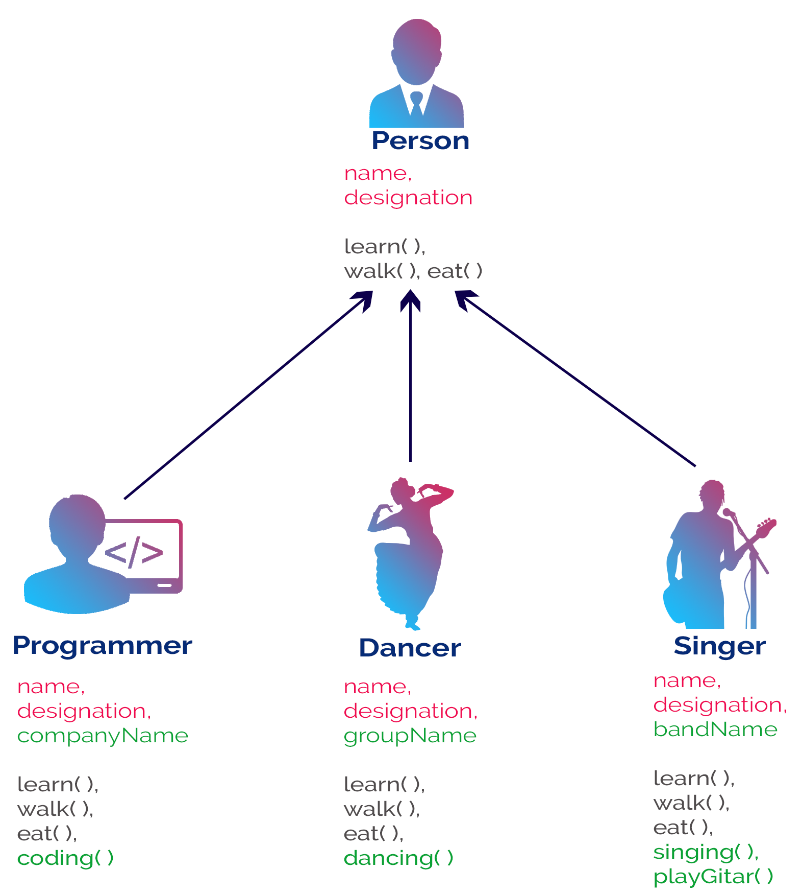
Inheritance
bg right:50% h:700px

Slide 76
Polymorphism
Polymorphism is the process of defining same method with different implementation. That means creating multiple methods with different behaviors.
The java uses method overloading and method overriding to implement polymorphism.
Method overloading - multiple methods with same name but different parameters.
Method overriding - multiple methods with same name and same parameters.

Slide 77
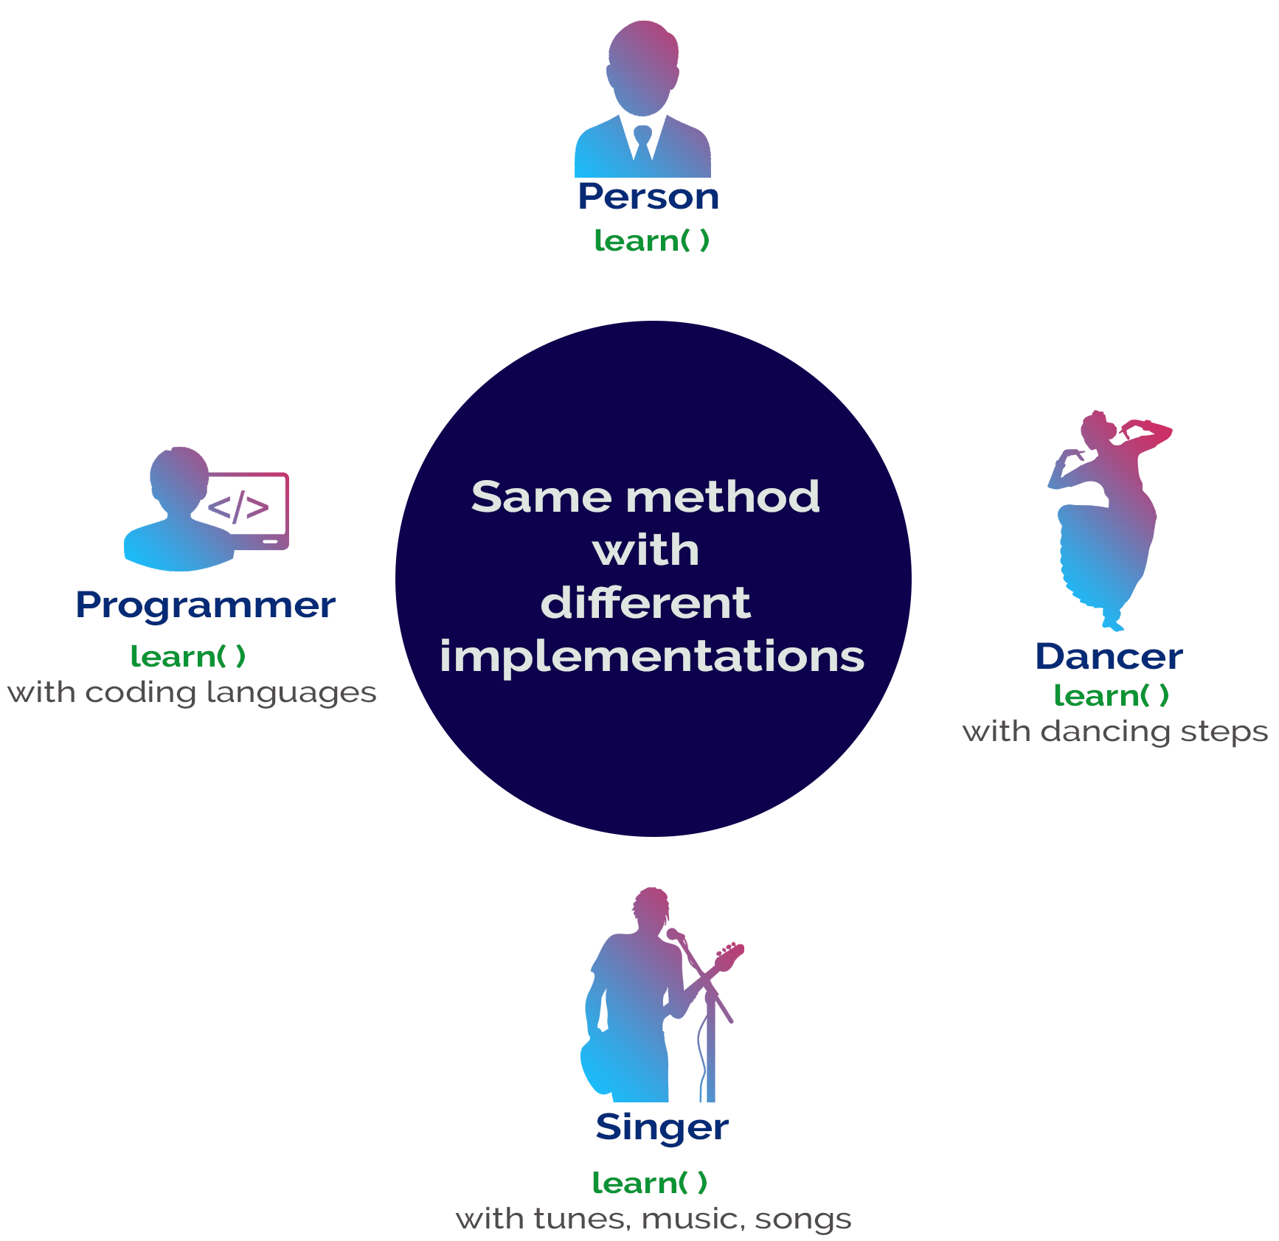
Polymorphism
bg right:50% h:700px

Slide 78
Abstraction
Abstraction is hiding the internal details and showing only esential functionality. In the abstraction concept, we do not show the actual implemention to the end user, instead we provide only esential things. For example, if we want to drive a car, we does not need to know about the internal functionality like how wheel system works? how brake system works? how music system works? etc.

Slide 79
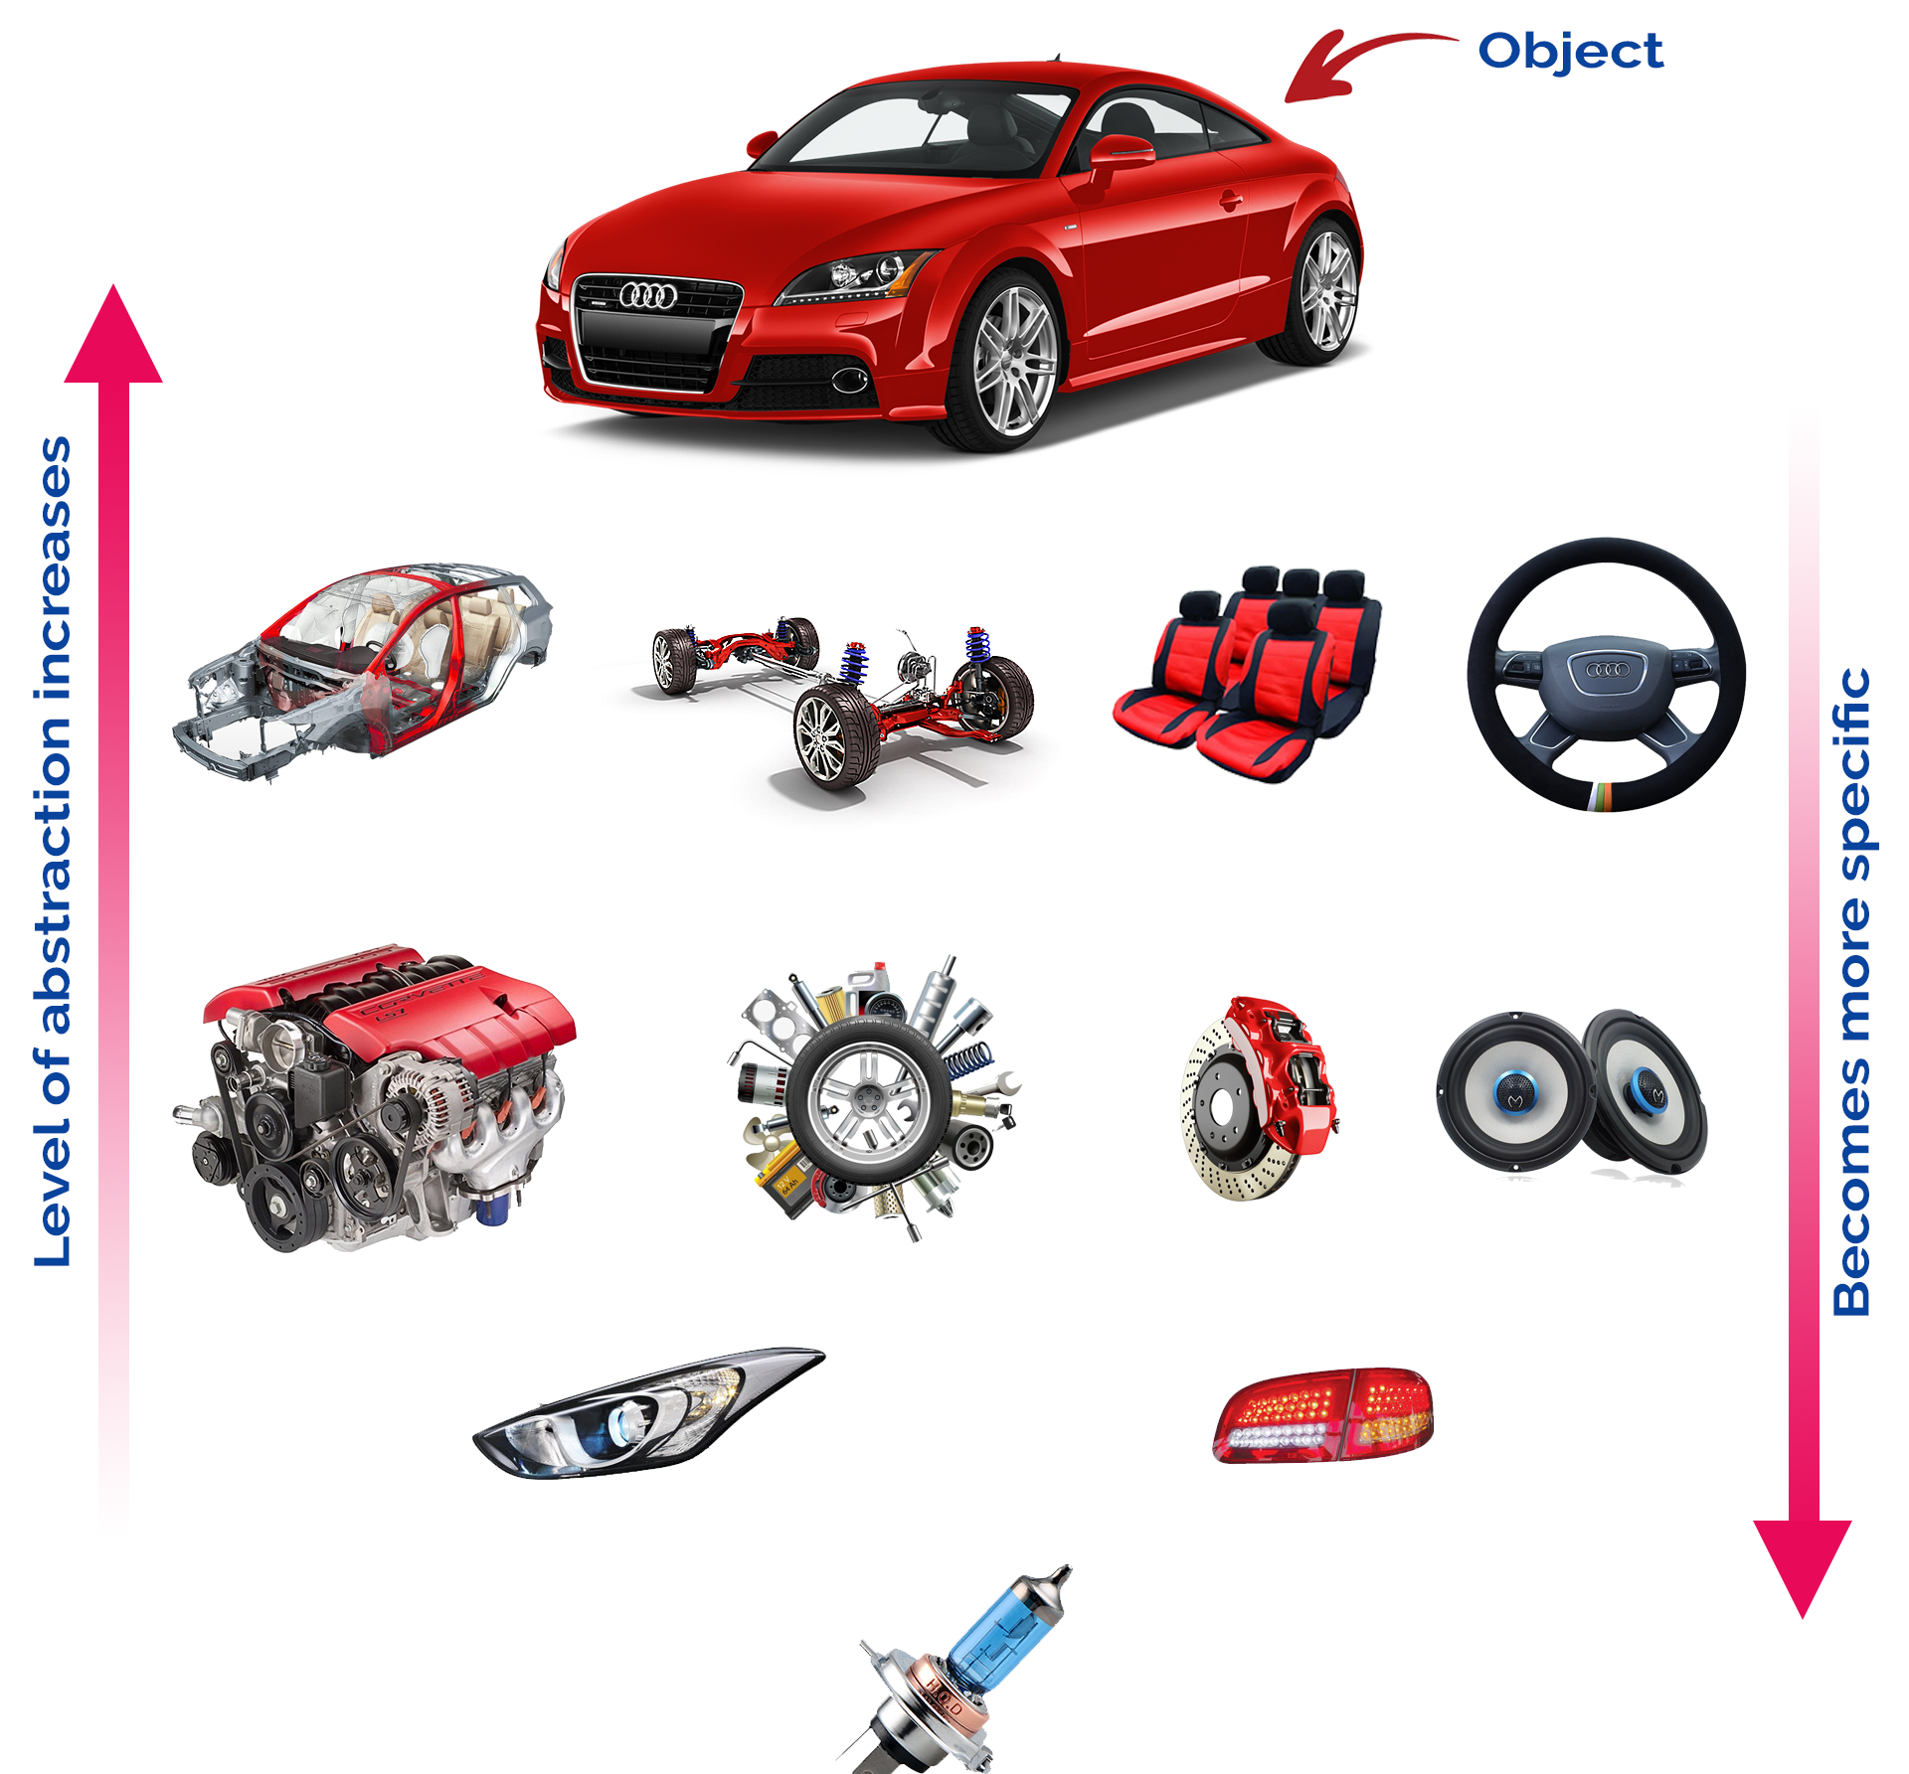
Abstraction
bg right:50% h:600px

Slide 80
Why Object Technology
Expectations are,
Reducing the effort, complexity, and cost of development and maintenance of software systems.
Reducing the time to adapt an existing system (quicker reaction to changes in the business environment): Flexibility, reusability.
Increasing the reliability of the system.

Slide 81
Object Orientation Part-2

Slide 82
Procedural Programming
Pascal, C, Basic, Fortran and similar traditional languages are procedural
Each statement tells the computer to do something
The emphasis is on doing things
Functions
A program is divided into functions
Each function has a clearly defined purpose and interface

Slide 83
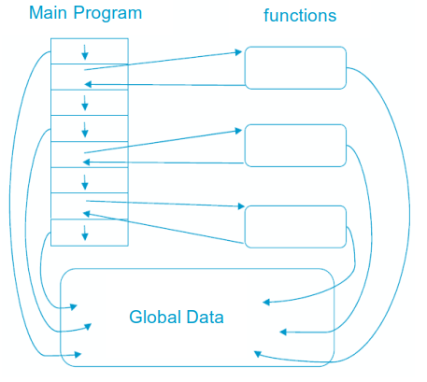
Procedural Programming
center h:500px

Slide 84
Problems with Procedural Programming
Data Is undervalued
Data is, after all, the reason for a program’s existence. The important parts of a program are not functions that display the data or functions that checks for correct input; they are data
Procedural programs don’t model the real world very well. The real world does not consist of functions
Global data can be corrupted by functions that have no business changing it
To add new data items, all the functions that access data must be modified so that they can also access these new items
Creating new data types is difficult

Slide 85
Besides
It is also possible to write good programs by using procedural programming (C programs).
But object-oriented programming offers programmers many advantages, enables them to write high-quality programs

Slide 86
Object-Oriented Programming
The fundamental idea behind object-oriented programming:
The real world consists of objects. Computer programs may contain computer world representations of the things (objects) that constitute the solutions of real world problems.
Real world objects have two parts:
Properties (or state: characteristics that can change),
Behavior (or abilities: things they can do).
To solve a programming problem in an object-oriented language,the programmer no longer asks how the problem will be divided into functions, but how it will be divided into objects.
The emphasis is on data

Slide 87
Object-Oriented Programming
What kinds of things become objects in object-oriented programs?
Human entities: Employees, customers, salespeople,worker, manager
Graphics program: Point, line, square, circle, …
Mathematics: Complex numbers, matrix
Computer user environment: Windows, menus, buttons
Data-storage constructs: Customized arrays, stacks, linked lists

Slide 88
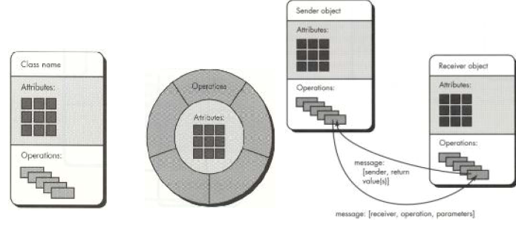
Object Model
A Java program typically consists of a number of objects that communicate with each other by calling one another’s member functions.
center h:400px

Slide 89
OOP vs. Procedural Programming
Procedural languages still require you to think in terms of the structure of the computer rather than the structure of the problem you are trying to solve.
The programmer must establish the association between the machine model and the model of the problem that is actually being solved.
The effort required to perform this mapping produces programs that are difficult to write and expensive to maintain. Because the real world thing and their models on the computer are quite different

Slide 90
Example: Procedural Programming
Real world thing: student
Computer model: char *, int, float
It is said that the C language is closer to the computer than the problem.

Slide 91
OOP vs. Procedural Programming
The OO approach provides tools for the programmer to represent elements in the problem space
Objects are both in the problem space and the solution
The OO programs are easy to update by adding new types of objects
OOP allows you to describe the problem in terms of the problem, rather than in terms of the computer where the solution will run.

Slide 92
OOP vs. Procedural Programming
Benefits of the object-oriented programming:
Readability
Understandability
Low probability of errors
Maintenance
Reusability
Teamwork

Slide 93
OOP vs. Procedural Programming
Procedural paradigm:
Software is organized around the notion of procedures
Procedural abstraction
Works as long as the data is simple
Adding data abstractions groups together the pieces of data that describe some entity
Helps reduce the system’s complexity.
Such as Records and structures
Object oriented paradigm:
Organizing procedural abstractions in the context of data abstractions

Slide 94
Object Oriented paradigm
All computations are performed in the context of objects.
The objects are instances of classes, which:
are data abstractions
contain procedural abstractions that operate on the objects
A running program can be seen as a collection of objects collaborating to perform a given task

Slide 95
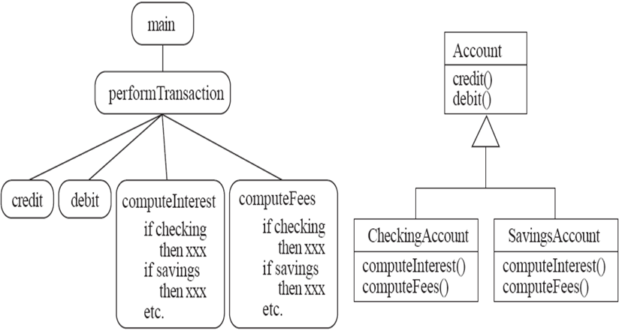
A View of the Two paradigms
center h:400px

Slide 96
Key Terminology
Abstraction
Object $⇒$ something in the world
Class $⇒$ objects
Superclass $⇒$ subclasses
Operation $⇒$ methods
Attributes and associations $⇒$ instance variables
Modularity
Code is divided into classes, and classes into methods
Encapsulation
Details can be hidden in classes
This gives rise to information hiding:
Programmers do not need to know all the details of a class

Slide 97
Takeaway: What is OOP?
OOP models real-world entities as objects with state (fields) and behavior (methods)
Four pillars: Encapsulation, Inheritance, Polymorphism, Abstraction
Procedural programming focuses on functions; OOP focuses on objects
OOP reduces complexity, improves reusability, and supports team development
Key terms: Class, Object, Message, Method, Instance Variable, Generalization, Specialization

Slide 98
Module D: Introduction to Java

Slide 99
Module Outline
What is Programming? Why Java?
Java Buzz Words and Features
Java Basics Overview (Types, Strings, Arrays, Casting, Exceptions)
Programming Style Guidelines
C++ vs Java Comparison

Slide 100
What is Programming?
A programming language provides a way to express concepts.
Program development involves creating models of real world - situations and building computer programs based on these models.
Computer programs describe the method of implementing the model.
Computer programs may contain computer world representations of the things that constitute the solutions of real world problems.

Slide 101
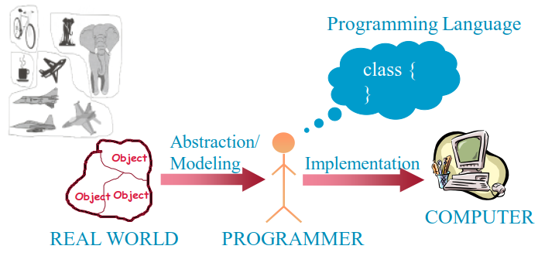
What is Programming?
If successful, this medium of expression (the object-oriented way) will be significantly easier, more flexible, and efficient than the alternatives as problems grow larger and more complex
center h:400px

Slide 102
Why JAVA
Java supports writing high quality programs (pure OO)
Provides an easy-to-use language
Provides an interpreted environment for
Improved development speed
Code portability
Simple
Architecture Neutral and Portable
Robust and Secure
High Performance

Slide 103
Why JAVA
Write less code
can be four times smaller than the same program written in C++
Write better code
encourages good coding practices, garbage collection for avoiding memory leaks, wide-ranging, easily extendible API
Avoid platform dependencies
Write once, run anywhere
Gained popularity in gadgets such as
PDAs, cell phones etc.

Slide 104
Learning JAVA
Many syntax and grammar rules
Learning how to write “good programs”
Focusing on concepts and not get lost in language-technical - details
Paying attention to design techniques rather than details
Building an effective programming scheme
Practicing, practicing and practicing!
Consequently, new and better ways of building systems

Slide 105
Java Buzz Words
Simple
Secure
Portable
Object-oriented
Robust
Architecture-neutral (or) Platform Independent
Multi-threaded
Interpreted
High performance
Distributed
Dynamic

Slide 106
Simple
Java programming language is very simple and easy to learn, understand, and code. Most of the syntaxes in java follow basic programming language C and object-oriented programming concepts are similar to C++. In a java programming language, many complicated features like pointers, operator overloading, structures, unions, etc. have been removed. One of the most useful features is the garbage collector it makes java more simple.

Slide 107
Secure
Java is said to be more secure programming language because it does not have pointers concept, java provides a feature “applet” which can be embedded into a web application. The applet in java does not allow access to other parts of the computer, which keeps away from harmful programs like viruses and unauthorized access.

Slide 108
Portable
Portability is one of the core features of java which enables the java programs to run on any computer or operating system. For example, an applet developed using java runs on a wide variety of CPUs, operating systems, and browsers connected to the Internet.

Slide 109
Object-oriented
Java is said to be a pure object-oriented programming language. In java, everything is an object. It supports all the features of the object-oriented programming paradigm. The primitive data types java also implemented as objects using wrapper classes, but still, it allows primitive data types to archive high-performance.

Slide 110
Robust
Java is more robust because the java code can be executed on a variety of environments, java has a strong memory management mechanism (garbage collector), java is a strictly typed language, it has a strong set of exception handling mechanism, and many more.

Slide 111
Architecture-neutral (or) Platform Independent
Java has invented to archive “write once; run anywhere, any time, forever”. The java provides JVM (Java Virtual Machine) to to archive architectural-neutral or platform-independent. The JVM allows the java program created using one operating system can be executed on any other operating system.

Slide 112
Multi-threaded
Java supports multi-threading programming, which allows us to write programs that do multiple operations simultaneously.

Slide 113
Interpreted
Java enables the creation of cross-platform programs by compiling into an intermediate representation called Java bytecode. The byte code is interpreted to any machine code so that it runs on the native machine.

Slide 114
High performance
Java provides high performance with the help of features like JVM, interpretation, and its simplicity.

Slide 115
Distributed
Java programming language supports TCP/IP protocols which enable the java to support the distributed environment of the Internet. Java also supports Remote Method Invocation (RMI), this feature enables a program to invoke methods across a network.

Slide 116
Dynamic
Java is said to be dynamic because the java byte code may be dynamically updated on a running system and it has a dynamic memory allocation and deallocation (objects and garbage collector).

Slide 117
The Basics of Java
History
The first object oriented programming language was Simula-67
designed to allow programmers to write simulation programs
In the early 1980’s, Smalltalk was developed at Xerox PARC
New syntax, large open-source library of reusable code, bytecode, platform independence, garbage collection.

Slide 118
The Basics of Java
late 1980’s, C++ was developed by B. Stroustrup,
Recognized the advantages of OO but also recognized that there were tremendous numbers of C programmers
In 1991, engineers at Sun Microsystems started a project to design a language that could be used in consumer ‘smart devices’: Oak
When the Internet gained popularity, Sun saw an opportunity to exploit the technology.
The new language, renamed Java, was formally presented in 1995 at the SunWorld ’95 conference.

Slide 119
Java documentation
Looking up classes and methods is an essential skill
Looking up unknown classes and methods will get you a long way towards understanding code
Java documentation can be automatically generated by a program called Javadoc
Documentation is generated from the code and its comments
You should format your comments as shown in some of the book’s examples
These may include embeded html

Slide 120
Characters and Strings
Character is a class representing Unicode characters
More than a byte each
Represent any world language
char is a primitive data type containing a Unicode character
String is a class containing collections of characters
+ is the operator used to concatenate strings

Slide 121
Arrays and Collections
Arrays are of fixed size and lack methods to manipulate them
ArrayList is the most widely used class to hold a collection of other objects
More powerful than arrays, but less efficient
Iterators are used to access members of Vectors
Enumerations were formally used, but were more complex
Java linenums="1" hl_lines="2 3 5" a = new ArrayList(); Iterator i = a.iterator(); while(i.hasNext()) { aMethod(i.next()); }

Slide 122
Casting
Java is very strict about types
If variable v is declared to have type X, you can only invoke operations on v that are defined in X or its superclasses
Even though an instance of a subclass of X may be actually stored in the variable
If you know an instance of a subclass is stored, then you can cast the variable to the subclass
E.g. if I know a Vector contains instances of String, I can get the next element of its Iterator using: (String)i.next();
To avoid casting you could also have used templates:: a = ArrayList<String>; i=a.iterator(); i.next()

Slide 123
Exceptions
Anything that can go wrong should result in the raising of an Exception
Exception is a class with many subclasses for specific things that can go wrong
Use a try - catch block to trap an exception
Java linenums="1" try { // some code } catch (ArithmeticException e) { // code to handle division by zero }

Slide 124
Interfaces
Like abstract classes, but cannot have executable statements
Define a set of operations that make sense in several classes
Abstract Data Types
A class can implement any number of interfaces
It must have concrete methods for the operations
You can declare the type of a variable to be an interface
This is just like declaring the type to be an abstract class
Important interfaces in Java’s library include
Runnable, Collection, Iterator, Comparable, Cloneable

Slide 125
Packages and importing
A package combines related classes into subsystems
All the classes in a particular directory
Classes in different packages can have the same name
Although not recommended
Importing a package is done as follows:
import finance.banking.accounts.*;

Slide 126
Access control
Applies to methods and variables
public
Any class can access
protected
Only code in the package, or subclasses can access
(blank)
Only code in the package can access
private
Only code written in the class can access
Inheritance still occurs!

Slide 127
Threads and concurrency
Thread:
Sequence of executing statements that can be running concurrently with other threads
To create a thread in Java:
Create a class implementing Runnable or extending Thread
Implement the run method as a loop that does something for a period of time
Create an instance of this class
Invoke the start operation, which calls run

Slide 128
Programming Style Guidelines
Remember that programs are for people to read
Always choose the simpler alternative
Reject clever code that is hard to understand
Shorter code is not necessarily better
Choose good names
Make them highly descriptive
Do not worry about using long names

Slide 129
Programming style
Comment extensively
Comment whatever is non-obvious
Do not comment the obvious
Comments should be 25-50% of the code
Organize class elements consistently
Variables, constructors, public methods then private methods
Be consistent regarding layout of code

Slide 130
Programming style
Avoid duplication of code
Do not “clone” if possible
Create a new method and call it
Cloning results in two copies that may both have bugs
When one copy of the bug is fixed, the other may be forgotten

Slide 131
Programming style
Adhere to good object oriented principles
E.g. the ‘isa rule’
Prefer private as opposed to public
Do not mix user interface code with non-user interface code
Interact with the user in separate classes
This makes non-UI classes more reusable

Slide 132
Difficulties and Risks in Programming
Language evolution and deprecated features:
Java is evolving, so some features are ‘deprecated’ at every release
Efficiency can be a concern in some object oriented systems
Java can be less efficient than other languages
VM-based
Dynamic binding

Slide 133
Comparison Index | C++ | Java
Platform-independent | C++ is platform-dependent. | Java is platform-independent.
Mainly used for | C++ is mainly used for system programming. | Java is mainly used for application programming. It is widely used in Windows-based, web-based, enterprise, and mobile applications.
C++ vs Java

Slide 134
Comparison Index | C++ | Java
Multiple inheritance | C++ supports multiple inheritance. | Java doesn’t support multiple inheritance through class. It can be achieved by using interfaces in java.
Operator Overloading | C++ supports operator overloading. | Java doesn’t support operator overloading.
C++ vs Java

Slide 135
Comparison Index | C++ | Java
Goto | C++ supports the goto statement. | Java doesn’t support the goto statement.
Compiler and Interpreter | C++ uses compiler only. C++ is compiled and run using the compiler which converts source code into machine code so, C++ is platform dependent. | Java uses both compiler and interpreter. Java source code is converted into bytecode at compilation time. The interpreter executes this bytecode at runtime and produces output. Java is interpreted that is why it is platform-independent.
C++ vs Java

Slide 136
Comparison Index | C++ | Java
Pointers | C++ supports pointers. You can write a pointer program in C++. | Java supports pointer internally. However, you can’t write the pointer program in java. It means java has restricted pointer support in java.
Design Goal | C++ was designed for systems and applications programming. It was an extension of the C programming language. | Java was designed and created as an interpreter for printing systems but later extended as a support network computing. It was designed to be easy to use and accessible to a broader audience.
C++ vs Java

Slide 137
Comparison Index | C++ | Java
Structure and Union | C++ supports structures and unions. | Java doesn’t support structures and unions.
Thread Support | C++ doesn’t have built-in support for threads. It relies on third-party libraries for thread support. | Java has built-in thread support.
C++ vs Java

Slide 138
Comparison Index | C++ | Java
Documentation comment | C++ doesn’t support documentation comments. | Java supports documentation comment (/** … */) to create documentation for java source code.
Virtual Keyword | C++ supports virtual keyword so that we can decide whether or not to override a function. | Java has no virtual keyword. We can override all non-static methods by default. In other words, non-static methods are virtual by default.
C++ vs Java

Slide 139
Comparison Index | C++ | Java
unsigned right shift >>> | C++ doesn’t support >>> operator. | Java supports unsigned right shift >>> operator that fills zero at the top for the negative numbers. For positive numbers, it works same like >> operator.
Inheritance Tree | C++ always creates a new inheritance tree. | Java always uses a single inheritance tree because all classes are the child of the Object class in Java. The Object class is the root of the inheritance tree in java.
C++ vs Java

Slide 140
Comparison Index | C++ | Java
Hardware | C++ is nearer to hardware. | Java is not so interactive with hardware.
Object-oriented | C++ is an object-oriented language. However, in the C language, a single root hierarchy is not possible. | Java is also an object-oriented language. However, everything (except fundamental types) is an object in Java. It is a single root hierarchy as everything gets derived from java.lang.Object.
C++ vs Java

Slide 141
Takeaway: Introduction to Java
Java is platform-independent, object-oriented, and strongly typed
Key features: Simple, Secure, Portable, Robust, Multi-threaded, Dynamic
Java vs C++: No pointers, automatic garbage collection, no multiple class inheritance
Good programming style: meaningful names, consistent indentation, clear comments
Java ecosystem: JDK, JRE, JVM, javadoc

Slide 142
Module E: Java Classes and Objects

Slide 143
Module Outline
Conceptual Understanding: Classes, Objects, and Variables
UML Instance Diagrams and Naming Conventions
Java Class Definition and Syntax
Creating Objects in Java
Accessing Members and Practical Examples

Slide 144
Classes and Objects
Object
A chunk of structured data in a running software system
Has properties
Represent its state
Has behaviour
How it acts and reacts
May simulate the behaviour of an object in the real world

Slide 145
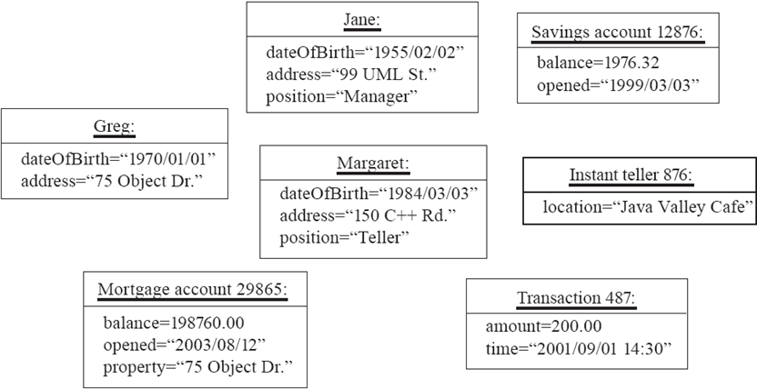
Objects: Shown as a UML instance diagram
center h:400px

Slide 146
Classes
A class:
A unit of abstraction in an object oriented (OO) program
Represents similar objects
Its instances
A kind of software module
Describes its instances’ structure (properties)
Contains methods to implement their behaviour

Slide 147
Is Something a Class or an Instance?
Something should be a class if it could have instances
Something should be an instance if it is clearly a single member of the set defined by a class
Film
Class; instances are individual films.
Reel of Film:
Class; instances are physical reels
Film reel with serial number SW19876
Instance of ReelOfFilm

Slide 148
Is Something a Class or an Instance?
Science Fiction
Instance of the class Genre.
Science Fiction Film
Class; instances include ‘Star Wars’
Showing of ‘Star Wars’ in the Phoenix Cinema at 7 p.m.:
Instance of ShowingOfFilm

Slide 149
Naming classes
Use capital letters
E.g. BankAccount not bankAccount
Use singular nouns
Use the right level of generality
E.g. Municipality, not City
Make sure the name has only one meaning
E.g. “bus” has several meanings

Slide 150
Instance Variables
Variables defined inside a class corresponding to data present in each instance
Also called fields or member variables
Attributes
Simple data
E.g. name, dateOfBirth
Associations
Relationships to other important classes
E.g. supervisor, coursesTaken

Slide 151
Variables vs. Objects
A variable
Refers to an object
May refer to different objects at different points in time
An object can be referred to by several different variables at the same time
Type of a variable
Determines what classes of objects it may contain

Slide 152
Class variables
A class variable’s value is shared by all instances of a class.
Also called a static variable
If one instance sets the value of a class variable, then all the other instances see the same changed value.
Class variables are useful for:
Default or ‘constant’ values (e.g. PI)
Lookup tables and similar structures
Caution: do not over-use class variables

Slide 153
Java Classes and Objects

Slide 154
Java Classes
Java is an object-oriented programming language, so everything in java program must be based on the object concept. In a java programming language, the class concept defines the skeleton of an object.

Slide 155
Java Classes
The java class is a template of an object. The class defines the blueprint of an object. Every class in java forms a new data type. Once a class got created, we can generate as many objects as we want. Every class defines the properties and behaviors of an object. All the objects of a class have the same properties and behaviors that were defined in the class.

Slide 156
Java Classes
Every class of java programming language has the following characteristics.
Identity - It is the name given to the class.
State - Represents data values that are associated with an object.
Behavior - Represents actions can be performed by an object.

Slide 157
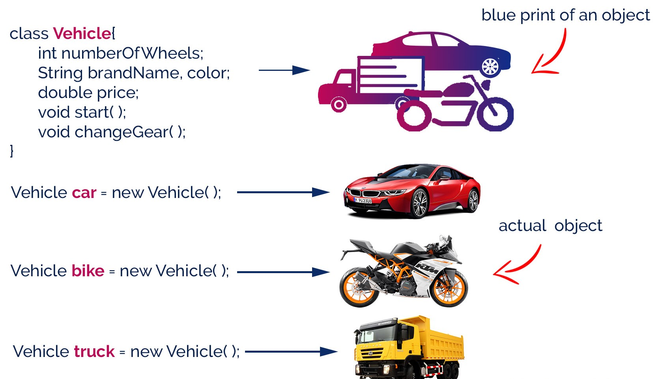
Java Classes
center h:500px

Slide 158
Creating a Class
In java, we use the keyword class to create a class. A class in java contains properties as variables and behaviors as methods. Following is the syntax of class in the java.
Java linenums="1" class <ClassName>{ data members declaration; methods defination; }
Here, fields (variables) and methods represent the state and behavior of the object respectively.
fields are used to store data
methods are used to perform some operations

Slide 159
Creating a Class
A class is a blueprint for the object. Before we create an object, we first need to define the class.
We can think of the class as a sketch (prototype) of a house. It contains all the details about the floors, doors, windows, etc. Based on these descriptions we build the house. House is the object.
Since many houses can be made from the same description, we can create many objects from a class.

Slide 160
Creating a Class
The ClassName must begin with an alphabet, and the Upper-case letter is preferred.
The ClassName must follow all naming rules.

Slide 161
Creating a Class
``` Java linenums=“1” class Bicycle {
// state or field private int gear = 5;
// behavior or method public void braking() { System.out.println(“Working of Braking”); } }
In the above example, we have created a class named Bicycle. It contains a field named gear and a method named braking(). --- ### Creating a Class Here, Bicycle is a prototype. Now, we can create any number of bicycles using the prototype. And, all the bicycles will share the fields and methods of the prototype. --- ### Creating an Object In java, an object is an instance of a class. When an object of a class is created, the class is said to be instantiated. All the objects that are created using a single class have the same properties and methods. But the value of properties is different for every object. Following is the syntax of class in the java. ``` Java linenums="1" <ClassName> <objectName> = new <ClassName>( );

Slide 162
Creating an Object
The objectName must begin with an alphabet, and a Lower-case letter is preferred.
The objectName must follow all naming rules.

Slide 163
Creating an Object
An object is called an instance of a class. For example, suppose Bicycle is a class then MountainBicycle, SportsBicycle, TouringBicycle, etc can be considered as objects of the class.
``` Java linenums=“1” className object = new className();
// for Bicycle class Bicycle sportsBicycle = new Bicycle();
Bicycle touringBicycle = new Bicycle();
We have used the new keyword along with the constructor of the class to create an object. Constructors are similar to methods and have the same name as the class. For example, Bicycle() is the constructor of the Bicycle class. --- ### Creating an Object Here, sportsBicycle and touringBicycle are the names of objects. We can use them to access fields and methods of the class. --- ### Access Members of a Class sportsBicycle.gear - access the field gear sportsBicycle.braking() - access the method braking() ``` Java linenums="1" class Bicycle { // field of class int gear = 5; // method of class void braking() { ... } } // create object Bicycle sportsBicycle = new Bicycle(); // access field and method sportsBicycle.gear; sportsBicycle.braking();

Slide 164
Example: Java Class and Objects
``` Java linenums=“1” class Lamp {
// stores the value for light // true if light is on // false if light is off boolean isOn;
// method to turn on the light void turnOn() { isOn = true; System.out.println(“Light on?” + isOn);
}
// method to turnoff the light void turnOff() { isOn = false; System.out.println(“Light on?” + isOn); } }
--- ### Example: Java Class and Objects ``` Java linenums="1" class Main { public static void main(String[] args) { // create objects led and halogen Lamp led = new Lamp(); Lamp halogen = new Lamp(); // turn on the light by // calling method turnOn() led.turnOn(); // turn off the light by // calling method turnOff() halogen.turnOff(); } }

Slide 165
Example: Create objects inside the same class
Note that in the previous example, we have created objects inside another class and accessed the members from that class.
However, we can also create objects inside the same class.

Slide 166
Example: Create objects inside the same class
``` Java linenums=“1” class Lamp {
// stores the value for light // true if light is on // false if light is off boolean isOn;
// method to turn on the light void turnOn() { isOn = true; System.out.println(“Light on?” + isOn);
}
public static void main(String[] args) {
// create an object of Lamp Lamp led = new Lamp(); // access method using object led.turnOn();
} }
--- ### Takeaway: Java Classes and Objects - A class is a blueprint/template that defines properties and behaviors - An object is a specific instance of a class, created with the 'new' keyword - Instance variables hold per-object state; class variables (static) are shared - UML instance diagrams visualize objects and their relationships - Access members using the dot (.) operator: object.field, object.method() --- ## **Module F: Java Methods and Method Overloading** --- ### Module Outline - Defining and Calling Methods - Method Parameters, Return Types, and Variable Arguments - Static vs Instance Methods - Method Overloading: Same Name, Different Parameters --- ## **Java Methods** --- ### Java Methods A method is a block of statements under a name that gets executes only when it is called. Every method is used to perform a specific task. The major advantage of methods is code re-usability (define the code once, and use it many times). --- ### Java Methods In a java programming language, a method defined as a behavior of an object. That means, every method in java must belong to a class. Every method in java must be declared inside a class. --- ### Java Methods Every method declaration has the following characteristics. - **returnType** - Specifies the data type of a return value. - **name** - Specifies a unique name to identify it. - **parameters** - The data values it may accept or recieve. - **{ }** - Defienes the block belongs to the method. --- ### Creating a method A method is created inside the class and it may be created with any access specifier. However, specifying access specifier is optional. Following is the syntax for creating methods in java. ``` Java linenums="1" class <ClassName>{ <accessSpecifier> <returnType> <methodName>( parameters ){ ... block of statements; ... } }

Slide 167
Creating a method
Java linenums="1" modifier static returnType nameOfMethod (parameter1, parameter2, ...) { // method body }
modifier - It defines access types whether the method is public, private, and so on. static - If we use the static keyword, it can be accessed without creating objects.

Slide 168
Creating a method
The methodName must begin with an alphabet, and the Lower-case letter is preferred.
The methodName must follow all naming rules.
If you don’t want to pass parameters, we ignore it.
If a method defined with return type other than void, it must contain the return statement, otherwise, it may be ignored.

Slide 169
Calling a method
In java, a method call precedes with the object name of the class to which it belongs and a dot operator. It may call directly if the method defined with the static modifier. Every method call must be made, as to the method name with parentheses (), and it must terminate with a semicolon.
Java linenums="1" <objectName>.<methodName>( actualArguments );

Slide 170
Calling a method
The method call must pass the values to parameters if it has.
If the method has a return type, we must provide the receiver.

Slide 171
Calling a Method : Example
``` Java linenums=“1” import java.util.Scanner; public class JavaMethodsExample { int sNo; String name; Scanner read = new Scanner(System.in);
void readData() { System.out.print("Enter Serial Number: "); sNo = read.nextInt(); System.out.print("Enter the Name: "); name = read.next(); } static void showData(int sNo, String name) { System.out.println("Hello, " + name + "! your serial number is " + sNo); }
…
--- ### Calling a Method : Example ``` Java linenums="1" ... public static void main(String[] args) { JavaMethodsExample obj = new JavaMethodsExample(); obj.readData(); // method call using object showData(obj.sNo, obj.name); // method call without using object } }

Slide 172
Variable arguments of a method
In java, a method can be defined with a variable number of arguments. That means creating a method that receives any number of arguments of the same data type.
Java linenums="1" <returnType> <methodName>(dataType...parameterName);

Slide 173
Variable arguments of a method : Example
``` Java linenums=“1” public class JavaMethodWithVariableArgs {
void display(int...list) { System.out.println("\nNumber of arguments: " + list.length); for(int i : list) { System.out.print(i + "\t"); } }
…
--- ### Variable arguments of a method : Example ``` Java linenums="1" ... public static void main(String[] args) { JavaMethodWithVariableArgs obj = new JavaMethodWithVariableArgs(); obj.display(1, 2); obj.display(10, 20, 30, 40, 50); } }

Slide 174
Java Normal Method Example
``` Java linenums=“1” class Main {
// create a method public int addNumbers(int a, int b) { int sum = a + b; // return value return sum; }
public static void main(String[] args) {
int num1 = 25; int num2 = 15; // create an object of Main Main obj = new Main(); // calling method int result = obj.addNumbers(num1, num2); System.out.println("Sum is: " + result);
} }
--- ### Java Static Method Example ``` Java linenums="1" class Main { // create a method public static int square(int num) { // return statement return num * num; } public static void main(String[] args) { int result; // call the method // store returned value to result result = square(10); System.out.println("Squared value of 10 is: " + result); } }

Slide 175
Java Method Parameters
``` Java linenums=“1” class Main {
// method with no parameter public void display1() { System.out.println(“Method without parameter”); }
// method with single parameter public void display2(int a) { System.out.println(“Method with a single parameter:” + a); }
public static void main(String[] args) {
// create an object of Main Main obj = new Main(); // calling method with no parameter obj.display1(); // calling method with the single parameter obj.display2(24);
} }
--- ## **Java Method Overloading** --- ### Java Method Overloading two or more methods may have the same name if they differ in parameters (different number of parameters, different types of parameters, or both). These methods are called overloaded methods and this feature is called method overloading. --- ### Java Method Overloading ``` Java linenums="1" void func() { ... } void func(int a) { ... } float func(double a) { ... } float func(int a, float b) { ... }
Note: The return types of the above methods are not the same. It is because method overloading is not associated with return types. Overloaded methods may have the same or different return types, but they must differ in parameters.

Slide 176
Why method overloading?
Suppose, you have to perform the addition of given numbers but there can be any number of arguments (let’s say either 2 or 3 arguments for simplicity).
In order to accomplish the task, you can create two methods sum2num(int, int) and sum3num(int, int, int) for two and three parameters respectively. However, other programmers, as well as you in the future may get confused as the behavior of both methods are the same but they differ by name.
The better way to accomplish this task is by overloading methods. And, depending upon the argument passed, one of the overloaded methods is called. This helps to increase the readability of the program.

Slide 177
How to perform method overloading in Java?
Overloading by changing the number of parameters
``` Java linenums=“1” class MethodOverloading { private static void display(int a){ System.out.println(“Arguments:” + a); }
private static void display(int a, int b){ System.out.println("Arguments: " + a + " and " + b); } public static void main(String[] args) { display(1); display(1, 4); }
}
--- ### How to perform method overloading in Java? - Method Overloading by changing the data type of parameters ``` Java linenums="1" class MethodOverloading { // this method accepts int private static void display(int a){ System.out.println("Got Integer data."); } // this method accepts String object private static void display(String a){ System.out.println("Got String object."); } public static void main(String[] args) { display(1); display("Hello"); } }

Slide 178
Java Overloading Example
``` Java linenums=“1” class HelperService {
private String formatNumber(int value) { return String.format("%d", value); } private String formatNumber(double value) { return String.format("%.3f", value); } private String formatNumber(String value) { return String.format("%.2f", Double.parseDouble(value)); } public static void main(String[] args) { HelperService hs = new HelperService(); System.out.println(hs.formatNumber(500)); System.out.println(hs.formatNumber(89.9934)); System.out.println(hs.formatNumber("550")); }
}
--- ### Takeaway: Java Methods and Method Overloading - Methods define the behavior of objects (access modifier + return type + name + parameters + body) - Static methods belong to the class; instance methods belong to objects - Varargs (Type... args) allow flexible number of parameters - Method Overloading: same method name with different parameter lists - Overloading is resolved at compile-time (compile-time polymorphism) --- ## **Module G: Java Constructors** --- ### Module Outline - What are Constructors? - No-Arg, Parameterized, and Default Constructors - Constructor Overloading --- ## **Java Constructor** --- ### Java Constructor A constructor is a special method of a class that has the same name as the class name. The constructor gets executes automatically on object creation. It does not require the explicit method call. A constructor may have parameters and access specifiers too. In java, if you do not provide any constructor the compiler automatically creates a default constructor. --- ### Java Constructor A constructor can not have return value. ``` Java linenums="1" public class ConstructorExample { ConstructorExample() { System.out.println("Object created!"); } public static void main(String[] args) { ConstructorExample obj1 = new ConstructorExample(); ConstructorExample obj2 = new ConstructorExample(); } }

Slide 179
Types of Constructor
In Java, constructors can be divided into 3 types:
No-Arg Constructor
Parameterized Constructor
Default Constructor

Slide 180
Java No-Arg Constructors
Java private no-arg constructor
``` Java linenums=“1” class Main {
int i;
// constructor with no parameter private Main() { i = 5; System.out.println(“Constructor is called”); }
public static void main(String[] args) {
// calling the constructor without any parameter Main obj = new Main(); System.out.println("Value of i: " + obj.i);
} }
--- ### Java No-Arg Constructors - Java public no-arg constructor ``` Java linenums="1" class Company { String name; // public constructor public Company() { name = "My Company"; } } class Main { public static void main(String[] args) { // object is created in another class Company obj = new Company(); System.out.println("Company name = " + obj.name); } }

Slide 181
Java Parameterized Constructor
``` Java linenums=“1” class Main {
String languages;
// constructor accepting single value Main(String lang) { languages = lang; System.out.println(languages + ” Programming Language”); }
public static void main(String[] args) {
// call constructor by passing a single value Main obj1 = new Main("Java"); Main obj2 = new Main("Python"); Main obj3 = new Main("C");
} }
--- ### Java Default Constructor ``` Java linenums="1" class Main { int a; boolean b; public static void main(String[] args) { // A default constructor is called Main obj = new Main(); System.out.println("Default Value:"); System.out.println("a = " + obj.a); System.out.println("b = " + obj.b); } }

Slide 182
Java Default Values
The default constructor initializes any uninitialized instance variables with default values.
Type $⇒$ Default Value boolean $⇒$ false byte $⇒$ 0 short $⇒$ 0 int $⇒$ 0 long $⇒$ 0L char $⇒$ 000 float $⇒$ 0.0f double $⇒$ 0.0d object $⇒$ Reference null

Slide 183
Java Default Constructor Equivalent
``` Java linenums=“1” class Main {
int a; boolean b;
// a private constructor private Main() { a = 0; b = false; }
public static void main(String[] args) { // call the constructor Main obj = new Main();
System.out.println("Default Value:"); System.out.println("a = " + obj.a); System.out.println("b = " + obj.b);
} }
--- ### Constructors Overloading in Java ``` Java linenums="1" class Main { String language; // constructor with no parameter Main() { this.language = "Java"; } // constructor with a single parameter Main(String language) { this.language = language; } public void getName() { System.out.println("Programming Langauage: " + this.language); } ...

Slide 184
Constructors Overloading in Java
``` Java linenums=“1” … public static void main(String[] args) {
// call constructor with no parameter Main obj1 = new Main(); // call constructor with a single parameter Main obj2 = new Main("Python"); obj1.getName(); obj2.getName();
} }
--- ### Takeaway: Java Constructors - Constructors initialize objects - called automatically when 'new' is used - No-arg constructor: no parameters, sets default values - Parameterized constructor: accepts arguments for custom initialization - If you define no constructor, Java provides a default no-arg constructor - Constructor overloading: multiple constructors with different parameter lists --- ## **Module H: Java Access Modifiers** --- ### Module Outline - Four Access Levels: public, protected, default, private - Access Modifiers with Classes and Members - Access Modifiers with Inheritance - Best Practices for Access Control --- ## **Java Access Modifiers** --- ### Java Access Modifiers - In Java, the access specifiers (also known as access modifiers) used to restrict - the scope or - accessibility of a - class, - constructor, - variable, - method or - data member of class and interface. --- ### Java Access Modifiers There are four access specifiers, and their list is below. - default (or) no modifier - public - protected - private --- ### Java Access Modifiers - In java, we can not employ all access specifiers on everything. The following table describes where we can apply the access specifiers. ![bg right:60% h:650px](assets/java-access-specifiers.png) --- ### Java Access Modifiers - Let's look at the following example java code, - which generates an error - because a class does not allow private access specifier - unless it is an inner class. ``` Java linenums="1" private class Sample{ ... } ``` --- ### Java Access Modifiers - In java, the accessibility of the members of a class or interface depends on its access specifiers. The following table provides information about the visibility of both data members and methods. ![bg right:60% h:370px](assets/java-access-modifiers.png) --- ### Java Access Modifiers - The public members can be accessed everywhere. - The private members can be accessed only inside the same class. - The protected members are accessible to every child class (same package or other packages). - The default members are accessible within the same package but not outside the package. --- ### Java Access Modifiers ``` Java linenums="1" class ParentClass{ int a = 10; public int b = 20; protected int c = 30; private int d = 40; void showData() { System.out.println("Inside ParentClass"); System.out.println("a = " + a); System.out.println("b = " + b); System.out.println("c = " + c); System.out.println("d = " + d); } }

Slide 185
Java Access Modifiers
``` Java linenums=“1” class ChildClass extends ParentClass{
void accessData() { System.out.println("Inside ChildClass"); System.out.println("a = " + a); System.out.println("b = " + b); System.out.println("c = " + c); //System.out.println("d = " + d); // private member can't be accessed }
}
--- ### Java Access Modifiers ``` Java linenums="1" public class AccessModifiersExample { public static void main(String[] args) { ChildClass obj = new ChildClass(); obj.showData(); obj.accessData(); } }

Slide 186
Java Access Modifiers
Default Access Modifier
Here, the Logger class has the default access modifier
Java linenums="1" package defaultpackage; class Logger { void message(){ System.out.println("This is a message"); } }
the class is visible to all the classes that belong to the defaultPackage package
However, if we try to use the Logger class in another class outside of defaultPackage, we will get a compilation error.

Slide 187
Java Access Modifiers
Private Access Modifier
When variables and methods are declared private, they cannot be accessed outside of the class
Java linenums="1" class Data { // private variable private String name; }

Slide 188
Java Access Modifiers
Private Access Modifier
``` Java linenums=“1” public class Main { public static void main(String[] main){
// create an object of Data Data d = new Data(); // access private variable and field from another class d.name = "My App"; }
}
--- ### Java Access Modifiers - **Private Access Modifier** - When we run the program, we will get the following error ``` Bash Main.java:18: error: name has private access in Data d.name = "My App"; ^

Slide 189
Java Access Modifiers
Private Access Modifier
if we need to access those private variables
we can use the getters and setters method
``` Java linenums=“1” class Data { private String name;
// getter method public String getName() { return this.name; } // setter method public void setName(String name) { this.name= name; }
}
--- ### Java Access Modifiers - **Private Access Modifier** ``` Java linenums="1" public class Main { public static void main(String[] main){ Data d = new Data(); // access the private variable using the getter and setter d.setName("My App"); System.out.println(d.getName()); } }

Slide 190
Java Access Modifiers
Private Access Modifier
We cannot declare classes and interfaces private in Java.
However, the nested classes can be declared private.

Slide 191
Java Access Modifiers
Protected Access Modifier
When methods and data members are declared protected,
we can access them within the same package
as well as from subclasses.

Slide 192
Java Access Modifiers
Protected Access Modifier
Java linenums="1" class Animal { // protected method protected void display() { System.out.println("I am an animal"); } }
``` Java linenums=“1” class Dog extends Animal { public static void main(String[] args) {
// create an object of Dog class Dog dog = new Dog(); // access protected method dog.display(); }
}
--- ### Java Access Modifiers - **Protected Access Modifier** (Ex-2) ``` Java linenums="1" class Animal { protected String name; protected void display() { System.out.println("I am an animal."); } }
``` Java linenums=“1” class Dog extends Animal {
public void getInfo() { System.out.println(“My name is” + name); } }
--- ### Java Access Modifiers - **Protected Access Modifier** (Ex-2) ``` Java linenums="1" class Main { public static void main(String[] args) { // create an object of the subclass Dog labrador = new Dog(); // access protected field and method // using the object of subclass labrador.name = "Rocky"; labrador.display(); labrador.getInfo(); } }

Slide 193
Java Access Modifiers
Protected Access Modifier
We cannot declare classes or interfaces protected in Java.

Slide 194
Java Access Modifiers
Public Access Modifier
When methods, variables, classes, and so on are declared public,
then we can access them from anywhere.
``` Java linenums=“1” // Animal.java file // public class public class Animal { // public variable public int legCount;
// public method public void display() { System.out.println("I am an animal."); System.out.println("I have " + legCount + " legs."); }
}
--- ### Java Access Modifiers - **Public Access Modifier** ``` Java linenums="1" // Main.java public class Main { public static void main( String[] args ) { // accessing the public class Animal animal = new Animal(); // accessing the public variable animal.legCount = 4; // accessing the public method animal.display(); } }

Slide 195
Takeaway: Java Access Modifiers
private: accessible only within the same class (most restrictive)
default (no modifier): accessible within the same package
protected: same package + subclasses in other packages
public: accessible from everywhere (least restrictive)
Best practice: use the most restrictive access level that makes sense

Slide 196
Module I: Basing Software Development on Reusable Technology

Slide 197
Module Outline
Building on the Experience of Others
Frameworks: Types and Benefits
Client-Server Architecture
The Object Client-Server Framework (OCSF)
SimpleChat: An Instant Messaging Application
Risks in Reuse and Client-Server Development

Slide 198
Basing Software Development on Reusable Technology

Slide 199
Building on the Experience of Others
Software engineers should avoid re-developing software already developed
Types of reuse:
Reuse of expertise
Reuse of standard designs and algorithms
Reuse of libraries of classes or procedures
Reuse of powerful commands built into languages and operating systems
Reuse of frameworks
Reuse of complete applications

Slide 200
Frameworks: Reusable Subsystems
A framework is reusable software that implements a generic solution to a generalized problem.
It provides common facilities applicable to different application programs. - Principle: Applications that do different, but related, things tend to have similar designs

Slide 201
Frameworks to promote reuse
A framework is intrinsically incomplete
Certain classes or methods are used by the framework, but are missing (slots)
Some functionality is optional
Allowance is made for developer to provide it (hooks or extension points)
Developers use the services that the framework provides
Taken together the services are called the Application Program Interface (API)

Slide 202
Object-oriented frameworks
In the object oriented paradigm, a framework is composed of a library of classes.
The API is defined by the set of all public methods of these classes.
Some of the classes will normally be abstract and there are often many Interfaces
Example:
A framework for payroll management
A framework for frequent buyer clubs
A framework for university registration
A framework for e-commerce web sites

Slide 203
Frameworks and product lines
A product line (or product family) is a set of products built on a common base of technology.
The various products in the product line have different features to satisfy different markets
The software common to all products in included in a framework
Each product is produced by filling the available hooks and slots
E.g. software products offering “demo”, “lite” or “pro” versions

Slide 204
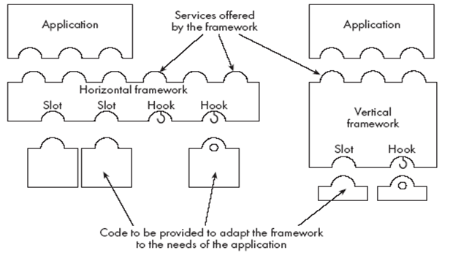
Types of frameworks
A horizontal framework provides general application facilities that a large number of applications can use
A vertical framework (application framework) is more ‘complete’ but still needs some slots to be filled to adapt it to specific application needs
center h:300px

Slide 205
The Client-Server Architecture
A distributed system is a system in which:
computations are performed by separate programs
… normally running on separate pieces of hardware
… that co-operate to perform the task of the system.
Server:
A program that provides a service for other programs that connect to it using a communication channel
Client
A program that accesses a server (or several servers) to obtain services
A server may be accessed by many clients simultaneously

Slide 206
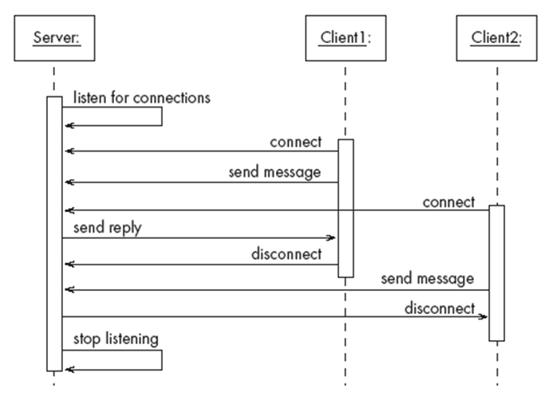
Example of client-server systems
center h:500px

Slide 207
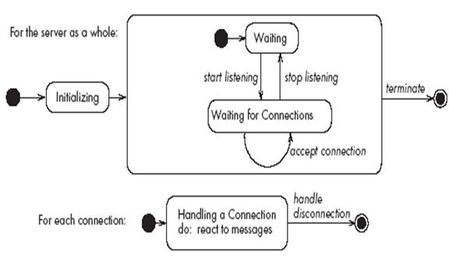
Activities of a server
Initializes itself
Starts listening for clients
Handles the following types of events originating from clients
accepts connections
responds to messages
handles client disconnection
May stop listening
Must cleanly terminate
bg right:50% h:350px

Slide 208
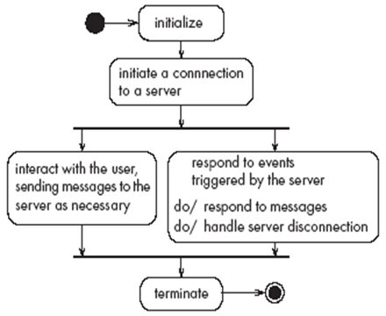
Activities of a client
Initializes itself
Initiates a connection
Sends messages
Handles the following types of events originating from the server
responds to messages
handles server disconnection
Must cleanly terminate
bg right:50% h:350px

Slide 209
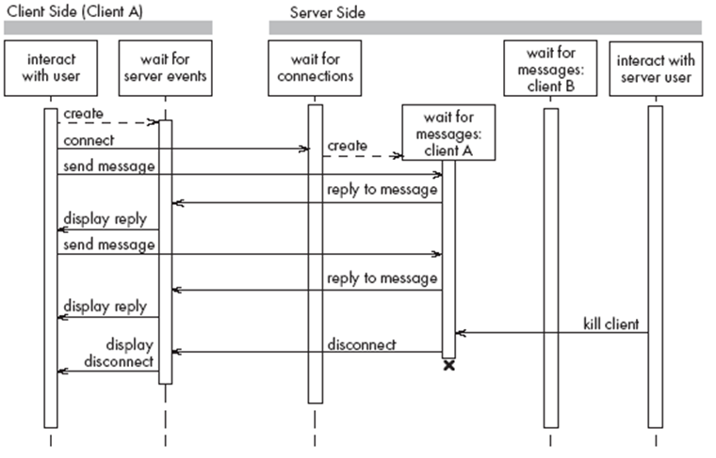
Threads in a client-server system
center h:550px

Slide 210
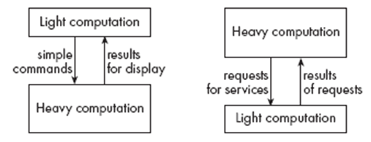
Thin- versus fat-client systems
Thin-client system (a)
Client is made as small as possible
Most of the work is done in the server.
Client easy to download over the network
Fat-client system (b)
As much work as possible is delegated to the clients.
Server can handle more clients
center h:230px

Slide 211
Communications protocols
The messages the client sends to the server form a language.
The server has to be programmed to understand that language.
The messages the server sends to the client also form a language.
The client has to be programmed to understand that language.
When a client and server are communicating, they are in effect having a conversation using these two languages
The two languages and the rules of the conversation, taken together, are called the protocol

Slide 212
Tasks to perform to develop client-server applications
Design the primary work to be performed by both client and server
Design how the work will be distributed
Design the details of the set of messages that will be sent
Design the mechanism for
Initializing
Handling connections
Sending and receiving messages
Terminating

Slide 213
Advantages of client-server systems
The work can be distributed among different machines
The clients can access the server’s functionality from a distance
The client and server can be designed separately
They can both be simpler
There is a choice about where to keep data:
All the data can be kept centrally at the server
Data can be distributed among many different clients or servers
The server can be accessed simultaneously by many clients
Competing clients can be written to communicate with the same server, and vice-versa

Slide 214
Technology Needed to Build Client-Server Systems
Internet Protocol (IP)
Route messages from one computer to another
Long messages are normally split up into small pieces
Transmission Control Protocol (TCP)
Handles connections between two computers
Computers can then exchange many IP messages over a connection
Assures that the messages have been satisfactorily received
A host has an IP address and a host name
Several servers can run on the same host.
Each server is identified by a port number (0 to 65535).
To initiate communication with a server, a client must know both the host name and the port number

Slide 215
Establishing a connection in Java
The java.net package
Permits the creation of a TCP/IP connection between two applications
Before a connection can be established, the server must start listening to one of the ports:
Java linenums="1" ServerSocket serverSocket = new ServerSocket(port); Socket clientSocket = serverSocket.accept();
For a client to connect to a server:
Java linenums="1" Socket clientSocket= new Socket(host, port);

Slide 216
Exchanging information in Java
Each program uses an instance of
InputStream to receive messages from the other program
OutputStream to send messages to the other program
These are found in package java.io
Java linenums="1" output = clientSocket.getOutputStream();
Java linenums="1" input = clientSocket.getInputStream();

Slide 217
Sending and receiving messages
without any filters (raw bytes)
Java linenums="1" output.write(msg); msg = input.read();
or using DataInputStream / DataOutputStream filters
Java linenums="1" output.writeDouble(msg); msg = input.readDouble();
or using ObjectInputStream / ObjectOutputStream filters
Java linenums="1" output.writeObject(msg); msg = input.readObject();

Slide 218
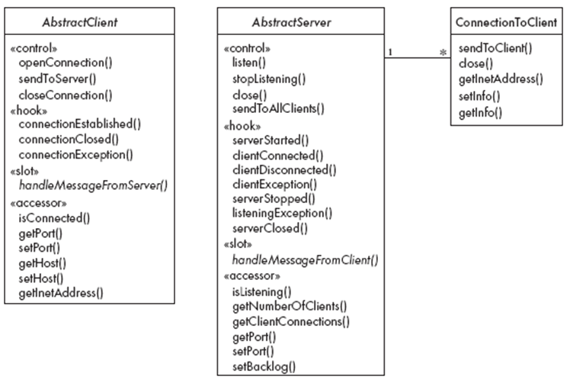
The Object Client-Server Framework (OCSF)
center h:550px

Slide 219
Using OCSF
Software engineers using OCSF never modify its three classes
They:
Create subclasses of the abstract classes in the framework
Call public methods that are provided by the framework
Override certain slot and hook methods (explicitly designed to be overridden)

Slide 220
The Client Side
Consists of a single class: AbstractClient
Must be subclassed
Any subclass must provide an implementation for handleMessageFromServer
Takes appropriate action when a message is received from a server
Implements the Runnable interface
Has a run method which
Contains a loop that executes for the lifetime of the thread

Slide 221
The public interface of AbstractClient
Controlling methods:
openConnection
closeConnection
sendToServer
Accessing methods:
isConnected
getHost
setHost
getPort
setPort
getInetAddress

Slide 222
The callback methods of AbstractClient
Methods that may be overridden:
connectionEstablished
connectionClosed
Method that must be implemented:
handleMessageFromServer

Slide 223
Using AbstractClient
Create a subclass of AbstractClient
Implement handleMessageFromServer slot method
Write code that:
Creates an instance of the new subclass
Calls openConnection
Sends messages to the server using the sendToServer service method
Implement the connectionClosed callback
Implement the connectionException callback

Slide 224
Internals of AbstractClient
Instance variables:
A Socket which keeps all the information about the connection to the server
Two streams, an ObjectOutputStream and an ObjectInputStream
A Thread that runs using AbstractClient’s run method
Two variables storing the host and port of the server

Slide 225
The Server Side
Two classes:
One for the thread which listens for new connections (AbstractServer)
One for the threads that handle the connections to clients (ConnectionToClient)

Slide 226
The public interface of AbstractServer
Controlling methods:
listen
stopListening
close
sendToAllClients
Accessing methods:
isListening
getClientConnections
getPort
setPort
setBacklog

Slide 227
The callback methods of AbstractServer
Methods that may be overridden:
serverStarted
clientConnected
clientDisconnected
clientException
serverStopped
listeningException
serverClosed
Method that must be implemented:
handleMessageFromClient

Slide 228
The public interface of ConnectionToClient
Controlling methods:
sendToClient
close
Accessing methods:
getInetAddress
setInfo
getInfo

Slide 229
Using AbstractServer and ConnectionToClient
Create a subclass of AbstractServer
Implement the slot method handleMessageFromClient
Write code that:
Creates an instance of the subclass of AbstractServer
Calls the listen method
Sends messages to clients, using:
the getClientConnections and sendToClient service methods
or sendToAllClients
Implement one or more of the other callback methods

Slide 230
Internals of AbstractServer and ConnectionToClient
The setInfo and getInfo methods make use of a Java class called HashMap
Many methods in the server side are synchronized
The collection of instances of ConnectionToClient is stored using a special class called ThreadGroup
The server must pause from listening every 500ms to see if the stopListening method has been called
if not, then it resumes listening immediately

Slide 231
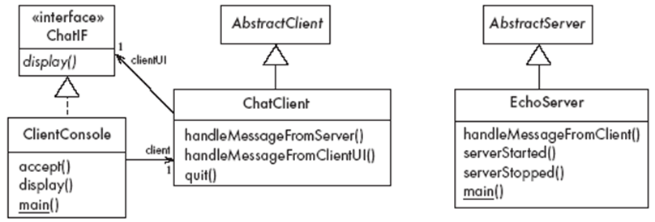
An Instant Messaging Application: SimpleChat
ClientConsole can eventually be replaced by ClientGUI
center h:450px

Slide 232
The server
EchoServer is a subclass of AbstractServer
The main method creates a new instance and starts it
It listens for clients and handles connections until the server is stopped
The three callback methods just print out a message to the user
handleMessageFromClient, serverStarted and serverStopped
The slot method handleMessageFromClient calls sendToAllClients
This echoes any messages

Slide 233
Key code in EchoServer
Java linenums="1" public void handleMessageFromClient (Object msg, ConnectionToClient client) { System.out.println( "Message received: " + msg + " from " + client); this.sendToAllClients(msg); }

Slide 234
The client
When the client program starts, it creates instances of two classes:
ChatClient
A subclass of AbstractClient
Overrides handleMessageFromServer
This calls the display method of the user interface
ClientConsole
User interface class that implements the interface ChatIF
Hence implements display which outputs to the console
Accepts user input by calling accept in its run method
Sends all user input to the ChatClient by calling its handleMessageFromClientUI
This, in turn, calls sendToServer

Slide 235
Key code in ChatClient
Java linenums="1" public void handleMessageFromClientUI( String message) { try { sendToServer(message); } catch(IOException e) { clientUI.display ( "Could not send message. " + "Terminating client."); quit(); } }

Slide 236
Key code in ChatClient
Java linenums="1" public void handleMessageFromServer(Object msg) { clientUI.display(msg.toString()); }

Slide 237
Risks when reusing technology
Poor quality reusable components
Ensure that the developers of the reusable technology:
follow good software engineering practices
are willing to provide active support
Compatibility not maintained
Avoid obscure features
Only re-use technology that others are also re-using

Slide 238
Risks when developing reusable technology
Investment uncertainty
Plan the development of the reusable technology, just as if it was a product for a client
The “not invented here syndrome”
Build confidence in the reusable technology by:
Guaranteeing support
Ensuring it is of high quality
Responding to the needs of its users

Slide 239
Risks when developing reusable technology
Competition
The reusable technology must be as useful and as high quality as possible
Divergence (tendency of various groups to change technology in different ways)
Design it to be general enough, test it and review it in advance

Slide 240
Risks when adopting a client-server approach
Security
Security is a big problem with no perfect solutions: consider the use of encryption, firewalls, …
Need for adaptive maintenance
Ensure that all software is forward and backward compatible with other versions of clients and servers

Slide 241
Takeaway: Reusable Technology
Software reuse saves time and reduces errors - build on proven solutions
Frameworks provide reusable subsystems with clearly defined extension points
Client-Server architecture separates service providers from consumers
OCSF demonstrates how OOP principles apply to real networking frameworks
Reuse has risks: dependency, learning curve, version compatibility issues

Slide 242
References
https://www.site.uottawa.ca/~tcl/seg2105/
https://cruise.umple.org/index.shtml
https://cruise.umple.org/umple/GettingStarted.html
Sanem Sarıel Associate Professor, PhD BT503 Application Development with Java (Kemerburgaz University 2013-2015)
How To Define The Project Scope The Foolproof Way

Slide 243
References
BtechSmartClass Java OOP Concepts
BtechSmartClass-Java Buzz Words
JavatPoint-Cpp vs Java
BtechSmartClass-Java Classes
Programiz-Class Objects

Slide 244
References
BtechSmartClass-Java-Methods-and-Classes
Programiz-Methods
Programiz-Method Overloading
Programiz-Constructors
BtechSmartClass-Java inheritance basics

Slide 245
References
BtechSmartClass-Java access specifiers
Programiz-Access Modifiers
BtechSmartClass-java constructors in inheritance
Programiz-Inheritance
Programiz-this Keyword
Programiz-instanceof

Slide 246
$End−Of−Week−1−Module$

