Slide 1
CEN206 Object-Oriented Programming
Software Engineering and OOP with Java-I Author: Asst. Prof. Dr. Uğur CORUH

Slide 2
CEN206 Object-Oriented Programming (formerly CE204)
Week-1 (Software Engineering and OOP with Java -I)
Spring Semester, 2024-2025
Download DOC-PDF, DOC-DOCX, SLIDE

Slide 3
Brief Description of Course and Rules
We will first talk about,
Course Plan and Communication
Grading System, Homeworks, and Exams
please read the syllabus carefully.

Slide 4
Course Growth Track
OOP with Java
UML
PlantUML + UMPLE + UML
PlantUML + UMPLE + UML + Java
Design Patterns + UML + Java + UMPLE

Slide 5
Outline (1)
Software and Software Engineering
Object Orientation and Review
OOP with Java Intro
Basing Software Development on Reusable Technology

Slide 6
Outline (2)
Java Classes
Java Objects
Java Methods
Java Inheritance
Java Access Modifiers
This and InstanceOf Keywords

Slide 7
Software and Software Engineering

Slide 8
Software
Computer Software is the product that software engineers design and build.
It encompasses
programs that execute within a computer of any size and architecture,
documents that encompass hard-copy and virtual forms,
data that combine numbers and text but also includes representations of pictorial, video, and audio information.

Slide 9
The Nature of Software… (1)
Software is intangible Hard to understand development effort
Software is easy to reproduce
Cost is in its development
in other engineering products, manufacturing is the costly stage
The industry is labor-intensive
Hard to automate
Untrained people can hack something together
Quality problems are hard to notice

Slide 10
The Nature of Software… (2)
Software is easy to modify
People make changes without fully understanding it
Software does not “wear out”
It deteriorates by having its design changed:
erroneously, or
in ways that were not anticipated, thus making it complex
Conclusions
Much software has poor design and is getting worse
We have to learn to ‘engineer’ software

Slide 11
Some types of Software
Real time embedded software
E.g. control and monitoring systems
Must react immediately
Safety often a concern
Data processing software
Used to run businesses
Accuracy and security of data are key
Game software
Mobile device software
Web-based software
Etc.

Slide 12
Single Chance
Most of the clients use applications to ease their tasks to make money. For this reason, you do not have a chance to try your application development in real system. Before this deployment you have to use
Theory
Experimentation
Guesses
Feedback

Slide 13
Lets talk about.

Slide 14
The Project Construction Cycle - The Tree Swing Example

Slide 15
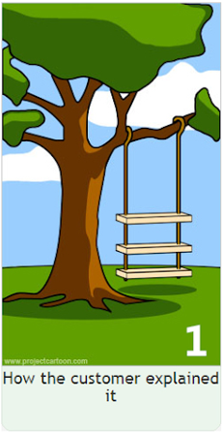
1-How the customer explained it
center h:500px

Slide 16
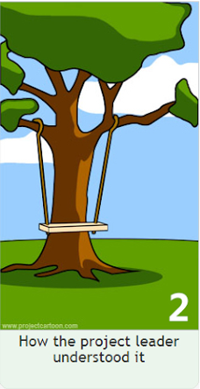
2-How the project leader understood it.
center h:500px

Slide 17
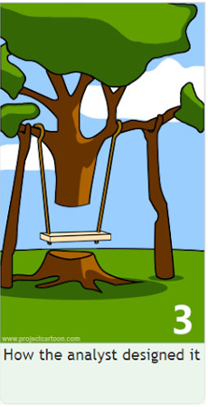
3- How the analyst designed it
center h:500px

Slide 18
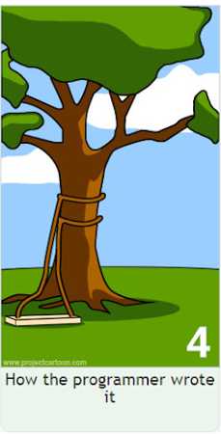
4-How the programmer wrote it
center h:500px

Slide 19
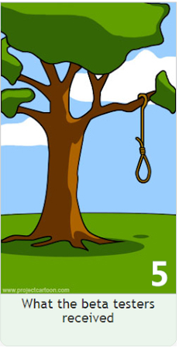
5-What the beta testers received
center h:500px

Slide 20

6-How the business consultant described it
center h:500px

Slide 21

7- How the project was documented
center h:500px

Slide 22
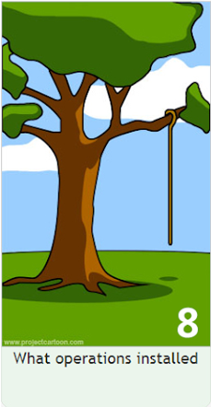
8-What operations installed
center h:500px

Slide 23
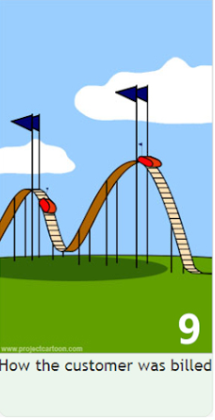
9-How the customer was billed
center h:500px

Slide 24

10-How it was supported
center h:500px

Slide 25

11-What marketing advertised
center h:500px

Slide 26
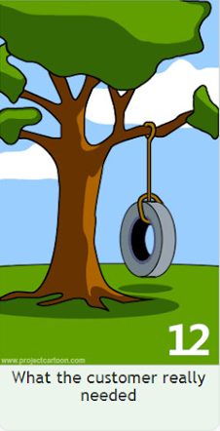
12-What the customer really needed
center h:500px

Slide 27

13-The disaster recover plan
center h:500px

Slide 28

14- What the digg effect can do to your site
center h:500px

Slide 29

15- (Finally) When it was delivered
center h:500px

Slide 30
Need for a good programming method
Common problems
Why does it take so long?
Why are development costs so high?
Why can’t find all faults before delivery?
Why can’t we measure development?
NIST reported that even though 50 percent of software development budgets go to testing, flaws in software still cost the U.S. economy $59.5 billion annually.*
Updated NIST Software Uses Combination Testing to Catch Bugs Fast and Easy | NIST

Slide 31
What is Software Engineering? (1)
The process of solving customers’ problems by the
systematic development and evolution of large,
high-quality software systems within
cost,
time and
other constraints

Slide 32
What is Software Engineering? (2)
Solving customers’ problems
The goal
Sometimes the solution is to buy, not build
Adding unnecessary features often makes software worse
Software engineers must communicate effectively to identify and understand the problem

Slide 33
What is Software Engineering? (3)
Systematic development and evolution
An engineering process involves applying well understood techniques in a organized and disciplined way
Many well-accepted practices have been formally standardized
e.g. by the IEEE or ISO
Most development work is evolution

Slide 34
What is Software Engineering? (4)
Large, high quality software systems
Software engineering techniques are needed because large systems cannot be completely understood by one person
Teamwork and co-ordination are required
Key challenge: Dividing up the work and ensuring that the parts of the system work properly together
The end-product must be of sufficient quality

Slide 35
What is Software Engineering? (5)
Cost, time and other constraints
Finite resources
The benefit must outweigh the cost
Others are competing to do the job cheaper and faster
Inaccurate estimates of cost and time have caused many project failures

Slide 36
The Software Engineering Profession
The term Software Engineering was coined in 1968
People began to realize that the principles of engineering should be applied to software development
Engineering is a licensed profession
In order to protect the public
Engineers design artifacts following well accepted practices which involve the application of science, mathematics and economics
Ethical practice is also a key tenet of the profession
In many countries, much software engineering does not require an engineering licence, but is still engineering

Slide 37
Software Engineering Code of Ethics
Software engineers shall
Act consistently with public interest
Act in the best interests of their clients
Develop and maintain with the highest standards possible
Maintain integrity and independence
Promote an ethical approach in management
Advance the integrity and reputation of the profession
Be fair and supportive to colleagues
Participate in lifelong learning

Slide 38
Software Quality
Usability
Users can learn it and fast and get their job done easily
Efficiency
It doesn’t waste resources such as CPU time and memory
Reliability
It does what it is required to do without failing
Maintainability
It can be easily changed
Reusability
Its parts can be used in other projects, so reprogramming is not needed

Slide 39
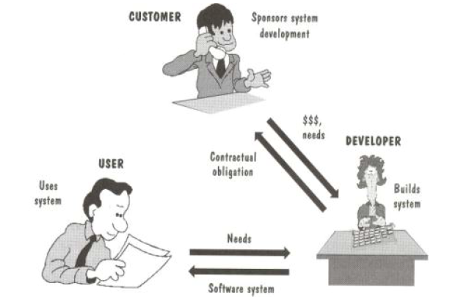
Software Quality and Stakeholders
center h:500px

Slide 40
Software Quality and Stakeholders
Customer (those who pay):
solves problems at an acceptable cost in terms of money paid and resources used
User
easy to learn; efficient to use; helps get work done
Developer
easy to design; easy to maintain; easy to reuse its parts
Development manager
sells more and pleases customers while costing less to develop and maintain

Slide 41
Software Quality Metrics – User
A program must do its job correctly. It must be useful and - usable
A program must run as fast as necessary (Real-time constraints)
A program must not waste system resources(processor time, - memory, disk capacity, network capacity) too much
It must be reliable
It must be easily updated
A good software must have sufficient documentation (users manual)

Slide 42
Software Quality Metrics – SW Developer
Source code must be readable and understandable
It must be easy to maintain and update the program
A program must consist of independent modules
An error may not affect other parts of a program (Locality of errors)
Modules of the program must be reusable in other projects
A software project must meet its deadline
Good software must have sufficient documentation

Slide 43
Software Quality Metrics - OOP
OOP techniques ensure high-quality programs
While designing and coding a program, these quality metrics must always be considered

Slide 44
Software Quality: Conflicts and Objectives
The different qualities can conflict
Increasing efficiency can reduce maintainability or reusability
Increasing usability can reduce efficiency
Setting objectives for quality is a key engineering activity
You then design to meet the objectives
Avoids “over-engineering” which wastes money

Slide 45
Software Engineering Projects
Most projects are evolutionary or maintenance projects, involving work on legacy systems
Corrective projects: fixing defects
Adaptive projects: changing the system in response to changes in
Operating system
Database
Rules and regulations
Enhancement projects: adding new features for users
Reengineering or perfective projects: changing the system internally so it is more maintainable

Slide 46
Software Engineering Projects Start Points
Green Field Development | Brownfield Development
Start afresh | Build on existing code
Choose your technology | Technology already chosen
Use your best ideas, patterns, techniques | Understand previous developers’ code
Learn from mistakes | Live with mistakes

Slide 47
Software Engineering Projects Start Points
 | Requirements must be determined | Clients have produced requirements
New development, Green Field Project | A | B
Evolution of Existing System, Brown Field Project | C | D

Slide 48
Activities Common to Software Projects
Requirements and specification
Includes
Domain analysis
Defining the problem
Requirements gathering
Obtaining input from as many sources as possible
Requirements analysis
Organizing the information
Requirements specification
Writing detailed instructions about how the software should behave

Slide 49
Activities Common to Software Projects
Design
Deciding how the requirements should be implemented, using the available technology
Includes:
Systems engineering: Deciding what should be in hardware and what in software
Software architecture: Dividing the system into subsystems and deciding how the subsystems will interact
Detailed design of the internals of a subsystem
User interface design
Design of databases

Slide 50
Activities Common to Software Projects
Modeling
Creating representations of the domain or the software
Use case modeling
Structural modeling
Dynamic and behavioural modeling
Programming
Quality assurance
Reviews and inspections
Testing
Deployment
Managing the process

Slide 51
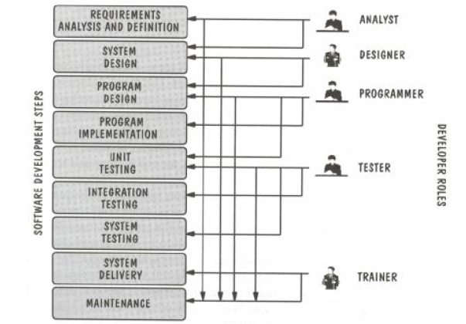
Software Projects Development Team
center h:500px

Slide 52
Software Life Cycle
Requirements Phase
Specification Phase
Design Phase
Implementation Phase
Integration Phase
Maintenance Phase
Retirement Phase

Slide 53
Requirements Phase
Defining constraints
Functions
Due dates
Costs
Reliability
Size
Types
Functional
Non-Functional

Slide 54
Specification Phase
Documentation of requirements
Inputs & Outputs
Formal
Understandable for user & developer
Usually functional requirements (what to do)
Base for testing & maintenance
The contract between customer & developer

Slide 55
Design Phase
Defining Internal structure (how to do)
Has some levels (or types of docs)
Architectural design
Detailed design
Important
To backtrack the aims of decisions
To easily maintain

Slide 56
Implementation and Integration Phases
Implementation phase: Simply coding
Unit tests
For verification
Combining modules
System tests
For validation
Quality tests

Slide 57
Maintenance Phase
Corrective
Enhancement
Perfective
Adaptive
Usually maintainers are not the same people with developers.
The only input is (in general) the source code of the software

Slide 58
Retirement Phase
When the cost of maintenance is not effective.
Changes are so drastic, that the software should be redesigned.
So many changes may have been made.
The update frequency of docs is not enough.
The hardware (or OS) will be changed.

Slide 59
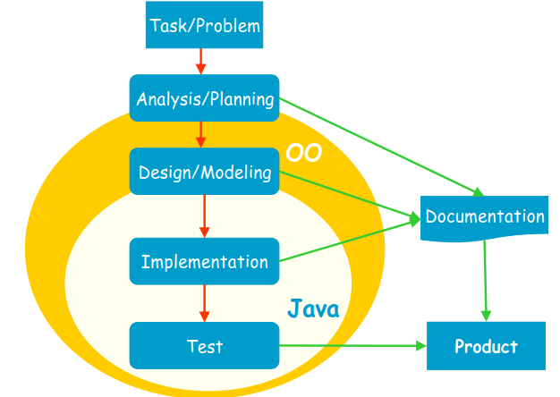
Software Development Process
center h:500px

Slide 60
Software Development Process
Analysis: Understanding requirements. They may change during (or after) development of the system! Building the programming team.
Design: Identifying the key concepts involved in a solution and creation of the models.
This stage has a strong effect on the quality of the software. Therefore, before the coding, verification of the created model must be done.
Design process is connected with the programming scheme. Here, our design style is object-oriented.

Slide 61
Software Development Process
Coding: The solution (model) is expressed in a program. In this course we will use Java.
Documentation: Each phase of a software project must be clearly explained. A users manual should also be written.
Test: the behavior of the program for possible inputs must be examined.
These steps are important design principles and design patterns, which help us developing high-quality software. The Unified Modeling Language (UML) is useful to express the model.

Slide 62
Unified Process (UP)
The UP promotes several best practices.
Iterative
Incremental
Risk-driven

Slide 63
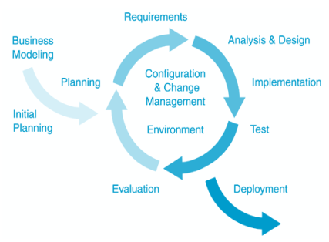
Unified Process (UP)
center h:500px

Slide 64
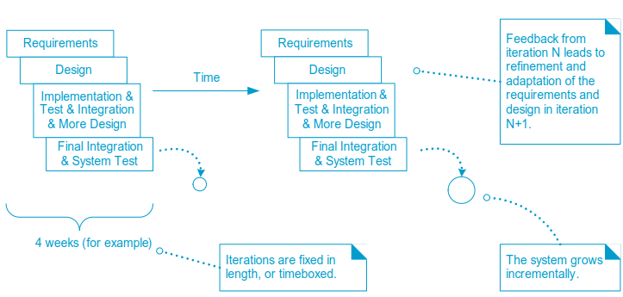
Unified Process (UP)
center h:500px

Slide 65
Object Orientation Part-1

Slide 66
OOP Concepts in Java
OOP stands for Object-Oriented Programming. OOP is a programming paradigm in which every program is follows the concept of object. In other words, OOP is a way of writing programs based on the object concept.
The object-oriented programming paradigm has the following core concepts.
Encapsulation
Inheritance
Polymorphism
Abstraction
The popular object-oriented programming languages are Smalltalk, C++, Java, PHP, C#, Python, etc.

Slide 67
Encapsulation
Encapsulation is the process of combining data and code into a single unit (object / class). In OOP, every object is associated with its data and code. In programming, data is defined as variables and code is defined as methods. The java programming language uses the class concept to implement encapsulation.

Slide 68
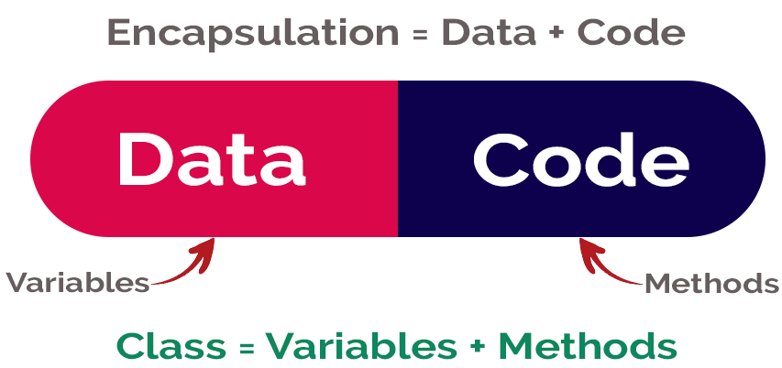
Encapsulation
center h:400px

Slide 69
Inheritance
Inheritance is the process of acquiring properties and behaviors from one object to another object or one class to another class. In inheritance, we derive a new class from the existing class. Here, the new class acquires the properties and behaviors from the existing class. In the inheritance concept, the class which provides properties is called as parent class and the class which recieves the properties is called as child class. The parent class is also known as base class or supre class. The child class is also known as derived class or sub class.
In the inheritance, the properties and behaviors of base class extended to its derived class, but the base class never receive properties or behaviors from its derived class.
In java programming language the keyword extends is used to implement inheritance.

Slide 70
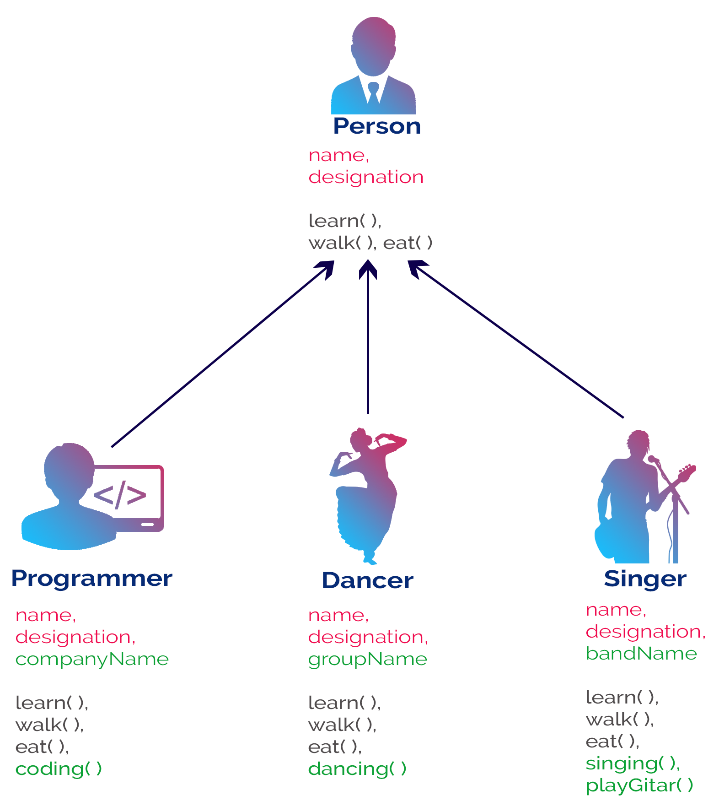
Inheritance
bg right:50% h:700px

Slide 71
Polymorphism
Polymorphism is the process of defining same method with different implementation. That means creating multiple methods with different behaviors.
The java uses method overloading and method overriding to implement polymorphism.
Method overloading - multiple methods with same name but different parameters.
Method overriding - multiple methods with same name and same parameters.

Slide 72
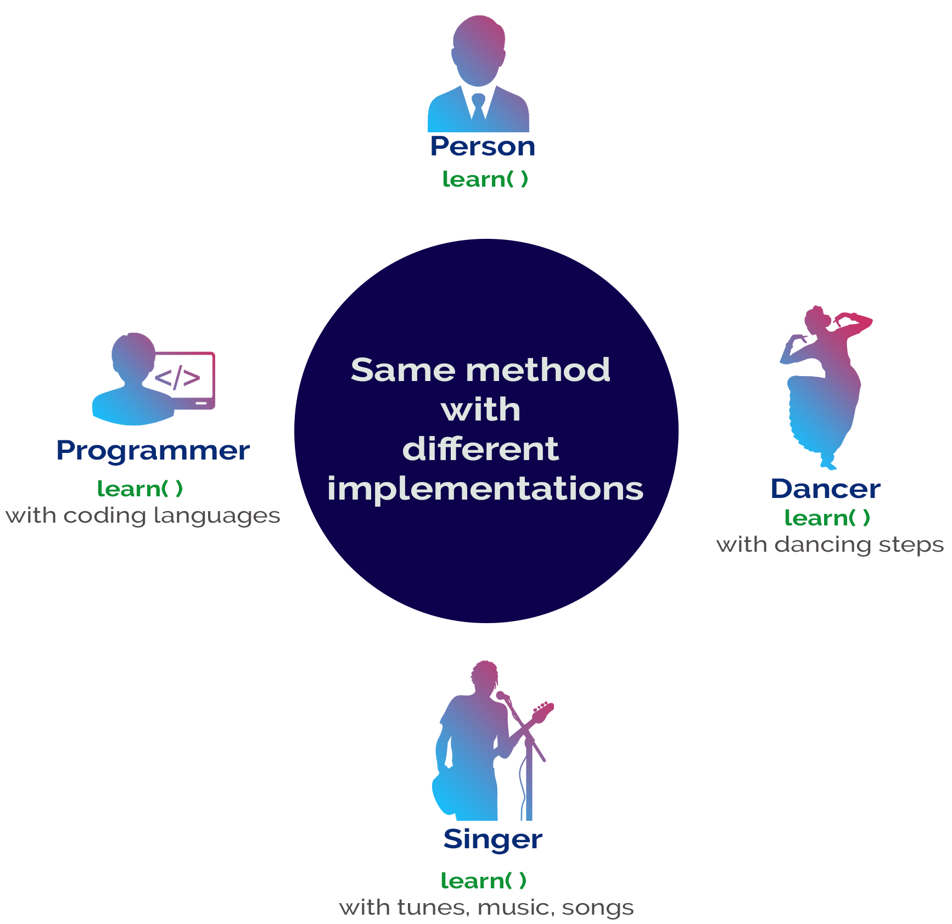
Polymorphism
bg right:50% h:700px

Slide 73
Abstraction
Abstraction is hiding the internal details and showing only esential functionality. In the abstraction concept, we do not show the actual implemention to the end user, instead we provide only esential things. For example, if we want to drive a car, we does not need to know about the internal functionality like how wheel system works? how brake system works? how music system works? etc.

Slide 74
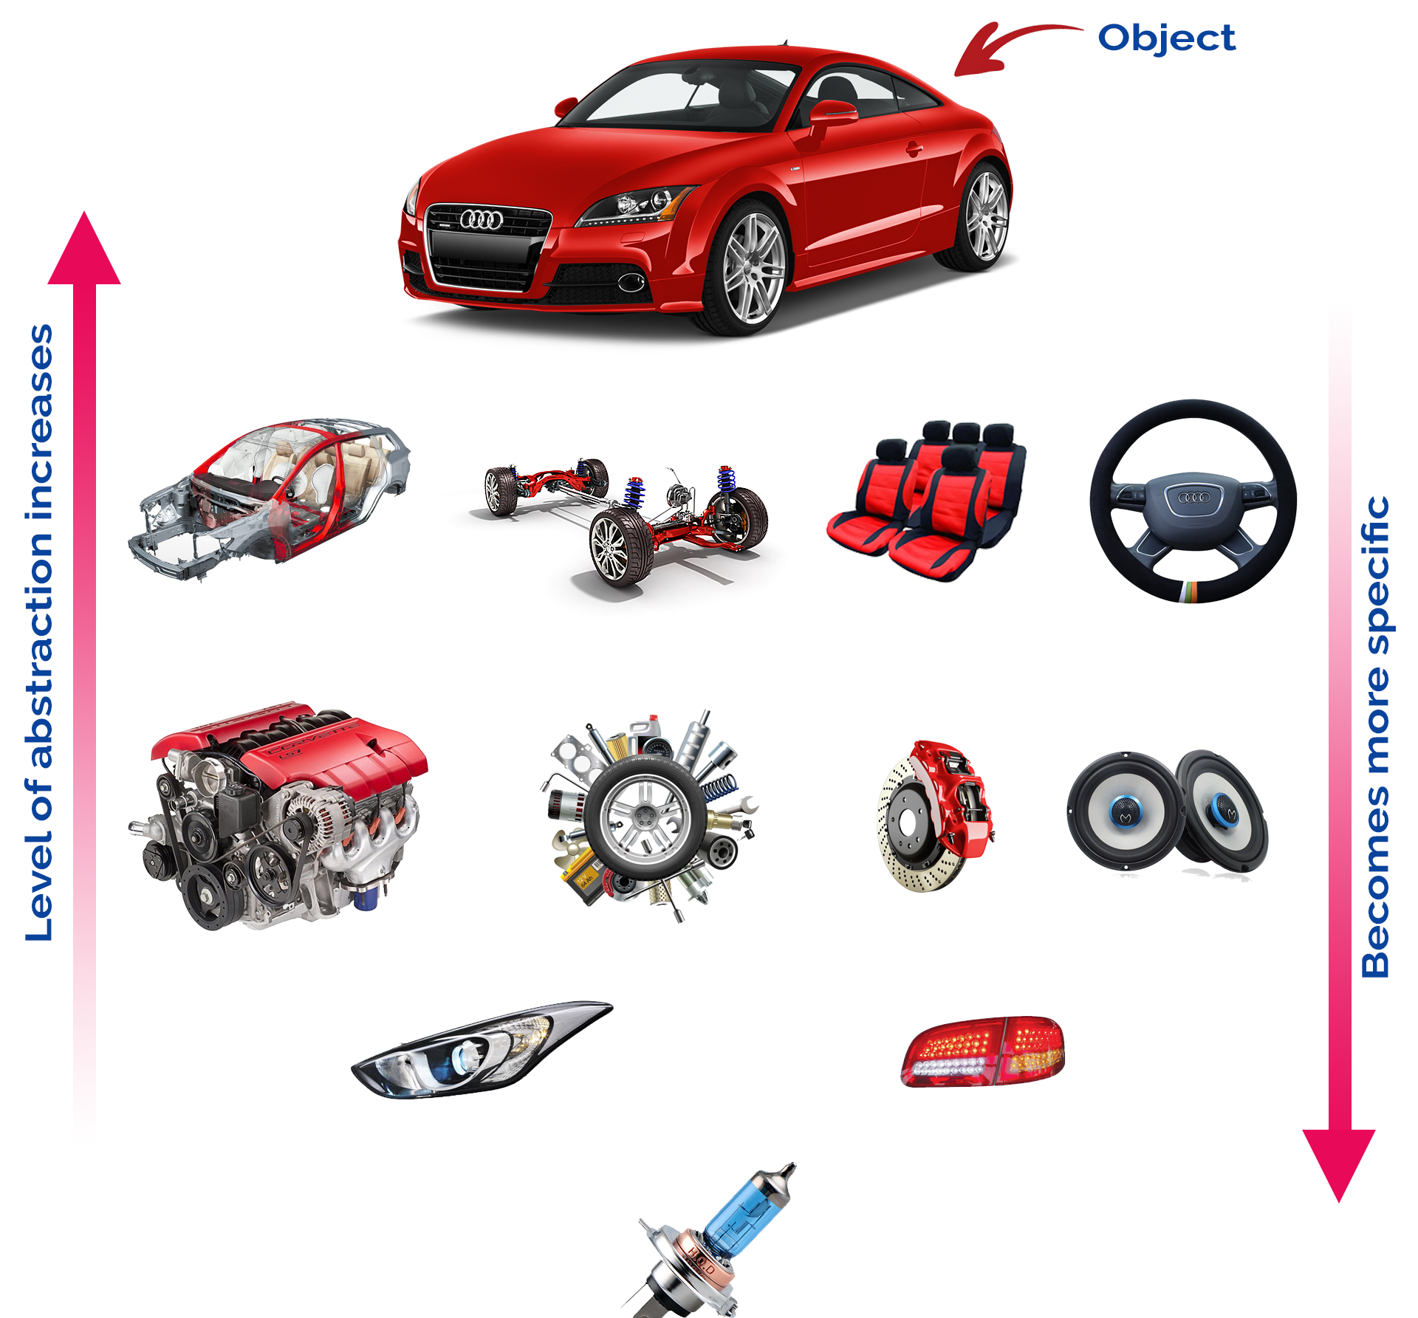
Abstraction
bg right:50% h:600px

Slide 75
Why Object Technology
Expectations are,
Reducing the effort, complexity, and cost of development and maintenance of software systems.
Reducing the time to adapt an existing system (quicker reaction to changes in the business environment): Flexibility, reusability.
Increasing the reliability of the system.

Slide 76
What is Programming?
A programming language provides a way to express concepts.
Program development involves creating models of real world - situations and building computer programs based on these models.
Computer programs describe the method of implementing the model.
Computer programs may contain computer world representations of the things that constitute the solutions of real world problems.

Slide 77
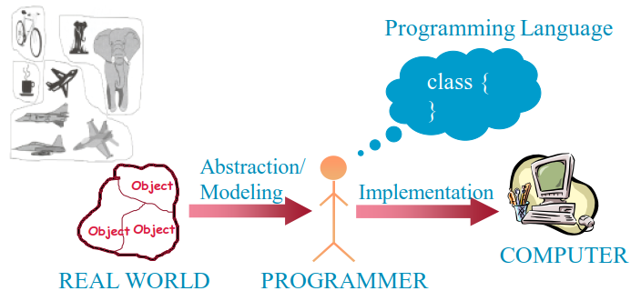
What is Programming?
If successful, this medium of expression (the object-oriented way) will be significantly easier, more flexible, and efficient than the alternatives as problems grow larger and more complex
center h:400px

Slide 78
Why JAVA
Java supports writing high quality programs (pure OO)
Provides an easy-to-use language
Provides an interpreted environment for
Improved development speed
Code portability
Simple
Architecture Neutral and Portable
Robust and Secure
High Performance

Slide 79
Why JAVA
Write less code
can be four times smaller than the same program written in C++
Write better code
encourages good coding practices, garbage collection for avoiding memory leaks, wide-ranging, easily extendible API
Avoid platform dependencies
Write once, run anywhere
Gained popularity in gadgets such as
PDAs, cell phones etc.

Slide 80
Learning JAVA
Many syntax and grammar rules
Learning how to write “good programs”
Focusing on concepts and not get lost in language-technical - details
Paying attention to design techniques rather than details
Building an effective programming scheme
Practicing, practicing and practicing!
Consequently, new and better ways of building systems

Slide 81
Java Buzz Words
Simple
Secure
Portable
Object-oriented
Robust
Architecture-neutral (or) Platform Independent
Multi-threaded
Interpreted
High performance
Distributed
Dynamic

Slide 82
Simple
Java programming language is very simple and easy to learn, understand, and code. Most of the syntaxes in java follow basic programming language C and object-oriented programming concepts are similar to C++. In a java programming language, many complicated features like pointers, operator overloading, structures, unions, etc. have been removed. One of the most useful features is the garbage collector it makes java more simple.

Slide 83
Secure
Java is said to be more secure programming language because it does not have pointers concept, java provides a feature “applet” which can be embedded into a web application. The applet in java does not allow access to other parts of the computer, which keeps away from harmful programs like viruses and unauthorized access.

Slide 84
Portable
Portability is one of the core features of java which enables the java programs to run on any computer or operating system. For example, an applet developed using java runs on a wide variety of CPUs, operating systems, and browsers connected to the Internet.

Slide 85
Object-oriented
Java is said to be a pure object-oriented programming language. In java, everything is an object. It supports all the features of the object-oriented programming paradigm. The primitive data types java also implemented as objects using wrapper classes, but still, it allows primitive data types to archive high-performance.

Slide 86
Robust
Java is more robust because the java code can be executed on a variety of environments, java has a strong memory management mechanism (garbage collector), java is a strictly typed language, it has a strong set of exception handling mechanism, and many more.

Slide 87
Architecture-neutral (or) Platform Independent
Java has invented to archive “write once; run anywhere, any time, forever”. The java provides JVM (Java Virtual Machine) to to archive architectural-neutral or platform-independent. The JVM allows the java program created using one operating system can be executed on any other operating system.

Slide 88
Multi-threaded
Java supports multi-threading programming, which allows us to write programs that do multiple operations simultaneously.

Slide 89
Interpreted
Java enables the creation of cross-platform programs by compiling into an intermediate representation called Java bytecode. The byte code is interpreted to any machine code so that it runs on the native machine.

Slide 90
High performance
Java provides high performance with the help of features like JVM, interpretation, and its simplicity.

Slide 91
Distributed
Java programming language supports TCP/IP protocols which enable the java to support the distributed environment of the Internet. Java also supports Remote Method Invocation (RMI), this feature enables a program to invoke methods across a network.

Slide 92
Dynamic
Java is said to be dynamic because the java byte code may be dynamically updated on a running system and it has a dynamic memory allocation and deallocation (objects and garbage collector).

Slide 93
The Basics of Java
History
The first object oriented programming language was Simula-67
designed to allow programmers to write simulation programs
In the early 1980’s, Smalltalk was developed at Xerox PARC
New syntax, large open-source library of reusable code, bytecode, platform independence, garbage collection.

Slide 94
The Basics of Java
late 1980’s, C++ was developed by B. Stroustrup,
Recognized the advantages of OO but also recognized that there were tremendous numbers of C programmers
In 1991, engineers at Sun Microsystems started a project to design a language that could be used in consumer ‘smart devices’: Oak
When the Internet gained popularity, Sun saw an opportunity to exploit the technology.
The new language, renamed Java, was formally presented in 1995 at the SunWorld ’95 conference.

Slide 95
Java documentation
Looking up classes and methods is an essential skill
Looking up unknown classes and methods will get you a long way towards understanding code
Java documentation can be automatically generated by a program called Javadoc
Documentation is generated from the code and its comments
You should format your comments as shown in some of the book’s examples
These may include embeded html

Slide 96
Characters and Strings
Character is a class representing Unicode characters
More than a byte each
Represent any world language
char is a primitive data type containing a Unicode character
String is a class containing collections of characters
+ is the operator used to concatenate strings

Slide 97
Arrays and Collections
Arrays are of fixed size and lack methods to manipulate them
ArrayList is the most widely used class to hold a collection of other objects
More powerful than arrays, but less efficient
Iterators are used to access members of Vectors
Enumerations were formally used, but were more complex
Java linenums="1" hl_lines="2 3 5" a = new ArrayList(); Iterator i = a.iterator(); while(i.hasNext()) { aMethod(i.next()); }

Slide 98
Casting
Java is very strict about types
If variable v is declared to have type X, you can only invoke operations on v that are defined in X or its superclasses
Even though an instance of a subclass of X may be actually stored in the variable
If you know an instance of a subclass is stored, then you can cast the variable to the subclass
E.g. if I know a Vector contains instances of String, I can get the next element of its Iterator using: (String)i.next();
To avoid casting you could also have used templates:: a = ArrayList<String>; i=a.iterator(); i.next()

Slide 99
Exceptions
Anything that can go wrong should result in the raising of an Exception
Exception is a class with many subclasses for specific things that can go wrong
Use a try - catch block to trap an exception
Java linenums="1" try { // some code } catch (ArithmeticException e) { // code to handle division by zero }

Slide 100
Interfaces
Like abstract classes, but cannot have executable statements
Define a set of operations that make sense in several classes
Abstract Data Types
A class can implement any number of interfaces
It must have concrete methods for the operations
You can declare the type of a variable to be an interface
This is just like declaring the type to be an abstract class
Important interfaces in Java’s library include
Runnable, Collection, Iterator, Comparable, Cloneable

Slide 101
Packages and importing
A package combines related classes into subsystems
All the classes in a particular directory
Classes in different packages can have the same name
Although not recommended
Importing a package is done as follows:
import finance.banking.accounts.*;

Slide 102
Access control
Applies to methods and variables
public
Any class can access
protected
Only code in the package, or subclasses can access
(blank)
Only code in the package can access
private
Only code written in the class can access
Inheritance still occurs!

Slide 103
Threads and concurrency
Thread:
Sequence of executing statements that can be running concurrently with other threads
To create a thread in Java:
Create a class implementing Runnable or extending Thread
Implement the run method as a loop that does something for a period of time
Create an instance of this class
Invoke the start operation, which calls run

Slide 104
Programming Style Guidelines
Remember that programs are for people to read
Always choose the simpler alternative
Reject clever code that is hard to understand
Shorter code is not necessarily better
Choose good names
Make them highly descriptive
Do not worry about using long names

Slide 105
Programming style
Comment extensively
Comment whatever is non-obvious
Do not comment the obvious
Comments should be 25-50% of the code
Organize class elements consistently
Variables, constructors, public methods then private methods
Be consistent regarding layout of code

Slide 106
Programming style
Avoid duplication of code
Do not “clone” if possible
Create a new method and call it
Cloning results in two copies that may both have bugs
When one copy of the bug is fixed, the other may be forgotten

Slide 107
Programming style
Adhere to good object oriented principles
E.g. the ‘isa rule’
Prefer private as opposed to public
Do not mix user interface code with non-user interface code
Interact with the user in separate classes
This makes non-UI classes more reusable

Slide 108
Difficulties and Risks in Programming
Language evolution and deprecated features:
Java is evolving, so some features are ‘deprecated’ at every release
Efficiency can be a concern in some object oriented systems
Java can be less efficient than other languages
VM-based
Dynamic binding

Slide 109
Comparison Index | C++ | Java
Platform-independent | C++ is platform-dependent. | Java is platform-independent.
Mainly used for | C++ is mainly used for system programming. | Java is mainly used for application programming. It is widely used in Windows-based, web-based, enterprise, and mobile applications.
C++ vs Java

Slide 110
Comparison Index | C++ | Java
Multiple inheritance | C++ supports multiple inheritance. | Java doesn’t support multiple inheritance through class. It can be achieved by using interfaces in java.
Operator Overloading | C++ supports operator overloading. | Java doesn’t support operator overloading.
C++ vs Java

Slide 111
Comparison Index | C++ | Java
Goto | C++ supports the goto statement. | Java doesn’t support the goto statement.
Compiler and Interpreter | C++ uses compiler only. C++ is compiled and run using the compiler which converts source code into machine code so, C++ is platform dependent. | Java uses both compiler and interpreter. Java source code is converted into bytecode at compilation time. The interpreter executes this bytecode at runtime and produces output. Java is interpreted that is why it is platform-independent.
C++ vs Java

Slide 112
Comparison Index | C++ | Java
Pointers | C++ supports pointers. You can write a pointer program in C++. | Java supports pointer internally. However, you can’t write the pointer program in java. It means java has restricted pointer support in java.
Design Goal | C++ was designed for systems and applications programming. It was an extension of the C programming language. | Java was designed and created as an interpreter for printing systems but later extended as a support network computing. It was designed to be easy to use and accessible to a broader audience.
C++ vs Java

Slide 113
Comparison Index | C++ | Java
Structure and Union | C++ supports structures and unions. | Java doesn’t support structures and unions.
Thread Support | C++ doesn’t have built-in support for threads. It relies on third-party libraries for thread support. | Java has built-in thread support.
C++ vs Java

Slide 114
Comparison Index | C++ | Java
Documentation comment | C++ doesn’t support documentation comments. | Java supports documentation comment (/** … */) to create documentation for java source code.
Virtual Keyword | C++ supports virtual keyword so that we can decide whether or not to override a function. | Java has no virtual keyword. We can override all non-static methods by default. In other words, non-static methods are virtual by default.
C++ vs Java

Slide 115
Comparison Index | C++ | Java
unsigned right shift >>> | C++ doesn’t support >>> operator. | Java supports unsigned right shift >>> operator that fills zero at the top for the negative numbers. For positive numbers, it works same like >> operator.
Inheritance Tree | C++ always creates a new inheritance tree. | Java always uses a single inheritance tree because all classes are the child of the Object class in Java. The Object class is the root of the inheritance tree in java.
C++ vs Java

Slide 116
Comparison Index | C++ | Java
Hardware | C++ is nearer to hardware. | Java is not so interactive with hardware.
Object-oriented | C++ is an object-oriented language. However, in the C language, a single root hierarchy is not possible. | Java is also an object-oriented language. However, everything (except fundamental types) is an object in Java. It is a single root hierarchy as everything gets derived from java.lang.Object.
C++ vs Java

Slide 117
Object Orientation Part-2

Slide 118
Procedural Programming
Pascal, C, Basic, Fortran and similar traditional languages are procedural
Each statement tells the computer to do something
The emphasis is on doing things
Functions
A program is divided into functions
Each function has a clearly defined purpose and interface

Slide 119
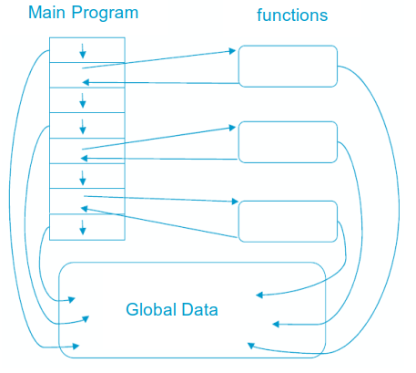
Procedural Programming
center h:500px

Slide 120
Problems with Procedural Programming
Data Is undervalued
Data is, after all, the reason for a program’s existence. The important parts of a program are not functions that display the data or functions that checks for correct input; they are data
Procedural programs don’t model the real world very well. The real world does not consist of functions
Global data can be corrupted by functions that have no business changing it
To add new data items, all the functions that access data must be modified so that they can also access these new items
Creating new data types is difficult

Slide 121
Besides
It is also possible to write good programs by using procedural programming (C programs).
But object-oriented programming offers programmers many advantages, enables them to write high-quality programs

Slide 122
Object-Oriented Programming
The fundamental idea behind object-oriented programming:
The real world consists of objects. Computer programs may contain computer world representations of the things (objects) that constitute the solutions of real world problems.
Real world objects have two parts:
Properties (or state: characteristics that can change),
Behavior (or abilities: things they can do).
To solve a programming problem in an object-oriented language,the programmer no longer asks how the problem will be divided into functions, but how it will be divided into objects.
The emphasis is on data

Slide 123
Object-Oriented Programming
What kinds of things become objects in object-oriented programs?
Human entities: Employees, customers, salespeople,worker, manager
Graphics program: Point, line, square, circle, …
Mathematics: Complex numbers, matrix
Computer user environment: Windows, menus, buttons
Data-storage constructs: Customized arrays, stacks, linked lists

Slide 124
OOP: Encapsulation and Data Hiding
Thinking in terms of objects rather than functions
Close match between objects in the programming sense and objects in the real world
Both data and the functions that operate on that data are combined into a single program entity
Data represent the properties (state), and functions represent the behavior of an object. Data and its functions are said to be encapsulated into a single entity
An object’s functions, called member functions in Java typically provide the only way to access its data. The data is hidden, so it is safe from accidental alteration.

Slide 125
OOP: Encapsulation and Data Hiding
Encapsulation and data hiding are key terms in the description of object-oriented languages.
If you want to modify the data in an object, you know exactly what functions to interact with it
The member functions in the object.
No other functions can access the data: This simplifies writing, debugging, and maintaining the program.

Slide 126
Example: A Point on the plane
A Point on a plane has two properties; x-y coordinates.
Abilities (behavior) of a Point are, moving on the plane, appearing on the screen and disappearing.
A model for 2 dimensional points with the following parts:
Two integer variables (x,y) to represent x and y coordinates
A function to move the point: move
A function to print the point on the screen: print
A function to hide the point: hide

Slide 127
Example: A Point on the plane
Once the model has been built and tested, it is possible to create many objects of this model, in the main program.
``` Java linenums=“1” Point pointOne = new Point(67, 89); Point pointTwo = new Point(12, 34);
public class Point { public int x = 0; public int y = 0; public Point(int a, int b) { x = a; y = b; } }
--- ### Object Model A Java program typically consists of a number of objects that communicate with each other by calling one another’s member functions. ![center h:400px](assets/2022-02-21-03-08-09-image.png) --- ### OOP vs. Procedural Programming - Procedural languages still require you to think in terms of the **structure of the computer** rather than the **structure of the problem** you are trying to solve. - The programmer must establish the association between the **machine model** and the **model of the problem** that is actually being solved. - The effort required to perform this mapping produces programs that are **difficult to write** and **expensive to maintain**. Because the real world thing and their models on the computer are quite different --- ### Example: Procedural Programming - Real world thing: **student** - Computer model: `char *, int, float` - It is said that the *C* language is **closer to the computer than the problem**. --- ### OOP vs. Procedural Programming - The OO approach provides tools for the programmer to **represent elements** in the problem space - **Objects** are both in the problem space and the solution - The OO programs are easy to update by adding **new types of objects** - OOP allows you to describe the problem in terms of the problem, rather than in terms of the computer where the solution will run. --- ### OOP vs. Procedural Programming Benefits of the object-oriented programming: - Readability - Understandability - Low probability of errors - Maintenance - Reusability - Teamwork --- ### OOP vs. Procedural Programming - **Procedural paradigm:** - Software is organized around the notion of procedures - Procedural abstraction - Works as long as the data is simple - **Adding data abstractions groups together the pieces of data that describe some entity** - Helps reduce the system’s complexity. - Such as Records and structures - **Object oriented paradigm:** - Organizing procedural abstractions in the context of data abstractions --- ### Object Oriented paradigm - **All computations are performed in the context of objects.** - The objects are instances of classes, which: - are data abstractions - contain procedural abstractions that operate on the objects - A running program can be seen as a collection of objects collaborating to perform a given task --- ### A View of the Two paradigms ![center h:400px](assets/2022-02-21-00-38-02-image.png) --- ### Classes and Objects **Object** - A chunk of structured data in a running software system - Has properties - Represent its state - Has behaviour - How it acts and reacts - May simulate the behaviour of an object in the real world --- ### Objects: Shown as a UML instance diagram ![center h:400px](assets/2022-02-21-00-40-56-image.png) --- ### Classes **A class:** - A unit of abstraction in an object oriented (OO) program - Represents similar objects - Its instances - A kind of software module - Describes its instances’ structure (properties) - Contains methods to implement their behaviour --- <style scoped>section{ font-size: 25px; }</style> ### Is Something a Class or an Instance? - Something should be a class if it could have instances - Something should be an instance if it is clearly a single member of the set defined by a class - **Film** - Class; instances are individual films. - **Reel of Film:** - Class; instances are physical reels - **Film reel with serial number SW19876** - Instance of ReelOfFilm --- <style scoped>section{ font-size: 25px; }</style> ### Is Something a Class or an Instance? - **Science Fiction** - Instance of the class Genre. - **Science Fiction Film** - Class; instances include ‘Star Wars’ - **Showing of ‘Star Wars’ in the Phoenix Cinema at 7 p.m.:** - Instance of ShowingOfFilm --- ### Naming classes - Use capital letters - E.g. `BankAccount` not `bankAccount` - Use *singular nouns* - Use the right level of generality - E.g. `Municipality`, not `City` - Make sure the name has only **one** meaning - E.g. "bus" has several meanings --- ### Instance Variables - **Variables defined inside a class corresponding to data present in each instance** - Also called *fields* or *member variables* - Attributes - Simple data - E.g. `name`, `dateOfBirth` - Associations - Relationships to other important classes - E.g. `supervisor`, `coursesTaken` --- ### Variables vs. Objects - **A variable** - Refers to an object - May refer to different objects at different points in time - **An object can be referred to by several different variables at the same time** - **Type of a variable** - Determines what classes of objects it may contain --- ### Class variables - **A class variable’s value is shared by all instances of a class.** - Also called a *static* variable - If one instance sets the value of a class variable, then all the other instances see the same changed value. - Class variables are useful for: - Default or ‘constant’ values (e.g. PI) - Lookup tables and similar structures **Caution**: do not over-use class variables --- ### Methods, Operations and Polymorphism - **Operation** - A higher-level procedural abstraction that specifies a type of behaviour - Independent of any code which implements that behaviour - E.g. calculating area (in general) --- ### Methods, Operations and Polymorphism - **Method** - A procedural abstraction used to implement the behaviour of a class - Several different classes can have methods with the same name - They implement the same abstract operation in ways suitable to each class - E.g. calculating area in a rectangle is done differently from in a circle --- ### Polymorphism - **A property of object oriented software by which an abstract operation may be performed in different ways in different classes.** - Requires that there be *multiple methods* of *the same name* - The choice of which one to execute depends on the object that is in a variable - Reduces the need for programmers to code many `if-else` or `switch` statements --- ### Organizing Classes into Inheritance Hierarchies - **Superclasses** - Contain features common to a set of subclasses - **Inheritance hierarchies** - Show the relationships among superclasses and subclasses - A triangle shows a *generalization* - **Inheritance** - The implicit possession by all subclasses of features defined in its superclasses --- ### An Example Inheritance Hierarchy ![center h:300px](assets/2022-02-21-01-23-58-image.png) - **Inheritance** - The *implicit* possession by all subclasses of features defined in its superclasses --- ### The Is-a Rule - **Always check generalizations to ensure they obey the isa rule** - "A checking account **is an** account" - "A village **is a** municipality" - **Should 'Province' be a subclass of 'Country'?** - No, it violates the is-a rule - "A province **is a** country" is invalid! --- ### A possible inheritance hierarchy of mathematical objects ![center h:550px](assets/2022-02-21-01-27-13-image.png) --- ### Make Sure all Inherited Features Make Sense in Subclasses ![center h:550px](assets/2022-02-21-01-28-36-image.png) --- ### Inheritance, Polymorphism and Variables ![center h:550px](assets/2022-02-21-01-29-28-image.png) --- ### Some Operations in the Shape Example ![center h:550px](assets/2022-02-21-01-30-01-image.png) --- ### Abstract Classes and Methods - **An operation should be declared to exist at the highest class in the hierarchy where it makes sense** - The *operation* may be *abstract* (lacking implementation) at that level - If so, the class also *must* be abstract - No instances can be created - The opposite of an abstract class is a *concrete* class - If a superclass has an abstract operation then its subclasses at some level must have a concrete method for the operation - Leaf classes must have or inherit concrete methods for all operations - Leaf classes must be concrete --- ### Overriding - A method would be inherited, but a subclass contains a new version instead - For extension - E.g. `SavingsAccount` might charge an extra fee following every debit - For optimization - E.g. The `getPerimeterLength` method in `Circle` is much simpler than the one in `Ellipse` - For restriction (best to avoid) - E.g. `scale(x,y)` would not work in `Circle` --- ### How a decision is made about which method to run - If there is a concrete method for the operation in the current class, run that method. - Otherwise, check in the immediate superclass to see if there is a method there; if so, run it. - Repeat step 2, looking in successively higher superclasses until a concrete method is found and run. - If no method is found, then there is an error In Java and C++ the program would not have compiled - In Java and C++ the program would not have compiled --- ### Dynamic binding - **Occurs when decision about which method to run can only be made at run time** - Needed when: - A variable is declared to have a superclass as its type, and - There is more than one possible polymorphic method that could be run among the type of the variable and its subclasses --- ### Key Terminology - Abstraction - Object $\Longrightarrow$ something in the world - Class $\Longrightarrow$ objects - Superclass $\Longrightarrow$ subclasses - Operation $\Longrightarrow$ methods - Attributes and associations $\Longrightarrow$ instance variables - Modularity - Code is divided into classes, and classes into methods - Encapsulation - Details can be hidden in classes - This gives rise to *information hiding*: - Programmers do not need to know all the details of a class --- ## **Basing Software Development on Reusable Technology** --- ### Building on the Experience of Others Software engineers should avoid re-developing software already developed - Types of reuse: - Reuse of <span style="color:red;">expertise</span> - Reuse of <span style="color:red;">standard designs</span> and algorithms - Reuse of <span style="color:red;">libraries</span> of classes or procedures - Reuse of powerful <span style="color:red;">commands</span> built into languages and operating systems - Reuse of <span style="color:red;">frameworks</span> - Reuse of complete <span style="color:red;">applications</span> --- ### Frameworks: Reusable Subsystems - **A *framework* is reusable software that implements a generic solution to a generalized problem.** - It provides common facilities applicable to different application programs. **- *Principle*: Applications that do different, but related, things tend to have similar designs** --- ### Frameworks to promote reuse - **A framework is intrinsically incomplete** - Certain classes or methods are used by the framework, but are missing (<span style="color:red;">*slots*</span>) - Some functionality is optional - Allowance is made for developer to provide it (<span style="color:red;">*hooks*</span> or <span style="color:red;">*extension points*</span>) - Developers use the services that the framework provides - Taken together the services are called the Application Program Interface (<span style="color:red;">*API*</span>) --- ### Object-oriented frameworks - **In the object oriented paradigm, a framework is composed of a library of classes.** - The API is defined by the set of all <span style="color:red;">public methods</span> of these classes. - Some of the classes will normally be abstract and there are often many Interfaces - **Example:** - A framework for payroll management - A framework for frequent buyer clubs - A framework for university registration - A framework for e-commerce web sites --- ### Frameworks and product lines - A product line (or product family) is a set of products built on a common base of technology. - The various products in the product line have different features to satisfy <span style="color:red;">different markets</span> - The software <span style="color:red;">common to all products</span> in included in a framework - Each product is produced by <span style="color:red;">filling the available hooks and slots</span> - E.g. software products offering "demo", "lite" or "pro" versions --- ### Types of frameworks - A *horizontal* framework provides general application facilities that a large number of applications can use - A *vertical* framework (*application framework*) is more ‘complete’ but still needs some slots to be filled to adapt it to specific application needs ![center h:300px](assets/2022-02-22-13-04-28-image.png) --- ### The Client-Server Architecture - **A distributed system is a system in which:** - computations are performed by *separate* programs - … normally running on separate pieces of hardware - … that *co-operate* to perform the task of the system. - **Server:** - A program that *provides a service* for other programs that connect to it using a communication channel - **Client** - A program that accesses a server (or several servers) to *obtain services* - A server may be accessed by many clients simultaneously --- ### Example of client-server systems ![center h:500px](assets/2022-02-22-13-09-26-image.png) --- ### Activities of a server - Initializes itself - Starts listening for clients - Handles the following types of events originating from clients - accepts connections - responds to messages - handles client disconnection - May stop listening - Must cleanly terminate ![bg right:50% h:350px](assets/2022-02-22-13-13-08-image.png) --- ### Activities of a client - Initializes itself - Initiates a connection - Sends messages - Handles the following types of events originating from the server - responds to messages - handles server disconnection - Must cleanly terminate ![bg right:50% h:350px](assets/2022-02-22-13-16-50-image.png) --- ### Threads in a client-server system ![center h:550px](assets/2022-02-22-13-17-34-image.png) --- ### Thin- versus fat-client systems - **Thin-client system (a)** - Client is made as small as possible - Most of the work is done in the server. - Client easy to download over the network - **Fat-client system (b)** - As much work as possible is delegated to the clients. - Server can handle more clients ![center h:230px](assets/2022-02-22-13-20-49-image.png) --- ### Communications protocols - The messages the client sends to the server form a language. - The server has to be programmed to understand that language. - The messages the server sends to the client also form a language. - The client has to be programmed to understand that language. - When a client and server are communicating, they are in effect having a conversation using these two languages - The two languages and the rules of the conversation, taken together, are called the protocol --- ### Tasks to perform to develop client-server applications - Design the <span style="color:red;">primary work to be performed</span> by both client and server - Design <span style="color:red;">how the work will be distributed</span> - Design the <span style="color:red;">details of the set of messages</span> that will be sent - Design the mechanism for - Initializing - Handling connections - Sending and receiving messages - Terminating --- ### Advantages of client-server systems - The work can be *distributed* among different machines - The clients can access the server’s functionality from a *distance* - The client and server can be designed separately - They can both be *simpler* - There is a choice about where to keep data: - All the *data can be kept centrally* at the server - Data *can be distributed* among many different clients or servers - The server can be accessed *simultaneously* by many clients - *Competing clients can be written* to communicate with the same server, and vice-versa --- ### Technology Needed to Build Client-Server Systems - Internet Protocol (IP) - Route messages from one computer to another - Long messages are normally split up into small pieces - Transmission Control Protocol (TCP) - Handles connections between two computers - Computers can then exchange many IP messages over a connection - Assures that the messages have been satisfactorily received - A host has an IP address and a host name - Several servers can run on the same host. - Each server is identified by a port number (0 to 65535). - To initiate communication with a server, a client must know both the host name and the port number --- ### Establishing a connection in Java - The `java.net` package - Permits the creation of a TCP/IP connection between two applications - Before a connection can be established, the server must start listening to one of the ports: ``` Java linenums="1" ServerSocket serverSocket = new ServerSocket(port); Socket clientSocket = serverSocket.accept();
For a client to connect to a server:
Java linenums="1" Socket clientSocket= new Socket(host, port);

Slide 128
Exchanging information in Java
Each program uses an instance of
InputStream to receive messages from the other program
OutputStream to send messages to the other program
These are found in package java.io
Java linenums="1" output = clientSocket.getOutputStream();
Java linenums="1" input = clientSocket.getInputStream();

Slide 129
Sending and receiving messages
without any filters (raw bytes)
Java linenums="1" output.write(msg); msg = input.read();
or using DataInputStream / DataOutputStream filters
Java linenums="1" output.writeDouble(msg); msg = input.readDouble();
or using ObjectInputStream / ObjectOutputStream filters
Java linenums="1" output.writeObject(msg); msg = input.readObject();

Slide 130
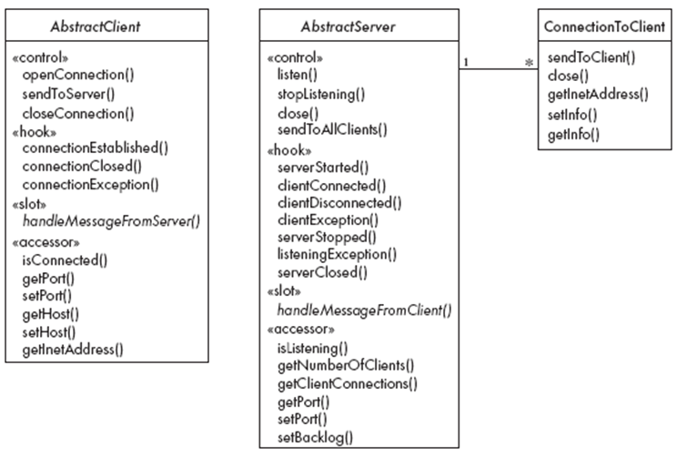
The Object Client-Server Framework (OCSF)
center h:550px

Slide 131
Using OCSF
Software engineers using OCSF never modify its three classes
They:
Create subclasses of the abstract classes in the framework
Call public methods that are provided by the framework
Override certain slot and hook methods (explicitly designed to be overridden)

Slide 132
The Client Side
Consists of a single class: AbstractClient
Must be subclassed
Any subclass must provide an implementation for handleMessageFromServer
Takes appropriate action when a message is received from a server
Implements the Runnable interface
Has a run method which
Contains a loop that executes for the lifetime of the thread

Slide 133
The public interface of AbstractClient
Controlling methods:
openConnection
closeConnection
sendToServer
Accessing methods:
isConnected
getHost
setHost
getPort
setPort
getInetAddress

Slide 134
The callback methods of AbstractClient
Methods that may be overridden:
connectionEstablished
connectionClosed
Method that must be implemented:
handleMessageFromServer

Slide 135
Using AbstractClient
Create a subclass of AbstractClient
Implement handleMessageFromServer slot method
Write code that:
Creates an instance of the new subclass
Calls openConnection
Sends messages to the server using the sendToServer service method
Implement the connectionClosed callback
Implement the connectionException callback

Slide 136
Internals of AbstractClient
Instance variables:
A Socket which keeps all the information about the connection to the server
Two streams, an ObjectOutputStream and an ObjectInputStream
A Thread that runs using AbstractClient’s run method
Two variables storing the host and port of the server

Slide 137
The Server Side
Two classes:
One for the thread which listens for new connections (AbstractServer)
One for the threads that handle the connections to clients (ConnectionToClient)

Slide 138
The public interface of AbstractServer
Controlling methods:
listen
stopListening
close
sendToAllClients
Accessing methods:
isListening
getClientConnections
getPort
setPort
setBacklog

Slide 139
The callback methods of AbstractServer
Methods that may be overridden:
serverStarted
clientConnected
clientDisconnected
clientException
serverStopped
listeningException
serverClosed
Method that must be implemented:
handleMessageFromClient

Slide 140
The public interface of ConnectionToClient
Controlling methods:
sendToClient
close
Accessing methods:
getInetAddress
setInfo
getInfo

Slide 141
Using AbstractServer and ConnectionToClient
Create a subclass of AbstractServer
Implement the slot method handleMessageFromClient
Write code that:
Creates an instance of the subclass of AbstractServer
Calls the listen method
Sends messages to clients, using:
the getClientConnections and sendToClient service methods
or sendToAllClients
Implement one or more of the other callback methods

Slide 142
Internals of AbstractServer and ConnectionToClient
The setInfo and getInfo methods make use of a Java class called HashMap
Many methods in the server side are synchronized
The collection of instances of ConnectionToClient is stored using a special class called ThreadGroup
The server must pause from listening every 500ms to see if the stopListening method has been called
if not, then it resumes listening immediately

Slide 143
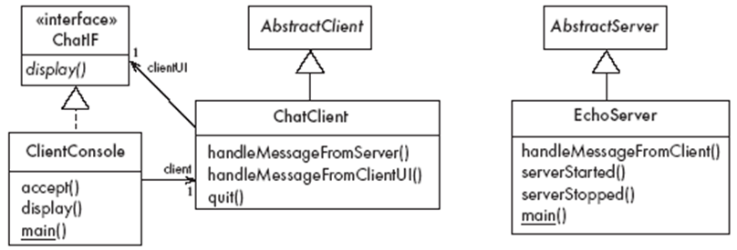
An Instant Messaging Application: SimpleChat
ClientConsole can eventually be replaced by ClientGUI
center h:450px

Slide 144
The server
EchoServer is a subclass of AbstractServer
The main method creates a new instance and starts it
It listens for clients and handles connections until the server is stopped
The three callback methods just print out a message to the user
handleMessageFromClient, serverStarted and serverStopped
The slot method handleMessageFromClient calls sendToAllClients
This echoes any messages

Slide 145
Key code in EchoServer
Java linenums="1" public void handleMessageFromClient (Object msg, ConnectionToClient client) { System.out.println( "Message received: " + msg + " from " + client); this.sendToAllClients(msg); }

Slide 146
The client
When the client program starts, it creates instances of two classes:
ChatClient
A subclass of AbstractClient
Overrides handleMessageFromServer
This calls the display method of the user interface
ClientConsole
User interface class that implements the interface ChatIF
Hence implements display which outputs to the console
Accepts user input by calling accept in its run method
Sends all user input to the ChatClient by calling its handleMessageFromClientUI
This, in turn, calls sendToServer

Slide 147
Key code in ChatClient
Java linenums="1" public void handleMessageFromClientUI( String message) { try { sendToServer(message); } catch(IOException e) { clientUI.display ( "Could not send message. " + "Terminating client."); quit(); } }

Slide 148
Key code in ChatClient
Java linenums="1" public void handleMessageFromServer(Object msg) { clientUI.display(msg.toString()); }

Slide 149
Risks when reusing technology
Poor quality reusable components
Ensure that the developers of the reusable technology:
follow good software engineering practices
are willing to provide active support
Compatibility not maintained
Avoid obscure features
Only re-use technology that others are also re-using

Slide 150
Risks when developing reusable technology
Investment uncertainty
Plan the development of the reusable technology, just as if it was a product for a client
The “not invented here syndrome”
Build confidence in the reusable technology by:
Guaranteeing support
Ensuring it is of high quality
Responding to the needs of its users

Slide 151
Risks when developing reusable technology
Competition
The reusable technology must be as useful and as high quality as possible
Divergence (tendency of various groups to change technology in different ways)
Design it to be general enough, test it and review it in advance

Slide 152
Risks when adopting a client-server approach
Security
Security is a big problem with no perfect solutions: consider the use of encryption, firewalls, …
Need for adaptive maintenance
Ensure that all software is forward and backward compatible with other versions of clients and servers

Slide 153
Java Classes and Objects

Slide 154
Java Classes
Java is an object-oriented programming language, so everything in java program must be based on the object concept. In a java programming language, the class concept defines the skeleton of an object.

Slide 155
Java Classes
The java class is a template of an object. The class defines the blueprint of an object. Every class in java forms a new data type. Once a class got created, we can generate as many objects as we want. Every class defines the properties and behaviors of an object. All the objects of a class have the same properties and behaviors that were defined in the class.

Slide 156
Java Classes
Every class of java programming language has the following characteristics.
Identity - It is the name given to the class.
State - Represents data values that are associated with an object.
Behavior - Represents actions can be performed by an object.

Slide 157
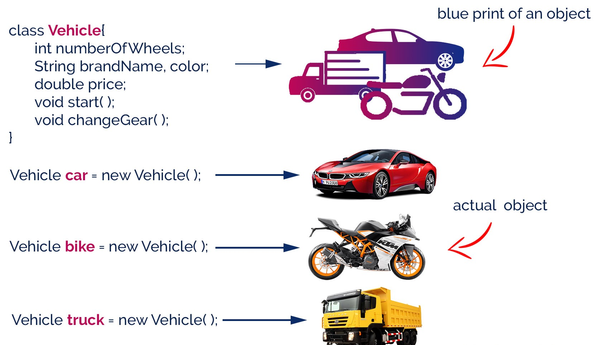
Java Classes
center h:500px

Slide 158
Creating a Class
In java, we use the keyword class to create a class. A class in java contains properties as variables and behaviors as methods. Following is the syntax of class in the java.
Java linenums="1" class <ClassName>{ data members declaration; methods defination; }
Here, fields (variables) and methods represent the state and behavior of the object respectively.
fields are used to store data
methods are used to perform some operations

Slide 159
Creating a Class
A class is a blueprint for the object. Before we create an object, we first need to define the class.
We can think of the class as a sketch (prototype) of a house. It contains all the details about the floors, doors, windows, etc. Based on these descriptions we build the house. House is the object.
Since many houses can be made from the same description, we can create many objects from a class.

Slide 160
Creating a Class
The ClassName must begin with an alphabet, and the Upper-case letter is preferred.
The ClassName must follow all naming rules.

Slide 161
Creating a Class
``` Java linenums=“1” class Bicycle {
// state or field private int gear = 5;
// behavior or method public void braking() { System.out.println(“Working of Braking”); } }
In the above example, we have created a class named Bicycle. It contains a field named gear and a method named braking(). --- ### Creating a Class Here, Bicycle is a prototype. Now, we can create any number of bicycles using the prototype. And, all the bicycles will share the fields and methods of the prototype. --- ### Creating an Object In java, an object is an instance of a class. When an object of a class is created, the class is said to be instantiated. All the objects that are created using a single class have the same properties and methods. But the value of properties is different for every object. Following is the syntax of class in the java. ``` Java linenums="1" <ClassName> <objectName> = new <ClassName>( );

Slide 162
Creating an Object
The objectName must begin with an alphabet, and a Lower-case letter is preferred.
The objectName must follow all naming rules.

Slide 163
Creating an Object
An object is called an instance of a class. For example, suppose Bicycle is a class then MountainBicycle, SportsBicycle, TouringBicycle, etc can be considered as objects of the class.
``` Java linenums=“1” className object = new className();
// for Bicycle class Bicycle sportsBicycle = new Bicycle();
Bicycle touringBicycle = new Bicycle();
We have used the new keyword along with the constructor of the class to create an object. Constructors are similar to methods and have the same name as the class. For example, Bicycle() is the constructor of the Bicycle class. --- ### Creating an Object Here, sportsBicycle and touringBicycle are the names of objects. We can use them to access fields and methods of the class. --- ### Access Members of a Class sportsBicycle.gear - access the field gear sportsBicycle.braking() - access the method braking() ``` Java linenums="1" class Bicycle { // field of class int gear = 5; // method of class void braking() { ... } } // create object Bicycle sportsBicycle = new Bicycle(); // access field and method sportsBicycle.gear; sportsBicycle.braking();

Slide 164
Example: Java Class and Objects
``` Java linenums=“1” class Lamp {
// stores the value for light // true if light is on // false if light is off boolean isOn;
// method to turn on the light void turnOn() { isOn = true; System.out.println(“Light on?” + isOn);
}
// method to turnoff the light void turnOff() { isOn = false; System.out.println(“Light on?” + isOn); } }
--- ### Example: Java Class and Objects ``` Java linenums="1" class Main { public static void main(String[] args) { // create objects led and halogen Lamp led = new Lamp(); Lamp halogen = new Lamp(); // turn on the light by // calling method turnOn() led.turnOn(); // turn off the light by // calling method turnOff() halogen.turnOff(); } }

Slide 165
Example: Create objects inside the same class
Note that in the previous example, we have created objects inside another class and accessed the members from that class.
However, we can also create objects inside the same class.

Slide 166
Example: Create objects inside the same class
``` Java linenums=“1” class Lamp {
// stores the value for light // true if light is on // false if light is off boolean isOn;
// method to turn on the light void turnOn() { isOn = true; System.out.println(“Light on?” + isOn);
}
public static void main(String[] args) {
// create an object of Lamp Lamp led = new Lamp(); // access method using object led.turnOn();
} }
--- ## **Java Methods** --- ### Java Methods A method is a block of statements under a name that gets executes only when it is called. Every method is used to perform a specific task. The major advantage of methods is code re-usability (define the code once, and use it many times). --- ### Java Methods In a java programming language, a method defined as a behavior of an object. That means, every method in java must belong to a class. Every method in java must be declared inside a class. --- ### Java Methods Every method declaration has the following characteristics. - **returnType** - Specifies the data type of a return value. - **name** - Specifies a unique name to identify it. - **parameters** - The data values it may accept or recieve. - **{ }** - Defienes the block belongs to the method. --- ### Creating a method A method is created inside the class and it may be created with any access specifier. However, specifying access specifier is optional. Following is the syntax for creating methods in java. ``` Java linenums="1" class <ClassName>{ <accessSpecifier> <returnType> <methodName>( parameters ){ ... block of statements; ... } }

Slide 167
Creating a method
Java linenums="1" modifier static returnType nameOfMethod (parameter1, parameter2, ...) { // method body }
modifier - It defines access types whether the method is public, private, and so on. static - If we use the static keyword, it can be accessed without creating objects.

Slide 168
Creating a method
The methodName must begin with an alphabet, and the Lower-case letter is preferred.
The methodName must follow all naming rules.
If you don’t want to pass parameters, we ignore it.
If a method defined with return type other than void, it must contain the return statement, otherwise, it may be ignored.

Slide 169
Calling a method
In java, a method call precedes with the object name of the class to which it belongs and a dot operator. It may call directly if the method defined with the static modifier. Every method call must be made, as to the method name with parentheses (), and it must terminate with a semicolon.
Java linenums="1" <objectName>.<methodName>( actualArguments );

Slide 170
Calling a method
The method call must pass the values to parameters if it has.
If the method has a return type, we must provide the receiver.

Slide 171
Calling a Method : Example
``` Java linenums=“1” import java.util.Scanner; public class JavaMethodsExample { int sNo; String name; Scanner read = new Scanner(System.in);
void readData() { System.out.print("Enter Serial Number: "); sNo = read.nextInt(); System.out.print("Enter the Name: "); name = read.next(); } static void showData(int sNo, String name) { System.out.println("Hello, " + name + "! your serial number is " + sNo); }
…
--- ### Calling a Method : Example ``` Java linenums="1" ... public static void main(String[] args) { JavaMethodsExample obj = new JavaMethodsExample(); obj.readData(); // method call using object showData(obj.sNo, obj.name); // method call without using object } }

Slide 172
Variable arguments of a method
In java, a method can be defined with a variable number of arguments. That means creating a method that receives any number of arguments of the same data type.
Java linenums="1" <returnType> <methodName>(dataType...parameterName);

Slide 173
Variable arguments of a method : Example
``` Java linenums=“1” public class JavaMethodWithVariableArgs {
void diaplay(int...list) { System.out.println("\nNumber of arguments: " + list.length); for(int i : list) { System.out.print(i + "\t"); } }
…
--- ### Variable arguments of a method : Example ``` Java linenums="1" ... public static void main(String[] args) { JavaMethodWithVariableArgs obj = new JavaMethodWithVariableArgs(); obj.diaplay(1, 2); obj.diaplay(10, 20, 30, 40, 50); } }

Slide 174
Java Normal Method Example
``` Java linenums=“1” class Main {
// create a method public int addNumbers(int a, int b) { int sum = a + b; // return value return sum; }
public static void main(String[] args) {
int num1 = 25; int num2 = 15; // create an object of Main Main obj = new Main(); // calling method int result = obj.addNumbers(num1, num2); System.out.println("Sum is: " + result);
} }
--- ### Java Static Method Example ``` Java linenums="1" class Main { // create a method public static int square(int num) { // return statement return num * num; } public static void main(String[] args) { int result; // call the method // store returned value to result result = square(10); System.out.println("Squared value of 10 is: " + result); } }

Slide 175
Java Method Parameters
``` Java linenums=“1” class Main {
// method with no parameter public void display1() { System.out.println(“Method without parameter”); }
// method with single parameter public void display2(int a) { System.out.println(“Method with a single parameter:” + a); }
public static void main(String[] args) {
// create an object of Main Main obj = new Main(); // calling method with no parameter obj.display1(); // calling method with the single parameter obj.display2(24);
} }
--- ## **Java Method Overloading** --- ### Java Method Overloading two or more methods may have the same name if they differ in parameters (different number of parameters, different types of parameters, or both). These methods are called overloaded methods and this feature is called method overloading. --- ### Java Method Overloading ``` Java linenums="1" void func() { ... } void func(int a) { ... } float func(double a) { ... } float func(int a, float b) { ... }
Note: The return types of the above methods are not the same. It is because method overloading is not associated with return types. Overloaded methods may have the same or different return types, but they must differ in parameters.

Slide 176
Why method overloading?
Suppose, you have to perform the addition of given numbers but there can be any number of arguments (let’s say either 2 or 3 arguments for simplicity).
In order to accomplish the task, you can create two methods sum2num(int, int) and sum3num(int, int, int) for two and three parameters respectively. However, other programmers, as well as you in the future may get confused as the behavior of both methods are the same but they differ by name.
The better way to accomplish this task is by overloading methods. And, depending upon the argument passed, one of the overloaded methods is called. This helps to increase the readability of the program.

Slide 177
How to perform method overloading in Java?
Overloading by changing the number of parameters
``` Java linenums=“1” class MethodOverloading { private static void display(int a){ System.out.println(“Arguments:” + a); }
private static void display(int a, int b){ System.out.println("Arguments: " + a + " and " + b); } public static void main(String[] args) { display(1); display(1, 4); }
}
--- ### How to perform method overloading in Java? - Method Overloading by changing the data type of parameters ``` Java linenums="1" class MethodOverloading { // this method accepts int private static void display(int a){ System.out.println("Got Integer data."); } // this method accepts String object private static void display(String a){ System.out.println("Got String object."); } public static void main(String[] args) { display(1); display("Hello"); } }

Slide 178
Java Overloading Example
``` Java linenums=“1” class HelperService {
private String formatNumber(int value) { return String.format("%d", value); } private String formatNumber(double value) { return String.format("%.3f", value); } private String formatNumber(String value) { return String.format("%.2f", Double.parseDouble(value)); } public static void main(String[] args) { HelperService hs = new HelperService(); System.out.println(hs.formatNumber(500)); System.out.println(hs.formatNumber(89.9934)); System.out.println(hs.formatNumber("550")); }
}
--- ## **Java Constructor** --- ### Java Constructor A constructor is a special method of a class that has the same name as the class name. The constructor gets executes automatically on object creation. It does not require the explicit method call. A constructor may have parameters and access specifiers too. In java, if you do not provide any constructor the compiler automatically creates a default constructor. --- ### Java Constructor A constructor can not have return value. ``` Java linenums="1" public class ConstructorExample { ConstructorExample() { System.out.println("Object created!"); } public static void main(String[] args) { ConstructorExample obj1 = new ConstructorExample(); ConstructorExample obj2 = new ConstructorExample(); } }

Slide 179
Types of Constructor
In Java, constructors can be divided into 3 types:
No-Arg Constructor
Parameterized Constructor
Default Constructor

Slide 180
Java No-Arg Constructors
Java private no-arg constructor
``` Java linenums=“1” class Main {
int i;
// constructor with no parameter private Main() { i = 5; System.out.println(“Constructor is called”); }
public static void main(String[] args) {
// calling the constructor without any parameter Main obj = new Main(); System.out.println("Value of i: " + obj.i);
} }
--- ### Java No-Arg Constructors - Java public no-arg constructor ``` Java linenums="1" class Company { String name; // public constructor public Company() { name = "My Company"; } } class Main { public static void main(String[] args) { // object is created in another class Company obj = new Company(); System.out.println("Company name = " + obj.name); } }

Slide 181
Java Parameterized Constructor
``` Java linenums=“1” class Main {
String languages;
// constructor accepting single value Main(String lang) { languages = lang; System.out.println(languages + ” Programming Language”); }
public static void main(String[] args) {
// call constructor by passing a single value Main obj1 = new Main("Java"); Main obj2 = new Main("Python"); Main obj3 = new Main("C");
} }
--- ### Java Default Constructor ``` Java linenums="1" class Main { int a; boolean b; public static void main(String[] args) { // A default constructor is called Main obj = new Main(); System.out.println("Default Value:"); System.out.println("a = " + obj.a); System.out.println("b = " + obj.b); } }

Slide 182
Java Default Values
The default constructor initializes any uninitialized instance variables with default values.
Type $⇒$ Default Value boolean $⇒$ false byte $⇒$ 0 short $⇒$ 0 int $⇒$ 0 long $⇒$ 0L char $⇒$ 000 float $⇒$ 0.0f double $⇒$ 0.0d object $⇒$ Reference null

Slide 183
Java Default Constructor Equivalent
``` Java linenums=“1” class Main {
int a; boolean b;
// a private constructor private Main() { a = 0; b = false; }
public static void main(String[] args) { // call the constructor Main obj = new Main();
System.out.println("Default Value:"); System.out.println("a = " + obj.a); System.out.println("b = " + obj.b);
} }
--- ### Constructors Overloading in Java ``` Java linenums="1" class Main { String language; // constructor with no parameter Main() { this.language = "Java"; } // constructor with a single parameter Main(String language) { this.language = language; } public void getName() { System.out.println("Programming Langauage: " + this.language); } ...

Slide 184
Constructors Overloading in Java
``` Java linenums=“1” … public static void main(String[] args) {
// call constructor with no parameter Main obj1 = new Main(); // call constructor with a single parameter Main obj2 = new Main("Python"); obj1.getName(); obj2.getName();
} }
--- ## **Java Inheritance** --- ### Inheritance Concept - The inheritance is a very useful and powerful concept of object-oriented programming. - In java, using the inheritance concept, we can use the existing features of one class in another class. - The inheritance provides a greate advantage called code re-usability. - With the help of code re-usability, the commonly used code in an application need not be written again and again. --- ### Inheritance Concept ![center h:550px](assets/OOP-Concept-Inheritance.png) --- ### Inheritance Concept The inheritance is the process of acquiring the properties of one class to another class. --- ### Inheritance Basics - In inheritance, we use the terms like - parent class, - child class, - base class, - derived class, - superclass, and - subclass. --- ### Inheritance Basics - **The Parent class** is the class which provides features to another class. - **The parent class** is also known as **Base class** or **Superclass**. - **The Child class** is the class which receives features from another class. - **The child class** is also known as the **Derived Class** or **Subclass**. --- ### Inheritance Basics - In the inheritance, - the child class acquires the features from its parent class. - But the parent class never acquires the features from its child class. --- ### Inheritance Basics There are five types of inheritances, and they are as follows. - Simple Inheritance (or) Single Inheritance - Multiple Inheritance - Multi-Level Inheritance - Hierarchical Inheritance - Hybrid Inheritance --- ### Inheritance Basics - Simple Inheritance (or) Single Inheritance ![center h:450px](assets/2022-02-23-23-30-38-image.png) --- ### Inheritance Basics - Multiple Inheritance ![center h:450px](assets/2022-02-23-23-30-55-image.png) --- ### Inheritance Basics - Multi-Level Inheritance ![center h:450px](assets/2022-02-23-23-31-17-image.png) --- ### Inheritance Basics - Hierarchical Inheritance ![center h:450px](assets/2022-02-23-23-31-46-image.png) --- ### Inheritance Basics - Hybrid Inheritance ![center h:450px](assets/2022-02-23-23-32-26-image.png) --- ### Inheritance Basics - The java programming language does not support multiple inheritance type. - However, it provides an alternate with the concept of **interfaces**. --- ### Creating Child Class in java - In java, we use the keyword **extends** to create a child class. - The following syntax used to create a child class in java. ``` Java linenums="1" class <ChildClassName> extends <ParentClassName>{ ... //Implementation of child class ... }
In a java programming language, a class extends only one class.
Extending multiple classes is not allowed in java.

Slide 185
Single Inheritance in Java Example-1
In this type of inheritance, one child class derives from one parent class.
Java linenums="1" class ParentClass{ int a; void setData(int a) { this.a = a; } }
Java linenums="1" class ChildClass extends ParentClass{ void showData() { System.out.println("Value of a is " + a); } }

Slide 186
Single Inheritance in Java Example-1
``` Java linenums=“1” public class SingleInheritance {
public static void main(String[] args) { ChildClass obj = new ChildClass(); obj.setData(100); obj.showData(); }
}
--- ### Single Inheritance in Java Example-2 ``` Java linenums="1" class Animal { // field and method of the parent class String name; public void eat() { System.out.println("I can eat"); } }
``` Java linenums=“1” // inherit from Animal class Dog extends Animal {
// new method in subclass public void display() { System.out.println(“My name is” + name); } }
--- ### Single Inheritance in Java Example-2 ``` Java linenums="1" class Main { public static void main(String[] args) { // create an object of the subclass Dog labrador = new Dog(); // access field of superclass labrador.name = "Rohu"; labrador.display(); // call method of superclass // using object of subclass labrador.eat(); } }

Slide 187
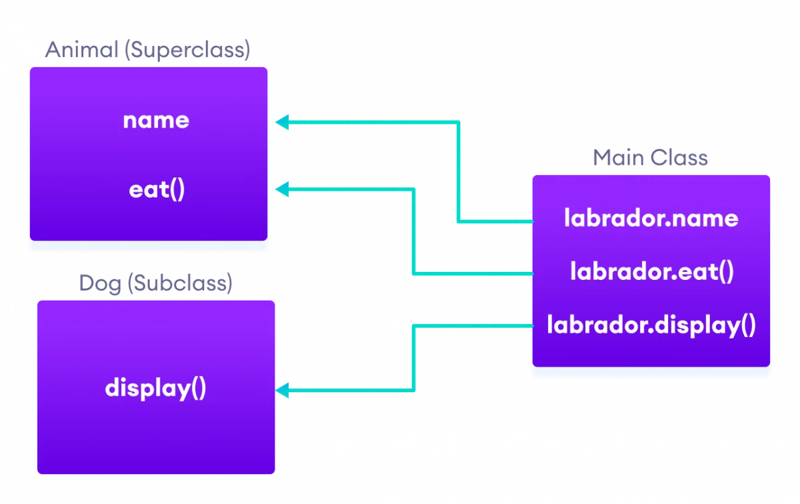
Single Inheritance in Java Example-2
center h:500px

Slide 188
Single Inheritance / is-a relationship
In Java, inheritance is an is-a relationship. That is, we use inheritance only if there exists an is-a relationship between two classes. For example,
Car is a Vehicle
Orange is a Fruit
Surgeon is a Doctor
Dog is an Animal
Here, Car can inherit from Vehicle, Orange can inherit from Fruit, and so on.

Slide 189
Multi-level Inheritance in java
In this type of inheritance, the child class derives from a class which already derived from another class
Java linenums="1" class ParentClass{ int a; void setData(int a) { this.a = a; } }

Slide 190
Multi-level Inheritance in java
Java linenums="1" class ChildClass extends ParentClass{ void showData() { System.out.println("Value of a is " + a); } }
Java linenums="1" class ChildChildClass extends ChildClass{ void display() { System.out.println("Inside ChildChildClass!"); } }

Slide 191
Multi-level Inheritance in java
``` Java linenums=“1” public class MultipleInheritance {
public static void main(String[] args) { ChildChildClass obj = new ChildChildClass(); obj.setData(100); obj.showData(); obj.display(); }
}
--- ### Hierarchical Inheritance in java - In this type of inheritance, two or more child classes derive from one parent class. ``` Java linenums="1" class ParentClass{ int a; void setData(int a) { this.a = a; } }

Slide 192
Hierarchical Inheritance in java
Java linenums="1" class ChildClass extends ParentClass{ void showData() { System.out.println("Inside ChildClass!"); System.out.println("Value of a is " + a); } } Java linenums="1" class ChildClassToo extends ParentClass{ void display() { System.out.println("Inside ChildClassToo!"); System.out.println("Value of a is " + a); } }

Slide 193
Hierarchical Inheritance in java
``` Java linenums=“1” public class HierarchicalInheritance { public static void main(String[] args) { ChildClass child_obj = new ChildClass(); child_obj.setData(100); child_obj.showData();
ChildClassToo childToo_obj = new ChildClassToo(); childToo_obj.setData(200); childToo_obj.display(); }
}
--- ### Hybrid Inheritance in java - The hybrid inheritance is the combination of more than one type of inheritance. - We may use any combination as a - single with multiple inheritances, - multi-level with multiple inheritances, etc., --- ## **Java Access Modifiers** --- ### Java Access Modifiers - In Java, the access specifiers (also known as access modifiers) used to restrict - the scope or - accessibility of a - class, - constructor, - variable, - method or - data member of class and interface. --- ### Java Access Modifiers There are four access specifiers, and their list is below. - default (or) no modifier - public - protected - private --- ### Java Access Modifiers - In java, we can not employ all access specifiers on everything. The following table describes where we can apply the access specifiers. ![bg right:60% h:650px](assets/java-access-specifiers.png) --- ### Java Access Modifiers - Let's look at the following example java code, - which generates an error - because a class does not allow private access specifier - unless it is an inner class. ``` Java linenums="1" private class Sample{ ... } ``` --- ### Java Access Modifiers - In java, the accessibility of the members of a class or interface depends on its access specifiers. The following table provides information about the visibility of both data members and methods. ![bg right:60% h:370px](assets/java-access-modifiers.png) --- ### Java Access Modifiers - The public members can be accessed everywhere. - The private members can be accessed only inside the same class. - The protected members are accessible to every child class (same package or other packages). - The default members are accessible within the same package but not outside the package. --- ### Java Access Modifiers ``` Java linenums="1" class ParentClass{ int a = 10; public int b = 20; protected int c = 30; private int d = 40; void showData() { System.out.println("Inside ParentClass"); System.out.println("a = " + a); System.out.println("b = " + b); System.out.println("c = " + c); System.out.println("d = " + d); } }

Slide 194
Java Access Modifiers
``` Java linenums=“1” class ChildClass extends ParentClass{
void accessData() { System.out.println("Inside ChildClass"); System.out.println("a = " + a); System.out.println("b = " + b); System.out.println("c = " + c); //System.out.println("d = " + d); // private member can't be accessed }
}
--- ### Java Access Modifiers ``` Java linenums="1" public class AccessModifiersExample { public static void main(String[] args) { ChildClass obj = new ChildClass(); obj.showData(); obj.accessData(); } }

Slide 195
Java Access Modifiers
Default Access Modifier
Here, the Logger class has the default access modifier
Java linenums="1" package defaultpackage; class Logger { void message(){ System.out.println("This is a message"); } }
the class is visible to all the classes that belong to the defaultPackage package
However, if we try to use the Logger class in another class outside of defaultPackage, we will get a compilation error.

Slide 196
Java Access Modifiers
Private Access Modifier
When variables and methods are declared private, they cannot be accessed outside of the class
Java linenums="1" class Data { // private variable private String name; }

Slide 197
Java Access Modifiers
Private Access Modifier
``` Java linenums=“1” public class Main { public static void main(String[] main){
// create an object of Data Data d = new Data(); // access private variable and field from another class d.name = "My App"; }
}
--- ### Java Access Modifiers - **Private Access Modifier** - When we run the program, we will get the following error ``` Bash Main.java:18: error: name has private access in Data d.name = "My App"; ^

Slide 198
Java Access Modifiers
Private Access Modifier
if we need to access those private variables
we can use the getters and setters method
``` Java linenums=“1” class Data { private String name;
// getter method public String getName() { return this.name; } // setter method public void setName(String name) { this.name= name; }
}
--- ### Java Access Modifiers - **Private Access Modifier** ``` Java linenums="1" public class Main { public static void main(String[] main){ Data d = new Data(); // access the private variable using the getter and setter d.setName("My App"); System.out.println(d.getName()); } }

Slide 199
Java Access Modifiers
Private Access Modifier
We cannot declare classes and interfaces private in Java.
However, the nested classes can be declared private.

Slide 200
Java Access Modifiers
Protected Access Modifier
When methods and data members are declared protected,
we can access them within the same package
as well as from subclasses.

Slide 201
Java Access Modifiers
Protected Access Modifier
Java linenums="1" class Animal { // protected method protected void display() { System.out.println("I am an animal"); } }
``` Java linenums=“1” class Dog extends Animal { public static void main(String[] args) {
// create an object of Dog class Dog dog = new Dog(); // access protected method dog.display(); }
}
--- ### Java Access Modifiers - **Protected Access Modifier** (Ex-2) ``` Java linenums="1" class Animal { protected String name; protected void display() { System.out.println("I am an animal."); } }
``` Java linenums=“1” class Dog extends Animal {
public void getInfo() { System.out.println(“My name is” + name); } }
--- ### Java Access Modifiers - **Protected Access Modifier** (Ex-2) ``` Java linenums="1" class Main { public static void main(String[] args) { // create an object of the subclass Dog labrador = new Dog(); // access protected field and method // using the object of subclass labrador.name = "Rocky"; labrador.display(); labrador.getInfo(); } }

Slide 202
Java Access Modifiers
Protected Access Modifier
We cannot declare classes or interfaces protected in Java.

Slide 203
Java Access Modifiers
Public Access Modifier
When methods, variables, classes, and so on are declared public,
then we can access them from anywhere.
``` Java linenums=“1” // Animal.java file // public class public class Animal { // public variable public int legCount;
// public method public void display() { System.out.println("I am an animal."); System.out.println("I have " + legCount + " legs."); }
}
--- ### Java Access Modifiers - **Public Access Modifier** ``` Java linenums="1" // Main.java public class Main { public static void main( String[] args ) { // accessing the public class Animal animal = new Animal(); // accessing the public variable animal.legCount = 4; // accessing the public method animal.display(); } }

Slide 204
Java Constructors in Inheritance

Slide 205
Java Constructors in Inheritance
It is very important to understand how the constructors get executed in the inheritance concept.
In the inheritance, the constructors never get inherited to any child class.
In java, the default constructor of a parent class called automatically by the constructor of its child class.
That means when we create an object of the child class,
the parent class constructor executed, followed by the child class constructor executed.

Slide 206
Java Constructors in Inheritance - Example
Java linenums="1" class ParentClass{ int a; ParentClass(){ System.out.println("Inside ParentClass constructor!"); } }
``` Java linenums=“1” class ChildClass extends ParentClass{
ChildClass(){ System.out.println("Inside ChildClass constructor!!"); }
}
--- ### Java Constructors in Inheritance - Example ``` Java linenums="1" class ChildChildClass extends ChildClass{ ChildChildClass(){ System.out.println("Inside ChildChildClass constructor!!"); } }
``` Java linenums=“1” public class ConstructorInInheritance {
public static void main(String[] args) { ChildChildClass obj = new ChildChildClass(); }
}
--- ### Java Constructors in Inheritance - if the parent class contains both default and parameterized constructor, - then only the default constructor called automatically - by the child class constructor --- ### Java Constructors in Inheritance - Example ``` Java linenums="1" class ParentClass{ int a; ParentClass(int a){ System.out.println("Inside ParentClass parameterized constructor!"); this.a = a; } ParentClass(){ System.out.println("Inside ParentClass default constructor!"); } }

Slide 207
Java Constructors in Inheritance - Example
Java linenums="1" class ChildClass extends ParentClass{ ChildClass(){ System.out.println("Inside ChildClass constructor!!"); } }
Java linenums="1" public class ConstructorInInheritance { public static void main(String[] args) { ChildClass obj = new ChildClass(); } }

Slide 208
Java Constructors in Inheritance
The parameterized constructor of parent class must be called explicitly using the super keyword.

Slide 209
Method Overriding in Java Inheritance
``` Java linenums=“1” class Animal {
// method in the superclass public void eat() { System.out.println(“I can eat”); } }
--- ### Method Overriding in Java Inheritance ``` Java linenums="1" // Dog inherits Animal class Dog extends Animal { // overriding the eat() method @Override public void eat() { System.out.println("I eat dog food"); } // new method in subclass public void bark() { System.out.println("I can bark"); } }

Slide 210
Method Overriding in Java Inheritance
``` Java linenums=“1” class Main { public static void main(String[] args) {
// create an object of the subclass Dog labrador = new Dog(); // call the eat() method labrador.eat(); labrador.bark();
} }
--- ### Method Overriding in Java Inheritance - In the above example, the eat() method is present in both the superclass Animal and the subclass Dog. - Here, we have created an object labrador of Dog. - Now when we call eat() using the object labrador, the method inside Dog is called. This is because the method inside the derived class overrides the method inside the base class. --- ## **super Keyword in Java Inheritance** --- ### super Keyword in Java Inheritance - the same method in the subclass overrides the method in superclass. - In such a situation, the super keyword is used to call the method of the parent class from the method of the child class. --- ### super Keyword in Java Inheritance ``` Java linenums="1" class Animal { // method in the superclass public void eat() { System.out.println("I can eat"); } }

Slide 211
super Keyword in Java Inheritance
``` Java linenums=“1” // Dog inherits Animal class Dog extends Animal {
// overriding the eat() method @Override public void eat() {
// call method of superclass super.eat(); System.out.println("I eat dog food");
}
// new method in subclass public void bark() { System.out.println(“I can bark”); } }
--- ### super Keyword in Java Inheritance ``` Java linenums="1" class Main { public static void main(String[] args) { // create an object of the subclass Dog labrador = new Dog(); // call the eat() method labrador.eat(); labrador.bark(); } }

Slide 212
Java this Keyword

Slide 213
Java this Keyword
In Java, this keyword is used to refer to
the current object
inside a
method or a
constructor

Slide 214
Java this Keyword
``` Java linenums=“1” class Main { int instVar;
Main(int instVar){ this.instVar = instVar; System.out.println("this reference = " + this); } public static void main(String[] args) { Main obj = new Main(8); System.out.println("object reference = " + obj); }
}
--- ### Using this for Ambiguity Variable Names - In Java, it is not allowed to declare two or more variables having the same name inside a scope (class scope or method scope). - However, instance variables and parameters may have the same name. --- ### Using this for Ambiguity Variable Names WRONG ``` Java linenums="1" class Main { int age; Main(int age){ age = age; } public static void main(String[] args) { Main obj = new Main(8); System.out.println("obj.age = " + obj.age); } }

Slide 215
Using this for Ambiguity Variable Names
CORRECT
``` Java linenums=“1” class Main {
int age; Main(int age){ this.age = age; } public static void main(String[] args) { Main obj = new Main(8); System.out.println("obj.age = " + obj.age); }
}
--- ### this with Getters and Setters - Another common use of this keyword is in setters and getters methods of a class ``` Java linenums="1" class Main { String name; // setter method void setName( String name ) { this.name = name; } // getter method String getName(){ return this.name; } ...

Slide 216
this with Getters and Setters
``` Java linenums=“1” … public static void main( String[] args ) { Main obj = new Main();
// calling the setter and the getter method obj.setName("Toshiba"); System.out.println("obj.name: "+obj.getName());
} }
--- ### Using this in Constructor Overloading - While working with constructor overloading, - we might have to invoke one constructor from another constructor. - In such a case, - we cannot call the constructor explicitly. Instead, - we have to use this keyword. --- ### Using this in Constructor Overloading ``` Java linenums="1" class Complex { private int a, b; // constructor with 2 parameters private Complex( int i, int j ){ this.a = i; this.b = j; } // constructor with single parameter private Complex(int i){ // invokes the constructor with 2 parameters this(i, i); } // constructor with no parameter private Complex(){ // invokes the constructor with single parameter this(0); } ...

Slide 217
Using this in Constructor Overloading
``` Java linenums=“1” @Override public String toString(){ return this.a + ” + ” + this.b + “i”; }
public static void main( String[] args ) { // creating object of Complex class // calls the constructor with 2 parameters Complex c1 = new Complex(2, 3); // calls the constructor with a single parameter Complex c2 = new Complex(3); // calls the constructor with no parameters Complex c3 = new Complex(); // print objects System.out.println(c1); System.out.println(c2); System.out.println(c3); }
}
--- ### Using this in Constructor Overloading - In the example, we have used this keyword, - to call the constructor `Complex(int i, int j)` from the constructor `Complex(int i)` - to call the constructor `Complex(int i)` from the constructor `Complex()` - the line, `System.out.println(c1);` process, the toString() is called Since we override the toString() method inside our class, we get the output according to that method. --- ### Using this in Constructor Overloading - One of the huge advantages of this() is to reduce the amount of duplicate code. However, we should be always careful while using this(). - This is because calling constructor from another constructor adds overhead and it is a slow process. Another huge advantage of using this() is to reduce the amount of duplicate code. --- ### Using this in Constructor Overloading - Invoking one constructor from another constructor is called explicit constructor invocation. --- ### Passing this as an Argument - We can use this keyword to pass the current object as an argument to a method ``` Java linenums="1" class ThisExample { // declare variables int x; int y; ThisExample(int x, int y) { // assign values of variables inside constructor this.x = x; this.y = y; // value of x and y before calling add() System.out.println("Before passing this to addTwo() method:"); System.out.println("x = " + this.x + ", y = " + this.y); // call the add() method passing this as argument add(this); // value of x and y after calling add() System.out.println("After passing this to addTwo() method:"); System.out.println("x = " + this.x + ", y = " + this.y); } void add(ThisExample o){ o.x += 2; o.y += 2; } }

Slide 218
Passing this as an Argument
Java linenums="1" class Main { public static void main( String[] args ) { ThisExample obj = new ThisExample(1, -2); } }

Slide 219
Passing this as an Argument
In the example, inside the constructor ThisExample(), notice the line, add(this);
Here, we are calling the add() method by passing this as an argument.
Since this keyword contains the reference to the object obj of the class,
we can change the value of x and y inside the add() method.

Slide 220
Java instanceof Operator

Slide 221
Java instanceof Operator
The instanceof operator in Java is used to
check whether an object is an instance of
a particular class or not.
Its syntax is
objectName instanceOf className;

Slide 222
Example: Java instanceof
``` Java linenums=“1” class Main {
public static void main(String[] args) {
// create a variable of string type String name = "My App"; // checks if name is instance of String boolean result1 = name instanceof String; System.out.println("name is an instance of String: " + result1); // create an object of Main Main obj = new Main(); // checks if obj is an instance of Main boolean result2 = obj instanceof Main; System.out.println("obj is an instance of Main: " + result2);
} }
--- ### Example: Java instanceof - In the example, we have created a variable name of the String type and an object obj of the Main class. - Here, we have used the instanceof operator to check whether name and obj are instances of the String and Main class respectively. And, the operator returns true in both cases. --- ### Java instanceof during Inheritance - We can use the instanceof operator to check if objects of the subclass is also an instance of the superclass. --- ### Java instanceof during Inheritance ``` Java linenums="1" // Java Program to check if an object of the subclass // is also an instance of the superclass // superclass class Animal { } // subclass class Dog extends Animal { } class Main { public static void main(String[] args) { // create an object of the subclass Dog d1 = new Dog(); // checks if d1 is an instance of the subclass System.out.println(d1 instanceof Dog); // prints true // checks if d1 is an instance of the superclass System.out.println(d1 instanceof Animal); // prints true } }

Slide 223
Java instanceof during Inheritance
In the above example, we have created a subclass Dog that inherits from the superclass Animal. We have created an object d1 of the Dog class.
Inside the print statement, notice the expression,
Java linenums="1" d1 instanceof Animal
Here, we are using the instanceof operator to check whether d1 is also an instance of the superclass Animal

Slide 224
Java instanceof in Interface
The instanceof operator is also used to check whether an object of a class is
also an instance of the interface implemented by the class

Slide 225
Java instanceof in Interface
``` Java linenums=“1” // Java program to check if an object of a class is also // an instance of the interface implemented by the class
interface Animal { }
class Dog implements Animal { }
--- ### Java instanceof in Interface ``` Java linenums="1" class Main { public static void main(String[] args) { // create an object of the Dog class Dog d1 = new Dog(); // checks if the object of Dog // is also an instance of Animal System.out.println(d1 instanceof Animal); // returns true } }

Slide 226
Java instanceof in Interface
In the example, the Dog class implements the Animal interface. Inside the print statement, notice the expression,
Java linenums="1" d1 instanceof Animal
Here, d1 is an instance of Dog class. The instanceof operator checks
if d1 is also an instance of the interface Animal.

Slide 227
Java instanceof in Interface
In Java, all the classes are inherited from the Object class. So, instances of all the classes are also an instance of the Object class.
In the previous example, if we check,
Java linenums="1" d1 instanceof Object
The result will be true.

Slide 228
References
https://www.site.uottawa.ca/~tcl/seg2105/
https://cruise.umple.org/index.shtml
https://cruise.umple.org/umple/GettingStarted.html
Sanem Sarıel Associate Professor, PhD BT503 Application Development with Java (Kemerburgaz University 2013-2015)
How To Define The Project Scope The Foolproof Way

Slide 229
References
BtechSmartClass Java OOP Concepts
BtechSmartClass-Java Buzz Words
JavatPoint-Cpp vs Java
BtechSmartClass-Java Classes
Programiz-Class Objects

Slide 230
References
BtechSmartClass-Java-Methods-and-Classes
Programiz-Methods
Programiz-Method Overloading
Programiz-Constructors
BtechSmartClass-Java inheritance basics

Slide 231
References
BtechSmartClass-Java access specifiers
Programiz-Access Modifiers
BtechSmartClass-java constructors in inheritance
Programiz-Inheritance
Programiz-this Keyword
Programiz-instanceof

Slide 232
$End−Of−Week−1−Module$

