Slide 1
CE204 Object-Oriented Programming
OOP with Java-II Author: Asst. Prof. Dr. Uğur CORUH

Slide 2
CE204 Object-Oriented Programming

Slide 3
Week-2 (OOP with Java-II)
Spring Semester, 2021-2022
Download DOC, SLIDE, PPTX

Slide 4
OOP with Java-II

Slide 5
Outline (1)
Java super Keyword
Java final Keyword
Java Polymorphism / Encapsulation
Java Method Overriding
Java Nested Inner Class
Java Static Class
Java Anonymous Class

Slide 6
Outline (2)
Java Enums / Enum-Constructor / Enum-String
Java Abstract Class
Java Object Class
Java Forms of Inheritance
Java Benefits and Costs of Inheritance
Java Packages
Java Access Protection in Packages

Slide 7
Java super keyword

Slide 8
Java super keyword
In java, super is a keyword used to refers to the parent class object.
The super keyword came into existence to solve the naming conflicts in the inheritance.
When both parent class and child class have members with the same name,
then the super keyword is used to refer to the parent class version.

Slide 9
Java super keyword
In another word, The super keyword in Java is used in subclasses to access superclass members (attributes, constructors and methods).

Slide 10
Java super keyword
In java, the super keyword is used for the following purposes.
To refer parent class data members
To refer parent class methods
To call parent class constructor

Slide 11
Java super keyword
To call methods of the superclass that is overridden in the subclass.
To access attributes (fields) of the superclass if both superclass and subclass have attributes with the same name.
To explicitly call superclass no-arg (default) or parameterized constructor from the subclass constructor.

Slide 12
Java super keyword
The super keyword is used inside the child class only.

Slide 13
super to refer parent class data members
When both parent class and child class have data members with the same name,
then the super keyword is used to refer to the parent class data member from child class.

Slide 14
super to refer parent class data members
``` Java linenums=“1” class ParentClass{
int num = 10;
}
``` Java linenums="1" class ChildClass extends ParentClass{ int num = 20; void showData() { System.out.println("Inside the ChildClass"); System.out.println("ChildClass num = " + num); System.out.println("ParentClass num = " + super.num); } }

Slide 15
super to refer parent class data members
``` Java linenums=“1” public class SuperKeywordExample {
public static void main(String[] args) { ChildClass obj = new ChildClass(); obj.showData(); System.out.println("\nInside the non-child class"); System.out.println("ChildClass num = " + obj.num); //System.out.println("ParentClass num = " + super.num); //super can't be used here }
}
--- ## super to refer parent class **method** - When both parent class and child class have method with the same name, - then the super keyword is used to refer to the parent class method from child class. --- ## super to refer parent class **method** ```Java class ParentClass{ int num1 = 10; void showData() { System.out.println("\nInside the ParentClass showData method"); System.out.println("ChildClass num = " + num1); } }

Slide 16
super to refer parent class method
class ChildClass extends ParentClass{ int num2 = 20; void showData() { System.out.println("\nInside the ChildClass showData method"); System.out.println("ChildClass num = " + num2); super.showData(); } }

Slide 17
super to refer parent class method
public class SuperKeywordExample { public static void main(String[] args) { ChildClass obj = new ChildClass(); obj.showData(); //super.showData(); // super can't be used here } }

Slide 18
super to call parent class constructor
When an object of child class is created, it automatically calls the parent class default-constructor before it’s own.
But, the parameterized constructor of parent class must be called explicitly using the super keyword inside the child class constructor.

Slide 19
super to call parent class constructor
``` Java linenums=“1” class ParentClass{
int num1; ParentClass(){ System.out.println("\nInside the ParentClass default constructor"); num1 = 10; } ParentClass(int value){ System.out.println("\nInside the ParentClass parameterized constructor"); num1 = value; }
}
--- ## super to call parent class **constructor** ``` Java linenums="1" class ChildClass extends ParentClass{ int num2; ChildClass(){ super(100); System.out.println("\nInside the ChildClass constructor"); num2 = 200; } }

Slide 20
super to call parent class constructor
``` Java linenums=“1” public class SuperKeywordExample {
public static void main(String[] args) { ChildClass obj = new ChildClass(); }
}
--- ## super to call parent class **constructor** - To call the parameterized constructor of the parent class, - the super keyword must be the first statement inside the child class constructor, - and we must pass the parameter values. --- ## Access Overridden Methods of the superclass - If methods with the same name are defined in both superclass and subclass, the method in the subclass overrides the method in the superclass. This is called method overriding. --- ## Example 1: Method overriding ``` Java linenums="1" class Animal { // overridden method public void display(){ System.out.println("I am an animal"); } }

Slide 21
Example 1: Method overriding
``` Java linenums=“1” class Dog extends Animal {
// overriding method @Override public void display(){ System.out.println(“I am a dog”); }
public void printMessage(){ display(); } }
--- ## Example 1: Method overriding ``` Java linenums="1" class Main { public static void main(String[] args) { Dog dog1 = new Dog(); dog1.printMessage(); } }

Slide 22
Example 1: Method overriding
In this example, by making an object dog1 of Dog class, we can call its method printMessage() which then executes the display() statement.
Since display() is defined in both the classes, the method of subclass Dog overrides the method of superclass Animal. Hence, the display() of the subclass is called.

Slide 23
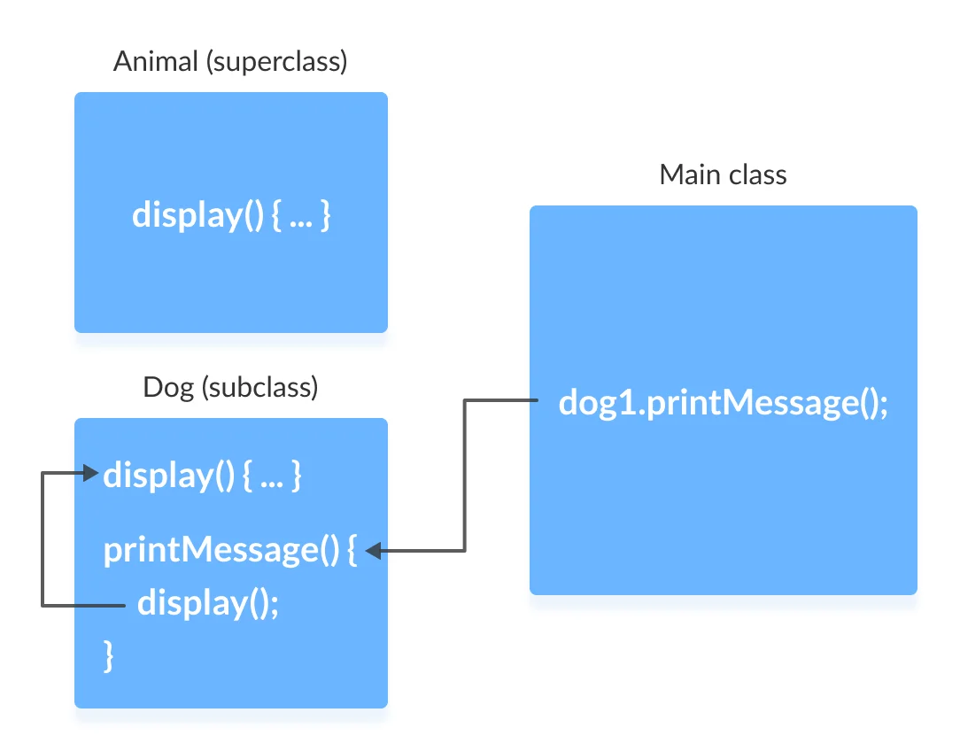
Example 1: Method overriding
center h:500px

Slide 24
What if the overridden method of the superclass has to be called?
We use super.display() if the overridden method display() of superclass Animal needs to be called.

Slide 25
Example 2: super to Call Superclass Method
``` Java linenums=“1” class Animal {
// overridden method public void display(){ System.out.println(“I am an animal”); } }
--- ## Example 2: super to Call Superclass Method ``` Java linenums="1" class Dog extends Animal { // overriding method @Override public void display(){ System.out.println("I am a dog"); } public void printMessage(){ // this calls overriding method display(); // this calls overridden method super.display(); } }

Slide 26
Example 2: super to Call Superclass Method
Java linenums="1" class Main { public static void main(String[] args) { Dog dog1 = new Dog(); dog1.printMessage(); } } —

Slide 27
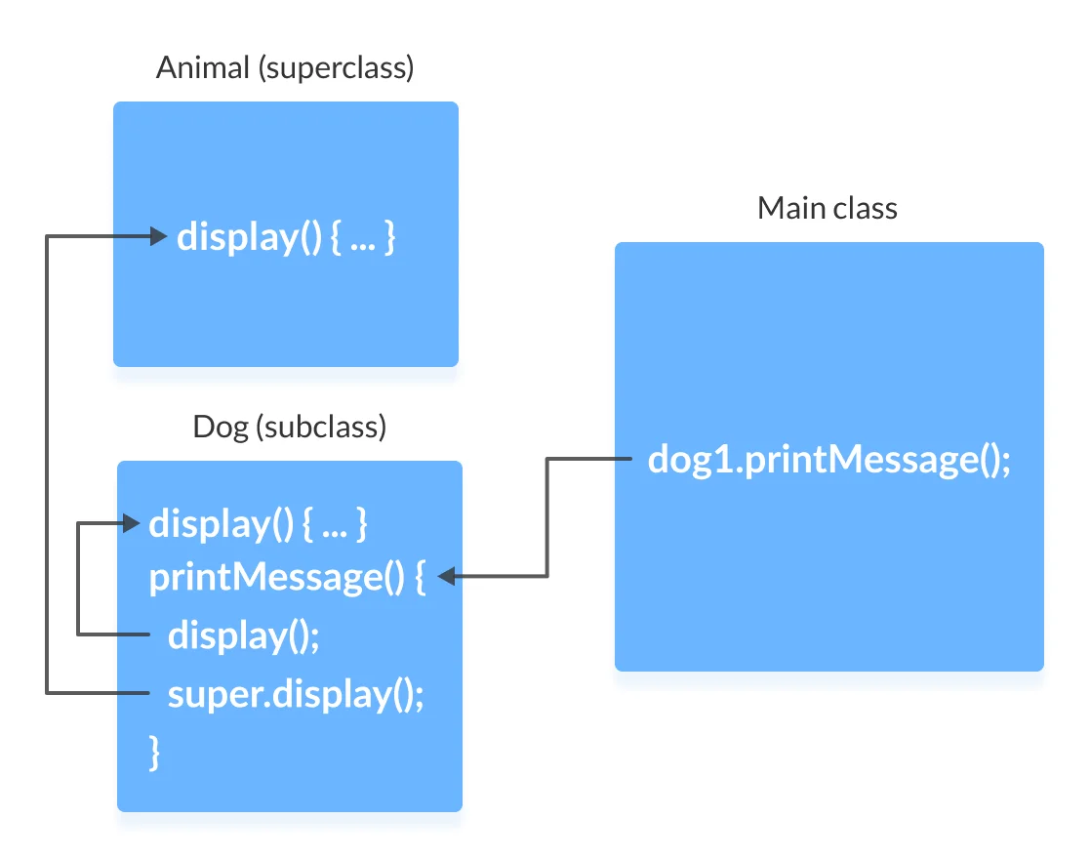
Example 2: super to Call Superclass Method
center h:500px

Slide 28
Access Attributes of the Superclass
The superclass and subclass can have attributes with the same name.
We use the super keyword to access the attribute of the superclass.

Slide 29
Example 3: Access superclass attribute
Java linenums="1" class Animal { protected String type="animal"; }
``` Java linenums=“1” class Dog extends Animal { public String type=“mammal”;
public void printType() { System.out.println(“I am a” + type); System.out.println(“I am an” + super.type); } }
--- ## Example 3: Access superclass attribute ``` Java linenums="1" class Main { public static void main(String[] args) { Dog dog1 = new Dog(); dog1.printType(); } }

Slide 30
Example 3: Access superclass attribute
In this example, we have defined the same instance field type in both the superclass Animal and the subclass Dog.
We then created an object dog1 of the Dog class. Then, the printType() method is called using this object.
Inside the printType() function,
type refers to the attribute of the subclass Dog.
super.type refers to the attribute of the superclass Animal.

Slide 31
Use of super() to access superclass constructor
As we know, when an object of a class is created, its default constructor is automatically called.
To explicitly call the superclass constructor from the subclass constructor, we use super(). It’s a special form of the super keyword.
super() can be used only inside the subclass constructor and must be the first statement.

Slide 32
Example 4: Use of super()
``` Java linenums=“1” class Animal {
// default or no-arg constructor of class Animal Animal() { System.out.println(“I am an animal”); } }
--- ## Example 4: Use of super() ``` Java linenums="1" class Dog extends Animal { // default or no-arg constructor of class Dog Dog() { // calling default constructor of the superclass super(); System.out.println("I am a dog"); } }

Slide 33
Example 4: Use of super()
Java linenums="1" class Main { public static void main(String[] args) { Dog dog1 = new Dog(); } }

Slide 34
Example 4: Use of super()
when an object dog1 of Dog class is created, it automatically calls the default or no-arg constructor of that class.
Inside the subclass constructor, the super() statement calls the constructor of the superclass and executes the statements inside it. Hence, we get the output I am an animal.

Slide 35
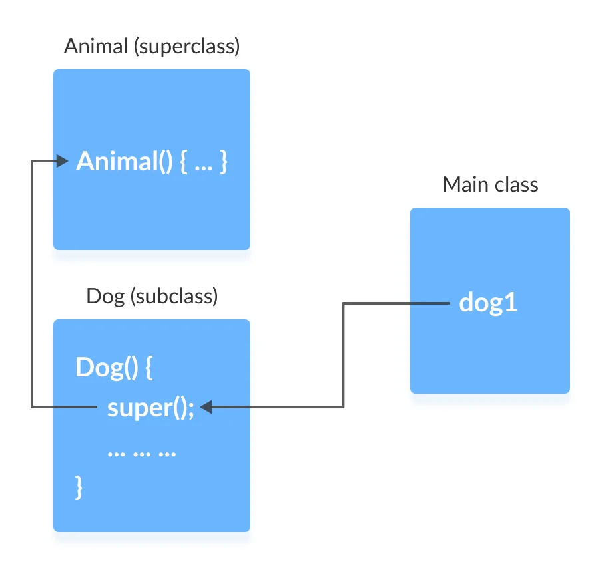
Example 4: Use of super()
bg right:50% h:400px

Slide 36
The flow of the program then returns back to the subclass constructor and executes the remaining statements. Thus, I am a dog will be printed.
However, using super() is not compulsory. Even if super() is not used in the subclass constructor, the compiler implicitly calls the default constructor of the superclass.

Slide 37
Example 4: Use of super()
So, why use redundant code if the compiler automatically invokes super()?
It is required if the parameterized constructor (a constructor that takes arguments) of the superclass has to be called from the subclass constructor.
The parameterized super() must always be the first statement
in the body of the constructor of the subclass,
otherwise, we get a compilation error.

Slide 38
Example 5: Call Parameterized Constructor Using super()
``` Java linenums=“1” class Animal {
// default or no-arg constructor Animal() { System.out.println(“I am an animal”); }
// parameterized constructor Animal(String type) { System.out.println(“Type:”+type); } }
--- ## Example 5: Call Parameterized Constructor Using super() ``` Java linenums="1" class Dog extends Animal { // default constructor Dog() { // calling parameterized constructor of the superclass super("Animal"); System.out.println("I am a dog"); } }

Slide 39
Example 5: Call Parameterized Constructor Using super()
Java linenums="1" class Main { public static void main(String[] args) { Dog dog1 = new Dog(); } }

Slide 40
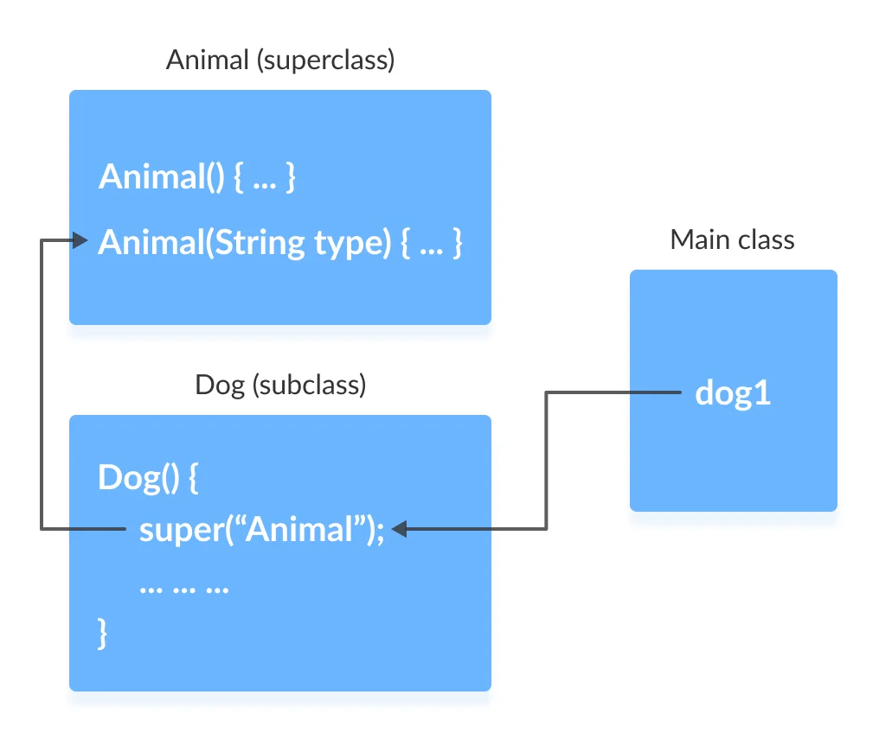
Example 5: Call Parameterized Constructor Using super()
If a parameterized constructor has to be called, we need to explicitly define it in the subclass constructor.
bg right:50% h:500px

Slide 41
Example 5: Call Parameterized Constructor Using super()
Note that in the above example, we explicitly called the parameterized constructor super(“Animal”). The compiler does not call the default constructor of the superclass in this case.

Slide 42
Java final keyword

Slide 43
Java final keyword
In java, the final is a keyword and it is used with the following things.
With variable (to create constant)
With method (to avoid method overriding)
With class (to avoid inheritance)

Slide 44
Java final restrictions
the final variable cannot be reinitialized with another value
the final method cannot be overridden
the final class cannot be extended

Slide 45
final with variables
When a variable defined with the final keyword,
it becomes a constant, and
it does not allow us to modify the value.
The variable defined with the final keyword allows only a one-time assignment,
once a value assigned to it,
never allows us to change it again.

Slide 46
final with variables example-1
Java linenums="1" public class FinalVariableExample { public static void main(String[] args) { final int a = 10; System.out.println("a = " + a); a = 100; // Can't be modified } }

Slide 47
final with variables example-2
``` Java linenums=“1” class Main { public static void main(String[] args) {
// create a final variable final int AGE = 32; // try to change the final variable AGE = 45; System.out.println("Age: " + AGE);
} }
--- ## **final** with variables recommendation - It is recommended to use uppercase to declare final variables in Java. --- ## **final** with methods - When a method defined with the final keyword, - it does not allow it to override. - The final method extends to the child class, - but the child class can not override or re-define it. - It must be used as it has implemented in the parent class. --- ## **final** with methods example-1 ``` Java linenums="1" class ParentClass{ int num = 10; final void showData() { System.out.println("Inside ParentClass showData() method"); System.out.println("num = " + num); } }

Slide 48
final with methods example-1
``` Java linenums=“1” class ChildClass extends ParentClass{
void showData() { System.out.println("Inside ChildClass showData() method"); System.out.println("num = " + num); }
}
--- ## **final** with methods example-1 ``` Java linenums="1" public class FinalKeywordExample { public static void main(String[] args) { ChildClass obj = new ChildClass(); obj.showData(); } }

Slide 49
final with methods example-2
``` Java linenums=“1” class FinalDemo { // create a final method public final void display() { System.out.println(“This is a final method.”); } }
class Main extends FinalDemo { // try to override final method public final void display() { System.out.println(“The final method is overridden.”); }
public static void main(String[] args) { Main obj = new Main(); obj.display(); } }
--- ## **final** with class - When a class defined with final keyword, it can not be extended by any other class. --- ## **final** with class example-1 ``` Java linenums="1" final class ParentClass{ int num = 10; void showData() { System.out.println("Inside ParentClass showData() method"); System.out.println("num = " + num); } }

Slide 50
final with class example-1
``` Java linenums=“1” class ChildClass extends ParentClass{
}
--- ## **final** with class example-1 ``` Java linenums="1" public class FinalKeywordExample { public static void main(String[] args) { ChildClass obj = new ChildClass(); } }

Slide 51
final with class example-2
``` Java linenums=“1” // create a final class final class FinalClass { public void display() { System.out.println(“This is a final method.”); } }
// try to extend the final class class Main extends FinalClass { public void display() { System.out.println(“The final method is overridden.”); }
public static void main(String[] args) { Main obj = new Main(); obj.display(); } }
--- ## **Java Polymorphism** --- ## Java Polymorphism - The polymorphism is the process of defining same method with different implementation. That means creating multiple methods with different behaviors. - In java, polymorphism implemented using - method overloading and - method overriding. --- ## Ad hoc polymorphism - The ad hoc polymorphism is a technique used to define - the same method with different implementations and - different arguments. - In a java programming language, ad hoc polymorphism carried out with - a method overloading concept. --- ## Ad hoc polymorphism - In ad hoc polymorphism the method binding happens at the time of compilation. - Ad hoc polymorphism is also known as compile-time polymorphism. - Every function call binded with the respective overloaded method based on the arguments. --- ## Ad hoc polymorphism - The ad hoc polymorphism implemented within the class only. --- ## Ad hoc polymorphism example-1 ``` Java linenums="1" import java.util.Arrays; public class AdHocPolymorphismExample { void sorting(int[] list) { Arrays.parallelSort(list); System.out.println("Integers after sort: " + Arrays.toString(list) ); } void sorting(String[] names) { Arrays.parallelSort(names); System.out.println("Names after sort: " + Arrays.toString(names) ); } ...

Slide 52
Ad hoc polymorphism example-1
``` Java linenums=“1” … public static void main(String[] args) {
AdHocPolymorphismExample obj = new AdHocPolymorphismExample(); int list[] = {2, 3, 1, 5, 4}; obj.sorting(list); // Calling with integer array String[] names = {"rama", "raja", "shyam", "seeta"}; obj.sorting(names); // Calling with String array }
}
--- ## Pure polymorphism - The pure polymorphism is a technique used to define the same method with the same arguments but different implementations. - In a java programming language, pure polymorphism carried out with - a method overriding concept. --- ## Pure polymorphism - In pure polymorphism, the method binding happens at run time. - Pure polymorphism is also known as run-time polymorphism. - Every function call binding with the respective overridden method based on the object reference. - When a child class has a definition for a member function of the parent class, - the parent class function is said to be overridden. --- ## Pure polymorphism - The pure polymorphism implemented in the inheritance concept only. --- ## Pure polymorphism example-1 ``` Java linenums="1" class ParentClass{ int num = 10; void showData() { System.out.println("Inside ParentClass showData() method"); System.out.println("num = " + num); } }

Slide 53
Pure polymorphism example-1
``` Java linenums=“1” class ChildClass extends ParentClass{
void showData() { System.out.println("Inside ChildClass showData() method"); System.out.println("num = " + num); }
}
--- ## Pure polymorphism example-1 ``` Java linenums="1" public class PurePolymorphism { public static void main(String[] args) { ParentClass obj = new ParentClass(); obj.showData(); obj = new ChildClass(); obj.showData(); } }

Slide 54
Java Method Overriding
During inheritance in Java, if the same method is present in both the superclass and the subclass.
Then, the method in the subclass overrides the same method in the superclass. This is called method overriding.

Slide 55
Polymorphism using method overriding example-2
``` Java linenums=“1” class Language { public void displayInfo() { System.out.println(“Common English Language”); } }
class Java extends Language { @Override public void displayInfo() { System.out.println(“Java Programming Language”); } }
--- ## Polymorphism using method overriding example-2 ``` Java linenums="1" class Main { public static void main(String[] args) { // create an object of Java class Java j1 = new Java(); j1.displayInfo(); // create an object of Language class Language l1 = new Language(); l1.displayInfo(); } }

Slide 56
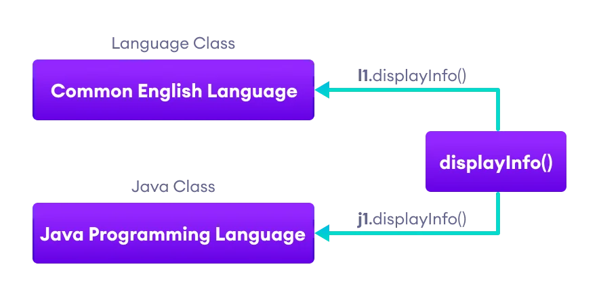
Polymorphism using method overriding example-2
center h:450px

Slide 57
Java Method Overloading
In a Java class, we can create methods with the same name if they differ in parameters. For example
Java linenums="1" void func() { ... } void func(int a) { ... } float func(double a) { ... } float func(int a, float b) { ... }
This is known as method overloading in Java. Here, the same method will perform different operations based on the parameter.

Slide 58
Polymorphism using method overloading example-3
``` Java linenums=“1” class Pattern {
// method without parameter public void display() { for (int i = 0; i < 10; i++) { System.out.print(“*“); } }
// method with single parameter public void display(char symbol) { for (int i = 0; i < 10; i++) { System.out.print(symbol); } } }
--- ## Polymorphism using method overloading example-3 ``` Java linenums="1" class Main { public static void main(String[] args) { Pattern d1 = new Pattern(); // call method without any argument d1.display(); System.out.println("\n"); // call method with a single argument d1.display('#'); } }

Slide 59
Polymorphic Variables
A variable is called polymorphic if it refers to different values under different conditions.
Object variables (instance variables) represent the behavior of polymorphic variables in Java.
It is because object variables of a class can refer to objects of its class as well as objects of its subclasses.

Slide 60
Polymorphic Variables Example-1
Java linenums="1" class ProgrammingLanguage { public void display() { System.out.println("I am Programming Language."); } }

Slide 61
Polymorphic Variables Example-1
Java linenums="1" class Java extends ProgrammingLanguage { @Override public void display() { System.out.println("I am Object-Oriented Programming Language."); } }

Slide 62
Polymorphic Variables Example-1
``` Java linenums=“1” class Main { public static void main(String[] args) {
// declare an object variable ProgrammingLanguage pl; // create object of ProgrammingLanguage pl = new ProgrammingLanguage(); pl.display(); // create object of Java class pl = new Java(); pl.display();
} }
--- ## **Java Encapsulation** --- ## Java Encapsulation - It prevents outer classes from accessing and changing fields and methods of a class. This also helps to achieve data hiding --- ## Java Encapsulation Example ``` Java linenums="1" class Area { // fields to calculate area int length; int breadth; // constructor to initialize values Area(int length, int breadth) { this.length = length; this.breadth = breadth; } // method to calculate area public void getArea() { int area = length * breadth; System.out.println("Area: " + area); } }

Slide 63
Java Encapsulation Example
``` Java linenums=“1” class Main { public static void main(String[] args) {
// create object of Area // pass value of length and breadth Area rectangle = new Area(5, 6); rectangle.getArea();
} }
--- ## Why Encapsulation? - In Java, encapsulation helps us to keep - related - fields and - methods together, - which makes our code cleaner and easy to read. --- ## Why Encapsulation? - It helps to control the values of our data fields ``` Java linenums="1" class Person { private int age; public void setAge(int age) { if (age >= 0) { this.age = age; } } }

Slide 64
Why Encapsulation?
The getter and setter methods provide
read-only or
write-only
access to our class fields
Java linenums="1" getName() // provides read-only access setName() // provides write-only access —

Slide 65
Why Encapsulation?
It helps to decouple components of a system.
For example,
we can encapsulate code into multiple bundles.
These decoupled components (bundle)
can be developed,
tested, and
debugged independently and concurrently.
And, any changes in a particular component
do not have any effect on other components.

Slide 66
Why Encapsulation?
We can also achieve data hiding using encapsulation.
In the next example,
if we change the length and breadth variable into private,
then the access to these fields is restricted.
And, they are kept hidden from outer classes.
This is called data hiding.

Slide 67
Why Encapsulation?
``` Java linenums=“1” class Area {
// fields to calculate area int length; int breadth;
// constructor to initialize values Area(int length, int breadth) { this.length = length; this.breadth = breadth; }
// method to calculate area public void getArea() { int area = length * breadth; System.out.println(“Area:” + area); } }
--- ## Why Encapsulation? ``` Java linenums="1" class Main { public static void main(String[] args) { // create object of Area // pass value of length and breadth Area rectangle = new Area(5, 6); rectangle.getArea(); } }

Slide 68
Data Hiding
Data hiding is a way of restricting the access of our data members by hiding the implementation details.
Encapsulation also provides a way for data hiding.
We can use access modifiers to achieve data hiding

Slide 69
Data hiding using the private specifier example
Making age private allowed us to restrict unauthorized access from outside the class. This is data hiding.

Slide 70
Data hiding using the private specifier example
``` Java linenums=“1” class Person {
// private field private int age;
// getter method public int getAge() { return age; }
// setter method public void setAge(int age) { this.age = age; } }
--- ## Data hiding using the private specifier example ``` Java linenums="1" class Main { public static void main(String[] args) { // create an object of Person Person p1 = new Person(); // change age using setter p1.setAge(24); // access age using getter System.out.println("My age is " + p1.getAge()); } }

Slide 71
Java Method Overriding

Slide 72
Java Method Overriding
The method overriding is the process of re-defining a method in a child class that is already defined in the parent class.
When both parent and child classes have the same method, then that method is said to be the overriding method.
The method overriding enables the child class to change the implementation of the method which aquired from parent class according to its requirement.

Slide 73
Java Method Overriding
The method overriding is also known as - dynamic method dispatch or - run time polymorphism or - pure polymorphism.

Slide 74
Java Method Overriding Example
``` Java linenums=“1” class ParentClass{
int num = 10; void showData() { System.out.println("Inside ParentClass showData() method"); System.out.println("num = " + num); }
}
--- ## Java Method Overriding Example ``` Java linenums="1" class ChildClass extends ParentClass{ void showData() { System.out.println("Inside ChildClass showData() method"); System.out.println("num = " + num); } }

Slide 75
Java Method Overriding Example
``` Java linenums=“1” public class PurePolymorphism {
public static void main(String[] args) { ParentClass obj = new ParentClass(); obj.showData(); obj = new ChildClass(); obj.showData(); }
}
--- ## Rules for method overriding While overriding a method, we must follow the below list of rules. - Static methods can not be overridden. - Final methods can not be overridden. - Private methods can not be overridden. - Constructor can not be overridden. - An abstract method must be overridden. - Use super keyword to invoke overridden method from child class. --- ## Rules for method overriding - The return type of the overriding method must be same as the parent has it. - The access specifier of the overriding method can be changed, but the visibility must increase but not decrease. For example, a protected method in the parent class can be made public, but not private, in the child class. --- ## Rules for method overriding - If the overridden method does not throw an exception in the parent class, then the child class overriding method can only throw the unchecked exception, throwing a checked exception is not allowed. - If the parent class overridden method does throw an exception, then the child class overriding method can only throw the same, or subclass exception, or it may not throw any exception. --- ## Method Overriding Example ``` Java linenums="1" class Animal { public void displayInfo() { System.out.println("I am an animal."); } } class Dog extends Animal { @Override public void displayInfo() { System.out.println("I am a dog."); } } class Main { public static void main(String[] args) { Dog d1 = new Dog(); d1.displayInfo(); } }

Slide 76
Method Overriding Example
annotations are the metadata that we used to provide information to the compiler
It is not mandatory to use @Override. However, when we use this, the method should follow all the rules of overriding. Otherwise, the compiler will generate an error.

Slide 77
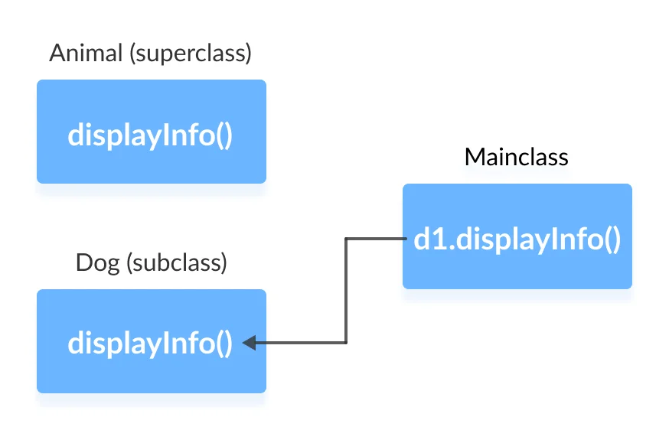
Method Overriding Example
center h:450px

Slide 78
super Keyword in Java Overriding
Can we access the method of the superclass after overriding?
The answer is Yes. To access the method of the superclass from the subclass, we use the super keyword

Slide 79
Use of super Keyword Example
``` Java linenums=“1” class Animal { public void displayInfo() { System.out.println(“I am an animal.”); } }
class Dog extends Animal { public void displayInfo() { super.displayInfo(); System.out.println(“I am a dog.”); } }
class Main { public static void main(String[] args) { Dog d1 = new Dog(); d1.displayInfo(); } }
--- ## Use of super Keyword Example - In the above example, the subclass Dog overrides the method displayInfo() of the superclass Animal. - When we call the method displayInfo() using the d1 object of the Dog subclass, the method inside the Dog subclass is called; the method inside the superclass is not called - Inside displayInfo() of the Dog subclass, we have used super.displayInfo() to call displayInfo() of the superclass. --- ## Use of super Keyword Example - note that constructors in Java are not inherited. Hence, there is no such thing as constructor overriding in Java. - However, we can call the constructor of the superclass from its subclasses. For that, we use super() --- ## Access Specifiers in Method Overriding - The same method declared in the superclass and its subclasses can have different access specifiers. However, there is a restriction. - We can only use those access specifiers in subclasses that provide larger access than the access specifier of the superclass. For example, - Suppose, a method myClass() in the superclass is declared protected. Then, the same method myClass() in the subclass can be either public or protected, but not private. --- ## Access Specifier in Overriding Example ``` Java linenums="1" class Animal { protected void displayInfo() { System.out.println("I am an animal."); } } class Dog extends Animal { public void displayInfo() { System.out.println("I am a dog."); } } class Main { public static void main(String[] args) { Dog d1 = new Dog(); d1.displayInfo(); } }

Slide 80
Access Specifier in Overriding Example
In the above example, the subclass Dog overrides the method displayInfo() of the superclass Animal.
Whenever we call displayInfo() using the d1 (object of the subclass), the method inside the subclass is called.
Notice that, the displayInfo() is declared protected in the Animal superclass. The same method has the public access specifier in the Dog subclass.
This is possible because the public provides larger access than the protected.

Slide 81
Overriding Abstract Methods
In Java, abstract classes are created to be the superclass of other classes.
And, if a class contains an abstract method,
it is mandatory to override it.

Slide 82
References
BtechSmartClass-super Keyword
Programiz-super Keyword
BtechSmartClass-Java final Keyword
Programiz-final Keyword
BtechSmartClass-java Polymorphism
Programiz-Polymorphism
Programiz-Encapsulation
BtechSmartClass-Java Method Overriding

Slide 83
References
Programiz-Method Overriding
Programiz-Nested Inner Class
Programiz-Static Class
Programiz-Anonymous Class
Programiz-enums
Programiz-enum constructor
Programiz-enum string
BtechSmartClass-Java Abstract Class
Programiz-Abstract Classes Methods

Slide 84
References
BtechSmartClass-Java Object class
BtechSmartClass-Java Forms of Inheritance
Programiz-Interfaces
BtechSmartClass-Java Benefits and Costs of Inheritance
BtechSmartClass-Java Defining Packages
BtechSmartClass-Java Access Protection in Packages
BtechSmartClass-Java Importing Packages

Slide 85
$End−Of−Week−2−Module$

