Slide 1
CE204 Object-Oriented Programming
UMPLE - Part 1 Author: Asst. Prof. Dr. Uğur CORUH

Slide 2
CE204 Object-Oriented Programming

Slide 3
Week-6 (UMPLE - Part 1)
Spring Semester, 2021-2022
Download DOC-PDF, DOC-DOCX, SLIDE, PPTX,

Slide 4
UMPLE
Common Scope
What is UMPLE?
What is its purpose?
How to create a UML model with UMPLE?
What is philosophy of UMPLE?

Slide 5
Common Scope
How to use UMPLE?
UMPLE Online
Command-Line
Eclipse Plugin
Visual Studio Code Plugin

Slide 6
Common Scope
How to learn UMPLE?
Online Documentations
Video Tutorials
UMPLE Community

Slide 7
Common Scope
Overview of the basics of UMPLE
Associations in UMPLE
State machines in UMPLE
Product lines in UMPLE: Mixins and Mixsets
Other separation of concerns mechanisms: (Aspects and traits) and their code generation
Other advanced features of UMPLE
Hands-on exercise developing versions of a concurrent system using state machines and product lines.
UMPLE as written in itself: A case study.

Slide 8
Common Scope
Introduction:
Overview of Model-Driven Development
Languages / Tools / Motivation for UMPLE
Class Modeling
Tools / Attributes / Methods / Associations / Exercises / Patterns
Modeling with State Machines
Basics / Concurrency / Case study and exercises
Separation of Concerns in Models
Mixins / Aspects / Traits
More Case Studies and Hands-on Exercises
UMPLE in itself / Real-Time / Data Oriented
Conclusion

Slide 9
Outline - UMPLE Part 1
Introduction to UMPLE
Motivation for developing UMPLE
Some key UMPLE innovations
Using UMPLE
UMPLE Philosophy
UMPLE Class Modeling

Slide 10
Outline - UMPLE Part 1
UMPLE Online Usage
UMPLE Attributes
UMPLE Generalization and interfaces
UMPLE Methods
UMPLE Associations

Slide 11
Introduction to UMPLE

Slide 12
UMPLE: Simple, Ample, UML Programming Language
Open source textual modelling tool set for 3 platforms
Command line compiler
Web-based tool (UMPLEOnline) for demos and education
Eclipse plugin
Code generator for UML ++
Infinitely nested state machines, with concurrency
Proper referential integrity and multiplicity constraints on associations
Traits, mixins, aspects for modularity
Text generation templates, patterns, traits
Pre-processor to add UML, patterns and other features on top of Java, PhP, C++ and other languages

Slide 13
UMPLE: Simple, Ample, UML Programming Language
Open source textual modeling tool and code generator
Adds modeling to Java,. C++, PHP
A sample of features
Referential integrity on associations
Code generation for patterns
Blending of conventional code with models
Infinitely nested state machines, with concurrency
Separation of concerns for models: mixins, traits, mixsets, aspects
Tools
Command line compiler
Web-based tool (UMPLEOnline) for demos and education
Plugins for Eclipse and other tools

Slide 14
What Are we Going to Learn About in This Tutorial? What Will You Be Able To Do?
Modeling using class diagrams
Attributes, Associations, Methods, Patterns, Constraints
Modeling using state diagrams
States, Events, Transitions, Guards, Nesting, Actions, Activities
Concurrency
Separation of Concerns in Models
Mixins, Traits, Aspects, Mixsets
Practice with a examples focusing on state machines and product lines
Building a complete system in UMPLE

Slide 15
What Technology Will You Need?
As a minimum: Any web browser.
For a richer command-line experience
A computer (laptop) with Java 8-14 JDK
Mac and Linux are the easiest platforms, but Windows also will work
Download UMPLE Jar at http://dl.UMPLE.org
You can also run UMPLE in Docker: http://docker.UMPLE.org

Slide 16
Key Websites
Entry-point: https://www.UMPLE.org
Everything you need to get started with UMPLE
Github: https://github.com/UMPLE/UMPLE
Source code and examples for UMPLE
UMPLE Online: https://try.UMPLE.org
Online application for UMPLE

Slide 17
Key Websites (Another way)
The UMPLEOnline web interface is at try.UMPLE.org
The user manual is at manual.UMPLE.org
The UMPLE home page is at www.UMPLE.org
UMPLE download page: dl.UMPLE.org

Slide 18
Motivation for developing UMPLE

Slide 19
Motivation for developing UMPLE (1)
Designers want the best combination of features:
Textual editing and blending with other languages
Ability to use in an agile process
Write tests, continuous integration, versioning
Combine the best of agility and modeling
Excellent code generation
A complete generation of real systems (including itself)
Multi-platform (command line, Eclipse, VsCode, Web)
Practical and easy to use for developers
Including great documentation
Open source

Slide 20
Motivation for developing UMPLE (2)
Many existing tools:
Lacked in usability
Awkward to edit diagrams
Many steps to do a task
Lengthy learning process
Lack in ongoing support
Could be enhanced by us perhaps, but we would be tied to key decisions (e.g. Eclipse-only)

Slide 21
Some key UMPLE innovations

Slide 22
Some key UMPLE innovations
Model is code
Traditional code is embedded in model
No need to edit generated code
No round-trip engineering

Slide 23
Using UMPLE

Slide 24
Using UMPLE
We will mostly be using
UMPLEonline
In a web browser: http://try.UMPLE.org
Or in Docker: http://docker.UMPLE.org
UMPLE on the command line: http://dl.UMPLE.org
Needs Java 8 JDK on the command line:
http://bit.ly/1lO1FSV
Java 9 works well too

Slide 25
Docker Container Experimental
mkdir ~/src && cd ~/src && git clone git@github.com:UMPLE/UMPLE.git
docker run -i -t -v `pwd`:/src UMPLE/UMPLE:0.4.0 bash

Slide 26
Using UMPLE
Optional:
UMPLE in Eclipse
https://github.com/UMPLE/UMPLE/wiki/InstallEclipsePlugin
cmake and gcc for compiling C++ code

Slide 27
UMPLE Philosophy

Slide 28
UMPLE Philosophy 1-4
P1. Modeling is programming and vice versa
P2. An UMPLE programmer should never need to edit generated code to accomplish any task.
P3. The UMPLE compiler can accept and generate code that uses nothing but UML abstractions.
The above is the inverse of the following
P4. A program without UMPLE features can be compiled by an UMPLE compiler.
e.g. input Java results in the same as output

Slide 29
UMPLE Philosophy 5-8
P5. A programmer can incrementally add UMPLE features to an existing program
Umplification
P6. UMPLE extends the base language in a minimally invasive and safe way.
P7. UMPLE features can be created and viewed diagrammatically or textually
P8. UMPLE goes beyond UML

Slide 30
UMPLE Class Modeling

Slide 31
UMPLE Class Models - Quick Overview
Key elements:
Classes
Attributes
Associations
Generalizations
Methods
We will look at all these using examples via UMPLE ONLINE
UMPLE code/models are stored in files with suffix .ump

Slide 32
Exercise: Compiling and changing a model
Look at the example at the bottom of
http://helloworld.UMPLE.org (also on next slide)
Observe: attribute, association, class hierarchy, mixin
Click on Load the above code into UMPLEOnline
Observe and modify the diagram
Add an attribute
Make a multiplicity error, then undo
Generate code and take a look
Download, compile and run if you want

Slide 33
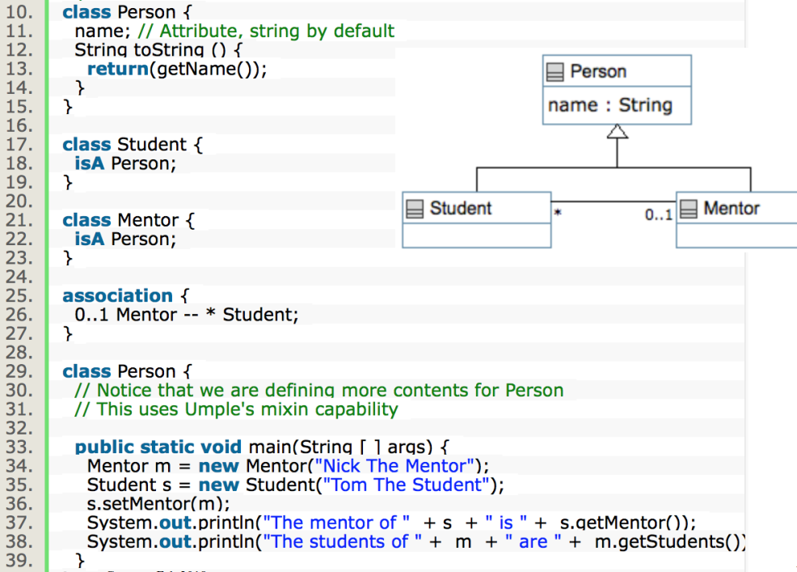
Hello World Example 2 in the User Manual
center h:550

Slide 34
Key tools:
UMPLE Online
Command-Line
User Manual

Slide 35
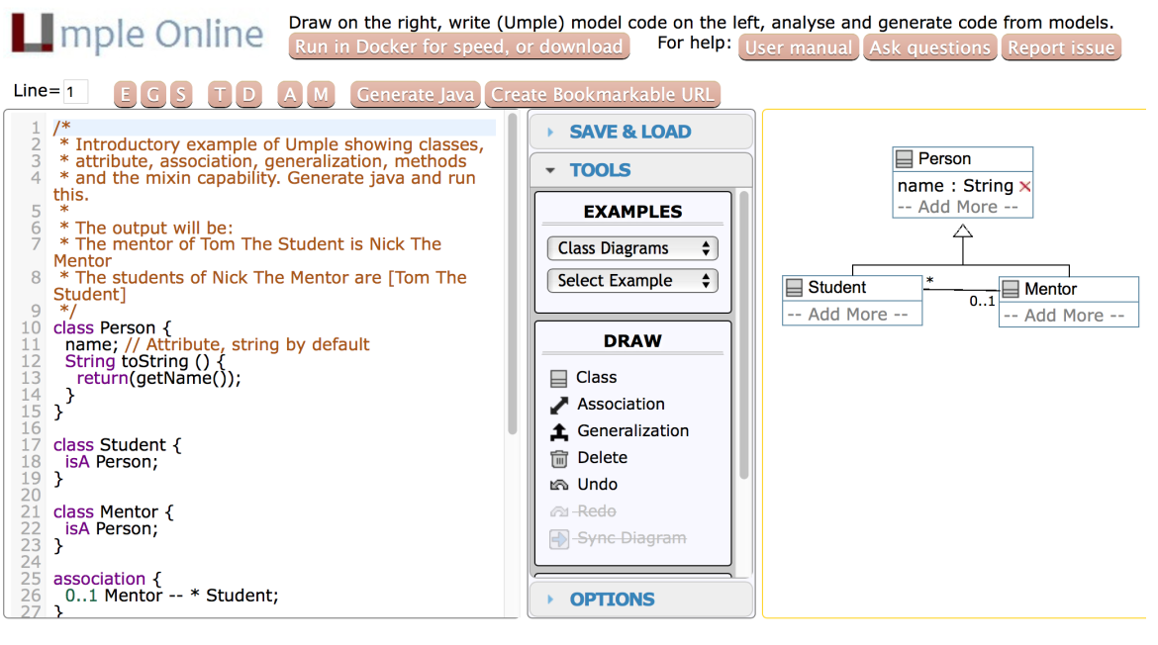
Hello World example 2 in UMPLEOnline
center h:500

Slide 36
Exploration of UMPLEOnline
Explore class diagram examples
Options
T or Control-t (hide and show text)
D or Control-d (hide and show diagram)
A, M to hide and show attributes, methods
Default diagram types
G/Control-g (Graphviz), S/Control-s (State Diagram)
E/Control-e (Editable class diagram)
Generate code and look at the results
In UMPLE you never should modify generated code
It is designed to be readable for educational purposes

Slide 37
Use of the UMPLEOnline Docker image
UMPLE’s server can handle 80,000 transactions per hour
Code generations, edits
But needs a good Internet connection (sometimes hundreds of students have assignments due)
To maximize speed of UMPLEOnline run it in your local machine:
Follow the instructions at http://docker.UMPLE.org

Slide 38
Demo of compiling on the command line
To compile on the command line you will need Java 8
Download UMPLE from http://dl.UMPLE.org
Basic compilation
java -jar UMPLE.jar model.ump
Help for features and commands
java -jar UMPLE.jar --help
To generate and compile the java to a final system
java –jar UMPLE.jar model.ump -c -

Slide 39
Quick walkthrough of the user manual
http://manual.UMPLE.org
Note in particular
Key sections:
attributes,
associations,
state machines
Grammar
Generated API
Errors and warnings
Editing pages in github

Slide 40
UMPLE Attributes
More than just variables
http://attributes.UMPLE.org

Slide 41
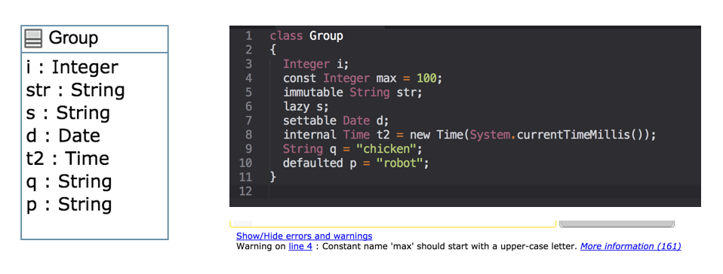
Attributes
center h:400

Slide 42
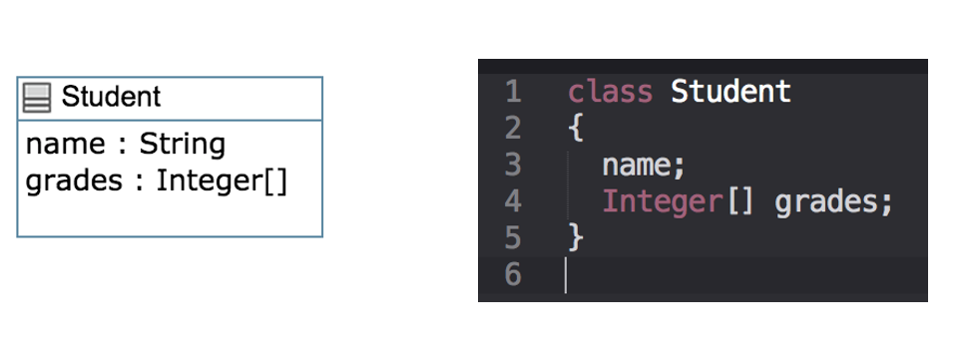
Attributes Exercise #1
center h:400

Slide 43
Attributes
“Instance variables”
Part of the state of an object
Simple data that will always be present in each instance
Specified like a Java or C++ field or member variable
But, intended to be more abstract!
Example, with an initial value
a = "init value";

Slide 44
Attributes
As in UML, more abstract than instance variables
Always private by default
Should only be accessed get, set methods
Can be stereotyped (upcoming slides) to affect code generation
Can have aspects applied (discussed later)
Can be constrained (discussed later)

Slide 45
Code generation from attributes
Default code generation
Generates a getName() and setName() method for name
public
Creates an arguments in the class constructor by default
An attribute is private to the class by default
Should only be accessed get, set methods

Slide 46
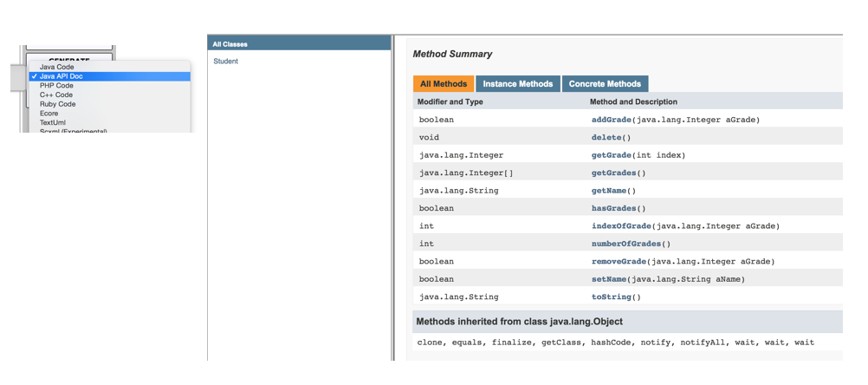
Code Generation (JavaDocs)
center h:500

Slide 47
Code Generation Patterns
Attributes
Set/Get (UB = 1)
Add/Remove/NumberOf/IndexOf/Get (UB > 1)
Lazy immutability
Default values
Constants
Before / After cod
UB = upper bound

Slide 48
Code Generation Patterns
Associations
Set/Get (UB = 1)
Add/Remove/NumberOf/IndexOf/Get (UB > 1)
Referential Integrity
Multiplicity Constraints
42 different cases
UB = upper bound

Slide 49
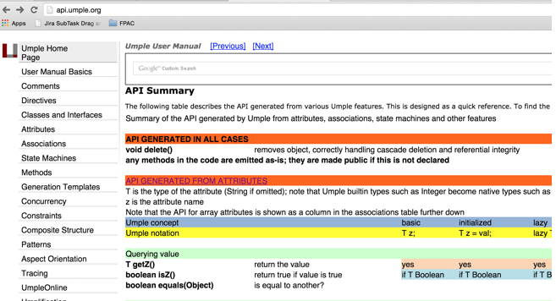
Code Generation (Semantics)
http://api.UMPLE.org/
center h:500

Slide 50
UMPLE builtin datatypes
String // (default if none specified) Integer Float Double Boolean Time Date
The above will generate appropriate code in Java, C++ etc.
e.g. Integer becomes int
Other (native) types can be used but without guaranteed correctness

Slide 51
Attribute stereotypes (1)
Code generation can be controlled through stereotypes:
lazy - don’t add a constructor argument
lazy b; // sets it to null, 0, “” depending on type
Defaulted – can be reset
defaulted s = "def"; // resettable to the default

Slide 52
Attribute stereotypes (2)
autounique – provide a unique value to each instance
autounique x; // sets attribute to 1, 2, 3 …
internal – don’t generate any methods
internal i; // doesn’t generate any get/set either

Slide 53
Immutability
Useful for objects where you want to guarantee no possible change once created
e.g. a geometric point
Generate a constructor argument and get method but no set method
immutable String str;
No constructor argument, but allows setting just once.
lazy immutable z;

Slide 54
Lets explore attributes by example
Go to
http://attributes.UMPLE.org

Slide 55
Derived attributes
These generate a get method that is calculated.
class Point { // Cartesian coordinates Float x; Float y; // Polar coordinates Float rho = {Math.sqrt(Math.pow(getX(), 2) + Math.pow(getY(), 2))} Float theta = {Math.toDegrees(Math.atan2(getY(),getX()))} }

Slide 56
Multi-valued attributes
Limit their use. Associations are generally better.
class Office { Integer number; Phone[] installedTelephones; } class Phone { String digits; String callerID; }

Slide 57
Keys
Enable UMPLE to generate an equals() and a hashcode() method
class Student { Integer id; name; key { id } }
The user manual has a sports team example showing keys on associations too
Note how this feature is not inherited from UML

Slide 58
UMPLE Generalization and interfaces

Slide 59
Generalization in UMPLE
UMPLE uses the isA keyword to indicate generalization
Used to indicate superclass, used trait, implemented interface
class Shape { colour; } class Rectangle { isA Shape; }

Slide 60
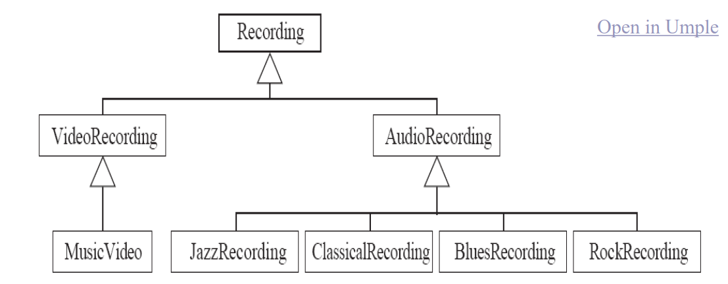
Avoiding unnecessary generalizations
Open in UMPLE
Inappropriate hierarchy of Classes
What should the model be?
center h:300

Slide 61
Interfaces
Declare signatures of a group of methods that must be implemented by various classes
Also declared using the keyword isA
Essentially the same concept as in Java
Let’s explore examples in the user manual …

Slide 62
UMPLE Methods

Slide 63
User-written Methods in UMPLE
Methods can be added to any UMPLE code.
UMPLE parses the signature only; the rest is passed to the generated code.
You can specify different bodies in different languages
We will look at examples in the user manual …

Slide 64
UMPLE Associations
http://associations.UMPLE.org
Notice the inline and independent state machines

Slide 65
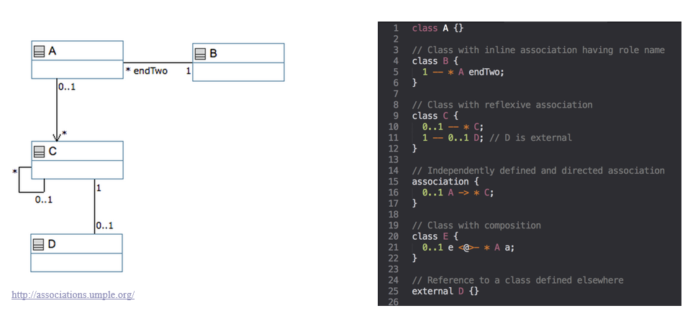
Associations
center h:500

Slide 66
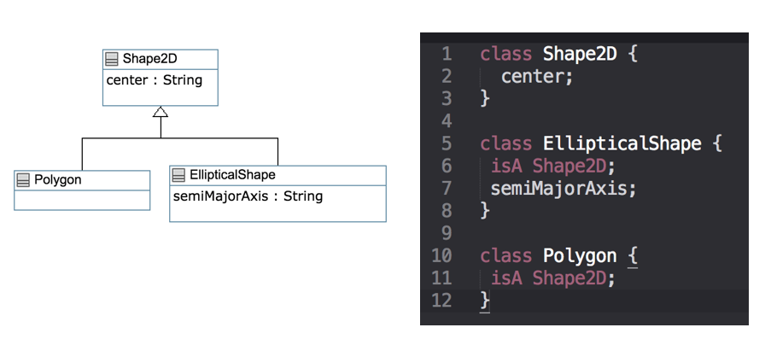
Associations Exercise #1
center h:500

Slide 67
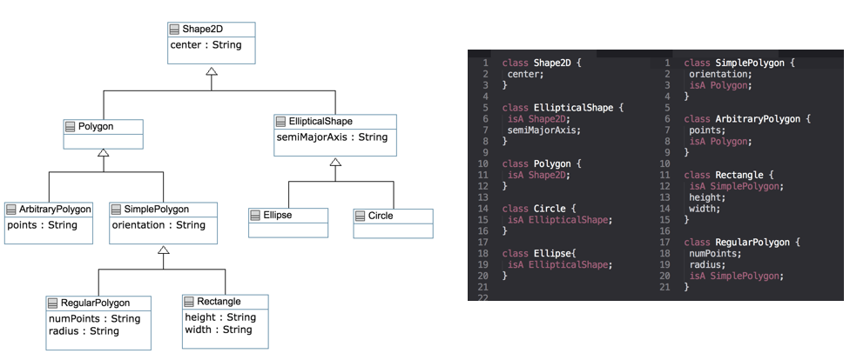
Associations Exercise #2
center h:500

Slide 68
Associations
Describe how instances of classes are linked at runtime
Bidirectional -- or
Unidirectional ->
Multiplicity:
Bounds on the number of linked instances
* Or 0..* $→$ 0 or more
1..* $→$ 1 or more
1 $→$ Exactly 1
2 $→$ Exactly 2
1..3 $→$ Between 1 and 3
0..2 $→$ Up to 2

Slide 69
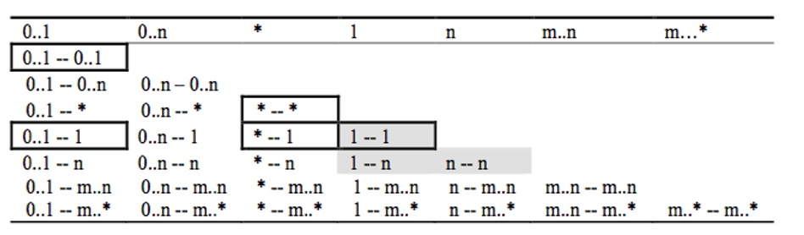
Association Relationships
center h:400

Slide 70
Association Relationships
Directional Associations
* -> 0..1, * -> 1, * -> *, * -> m..n, * - >n, *->m..* and*->0..n.
Symmetric Reflexive
0..1, 0..n, *, 1, n, m..n,m..*

Slide 71
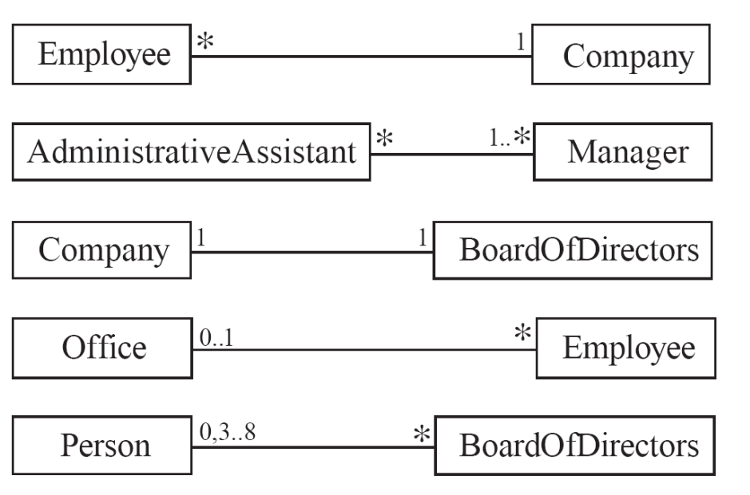
Basic UML associations
center h:500

Slide 72
Many-to-one associations (1)
class Employee { id; firstName; lastName; } class Company { name; 1 -- * Employee; }

Slide 73
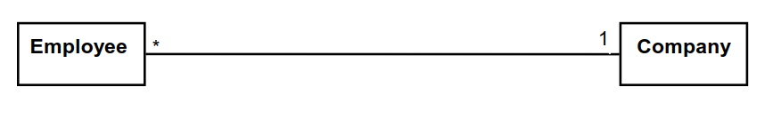
Many-to-one associations (2)
A company has many employees,
An employee can only work for one company.
This company will not store data about the moonlighting activities of employees!
A company can have zero employees
E.g. a ‘shell’ company
It is not possible to be an employee unless you work for a company
Let’s draw and write this in UMPLEOnline:
center h:150

Slide 74
Role names (optional, in most cases)
Allow you to better label either end of an association
class Person{ id; firstName; lastName; } class Company { name; 1 employer -- * Person employee; }

Slide 75
Referential Integrity
When an instance on one side of the association changes
The linked instances on the other side know …
And vice-versa
This is standard in UMPLE associations, which are bidirectional

Slide 76
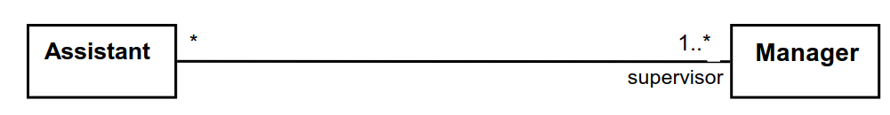
Many-to-Many Associations
An assistant can work for many managers
A manager can have many assistants
Assistants can work in pools working for several managers
Managers can have a group of assistants
Some managers might have zero assistants.
Is it possible for an assistant to have, perhaps temporarily, zero managers?
Open in UMPLE
center h:150

Slide 77
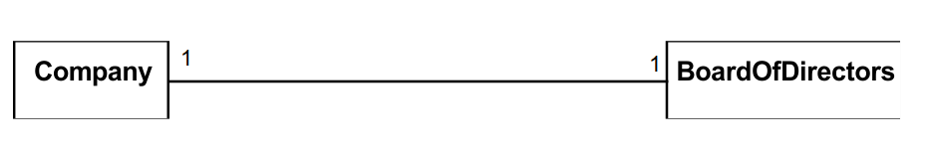
One-to-One Associations (Use cautiously)
For each company, there is exactly one board of directors
A board is the board of only one company
A company must always have a board
A board must always be of some company
Open in UMPLE
center h:150

Slide 78
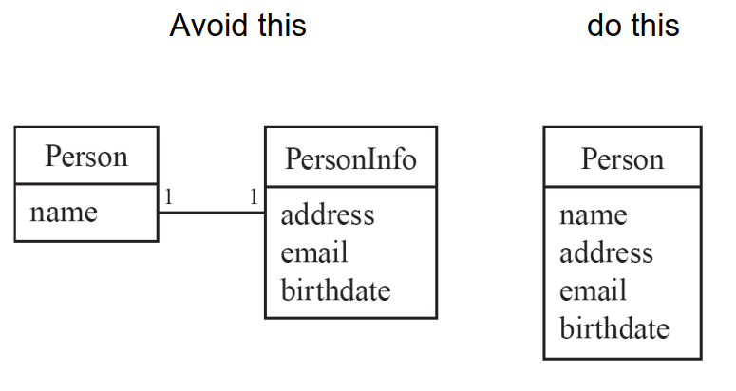
Typical erroneous use of one-to-one
center h:500

Slide 79
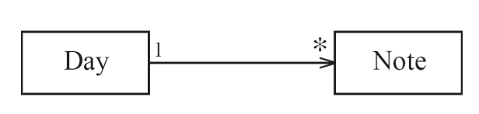
Unidirectional Associations
Associations are by default bi-directional
It is possible to limit the direction of an association by adding an arrow at one end
In the following unidirectional association
A Day knows about its notes, but a Note does not know which Day is belongs to
Note remains ‘uncoupled’ and can be used in other contexts
class Day { * -> 1 Note; } class Note {}
Open in UMPLE
center h:150

Slide 80
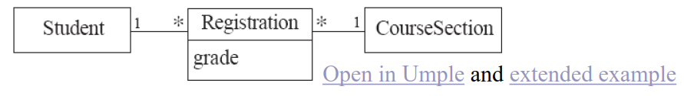
Association Classes
Sometimes, an attribute that concerns two associated classes cannot be placed in either of the classes
Open in UMPLE
and Extended Example
center h:100

Slide 81
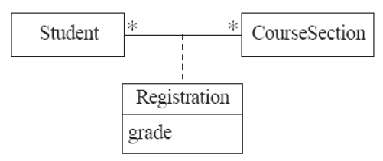
The following are nearly equivalent
The only difference:
in the association class there can be only a single registration of a given Student in a CourseSection
center h:200

Slide 82
Association classes (cont.)
UMPLE code
class Student {} class CourseSection {} associationClass Registration { * Student; * CourseSection; }
Open in UMPLEOnline, and then generate code

Slide 83
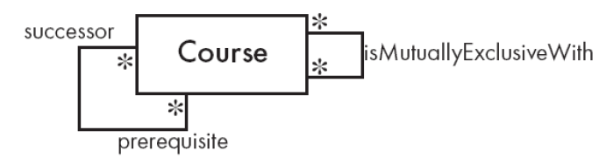
Reflexive Associations
An association that connects a class to itself
center

Slide 84
Open in UMPLE
class Course { * self isMutuallyExclusiveWith; // Symmetric } association { * Course successor -- * Course prerequisite; }

Slide 85
Inline vs. Standalone associations
The following are equivalent to allow flexibility:
class X {} class Y { 1 -- * X; }
class X {} class Y {} association { 1 Y -- * X; }

Slide 86
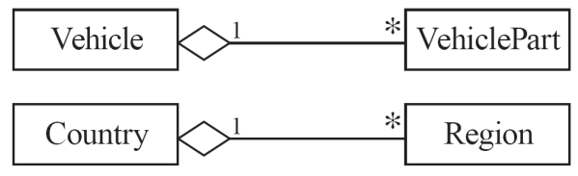
Aggregation
Aggregations are ordinary associations that represent part-whole relationships.
The ‘whole’ side is often called the assembly or the aggregate
This is a shorthand for association named isPartOf
UMPLE has no special syntax currently
center

Slide 87
class Vehicle { 1 whole -- * VehiclePart part; } class VehiclePart{ }

Slide 88
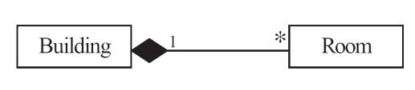
Composition
A composition is a strong kind of aggregation
If the aggregate is destroyed, then the parts are destroyed as well

Slide 89
class Building { 1 <@>- * Room; } class Room{ }

Slide 90
Sorted Associations
Order objects in the association according to a specific key
class Academy { 1 -- * Student registrants sorted {id}; } class Student { Integer id; name; }
We will look at a more complete example in the User Manual

Slide 91
A final word on associations
More help and examples are in the user manual online at
http://associations.UMPLE.org

Slide 92
References
UMPLE Tutorials
UMPLE Github
UMPLE Online
UMPLE Documentation
UMPLE CSI5112– February 2018
UMPLE Tutorial: Models 2020 Web
UMPLE Tutorial: Models 2020 Pdf

Slide 93
References
Getting Started in UMPLE
Experiential Learning for Software Engineering Using Agile Modeling in UMPLE (Youtube)
Experiential Learning for Software Engineering Using Agile Modeling in UMPLE (Slide)
Tomassetti Code Generation

Slide 94
$End−Of−Week−6$

