Slide 1
CE204 Object-Oriented Programming
UMPLE - Part 2 Author: Asst. Prof. Dr. Uğur CORUH

Slide 2
CE204 Object-Oriented Programming

Slide 3
Week-7 (UMPLE - Part 2)
Spring Semester, 2021-2022
Download DOC-PDF, DOC-DOCX, SLIDE, PPTX,

Slide 4
UMPLE
Common Scope
What is UMPLE?
What is its purpose?
How to create a UML model with UMPLE?
What is philosophy of UMPLE?

Slide 5
Common Scope
How to use UMPLE?
UMPLE Online
Command-Line
Eclipse Plugin
Visual Studio Code Plugin

Slide 6
Common Scope
How to learn UMPLE?
Online Documentations
Video Tutorials
UMPLE Community

Slide 7
Common Scope
Overview of the basics of Umple
Associations in Umple
State machines in Umple
Product lines in Umple: Mixins and Mixsets
Other separation of concerns mechanisms: (Aspects and traits) and their code generation
Other advanced features of Umple
Hands-on exercise developing versions of a concurrent system using state machines and product lines.
Umple as written in itself: A case study.

Slide 8
Common Scope
Introduction:
Overview of Model-Driven Development
Languages / Tools / Motivation for Umple
Class Modeling
Tools / Attributes / Methods / Associations / Exercises / Patterns
Modeling with State Machines
Basics / Concurrency / Case study and exercises
Separation of Concerns in Models
Mixins / Aspects / Traits
More Case Studies and Hands-on Exercises
Umple in itself / Real-Time / Data Oriented
Conclusion

Slide 9
Outline - Part 2
Modeling exercises
Simple patterns (if time)
Basic state machines
Analysing models
Concurrency
State machine case study
Mixins
Aspect orientation

Slide 10
Outline - Part 2
Traits
Mixins and Traits together
Mixsets
Case Studies
Unit Testing with UMPLE
UMPLE issues list
UMPLE’s Architecture
Umplification
Conclusion

Slide 11
Modeling exercises

Slide 12
Modeling Exercise
Build a class diagram for the following description.
If you think there are key requirements missing, then add them.
A football (soccer) team has players. Each player plays a position. The team plays some games against other teams during each season. The system needs to record who scored goals, and the score of each game.

Slide 13
Simple patterns (if time)

Slide 14
Singleton pattern
Standard pattern to enable only a single instance of a class to be created.
private constructor
getInstance() method
Declaring in Umple
class University { singleton; name; }

Slide 15
Delegation pattern
A class calls a method in its “neighbour”
class RegularFlight { flightNumber; } Class SpecificFlight { * -- 1 RegularFlight; flightNumber = {getRegularFlight().getFullNumber()} }
Full details of this example in the user manual

Slide 16
Basic constraints
Shown in square brackets
Code is added to the constructor and the set method
class X { Integer i; [! (i == 10)] }
We will see constraints later in state machines

Slide 17
Basic state machines
http://statemachines.umple.org

Slide 18
Basics of state machines
At any given point in time, the system is in one state.
It will remain in this state until an event occurs that causes it to change state.
A state is represented by a rounded rectangle containing the name of the state.
Special states:
A black circle represents the start state
A circle with a ring around it represents an end state

Slide 19
Garage door state machine
class GarageDoor{ status { Open { buttonOrObstacle -> Closing; } Closing { buttonOrObstacle -> Opening; reachBottom -> Closed; } Closed { buttonOrObstacle -> Opening; } Opening { buttonOrObstacle -> HalfOpen; reachTop -> Open; } HalfOpen { buttonOrObstacle -> Opening; } } }

Slide 20
Events
An occurrence that may trigger a change of state
Modeled in Umple as generated methods that can be called
Several states may be able to respond to the same event

Slide 21
Transitions
A change of state in response to an event.
It is considered to occur instantaneously.
The label on each transition is the event that causes the change of state.

Slide 22
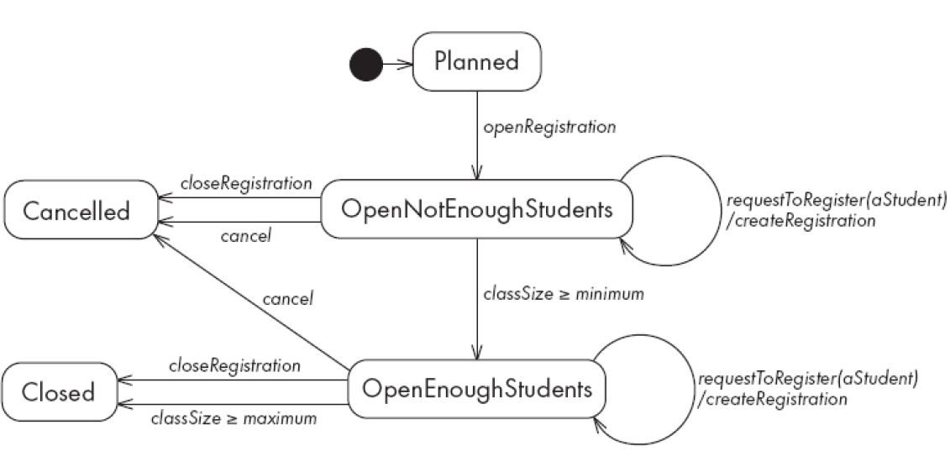
State diagrams – an example with conditional transitions
center h:500

Slide 23
Actions in state diagrams
An action is a block of code that must be executed effectively instantaneously
When a particular transition is taken,
Upon entry into a particular state, or
Upon exit from a particular state
An action should consume no noticeable amount of time

Slide 24
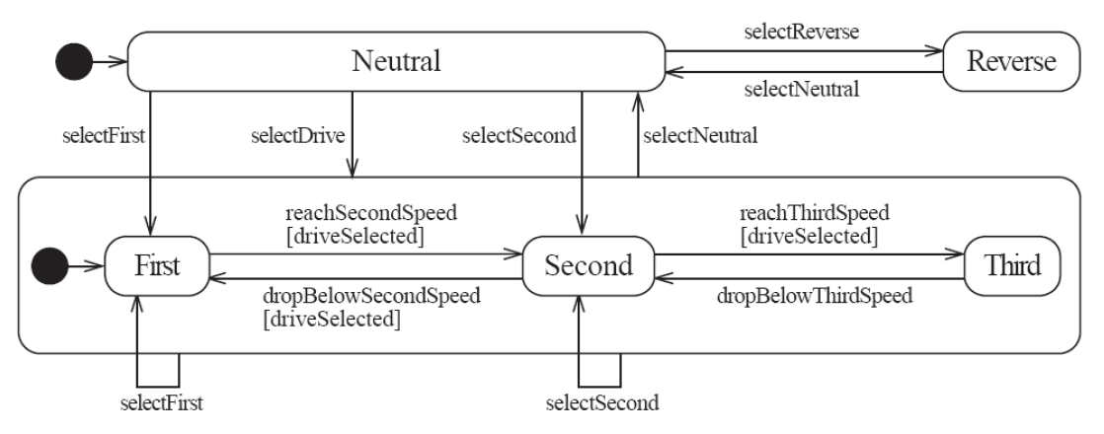
Nested substates and guard conditions
A state diagram can be nested inside a state.
The states of the inner diagram are called substates.
center

Slide 25
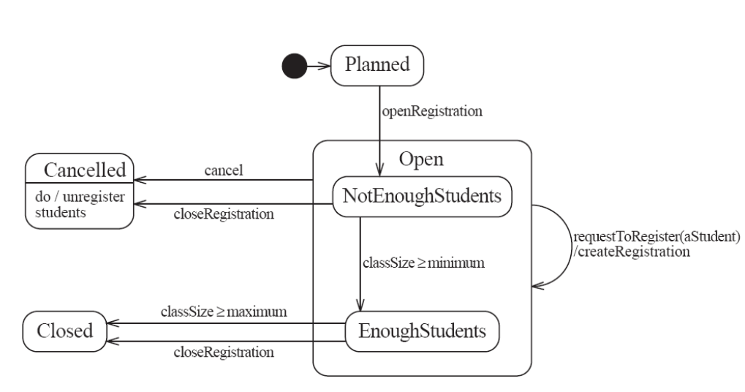
Nested state diagram – Another example
center

Slide 26
Auto-transitions
A transition taken immediately upon entry into a state
Unless guarded
We will look at an example in the user manual

Slide 27
Events with parameters
Parameters can be referenced in guards and actions.
We will look at an example in the user manual.

Slide 28
Analysing models

Slide 29
Models can be analysed in several ways
Visually
Automatically generated errors and warnings
State tables (next slide)
Metrics
Formal methods (nuXMV)

Slide 30
State tables and simulations
Allow analysis of state machines statically without having to write code
We will explore these in UmpleOnline by looking at state machine examples and generating tables and simulations

Slide 31
Concurrency

Slide 32
Do activities and concurrency
A do activity executes
In a separate thread
Until
Its method terminates, or
The state needs to exit (killing the tread)
Example uses:
Outputting a stream (e.g. playing music)
Monitoring something
Running a motor while in the state
Achieving concurrency, using multiple do activities

Slide 33
Active objects
These start in a separate thread as they are instantiated.
Declared with the keyword
active

Slide 34
Default threading in state machines
As discussed so far, code generated for state machines has the following behaviour:
A single thread:
Calls an event
Executes the event (running any actions)
Returns to the caller and continues
This has two problems:
If another thread calls the event at the same time they will interfere
There can be deadlocks if an action itself triggers an event

Slide 35
Queued state machines
Solve the threading problem:
Callers can add events to a queue without blocking
A separate thread takes items off the queue ‘as fast as it can’ and processes them
Umple syntax: queued before the state machine declaration
We will look at examples in the manual

Slide 36
Pooled state machines
Default Umple Behavior (including with queued):
If an event is received but the system is not in a state that can handle it, then the event is ignored.
Alternative pooled stereotype:
Uses a queue (see previous slide)
Events that cannot be processed in the current state are left at the head of the queue until a relevant state reached
The first relevant event nearest the head of the queue is processed
Events may hence be processed out of order, but not ignored

Slide 37
Unspecified pseudo-event
Matches any event that is not listed
Can be in any state, e.g.
unspecified -> error;

Slide 38
Example using unspecified
class AutomatedTellerMachine{ queued sm { idle { cardInserted -> active; maintain -> maintenance; unspecified -> error1; } maintenance { isMaintained -> idle; } active { entry /{addLog("Card is read");} exit /{addLog("Card is ejected");} validating { validated -> selecting; unspecified -> error2; } selecting {select -> processing; } processing { selectAnotherTransiction -> selecting; finish -> printing; } printing {receiptPrinted -> idle;} cancel -> idle; } error1 {entry / {printError1();} ->idle;} error2 {entry / {printError2();} ->validating;} } }

Slide 39
State machines in the user manual
http://statemachines.umple.org

Slide 40
State machine case study

Slide 41
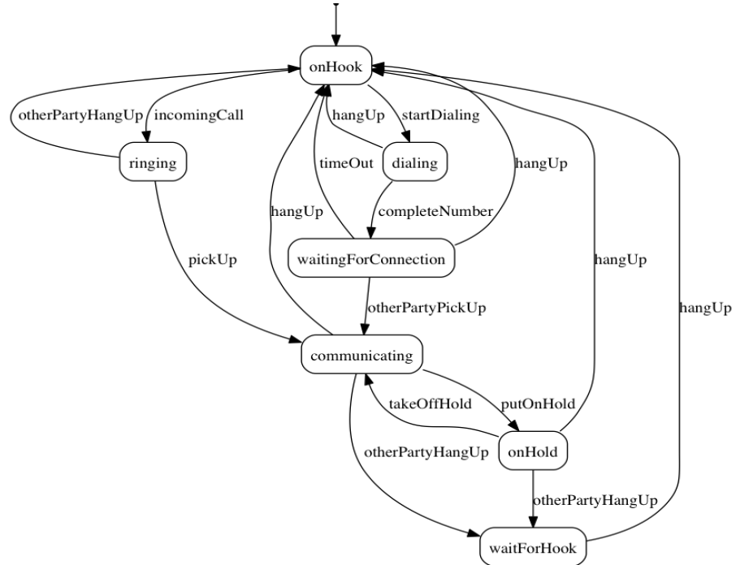
State machine for a phone line
center h:550

Slide 42
Umple for the phone line example
class phone { state { onHook { startDialing -> dialling; incomingCall -> ringing; } ringing { pickUp -> communicating; otherPartyHangUp -> onHook; } communicating { hangUp -> onHook; otherPartyHangUp -> waitForHook; putOnHold -> onHold; } onHold { hangUp -> onHook; otherPartyHangUp -> waitForHook; takeOffHold -> communicating; }
next slide

Slide 43
Umple for the phone line example
con’t.
dialing { completeNumber -> waitingForConnection; hangUp -> onHook; } waitingForConnection { otherPartyPickUp -> communicating; hangUp -> onHook; timeOut -> onHook; } waitForHook { hangUp -> onHook; } } }

Slide 44
In-class modeling exercise for state machines
Microwave oven system state machine
Events include
pressing of buttons
door opening
door closing
timer ending
etc.

Slide 45
Mixins

Slide 46
Mixins : Motivation
Product variants have long been important for
Product lines/families, whose members target different:
hardware, OS, feature sets, basic/pro versions
Feature-oriented development (separation of concerns)

Slide 47
Separation of concerns by mixins in Umple
Mixins allow including attributes, associations, state machines, groups of states, stereotypes, etc
Example:
class X { a; } class X { b; }
The result would be a class with both a and b.
It doesn’t matter whether the mixins are
Both in the same file
One in one file, that includes the other in an other file
In two separate files, with a third file invoking them

Slide 48
Typical ways of using mixins
Separate groups of classes for
model (classes, attributes, associations)
Methods operating on the model
Allows a clearer view of the core model
Another possibility
One feature per file

Slide 49
Typical ways of using mixins
Separate model files (classes, attributes associations)
… from files for the same class containing methods
Allows a clearer view of the core model
Separate system features, each into a separate file

Slide 50
Advantages and disadvantages of mixins
Advantages:
Smaller files that are easier to understand
Different versions of a class for different software versions (e.g. a professional version) can be built by using different mixins
Disadvantage
Delocalization:
Bits of functionality of a class in different files
The developer may not know that a mixin exists unless a tool helps show this

Slide 51
Aspect orientation

Slide 52
Aspects : Motivation
We often don’t quite like the code as generated
Or
We want to do a little more than what the generated code does
Or
We want to inject some feature (e.g. security checks) into many places of generated or custom code

Slide 53
Aspect orientation : General Concept
Create a pointcut that specifies (advises) where to inject code at multiple points elsewhere in a system
The pointcut uses a pattern
Pieces of code that would otherwise be scattered are thus gathered into the aspect
But: There is potentially acute sensitivity to change
If the code changes the aspect may need to change
Yet without tool support, developers wouldn’t know this
Drawback : Delocalization even stronger than for mixins

Slide 54
Aspect orientation in Umple
It is common to limit a pointcuts a single class
Inject code before, after, or around execution of custom or generated methods and constructors
class Person { name; before setName { if (aName != null && aName.length() > 20) { return false; } } }
We have found these limited abilities nonetheless solve key problems

Slide 55
Traits

Slide 56
Traits : Motivation
We may want to inject similar elements into unrelated classes
without complex multiple inheritance
Elements can be
Methods
Attributes
Associations
States or state machines
.. Anything

Slide 57
Separation of Concerns by Traits
Allow modeling elements to be made available in multiple classes
trait Identifiable { firstName; lastName; address; phoneNumber; fullName = {firstName + " " + lastName} Boolean isLongName() {return lastName.length() > 1;} } class Person { isA Identifiable; }
See more complete version of this in the user manual

Slide 58
Another Trait example
trait T1{ abstract void method1(); /* required method */ abstract void method2(); void method4(){/*implementation – provided method*/ } } trait T2{ isA T1; void method3(); void method1(){/*implementation*/ } void method2(){/*implementation*/ } } class C1{ void method3(){/*implementation*/ } } class C2{ isA C1; isA T2; void method2(){/*implementation*/ } }

Slide 59
Traits With Parameters
trait T1< TP isA I1 > { abstract TP method2(TP data); String method3(TP data){ /*implementation*/ } } interface I1{ void method1(); } class C1{ isA I1; isA T1<TP = C1>; void method1(){/*implementation*/} C1 method2(C1 data){ /*implementation*/ } } class C2{ isA I1; isA T1< TP = C2 >; void method1(){/*implementation*/} C2 method2(C2 data){ /*implementation*/ } }

Slide 60
Trait Parameters in Methods
trait T1 <TP>{ String method1(); String method2(){ #TP# instance = new #TP#(); return method1() +":"+instance.process(); } } class C1{ String process(){/*implementation*/} } class C2{ isA T1< TP = C1 >; String method1(){/*implementation*/ } }

Slide 61
Selecting Subsets of Items in Traits
trait T1{ abstract method1(); void method2(){/*implementation*/} void method3(){/*implementation*/} void method4(){/*implementation*/} void method5(){/*implementation*/} } class C1{ isA T1<-method2() , -method3()>; void method1() {/*implementation related to C1*/} } class C2{ isA T1<+method5()>; void method1() { /*implementation related to C2*/} }

Slide 62
Renaming Elements when Using Traits
trait T1{ abstract method1(); void method2(){/*implementation*/} void method3(){/*implementation*/} void method4(){/*implementation*/} void method5(Integer data){/* implementation*/} } class C1{ isA T1< method2() as function2 >; void method1() {/*implementation related to C1*/} } class C2{ isA T1< method3() as private function3 >; void method1() {/*implementation related to C2*/} } class C3{ isA T1< +method5(Integer) as function5 >; void method1() {/*implementation related to C3*/} }

Slide 63
Associations in Traits: Observer Pattern
class Dashboard{ void update (Sensor sensor){ /*implementation*/ } } class Sensor{ isA Subject< Observer = Dashboard >; } trait Subject <Observer>{ 0..1 -> * Observer; void notifyObservers() { /*implementation*/ } }

Slide 64
Using Traits to Reuse State Machines
trait T1 { sm1{ s0 {e1-> s1;} s1 {e0-> s0;} } } trait T2 { isA T1; sm2{ s0 {e1-> s1;} s1 {e0-> s0;} } } class C1 { isA T2; }

Slide 65
Satisfaction of Required Methods Through State Machines
trait T1{ Boolean m1(String input); Boolean m2(); sm1{ s1{ e1(String data) -> /{ m1(data); } s2; } s2{ e2 -> /{ m2(); } s1; } } } class C1{ isA T1; sm2{ s1{ m1(String str) -> s2;} s2{ m2 -> s1;} } }

Slide 66
Changing Name of a State Machine Region
trait T1{ sm { s1{ r1{ e1-> r11; } r11{} || r2{ e2-> r21; } r21{} } } } class C1{ isA T1<sm.s1.r1 as region1,sm.s1.r2 as region2>; }

Slide 67
Changing the Name of an Event
trait T1 { sm1{ s0 { e1(Integer index)-> s1;} s1 {e0-> s0;} } sm2{ t0 {e1(Integer index)-> t1;} t1 {e0-> t0;} } } class C1 { isA T1<sm1.e1(Integer) as event1, *.e0() as event0>; }

Slide 68
Mixins and Traits together
Examples of mixins and traits combined in the user manual:
Mixins with traits:
https://cruise.umple.org/umple/TraitsandUmpleMixins.html

Slide 69
Mixsets

Slide 70
Mixsets: Motivations
A feature or variant needs to inject or alter code in many places
Historically tools like the C Preprocessor were used
Now tools like “Pure: Variants”
There is also a need to
Enable model variants in a very straightforward way
Blend variants with code/models in core compilers
With harmonious syntax + analysable semantics
Without the need for tools external to the compiler

Slide 71
Mixsets: Top-Level Syntax
Mixsets are named sets of mixins
mixset Name { // Anything valid in Umple at top level }
The following syntactic sugar works for top level elements (class, trait, interface, association, etc.)
mixset Name class Classname { }

Slide 72
Use Statements
A use statement specifies inclusion of either
A file, or
A mixset
use Name;
A mixset is conceptually a virtual file that is composed of a set of model/code elements
The use statement for a mixset can appear
Before, after or among the definition of the mixset parts
In another mixset
On the command line to generate a variant

Slide 73
Mixsets and Mixins: Synergies
The blocks defined by a mixset are mixins
Mixsets themselves can be composed using mixins
e.g.
mixset Name1 {class X { a; } }
And somewhere else
mixset Name1 {class X { b; } } use Name1;
Would be the same as:
class X { a; b;}

Slide 74
Mixset Definitions Internal to a Top-Level Element
class X { mixset Name2 {a;} b; }
Is the same as,
mixset Name2 class X {a;} class X {b;}
The above works for attributes, associations, state machines, states, etc.

Slide 75
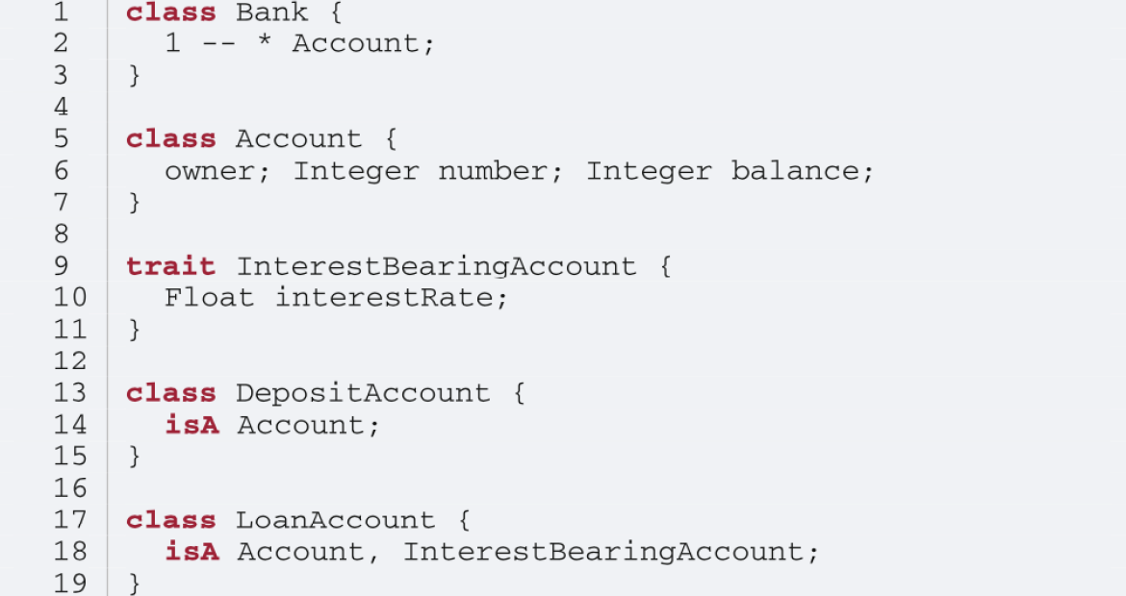
Motivating Example: Umple Model/Code for Basic Bank
center h:550

Slide 76
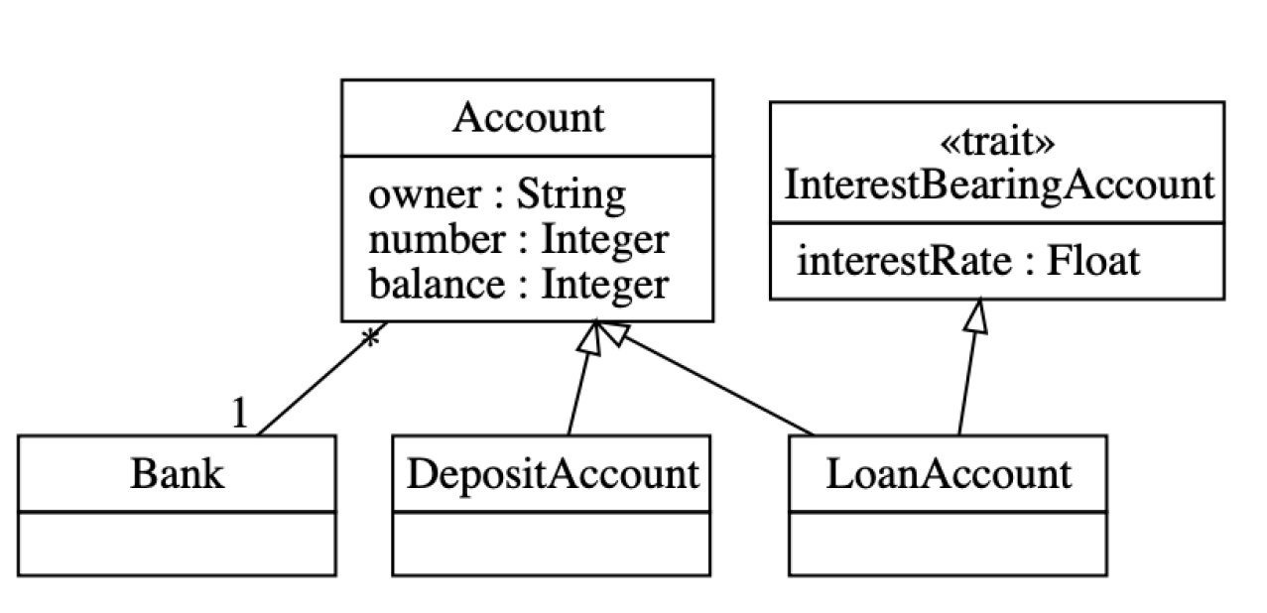
Class Diagram of Basic Bank Example:
center h:550

Slide 77
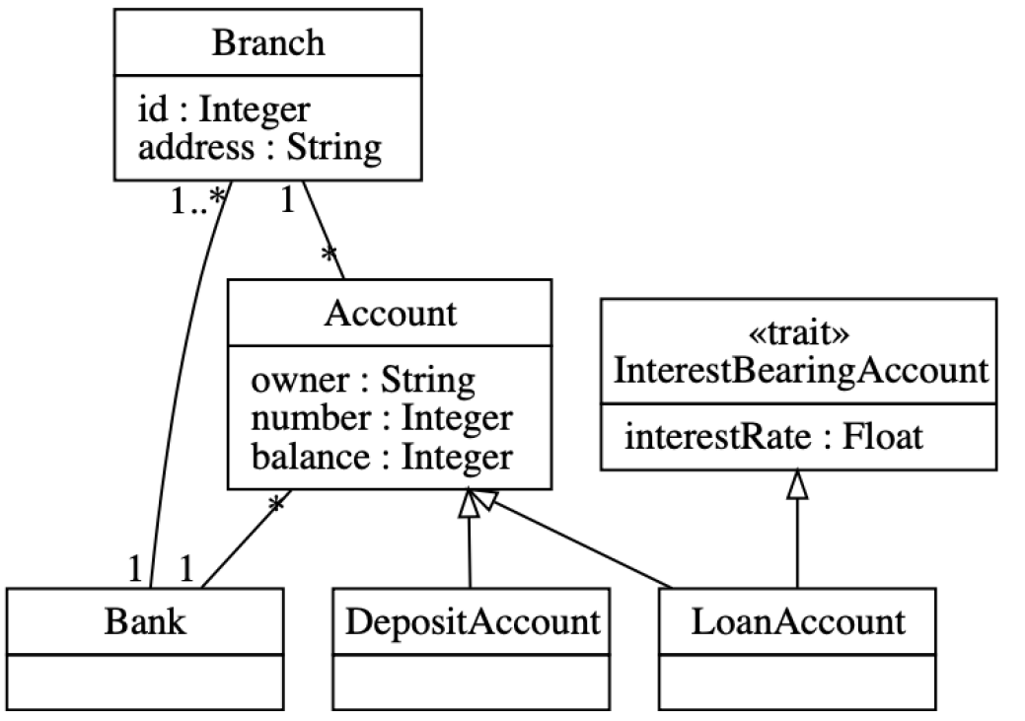
Adding Optional Multi-branch Feature
center h:550

Slide 78
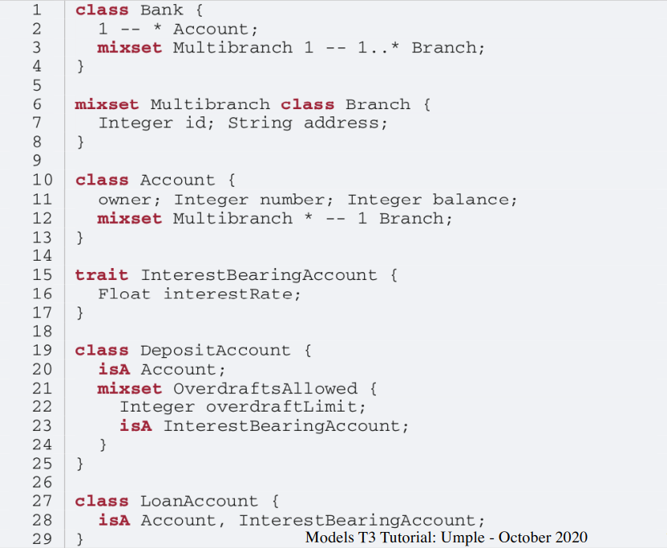
Example: Multi-branch Umple Model/Code
center h:550

Slide 79
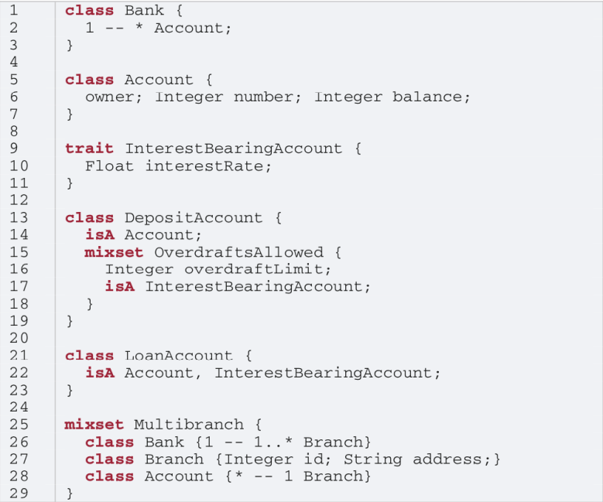
Alternative Approach (same system)
center h:550

Slide 80
Constraints on Mixsets
require [Mixset1 or Mixset2];
Allowed operators
and, or, xor
not
n..m of {…}
Parentheses allowed
opt X (means 0..1 of {X})

Slide 81
Case Study and Exercise 1: Modifying the banking example
I will give you the text of the banking example and set up a task for you to:
Add the ability to have one or more account holders
Add the ability to have one or more co-signers

Slide 82
Case Study and Exercise 2: Dishwasher example
We will start with the Dishwasher example in UmpleOnline
We will use UmpleOnline’s Task capability to ask you to split the Dishwasher example into two versions
A cheap version that only does normal wash and not fast wash
A full version that does everything
Hint: Pull out the relevant state and transition for fast wash and wrap it in a mixset

Slide 83
Case Study 3: Umple itself, written in Umple
We will look at:
Code in Github
Generated Architecture diagrams
Generated Javadoc
Sample master code
Sample test output
Sample code for generators (that replaced Jet)
UmpleParser (that replaced Antlr

Slide 84
Unit Testing with UMPLE

Slide 85
Unit Testing with Umple
To see how to integrate Unit Testing with Umple, see the sample project at
https://github.com/umple/umple/tree/master/sandbox
And the build script at
https://github.com/umple/umple/blob/master/build/build.sandbox.xml
Command line from build directory
ant -f build.xml sandbox

Slide 86
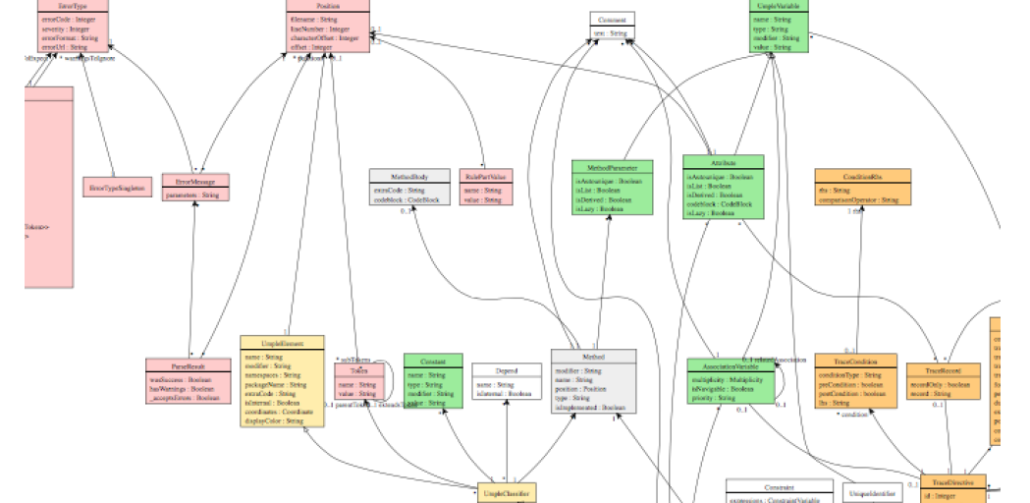
A Look at How Umple is Written in Itself
Source:
https://github.com/umple/umple/tree/master/cruise.umple/src
Umple’s own class diagram generated by itself from itself:
http://metamodel.umple.org
Colours represent key subsystems
Click on classes to see Javadoc, and then Umple Code
center h:300

Slide 87
Testing: TDD with100% pass always required
Multiple levels: https://cruise.eecs.uottawa.ca/qa/index.php
Parsing tests: basic constructs
Metamodel tests: ensure it is populated properly
E.g.
https://github.com/umple/umple/blob/master/cruise.umple/test/cruise/umple/compiler/AssociationTest.java
Implementation template tests: to ensure constructs generate code that looks as expected
Testbed semantic tests: Generate code and make sure it behaves the way it should

Slide 88
UMPLE issues list

Slide 89
UMPLE issues list
Tagged by
Priority
Perceived difficulty
Scale (bug, project, research project)
Milestone (slow release)
http://bugs.umple.org

Slide 90
Using Umple with Builds and Continuous Integration

Slide 91
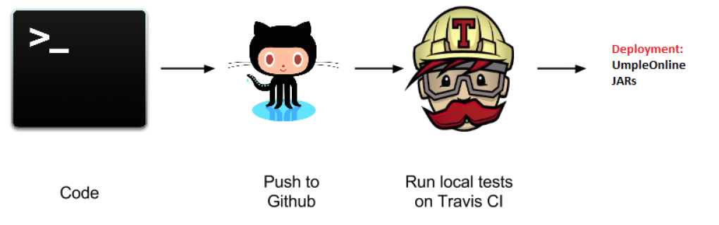
Using Umple with Builds and Continuous Integration
Example build scripts
Example travis.yml
Umple’s own Travis page
center h:300

Slide 92
UMPLE’s Architecture

Slide 93
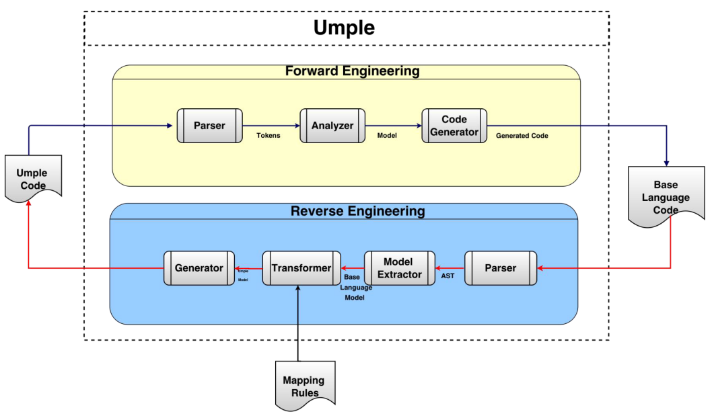
Umple’s Architecture
center h:550

Slide 94
Umplification

Slide 95
Umplification
Umplification: ‘amplication’ + converting into Umple.
Produces a program with behavior identical to the original one but written in Umple.
Eliminates the distinction between code and model. Proceeds incrementally until the desired level of abstraction is achieved.

Slide 96
Umplification: The Transformation Steps
Transformation 0: Initial transformation
Transformation 1: Transformation of generalization, dependency, and namespace declarations.
Transformation 2: Analysis and conversion of many instance variables, along with the methods that use the variables.
Transformation 2a: Transformation of variables to UML/Umple attributes.
Transformation 2b: Transformation of variables in one or more classes to UML/Umple associations.
Transformation 2c: Transformation of variables to UML/Umple state machines.

Slide 97
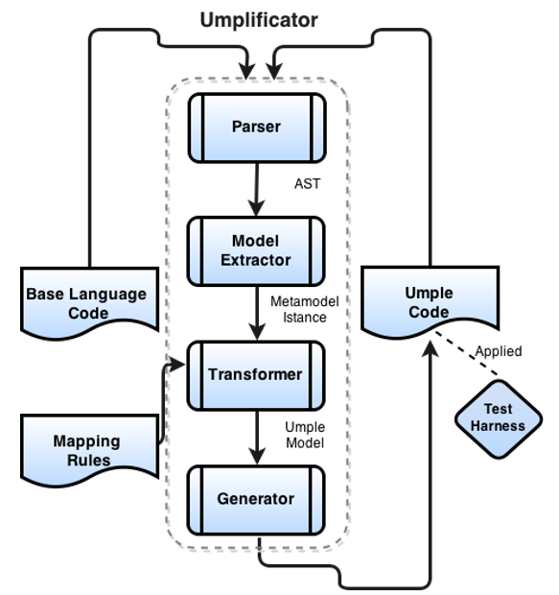
Umplification Process
center h:550

Slide 98
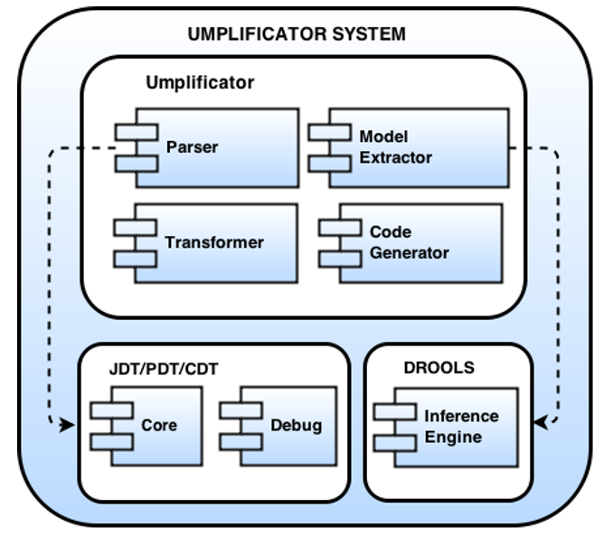
Umplificator Architecture
center h:550

Slide 99
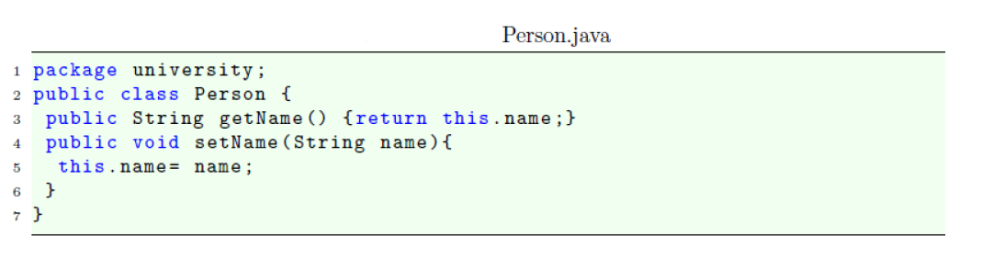
Umplification - Example
center h:400

Slide 100
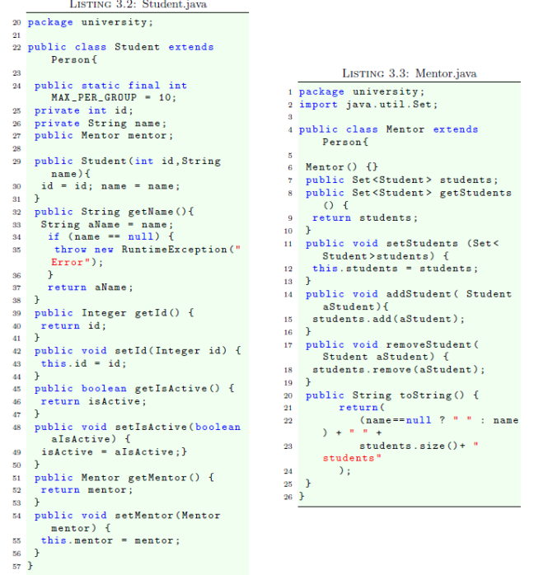
Umplification - Example
center h:550

Slide 101
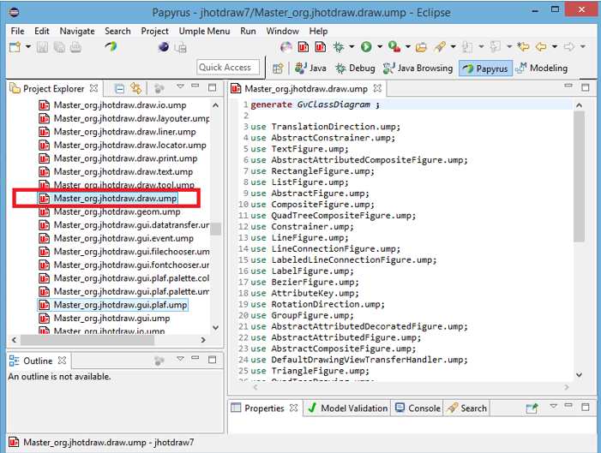
Systems umplified (JhotDraw 7.5.1)
center h:550

Slide 102
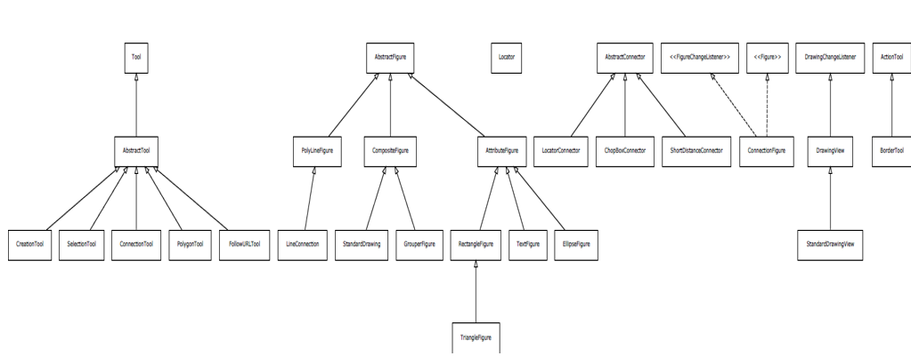
Systems umplified (JhotDraw 7.5.1)
center h:550

Slide 103
Systems umplified
Weka
Associations umplified
Args4J- Modernization
Original Args4j source code is composed of 61 classes and 2223 LOC.
Umplified Args4j source code is composed of 122 (2 per input class) umple files and 1980 LOC.
# LOC in files containing modeling constructs (X.ump) is 312.
# LOC in files with algorithmic/logic code (X code.ump) is 1668.
The developer must then translate 1518 lines of code rather than 2223 lines of code.

Slide 104
Conclusion

Slide 105
Conclusion
Umple
Is simple but powerful modeling tool
Generates state-of-the-art code
Enables agility + model-driven development
We call the overall approach model-based programming

Slide 106
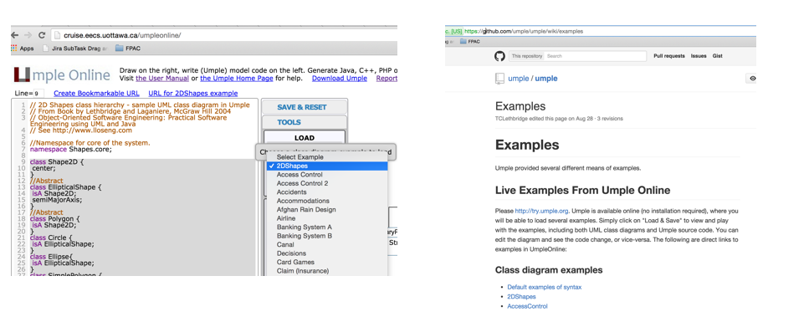
Umple Examples More ..
http://try.umple.org
https://github.com/umple/umple/wiki/examples
http://umpr.a4word.com/
http://code.umple.org
http://metamodel.umple.org
center h:250

Slide 107
References

Slide 108
References
UMPLE Tutorials
UMPLE Github
UMPLE Online
UMPLE Documentation
UMPLE CSI5112– February 2018
Umple Tutorial: Models 2020 Web
Umple Tutorial: Models 2020 Pdf

Slide 109
References
Getting Started in UMPLE
Experiential Learning for Software Engineering Using Agile Modeling in Umple (Youtube)
Experiential Learning for Software Engineering Using Agile Modeling in Umple (Slide)
Tomassetti Code Generation

Slide 110
$End−Of−Week−7$

