Slide 1

CEN207 Data Structures · Week 10
Sorting
CEN207 Data Structures — Week 10
Asst. Prof. Dr. Uğur CORUH · Fall 2026–2027
RTEU Computer Engineering · Fall 2026–2027
Notes:
Today we sort the same array eleven different ways, and count exactly what each one costs. By the end, "which sort should I use" has a real, numeric answer.

Slide 2
CEN207 Data Structures · Week 10
Today's plan (3 hours)
Hour | Topic
1 | Cost model · bubble, selection, insertion, shell sort
2 | Merge sort (top-down, bottom-up) · quick sort (Lomuto, Hoare, worst case)
3 | Counting, radix, bucket sort · stability · empirical comparison · choosing
Learning outcomes: LO.1 (explain fundamental data structures) · LO.2 (analyze complexity) · LO.7 (choose the right structure)
RTEU Computer Engineering · Fall 2026–2027
2
Notes:
Fourteen short animations carry the whole lecture; every algorithm gets a normal run and at least one edge/hard run, right where it is introduced.

Slide 3
CEN207 Data Structures · Week 10
This week's concepts — where
Concept | Where
Bubble, selection, insertion, shell sort | Sections 2–5
Merge sort (top-down / bottom-up) | Section 6
Quick sort (Lomuto / Hoare / worst case) | Section 7
Counting, radix, bucket sort | Sections 8–10
Stability, comparison, choosing | Sections 11–13
RTEU Computer Engineering · Fall 2026–2027
3
Notes:
Every term gets a full definition the first time it appears; this table just says where to find it again.

Slide 4
CEN207 Data Structures · Week 10
How the code examples work
• Every algorithm has a complete C and Java program
• C: gcc -std=c11 -Wall -Wextra -o /tmp/x file.c && /tmp/x
• Java: javac -d /tmp/j File.java && java -cp /tmp/j File
• Sources: code/week-10/c/ and code/week-10/java/
• Each program's expected output is in the week notes
RTEU Computer Engineering · Fall 2026–2027
4
Notes:
Open a terminal now if you want to run these live; every snippet on today's slides compiles and runs exactly as shown.

Slide 5
CEN207 Data Structures · Week 10
Recap — arrays and Big-O (Week 1)
• Every sort today works on a plain array, O(1) access
• Best / average / worst case is not decoration
• It is why eleven different sorts exist, not one
• Watch the same input give wildly different costs
RTEU Computer Engineering · Fall 2026–2027
5
Notes:
This week is, above all, an exercise in Big-O — you will watch the numbers diverge in real time.

Slide 6
CEN207 Data Structures · Week 10
Recap — heap sort (Week 4)
• You already built an O(n log n), in-place sort
• Keep it as today's yardstick throughout
• Merge sort matches its guarantee, at O(n) extra cost
• Quick sort matches it only on average
RTEU Computer Engineering · Fall 2026–2027
6
Notes:
Heap sort does not get its own section today — you already earned it — but it reappears as the reference point all afternoon.

Slide 7
CEN207 Data Structures · Week 10
Two genuinely new ideas
• Divide and conquer: split, solve each half, combine
• Powers merge sort and quick sort (Sections 6–7)
• Non-comparison sorting: never compare two keys
• Powers counting, radix, bucket sort (Sections 8–10)
RTEU Computer Engineering · Fall 2026–2027
7
Notes:
Both ideas will reappear constantly for the rest of this course and the next.

Slide 8
CEN207 Data Structures · Week 10
Map of the week — at a glance
O(n²) family | O(n log n) guaranteed
Bubble, selection, insertion, shell | Merge sort (top-down, bottom-up)
Average O(n log n) | Non-comparison, O(n+k)
Quick sort (Lomuto, Hoare) | Counting, radix, bucket sort
RTEU Computer Engineering · Fall 2026–2027
8
Notes:
Every box on this map gets its own slides below, most with a short animation and a complete C/Java program.

Slide 9
CEN207 Data Structures · Week 10
Mini-quiz
Every sort you have met before today assumes one thing about how order is decided. What is it, and which three sorts today break that rule?
RTEU Computer Engineering · Fall 2026–2027
9
Notes:
Give them a moment — the answer sets up the whole second half of the lecture.

Slide 10
CEN207 Data Structures · Week 10
Answer
Comparing two keys with `<` or `>`. Counting, radix, and bucket sort (Sections 8–10) never compare keys — they compute locations directly.
RTEU Computer Engineering · Fall 2026–2027
10
Notes:
This is the single biggest idea shift of the week: from "compare and narrow" to "compute the address".

Slide 11
CEN207 Data Structures · Week 10
1. The Sorting Problem, and How to Measure It
RTEU Computer Engineering · Fall 2026–2027
11
Notes:
Section 1 sets up the two numbers — comparisons and writes — that every algorithm today will be measured by.

Slide 12
CEN207 Data Structures · Week 10
A question to start
Sorting has been solved a dozen different ways in the history of computing. Given how simple the problem sounds, why does it need so many answers?
RTEU Computer Engineering · Fall 2026–2027
12
Notes:
Because "rearrange the array" leaves enormous room for how: memory budget, what you already know about the input, whether ties may move.

Slide 13
CEN207 Data Structures · Week 10
The sorting problem, restated
• Array of n values, a rule ("is a less than b?")
• Rearrange so every element is <= the next one
• Freedom: how much extra memory, what you exploit
• Freedom: whether equal elements may change order
RTEU Computer Engineering · Fall 2026–2027
13
Notes:
That last freedom — stability — turns out to matter a great deal, and gets its own full section (11) later today.

Slide 14
CEN207 Data Structures · Week 10
Measuring cost: two numbers
Quantity | Counts | Matters when
comparisons | every </>/== | the classic cost measure
moves / writes / swaps | every array write | records are big, or writes are expensive
RTEU Computer Engineering · Fall 2026–2027
14
Notes:
These two numbers do not always agree on a winner — Section 12's animation puts five algorithms side by side to show exactly that.

Slide 15
CEN207 Data Structures · Week 10
Stability, defined
• Equal keys keep their input order in the output
• Not about correctness — the output is still sorted
• An extra guarantee some algorithms give for free
• Gets a dedicated animation in Section 11
RTEU Computer Engineering · Fall 2026–2027
15
Notes:
A stable sort on students-by-grade leaves every same-grade group in their prior (name) order; an unstable one may shuffle them.

Slide 16
CEN207 Data Structures · Week 10
In place, or extra memory?
• In place: rearranges with O(1) extra memory
• Bubble, selection, insertion, shell, quick sort: in place
• Merge sort needs O(n) extra — the price of its guarantee
• Counting/radix sort need O(n+k) extra too
RTEU Computer Engineering · Fall 2026–2027
16
Notes:
Time and space are always a trade-off — Section 13 ends the week with a decision table instead of one winner.

Slide 17
CEN207 Data Structures · Week 10
2. Bubble Sort
RTEU Computer Engineering · Fall 2026–2027
17
Notes:
Section 2 opens the simple O(n²) family with the most intuitive idea: compare neighbors, swap if wrong, and know when to stop.

Slide 18
CEN207 Data Structures · Week 10
A question to start
Comparing two neighbors and swapping them if they are backwards is the most natural sorting instinct there is. How far does that idea alone get you?
RTEU Computer Engineering · Fall 2026–2027
18
Notes:
Surprisingly far, if you add one refinement: noticing when a whole pass made no swaps at all.

Slide 19
CEN207 Data Structures · Week 10
A short history
• No single named inventor, unlike quick or merge sort
• One of the oldest sorting ideas in computing
• Appears in the literature as early as the mid-1950s
• Taught first because it needs no cleverness to invent
RTEU Computer Engineering · Fall 2026–2027
19
Notes:
Only the discipline of noticing "a pass made zero swaps, stop" turns it from a curiosity into something worth teaching.

Slide 20
CEN207 Data Structures · Week 10
The bubble sort idea
• Walk left to right, compare each neighbor pair
• Swap if out of order — the larger value "bubbles" right
• Repeat the whole walk, one cell shorter each time
• Early exit: a pass with zero swaps means done
RTEU Computer Engineering · Fall 2026–2027
20
Notes:
Every pass settles one more maximum at the tail; the early-exit flag is the one thing that makes this worth teaching.

Slide 21
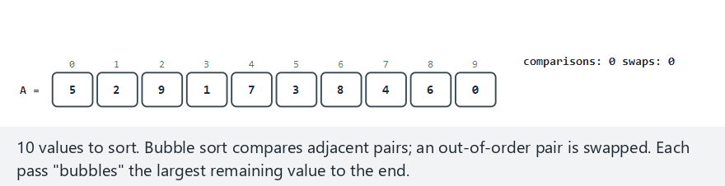
CEN207 Data Structures · Week 10
Bubble sort, step by step
RTEU Computer Engineering · Fall 2026–2027
21
Notes:
Normal example: 10 unordered values — watch the counters on the right and the "settled" brace grow from the tail.

Slide 22
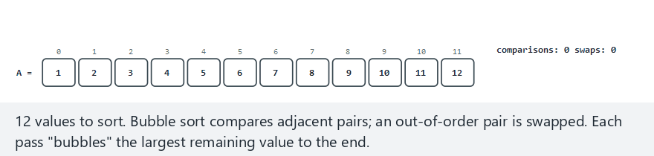
CEN207 Data Structures · Week 10
Edge case — already sorted
RTEU Computer Engineering · Fall 2026–2027
22
Notes:
One pass, zero swaps, early exit — this is bubble sort's O(n) best case, made visible.

Slide 23
CEN207 Data Structures · Week 10
Code — the pass and the early exit
for (int pass = 0; pass < n - 1; pass++) {
int swapped = 0;
for (int i = 0; i < n - 1 - pass; i++) {
if (a[i] > a[i + 1]) {
int tmp = a[i]; a[i] = a[i + 1];
a[i + 1] = tmp; swapped = 1;
}
}
if (!swapped) break;
}
RTEU Computer Engineering · Fall 2026–2027
23
Notes:
`n - 1 - pass` shrinks the inner loop every pass — the tail is already settled and never re-checked.

Slide 24
CEN207 Data Structures · Week 10
Complexity and mistakes
• Best case O(n): early exit on already-sorted input
• Worst/average case O(n²): reverse-sorted or random
• Common bug: using >=, which breaks stability
• Common bug: forgetting the early-exit flag entirely
RTEU Computer Engineering · Fall 2026–2027
24
Notes:
Without the flag, bubble sort is always O(n²) — the flag is the entire reason it is worth teaching.

Slide 25
CEN207 Data Structures · Week 10
Mini-quiz
Why is bubble sort stable — what specific line of code guarantees that two equal elements are never swapped past each other?
RTEU Computer Engineering · Fall 2026–2027
25
Notes:
Point them at the comparison operator itself.

Slide 26
CEN207 Data Structures · Week 10
Answer
The strict `>` in `if (a[i] > a[i+1])`. Equal elements never satisfy >, so they are never swapped — their input order survives.
RTEU Computer Engineering · Fall 2026–2027
26
Notes:
Change that one operator to `>=` and stability is gone, with no change to the sorted result itself.

Slide 27
CEN207 Data Structures · Week 10
3. Selection Sort
RTEU Computer Engineering · Fall 2026–2027
27
Notes:
Section 3 trades bubble sort's many small swaps for a different cost profile: full scans, but the fewest writes possible.

Slide 28
CEN207 Data Structures · Week 10
A question to start
Bubble sort's reverse-sorted case did 66 swaps to sort 12 values. What if you scanned once for the true minimum, and moved it directly into place?
RTEU Computer Engineering · Fall 2026–2027
28
Notes:
You still scan the whole remainder every time — no early exit is possible — but you write far less.

Slide 29
CEN207 Data Structures · Week 10
A short history
• Like bubble sort, no single named inventor
• The direct algorithmic form of "pick the smallest left"
• At least as old as the idea of sorting itself
• Valued today for its minimal-write guarantee
RTEU Computer Engineering · Fall 2026–2027
29
Notes:
It is the clearest example this week of trading comparisons for writes — see Section 12's empirical numbers.

Slide 30
CEN207 Data Structures · Week 10
The selection sort idea
• For each i, scan i+1..n-1 for the minimum's index
• Swap it into position i — skip if already there
• Sorted region grows from the left (bubble: right)
• At most n-1 swaps, ever — but always O(n²) scans
RTEU Computer Engineering · Fall 2026–2027
30
Notes:
No early exit is possible: finding the true minimum requires checking every remaining candidate, sorted or not.

Slide 31
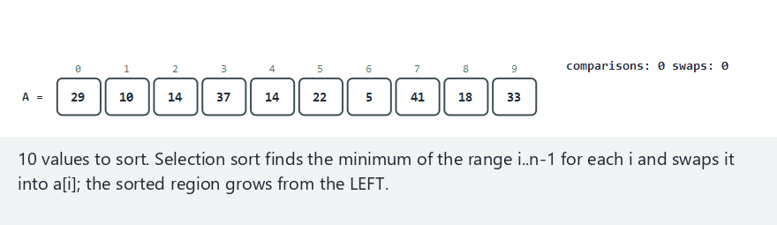
CEN207 Data Structures · Week 10
Selection sort, step by step
RTEU Computer Engineering · Fall 2026–2027
31
Notes:
Normal example: watch `min_idx` update as the scan finds smaller candidates, then the single swap into place.

Slide 32
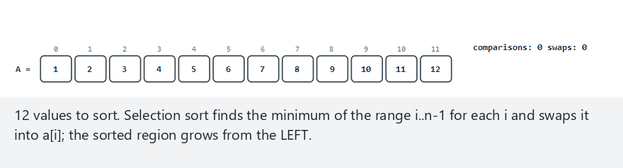
CEN207 Data Structures · Week 10
Edge case — already sorted
RTEU Computer Engineering · Fall 2026–2027
32
Notes:
Still the full n(n-1)/2 comparisons, and zero swaps — no early exit exists here, unlike bubble sort.

Slide 33
CEN207 Data Structures · Week 10
Code — find the minimum, swap once
for (int i = 0; i < n - 1; i++) {
int min_idx = i;
for (int j = i + 1; j < n; j++)
if (a[j] < a[min_idx]) min_idx = j;
if (min_idx != i) {
int tmp = a[i];
a[i] = a[min_idx]; a[min_idx] = tmp;
}
}
RTEU Computer Engineering · Fall 2026–2027
33
Notes:
The swap is skipped entirely when i is already the minimum — one of the few "wasted work" checks worth adding.

Slide 34
CEN207 Data Structures · Week 10
Complexity and mistakes
• Best/average/worst: all O(n²) comparisons, always
• At most n-1 swaps — the fewest of any sort today
• Common bug: swapping unconditionally, wasting writes
• Not stable: the long-range swap can jump a tie
RTEU Computer Engineering · Fall 2026–2027
34
Notes:
Selection sort and quick sort are this week's two clearest examples of instability — Section 11 shows why.

Slide 35
CEN207 Data Structures · Week 10
Mini-quiz
Selection sort does at most n-1 swaps, no matter the input. Why does that bound hold regardless of how scrambled the array is?
RTEU Computer Engineering · Fall 2026–2027
35
Notes:
Point them at how many swaps happen per outer-loop iteration.

Slide 36
CEN207 Data Structures · Week 10
Answer
At most one swap per outer-loop step. Each element that needs to move, moves once, directly to its final spot — n-1 steps, n-1 swaps max.
RTEU Computer Engineering · Fall 2026–2027
36
Notes:
Contrast with bubble sort, where a badly placed value crawls one cell at a time — up to n(n-1)/2 swaps total.

Slide 37
CEN207 Data Structures · Week 10
4. Insertion Sort
RTEU Computer Engineering · Fall 2026–2027
37
Notes:
Section 4 is the sort you already draw on the board — the picture matches exactly how people sort a hand of cards.

Slide 38
CEN207 Data Structures · Week 10
A question to start
Think about sorting a hand of playing cards. You never compare every card to every other card. What do you actually do instead?
RTEU Computer Engineering · Fall 2026–2027
38
Notes:
You hold a small sorted hand, and slide each new card into the one gap where it belongs.

Slide 39
CEN207 Data Structures · Week 10
A short history
• The card-sorting idea itself — no single inventor
• One of the oldest, most intuitive sorting methods
• The instructor's own board drawings use exactly this model
• Real library sorts fall back to it for small sub-arrays
RTEU Computer Engineering · Fall 2026–2027
39
Notes:
C's qsort and Java's Arrays.sort both switch to insertion sort once a recursive sub-array shrinks below ~16-32 elements.

Slide 40
CEN207 Data Structures · Week 10
The insertion sort idea
• A[0..i-1] is always already sorted
• Pull A[i] out as the key (the red box)
• Shift every > key element one cell right
• Drop the key into the hole it opened
RTEU Computer Engineering · Fall 2026–2027
40
Notes:
The hole moves left with every shift; the key drops in the moment a comparison finds "not greater than".

Slide 41
CEN207 Data Structures · Week 10
The board-drawing model
• Brace over A[0..i-1]: "already sorted"
• Red box: the key, pulled out of the array
• `<= key` region stays; `> key` region shifts
• Shift arrow: the hole moving one step left
RTEU Computer Engineering · Fall 2026–2027
41
Notes:
This is drawn on the board exactly this way every time — the animation matches it element for element.

Slide 42
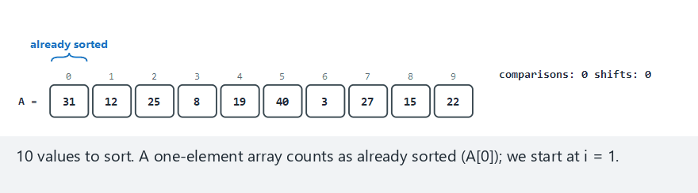
CEN207 Data Structures · Week 10
Insertion sort, step by step
RTEU Computer Engineering · Fall 2026–2027
42
Notes:
Normal example: watch the red key box, the "already sorted" brace grow, and the shift arrows one at a time.

Slide 43
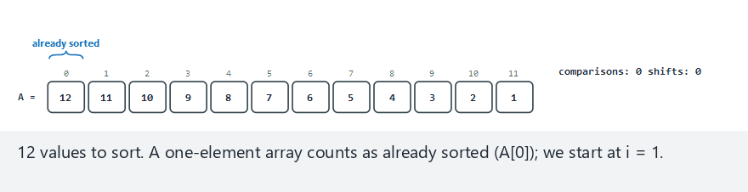
CEN207 Data Structures · Week 10
Edge case — reverse sorted
RTEU Computer Engineering · Fall 2026–2027
43
Notes:
The worst case — every single key shifts all the way to the front, one cell at a time.

Slide 44
CEN207 Data Structures · Week 10
Code — pull the key, shift, drop it in
for (int i = 1; i < n; i++) {
int key = a[i];
int j = i - 1;
while (j >= 0 && a[j] > key) {
a[j + 1] = a[j];
j--;
}
a[j + 1] = key;
}
RTEU Computer Engineering · Fall 2026–2027
44
Notes:
The bound check `j >= 0` must come first in the && — never read a[-1] to find out.

Slide 45
CEN207 Data Structures · Week 10
Complexity and mistakes
• Best case O(n): already sorted, one check per i
• Worst case O(n²): reverse sorted, full shifts
• Common bug: >= instead of > breaks stability
• Common bug: checking a[j] > key before j >= 0
RTEU Computer Engineering · Fall 2026–2027
45
Notes:
Small average-case constant makes it genuinely fast for small or nearly-sorted arrays in practice.

Slide 46
CEN207 Data Structures · Week 10
Mini-quiz
Why is insertion sort's best case exactly O(n), and what specific kind of real-world data makes that best case the common case?
RTEU Computer Engineering · Fall 2026–2027
46
Notes:
Nearly-sorted data — log files, re-sorting after a small update — is exactly insertion sort's sweet spot.

Slide 47
CEN207 Data Structures · Week 10
Answer
Already-sorted (or nearly so) input. Each a[j] <= key check succeeds immediately, so most of the n outer steps cost only O(1).
RTEU Computer Engineering · Fall 2026–2027
47
Notes:
Selection sort gets none of this benefit — its full scan costs the same regardless of how sorted the input already is.

Slide 48
CEN207 Data Structures · Week 10
5. Shell Sort
RTEU Computer Engineering · Fall 2026–2027
48
Notes:
Section 5 asks: what if insertion sort moved badly placed elements most of the way home BEFORE the final pass?

Slide 49
CEN207 Data Structures · Week 10
A question to start
Insertion sort is slow exactly when an element starts far from home. What if you closed most of that distance first, in big jumps?
RTEU Computer Engineering · Fall 2026–2027
49
Notes:
Donald Shell asked exactly this question in 1959 and published the first sort to beat O(n²) in the worst case.

Slide 50
CEN207 Data Structures · Week 10
A short history
• Donald L. Shell, "A High-Speed Sorting Procedure"
• Communications of the ACM, 1959
• The first sorting algorithm to beat plain O(n²)
• Gap-sequence choice remains an open research area
RTEU Computer Engineering · Fall 2026–2027
50
Notes:
This is a genuinely rare thing in this course: a named person, a named paper, a specific year, still actively researched.

Slide 51
CEN207 Data Structures · Week 10
The shell sort idea
• Insertion sort, but comparing gap apart, not 1 apart
• Start gap = n/2, halve every round, end at gap = 1
• Large gaps move far-out elements home in one jump
• By gap = 1, the array is "almost sorted" — cheap pass
RTEU Computer Engineering · Fall 2026–2027
51
Notes:
The final gap=1 pass is literally plain insertion sort, but on data that barely needs any shifting left.

Slide 52
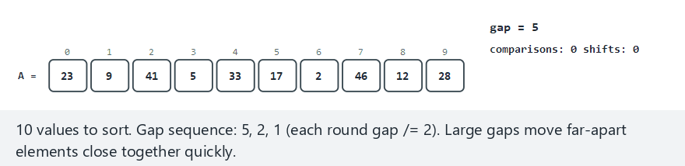
CEN207 Data Structures · Week 10
Shell sort, step by step
RTEU Computer Engineering · Fall 2026–2027
52
Notes:
Normal example: gap sequence 5, 2, 1 — watch how few shifts the final gap=1 pass needs.

Slide 53
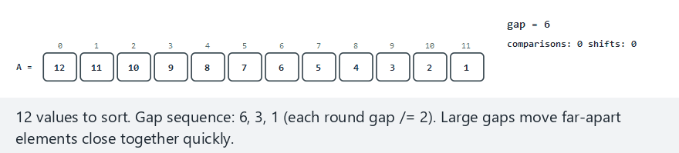
CEN207 Data Structures · Week 10
Edge case — reverse sorted
RTEU Computer Engineering · Fall 2026–2027
53
Notes:
Compare this against Section 4's plain-insertion-sort reverse-sorted example — far fewer total shifts here.

Slide 54
CEN207 Data Structures · Week 10
Code — insertion sort, gapped
for (int gap = n/2; gap > 0; gap /= 2) {
for (int i = gap; i < n; i++) {
int key = a[i];
int j = i;
while (j >= gap && a[j-gap] > key) {
a[j] = a[j - gap];
j -= gap;
}
a[j] = key;
}
}
RTEU Computer Engineering · Fall 2026–2027
54
Notes:
Every line matches plain insertion sort exactly, with "1" replaced by "gap" throughout.

Slide 55
CEN207 Data Structures · Week 10
Complexity and mistakes
• Worst case O(n²) with this simple gap sequence
• Far faster than plain insertion sort in practice
• Better sequences (Hibbard, Sedgewick) lower the bound
• Not stable: gapped moves can cross equal elements
RTEU Computer Engineering · Fall 2026–2027
55
Notes:
The important idea is the gap itself — the exact optimal sequence is a research question outside this course's scope.

Slide 56
CEN207 Data Structures · Week 10
Mini-quiz
In the reverse-sorted example, the smallest value starts at the last index. How many total shifts does it take across all three gap rounds?
RTEU Computer Engineering · Fall 2026–2027
56
Notes:
Compare this to the 11 single-cell shifts plain insertion sort would need for the same value.

Slide 57
CEN207 Data Structures · Week 10
Answer
Four shifts total (sizes 6, 3, 1, 1) — covering the same 11-position distance plain insertion sort would need 11 single-cell shifts to cover.
RTEU Computer Engineering · Fall 2026–2027
57
Notes:
Large early gaps cover far more ground per shift — that is the entire mechanism behind shell sort's speed.

Slide 58
CEN207 Data Structures · Week 10
6. Merge Sort
RTEU Computer Engineering · Fall 2026–2027
58
Notes:
Section 6 introduces divide and conquer: split, solve each half the same way, combine — the first O(n log n) guarantee today.

Slide 59
CEN207 Data Structures · Week 10
A question to start
What if, instead of moving elements around inside one array, you split it in half, sorted each half completely, then just combined them?
RTEU Computer Engineering · Fall 2026–2027
59
Notes:
Combining two already-sorted halves is cheap — the only remaining question is how to sort each half.

Slide 60
CEN207 Data Structures · Week 10
A short history
• John von Neumann, 1945
• One of the first algorithms for a stored-program computer
• Founding example of divide and conquer in computing
• The pattern reappears constantly for the rest of this course
RTEU Computer Engineering · Fall 2026–2027
60
Notes:
1945 predates almost every other named algorithm this week — merge sort is genuinely one of the oldest.

Slide 61
CEN207 Data Structures · Week 10
The divide-and-conquer idea
• Split [lo, hi) at its midpoint into two halves
• Recursively sort each half the same way
• Merge the two sorted halves with a helper array
• log2(n) levels × O(n) per level = O(n log n)
RTEU Computer Engineering · Fall 2026–2027
61
Notes:
This holds in every case — best, average, worst — the only algorithm today with that guarantee.

Slide 62
CEN207 Data Structures · Week 10
Why the guarantee never breaks
• No early exit, no data-dependent shortcuts anywhere
• Every level always touches every element once
• Price: an auxiliary array of size n — O(n) extra
• Two equivalent forms: top-down, bottom-up
RTEU Computer Engineering · Fall 2026–2027
62
Notes:
That O(n) extra memory is the one real cost of merge sort's unconditional guarantee.

Slide 63
CEN207 Data Structures · Week 10
Top-down — recursion depth as rows
• d=0: the whole array; d=1: two halves; …
• Splitting never changes values, only brace boundaries
• Then merging goes back up the same rows
• Last row: the fully sorted array
RTEU Computer Engineering · Fall 2026–2027
63
Notes:
The animation draws the recursion literally — one row per depth, split going down, merge continuing further down.

Slide 64
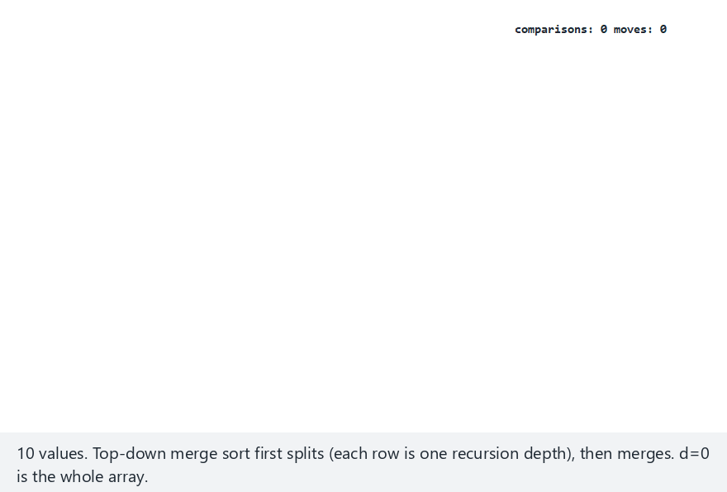
CEN207 Data Structures · Week 10
Merge sort (top-down), step by step
RTEU Computer Engineering · Fall 2026–2027
64
Notes:
Normal example: watch the split rows (braces only, no value changes), then the merge rows building the sorted result.

Slide 65
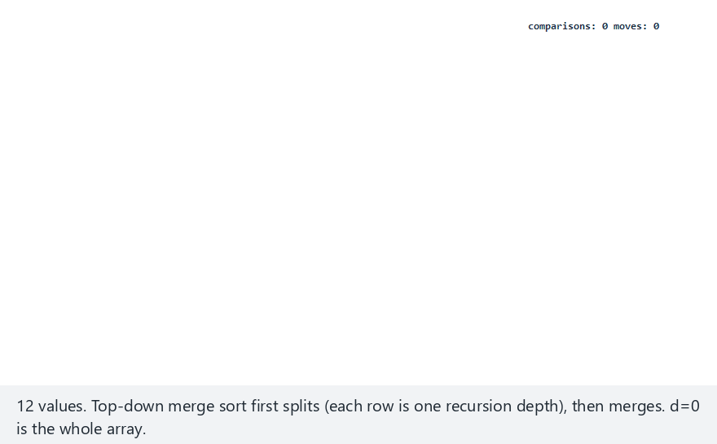
CEN207 Data Structures · Week 10
Edge case — already sorted
RTEU Computer Engineering · Fall 2026–2027
65
Notes:
Every split and every merge still runs in full — merge sort's guarantee is unconditional, unlike bubble sort's early exit.

Slide 66
CEN207 Data Structures · Week 10
Code — the merge step
int i = lo, j = mid, k = lo;
while (i < mid && j < hi)
tmp[k++] = (a[i] <= a[j])
? a[i++] : a[j++];
while (i < mid) tmp[k++] = a[i++];
while (j < hi) tmp[k++] = a[j++];
for (int x=lo; x<hi; x++) a[x]=tmp[x];
RTEU Computer Engineering · Fall 2026–2027
66
Notes:
`<=` (not `<`) always prefers the left run on a tie — this single choice is what makes merge sort stable.

Slide 67
CEN207 Data Structures · Week 10
Code — the recursive driver
void merge_sort(int a[], int lo,
int hi, int tmp[]) {
if (hi - lo <= 1) return;
int mid = lo + (hi - lo) / 2;
merge_sort(a, lo, mid, tmp);
merge_sort(a, mid, hi, tmp);
merge(a, lo, mid, hi, tmp);
}
RTEU Computer Engineering · Fall 2026–2027
67
Notes:
`lo + (hi-lo)/2`, not `(lo+hi)/2` — the form that stays correct even near integer overflow.

Slide 68
CEN207 Data Structures · Week 10
Bottom-up — no recursion at all
• Every element starts as a sorted run of width 1
• Merge adjacent runs into width-2, then width-4, …
• Doubling stops once one run covers the whole array
• Same merge(), reached by a loop instead of a call stack
RTEU Computer Engineering · Fall 2026–2027
68
Notes:
Bottom-up can never overflow a call stack, no matter how large n is — a real practical advantage.

Slide 69
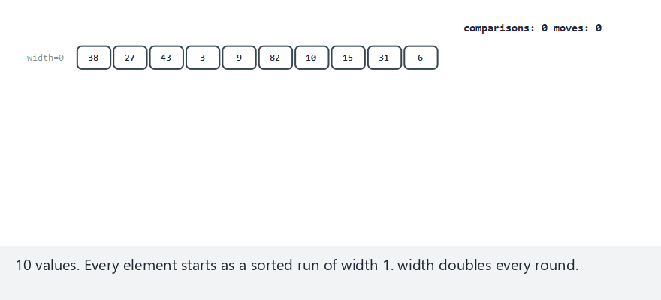
CEN207 Data Structures · Week 10
Merge sort (bottom-up), step by step
RTEU Computer Engineering · Fall 2026–2027
69
Notes:
Normal example: watch the width label double each round — width=1, 2, 4, 8 — with no recursion anywhere.

Slide 70
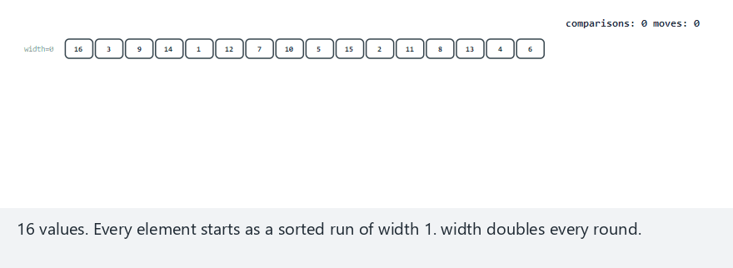
CEN207 Data Structures · Week 10
Edge case — n a power of two
RTEU Computer Engineering · Fall 2026–2027
70
Notes:
Every round is perfectly even here — compare against the "hard" example, where the last pair each round is partial.

Slide 71
CEN207 Data Structures · Week 10
Code — the width-doubling loop
for (int width=1; width<n; width*=2) {
for (int lo=0; lo<n-width;
lo += 2*width) {
int mid = lo + width;
int hi = min(mid+width, n);
merge(a, lo, mid, hi, tmp);
}
}
RTEU Computer Engineering · Fall 2026–2027
71
Notes:
The `min(mid+width, n)` clamp handles both power-of-two and uneven array sizes with no special-casing.

Slide 72
CEN207 Data Structures · Week 10
Complexity and mistakes
• O(n log n) in every case — best, average, worst
• O(n) extra memory — the price of that guarantee
• Stable: the <= tie-break always prefers the left run
• Common bug: < instead of <= breaks stability silently
RTEU Computer Engineering · Fall 2026–2027
72
Notes:
Heap sort (Week 4) shares this O(n log n)-always guarantee, but needs no extra memory — merge sort trades memory for stability.

Slide 73
CEN207 Data Structures · Week 10
Mini-quiz
Both top-down and bottom-up merge sort do the same total work. Name one real advantage bottom-up has, and one top-down has in return.
RTEU Computer Engineering · Fall 2026–2027
73
Notes:
Give them a moment before revealing — both answers are genuinely practical, not just theoretical.

Slide 74
CEN207 Data Structures · Week 10
Answer
Bottom-up: never uses the call stack, cannot overflow it. Top-down: its recursive structure is easier to adapt — e.g. switch to insertion sort early.
RTEU Computer Engineering · Fall 2026–2027
74
Notes:
Production sort libraries do exactly this second optimization — recursive structure makes it a natural fit.

Slide 75
CEN207 Data Structures · Week 10
7. Quick Sort
RTEU Computer Engineering · Fall 2026–2027
75
Notes:
Section 7 asks: can a sort guarantee O(n log n) on average AND sort in place, with no extra array?

Slide 76
CEN207 Data Structures · Week 10
A question to start
Merge sort's O(n log n) costs O(n) extra memory. Is there a divide-and-conquer sort that is just as fast on average, but sorts in place?
RTEU Computer Engineering · Fall 2026–2027
76
Notes:
Tony Hoare invented exactly that in 1959-1960, and it remains one of the most-used sorts in real software today.

Slide 77
CEN207 Data Structures · Week 10
A short history
• C. A. R. Hoare, 1959–1960, Moscow State University
• Published as "Quicksort", The Computer Journal, 1962
• Still the default array sort in many language libraries
• One of the most consequential algorithms in this course
RTEU Computer Engineering · Fall 2026–2027
77
Notes:
Hoare was 26, a visiting researcher on a machine-translation project — quicksort was almost a side project.

Slide 78
CEN207 Data Structures · Week 10
The quick sort idea
• Pick one element of the range as the pivot
• Partition: <= pivot left, >= pivot right
• Recursively quick-sort left part and right part
• No separate "combine" step — partitioning does the work
RTEU Computer Engineering · Fall 2026–2027
78
Notes:
Once both sides are recursively sorted, the whole range is sorted — everything on the left is already <= everything on the right.

Slide 79
CEN207 Data Structures · Week 10
Two classic partition schemes
• Lomuto: pivot = last element, one forward scan
• Hoare: pivot = first element, two inward scans
• Both studied side by side — they differ in a way
• that trips up almost everyone the first time
RTEU Computer Engineering · Fall 2026–2027
79
Notes:
The difference is not cosmetic — it changes the recursive call boundaries, a classic source of off-by-one bugs.

Slide 80
CEN207 Data Structures · Week 10
Lomuto partition — the idea
• Pivot = the range's last element
• i marks the boundary of the "<= pivot" region
• j scans left to right; a[j] <= pivot advances i
• Pivot swaps to i+1 — its final, correct position
RTEU Computer Engineering · Fall 2026–2027
80
Notes:
The pivot's final position is guaranteed by construction — this is what makes Lomuto's recursion lo,p-1 / p+1,hi correct.

Slide 81
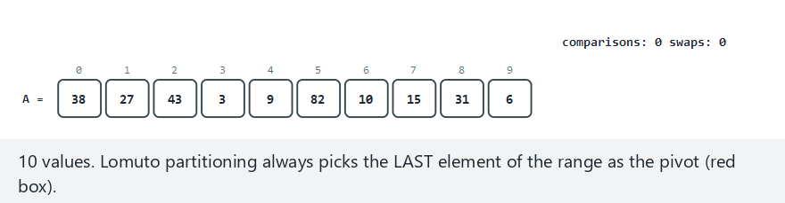
CEN207 Data Structures · Week 10
Quick sort (Lomuto), step by step
RTEU Computer Engineering · Fall 2026–2027
81
Notes:
Normal example: watch the pivot (red box), the i boundary, and the pivot's final swap into place.

Slide 82
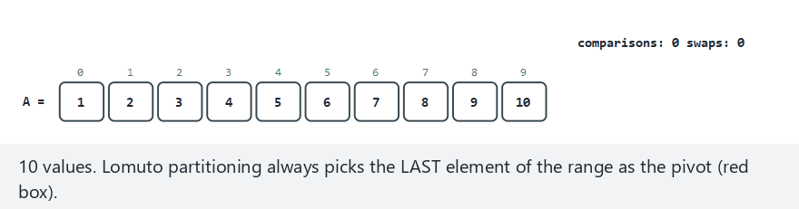
CEN207 Data Structures · Week 10
Edge case — already sorted
RTEU Computer Engineering · Fall 2026–2027
82
Notes:
The classic trap — every partition splits n-1 against 0, the worst possible split. Section 7's worst-case slides return to this.

Slide 83
CEN207 Data Structures · Week 10
Code — Lomuto partition
int pivot = a[hi];
int i = lo - 1;
for (int j = lo; j < hi; j++) {
if (a[j] <= pivot) {
i++;
int t=a[i]; a[i]=a[j]; a[j]=t;
}
}
int t=a[i+1]; a[i+1]=a[hi]; a[hi]=t;
return i + 1;
RTEU Computer Engineering · Fall 2026–2027
83
Notes:
The final three lines place the pivot into its guaranteed final position, i+1.

Slide 84
CEN207 Data Structures · Week 10
Code — Lomuto's recursion
void quick_sort_lomuto(
int a[], int lo, int hi) {
if (lo < hi) {
int p = partition_lomuto(
a, lo, hi);
quick_sort_lomuto(a, lo, p-1);
quick_sort_lomuto(a, p+1, hi);
}
}
RTEU Computer Engineering · Fall 2026–2027
84
Notes:
p-1 and p+1 both exclude the pivot itself, which is correct because Lomuto guarantees it sits exactly at p.

Slide 85
CEN207 Data Structures · Week 10
Hoare partition — the idea
• Pivot = the range's first element
• Two pointers i, j scan inward from both ends
• Swap when a pair is found out of place; repeat
• Pivot's final resting spot is not guaranteed to be j
RTEU Computer Engineering · Fall 2026–2027
85
Notes:
This "not guaranteed" is the single most important fact about Hoare's scheme — it changes the recursion boundaries.

Slide 86
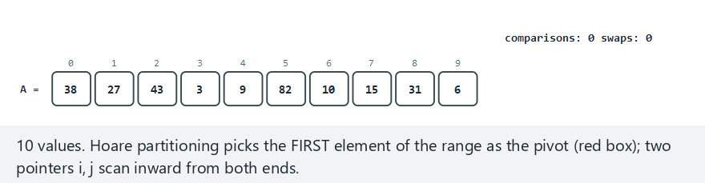
CEN207 Data Structures · Week 10
Quick sort (Hoare), step by step
RTEU Computer Engineering · Fall 2026–2027
86
Notes:
Normal example: watch the two pointers scan inward and swap, and compare the total swap count to Lomuto's.

Slide 87
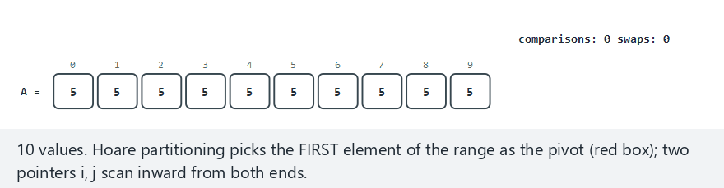
CEN207 Data Structures · Week 10
Edge case — all equal values
RTEU Computer Engineering · Fall 2026–2027
87
Notes:
Even with every value equal to the pivot, the scan still converges correctly — a good invariant check.

Slide 88
CEN207 Data Structures · Week 10
Code — Hoare partition
int pivot = a[lo];
int i = lo - 1, j = hi + 1;
while (1) {
do { i++; } while (a[i] < pivot);
do { j--; } while (a[j] > pivot);
if (i >= j) return j;
int t=a[i]; a[i]=a[j]; a[j]=t;
}
RTEU Computer Engineering · Fall 2026–2027
88
Notes:
Two do-while loops, each guaranteed to stop at or before the pivot's own position on that side.

Slide 89
CEN207 Data Structures · Week 10
Code — Hoare's recursion trap
void quick_sort_hoare(
int a[], int lo, int hi) {
if (lo < hi) {
int p = partition_hoare(
a, lo, hi);
quick_sort_hoare(a, lo, p);
quick_sort_hoare(a, p+1, hi);
}
}
RTEU Computer Engineering · Fall 2026–2027
89
Notes:
Note: p, NOT p-1 — the single most common quick sort bug, because Hoare never guarantees the pivot sits at p.

Slide 90
CEN207 Data Structures · Week 10
Quick sort's worst case
• Both schemes above pick a fixed corner as pivot
• Always the smallest/largest element = worst split
• Sorted or reverse-sorted input triggers it directly
• Median-of-three is the standard real-world defense
RTEU Computer Engineering · Fall 2026–2027
90
Notes:
The same three animations you've already seen — Lomuto's already-sorted example was this exact trap.

Slide 91
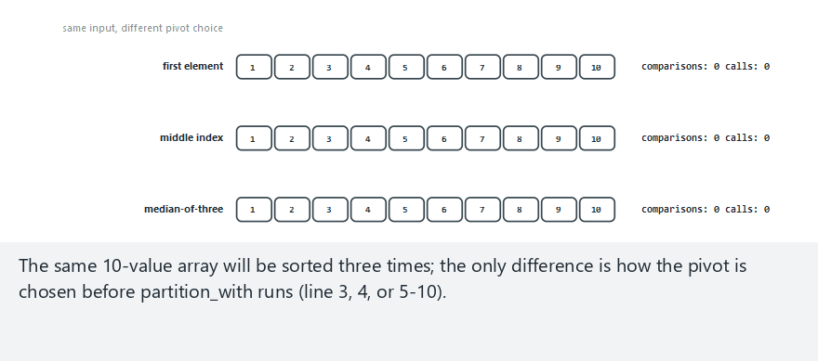
CEN207 Data Structures · Week 10
Comparing pivot strategies
RTEU Computer Engineering · Fall 2026–2027
91
Notes:
Same input, three pivot strategies — first, middle, median-of-three — comparisons and depth counted side by side.

Slide 92
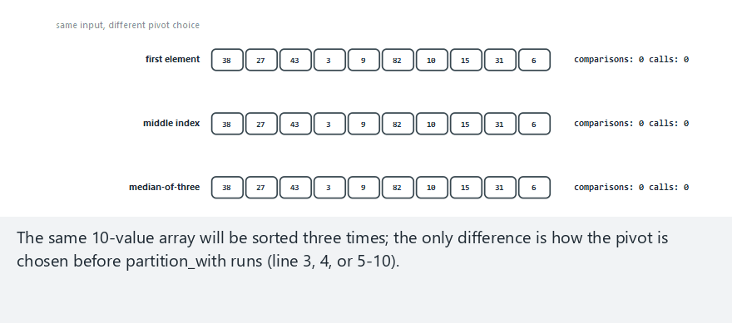
CEN207 Data Structures · Week 10
Edge case — random input
RTEU Computer Engineering · Fall 2026–2027
92
Notes:
On random data with no adversarial structure, all three strategies perform similarly — the trap needs sorted-like input.

Slide 93
CEN207 Data Structures · Week 10
The numbers, made concrete
Strategy | Comparisons (n=14, sorted) | Depth
First element | 91 | 13
Median-of-three | 31 | 3
RTEU Computer Engineering · Fall 2026–2027
93
Notes:
91 vs 31 on the identical input — O(n²) vs O(n log n) is not an abstraction, it is this exact table.

Slide 94
CEN207 Data Structures · Week 10
The comparison-sorting lower bound
• n! possible orderings of n distinct elements
• A decision tree distinguishing all of them needs
• at least log2(n!) levels — which is O(n log n)
• No comparison-based sort can ever beat this bound
RTEU Computer Engineering · Fall 2026–2027
94
Notes:
This is a genuine theorem, not a rule of thumb — you will prove it yourself as an exercise.

Slide 95
CEN207 Data Structures · Week 10
Complexity and mistakes
• Average O(n log n), in place — the fastest in practice
• Worst O(n²) on a badly-chosen, adversarial pivot
• Common bug: mixing Lomuto's p-1 with Hoare's p
• Not stable: both schemes swap across long distances
RTEU Computer Engineering · Fall 2026–2027
95
Notes:
This single mix-up — p-1 vs p — is the most common bug students write when implementing quick sort from memory.

Slide 96
CEN207 Data Structures · Week 10
Mini-quiz
Explain in one sentence why Hoare's partition must recurse on (lo, p) and (p+1, hi), not (lo, p-1) like Lomuto's.
RTEU Computer Engineering · Fall 2026–2027
96
Notes:
The answer is entirely about what each scheme actually guarantees about the pivot's final position.

Slide 97
CEN207 Data Structures · Week 10
Answer
Hoare never guarantees the pivot sits at `p` — only that everything <= p is <= pivot. Excluding p (as p-1 would) could drop an unsorted element.
RTEU Computer Engineering · Fall 2026–2027
97
Notes:
Lomuto's explicit final swap is exactly what makes its p-1/p+1 recursion safe — Hoare has no equivalent guarantee.

Slide 98
CEN207 Data Structures · Week 10
8. Counting Sort
RTEU Computer Engineering · Fall 2026–2027
98
Notes:
Section 8 opens the second half of the week: sorts that never compare two keys against each other at all.

Slide 99
CEN207 Data Structures · Week 10
A question to start
The O(n log n) lower bound assumes you only know how two keys compare. What if you know every value is a small, non-negative integer?
RTEU Computer Engineering · Fall 2026–2027
99
Notes:
Then you don't need to compare at all — you can simply count how many times each value occurs.

Slide 100
CEN207 Data Structures · Week 10
A short history
• Harold H. Seward, MIT master's thesis, 1954
• The simplest way to beat the comparison lower bound
• Requires knowing the key range 0..maxVal in advance
• Foundation for radix sort (Section 9)
RTEU Computer Engineering · Fall 2026–2027
100
Notes:
Seward's thesis is one of the earliest documented non-comparison sorting ideas in computing.

Slide 101
CEN207 Data Structures · Week 10
The counting sort idea
• Count occurrences of each value into count[]
• Turn counts cumulative: count[v] = "how many <= v"
• Place each value at output[count[a[i]]-1], decrement
• Scan backwards — this is what keeps it stable
RTEU Computer Engineering · Fall 2026–2027
101
Notes:
The backward scan guarantees that among equal values, the one appearing earlier in the input claims the earlier output slot.

Slide 102
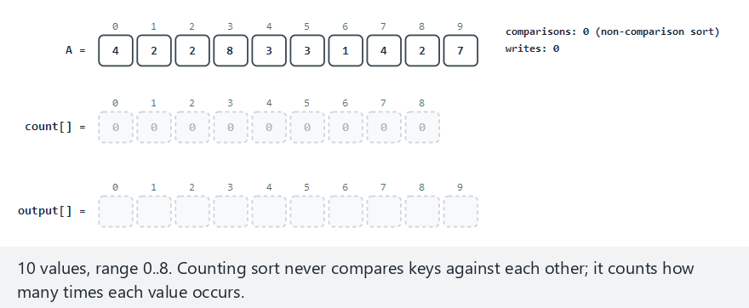
CEN207 Data Structures · Week 10
Counting sort, step by step
RTEU Computer Engineering · Fall 2026–2027
102
Notes:
Watch the comparisons counter — it stays at zero the entire time. That is the whole point of a non-comparison sort.

Slide 103
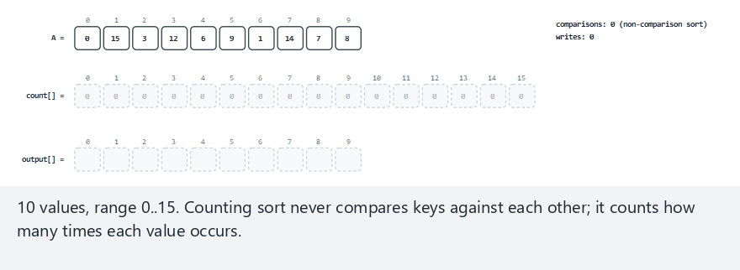
CEN207 Data Structures · Week 10
Edge case — sparse range
RTEU Computer Engineering · Fall 2026–2027
103
Notes:
10 values but maxVal=15 — the O(n+k) cost made visible: count[] must cover every value up to 15.

Slide 104
CEN207 Data Structures · Week 10
Code — count, then accumulate
int count[max_val + 1] = {0};
for (int i = 0; i < n; i++)
count[a[i]]++;
for (int v = 1; v <= max_val; v++)
count[v] += count[v - 1];
RTEU Computer Engineering · Fall 2026–2027
104
Notes:
After this, count[v] means "how many values are <= v" — the last output index that value should occupy.

Slide 105
CEN207 Data Structures · Week 10
Code — place, scanning backwards
for (int i = n - 1; i >= 0; i--) {
output[count[a[i]] - 1] = a[i];
count[a[i]]--;
}
for (int i = 0; i < n; i++)
a[i] = output[i];
RTEU Computer Engineering · Fall 2026–2027
105
Notes:
Backwards is not optional here — it is the entire mechanism that keeps counting sort stable.

Slide 106
CEN207 Data Structures · Week 10
Complexity and mistakes
• O(n + k) time and space, k = maxVal — every case
• Beats O(n log n) genuinely, when k is not >> n
• Wasteful when k is much larger than n (sparse example)
• Stable by construction, via the backward scan
RTEU Computer Engineering · Fall 2026–2027
106
Notes:
The sparse-range example already showed count[] larger than the input itself for k=15, n=10 — imagine k=1,000,000.

Slide 107
CEN207 Data Structures · Week 10
Mini-quiz
Two equal values a[p] and a[q], with p < q. Trace the backward scan — why does a[p] always end up to the LEFT of a[q] in the output?
RTEU Computer Engineering · Fall 2026–2027
107
Notes:
The scan processes a[q] first (larger index), so it claims the later slot; a[p] then claims what's left, one slot earlier.

Slide 108
CEN207 Data Structures · Week 10
Answer
`a[q]` is placed first (scan goes n-1 down to 0), claiming the later slot and decrementing count[v]. a[p] then claims the next slot — one to the left.
RTEU Computer Engineering · Fall 2026–2027
108
Notes:
This is exactly the mechanism from the code slide, traced through for two specific tied elements.

Slide 109
CEN207 Data Structures · Week 10
9. Radix Sort (LSD)
RTEU Computer Engineering · Fall 2026–2027
109
Notes:
Section 9 rescues counting sort's idea for larger integers, by processing one digit at a time instead of the whole range at once.

Slide 110
CEN207 Data Structures · Week 10
A question to start
Counting sort needs a small key range. What if your keys are five-digit integers — too many distinct values, but each built from tiny digits?
RTEU Computer Engineering · Fall 2026–2027
110
Notes:
Run counting sort digit by digit instead of value by value — always 10 buckets, no matter how large the numbers are.

Slide 111
CEN207 Data Structures · Week 10
A short history
• Herman Hollerith, 1890 US census tabulating machines
• Mechanical card sorters processed one column at a time
• Far older than counting sort itself
• Still used today for fixed-width integer/string keys
RTEU Computer Engineering · Fall 2026–2027
111
Notes:
This is one of the oldest ideas in this entire course — punched-card sorting predates electronic computing by decades.

Slide 112
CEN207 Data Structures · Week 10
The radix sort (LSD) idea
• Start at the ones place, run a stable counting sort
• Move to tens, then hundreds — always 10 buckets
• Stability of every pass is not optional — it's required
• Stops once max_val / place reaches zero
RTEU Computer Engineering · Fall 2026–2027
112
Notes:
A stable pass preserves every earlier, less-significant digit's ordering — that composability is the whole algorithm.

Slide 113
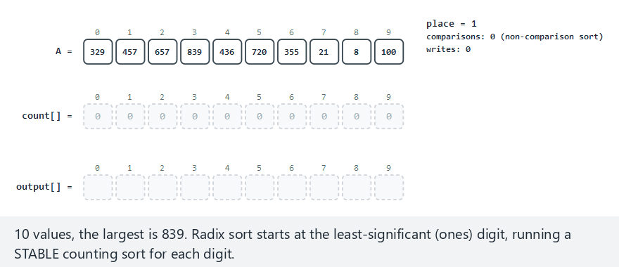
CEN207 Data Structures · Week 10
Radix sort (LSD), step by step
RTEU Computer Engineering · Fall 2026–2027
113
Notes:
Normal example: 3-digit values, 3 passes — watch the array reorder pass by pass, place=1, 10, 100.

Slide 114
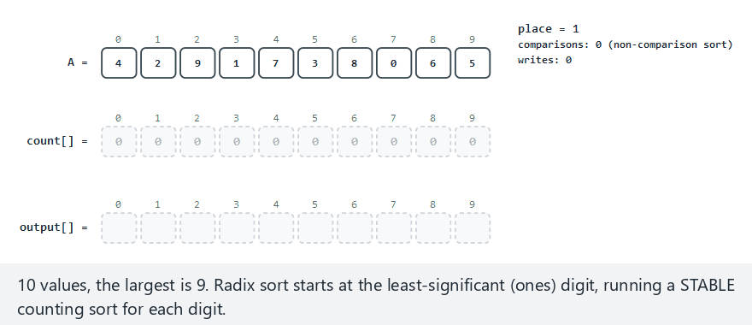
CEN207 Data Structures · Week 10
Edge case — single-digit values
RTEU Computer Engineering · Fall 2026–2027
114
Notes:
Only one pass ever runs — the loop condition naturally stops once every value fits in one digit.

Slide 115
CEN207 Data Structures · Week 10
Code — extracting a digit
int get_digit(int x, int place) {
return (x / place) % 10;
}
for (int place = 1;
max_val / place > 0;
place *= 10) { ... }
RTEU Computer Engineering · Fall 2026–2027
115
Notes:
get_digit(5, 100) correctly returns 0 — shorter numbers act as if left-padded with invisible zeros.

Slide 116
CEN207 Data Structures · Week 10
Code — one digit pass
/* stable counting sort,
keyed on get_digit(a[i], place) */
count_and_accumulate(place);
for (int i = n-1; i >= 0; i--)
place_by_digit(a[i], place);
copy_output_back();
RTEU Computer Engineering · Fall 2026–2027
116
Notes:
This is literally counting sort's exact two-phase structure (Section 8), just keyed on one digit instead of the whole value.

Slide 117
CEN207 Data Structures · Week 10
Complexity and mistakes
• O(d × (n + b)) — d digits, base b=10
• Fixed-width keys: effectively O(n), no log factor
• Common bug: an unstable per-digit pass breaks correctness
• Common bug: sorting from the MOST significant digit first
RTEU Computer Engineering · Fall 2026–2027
117
Notes:
Unlike most other contexts, stability here is not a nicety — it is load-bearing for correctness itself.

Slide 118
CEN207 Data Structures · Week 10
Mini-quiz
Why does sorting least-significant-digit FIRST work, when running the exact same algorithm most-significant-digit first would not?
RTEU Computer Engineering · Fall 2026–2027
118
Notes:
The answer is entirely about what each pass can and cannot assume about the digits it has not processed yet.

Slide 119
CEN207 Data Structures · Week 10
Answer
Stability composes upward. Each pass preserves order from all earlier, less-significant digits — MSD-first has no such guarantee to build on.
RTEU Computer Engineering · Fall 2026–2027
119
Notes:
MSD-first radix sort exists too, but needs a different, recursive structure to work — outside this week's scope.

Slide 120
CEN207 Data Structures · Week 10
10. Bucket Sort
RTEU Computer Engineering · Fall 2026–2027
120
Notes:
Section 10 generalizes counting sort: instead of one bucket per value, one bucket per RANGE of values.

Slide 121
CEN207 Data Structures · Week 10
A question to start
What if, instead of exact counts, you just threw each value into one of a few buckets by rough magnitude, then cleaned up each small bucket?
RTEU Computer Engineering · Fall 2026–2027
121
Notes:
If values are spread evenly, each bucket holds only a handful of elements — cheap to finish sorting locally.

Slide 122
CEN207 Data Structures · Week 10
A short history
• The oldest and most general of today's three
• non-comparison sorts — no single inventor or date
• A natural generalization of counting sort
• Depends entirely on the input's actual distribution
RTEU Computer Engineering · Fall 2026–2027
122
Notes:
Unlike Seward (counting sort) or Hollerith (radix sort), bucket sort is usually presented without a specific attribution.

Slide 123
CEN207 Data Structures · Week 10
The bucket sort idea
• Divide [0, max_val] into 10 equal-sized buckets
• Distribute each value into its bucket (tens digit here)
• Sort each small bucket (insertion sort — cheap)
• Concatenate buckets 0..9 — automatically sorted
RTEU Computer Engineering · Fall 2026–2027
123
Notes:
Bucket b's values are all smaller than bucket b+1's, by construction — concatenation alone finishes the sort.

Slide 124
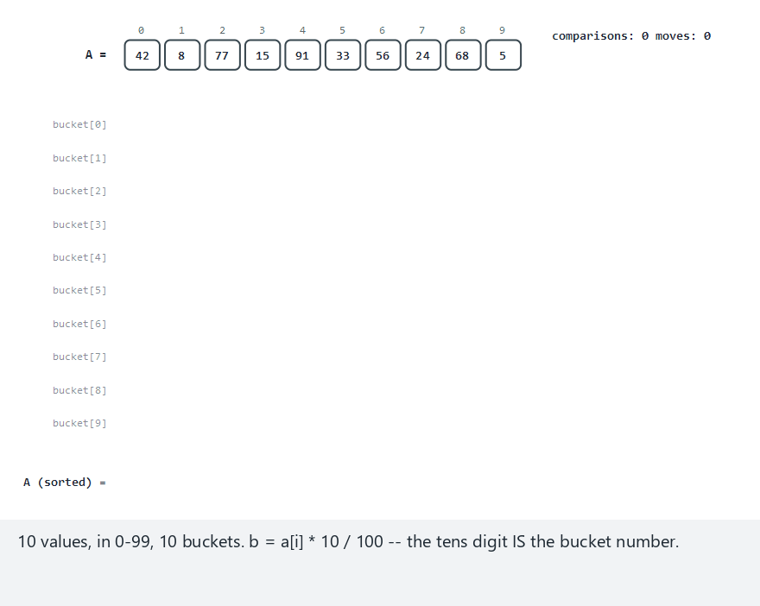
CEN207 Data Structures · Week 10
Bucket sort, step by step
RTEU Computer Engineering · Fall 2026–2027
124
Notes:
Normal example: watch values distribute into 10 buckets, then each small bucket get insertion-sorted.

Slide 125
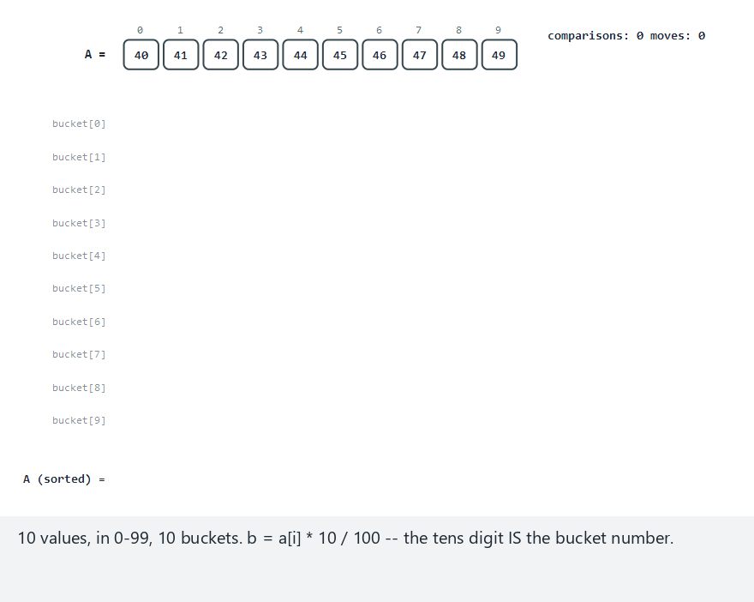
CEN207 Data Structures · Week 10
Edge case — all in one bucket
RTEU Computer Engineering · Fall 2026–2027
125
Notes:
The worst case — every value collides into one bucket, degrading to plain insertion sort on the whole array.

Slide 126
CEN207 Data Structures · Week 10
Code — distribute, then finish
int b = (a[i]*BUCKETS)
/ (max_val+1);
bucket[b][bucket_len[b]++]=a[i];
/* ... then insertion-sort each
bucket, then concatenate */
RTEU Computer Engineering · Fall 2026–2027
126
Notes:
With max_val=99 and 10 buckets, b is literally the tens digit — a clean, easy-to-explain mapping.

Slide 127
CEN207 Data Structures · Week 10
Complexity and mistakes
• Average O(n): values spread evenly across buckets
• Worst O(n²): all values collide into one bucket
• Common bug: bucket boundaries that ignore the real data
• Stable, if the inner per-bucket sort is stable
RTEU Computer Engineering · Fall 2026–2027
127
Notes:
Bucket sort's O(n) promise is entirely conditional on the input actually being evenly spread — there is no way to detect this from inside the algorithm.

Slide 128
CEN207 Data Structures · Week 10
Mini-quiz
Bucket sort needs an internal sort per bucket; counting sort needs nothing similar per value. What structural difference explains this?
RTEU Computer Engineering · Fall 2026–2027
128
Notes:
The key word is "range" versus "single value" — think about what could still be out of order within a bucket.

Slide 129
CEN207 Data Structures · Week 10
Answer
A bucket covers a RANGE of values, so it can hold several genuinely different values still needing relative order — counting sort's counts cannot.
RTEU Computer Engineering · Fall 2026–2027
129
Notes:
This is exactly why bucket sort can handle floating-point values in its general form, unlike counting sort's per-value counting.

Slide 130
CEN207 Data Structures · Week 10
11. Stability, Demonstrated
RTEU Computer Engineering · Fall 2026–2027
130
Notes:
Section 11 stops defining stability in words and shows it happening, on the same input, with two named algorithms.

Slide 131
CEN207 Data Structures · Week 10
A question to start
We defined stability in Section 1. Words are not proof. Can we watch the SAME input produce two different results, depending only on the sort?
RTEU Computer Engineering · Fall 2026–2027
131
Notes:
Yes — and this is exactly what today's dedicated stability animation does, live, with tagged records.

Slide 132
CEN207 Data Structures · Week 10
The demo's setup
• Records are (key, tag) pairs — e.g. 5a, 5b, 5c
• Several records deliberately share a key (a "tie")
• Row 1: insertion sort — stable (Section 4)
• Row 2: selection sort — unstable (Section 3)
RTEU Computer Engineering · Fall 2026–2027
132
Notes:
The tag is a stand-in for "which physical record this was" — imagine a student name, sorted by grade.

Slide 133
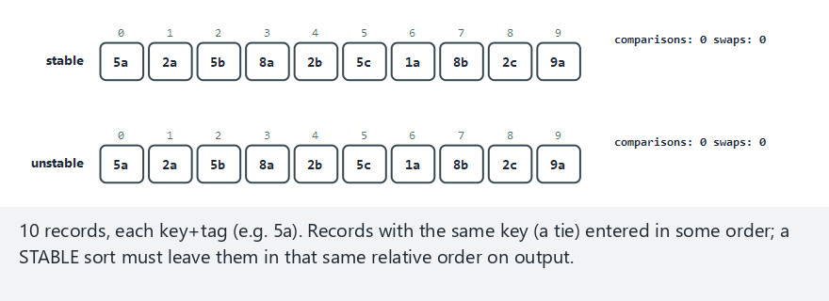
CEN207 Data Structures · Week 10
Stability, demonstrated
RTEU Computer Engineering · Fall 2026–2027
133
Notes:
Watch the 5a, 5b, 5c group specifically — stable keeps them in order, unstable does not.

Slide 134
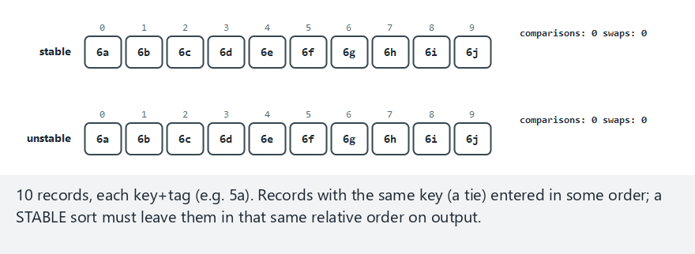
CEN207 Data Structures · Week 10
Edge case — all keys equal
RTEU Computer Engineering · Fall 2026–2027
134
Notes:
The most extreme case — a fully stable sort must reproduce the ENTIRE input order unchanged.

Slide 135
CEN207 Data Structures · Week 10
The result, read closely
• Stable (insertion): 5a 5b 5c — exact input order
• Unstable (selection): 5b 5c 5a — 5a pushed to the end
• Not a bug — selection sort's long-range swap in action
• Already-sorted input shows NO difference between them
RTEU Computer Engineering · Fall 2026–2027
135
Notes:
Instability only has something to act on when a swap actually crosses a tied element — sorted input never triggers that.

Slide 136
CEN207 Data Structures · Week 10
Which sorts are stable?
Sort | Stable?
Bubble, insertion, merge, counting, radix | Yes
Selection, shell, quick (Lomuto/Hoare) | No
Bucket | Yes, if inner sort is stable
RTEU Computer Engineering · Fall 2026–2027
136
Notes:
Radix sort's stability is not optional — Section 9 showed it is required for correctness, not just a nice-to-have.

Slide 137
CEN207 Data Structures · Week 10
Mini-quiz
Selection sort is unstable. Describe, without code, one general way to force it — or any comparison sort — to become stable.
RTEU Computer Engineering · Fall 2026–2027
137
Notes:
The trick generalizes to any comparison-based sort, not just selection sort specifically.

Slide 138
CEN207 Data Structures · Week 10
Answer
Attach the original index to each element, and break ties in the comparison by that index. The sort's mechanics never need to change.
RTEU Computer Engineering · Fall 2026–2027
138
Notes:
This costs extra memory to track indices, but works universally — a good trick to know even if today's sorts don't need it.

Slide 139
CEN207 Data Structures · Week 10
12. Comparing the Algorithms, Empirically
RTEU Computer Engineering · Fall 2026–2027
139
Notes:
Section 12 stops trusting Big-O's hidden constants and just runs five algorithms on the same input, counting exactly.

Slide 140
CEN207 Data Structures · Week 10
A question to start
Big-O hides constant factors. The only way to settle "which sort actually wins on THIS data" is to run them and count. So — let's count.
RTEU Computer Engineering · Fall 2026–2027
140
Notes:
Five algorithms, one identical input each time, comparisons and writes counted through the same two primitives.

Slide 141
CEN207 Data Structures · Week 10
The setup
• Bubble, selection, insertion, merge, quick (Lomuto)
• All sort the identical array, every single time
• Every comparison and write goes through counted helpers
• The tallies are a measurement, not an estimate
RTEU Computer Engineering · Fall 2026–2027
141
Notes:
No algorithm here is re-taught — each already has its own dedicated animation. This is purely a side-by-side measurement.

Slide 142
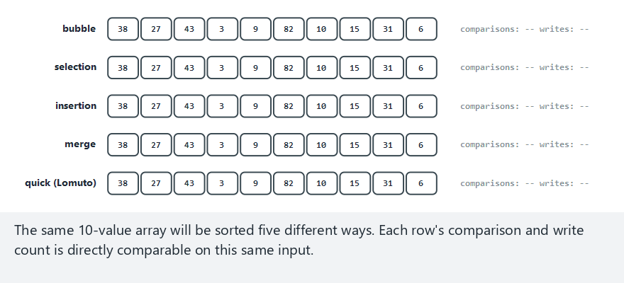
CEN207 Data Structures · Week 10
Sorting algorithms, compared
RTEU Computer Engineering · Fall 2026–2027
142
Notes:
Normal example: watch each row reveal its comparisons/writes tally as its "running..." highlight resolves.

Slide 143
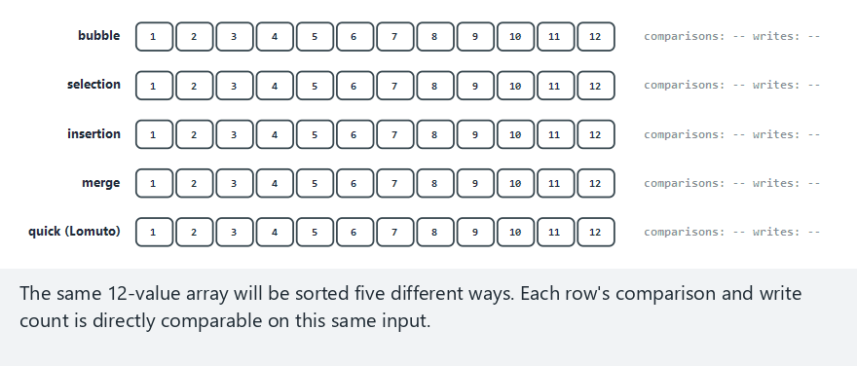
CEN207 Data Structures · Week 10
Edge case — already sorted
RTEU Computer Engineering · Fall 2026–2027
143
Notes:
The whole week's lesson in one animation: bubble wins by a landslide, quick (Lomuto) has its worst possible day.

Slide 144
CEN207 Data Structures · Week 10
Four numbers, one story
Input | Bubble | Quick (Lomuto)
Already sorted (n=12) | 11 | 66
Reverse sorted (n=12) | 66 | 66
RTEU Computer Engineering · Fall 2026–2027
144
Notes:
The exact same 66-comparison worst case from Section 7's quick sort slides, now sitting right next to bubble's 11.

Slide 145
CEN207 Data Structures · Week 10
No single winner
• Bubble: wins decisively on already-sorted data
• Quick (Lomuto): wins on average for large random data
• Insertion: wins on nearly-sorted data specifically
• The winner always depends on the shape of the input
RTEU Computer Engineering · Fall 2026–2027
145
Notes:
This single sentence is the entire justification for teaching eleven different sorting algorithms instead of one "best" one.

Slide 146
CEN207 Data Structures · Week 10
Mini-quiz
On nearly-sorted input (just two values swapped), insertion sort needed only 18 comparisons while selection sort needed the full 66. Why the gap?
RTEU Computer Engineering · Fall 2026–2027
146
Notes:
Point them back at Section 4's self-check about why insertion sort's cost tracks how far out of place elements are.

Slide 147
CEN207 Data Structures · Week 10
Answer
Insertion sort exploits partial order — most elements need one check and stop. Selection sort's full scan ignores how sorted the input is.
RTEU Computer Engineering · Fall 2026–2027
147
Notes:
Nearly-sorted data is insertion sort's best case in practice, but not selection sort's — a direct callback to Section 4.5.

Slide 148
CEN207 Data Structures · Week 10
13. Choosing a Sorting Algorithm
RTEU Computer Engineering · Fall 2026–2027
148
Notes:
Section 13 turns everything today into a single practical question: given what you know about your data, which sort?

Slide 149
CEN207 Data Structures · Week 10
The decision table
Situation | Best choice
Tiny array, or a recursive sub-array | Insertion sort
Already / nearly sorted | Insertion, or bubble (early exit)
Writes expensive, comparisons cheap | Selection sort
RTEU Computer Engineering · Fall 2026–2027
149
Notes:
This table continues over the next two slides — read the full version in this week's notes for the complete nine-row table.

Slide 150
CEN207 Data Structures · Week 10
The decision table, continued
Situation | Best choice
Need guaranteed O(n log n), memory OK | Merge sort
Need average O(n log n), in place | Quick sort, median-of-3
No recursion allowed | Merge sort (bottom-up), heap sort
RTEU Computer Engineering · Fall 2026–2027
150
Notes:
"Memory OK" versus "in place" is the single biggest fork in this whole table — merge sort or quick sort, rarely both matter equally.

Slide 151
CEN207 Data Structures · Week 10
The decision table, concluded
Situation | Best choice
Small-integer keys, range ≈ n | Counting sort
Larger integer/string keys | Radix sort (LSD)
Keys spread evenly over a range | Bucket sort
Ties must keep input order | Any stable sort (Section 11.5)
RTEU Computer Engineering · Fall 2026–2027
151
Notes:
These four rows are this week's second half in one glance — the non-comparison sorts, chosen by what you know about the keys.

Slide 152
CEN207 Data Structures · Week 10
The real question
• Not "which sort is fastest in general" — there isn't one
• What do you actually know about your data?
• What do you actually need: a guarantee? stability?
• Section 12 gave you the tool to measure, not guess
RTEU Computer Engineering · Fall 2026–2027
152
Notes:
Knowing all eleven well enough to recognize which situation you're in — that is this week's real, transferable skill.

Slide 153
CEN207 Data Structures · Week 10
Summary
• O(n²) family: bubble, selection, insertion, shell sort
• O(n log n) guaranteed: merge sort (top-down, bottom-up)
• O(n log n) average, in place: quick sort (Lomuto, Hoare)
• Non-comparison, O(n+k): counting, radix, bucket sort
RTEU Computer Engineering · Fall 2026–2027
153
Notes:
Eleven algorithms, four families, one underlying question each time: what do you know, and what can you afford?

Slide 154
CEN207 Data Structures · Week 10
Summary, continued
• Comparison-sorting lower bound: O(n log n), provably
• Non-comparison sorts beat it by never comparing keys
• Stability: an extra guarantee, not correctness itself
• No single "best" sort — the input's shape decides
RTEU Computer Engineering · Fall 2026–2027
154
Notes:
If you remember one thing from today, make it this: measure, don't assume, and know which situation you are actually in.

Slide 155
CEN207 Data Structures · Week 10
Looking ahead
• Week 11: advanced tree structures
• Balanced trees maintain sorted order incrementally
• Merge sort's divide-and-conquer reappears, tree-shaped
• Later: external sorting — data too big for memory
RTEU Computer Engineering · Fall 2026–2027
155
Notes:
Bottom-up merge sort's "merge sorted runs" mechanism becomes the literal foundation for sorting data that lives on disk.

Slide 156
CEN207 Data Structures · Week 10
Questions?
CEN207 Data Structures — Week 10
Asst. Prof. Dr. Uğur CORUH · Fall 2026–2027
RTEU Computer Engineering · Fall 2026–2027
156
Notes:
Full notes, all fourteen animations, and every program are in this week's lecture notes — thank you.

