Slide 1

CEN207 Data Structures · Week 13
File Organisation I: Sequential and Direct Files
CEN207 Data Structures — Week 13
Asst. Prof. Dr. Uğur CORUH · Fall 2026–2027
RTEU Computer Engineering · Fall 2026–2027
Notes:
Every structure so far lived in RAM. This week moves to disk, where the unit that matters is not a comparison but a block read.

Slide 2
CEN207 Data Structures · Week 13
Today's plan (3 hours)
Hour | Topic
1 | Blocks, records/fields Anim 1 · blocking factor Anim 2 · sequential search Anim 3
2 | Binary search of a sorted file Anim 4 · sequential update / merge Anim 5
3 | Relative access Anim 6 · hashing to buckets Anim 7 · progressive overflow Anim 8 · tombstones Anim 9
Learning outcomes: LO.1 (explain fundamental data structures) · LO.2 (analyze complexity) · LO.6 (implement in C and Java) · LO.7 (choose the right structure)
RTEU Computer Engineering · Fall 2026–2027
2
Notes:
Nine short animations carry the whole lecture; each idea gets one normal run and one edge/hard run, right where it is introduced.

Slide 3
CEN207 Data Structures · Week 13
This week's concepts — where
Concept | Where
Records/fields, blocking factor | Sections 2–3
Sequential search, binary search of a sorted file | Sections 4–5
Sequential update (merge master + transactions) | Section 6
Relative (direct) access | Section 7
Hashing to buckets, progressive overflow, tombstones | Sections 8–10
RTEU Computer Engineering · Fall 2026–2027
3
Notes:
Every term gets a full definition the first time it appears; this table just says where to find it again.

Slide 4
CEN207 Data Structures · Week 13
How the code examples work
• Every idea has a complete C and Java program
• Both perform real file I/O: fopen/fseek/fread/fwrite, RandomAccessFile
• Each program creates its own temporary lab folder, then deletes it
• Sources: code/week-13/c/ and code/week-13/java/
• Each program's expected output is in the week notes
RTEU Computer Engineering · Fall 2026–2027
4
Notes:
Open a terminal now if you want to run these live; every program creates a scratch folder in the OS temp directory, never inside the repo.

Slide 5
CEN207 Data Structures · Week 13
Recap — computed addresses (Week 1)
• arr[i] = base_address + i * element_size
• No searching needed to reach index i — just arithmetic
• Section 7's relative file is exactly this idea, moved to disk
• block = rrn / bf, offset = rrn % bf — computed, not searched
RTEU Computer Engineering · Fall 2026–2027
5
Notes:
This week keeps returning to one theme — trading a search for a computation whenever the data's layout allows it.

Slide 6
CEN207 Data Structures · Week 13
Recap — hashing and collisions (Week 6)
• h(key) = key mod m picks a slot in RAM
• Collisions resolved by chaining or open addressing
• Sections 8–10 reuse both ideas, unchanged in logic
• The only difference: every "slot" is now a disk position
RTEU Computer Engineering · Fall 2026–2027
6
Notes:
If you understood Week 6's hash table, sections 8-10 are the same table, just one level removed from RAM.

Slide 7
CEN207 Data Structures · Week 13
The one genuinely new idea
• Weeks 1–12: cost = comparisons, swaps, pointer hops
• This week: cost = block reads and writes
• A block read costs orders of magnitude more than any RAM op
• Comparing extra records already in RAM costs almost nothing
RTEU Computer Engineering · Fall 2026–2027
7
Notes:
This single shift in what you count is the organizing idea of the entire week — everything else follows from it.

Slide 8
CEN207 Data Structures · Week 13
Map of the week — at a glance
Family | Sections
Foundations | Records/fields (2), blocking factor (3)
Sequential — process in order | Search (4), sorted search (5), update (6)
Direct — compute the location | Relative (7), hashing (8–10)
RTEU Computer Engineering · Fall 2026–2027
8
Notes:
Every box here gets its own full section below, each with an animation, a real program, and a complexity/mistakes discussion.

Slide 9
CEN207 Data Structures · Week 13
1. Why Files Are Different: Block-Oriented I/O
RTEU Computer Engineering · Fall 2026–2027
9
Notes:
Section 1 has no animation of its own — it sets up the drawing convention and cost model every later section reuses.

Slide 10
CEN207 Data Structures · Week 13
A question to start
A file usually cannot fit in RAM at all. If a program needs one 20-byte record, why does the disk not just hand over 20 bytes?
RTEU Computer Engineering · Fall 2026–2027
10
Notes:
The answer is a hardware and file-system fact, not a design choice any program can opt out of.

Slide 11
CEN207 Data Structures · Week 13
The idea: a block is the smallest unit of I/O
• Disks are organized into fixed-size blocks
• Every read/write transfers one whole block, never less
• Even a 20-byte request loads the entire surrounding block
• This is why file organisation exists as a topic at all
RTEU Computer Engineering · Fall 2026–2027
11
Notes:
Every technique this week is really a strategy for minimizing the number of block reads and writes.

Slide 12
CEN207 Data Structures · Week 13
This week's drawing convention
• A disk row: named, numbered blocks, contents drawn inside
• A RAM buffer row: the one block currently loaded
• Block reads and block writes, counted on the right
• That count is this week's O(...) — watch it, not the keys
RTEU Computer Engineering · Fall 2026–2027
12
Notes:
Every single animation this week uses exactly this layout — once you can read one, you can read all nine.

Slide 13
CEN207 Data Structures · Week 13
Two families, one week
Family | Locate a record
Sequential (sections 4–6) | Read blocks in order, or jump to a middle block
Direct (sections 7–10) | One calculation, then one block read
Sequential wins when you process every record anyway; direct wins for one lookup among millions.
RTEU Computer Engineering · Fall 2026–2027
13
Notes:
Real systems very often use both at once — a sequential file for batch jobs, a hashed file for interactive lookups.

Slide 14
CEN207 Data Structures · Week 13
Mini-quiz
A sequential search reads 100 blocks, comparing 1 key per block. A second file reads 100 blocks, comparing 1000 keys per block. Which is faster?
RTEU Computer Engineering · Fall 2026–2027
14
Notes:
Think about what actually costs time here — the comparisons, or the disk accesses.

Slide 15
CEN207 Data Structures · Week 13
Answer
Neither — they cost about the same. The disk access dominates; comparing extra keys already sitting in a loaded block is nearly free.
RTEU Computer Engineering · Fall 2026–2027
15
Notes:
This is precisely why every section from here on counts block reads, not comparisons, as its complexity.

Slide 16
CEN207 Data Structures · Week 13
2. Records and Fields
RTEU Computer Engineering · Fall 2026–2027
16
Notes:
Section 2 is about packing several fields of a record into bytes — and unpacking them again on read.

Slide 17
CEN207 Data Structures · Week 13
A question to start
A name field can hold "Al" or "Christopherson". Should every record reserve the same number of bytes for it regardless?
RTEU Computer Engineering · Fall 2026–2027
17
Notes:
The three answers below trade wasted space against parsing cost, and none of them is free.

Slide 18
CEN207 Data Structures · Week 13
Three layouts for the same field
Layout | How | Cost
Fixed-length | Pad or truncate to NAME_FIXED | Wasted space or lost data
Delimited | Write value, then a delimiter byte | Scan to find the delimiter
Length-prefixed | Write length byte, then that many bytes | O(1) read, max length 255
RTEU Computer Engineering · Fall 2026–2027
18
Notes:
Fixed-length pays with wasted or lost bytes; delimited pays with a scan; length-prefixed pays with a hard size cap.

Slide 19
CEN207 Data Structures · Week 13
Why fixed-length matters most
• Every record is exactly the same size
• That is what makes computing an address from a position possible
• Section 3 (blocking) and section 7 (direct access) both need this
• Delimited/length-prefixed records cannot be located this way
RTEU Computer Engineering · Fall 2026–2027
19
Notes:
This is the seed of the whole "compute instead of search" theme that runs through the rest of the week.

Slide 20
CEN207 Data Structures · Week 13
Intuition — a form with a "name" box
• A paper form's name box is a fixed size on the page
• A spreadsheet cell grows to fit whatever you type — delimited
• A shipping label prints a length, then that many characters
• All three exist in real systems, for exactly these trade-offs
RTEU Computer Engineering · Fall 2026–2027
20
Notes:
None of these three is "the right one" in general — the right choice depends entirely on whether records need a fixed, computable size.

Slide 21
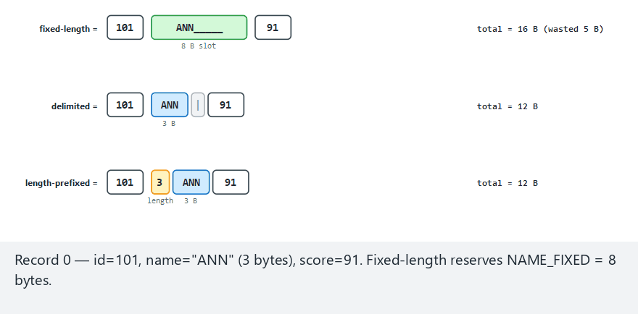
CEN207 Data Structures · Week 13
Records and fields, step by step
RTEU Computer Engineering · Fall 2026–2027
21
Notes:
Normal example: 11 records, `NAME_FIXED=8` — watch which names get padded and which get silently truncated.

Slide 22
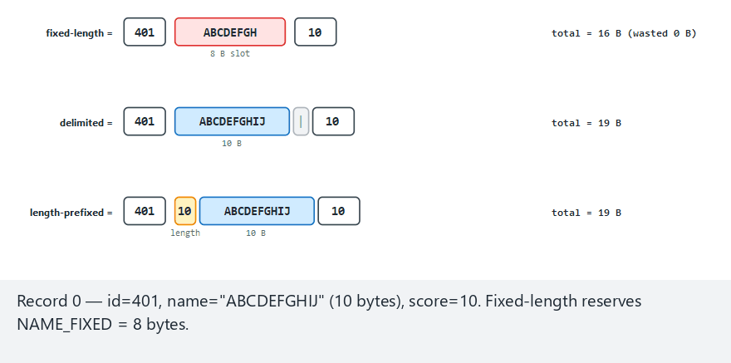
CEN207 Data Structures · Week 13
Edge case — every name longer than 8 characters
RTEU Computer Engineering · Fall 2026–2027
22
Notes:
Every single record loses data in the fixed layout here — the worst case for this technique, made maximal on purpose.

Slide 23
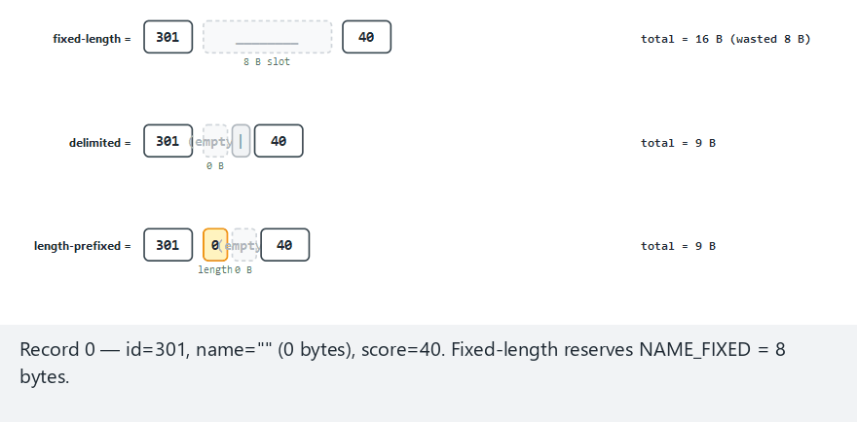
CEN207 Data Structures · Week 13
Edge case — an empty name and a very long name
RTEU Computer Engineering · Fall 2026–2027
23
Notes:
An empty name is fully padded in the fixed layout, costs zero bytes in the delimited layout — two very different ways to handle the same extreme.

Slide 24
CEN207 Data Structures · Week 13
Code — fixed-length: pad or truncate
#define NAME_FIXED 8
int n = (int) strlen(name);
if (n >= NAME_FIXED) {
/* too long: truncate, data is LOST */
memcpy(r.name, name, NAME_FIXED);
} else {
memcpy(r.name, name, n);
/* pad with filler bytes */
memset(r.name + n, '_', NAME_FIXED - n);
}
RTEU Computer Engineering · Fall 2026–2027
24
Notes:
Truncation is silent unless the program itself decides to report it — the code above prints a warning specifically for that reason.

Slide 25
CEN207 Data Structures · Week 13
Code — length-prefixed: O(1) to read back
unsigned char len =
(unsigned char) strlen(name);
fwrite(&len, 1, 1, fp); /* 1-byte prefix */
fwrite(name, 1, len, fp);
/* reading back: read len, then read
exactly len more bytes — no scanning */
RTEU Computer Engineering · Fall 2026–2027
25
Notes:
No delimiter character is needed at all, and no character has to be forbidden inside the name — the trade is a 255-byte length cap.

Slide 26
CEN207 Data Structures · Week 13
Complexity
• Writing/reading one field: O(field length), all three layouts
• The difference is not asymptotic
• It is wasted space (fixed) vs. parsing cost (delimited) vs. neither (capped, length-prefixed)
RTEU Computer Engineering · Fall 2026–2027
26
Notes:
This is a rare case this semester where the interesting trade-off is not in the big-O at all.

Slide 27
CEN207 Data Structures · Week 13
Common mistakes
• Forgetting a full/truncated fixed field has no room for `'0'`
• Choosing a delimiter that can legally appear inside the data
• Silently truncating instead of reporting the data loss
RTEU Computer Engineering · Fall 2026–2027
27
Notes:
A delimiter like a comma inside a name breaks the moment a real name contains a comma — length-prefixing sidesteps this class of bug entirely.

Slide 28
CEN207 Data Structures · Week 13
Mini-quiz
Why is a length-prefixed field's read cost O(1) plus its own length, while a delimited field's read cost is a full scan?
RTEU Computer Engineering · Fall 2026–2027
28
Notes:
Think about what information the reader has *before* it starts reading the field's content.

Slide 29
CEN207 Data Structures · Week 13
Answer
The length-prefixed reader is told the size in advance (one byte, then that many bytes). A delimited reader must scan byte by byte, comparing against the delimiter, to find the end.
RTEU Computer Engineering · Fall 2026–2027
29
Notes:
The length-prefixed scheme's one byte of overhead buys it certainty a scan can never have in advance.

Slide 30
CEN207 Data Structures · Week 13
3. Blocking Factor
RTEU Computer Engineering · Fall 2026–2027
30
Notes:
Section 3 answers a question section 1 left open — how many records actually share one disk access?

Slide 31
CEN207 Data Structures · Week 13
A question to start
A block is 100 bytes; one record is 20 bytes. Does the disk waste 80 bytes on every read, or can several records share one block?
RTEU Computer Engineering · Fall 2026–2027
31
Notes:
The answer is the blocking factor — and it does not eliminate waste, it only relocates where the waste happens.

Slide 32
CEN207 Data Structures · Week 13
The idea: pack bf records per block
• bf = floor(blockSize / recSize)
• Records fill a small RAM buffer, one at a time
• The moment the buffer reaches bf records: one fwrite
• Disk access happens per block, not per record
RTEU Computer Engineering · Fall 2026–2027
32
Notes:
This is the entire payoff of blocking — bf records for the price of one disk access, not bf separate accesses.

Slide 33
CEN207 Data Structures · Week 13
Two kinds of waste
Kind | Where | Cause
Internal fragmentation | Every full block | bf * recSize rarely equals blockSize exactly
Last-block waste | Only the final block | Record count is not an exact multiple of bf
RTEU Computer Engineering · Fall 2026–2027
33
Notes:
A partial last block still occupies a whole block on disk — block_flush writes it anyway, waste included.

Slide 34
CEN207 Data Structures · Week 13
Intuition — a moving truck, not a courier bike
• A courier bike carries one package per trip: slow, one at a time
• A moving truck carries bf boxes per trip: fewer trips, same boxes
• A truck that leaves half-empty still burns a full trip's fuel
• That "half-empty trip" is exactly this section's last-block waste
RTEU Computer Engineering · Fall 2026–2027
34
Notes:
The truck analogy makes both kinds of waste tangible: cargo space unused per trip, and a trip taken for very little cargo.

Slide 35
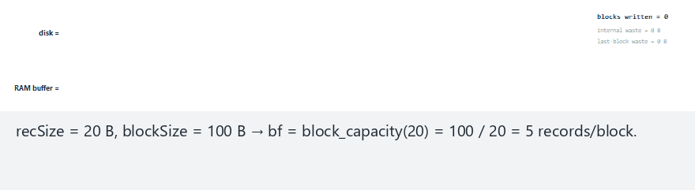
CEN207 Data Structures · Week 13
Blocking factor, step by step
RTEU Computer Engineering · Fall 2026–2027
35
Notes:
Watch the RAM buffer fill to bf, flush as one block write, then start over empty for the next block.

Slide 36
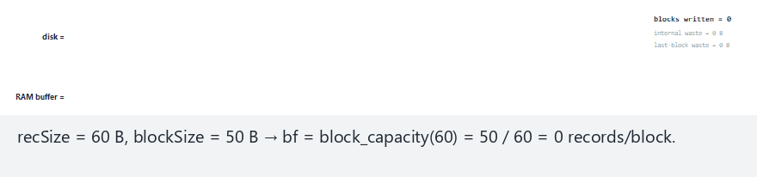
CEN207 Data Structures · Week 13
Edge case — record bigger than the block
RTEU Computer Engineering · Fall 2026–2027
36
Notes:
bf computes to 0 here — a real system must detect and reject this as a design error, never silently misbehave.

Slide 37
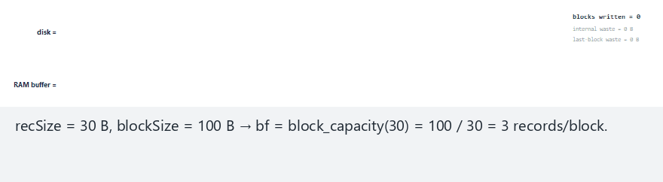
CEN207 Data Structures · Week 13
Edge case — 12 keys divide bf=3 exactly
RTEU Computer Engineering · Fall 2026–2027
37
Notes:
No last-block waste here — but internal fragmentation still happens inside every full block, since the two kinds of waste are independent.

Slide 38
CEN207 Data Structures · Week 13
Code — capacity, fill, and flush
#define BLOCK_SIZE 100
int block_capacity(int rec_size) {
return BLOCK_SIZE / rec_size;
}
/* block_put: append a key; flush when full */
/* block_flush: write a PARTIAL last block */
/* anyway — a whole block, however few keys */
RTEU Computer Engineering · Fall 2026–2027
38
Notes:
block_flush is only ever called once, after the main loop — it is what pays the last-block waste.

Slide 39
CEN207 Data Structures · Week 13
Complexity
• Blocking itself changes no algorithm's asymptotic cost
• It changes the constant: block reads/writes, not record count
• Larger bf → fewer, bigger disk accesses → faster in practice
• Up to the point a block becomes too large to buffer in RAM
RTEU Computer Engineering · Fall 2026–2027
39
Notes:
Sections 4 and 5's O(numBlocks) and O(log numBlocks) both shrink directly as bf grows, because numBlocks = n / bf.

Slide 40
CEN207 Data Structures · Week 13
Common mistakes
• Forgetting the last block still costs a full block write
• Picking blockSize smaller than one record (bf = 0)
• Confusing internal fragmentation with last-block waste — they are independent
RTEU Computer Engineering · Fall 2026–2027
40
Notes:
These two kinds of waste have different causes and different fixes — conflating them leads to the wrong optimization.

Slide 41
CEN207 Data Structures · Week 13
Mini-quiz
recSize = 24, blockSize = 100. What is bf, and how many bytes of internal fragmentation does one full block waste?
RTEU Computer Engineering · Fall 2026–2027
41
Notes:
bf = floor(100/24) = 4; the wasted bytes are what is left over after bf*recSize.

Slide 42
CEN207 Data Structures · Week 13
Answer
`bf = 4`. 4 * 24 = 96 bytes used, 4 bytes wasted per full block — small here, but multiplied by every block in a huge file.
RTEU Computer Engineering · Fall 2026–2027
42
Notes:
4 bytes looks trivial for one block — the "hard" scenario in the animation shows it compounding across many blocks.

Slide 43
CEN207 Data Structures · Week 13
4. Sequential Search of a File
RTEU Computer Engineering · Fall 2026–2027
43
Notes:
Section 4 is Week 1's linear search, adapted to the fact that records arrive bf at a time, not one at a time.

Slide 44
CEN207 Data Structures · Week 13
A question to start
A file's records are not sorted. To find one key, is there any option other than reading every block until it turns up, or the file ends?
RTEU Computer Engineering · Fall 2026–2027
44
Notes:
With no sort order to exploit, the answer this section gives is: no — every block must be checked.

Slide 45
CEN207 Data Structures · Week 13
The idea: read blocks in order, compare inside
• Read block 0 into the RAM buffer
• Compare every record inside it against the target
• Not found? Read block 1 — and so on
• Cost that matters: block reads, not comparisons
RTEU Computer Engineering · Fall 2026–2027
45
Notes:
Comparing a few extra records already sitting in RAM costs almost nothing next to the disk access that loaded them.

Slide 46
CEN207 Data Structures · Week 13
Intuition — reading a shelf of unsorted boxes
• Looking for one file in an unsorted shelf of boxes
• You must open every box, one by one, until you find it
• Or open every box and find nothing — you still opened them all
• A "box" here is one block; opening it is one disk read
RTEU Computer Engineering · Fall 2026–2027
46
Notes:
This is Week 1's linear search, retold with disk-sized units — the box, not the paper inside it, is what costs time to open.

Slide 47
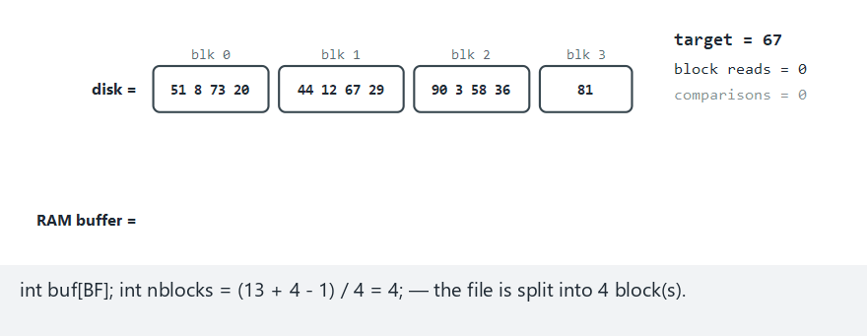
CEN207 Data Structures · Week 13
Sequential search, step by step
RTEU Computer Engineering · Fall 2026–2027
47
Notes:
Normal example: bf=4 — watch the block-read counter, not the comparison counter, as the true cost.

Slide 48
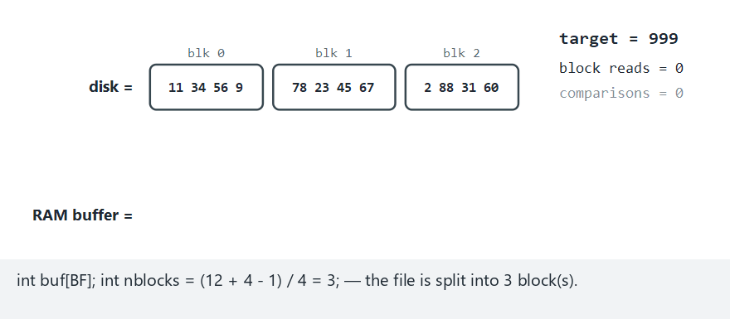
CEN207 Data Structures · Week 13
Edge case — target absent, whole file scanned
RTEU Computer Engineering · Fall 2026–2027
48
Notes:
An absent target costs exactly the same as finding the very last record — every block must be read either way.

Slide 49
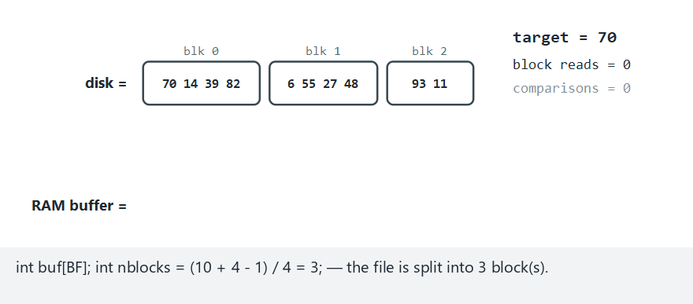
CEN207 Data Structures · Week 13
Edge case — target is the first record (best case)
RTEU Computer Engineering · Fall 2026–2027
49
Notes:
One block read, one comparison — the best case, exactly as far from the worst case as this technique's variance ever gets.

Slide 50
CEN207 Data Structures · Week 13
Code — scan one block, then the next
for (int b = 0; b < nblocks; b++) {
load_block(f, b, buf, &cnt);
(*block_reads)++;
for (int i = 0; i < cnt; i++) {
(*comparisons)++;
if (buf[i] == target)
return b * bf + i;
}
}
return -1; /* exhausted every block */
RTEU Computer Engineering · Fall 2026–2027
50
Notes:
block_reads increments once per block; comparisons increments once per record — only the first is this week's real cost.

Slide 51
CEN207 Data Structures · Week 13
Complexity
• Worst case: `ceil(n / bf)` block reads — every block
• Average case: about half that
• The exact file analogue of Week 1's O(n) linear search
• Unit counted is blocks, not records — O(n / bf)
RTEU Computer Engineering · Fall 2026–2027
51
Notes:
A larger blocking factor from section 3 directly speeds up sequential search, since numBlocks shrinks as bf grows.

Slide 52
CEN207 Data Structures · Week 13
Common mistakes
• Counting comparisons instead of block reads as the real cost
• Assuming a key is absent before reading every remaining block
• Returning the last match of a duplicate instead of the first
RTEU Computer Engineering · Fall 2026–2027
52
Notes:
Unlike section 5's sorted file, an unsorted sequential file offers no shortcut at all for the not-found case.

Slide 53
CEN207 Data Structures · Week 13
Mini-quiz
Why is sequential search's worst case exactly the same whether the target is absent, or is the very last record in the file?
RTEU Computer Engineering · Fall 2026–2027
53
Notes:
Think about what the algorithm can conclude before it has read the final block.

Slide 54
CEN207 Data Structures · Week 13
Answer
Both require reading every block. For the last record, the match is not found until the final block; for an absent key, nothing rules out any block early — every one must be checked.
RTEU Computer Engineering · Fall 2026–2027
54
Notes:
This is the same shape of answer section 5 will contrast against a moment from now, once the file is sorted.

Slide 55
CEN207 Data Structures · Week 13
5. Binary Search of a Sorted File
RTEU Computer Engineering · Fall 2026–2027
55
Notes:
Section 5 asks what section 4 never used — the fact that the file could be sorted at all.

Slide 56
CEN207 Data Structures · Week 13
A question to start
If section 4's file is kept sorted, can it be searched the way Week 1's binary search searches a sorted array — but block by block?
RTEU Computer Engineering · Fall 2026–2027
56
Notes:
The answer is yes, with one twist: an entire block is ruled out per comparison, not one element.

Slide 57
CEN207 Data Structures · Week 13
The idea: binary search over BLOCKS
• Block b's records are a sorted, non-overlapping range
• Compare target to a block's first and last key
• Too small? Discard the right half of the block range
• Too big? Discard the left half — otherwise, it is in this block
RTEU Computer Engineering · Fall 2026–2027
57
Notes:
Once binary search narrows down to one block, a short linear scan inside it (section 4's idea, bounded to bf) finds it or confirms a gap.

Slide 58
CEN207 Data Structures · Week 13
What "gap" means
• "In range" does not mean "present"
• A target between a block's first and last key might still be absent
• The linear scan inside that one block confirms or denies it
• This never happens in section 4 — an unsorted file has no ranges
RTEU Computer Engineering · Fall 2026–2027
58
Notes:
This is the edge case worth its own animation run — binary search narrows down WHICH block, not whether the key exists.

Slide 59
CEN207 Data Structures · Week 13
Intuition — a labeled shelf of sorted boxes
• Now the shelf's boxes are labeled with their contents' range
• Check one box's label: your file is before it, inside it, or after
• Skip straight past every box that cannot possibly hold it
• Only open the one box whose label range matches
RTEU Computer Engineering · Fall 2026–2027
59
Notes:
The label is exactly a block's first/last key — reading it costs one glance, ruling out everything on the wrong side.

Slide 60
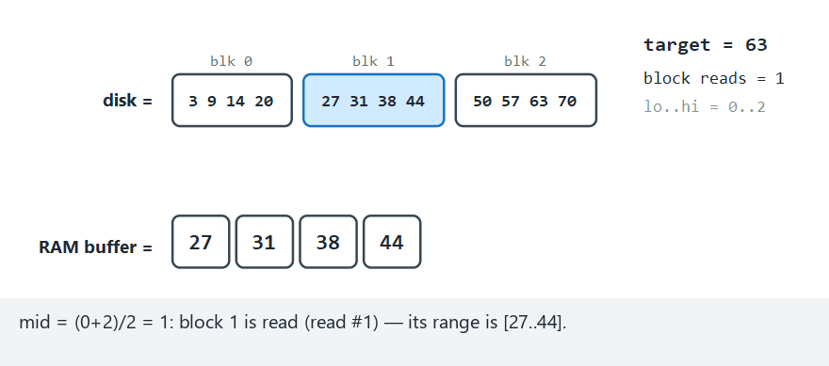
CEN207 Data Structures · Week 13
Binary search of a sorted file, step by step
RTEU Computer Engineering · Fall 2026–2027
60
Notes:
Normal example: watch each comparison rule out an entire block's worth of records at once.

Slide 61
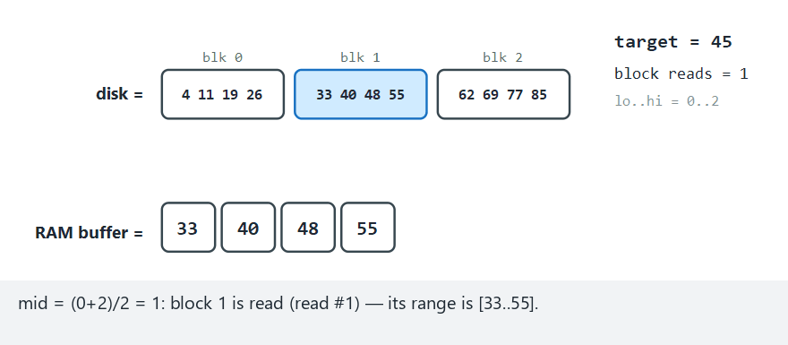
CEN207 Data Structures · Week 13
Edge case — a gap inside a block's range
RTEU Computer Engineering · Fall 2026–2027
61
Notes:
The target falls between two real keys in the same block — the short scan inside it correctly reports "not found".

Slide 62
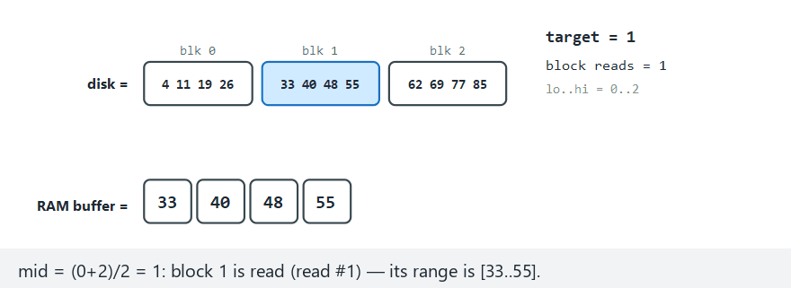
CEN207 Data Structures · Week 13
Edge case — target below the file's minimum key
RTEU Computer Engineering · Fall 2026–2027
62
Notes:
The very first comparison against block 0's first key already rules out the whole file — no further reads needed.

Slide 63
CEN207 Data Structures · Week 13
Code — narrow to one block, then scan
while (lo <= hi) {
int mid = (lo + hi) / 2;
block_reads++;
if (target < first_key(mid)) hi = mid-1;
else if (target > last_key(mid)) lo = mid+1;
else {
/* target's range: short scan inside */
return scan_block(mid, target);
}
}
RTEU Computer Engineering · Fall 2026–2027
63
Notes:
Every iteration reads exactly one block, exactly like array binary search examines exactly one element.

Slide 64
CEN207 Data Structures · Week 13
Complexity
• `O(log2 numBlocks)` block reads, plus a scan of ≤ bf records
• Compare to section 4's `O(numBlocks)`
• 24 keys, 6 blocks: 3 reads here vs. 6 for sequential
• Gap widens dramatically as the file grows
RTEU Computer Engineering · Fall 2026–2027
64
Notes:
Exactly like Week 1's binary vs. linear search on an array — same shape of speedup, one level up.

Slide 65
CEN207 Data Structures · Week 13
Common mistakes
• Forgetting "in range" does not mean "present" (the gap case)
• Comparing against the block's middle key instead of first/last
• Applying this to an unsorted file — silently wrong, not just slow
RTEU Computer Engineering · Fall 2026–2027
65
Notes:
This algorithm must compare against a whole block's range, because a block of several records, not one record, is ruled in or out at each step.

Slide 66
CEN207 Data Structures · Week 13
Mini-quiz
Array binary search (Week 1) needs O(log n) comparisons. File binary search needs O(log numBlocks) reads. Is one better?
RTEU Computer Engineering · Fall 2026–2027
66
Notes:
Recall numBlocks = n / bf — think about whether this is a fundamentally different algorithm or the same one, one level up.

Slide 67
CEN207 Data Structures · Week 13
Answer
Neither — same idea, different unit. Array search halves elements; file search halves blocks, and numBlocks is already bf times smaller than n to start with.
RTEU Computer Engineering · Fall 2026–2027
67
Notes:
File binary search is binary search performed over groups of bf records, because block-oriented I/O forces that grouping.

Slide 68
CEN207 Data Structures · Week 13
6. Sequential Update: Merging Master and Transactions
RTEU Computer Engineering · Fall 2026–2027
68
Notes:
Section 6 is the classical algorithm this whole topic is named for — updating a huge file without touching it record by record.

Slide 69
CEN207 Data Structures · Week 13
A question to start
A bank's account file changes daily. Rewriting the entire file for every change is absurd at millions of records. What is the alternative?
RTEU Computer Engineering · Fall 2026–2027
69
Notes:
The alternative predates modern databases by decades — it comes straight from early batch-processing systems.

Slide 70
CEN207 Data Structures · Week 13
A short history
• The sorted master + transaction file merge is a classical
batch-processing pattern, older than random-access disks
• Tharp's File Organization and Processing treats it as the
canonical sequential-file update algorithm
• Still used today for huge, periodic batch jobs (billing runs)
RTEU Computer Engineering · Fall 2026–2027
70
Notes:
This pattern is one of the oldest ideas in file processing — it long predates the databases most students think of first.

Slide 71
CEN207 Data Structures · Week 13
The idea: merge two SORTED files, one pass
• Transaction file: sorted, same key, each with an op
• 'A' add, 'C' change, 'D' delete
• Two "read heads", one per file — exactly Week 10's merge step
• Compare master.key to txn.key at every step
RTEU Computer Engineering · Fall 2026–2027
71
Notes:
This is literally the merge step of merge sort from Week 10, applied to two files instead of two arrays.

Slide 72
CEN207 Data Structures · Week 13
The three cases
Compare | Meaning | Action
master.key < txn.key | No transaction for this record | Copy unchanged
master.key > txn.key | Key not yet in master | 'A': insert; else error
master.key == txn.key | Transaction applies here | See next slide
RTEU Computer Engineering · Fall 2026–2027
72
Notes:
Whichever pointer is "behind" advances — this is exactly the same comparison logic as merging two sorted arrays.

Slide 73
CEN207 Data Structures · Week 13
The equal-key case, in detail
• 'A' on an existing key: duplicate-add error
• The original record is still copied through unchanged
• 'C': value replaced, updated record written
• 'D': record simply not written — that is the delete
RTEU Computer Engineering · Fall 2026–2027
73
Notes:
A rejected transaction must never delete data nobody asked to delete — this is the single most important rule in this algorithm.

Slide 74
CEN207 Data Structures · Week 13
Intuition — two people reading two sorted lists
• One person reads the master list aloud, in order
• A second person reads the transaction list aloud, in order
• At every step, they compare their current word out loud
• Whoever is "behind" alphabetically reads their next word
RTEU Computer Engineering · Fall 2026–2027
74
Notes:
This two-reader picture is exactly Week 10's merge step, and it is the cleanest way to visualize why the algorithm never backtracks.

Slide 75
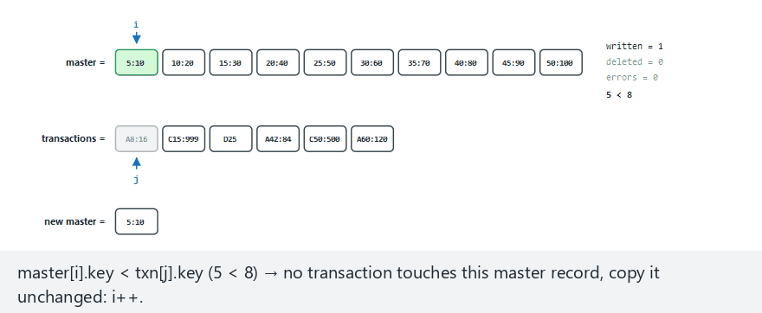
CEN207 Data Structures · Week 13
Sequential update, step by step
RTEU Computer Engineering · Fall 2026–2027
75
Notes:
Normal example: 10 master records, 6 transactions mixing add/change/delete — watch both pointers advance together.

Slide 76
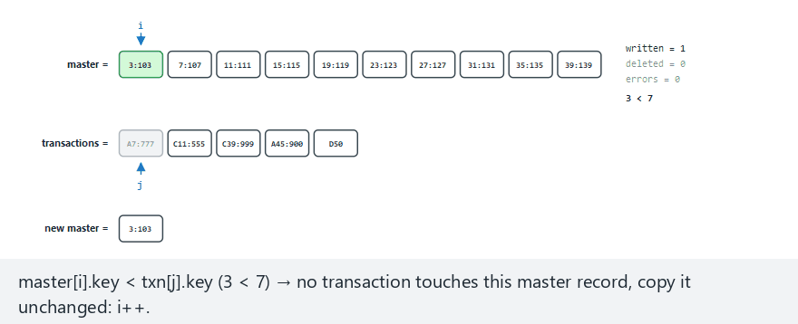
CEN207 Data Structures · Week 13
Edge case — duplicate add + missing key
RTEU Computer Engineering · Fall 2026–2027
76
Notes:
Two error types in one run: adding a key that exists, and changing/deleting a key that does not.

Slide 77
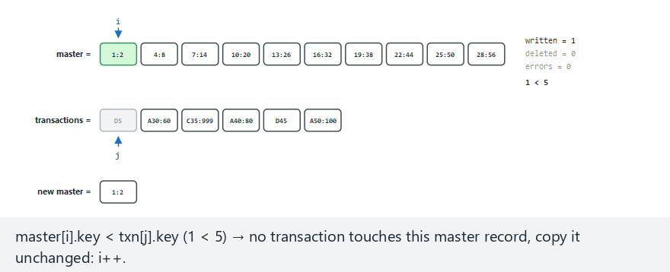
CEN207 Data Structures · Week 13
Edge case — master runs out, trailing transactions
RTEU Computer Engineering · Fall 2026–2027
77
Notes:
This is exactly the "leftover transactions" loop — some trailing adds succeed, some trailing changes/deletes are rejected.

Slide 78
CEN207 Data Structures · Week 13
Code — the merge loop's core comparison
while (i < nm && j < nt) {
if (master[i].key < txn[j].key) {
write(master[i]); i++;
} else if (master[i].key > txn[j].key) {
if (txn[j].op == 'A') write(new);
else errors++; /* C/D: missing */
j++;
} else { /* equal key: next slide */ }
}
RTEU Computer Engineering · Fall 2026–2027
78
Notes:
This is exactly the merge-sort comparison structure from Week 10 — the only new part is the equal-key branch.

Slide 79
CEN207 Data Structures · Week 13
Code — the equal-key branch, and leftovers
else {
if (txn[j].op == 'A') {
write(master[i]); /* KEEP it */
errors++;
} else if (txn[j].op == 'C') write(new);
else deleted++; /* 'D': skip write */
i++; j++;
}
/* + two leftover loops when one file ends */
RTEU Computer Engineering · Fall 2026–2027
79
Notes:
Forgetting the leftover loops after the main merge ends is the single most common bug in this algorithm.

Slide 80
CEN207 Data Structures · Week 13
Complexity
• `O(nm + nt)` — one pass, every record read exactly once
• Compare to searching the master once per transaction: O(nt * nm)
• Section 4 or 5's search, applied nt times, would cost exactly that
• The merge is dramatically cheaper at any real scale
RTEU Computer Engineering · Fall 2026–2027
80
Notes:
This complexity gap is precisely why batch systems merge sorted files instead of searching for each transaction individually.

Slide 81
CEN207 Data Structures · Week 13
Common mistakes
• Silently dropping the master record on a duplicate-add error
• Forgetting the two leftover loops after the main merge ends
• Assuming both files are sorted, without checking or guaranteeing it
RTEU Computer Engineering · Fall 2026–2027
81
Notes:
A single out-of-order record anywhere silently produces a wrong merge — not a crash, not an error message.

Slide 82
CEN207 Data Structures · Week 13
Mini-quiz
Why is a delete, in this algorithm, done by not writing a record, rather than writing a special "deleted" record?
RTEU Computer Engineering · Fall 2026–2027
82
Notes:
Think about what the new master file actually contains when the merge finishes.

Slide 83
CEN207 Data Structures · Week 13
Answer
The new file is built from scratch, record by record. A deleted record should not exist in it at all — skipping the write is the deletion, with no extra bookkeeping.
RTEU Computer Engineering · Fall 2026–2027
83
Notes:
Contrast this with section 10's tombstones, which need an explicit marker precisely because a probed file cannot be rewritten from scratch.

Slide 84
CEN207 Data Structures · Week 13
7. Relative (Direct) File Access
RTEU Computer Engineering · Fall 2026–2027
84
Notes:
Section 7 is Week 1's array-indexing idea, moved to disk — no searching at all, just arithmetic.

Slide 85
CEN207 Data Structures · Week 13
A question to start
A program already knows it wants "record number 7." Sections 4 and 5 both search. Does finding record 7 need any searching?
RTEU Computer Engineering · Fall 2026–2027
85
Notes:
The answer is no — and this is the fastest technique in the entire week, by a wide margin.

Slide 86
CEN207 Data Structures · Week 13
The idea: compute, do not search
• Every record gets a relative record number (RRN): 0, 1, 2, ...
• block = rrn / bf, offset = rrn % bf
• One division, one modulo — no comparisons at all
• One fseek, one block read — genuine O(1)
RTEU Computer Engineering · Fall 2026–2027
86
Notes:
This costs exactly the same one block read whether the file holds a hundred records or a hundred million.

Slide 87
CEN207 Data Structures · Week 13
What must still be validated
• Negative rrn, or rrn >= total: reject before any read
• A valid-looking rrn can still land in a partial last block
• Must check against the total record count, not block bounds alone
RTEU Computer Engineering · Fall 2026–2027
87
Notes:
Computing a location instead of searching for it does not mean skipping validation — quite the opposite.

Slide 88
CEN207 Data Structures · Week 13
Intuition — a numbered parking garage
• Every parking space has a number, painted on the floor
• "Space 37" needs no searching — go straight to floor 37/bf
• A parking attendant never walks every floor looking for space 37
• Exactly section 7's block = rrn / bf, offset = rrn % bf
RTEU Computer Engineering · Fall 2026–2027
88
Notes:
A numbered space is the cleanest possible picture of a computed address — nobody would search a garage floor by floor for a known number.

Slide 89
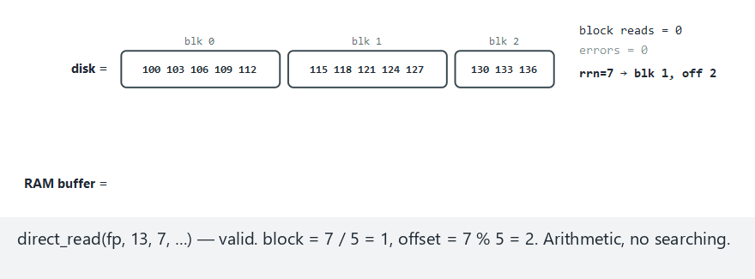
CEN207 Data Structures · Week 13
Relative file access, step by step
RTEU Computer Engineering · Fall 2026–2027
89
Notes:
Normal example: bf=5, 13 records — watch every request cost exactly one block read, valid or invalid.

Slide 90
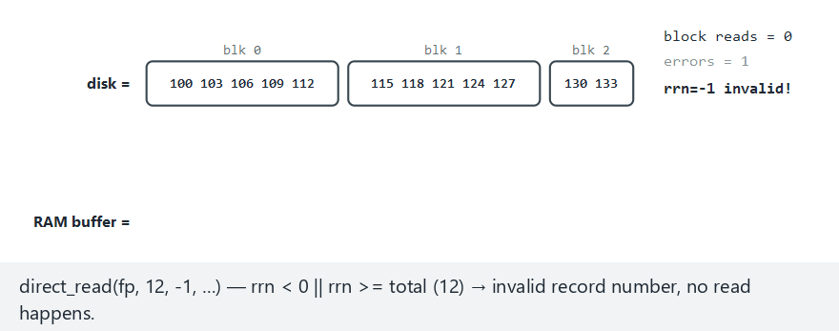
CEN207 Data Structures · Week 13
Edge case — negative and out-of-range requests
RTEU Computer Engineering · Fall 2026–2027
90
Notes:
A negative rrn is rejected cleanly here — an unchecked one would compute a negative block and a corrupt fseek.

Slide 91
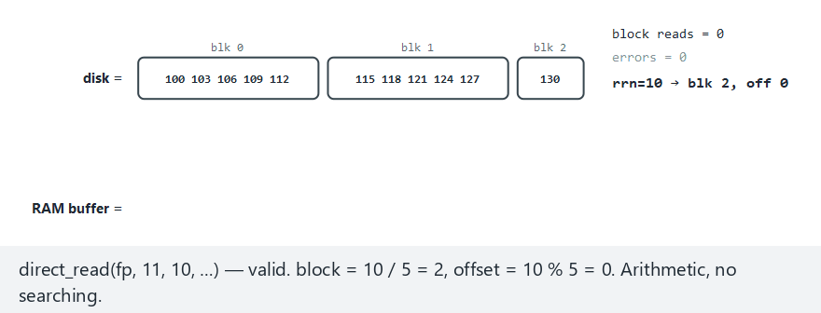
CEN207 Data Structures · Week 13
Edge case — the single record in a partial last block
RTEU Computer Engineering · Fall 2026–2027
91
Notes:
One valid rrn lands correctly in a block that is otherwise mostly empty; the very next rrn must still be rejected as out of range.

Slide 92
CEN207 Data Structures · Week 13
Code — the entire algorithm, in two lines
int direct_read(FILE *f, int bf,
int total, int rrn) {
if (rrn < 0 || rrn >= total)
return -1; /* reject */
int block = rrn / bf;
int offset = rrn % bf;
/* one fseek, one fread, done */
}
RTEU Computer Engineering · Fall 2026–2027
92
Notes:
No loop, no comparison against stored data at all — this is genuinely the simplest algorithm of the entire week.

Slide 93
CEN207 Data Structures · Week 13
Complexity
• O(1) — exactly one block read, for every valid request
• Sections 4 and 5's costs both still grow as the file grows
• Direct access does not grow at all, ever
• The upper bound this whole chapter of techniques aims toward
RTEU Computer Engineering · Fall 2026–2027
93
Notes:
This is the theoretical ceiling every other technique this week is trying to approximate with a computed or hashed location.

Slide 94
CEN207 Data Structures · Week 13
Common mistakes
• Checking rrn >= total but forgetting rrn < 0
• Not accounting for a partial last block
• Assuming "direct" means "no validation needed" — it still does
RTEU Computer Engineering · Fall 2026–2027
94
Notes:
An unvalidated rrn computed into an out-of-bounds fseek is exactly the kind of bug that corrupts a file, not just fails cleanly.

Slide 95
CEN207 Data Structures · Week 13
Mini-quiz
Why does relative access's O(1) cost not depend on bf at all, while sections 4 and 5's search costs both do?
RTEU Computer Engineering · Fall 2026–2027
95
Notes:
Think about how many blocks each technique must visit to find an answer, versus how many it must compute.

Slide 96
CEN207 Data Structures · Week 13
Answer
Direct access always does exactly one seek and one read, regardless of bf — only which block changes. Searching must visit blocks one at a time until it finds the answer.
RTEU Computer Engineering · Fall 2026–2027
96
Notes:
numBlocks = n / bf appears explicitly in both search techniques' complexity — never in direct access's.

Slide 97
CEN207 Data Structures · Week 13
8. Hashing to Buckets
RTEU Computer Engineering · Fall 2026–2027
97
Notes:
Section 8 takes Week 6's hash table and moves it to disk, where "one slot" becomes "one block", not one cell.

Slide 98
CEN207 Data Structures · Week 13
A question to start
Real keys are rarely a convenient 0, 1, 2, .... Week 6 solved this in RAM with a hash function. Can the same idea work for a file?
RTEU Computer Engineering · Fall 2026–2027
98
Notes:
Yes — and the key change is that one hash "slot" here is an entire block, which can already hold bf keys.

Slide 99
CEN207 Data Structures · Week 13
The idea: hash to a BUCKET, chain overflow
• h(key) = key mod m picks one of m buckets
• A bucket is a block, holding up to bf keys, not one
• Two keys, same bucket: fine, until the bucket is full
• Only then: allocate an overflow block, chain it on
RTEU Computer Engineering · Fall 2026–2027
99
Notes:
This is exactly Week 6's separate chaining, except the "linked list nodes" are now whole disk blocks, not individual records.

Slide 100
CEN207 Data Structures · Week 13
Intuition — a row of mailboxes, each holding several letters
• Each mailbox (bucket) already holds up to bf letters (keys)
• Two letters for the same box: fine, until the box is full
• A full mailbox gets an extra tray clipped on beside it
• The extra tray is exactly one overflow block, chained on
RTEU Computer Engineering · Fall 2026–2027
100
Notes:
A mailbox that can already hold bf letters is the key difference from Week 6's RAM table, where every "mailbox" held exactly one letter.

Slide 101
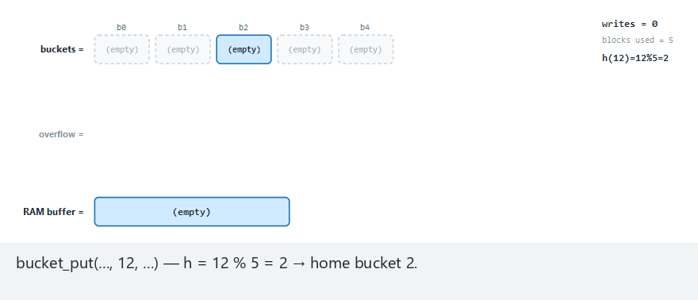
CEN207 Data Structures · Week 13
Hashing to buckets, step by step
RTEU Computer Engineering · Fall 2026–2027
101
Notes:
Watch how many keys accumulate in one bucket before an overflow block is finally allocated.

Slide 102
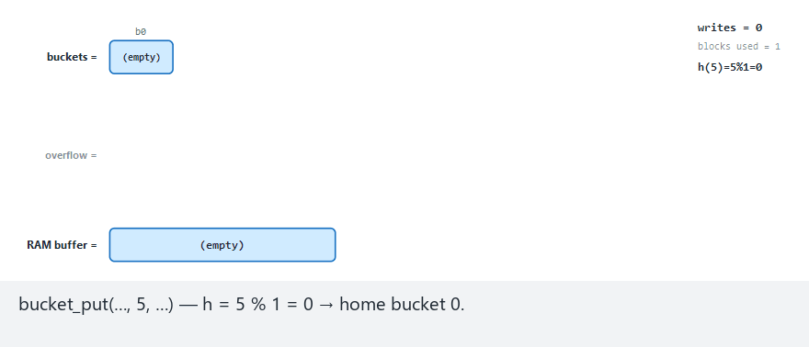
CEN207 Data Structures · Week 13
Edge case — m=1, everything chains
RTEU Computer Engineering · Fall 2026–2027
102
Notes:
With only one bucket, every key beyond the first bf collides — a long overflow chain, the worst case made maximal.

Slide 103
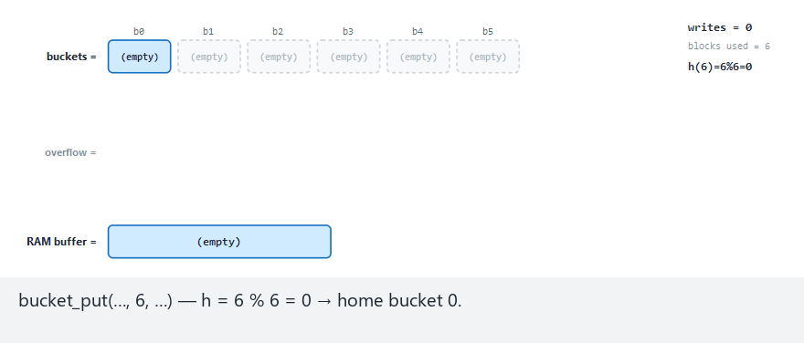
CEN207 Data Structures · Week 13
Edge case — all 10 keys hash to the same bucket
RTEU Computer Engineering · Fall 2026–2027
103
Notes:
With m greater than 1 but every key still colliding, this isolates a bad hash outcome from a badly chosen m.

Slide 104
CEN207 Data Structures · Week 13
Code — hash, then chain on overflow
int h = key % m, cur = h;
while (bucket[cur].count == bf) {
if (bucket[cur].next < 0)
bucket[cur].next = new_block();
cur = bucket[cur].next; /* follow chain */
}
bucket[cur].keys[bucket[cur].count++] = key;
RTEU Computer Engineering · Fall 2026–2027
104
Notes:
A new overflow block must chain onto the LAST block in the chain, never back onto the home bucket directly.

Slide 105
CEN207 Data Structures · Week 13
Complexity
• Average case: O(1) block accesses, same as Week 6's chaining
• Plus one more access per overflow block that must be followed
• Stays small while the load factor n / (m * bf) is reasonable
• Worst case ("m=1" above): degrades toward O(n / bf)
RTEU Computer Engineering · Fall 2026–2027
105
Notes:
This is exactly Week 6's chaining degradation, now measured in block accesses instead of comparisons.

Slide 106
CEN207 Data Structures · Week 13
Common mistakes
• Chaining a new overflow block onto the wrong block
• Choosing m too small for the expected key count
• Forgetting a bucket's capacity is bf, not 1 — unlike Week 6
RTEU Computer Engineering · Fall 2026–2027
106
Notes:
A collision here means "the bf-th key competing for one already-full block" — materially rarer than Week 6's one-key-per-slot.

Slide 107
CEN207 Data Structures · Week 13
Mini-quiz
Is bucket chaining here closer to Week 6's separate chaining, or Week 6's open addressing? Why?
RTEU Computer Engineering · Fall 2026–2027
107
Notes:
Think about whether a colliding key stays inside the same table structure, or grows something separate.

Slide 108
CEN207 Data Structures · Week 13
Answer
Separate chaining. A full bucket grows a chain of additional blocks, off to the side — never touching any other bucket, exactly like Week 6's per-slot linked list.
RTEU Computer Engineering · Fall 2026–2027
108
Notes:
Section 9's progressive overflow is the other family — claiming a different slot inside the same table, like Week 6's open addressing.

Slide 109
CEN207 Data Structures · Week 13
9. Progressive Overflow: Linear Probing on Disk
RTEU Computer Engineering · Fall 2026–2027
109
Notes:
Section 9 is Week 6's open addressing, moved to disk — no separate structure at all, just keep probing.

Slide 110
CEN207 Data Structures · Week 13
A question to start
Section 8's overflow blocks cost a whole extra block per overflow, however few keys it holds. Can probing avoid that extra block entirely?
RTEU Computer Engineering · Fall 2026–2027
110
Notes:
Week 6's open addressing solved exactly this waste in RAM by keeping every key inside the original table.

Slide 111
CEN207 Data Structures · Week 13
The idea: probe the next slot, wrap around
• Home slot: h(key) = key mod m
• Occupied by a different key? Try (h+1) mod m, then next
• mod m makes the sequence wrap around past the last slot
• Stop: empty slot (insert), duplicate, or all m slots tried (full)
RTEU Computer Engineering · Fall 2026–2027
111
Notes:
Every slot probed, empty or not, costs one real disk access — this is why the technique's cost is measured in probes.

Slide 112
CEN207 Data Structures · Week 13
Intuition — parking in the nearest free spot
• Your assigned spot is taken? Take the next spot over
• Still taken? The next one — wrapping to spot 0 at the end
• No separate overflow lot at all — everyone parks in the same lot
• Exactly Week 6's open addressing, one level down, on disk
RTEU Computer Engineering · Fall 2026–2027
112
Notes:
Unlike section 8's mailbox trays, there is no separate structure here at all — every key genuinely lives inside the one table.

Slide 113
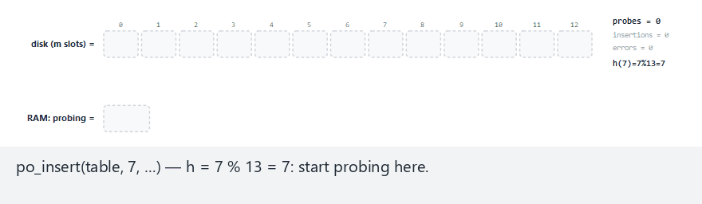
CEN207 Data Structures · Week 13
Progressive overflow, step by step
RTEU Computer Engineering · Fall 2026–2027
113
Notes:
Watch the probe sequence wrap around from the last slot back to slot 0 when a home slot is near the end.

Slide 114
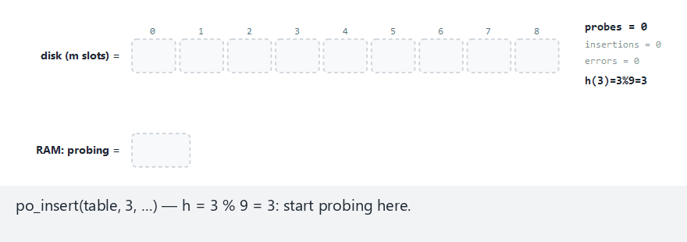
CEN207 Data Structures · Week 13
Edge case — every key shares one home slot
RTEU Computer Engineering · Fall 2026–2027
114
Notes:
Probe counts grow 1, 2, 3, ... in lock-step with insertion order — the textbook signature of primary clustering.

Slide 115
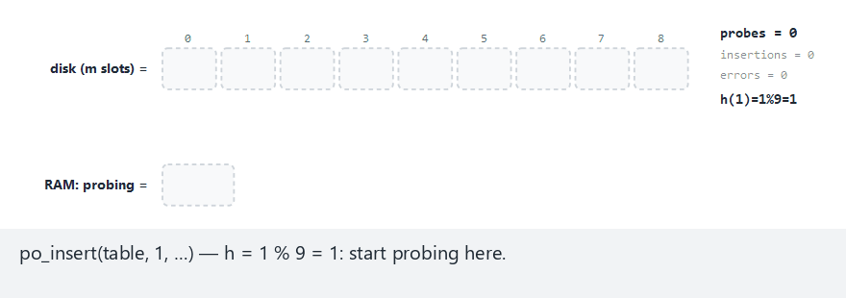
CEN207 Data Structures · Week 13
Edge case — the table is completely full
RTEU Computer Engineering · Fall 2026–2027
115
Notes:
The last insert tries every one of the m slots and finds none free — a clean "file full" report, never an infinite loop.

Slide 116
CEN207 Data Structures · Week 13
Code — probe until room, duplicate, or full
int h = key % m, i = h, tries = 0;
while (tries < m) {
if (table[i] == EMPTY) {
table[i] = key; return i;
}
if (table[i] == key) return -2; /* dup */
i = (i + 1) % m; tries++;
}
return -1; /* file genuinely full */
RTEU Computer Engineering · Fall 2026–2027
116
Notes:
Without the `tries < m` guard, a full table with no matching key would loop forever — this bound is not optional.

Slide 117
CEN207 Data Structures · Week 13
Complexity
• Close to O(1) probes at a low load factor n / m
• Degrades sharply as load factor rises
• "Hard" scenario (91% loaded): up to 5 probes for one insert
• Worst case, nearly full: O(m) probes
RTEU Computer Engineering · Fall 2026–2027
117
Notes:
This is exactly Week 6's open-addressing degradation, now paid for in real disk accesses instead of RAM comparisons.

Slide 118
CEN207 Data Structures · Week 13
Common mistakes
• Not bounding the probe loop (tries < m): risks an infinite loop
• Treating "file full" as a crash instead of a normal outcome
• Forgetting key % m needs a guard for negative keys
RTEU Computer Engineering · Fall 2026–2027
118
Notes:
A well-designed program must detect and report a full file gracefully, exactly as the sample program above does.

Slide 119
CEN207 Data Structures · Week 13
Mini-quiz
What is "primary clustering", and why does the "same home slot" edge case demonstrate it at its most extreme?
RTEU Computer Engineering · Fall 2026–2027
119
Notes:
Recall the Week 6 term — think about why an occupied run of slots keeps growing once it starts.

Slide 120
CEN207 Data Structures · Week 13
Answer
A growing occupied run that keeps attracting more collisions. Here, every key shares one home slot, so probe counts grow 1, 2, 3, ... in lock-step — clustering at its most extreme.
RTEU Computer Engineering · Fall 2026–2027
120
Notes:
Any new key whose probe sequence reaches an existing run is forced to extend it by one more slot, making the next collision more likely too.

Slide 121
CEN207 Data Structures · Week 13
10. Deletion with Tombstones
RTEU Computer Engineering · Fall 2026–2027
121
Notes:
Section 10 asks what happens to section 9's probing when a key in the MIDDLE of a probe chain is deleted.

Slide 122
CEN207 Data Structures · Week 13
A question to start
If a deleted slot is simply cleared to EMPTY, what happens to a later search for a different key whose probe chain passed through it?
RTEU Computer Engineering · Fall 2026–2027
122
Notes:
EMPTY is exactly the signal a search uses to give up — clearing a mid-chain slot breaks every key that comes after it.

Slide 123
CEN207 Data Structures · Week 13
The idea: a tombstone means "keep looking"
• Tombstone: distinct from both EMPTY and any real key
• A search skips over a tombstone, exactly like any occupied slot
• Only a genuine EMPTY slot is allowed to end a search
• An insert, though, is free to treat a tombstone as reusable
RTEU Computer Engineering · Fall 2026–2027
123
Notes:
Search and insert ask genuinely different questions here, which is exactly why they treat a tombstone differently.

Slide 124
CEN207 Data Structures · Week 13
Intuition — a "gone, but do not stop here" sign
• A parking spot's occupant left: put up a temporary sign
• The sign is not "empty" (keep circling) or "occupied" (keep out)
• It means: someone parked here once, your car might be further on
• A new car may still park here; the sign then comes down
RTEU Computer Engineering · Fall 2026–2027
124
Notes:
The sign is the tombstone, in one image — it changes what a passing search does, without changing what a passing insert may do.

Slide 125
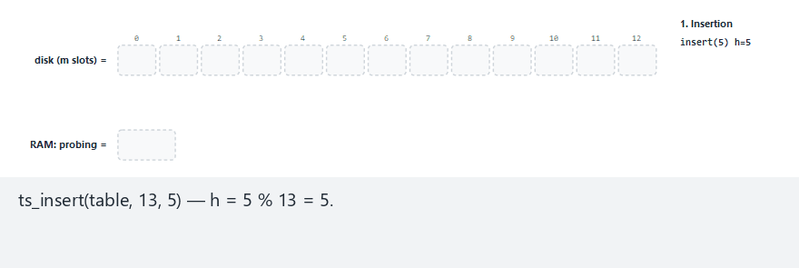
CEN207 Data Structures · Week 13
Deletion with tombstones, step by step
RTEU Computer Engineering · Fall 2026–2027
125
Notes:
Watch a delete turn a slot into TOMB, then a later find() correctly skip past it to reach a key further along the chain.

Slide 126
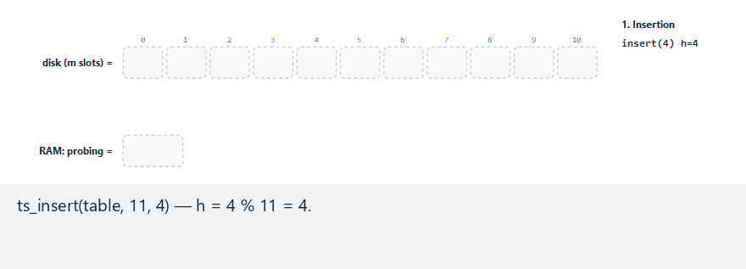
CEN207 Data Structures · Week 13
Edge case — a fully-tombstoned table
RTEU Computer Engineering · Fall 2026–2027
126
Notes:
No true-empty slot remains at all — only the tries < m bound from section 9 stops find() from probing forever.

Slide 127
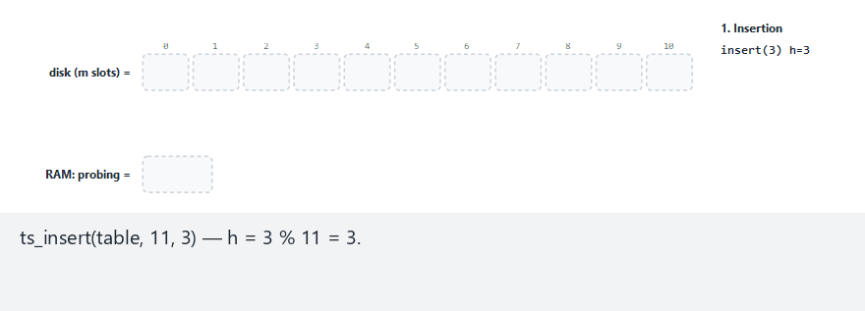
CEN207 Data Structures · Week 13
Edge case — delete a key, then reinsert the same key
RTEU Computer Engineering · Fall 2026–2027
127
Notes:
The reinserted key lands back at its own home slot, reusing its own tombstone — a satisfying, and correct, round trip.

Slide 128
CEN207 Data Structures · Week 13
Code — find must skip tombstones, not stop
int i = key % m, tries = 0;
while (tries < m) {
if (table[i] == EMPTY) return -1;
if (table[i] == key) return i;
/* TOMB: fall through, keep probing */
i = (i + 1) % m; tries++;
}
return -1;
RTEU Computer Engineering · Fall 2026–2027
128
Notes:
TOMB is neither "found" nor "safe to stop at" — it must be skipped exactly like any other occupied-but-different slot.

Slide 129
CEN207 Data Structures · Week 13
Code — insert may reuse a tombstone
int i = key % m, tries = 0;
while (tries < m) {
if (table[i] == EMPTY ||
table[i] == TOMB) {
table[i] = key; return i; /* reused! */
}
if (table[i] == key) return -2;
i = (i + 1) % m; tries++;
}
RTEU Computer Engineering · Fall 2026–2027
129
Notes:
Reusing a tombstone reclaims deleted space without ever breaking any other key's probe chain.

Slide 130
CEN207 Data Structures · Week 13
Complexity
• ts_find/ts_delete: same O(probe chain length) as section 9
• Tombstones add no new asymptotic cost
• ts_insert: often less in practice — may reuse a tombstone early
• Only which slots a search is willing to pass through changes
RTEU Computer Engineering · Fall 2026–2027
130
Notes:
A search was always going to walk past occupied slots anyway — tombstones just widen what counts as "occupied but passable".

Slide 131
CEN207 Data Structures · Week 13
Common mistakes
• Deleting by simply clearing the slot to EMPTY
• Making ts_find stop at, or match, a tombstone
• Forgetting a fully-tombstoned table has no EMPTY to rely on
RTEU Computer Engineering · Fall 2026–2027
131
Notes:
The last case is exactly why the tries < m bound from section 9 is load-bearing, not a defensive nicety.

Slide 132
CEN207 Data Structures · Week 13
Mini-quiz
After ts_insert reuses a tombstone for a new key, why does a search for some other key that also probes past that slot still work?
RTEU Computer Engineering · Fall 2026–2027
132
Notes:
Think about what the slot looks like to a search, once it holds a real key again.

Slide 133
CEN207 Data Structures · Week 13
Answer
Once reused, the slot holds a real key again — indistinguishable from any other occupied slot. Other keys' searches behave exactly as if the deletion never happened.
RTEU Computer Engineering · Fall 2026–2027
133
Notes:
From any other key's point of view, an occupied slot is an occupied slot, whether original or reclaimed.

Slide 134
CEN207 Data Structures · Week 13
11–12. Comparing and Choosing
RTEU Computer Engineering · Fall 2026–2027
134
Notes:
We now step back from individual algorithms to compare all five organisations side by side, and when to pick each.

Slide 135
CEN207 Data Structures · Week 13
Comparison table
Organisation | Locate | Insert / Delete | Best for
Sequential (unsorted) | O(numBlocks) | O(1) / O(numBlocks) | Process every record anyway
Sequential (sorted) | O(log numBlocks) | O(numBlocks) both | Batch updates (section 6)
Relative (direct) | O(1) | O(1) / O(1), leaves a hole | RRN is naturally known
Hashing (buckets or probing) | O(1) avg | O(1) avg | Arbitrary keys, fast lookup
RTEU Computer Engineering · Fall 2026–2027
135
Notes:
The one column every row shares is the unit being counted — block reads and writes, from section 1, never comparisons.

Slide 136
CEN207 Data Structures · Week 13
Choosing a technique (1/2)
Situation | Best choice
Process every record anyway | Sequential, any order
Batch of changes, periodically | Sequential (sorted) + transactions
Occasional lookups, rarely changes | Sequential (sorted), binary search
Records numbered 0, 1, 2, ... | Relative (direct) file
RTEU Computer Engineering · Fall 2026–2027
136
Notes:
No technique beats reading every block once when every record must be visited anyway — sorting buys nothing there.

Slide 137
CEN207 Data Structures · Week 13
Choosing a technique (2/2)
Situation | Best choice
Arbitrary key, simplicity over compactness | Hashing, bucket chaining
Arbitrary key, compactness, rare deletes | Hashing, progressive overflow
Arbitrary key, frequent deletes | Progressive overflow + tombstones
RTEU Computer Engineering · Fall 2026–2027
137
Notes:
The single biggest decision, as in Week 6, is: does this file need efficient exact-match lookup, or will it always be processed whole?

Slide 138
CEN207 Data Structures · Week 13
Wrap-Up
RTEU Computer Engineering · Fall 2026–2027
138
Notes:
One question drove every section this week: how many block reads and writes does each technique need?

Slide 139
CEN207 Data Structures · Week 13
Summary
• Records/fields: fixed, delimited, or length-prefixed
• Blocking factor: bf records share one disk access
• Sequential: search every block, or binary-search a sorted one
• Sequential update: merge master + transactions in one pass
• Relative access: block = rrn/bf — true O(1)
• Hashing: chain overflow blocks, or probe with tombstones
RTEU Computer Engineering · Fall 2026–2027
139
Notes:
Every idea from Weeks 1, 6, and 10 reappears here, unchanged in logic, now paid for in block reads instead of RAM operations.

Slide 140
CEN207 Data Structures · Week 13
1. Why does this week count block reads, not comparisons?
RTEU Computer Engineering · Fall 2026–2027
140
Notes:
Recall section 1 — a block read costs orders of magnitude more than any in-memory operation on its contents.

Slide 141
CEN207 Data Structures · Week 13
A disk access costs vastly more than any RAM operation, and always transfers a WHOLE block — so block count, not comparison count, predicts real speed.
RTEU Computer Engineering · Fall 2026–2027
141
Notes:
This is the organizing idea of the entire week, stated once more as a review question.

Slide 142
CEN207 Data Structures · Week 13
2. Why must a sorted file's binary search compare against a block's first/last key, not its middle key?
RTEU Computer Engineering · Fall 2026–2027
142
Notes:
Recall section 5 — an entire block, not one record, is ruled in or out at each step.

Slide 143
CEN207 Data Structures · Week 13
A whole BLOCK of records is being ruled in or out per comparison, and only the first/last key defines that block's range.
RTEU Computer Engineering · Fall 2026–2027
143
Notes:
This is exactly the difference between array binary search (Week 1) and file binary search (section 5).

Slide 144
CEN207 Data Structures · Week 13
3. Why must a duplicate-add error still copy the original master record forward?
RTEU Computer Engineering · Fall 2026–2027
144
Notes:
Recall section 6 — an unrelated rejected transaction must never delete valid data as a side effect.

Slide 145
CEN207 Data Structures · Week 13
The master record did nothing wrong — only the transaction is rejected; not copying it forward would silently lose valid data.
RTEU Computer Engineering · Fall 2026–2027
145
Notes:
This was a real bug found and fixed in this week's own reference programs while building them — a genuine, not hypothetical, mistake.

Slide 146
CEN207 Data Structures · Week 13
4. Why can insert safely reuse a tombstone, when search must not stop at one?
RTEU Computer Engineering · Fall 2026–2027
146
Notes:
Recall section 10 — insert and search are answering fundamentally different questions.

Slide 147
CEN207 Data Structures · Week 13
Search must preserve every OTHER key's ability to be found; reuse by insert does not interfere, because the slot then just holds a new, real key.
RTEU Computer Engineering · Fall 2026–2027
147
Notes:
This is the single most commonly mis-implemented detail of open addressing with deletion, in any language.

Slide 148
CEN207 Data Structures · Week 13
5. Why does a relative file's O(1) cost not depend on the file's total size at all?
RTEU Computer Engineering · Fall 2026–2027
148
Notes:
Recall section 7 — the arithmetic is the same one division and one modulo, no matter how many records exist.

Slide 149
CEN207 Data Structures · Week 13
One fseek, computed from rrn and bf alone, then one block read — nothing about that computation depends on how many OTHER records the file holds.
RTEU Computer Engineering · Fall 2026–2027
149
Notes:
Contrast this with every searching technique this week, whose cost is expressed directly in terms of numBlocks = n / bf.

Slide 150
CEN207 Data Structures · Week 13
6. Why is chaining overflow blocks (section 8) a closer match to separate chaining than to open addressing?
RTEU Computer Engineering · Fall 2026–2027
150
Notes:
Recall Week 6 — think about whether a collision grows a side structure, or claims a slot inside the same table.

Slide 151
CEN207 Data Structures · Week 13
A full bucket grows a chain of ADDITIONAL blocks off to the side, never touching any other bucket — exactly Week 6's separate chaining, one level down.
RTEU Computer Engineering · Fall 2026–2027
151
Notes:
Section 9's progressive overflow is the other Week 6 family instead — claiming a different slot inside the very same table.

Slide 152
CEN207 Data Structures · Week 13
Next week
Week 14 — File Organisation II
Indexed sequential files · B-trees · extendible hashing · external sorting — extending this week's block-read cost model to bigger tools.
RTEU Computer Engineering · Fall 2026–2027
152
Notes:
Week 14 answers exactly the question sections 8-10 left open: what happens when a hashed file outgrows its m?

Slide 153
CEN207 Data Structures · Week 13
References (1/2)
• Course syllabus, Week 13: docs/syllabus/syllabus.en.md
• A. L. Tharp. File Organization and Processing.
John Wiley & Sons, 1988 — the primary textbook
• Cormen, Leiserson, Rivest, Stein. *Introduction
to Algorithms*. MIT Press — hash table chapter
RTEU Computer Engineering · Fall 2026–2027
153
Notes:
These are the same references listed at the end of the week's written notes.

Slide 154
CEN207 Data Structures · Week 13
References (2/2)
• Knuth. *The Art of Computer Programming, Vol. 3:
Sorting and Searching*, 2nd ed — file processing, hashing, and linear probing's historical analysis
• williamfiset/Algorithms · Programiz DSA
RTEU Computer Engineering · Fall 2026–2027
154
Notes:
Knuth's analysis of linear probing is the historical root of this week's "progressive overflow" terminology.

