Slide 1
CE205 Data Structures Week-1
Introduction to Data Structure Author: Asst. Prof. Dr. Uğur CORUH

Slide 2
CE205 Data Structures

Slide 3
Week-1

Slide 4
Course Plan and Communication, Course Plan and Communication, Introduction to Linear & Non-Linear Data Structure and Performance Analysis, Implementing Pointer and Objects for Data and Variables Basic of ASN.1 / BER TLV / PER TLV
Download DOC, SLIDE, PPTX

Slide 5
Outline
Data States
Data Structure Metrics
Data Mapping
Data Structure Selection
Data Structure References
Industrial Data Standards (ASN.1,BER-TLV,etc.)
Trends (Open API, 5G Systems etc.)

Slide 6
Introduction to Data Structures

Slide 7
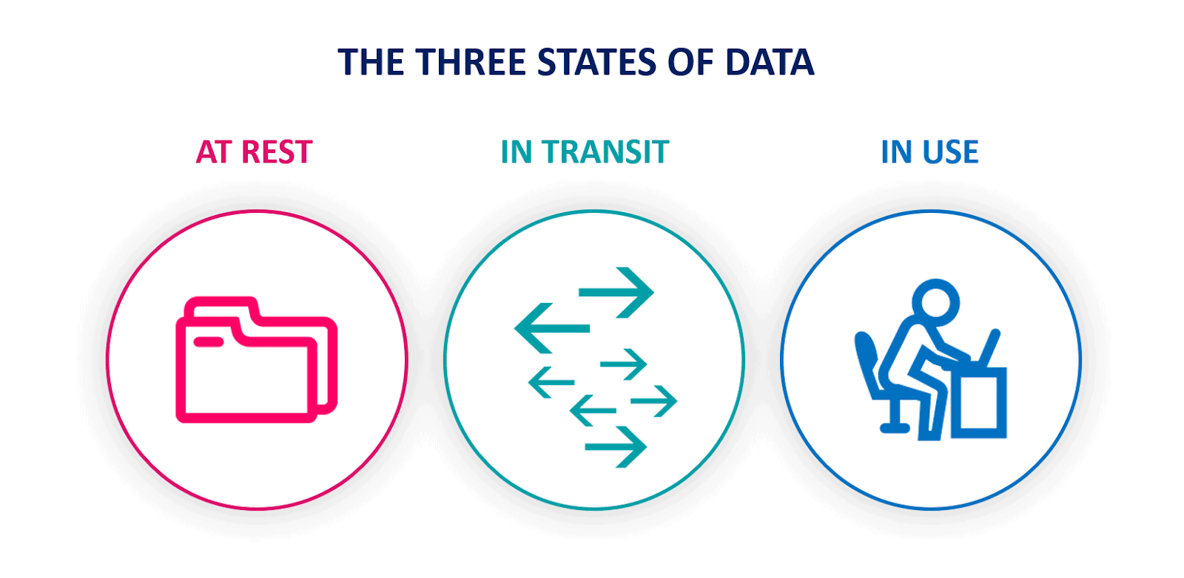
Data States
center width:900px

Slide 8
Data States
Data-in-use
Data in use - Wikipedia
Data-in-transit
Data in transit - Wikipedia
Data-at-rest
Data at rest - Wikipedia

Slide 9
Data Structure Metrics
Performance Analysis
Data Structures Tutorials - Performance Analysis with examples
Space Complexity
Data Structures Tutorials - Space Complexity with examples
Time Complexity
Data Structures Tutorials - Time Complexity with examples

Slide 10
Data Mapping
Data and Variables
C++ Data Types

Slide 11
Data Structure Selection
Linear & Non-Linear Data Structures
Data Structures Tutorials - Linear and Non-linear types
Data Structure and Types

Slide 12
Data Structure References
Implementing Pointer and Objects
Check CS50 Pointer Notes
Week 0 - CS50

Slide 13
Industrial Data Standards
ASN.1 / BER TLV / PER TLV
http://lionet.info/asn1c/download.html
GitHub - ucoruh/asn1c-wsl-sample: ASN.1 C WSL and Windows Execution, Debugging and Code Generation Sample
Open Source ASN.1 Compiler: asn1c 0.9.28

Slide 14
Industrial Data Standards - Telco
Sample Standard for ASN.1 Usage
https://www.etsi.org/deliver/etsi_ts/125400_125499/125413/04.09.00_60/ts_125413v040900p.pdf

Slide 15
Industrial Data Standards - Payment
Payment BER TLV Parser Sample
TLV Utilities
https://paymentcardtools.com/

Slide 16
Industrial Data Standards - Telco
ASN.1 Standartları
ETSI
https://portal.etsi.org/Services/Centre-for-Testing-Interoperability/ETSI-Approach/Specification-Languages/ASN1
ITU-T
https://www.itu.int/ITU-T/recommendations/fl.aspx?lang=1
ASN.1 Book
https://www.oss.com/asn1/resources/books-whitepapers-pubs/dubuisson-asn1-book.PDF

Slide 17
Network Measurement Results Data
NMR
https://www.etsi.org/deliver/etsi_ts/101500_101599/101503/08.27.00_60/ts_101503v082700p.pdf
GSM API
https://www.etsi.org/deliver/etsi_ts/101400_101499/101476/08.04.01_60/ts_101476v080401p.pdf
UTRAN
https://www.etsi.org/deliver/etsi_ts/125300_125399/125331/13.01.00_60/ts_125331v130100p.pdf
E-UTRAN
https://www.etsi.org/deliver/etsi_ts/136300_136399/136331/15.03.00_60/ts_136331v150300p.pdf

Slide 18
Open Source 5G Projects
https://open5gs.org/
5g nr development and setup · Wiki · oai / openairinterface5G · GitLab

Slide 19
OPEN API
Open API Generator
https://openapi-generator.tech/
Open API Yaml Configurations
GitHub - jdegre/5GC_APIs: RESTful APIs of main Network Functions in the 3GPP 5G Core Network
Open API AUSF Yaml Configuration
https://www.etsi.org/deliver/etsi_TS/129500_129599/129509/17.06.00_60/ts_129509v170600p.pdf
https://www.etsi.org/deliver/etsi_TS/129500_129599/129509/17.06.00_60/ts_129509v170600p0.zip

Slide 20
$$End−Of−Week−1$$

