Slide 1
CE205 Data Structures Week-4
Tree Data Structure Types and Applications (Binary Tree, Tree Traversals, Heaps) Author: Asst. Prof. Dr. Uğur CORUH

Slide 2
CE205 Data Structures

Slide 3
Week-4

Slide 4
Tree Data Structure Types and Applications (Binary Tree, Tree Traversals, Heaps)
Download DOC, SLIDE, PPTX

Slide 5
Outline
Graph Representation Tools
Tree Structures and Binary Tree and Traversals (In-Order, Pre-Order, Post-Order)
Heaps (Max, Min, Binary , Binomial, Fibonacci, Leftist, K-ary) and Priority Queue
Heap Sort
Huffman Coding

Slide 6
Graph Representation Tools
Microsoft Automatic Graph Layout
https://www.microsoft.com/en-us/download/details.aspx?id=52034
https://github.com/microsoft/automatic-graph-layout
Graphviz
https://graphviz.org/resources/
Plantuml
https://ucoruh.github.io/ce204-object-oriented-programming/week-5/ce204-week-5/#calling-plantuml-from-java_1

Slide 7
Tree - Terminology
Btech Smart Class
http://www.btechsmartclass.com/data_structures/tree-terminology.html

Slide 8
Tree Representations
Btech Smart Class
http://www.btechsmartclass.com/data_structures/tree-representations.html

Slide 9
Binary Tree Datastructure
Construction and Conversion
Checking and Printing
Summation
Longest Common Ancestor
Btech Smart Class
http://www.btechsmartclass.com/data_structures/binary-tree.html
William Fiset
https://www.youtube.com/watch?v=sD1IoalFomA&ab_channel=WilliamFiset

Slide 10
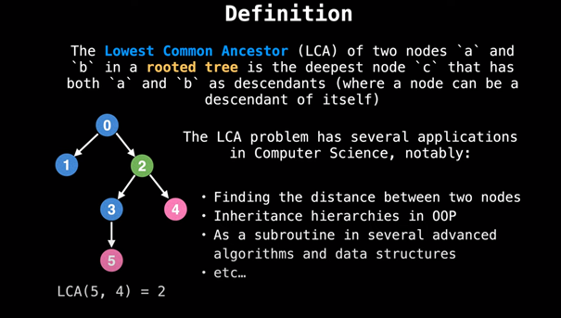
Longet Common Ancestor

Slide 11
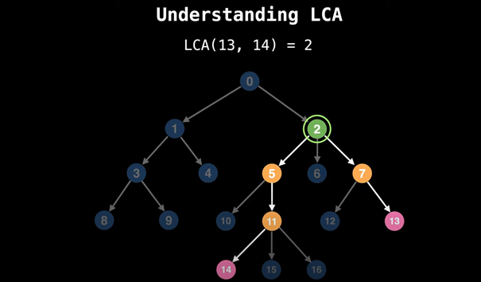
Longet Common Ancestor

Slide 12
Binary Tree Representations
Btech Smart Class
http://www.btechsmartclass.com/data_structures/binary-tree-representations.html

Slide 13
Binary Tree Traversals
Btech Smart Class
http://www.btechsmartclass.com/data_structures/binary-tree-traversals.html
In-Order
Pre-Order
Post-Order

Slide 14
Threaded Binary Trees
Btech Smart Class
http://www.btechsmartclass.com/data_structures/threaded-binary-trees.html

Slide 15
Max Priority Queue
Btech Smart Class
http://www.btechsmartclass.com/data_structures/max-priority-queue.html
William Fiset
https://www.youtube.com/watch?v=wptevk0bshY&t=0s&ab_channel=WilliamFiset
https://github.com/williamfiset/Algorithms/tree/master/src/main/java/com/williamfiset/algorithms/datastructures/priorityqueue

Slide 16
Heap Data Structure
Heap Sort
https://ucoruh.github.io/ce100-algorithms-and-programming-II/week-4/ce100-week-4-heap/

Slide 17
Heap Data Structure
Programiz
https://www.programiz.com/dsa/heap-data-structure
Btech Smart Class
Max-Heap
http://www.btechsmartclass.com/data_structures/max-heap.html
Geeks for Geeks
Binary Heap
https://www.geeksforgeeks.org/binary-heap/?ref=lbp
https://www.geeksforgeeks.org/difference-between-binary-heap-binomial-heap-and-fibonacci-heap/?ref=rp

Slide 18
Heap Data Structure
Binomial Heap
Geeks for Geeks
https://www.geeksforgeeks.org/binomial-heap-2/

Slide 19
Heap Data Structure
Structure of Fibonacci Heaps
Mergeable-heap operations
Fibonacci Heap
William Fiset
https://github.com/williamfiset/Algorithms/tree/master/src/main/java/com/williamfiset/algorithms/datastructures/fibonacciheap
Geeks for Geeks
https://www.geeksforgeeks.org/fibonacci-heap-set-1-introduction/?ref=lbp

Slide 20
Heap Data Structure
Decreasing a key and deleting a node
Bounding the maximum degree
Heap Operations
https://www.geeksforgeeks.org/fibonacci-heap-insertion-and-union/?ref=lbp
https://www.geeksforgeeks.org/fibonacci-heap-deletion-extract-min-and-decrease-key/?ref=lbp

Slide 21
Heap Data Structure
Leftist Heap
Geeks for Geeks
https://www.geeksforgeeks.org/leftist-tree-leftist-heap/?ref=lbp
Toronto
https://www.dgp.toronto.edu/public_user/JamesStewart/378notes/10leftist/

Slide 22
Heap Data Structure
Geeks for Geeks
https://www.geeksforgeeks.org/k-ary-heap/?ref=lbp

Slide 23
Heap Data Structure
Heap Sort
https://ucoruh.github.io/ce100-algorithms-and-programming-II/week-4/ce100-week-4-heap/

Slide 24
Heap Data Structure
Huffman Coding
https://ucoruh.github.io/ce100-algorithms-and-programming-II/week-9/ce100-week-9-huffman/
Geeks for Geeks
https://www.geeksforgeeks.org/difference-between-binary-heap-binomial-heap-and-fibonacci-heap/?ref=rp

Slide 25
$$End−Of−Week−4$$

