Slide 1

CEN207 Data Structures · Week 12
Strings: Structures and Algorithms
CEN207 Data Structures — Week 12
Asst. Prof. Dr. Uğur CORUH · Fall 2026–2027
RTEU Computer Engineering · Fall 2026–2027
Notes:
Every editor, compiler, and search engine you have ever used leans on the ideas in today's lecture — how a string sits in memory, and how to find one string inside another, fast.

Slide 2
CEN207 Data Structures · Week 12
Today's plan (3 hours)
Hour | Topic
1 | C strings, buffers, tries, compressed tries, suffix arrays
2 | Naive search, KMP (failure fn + search), Rabin-Karp
3 | Boyer-Moore, Z-algorithm, dynamic programming: edit distance, LCS
Learning outcomes: LO.1 (explain data structures) · LO.2 (analyze complexity) · LO.6 (dynamic programming) · LO.7 (choose the right structure)
RTEU Computer Engineering · Fall 2026–2027
2
Notes:
Thirteen short animations carry the whole lecture; each idea gets a normal run and an edge/hard run right where it is introduced.

Slide 3
CEN207 Data Structures · Week 12
This week's concepts — where
Concept | Where
C strings, buffers, tries, radix trees, suffix arrays | Sections 1–5
Naive, KMP, Rabin-Karp, Boyer-Moore, Z-algorithm | Sections 6–11
Dynamic programming: edit distance, LCS | Sections 13–14
RTEU Computer Engineering · Fall 2026–2027
3
Notes:
Every term gets a full definition the first time it appears; this table just says where to find it again.

Slide 4
CEN207 Data Structures · Week 12
How the code examples work
• Every idea has a complete C and Java program
• C: gcc -std=c11 -Wall -Wextra -o /tmp/x file.c && /tmp/x
• Java: javac -d /tmp/j File.java && java -cp /tmp/j File
• Sources: code/week-12/c/ and code/week-12/java/
• Each program's expected output is in the week notes
RTEU Computer Engineering · Fall 2026–2027
4
Notes:
Open a terminal now if you want to run these live; every snippet on today's slides compiles and runs exactly as shown.

Slide 5
CEN207 Data Structures · Week 12
Recap — arrays and the char array (Week 1)
• Array: contiguous memory, O(1) access by index
• A C string is nothing but a char array
• Week 1's index arithmetic (base + i) still applies
• Today adds one convention on top: '0' marks the end
RTEU Computer Engineering · Fall 2026–2027
5
Notes:
Nothing about a C string's memory layout is new — only the "where does it end" convention is.

Slide 6
CEN207 Data Structures · Week 12
Recap — trees and hashing (Weeks 4 and 6)
• Trees: recursive nodes with children (Week 4)
• A trie node is a tree node with one child per letter
• Hashing: a function computes a location, O(1) (Week 6)
• Rabin-Karp reuses hashing — but rolls it forward
RTEU Computer Engineering · Fall 2026–2027
6
Notes:
A trie is "Week 4's tree, but the branching factor is the alphabet size." Rabin-Karp is "Week 6's hash, made incremental."

Slide 7
CEN207 Data Structures · Week 12
A brand-new idea: dynamic programming
• No prior week broke a problem into overlapping sub-problems
• Solve each sub-problem once, store it in a table
• Sections 13–14 introduce this from first principles
• Two classic examples: edit distance and LCS
RTEU Computer Engineering · Fall 2026–2027
7
Notes:
This is genuinely new machinery — worth flagging up front so today doesn't feel like "just more search algorithms."

Slide 8
CEN207 Data Structures · Week 12
Map of the week — at a glance
Structures | Search | Dynamic programming
C strings, buffers | Naive, KMP, Rabin-Karp | Edit distance
Tries, radix trees | Boyer-Moore, Z-algorithm | LCS
Suffix arrays
RTEU Computer Engineering · Fall 2026–2027
8
Notes:
Every box on this map gets its own slides below, most with a short animation and a complete C/Java program.

Slide 9
CEN207 Data Structures · Week 12
1. C Strings: Memory, '0', and strlen
RTEU Computer Engineering · Fall 2026–2027
9
Notes:
Section 1 sets up the one convention every later section assumes: a C string is a char array plus a NUL terminator, nothing more.

Slide 10
CEN207 Data Structures · Week 12
A question to start
Every structure so far stored its size somewhere. A C string does not. So how does any function know where it ends?
RTEU Computer Engineering · Fall 2026–2027
10
Notes:
The answer — a single reserved byte — has shaped C programming (and C bugs) for over fifty years.

Slide 11
CEN207 Data Structures · Week 12
A short history
• C designed at Bell Labs, early 1970s (Dennis Ritchie)
• No length field: just a char array + a convention
• '0' (NUL, value 0) marks "the string ends here"
• This single choice enables the buffer overflow
RTEU Computer Engineering · Fall 2026–2027
11
Notes:
Contrast with Pascal-style strings, which do store a length byte — a design choice with real consequences.

Slide 12
CEN207 Data Structures · Week 12
Intuition — a row of mailboxes
• Each mailbox (byte) holds one letter
• No sign says "this is the last occupied box"
• Instead: the first empty mailbox marks the end
• Walking past it means walking into someone else's mail
RTEU Computer Engineering · Fall 2026–2027
12
Notes:
"Someone else's mail" is a friendly way to say undefined behavior — corrupting memory you do not own.

Slide 13
CEN207 Data Structures · Week 12
The idea: array + convention
• A C string = a char array, nothing more
• '0' (NUL) is the end-of-string marker
• Every operation walks byte by byte to find it
• No shortcut exists — the length is never cached
RTEU Computer Engineering · Fall 2026–2027
13
Notes:
"No shortcut exists" is the single fact that explains every complexity result in this section.

Slide 14
CEN207 Data Structures · Week 12
The buffer overflow bug
• strcpy-style copying writes until it copies '0' too
• If the destination is smaller than the source: trouble
• Writing past the last valid index is undefined behavior
• Today: we always guard every write with a bound check
RTEU Computer Engineering · Fall 2026–2027
14
Notes:
We show the danger by FLAGGING it and stopping — never by actually executing an out-of-bounds write.

Slide 15
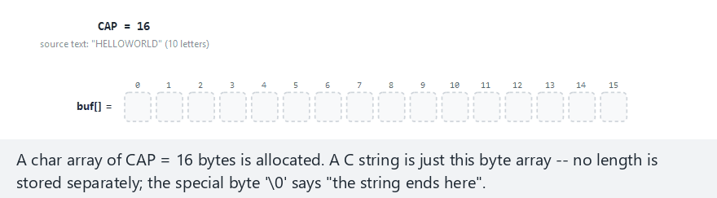
CEN207 Data Structures · Week 12
C string memory, step by step
RTEU Computer Engineering · Fall 2026–2027
15
Notes:
Normal example: cap=16, "HELLOWORLD" fits comfortably — watch the copy loop, the terminator, then strlen's second walk.

Slide 16
CEN207 Data Structures · Week 12
Edge case — overflow, flagged, never executed
RTEU Computer Engineering · Fall 2026–2027
16
Notes:
cap=8, a 10-letter source — watch the guard `if (i == cap) break;` stop the copy one write before it would go out of bounds.

Slide 17
CEN207 Data Structures · Week 12
Code — the guarded copy loop
int i = 0;
while (src[i] != '\0') {
if (i == cap) break;
buf[i] = src[i];
i++;
}
int overflow = (src[i] != '\0');
if (!overflow) buf[i] = '\0';
RTEU Computer Engineering · Fall 2026–2027
17
Notes:
The guard line is the ONE addition that turns a dangerous naive strcpy loop into a safe, teachable one.

Slide 18
CEN207 Data Structures · Week 12
Code — strlen walks it a second time
size_t len = 0;
if (!overflow)
while (buf[len] != '\0') len++;
• No length is ever cached anywhere
• Calling strlen in a loop condition: O(n) becomes O(n^2)
RTEU Computer Engineering · Fall 2026–2027
18
Notes:
This one-line trap (strlen inside a loop condition) is one of the most common accidental-quadratic bugs in C.

Slide 19
CEN207 Data Structures · Week 12
Complexity
• Copying a length-L string: O(L)
• strlen: O(L) — every single call, recomputed from scratch
• No caching, no shortcut, ever
• A cached length would break the moment the string changes
RTEU Computer Engineering · Fall 2026–2027
19
Notes:
Emphasize "every single call" — this is the fact students most often forget in later courses.

Slide 20
CEN207 Data Structures · Week 12
Common mistakes
• Forgetting the +1 for the terminator when sizing a buffer
• Calling strlen inside a loop's condition
• Comparing strings with == instead of strcmp
RTEU Computer Engineering · Fall 2026–2027
20
Notes:
`==` compares pointers in C, not characters — two identical-looking strings at different addresses compare unequal.

Slide 21
CEN207 Data Structures · Week 12
Mini-quiz
A 10-character word needs a buffer of what size? Why is char buf[10] one byte too small?
RTEU Computer Engineering · Fall 2026–2027
21
Notes:
Let a few hands go up before revealing the answer — this is a very common off-by-one in real code.

Slide 22
CEN207 Data Structures · Week 12
Answer
11 bytes. Ten characters plus one byte for '0' — forgetting the terminator is this section's classic bug.
RTEU Computer Engineering · Fall 2026–2027
22
Notes:
Tie this back to the overflow animation: exactly this omission is what "cap=8, 10 letters" demonstrates.

Slide 23
CEN207 Data Structures · Week 12
2. A Growable String Buffer
RTEU Computer Engineering · Fall 2026–2027
23
Notes:
Section 2 answers "what if we don't know the final length in advance?" — the same question Week 1's dynamic array answered for numbers.

Slide 24
CEN207 Data Structures · Week 12
A question to start
Section 1's buffer had a fixed capacity, chosen before one character was written. What if it could grow itself instead?
RTEU Computer Engineering · Fall 2026–2027
24
Notes:
This is exactly what java.lang.StringBuilder, C++'s std::string, and Week 1's dynamic array all do internally.

Slide 25
CEN207 Data Structures · Week 12
Intuition — outgrowing a drawer
• A drawer holds a fixed number of files
• Full drawer: buy a bigger one, move every file across
• Buying "one size bigger" every time: constant moving
• Buying double the size: moving becomes rare
RTEU Computer Engineering · Fall 2026–2027
25
Notes:
The "double, not +1" choice is the whole content of this section's complexity argument.

Slide 26
CEN207 Data Structures · Week 12
The idea: double when full
• Track len (used), cap (allocated), and storage
• len == cap: allocate a block double the size
• Copy every existing character across, then write the new one
• Doubling makes growth exponentially rarer as n grows
RTEU Computer Engineering · Fall 2026–2027
26
Notes:
"Exponentially rarer" is the intuitive version of the amortized-analysis argument on the complexity slide.

Slide 27
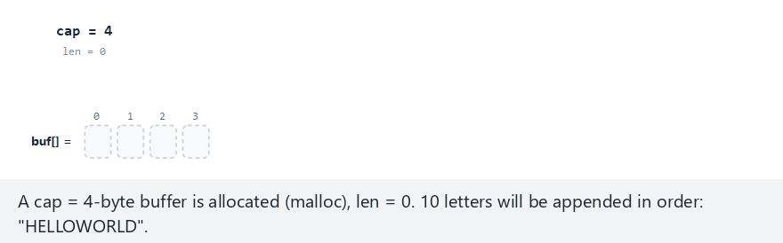
CEN207 Data Structures · Week 12
Growable buffer, step by step
RTEU Computer Engineering · Fall 2026–2027
27
Notes:
Normal example: initCap=4, "HELLOWORLD" — watch the buffer fill, hit capacity, and grow, with old characters visibly copied.

Slide 28
CEN207 Data Structures · Week 12
Edge case — smallest possible start
RTEU Computer Engineering · Fall 2026–2027
28
Notes:
initCap=1 forces the most growths for 10 letters — a good stress test of the doubling rule.

Slide 29
CEN207 Data Structures · Week 12
Code — grow, then write
void append(char c) {
if (len == cap) {
cap = cap * 2;
buf = realloc(buf, cap);
}
buf[len] = c;
len++;
}
RTEU Computer Engineering · Fall 2026–2027
29
Notes:
In C, realloc may MOVE the block — every old pointer into buf becomes invalid the instant this line runs.

Slide 30
CEN207 Data Structures · Week 12
Complexity
• One append: O(1) usually, O(len) on a growth
• n appends total: O(n) — amortized O(1) per append
• Growth copying forms a geometric series, bounded by n
• Same guarantee as Week 1's dynamic array
RTEU Computer Engineering · Fall 2026–2027
30
Notes:
"Amortized" means: not every single operation is cheap, but the AVERAGE over a long sequence is.

Slide 31
CEN207 Data Structures · Week 12
Common mistakes
• Growing by a fixed amount instead of doubling: O(n^2) total
• Forgetting to update the pointer after realloc (C)
• Allocating len bytes when a C string also needs +1
RTEU Computer Engineering · Fall 2026–2027
31
Notes:
A fixed growth amount is a classic "looks fine on small inputs, falls over at scale" bug.

Slide 32
CEN207 Data Structures · Week 12
Mini-quiz
Why does doubling give amortized O(1), but growing by a fixed amount of 10 gives O(n) per append on average?
RTEU Computer Engineering · Fall 2026–2027
32
Notes:
Ask students to think in terms of "how many growths happen, and how much does each one cost."

Slide 33
CEN207 Data Structures · Week 12
Answer
Doubling: `n/k` shrinks to `log n` growths. A fixed +10: n/10 growths, each copying up to n bytes.
RTEU Computer Engineering · Fall 2026–2027
33
Notes:
log(n) growths costing up to n each (decreasing) sums to O(n); n/10 growths costing up to n each sums to O(n^2).

Slide 34
CEN207 Data Structures · Week 12
3. Tries: One Edge Per Character
RTEU Computer Engineering · Fall 2026–2027
34
Notes:
Section 3 introduces the trie — the structure behind every autocomplete box and spell checker you have ever used.

Slide 35
CEN207 Data Structures · Week 12
A question to start
A hash table answers "is X a word?" in O(1). It cannot answer "what words start with X?" at all. What can?
RTEU Computer Engineering · Fall 2026–2027
35
Notes:
Hashing deliberately scatters similar keys — that is exactly why it cannot answer a "starts with" question.

Slide 36
CEN207 Data Structures · Week 12
A short history
• Edward Fredkin, "Trie Memory," 1960
• Name comes from "retrieval"
• Usually pronounced "try" to avoid confusion with "tree"
• Still the standard structure behind autocomplete today
RTEU Computer Engineering · Fall 2026–2027
36
Notes:
Sixty-five years old and still the first idea any interviewer expects for "design an autocomplete feature."

Slide 37
CEN207 Data Structures · Week 12
Intuition — a signpost tree
• Each fork in the path is labeled with one letter
• Follow a word's letters, one fork at a time
• Shared prefixes share the same early forks
• A small flag marks "a complete word ends here"
RTEU Computer Engineering · Fall 2026–2027
37
Notes:
The flag matters — a fork can be mid-path for one word AND the end of a shorter word at the same time.

Slide 38
CEN207 Data Structures · Week 12
The idea: shared prefixes share nodes
• insert("CAT"), then insert("CAR"): share C→A
• insert("CARD"): shares C→A→R with "CAR"
• insert("DOG"): shares nothing, new branch from root
• A node can be both "end of CAR" and "path to CARD"
RTEU Computer Engineering · Fall 2026–2027
38
Notes:
This dual role — end-of-word AND has-children — is the single most common source of trie bugs.

Slide 39
CEN207 Data Structures · Week 12
Trie operations
Operation | Cost
insert(word) | O(L), L = word length
search(word) | O(L)
prefix check | O(L)
Independent of how many other words are stored!
RTEU Computer Engineering · Fall 2026–2027
39
Notes:
A 10-word trie and a 10-million-word trie answer search("CAT") in exactly the same number of steps.

Slide 40
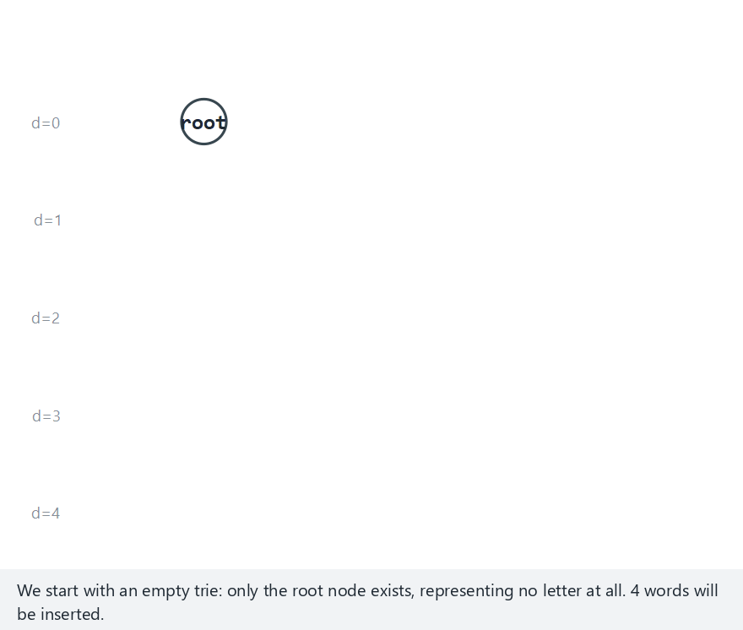
CEN207 Data Structures · Week 12
Trie insert and search, step by step
RTEU Computer Engineering · Fall 2026–2027
40
Notes:
Normal example: CAT, CAR, CARD, DOG — watch shared edges get reused, and the "end" flag appear at word boundaries.

Slide 41
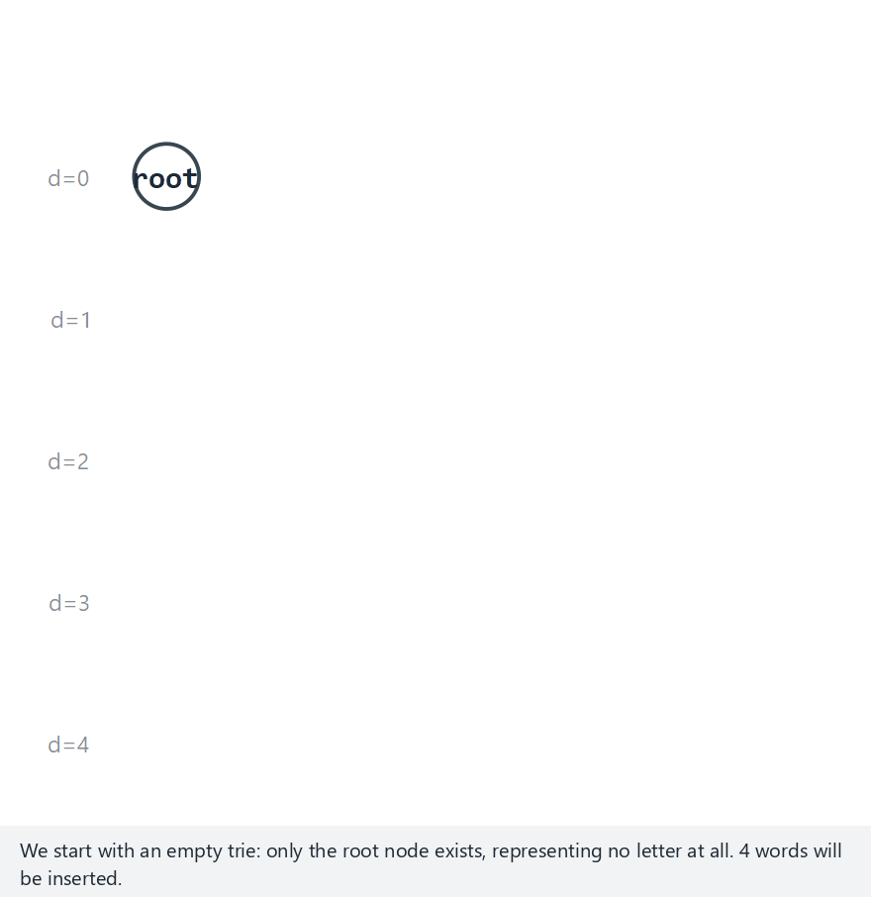
CEN207 Data Structures · Week 12
Edge case — a branchless chain
RTEU Computer Engineering · Fall 2026–2027
41
Notes:
A, AB, ABC, ABCD — no branching at all, a plain linked-list-like chain. This is exactly what section 4 compresses.

Slide 42
CEN207 Data Structures · Week 12
Code — insert
void insert(TrieNode *root, const char *word) {
TrieNode *cur = root;
for (int i = 0; word[i]; i++) {
int c = word[i] - 'A';
if (cur->child[c] == NULL)
cur->child[c] = new_node();
cur = cur->child[c];
}
cur->isEnd = true;
}
RTEU Computer Engineering · Fall 2026–2027
42
Notes:
C uses a fixed 26-slot array per node; the Java version (in the notes) uses a HashMap instead — a real trade-off.

Slide 43
CEN207 Data Structures · Week 12
Code — search
bool search(TrieNode *root, const char *word) {
TrieNode *cur = root;
for (int i = 0; word[i]; i++) {
int c = word[i] - 'A';
if (cur->child[c] == NULL) return false;
cur = cur->child[c];
}
return cur->isEnd;
}
RTEU Computer Engineering · Fall 2026–2027
43
Notes:
Reaching the end of the loop only proves "this is a prefix" — the return value also checks isEnd.

Slide 44
CEN207 Data Structures · Week 12
Complexity
• Every operation: O(L), L = word's length
• Independent of n, the trie's total word count
• Beats a sorted array or balanced tree: O(L log n)
• Price: memory — many mostly-empty child arrays
RTEU Computer Engineering · Fall 2026–2027
44
Notes:
That memory price is exactly what section 4's compressed trie fixes.

Slide 45
CEN207 Data Structures · Week 12
Common mistakes
• Confusing "found" with "is a prefix"
• Forgetting a node can be isEnd AND have children
• Never freeing the trie in C (a recursive leak, one node at a time)
RTEU Computer Engineering · Fall 2026–2027
45
Notes:
search("CAR") and search("CARP") walk the same three edges in a trie holding "CARPET" — only one of them is a stored word.

Slide 46
CEN207 Data Structures · Week 12
Mini-quiz
A trie holds "DOG". You call search("DO"). Does it return true or false — and why?
RTEU Computer Engineering · Fall 2026–2027
46
Notes:
Give students 30 seconds; many will initially say true because the path exists.

Slide 47
CEN207 Data Structures · Week 12
Answer
False. The path D→O exists, so "DO" is a valid prefix — but the O node is not marked isEnd.
RTEU Computer Engineering · Fall 2026–2027
47
Notes:
This is precisely the found-vs-prefix distinction the "Common mistakes" slide just warned about.

Slide 48
CEN207 Data Structures · Week 12
4. Compressed Tries (Radix Trees)
RTEU Computer Engineering · Fall 2026–2027
48
Notes:
Section 4 fixes the memory waste a plain trie has on long, non-branching words.

Slide 49
CEN207 Data Structures · Week 12
A question to start
Inserting "INTERNATIONAL" (13 letters) into a plain trie makes 13 new nodes, each with one child. Can we do better?
RTEU Computer Engineering · Fall 2026–2027
49
Notes:
Thirteen nodes for something that could, in principle, be one string with no branching at all.

Slide 50
CEN207 Data Structures · Week 12
A short history
• Donald R. Morrison, "PATRICIA," 1968
• Name: an acronym for a practical retrieval algorithm
• Also called a radix tree in general use
• Same idea underlies real-world IP routing tables
RTEU Computer Engineering · Fall 2026–2027
50
Notes:
PATRICIA tries are still used today in networking — longest-prefix-match IP routing is a direct application.

Slide 51
CEN207 Data Structures · Week 12
The idea: extend, create, or split
• Word matches an edge label completely: descend
• No edge starts with the next letter: new leaf edge
• Word shares only part of an edge label: split it
• A split creates a new branching node at the mismatch
RTEU Computer Engineering · Fall 2026–2027
51
Notes:
Case 3 — the split — is the one genuinely new idea; the other two cases are exactly a plain trie's logic.

Slide 52
CEN207 Data Structures · Week 12
Splitting an edge
• "TEST" alone: one leaf edge, labeled "TEST"
• Insert "TEA": shares only "TE" before diverging
• The "TEST" edge splits at "TE"
• Two children now: "ST" (old) and "A" (new)
RTEU Computer Engineering · Fall 2026–2027
52
Notes:
Walk this on the board before playing the animation — it is the one step students need to see by hand first.

Slide 53
CEN207 Data Structures · Week 12
Link back — Week 4's Huffman coding
• Huffman: compresses by exploiting skewed frequencies
• Compressed trie: compresses by removing structural waste
• Huffman shape depends on how OFTEN symbols occur
• Trie shape depends only on the actual characters stored
RTEU Computer Engineering · Fall 2026–2027
53
Notes:
Two completely different compression ideas from this course — worth naming the difference explicitly.

Slide 54
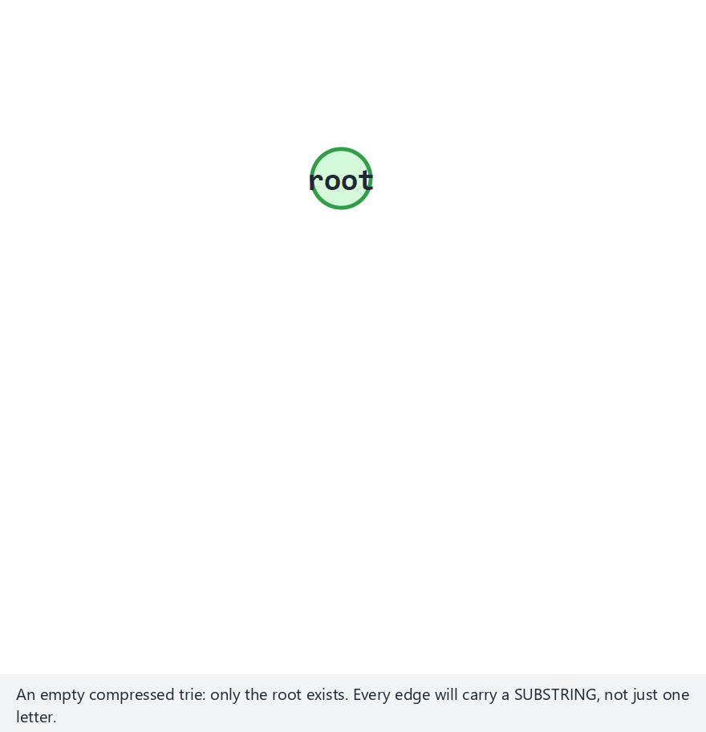
CEN207 Data Structures · Week 12
Compressed trie, step by step
RTEU Computer Engineering · Fall 2026–2027
54
Notes:
Normal example: TEST, TEA, TEAM — watch the TEST edge split into TE + ST, then TEAM extend past the A node.

Slide 55
CEN207 Data Structures · Week 12
Edge case — splits nested inside splits
RTEU Computer Engineering · Fall 2026–2027
55
Notes:
ANT, ARM, ART, AXE — a split inside a split, the hardest case this structure has to handle correctly.

Slide 56
CEN207 Data Structures · Week 12
Code — insert (extend, create, or split)
int j = common_prefix_len(word + i, child->label);
if (j == strlen(child->label)) {
node = child; i += j; /* descend */
} else {
RNode *mid = split_edge(node, child, j);
/* new leaf for the remaining suffix */
}
RTEU Computer Engineering · Fall 2026–2027
56
Notes:
The full split_edge logic (shortening the old label, re-keying the child) is in the notes — this is the decision point.

Slide 57
CEN207 Data Structures · Week 12
Complexity
• insert, search: still O(L), exactly like a plain trie
• Savings are in space, not time
• Node count bounded by branch points + word endings
• Not by total character count
RTEU Computer Engineering · Fall 2026–2027
57
Notes:
The time complexity is unchanged; only the constant factor on memory improves, sometimes dramatically.

Slide 58
CEN207 Data Structures · Week 12
Common mistakes
• Splitting at the wrong length (must be the common prefix length)
• Forgetting to re-key the split child under its new first letter
• Treating "path exists" as "word found" (same trap as section 3)
RTEU Computer Engineering · Fall 2026–2027
58
Notes:
The re-keying bug is subtle — the child's map/array key must change to match its shortened label's new first letter.

Slide 59
CEN207 Data Structures · Week 12
Mini-quiz
A compressed trie holds only "APPLE" and "BANANA". How many non-root nodes does it have, and why so few?
RTEU Computer Engineering · Fall 2026–2027
59
Notes:
Let students reason it out before revealing — the "no shared prefix" case is the simplest possible one.

Slide 60
CEN207 Data Structures · Week 12
Answer
Two. No shared prefix at all, so each word becomes one single leaf edge straight from the root.
RTEU Computer Engineering · Fall 2026–2027
60
Notes:
Contrast with a plain trie, which would need 5 + 6 = 11 nodes for the same two words.

Slide 61
CEN207 Data Structures · Week 12
5. Suffix Arrays
RTEU Computer Engineering · Fall 2026–2027
61
Notes:
Section 5 answers a different question: not "is X a word?" but "does pattern P occur anywhere in text T?"

Slide 62
CEN207 Data Structures · Week 12
A question to start
A trie answers "is X a stored word?" What about "does P occur anywhere inside one long text T?"
RTEU Computer Engineering · Fall 2026–2027
62
Notes:
This is the question a text editor's "find" feature, or a genome browser, asks constantly.

Slide 63
CEN207 Data Structures · Week 12
The idea: every suffix, sorted
• List every suffix of T, starting position by position
• Sort those n suffixes lexicographically
• A pattern search becomes a binary search: O(m log n)
• No sentinel needed — two suffixes always differ in length
RTEU Computer Engineering · Fall 2026–2027
63
Notes:
"Always differ in length" is why a shorter suffix that is a prefix of a longer one just sorts first, automatically.

Slide 64
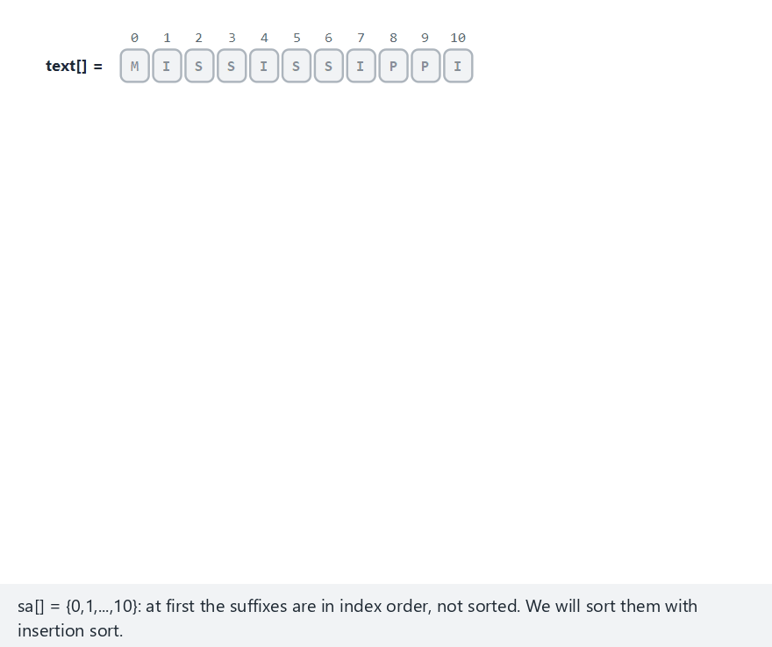
CEN207 Data Structures · Week 12
Suffix array, step by step
RTEU Computer Engineering · Fall 2026–2027
64
Notes:
Normal example: MISSISSIPPI — watch each suffix, as its own row, slide into sorted position via insertion sort.

Slide 65
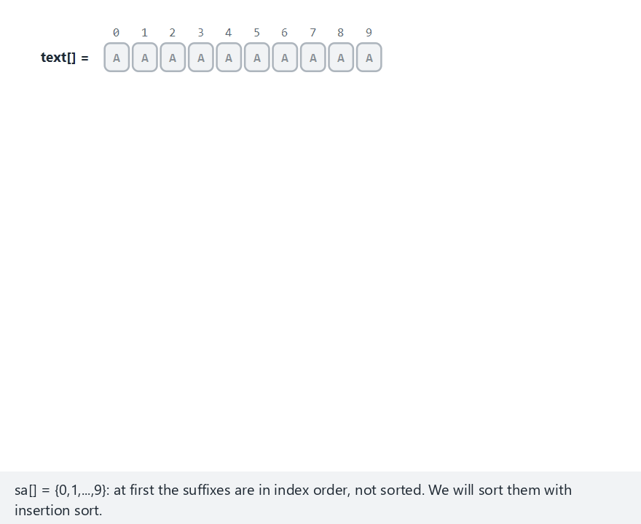
CEN207 Data Structures · Week 12
Edge case — every character identical
RTEU Computer Engineering · Fall 2026–2027
65
Notes:
AAAAAAAAAA — every comparison runs all the way to the shorter suffix's end; the length rule alone decides every tie.

Slide 66
CEN207 Data Structures · Week 12
Code — insertion sort over suffixes
int compare_suffix(const char *text, int a, int b) {
return strcmp(text + a, text + b);
}
• Each suffix is a pointer into the same buffer
• No character is ever copied during the sort
RTEU Computer Engineering · Fall 2026–2027
66
Notes:
This is a nice, concrete example of "clever pointer use avoids O(n) extra memory and copying."

Slide 67
CEN207 Data Structures · Week 12
Complexity
• Insertion sort here: O(n^2) comparisons, worst case
• Each comparison: up to O(n) characters
• Real libraries build it in O(n log n) or O(n)
• Once built: pattern search is O(m log n)
RTEU Computer Engineering · Fall 2026–2027
67
Notes:
The construction cost is paid ONCE; every subsequent search against the same text is fast.

Slide 68
CEN207 Data Structures · Week 12
Common mistakes
• Adding an unneeded sentinel character "just in case"
• Comparing suffixes by copying substrings (wastes memory)
• Confusing the array's indices with the suffixes' characters
RTEU Computer Engineering · Fall 2026–2027
68
Notes:
`sa[i]` is a starting POSITION, not a copy of the suffix — printing the suffix needs `text + sa[i]`.

Slide 69
CEN207 Data Structures · Week 12
Mini-quiz
Why can two suffixes of the same text never be byte-for-byte identical?
RTEU Computer Engineering · Fall 2026–2027
69
Notes:
This is the key fact that makes a sentinel character unnecessary for the comparison rule.

Slide 70
CEN207 Data Structures · Week 12
Answer
They always have different lengths. Suffixes start at different positions in a finite string, so lengths differ.
RTEU Computer Engineering · Fall 2026–2027
70
Notes:
Different lengths mean plain lexicographic comparison already handles every possible tie correctly.

Slide 71
CEN207 Data Structures · Week 12
6. The String-Matching Problem, and Naive Search
RTEU Computer Engineering · Fall 2026–2027
71
Notes:
Section 6 opens the search family — five algorithms, five different tricks, all answering the same question.

Slide 72
CEN207 Data Structures · Week 12
A question to start
Given one text and one pattern, where does the pattern occur? What is the simplest possible way to answer this?
RTEU Computer Engineering · Fall 2026–2027
72
Notes:
"Simplest possible" is naive search — exactly where you would start with no cleverer idea taught yet.

Slide 73
CEN207 Data Structures · Week 12
The idea: try every shift
• Slide the pattern across the text, one position at a time
• At each shift: compare left to right
• Stop at the first mismatch, or record a full match
• Keep going after a match — occurrences can overlap
RTEU Computer Engineering · Fall 2026–2027
73
Notes:
"Keep going after a match" is the single most-forgotten rule — a common bug jumps m positions after a hit.

Slide 74
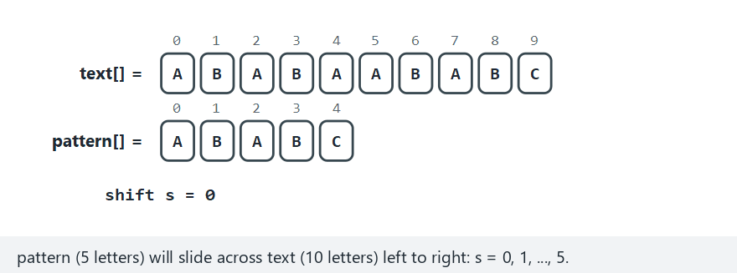
CEN207 Data Structures · Week 12
Naive search, step by step
RTEU Computer Engineering · Fall 2026–2027
74
Notes:
Normal example: text="ABABAABABC", pattern="ABABC" — watch a few false starts before the real match at shift 5.

Slide 75
CEN207 Data Structures · Week 12
Edge case — the worst case
RTEU Computer Engineering · Fall 2026–2027
75
Notes:
text="AAAAAAAAAA", pattern="AAAB" — every shift compares nearly the whole pattern before failing on the LAST character.

Slide 76
CEN207 Data Structures · Week 12
Code — the double loop
for (int s = 0; s <= n - m; s++) {
int j = 0;
while (j < m && text[s+j] == pattern[j])
j++;
if (j == m) occ[c++] = s;
}
RTEU Computer Engineering · Fall 2026–2027
76
Notes:
Every algorithm from here to Section 11 is, in some sense, a smarter way to avoid this double loop's worst case.

Slide 77
CEN207 Data Structures · Week 12
Complexity
• Best case: O(n) — mismatches happen immediately
• Worst case: *`O(nm)`**
• "AAAA...AB" vs "AAAB": nearly every shift, near-full compare
• This worst case is exactly what Sections 7–11 each fix
RTEU Computer Engineering · Fall 2026–2027
77
Notes:
Frame naive search's worst case as the villain of the rest of the lecture — every later algorithm is "the fix."

Slide 78
CEN207 Data Structures · Week 12
Common mistakes
• Forgetting matches can overlap (skipping m positions after a hit)
• Looping s up to n instead of n - m
• Assuming naive search is always "bad" — it often wins for short input
RTEU Computer Engineering · Fall 2026–2027
78
Notes:
Worst-case complexity is not the only consideration — small inputs favor naive search's tiny constant factor.

Slide 79
CEN207 Data Structures · Week 12
Mini-quiz
Construct a 2-letter-alphabet text and pattern that forces EVERY comparison to reach the pattern's last character.
RTEU Computer Engineering · Fall 2026–2027
79
Notes:
Give 60 seconds — many will independently rediscover the "AAAA...B" pattern shown in the hard example.

Slide 80
CEN207 Data Structures · Week 12
Answer
`text="AAAAAAAAAA"`, `pattern="AAAB"`. The first 3 letters always match; only the last, 'B', ever fails.
RTEU Computer Engineering · Fall 2026–2027
80
Notes:
This is exactly the hard-scenario animation shown two slides ago.

Slide 81
CEN207 Data Structures · Week 12
7. Knuth-Morris-Pratt: the Failure Function
RTEU Computer Engineering · Fall 2026–2027
81
Notes:
Section 7 builds the table Section 8 uses — a KMP lecture needs both halves to make sense.

Slide 82
CEN207 Data Structures · Week 12
A question to start
Naive search throws away everything it learned after a mismatch. What if the pattern's own structure told us more?
RTEU Computer Engineering · Fall 2026–2027
82
Notes:
The key insight: the pattern can be studied ONCE, in advance, independent of the text it will search.

Slide 83
CEN207 Data Structures · Week 12
A short history
• Knuth, Morris, and Pratt, 1977 (SIAM J. Computing)
• Independently developed by Morris & Pratt, ~1970
• The table: lps[] — "longest proper prefix, also a suffix"
• Built by comparing the pattern to itself
RTEU Computer Engineering · Fall 2026–2027
83
Notes:
One of the most-cited papers in string algorithms — still the first thing taught after naive search in most courses.

Slide 84
CEN207 Data Structures · Week 12
The idea: lps[i]
• For every prefix pattern[0..i]...
• ...the longest proper prefix that is ALSO a suffix
• "ABAB": longest such match is "AB" — lps[3] = 2
• Tells a future search: "this much can be reused"
RTEU Computer Engineering · Fall 2026–2027
84
Notes:
Work through "ABAB" -> lps=2 on the board; it is short enough to do by hand in under a minute.

Slide 85
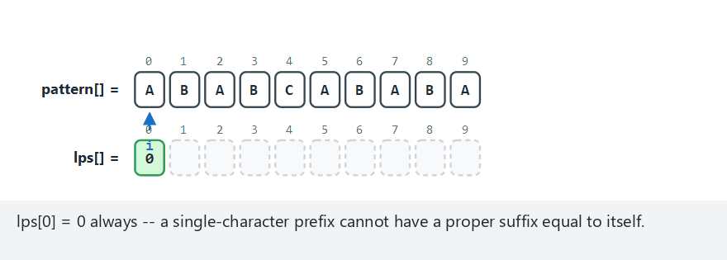
CEN207 Data Structures · Week 12
KMP failure function, step by step
RTEU Computer Engineering · Fall 2026–2027
85
Notes:
Normal example: ABABCABABA — watch len grow on a match, and fall back through lps[len-1] (never straight to 0) on a mismatch.

Slide 86
CEN207 Data Structures · Week 12
Edge case — the fallback chases a chain
RTEU Computer Engineering · Fall 2026–2027
86
Notes:
AABAACAABAA — a mismatch falls back through more than one level of lps, not straight to 0.

Slide 87
CEN207 Data Structures · Week 12
Code — building lps[]
int len = 0, i = 1;
while (i < m) {
if (pattern[i] == pattern[len]) {
lps[i++] = ++len;
} else if (len != 0) {
len = lps[len - 1];
} else {
lps[i++] = 0;
}
}
RTEU Computer Engineering · Fall 2026–2027
87
Notes:
The "else if (len != 0)" branch — falling back instead of resetting — is THE line students get wrong first.

Slide 88
CEN207 Data Structures · Week 12
Complexity
• O(m) to build the whole table
• len decreases at most as many times as it increases
• Total work bounded by O(m), never O(m^2)
• Same amortized argument reused in Sections 8 and 11
RTEU Computer Engineering · Fall 2026–2027
88
Notes:
This amortized argument (a value that only decreases as much as it increased) recurs constantly in string algorithms.

Slide 89
CEN207 Data Structures · Week 12
Common mistakes
• Resetting len to 0 on every mismatch (the #1 KMP bug)
• Off-by-one: comparing pattern[len], not pattern[len+1]
• Forgetting lps[0] = 0 is a fixed base case, not computed
RTEU Computer Engineering · Fall 2026–2027
89
Notes:
Resetting to 0 still produces A table — just the WRONG one, one that under-reports safe skip distance.

Slide 90
CEN207 Data Structures · Week 12
Mini-quiz
What does lps[m-1] — the very last entry — tell you about the whole pattern?
RTEU Computer Engineering · Fall 2026–2027
90
Notes:
This connects the table's last entry to the pattern's own self-overlap as a whole, not just a prefix.

Slide 91
CEN207 Data Structures · Week 12
Answer
The pattern's longest "border" — its longest proper prefix that is also its own suffix, as a whole.
RTEU Computer Engineering · Fall 2026–2027
91
Notes:
"AAAAAAAAAA" has lps[m-1] = m-1, the maximum possible self-overlap.

Slide 92
CEN207 Data Structures · Week 12
8. Knuth-Morris-Pratt: the Search
RTEU Computer Engineering · Fall 2026–2027
92
Notes:
Section 8 is where the lps table earns its keep — this is the payoff slide sequence for section 7's setup.

Slide 93
CEN207 Data Structures · Week 12
A question to start
With lps[] in hand, can we search the text with a pointer that never moves backward?
RTEU Computer Engineering · Fall 2026–2027
93
Notes:
"Never moves backward" is the single guarantee that gives KMP its O(n+m) bound — say it more than once.

Slide 94
CEN207 Data Structures · Week 12
The idea: i never rewinds
• Two pointers: i (text), j (pattern)
• Match: both advance
• Mismatch, j > 0: j falls back to lps[j-1] — i stays put
• Mismatch, j == 0: only i advances
RTEU Computer Engineering · Fall 2026–2027
94
Notes:
"i stays put" on a fallback is the key line — the text character is never re-examined.

Slide 95
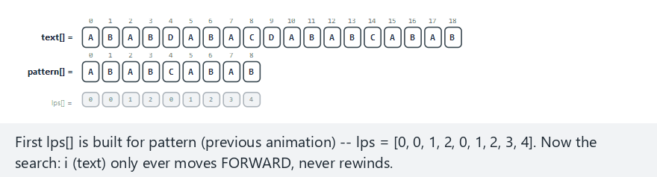
CEN207 Data Structures · Week 12
KMP search, step by step
RTEU Computer Engineering · Fall 2026–2027
95
Notes:
Normal example: the classic CLRS-style text/pattern pair — watch i march forward while j jumps around using lps.

Slide 96
CEN207 Data Structures · Week 12
Edge case — many lps fallbacks
RTEU Computer Engineering · Fall 2026–2027
96
Notes:
text="AAAAAAAAAAAAAAAB", pattern="AAAAB" — a dense sequence of fallbacks, but i still only ever moves forward.

Slide 97
CEN207 Data Structures · Week 12
Code — the main loop
while (i < n) {
if (text[i] == pattern[j]) {
i++; j++;
if (j == m) { occ[c++] = i-m; j = lps[j-1]; }
} else if (j > 0) {
j = lps[j - 1];
} else { i++; }
}
RTEU Computer Engineering · Fall 2026–2027
97
Notes:
Three branches, one for each case on the "idea" slide — map them 1:1 with students before moving on.

Slide 98
CEN207 Data Structures · Week 12
Complexity
• O(n + m): O(m) to build lps, O(n) for the search
• i advances at most n times, total, ever
• Holds for any text or pattern — no bad input exists
• Compare to naive search's O(n*m) worst case
RTEU Computer Engineering · Fall 2026–2027
98
Notes:
"No bad input exists" is worth repeating — KMP has no configuration or input that degrades it.

Slide 99
CEN207 Data Structures · Week 12
Common mistakes
• Advancing i on a fallback (defeats the whole guarantee)
• Forgetting to fall back again after recording a match
• Reusing a stale lps[] table built for a different pattern
RTEU Computer Engineering · Fall 2026–2027
99
Notes:
Forgetting the post-match fallback silently misses overlapping occurrences — a quiet, hard-to-spot bug.

Slide 100
CEN207 Data Structures · Week 12
Mini-quiz
Why is O(n+m) achievable for KMP but not for naive search, in one sentence?
RTEU Computer Engineering · Fall 2026–2027
100
Notes:
The answer should connect directly back to naive search's "re-examines text characters" root cause.

Slide 101
CEN207 Data Structures · Week 12
Answer
No text character is ever re-examined — naive search's O(n*m) comes exactly from re-examining them.
RTEU Computer Engineering · Fall 2026–2027
101
Notes:
This slide is the payoff of the whole KMP arc — say it slowly, it is the one sentence worth remembering.

Slide 102
CEN207 Data Structures · Week 12
9. Rabin-Karp: Rolling Hash and Spurious Hits
RTEU Computer Engineering · Fall 2026–2027
102
Notes:
Section 9 brings hashing (Week 6) back, in a genuinely new, incremental form.

Slide 103
CEN207 Data Structures · Week 12
A question to start
What if, instead of comparing characters at all, we compared a cheap HASH of each window?
RTEU Computer Engineering · Fall 2026–2027
103
Notes:
This is a completely different strategy from KMP's — comparison-avoidance instead of comparison-optimization.

Slide 104
CEN207 Data Structures · Week 12
A short history
• Rabin and Karp, 1987 (IBM J. Research & Development)
• Reuses Week 6's hashing — but rolls it forward
• A hash match is only a candidate, never a certainty
• Must always verify before reporting a match
RTEU Computer Engineering · Fall 2026–2027
104
Notes:
"Candidate, never a certainty" is the single most important sentence in this section.

Slide 105
CEN207 Data Structures · Week 12
The idea: roll, don't recompute
• Treat each character as a digit in a fixed base
• Sliding the window: remove outgoing char, add incoming
• One O(1) update — the middle characters are never re-read
• A hash match must still be verified character by character
RTEU Computer Engineering · Fall 2026–2027
105
Notes:
"Verified" — say it again. Two different substrings CAN hash to the same value; that is not a bug, it is math.

Slide 106
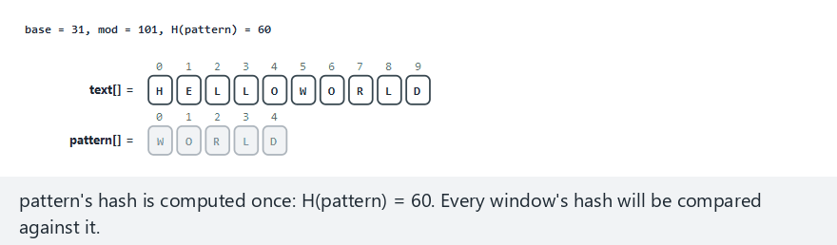
CEN207 Data Structures · Week 12
Rabin-Karp, step by step
RTEU Computer Engineering · Fall 2026–2027
106
Notes:
Normal example: mod=101, no spurious hits — watch the rolling hash update, O(1), skipping most windows entirely.

Slide 107
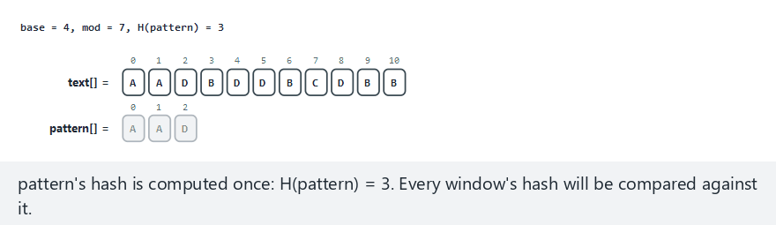
CEN207 Data Structures · Week 12
Edge case — spurious hits
RTEU Computer Engineering · Fall 2026–2027
107
Notes:
mod=7 (deliberately small) — a hash match that FAILS verification: a spurious hit, correctly rejected.

Slide 108
CEN207 Data Structures · Week 12
A real bug caught while building this note
• First C draft used long for the hash — not long long
• On this course's toolchain, long is only 32 bits
• mod = 1e9+7 overflowed it — silent wrong answer
• Comparing C vs Java output caught it immediately
RTEU Computer Engineering · Fall 2026–2027
108
Notes:
A genuine teaching moment — never assume `long` means 64 bits in C; its width is platform-defined.

Slide 109
CEN207 Data Structures · Week 12
Code — the rolling update
if (s > 0)
tHash = ((tHash - text[s-1]*hPow % mod + mod)
* base + text[s+m-1]) % mod;
if (tHash == pHash && strncmp(...) == 0)
occ[c++] = s; /* VERIFY, always */
RTEU Computer Engineering · Fall 2026–2027
109
Notes:
Point at `strncmp` — that call is not optional; skipping it silently reports spurious hits as real matches.

Slide 110
CEN207 Data Structures · Week 12
Complexity
• Average case: O(n + m) — O(1) per window
• O(m) extra, only for windows whose hash actually matches
• Worst case: O(n*m) if the modulus is small/poorly chosen
• A large prime modulus makes that worst case vanishingly rare
RTEU Computer Engineering · Fall 2026–2027
110
Notes:
The "hard" example deliberately used mod=7 to make this worst-case behavior visible on purpose.

Slide 111
CEN207 Data Structures · Week 12
Common mistakes
• Skipping verification (correctness bug, not just speed)
• Using too small a modulus "for simplicity"
• Using a type too narrow for the arithmetic (the long bug above)
RTEU Computer Engineering · Fall 2026–2027
111
Notes:
These three map exactly to the three things this section's animation and program deliberately demonstrate.

Slide 112
CEN207 Data Structures · Week 12
Mini-quiz
Why must every Rabin-Karp hash match still be verified character by character?
RTEU Computer Engineering · Fall 2026–2027
112
Notes:
The pigeonhole principle is the precise mathematical answer, worth naming explicitly.

Slide 113
CEN207 Data Structures · Week 12
Answer
Pigeonhole principle — more possible substrings than hash values means some MUST collide. Not a bug; math.
RTEU Computer Engineering · Fall 2026–2027
113
Notes:
This is a nice callback to any discrete-math course students may have also taken.

Slide 114
CEN207 Data Structures · Week 12
10. Boyer-Moore: the Bad-Character Rule
RTEU Computer Engineering · Fall 2026–2027
114
Notes:
Section 10 introduces the algorithm that is, in practice, often the fastest for natural-language text.

Slide 115
CEN207 Data Structures · Week 12
A question to start
Every algorithm so far compares left to right. What if comparing RIGHT to LEFT let us jump further?
RTEU Computer Engineering · Fall 2026–2027
115
Notes:
This sounds backward at first — that is exactly why it is worth pausing on before revealing the idea.

Slide 116
CEN207 Data Structures · Week 12
A short history
• Boyer and Moore, 1977 (Communications of the ACM)
• This course covers only the bad-character rule
• The full algorithm adds a second "good suffix" rule
• Often the fastest string search in practice today
RTEU Computer Engineering · Fall 2026–2027
116
Notes:
Mention the good-suffix rule exists, but is out of scope — students should know the name for later reading.

Slide 117
CEN207 Data Structures · Week 12
The idea: scan backward, jump using what you saw
• Compare pattern[m-1] first, then m-2, ... right to left
• Mismatch: look up that character's LAST occurrence in the pattern
• Character absent from pattern: jump the whole pattern length
• Shift never less than 1 (never backward, never stationary)
RTEU Computer Engineering · Fall 2026–2027
117
Notes:
"Never less than 1" is a real implementation trap — repeated characters can make the naive shift formula go to 0.

Slide 118
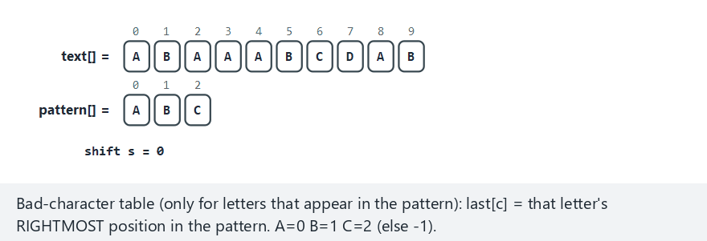
CEN207 Data Structures · Week 12
Boyer-Moore, step by step
RTEU Computer Engineering · Fall 2026–2027
118
Notes:
Normal example: text="ABAAABCDAB", pattern="ABC" — watch the right-to-left scan and the resulting jump size.

Slide 119
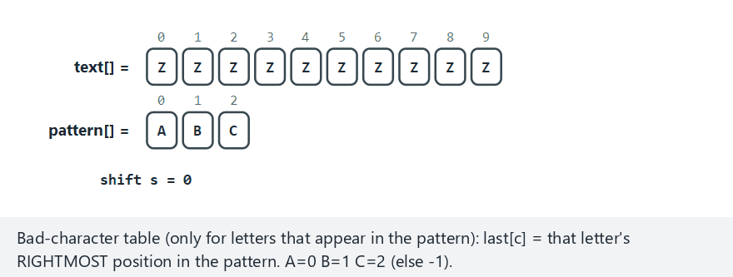
CEN207 Data Structures · Week 12
Edge case — the biggest possible jump
RTEU Computer Engineering · Fall 2026–2027
119
Notes:
text="ZZZZZZZZZZ", pattern="ABC" — Z never appears in the pattern, so every window jumps the full pattern length.

Slide 120
CEN207 Data Structures · Week 12
Code — the bad-character table and shift
for (int c = 0; c < 256; c++) last[c] = -1;
for (int j = 0; j < m; j++) last[pattern[j]] = j;
/* ... */
int shift = j - last[text[s + j]];
s += shift > 1 ? shift : 1;
RTEU Computer Engineering · Fall 2026–2027
120
Notes:
The table is built ONCE from the pattern alone — exactly like KMP's lps table, reused unchanged across every window.

Slide 121
CEN207 Data Structures · Week 12
Complexity
• Best case: O(n/m) — large jumps, rich alphabet
• Worst case: O(n*m) — low-diversity text (bad-character rule alone)
• Often fastest in practice on natural-language text
• The good-suffix rule (not covered) fixes the worst case
RTEU Computer Engineering · Fall 2026–2027
121
Notes:
Emphasize "in practice" — the average case on real text is what makes this algorithm's reputation.

Slide 122
CEN207 Data Structures · Week 12
Common mistakes
• Forgetting the shift >= 1 guard (can loop forever without it)
• Building the bad-character table from the TEXT, not the pattern
• Comparing left to right out of habit — loses the whole advantage
RTEU Computer Engineering · Fall 2026–2027
122
Notes:
Comparing left-to-right by mistake still finds correct matches — it just throws away Boyer-Moore's entire point.

Slide 123
CEN207 Data Structures · Week 12
Mini-quiz
Why can Boyer-Moore skip text characters naive search is forced to examine?
RTEU Computer Engineering · Fall 2026–2027
123
Notes:
The answer is about PROVING a range of positions cannot match, without ever looking at the characters there.

Slide 124
CEN207 Data Structures · Week 12
Answer
One comparison proves several shifts impossible — no match can exist there, so they are never checked.
RTEU Computer Engineering · Fall 2026–2027
124
Notes:
This "prove, don't check" idea is the conceptual heart of every algorithm faster than naive search this week.

Slide 125
CEN207 Data Structures · Week 12
11. The Z-Algorithm
RTEU Computer Engineering · Fall 2026–2027
125
Notes:
Section 11 closes the search family with the most conceptually elegant of the five algorithms.

Slide 126
CEN207 Data Structures · Week 12
A question to start
Every algorithm so far built its own bespoke table. Can ONE self-comparison answer the whole search?
RTEU Computer Engineering · Fall 2026–2027
126
Notes:
Frame this as "the elegant one" — students often find the Z-algorithm the most satisfying of the five.

Slide 127
CEN207 Data Structures · Week 12
The idea: Z[i] and a combined string
• Z[i]: how much does S[i..] match S's own start?
• Let S = pattern + '#' + text (a separator, unused elsewhere)
• Z[i] >= |pattern| in the text part: an occurrence
• A [l, r) window reuses known values — O(n + m) total
RTEU Computer Engineering · Fall 2026–2027
127
Notes:
The window [l, r) plays the exact same role as KMP's lps table — "remember what you already know."

Slide 128
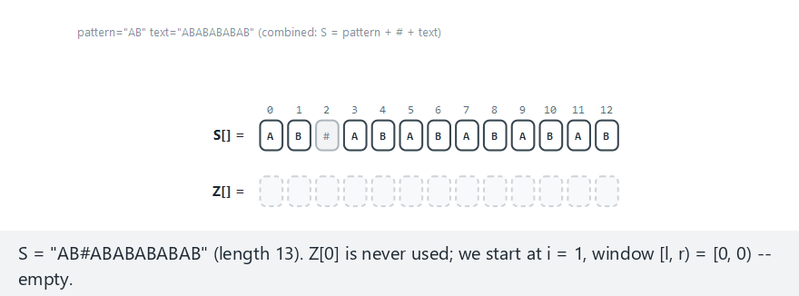
CEN207 Data Structures · Week 12
Z-algorithm, step by step
RTEU Computer Engineering · Fall 2026–2027
128
Notes:
Normal example: pattern="AB", text="ABABABABAB" — watch the [l,r) window grow and get reused for later positions.

Slide 129
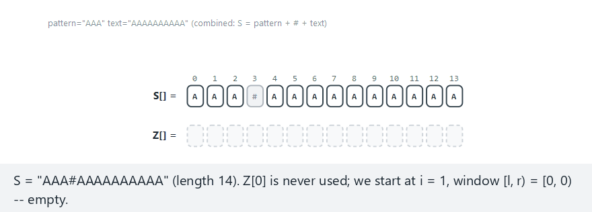
CEN207 Data Structures · Week 12
Edge case — the window is reused constantly
RTEU Computer Engineering · Fall 2026–2027
129
Notes:
pattern="AAA" against "AAAAAAAAAA" — the window keeps growing to the string's very end, reuse at almost every step.

Slide 130
CEN207 Data Structures · Week 12
Code — the Z-array construction
if (i < r)
z[i] = min(r - i, z[i - l]);
while (i + z[i] < n && s[z[i]] == s[i + z[i]])
z[i]++;
if (i + z[i] > r) { l = i; r = i + z[i]; }
RTEU Computer Engineering · Fall 2026–2027
130
Notes:
Three lines, one per idea: reuse the window, extend it if possible, remember the new window if it grew.

Slide 131
CEN207 Data Structures · Week 12
Complexity
• O(n + m) for the whole combined-string Z-array
• Same amortized argument as KMP's lps: window only grows
• O(1) per position to check for an occurrence
• Conceptually the simplest of all five search algorithms
RTEU Computer Engineering · Fall 2026–2027
131
Notes:
Worth reminding students this is the third time this lecture has used the same "only grows" amortized argument.

Slide 132
CEN207 Data Structures · Week 12
Common mistakes
• Forgetting the separator, or picking one that appears in the text
• Using Z[i] == m instead of Z[i] >= m
• Treating Z[0] as meaningful (it is conventionally unused)
RTEU Computer Engineering · Fall 2026–2027
132
Notes:
A Z value CAN legitimately exceed m if the text itself repeats — >= is the correct match test, not ==.

Slide 133
CEN207 Data Structures · Week 12
Mini-quiz
How does the Z-algorithm avoid building a SEPARATE table like KMP's lps, in one sentence?
RTEU Computer Engineering · Fall 2026–2027
133
Notes:
The honest answer is "it doesn't avoid a table" — Z[] IS the table, playing an analogous role.

Slide 134
CEN207 Data Structures · Week 12
Answer
It doesn't avoid one — Z[] IS the table, just describing overlap with the WHOLE combined string.
RTEU Computer Engineering · Fall 2026–2027
134
Notes:
lps[i] describes overlap within the pattern alone; Z[i] describes overlap with the whole glued-together string.

Slide 135
CEN207 Data Structures · Week 12
12. Comparing the Five Search Algorithms
RTEU Computer Engineering · Fall 2026–2027
135
Notes:
A short pause-and-compare section before the lecture pivots to dynamic programming.

Slide 136
CEN207 Data Structures · Week 12
Comparison table
Algorithm | Worst case | Typical case | Extra idea
Naive | O(n·m) | O(n) | Baseline
KMP | O(n+m) | O(n+m) | lps[], i never rewinds
Rabin-Karp | O(n·m) | O(n+m) avg | Rolling hash, verify
Boyer-Moore | O(n·m) | O(n/m) | Right-to-left, big jumps
Z-algorithm | O(n+m) | O(n+m) | One self-comparison array
RTEU Computer Engineering · Fall 2026–2027
136
Notes:
KMP is the only one with a GUARANTEED worst case — the safe default whenever adversarial input is a concern.

Slide 137
CEN207 Data Structures · Week 12
13. A New Strategy: Dynamic Programming
RTEU Computer Engineering · Fall 2026–2027
137
Notes:
Section 13 introduces dynamic programming from scratch — no prior week in this course has covered it.

Slide 138
CEN207 Data Structures · Week 12
A question to start
How "different" are two strings? Spell checkers, git diff, and DNA tools all ask a version of this question.
RTEU Computer Engineering · Fall 2026–2027
138
Notes:
These three real-world examples ground an otherwise abstract question in things students already know.

Slide 139
CEN207 Data Structures · Week 12
Why brute force is too slow
• Recursive definition: match, substitute, delete, or insert
• Correct — but branches into 3 calls at nearly every step
• The SAME sub-problem gets recomputed, exponentially often
• Overlapping sub-problems: the wasted work is fixable
RTEU Computer Engineering · Fall 2026–2027
139
Notes:
Write the naive recursive call tree on the board — the repeated sub-trees are visually obvious even for small inputs.

Slide 140
CEN207 Data Structures · Week 12
The idea: solve each sub-problem once
• Optimal substructure: best answer built from best sub-answers
• Overlapping sub-problems: the same one recurs many times
• Solve each sub-problem exactly ONCE, store it in a table
• This is dynamic programming — genuinely new this week
RTEU Computer Engineering · Fall 2026–2027
140
Notes:
Both properties are required — optimal substructure makes the recursion correct; overlap makes memoizing worthwhile.

Slide 141
CEN207 Data Structures · Week 12
Edit distance: the question
• Fewest single-character edits to turn a into b
• Insert, delete, or substitute — each costs 1
• Also called Levenshtein distance (1965)
• dp[i][j] = edit distance between a's first i, b's first j
RTEU Computer Engineering · Fall 2026–2027
141
Notes:
Levenshtein's original paper predates the "dynamic programming" name becoming standard in this exact context.

Slide 142
CEN207 Data Structures · Week 12
The recurrence
• Base case: dp[i][0] = i, dp[0][j] = j
• Characters match: dp[i][j] = dp[i-1][j-1] (free)
• Otherwise: 1 + min(diagonal, up, left)
• Fill row by row — every dependency is already computed
RTEU Computer Engineering · Fall 2026–2027
142
Notes:
"Every dependency is already computed" is why no recursion is needed at all — a single pass suffices.

Slide 143
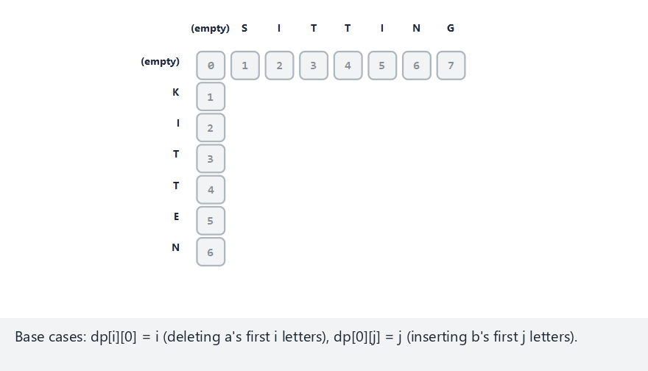
CEN207 Data Structures · Week 12
Edit distance, step by step
RTEU Computer Engineering · Fall 2026–2027
143
Notes:
Normal example: KITTEN -> SITTING, distance 3 — watch the table fill, then the traceback reconstruct one edit sequence.

Slide 144
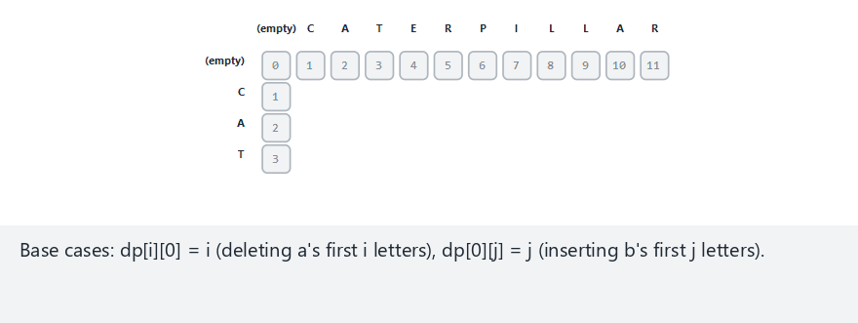
CEN207 Data Structures · Week 12
Edge case — pure insertion
RTEU Computer Engineering · Fall 2026–2027
144
Notes:
CAT -> CATERPILLAR — a is a prefix of b, so every non-matching step is a pure insert, never a substitute or delete.

Slide 145
CEN207 Data Structures · Week 12
Code — filling the table
if (a[i-1] == b[j-1])
dp[i][j] = dp[i-1][j-1];
else {
int best = min(dp[i-1][j-1],
min(dp[i-1][j], dp[i][j-1]));
dp[i][j] = 1 + best;
}
RTEU Computer Engineering · Fall 2026–2027
145
Notes:
This is the entire algorithm's core — everything else (base cases, traceback) is bookkeeping around this recurrence.

Slide 146
CEN207 Data Structures · Week 12
Complexity
• O(n*m) time — every cell computed once, in O(1)
• O(n*m) space for the full table (needed for traceback)
• Dramatic improvement over the naive recursion's exponential time
• A row-only optimization gets space down to O(m) (length only)
RTEU Computer Engineering · Fall 2026–2027
146
Notes:
Mention the space optimization exists but note it sacrifices the ability to run the traceback afterward.

Slide 147
CEN207 Data Structures · Week 12
Common mistakes
• Off-by-one: dp[i][j] compares a[i-1], not a[i]
• Forgetting base cases are i and j, not zero
• Filling the table in an inconsistent or wrong order
RTEU Computer Engineering · Fall 2026–2027
147
Notes:
The base-case bug is sneaky — it silently makes "compare against an empty prefix" look free when it should cost.

Slide 148
CEN207 Data Structures · Week 12
Mini-quiz
Why does dynamic programming need BOTH optimal substructure AND overlapping sub-problems?
RTEU Computer Engineering · Fall 2026–2027
148
Notes:
This connects directly back to the "the idea" slide a few slides ago — a good comprehension check.

Slide 149
CEN207 Data Structures · Week 12
Answer
Substructure makes it CORRECT. Overlap makes memoizing WORTH IT — without overlap, nothing is recomputed.
RTEU Computer Engineering · Fall 2026–2027
149
Notes:
Both halves of this answer matter — many students only remember one of the two properties.

Slide 150
CEN207 Data Structures · Week 12
14. Longest Common Subsequence
RTEU Computer Engineering · Fall 2026–2027
150
Notes:
Section 14 reuses section 13's exact table shape with one changed recurrence — a nice "same shape, different meaning" close.

Slide 151
CEN207 Data Structures · Week 12
A question to start
Not "how different" — but "what stayed the SAME, in order, even if not contiguous"?
RTEU Computer Engineering · Fall 2026–2027
151
Notes:
This is exactly what a diff tool highlights as unchanged — the connection to git diff pays off here.

Slide 152
CEN207 Data Structures · Week 12
Subsequence vs substring
• Substring: contiguous — "ACE" is NOT a substring of "ABCDE"
• Subsequence: order preserved, gaps allowed
• "ACE" IS a subsequence of "ABCDE"
• LCS: the longest sequence common to BOTH strings
RTEU Computer Engineering · Fall 2026–2027
152
Notes:
This distinction is the single most common conceptual error with LCS — spend real time on this slide.

Slide 153
CEN207 Data Structures · Week 12
The recurrence — almost the same table
• Base case: dp[i][0] = dp[0][j] = 0
• Characters match: dp[i][j] = dp[i-1][j-1] + 1 (extend)
• Otherwise: dp[i][j] = max(dp[i-1][j], dp[i][j-1])
• No penalty for a mismatch — only matches ever add anything
RTEU Computer Engineering · Fall 2026–2027
153
Notes:
Contrast explicitly with edit distance's min+1 — that contrast is this section's core teaching point.

Slide 154
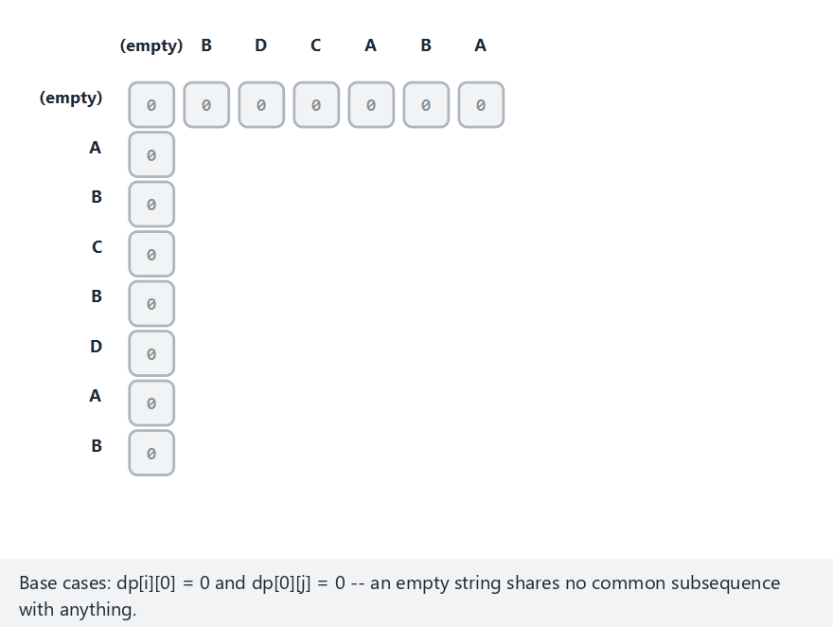
CEN207 Data Structures · Week 12
LCS, step by step
RTEU Computer Engineering · Fall 2026–2027
154
Notes:
Normal example: ABCBDAB / BDCABA, length 4 — watch the diagonal grow on matches, max carried forward otherwise.

Slide 155
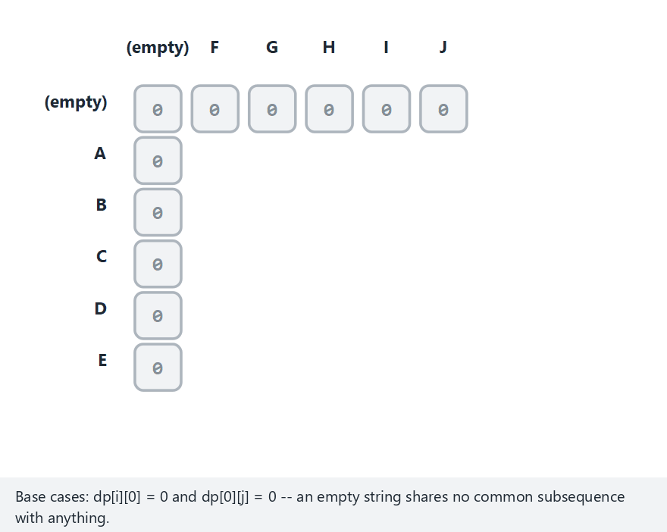
CEN207 Data Structures · Week 12
Edge case — no shared letters at all
RTEU Computer Engineering · Fall 2026–2027
155
Notes:
ABCDE vs FGHIJ — every cell stays 0, the whole table fills with the "no match, carry max" branch only.

Slide 156
CEN207 Data Structures · Week 12
Code — the recurrence
if (a[i-1] == b[j-1])
dp[i][j] = dp[i-1][j-1] + 1;
else
dp[i][j] = max(dp[i-1][j], dp[i][j-1]);
RTEU Computer Engineering · Fall 2026–2027
156
Notes:
Compare this side by side with edit distance's code slide — the visual similarity is deliberate and instructive.

Slide 157
CEN207 Data Structures · Week 12
Complexity
• O(n*m) time and space — identical to edit distance
• Same table shape, filled the same way
• Only the recurrence at each cell differs
• A template you will recognize again in later algorithm design
RTEU Computer Engineering · Fall 2026–2027
157
Notes:
This is the moment to say explicitly: "you now know the DP table shape, not just two isolated algorithms."

Slide 158
CEN207 Data Structures · Week 12
Common mistakes
• Confusing subsequence with substring (see two slides back)
• Accidentally reusing edit distance's min+1 recurrence
• Reporting only the length when the actual subsequence is wanted
RTEU Computer Engineering · Fall 2026–2027
158
Notes:
The traceback is required to recover the actual characters — dp[n][m] alone only answers "how long?"

Slide 159
CEN207 Data Structures · Week 12
Mini-quiz
Why does LCS use max, while edit distance uses min+1, even though both fill the same table shape?
RTEU Computer Engineering · Fall 2026–2027
159
Notes:
The closing conceptual question of the lecture — tying together sections 13 and 14 explicitly.

Slide 160
CEN207 Data Structures · Week 12
Answer
Edit distance counts a COST (min the cheapest). LCS counts a LENGTH of matches (max what is already best).
RTEU Computer Engineering · Fall 2026–2027
160
Notes:
This is the cleanest one-sentence summary of the whole DP half of today's lecture.

Slide 161
CEN207 Data Structures · Week 12
Summary
• Structures: char array + '0', growable buffers, tries,
compressed tries, suffix arrays
• Search: naive, KMP, Rabin-Karp, Boyer-Moore, Z-algorithm
• New this week: dynamic programming — edit distance, LCS
• Same DP table shape, two different recurrences
RTEU Computer Engineering · Fall 2026–2027
161
Notes:
Five structures, five search algorithms, two DP algorithms — thirteen animations, one lecture.

Slide 162
CEN207 Data Structures · Week 12
Exercises and self-check
• 10 exercises in the week notes — trace tables and code by hand
• 10 self-check questions with full worked answers
• Try every "edge" preset in the picker, not just "normal"
• Run every program yourself — outputs are all real, captured output
RTEU Computer Engineering · Fall 2026–2027
162
Notes:
Encourage students to actually run the programs — every output shown all lecture has been real, not invented.

Slide 163
CEN207 Data Structures · Week 12
Looking ahead
• Weeks 13–14: more new material before project weeks 15–16
• The DP table shape (dp[i][j], filled once, read via traceback)
• ...reappears throughout algorithm design, not just for strings
• Keep this week's table shape in mind as a template
RTEU Computer Engineering · Fall 2026–2027
163
Notes:
Dynamic programming is the one idea this week that will keep resurfacing for the rest of your studies.

Slide 164
CEN207 Data Structures · Week 12
References
• Cormen, Leiserson, Rivest, Stein — Introduction to Algorithms
• Knuth, Morris, Pratt (1977) · Boyer, Moore (1977) · Karp, Rabin (1987)
• Fredkin (1960) · Morrison (1968) · Levenshtein (1965)
• Sedgewick & Wayne — Algorithms, 4th ed. (Strings chapter)
• Full list with details in the week notes
RTEU Computer Engineering · Fall 2026–2027
164
Notes:
Full citations with journal names, volumes, and years are all in the printed notes' References section.

Slide 165
CEN207 Data Structures · Week 12
Questions?
CEN207 Data Structures — Week 12
Next week: continuing new material before Weeks 15–16's project demonstrations
RTEU Computer Engineering · Fall 2026–2027
165
Notes:
Thank the class, remind them where the code and notes live, and open the floor.

