Slide 1

CEN207 Data Structures · Week 3
Stacks and Queues
CEN207 Data Structures — Week 3
Asst. Prof. Dr. Uğur CORUH · Fall 2026–2027
RTEU Computer Engineering · Fall 2026–2027
Notes:
Today we meet the two oldest, most-used linear structures in computing. Stack = touch one end only. Queue = add at one end, remove at the other. That single rule change explains everything that follows.

Slide 2
CEN207 Data Structures · Week 3
Today's plan (3 hours)
Hour | Topic
1 | Stack ADT · array stack · overflow Anim 1–2 · linked stack Anim 3
2 | Stack apps: brackets, postfix, prefix, infix Anim 4–8 · recursion Anim 9–10
3 | Hanoi Anim 11 · queue variants Anim 12–16 · self-check
Learning outcomes: LO.1 (explain fundamental data structures) · LO.7 (choose the right structure)
RTEU Computer Engineering · Fall 2026–2027
2
Notes:
Sixteen short animations carry the whole lecture; each appears once, exactly where its idea is introduced.

Slide 3
CEN207 Data Structures · Week 3
This week's concepts — where
Concept | Where
Stack ADT, LIFO, push/pop | Section 1
Expression algorithms (postfix, infix) | Section 2
Recursion, call stack, Tower of Hanoi | Sections 3–4
Queue ADT, FIFO, circular queue, deque | Section 5
RTEU Computer Engineering · Fall 2026–2027
3
Notes:
Every term gets a full definition the first time it appears; this table just says where to find it again.

Slide 4
CEN207 Data Structures · Week 3
How the code examples work
• Every idea has a complete C and Java program
• C: gcc -std=c11 -Wall -Wextra -o /tmp/x file.c && /tmp/x
• Java: javac -d /tmp/j File.java && java -cp /tmp/j File
• Sources: code/week-03/c/ and code/week-03/java/
• Each program's expected output is in the week notes
RTEU Computer Engineering · Fall 2026–2027
4
Notes:
Open a terminal now if you want to run these live; every snippet on today's slides compiles and runs exactly as shown.

Slide 5
CEN207 Data Structures · Week 3
Bridge from Weeks 1–2
• Weeks 1–2 gave you two tools: pointers/memory and the linked list
• This week reuses both, constantly, in new shapes
• New idea this week: restricting where you may touch a structure
RTEU Computer Engineering · Fall 2026–2027
5
Notes:
Nothing new about memory is needed today — only new rules about which end of it you are allowed to touch.

Slide 6
CEN207 Data Structures · Week 3
Recap — Week 1: pointers and memory
• int *p holds an address, not a number
• malloc asks the OS for a box; free gives it back
• Forgetting free → memory leak
• Using memory after free → dangling pointer
RTEU Computer Engineering · Fall 2026–2027
6
Notes:
We will do both malloc and free again today, and point out exactly where a forgotten free would bite.

Slide 7
CEN207 Data Structures · Week 3
Recap — Week 2: linked lists
• A linked list is a chain of nodes
• Each node: a value + a pointer to the next node
• Adding/removing rewires a couple of pointers — no shifting
• Today's linked stack/queue reuse this idea exactly
RTEU Computer Engineering · Fall 2026–2027
7
Notes:
The only new part today is restricting which end(s) of the chain you are allowed to touch.

Slide 8
CEN207 Data Structures · Week 3
Map of the week — the one rule
• Both stacks and queues are linear structures
• A stack lets you touch only one end
• A queue makes you add at one end, remove at the other
• That single rule change decides what each is good for
RTEU Computer Engineering · Fall 2026–2027
8
Notes:
Ask the class: which end of a queue do the ones who arrived first sit at? The front — and that is the whole idea.

Slide 9
CEN207 Data Structures · Week 3
Map of the week — at a glance
Stack topics | Queue topics
Array stack, linked stack | Array queue, circular queue
Brackets, postfix, infix | Linked-list queue
Recursion, call stack | Deque, multilevel queue
Tower of Hanoi | —
RTEU Computer Engineering · Fall 2026–2027
9
Notes:
Every box on this map gets its own slides below, most with a short animation and a complete C/Java program.

Slide 10
CEN207 Data Structures · Week 3
1. The Stack: Last In, First Out
RTEU Computer Engineering · Fall 2026–2027
10
Notes:
Section 1 builds the stack from scratch: an array version, then a linked version, both with the same tiny interface.

Slide 11
CEN207 Data Structures · Week 3
A question to start
Visit three web pages, then click Back three times.
You land on page 2, then page 1, then nowhere. The last page visited is the first one revisited.
RTEU Computer Engineering · Fall 2026–2027
11
Notes:
Ask: how would you build that "history" feature with only an array or a linked list? The answer is coming.

Slide 12
CEN207 Data Structures · Week 3
A short history
• Late 1950s: "stack", "push", "pop" already in CS literature
• 1957 — Bauer & Samelson (Munich) patent a hardware stack
• 1946 — Turing used a similar idea in the ACE computer
• One of the oldest ideas in computing — still in every program
RTEU Computer Engineering · Fall 2026–2027
12
Notes:
Every function call your computer makes right now still uses a hardware/software stack, exactly like these early machines did.

Slide 13
CEN207 Data Structures · Week 3
Intuition — a stack of plates
• Take a plate only from the top
• Add a plate only to the top
• Cannot reach the middle without removing everything above it
• Last plate placed is the first one removed — LIFO
RTEU Computer Engineering · Fall 2026–2027
13
Notes:
LIFO = Last In, First Out. Keep this cafeteria picture in mind for every operation today.

Slide 14
CEN207 Data Structures · Week 3
Three operations
• push — put a new element on top
• pop — remove and return the top element
• peek (or top) — look at the top without removing it
• All three touch only one end
RTEU Computer Engineering · Fall 2026–2027
14
Notes:
These three short names are standard across every language and textbook; learn them now, they never change.

Slide 15
CEN207 Data Structures · Week 3
The Stack ADT
Operation | What it does | Precondition | Complexity
push(x) | Add x on top | not full (array) | O(1)
pop() | Remove/return top | not empty | O(1)
peek() | Return top, keep it | not empty | O(1)
isEmpty() | zero elements? | none | O(1)
RTEU Computer Engineering · Fall 2026–2027
15
Notes:
An ADT describes what a structure does, not how — this table holds whether it is built from an array or a linked list.

Slide 16
CEN207 Data Structures · Week 3
Array stack — the idea
• Reserve a fixed-size array data[CAP]
• Keep one integer, top: index of the topmost slot
• Empty stack: top == -1 — "no top yet"
• push: top++, write; pop: read, top--
RTEU Computer Engineering · Fall 2026–2027
16
Notes:
Nothing else in memory ever moves — only the single integer top changes.

Slide 17
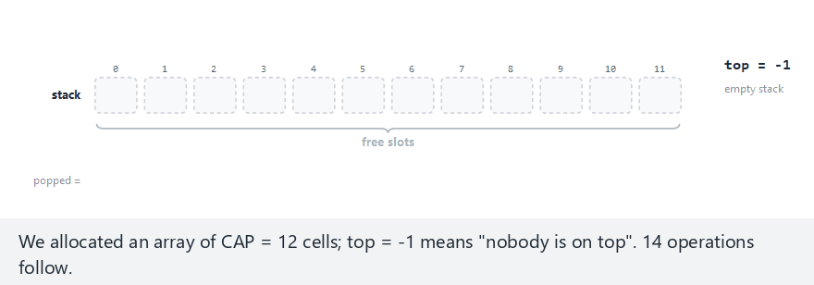
CEN207 Data Structures · Week 3
Array stack: push and pop
RTEU Computer Engineering · Fall 2026–2027
17
Notes:
Normal example: 10 pushes (12, 7, 25, 3, 18, 9, 30, 14, 5, 21), then 4 pops — watch top and the array update one step at a time.

Slide 18
CEN207 Data Structures · Week 3
Code — push()
bool push(int x) {
if (top == CAP - 1) return false;
top = top + 1;
data[top] = x;
return true;
}
RTEU Computer Engineering · Fall 2026–2027
18
Notes:
Check first, refuse if full, then two writes — top moves, the value lands. Two steps, always.

Slide 19
CEN207 Data Structures · Week 3
Code — pop()
bool pop(int *out) {
if (top == -1) return false;
*out = data[top];
top = top - 1;
return true;
}
RTEU Computer Engineering · Fall 2026–2027
19
Notes:
Same shape as push, mirrored: check empty, read the top slot, move top down.

Slide 20
CEN207 Data Structures · Week 3
Expected output
push(12) -> true [top = 0]
push(21) -> true [top = 9]
pop() -> 21 [top = 8]
pop() -> 5 [top = 7]
pop() -> 14 [top = 6]
pop() -> 30 [top = 5]
RTEU Computer Engineering · Fall 2026–2027
20
Notes:
Last pushed (21) comes back first, then 5, 14, 30 — last in, first out.

Slide 21
CEN207 Data Structures · Week 3
Why every operation is O(1)
• push/pop do a fixed number of steps
• One condition check, one move of top, one array access
• True whether the stack holds 1 element or a million
• No loop ever touches the other elements
RTEU Computer Engineering · Fall 2026–2027
21
Notes:
This constant-time guarantee is the entire point of a stack — reaching the middle needs a different structure.

Slide 22
CEN207 Data Structures · Week 3
Overflow and underflow — the question
An array has a fixed size. What happens when you push a full stack, or pop an empty one?
A correct stack must check first and refuse.
RTEU Computer Engineering · Fall 2026–2027
22
Notes:
Writing outside array bounds in C does not raise a friendly error — it corrupts nearby memory silently.

Slide 23
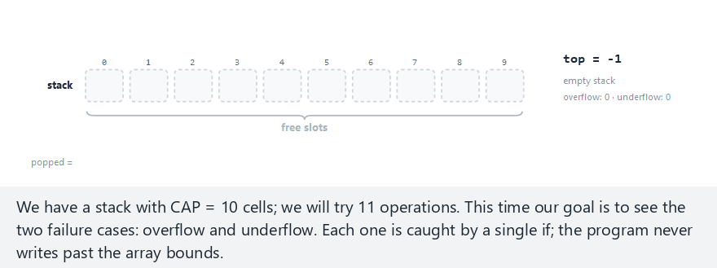
CEN207 Data Structures · Week 3
Stack overflow and underflow
RTEU Computer Engineering · Fall 2026–2027
23
Notes:
A 10-slot stack takes 11 pushes (overflow on the last one), then 13 pops (underflow after draining) — watch both checks fire.

Slide 24
CEN207 Data Structures · Week 3
Common mistakes (array stack)
• Checking top == CAP, not top == CAP - 1
• Popping without checking isEmpty first
• Ignoring the bool return value of push
RTEU Computer Engineering · Fall 2026–2027
24
Notes:
Valid indices run 0..CAP-1, so the stack is full the moment top reaches CAP-1, not one step later.

Slide 25
CEN207 Data Structures · Week 3
Quick question
Why is top = -1 a better choice for "empty" than, say, top = 0?
RTEU Computer Engineering · Fall 2026–2027
25
Notes:
Let the class answer before revealing — index 0 is a real, valid slot.

Slide 26
CEN207 Data Structures · Week 3
Answer
Index 0 is a valid slot. If top = 0 meant "empty", you could not tell an empty stack from one holding a single element at index 0.
RTEU Computer Engineering · Fall 2026–2027
26
Notes:
-1 is not a valid index, so it can only ever mean "no elements".

Slide 27
CEN207 Data Structures · Week 3
A stack that never overflows
• Array stack has a hard ceiling: CAP
• Linked-list stack: every element is its own node
• top is now a pointer, not an index
• push allocates; pop frees
RTEU Computer Engineering · Fall 2026–2027
27
Notes:
Exactly the same node-and-pointer idea from Week 2, restricted to touching one end.

Slide 28
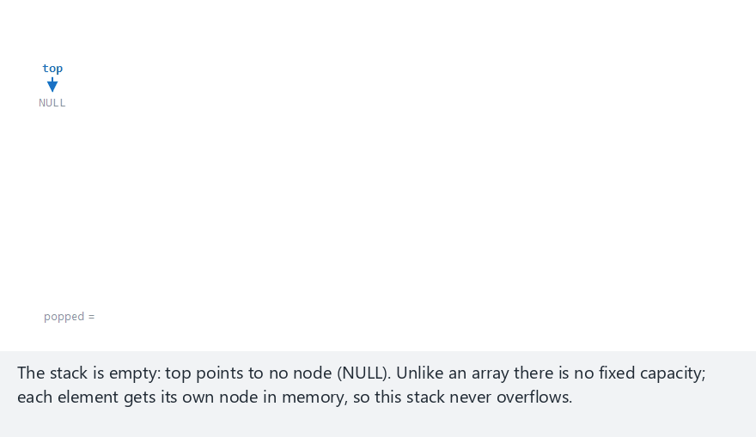
CEN207 Data Structures · Week 3
Linked-list stack: push and pop
RTEU Computer Engineering · Fall 2026–2027
28
Notes:
Watch malloc create a node, then three pointer rewrites move top — no capacity limit anywhere.

Slide 29
CEN207 Data Structures · Week 3
Code — struct Node + push()
typedef struct Node {
int data;
struct Node *next;
} Node;
Node *top = NULL;
void push(int x) {
Node *n = malloc(sizeof(Node));
n->data = x;
n->next = top;
top = n;
}
RTEU Computer Engineering · Fall 2026–2027
29
Notes:
New node points at the old top, then top moves to the new node — three assignments, always.

Slide 30
CEN207 Data Structures · Week 3
Code — pop()
bool pop(int *out) {
if (top == NULL) return false;
Node *tmp = top;
*out = tmp->data;
top = top->next;
free(tmp);
return true;
}
RTEU Computer Engineering · Fall 2026–2027
30
Notes:
tmp holds the old top just long enough to read its value and free it after top has already moved on.

Slide 31
CEN207 Data Structures · Week 3
Why push is still O(1)
• malloc for one fixed-size node is constant time
• Does not depend on how many nodes already exist
• No loop over existing elements
• Cost: one pointer (next) per node vs. array's zero
RTEU Computer Engineering · Fall 2026–2027
31
Notes:
The trade for unlimited capacity is a little extra memory per element and worse cache locality.

Slide 32
CEN207 Data Structures · Week 3
Common mistakes (linked stack)
• Forgetting free(tmp) in pop — slow memory leak
• Using a pointer after freeing it — undefined behavior
• Java: holding an old reference blocks garbage collection
RTEU Computer Engineering · Fall 2026–2027
32
Notes:
free(tmp); return tmp->data; reads memory already given back — sometimes it "works", sometimes it crashes.

Slide 33
CEN207 Data Structures · Week 3
Array vs. linked-list stack
 | Array stack | Linked stack
Capacity | Fixed, can overflow | Limited by memory
Extra memory | None | One pointer/node
Cache behavior | Contiguous, fast | Scattered, slower
RTEU Computer Engineering · Fall 2026–2027
33
Notes:
Both push and pop are O(1) either way; the difference is capacity and memory locality, not speed class.

Slide 34
CEN207 Data Structures · Week 3
Quick question
CAP = 8. After 5 pushes and 2 pops, what is top?
RTEU Computer Engineering · Fall 2026–2027
34
Notes:
Each push adds 1 to top, each pop subtracts 1 — do the arithmetic together.

Slide 35
CEN207 Data Structures · Week 3
Answer
-1 + 5 - 2 = 2. Three elements remain (indices 0, 1, 2), and top == 2.
RTEU Computer Engineering · Fall 2026–2027
35
Notes:
This is exactly the bookkeeping the push/pop code we just read performs, one step at a time.

Slide 36
CEN207 Data Structures · Week 3
2. Stack Applications: Expressions
RTEU Computer Engineering · Fall 2026–2027
36
Notes:
Three classic algorithms, all built on the same tiny stack interface: check brackets, evaluate postfix, convert infix to postfix.

Slide 37
CEN207 Data Structures · Week 3
Infix is awkward for computers
• A + B * C — is * computed before +? Needs precedence
• Two other notations move the operator so no
precedence rule is ever needed at evaluation time
RTEU Computer Engineering · Fall 2026–2027
37
Notes:
Ask the class to compute A + B * C by hand — everyone silently applies precedence without noticing.

Slide 38
CEN207 Data Structures · Week 3
A short history
• 1920s — Polish logician Jan Łukasiewicz introduces
prefix ("Polish") and postfix ("Reverse Polish") notation
• Famous via HP calculators: no parenthesis keys needed
• Evaluated by a small stack machine — what you build next
RTEU Computer Engineering · Fall 2026–2027
38
Notes:
RPN calculators are still sold today; the algorithm on the next slides is exactly what runs inside them.

Slide 39
CEN207 Data Structures · Week 3
Three notations
Notation | Operator position | A + B * C
Infix | Between operands | A + B * C
Postfix (RPN) | After both operands | A B C * +
Prefix (Polish) | Before both operands | + A * B C
RTEU Computer Engineering · Fall 2026–2027
39
Notes:
Postfix and prefix need no parentheses and no precedence table at evaluation time — that work was already done once.

Slide 40
CEN207 Data Structures · Week 3
Balanced brackets — the question
Is {([])(]} validly nested?
Every closer must match the most recently opened bracket that is still open.
RTEU Computer Engineering · Fall 2026–2027
40
Notes:
"Most recently opened" should immediately make everyone think of a stack — that phrase is the whole algorithm.

Slide 41
CEN207 Data Structures · Week 3
The rule
• Scan the string once
• Every opener: push it
• Every closer: pop, and it must match
• If empty stack when a closer arrives → unbalanced
• If the stack is not empty at the end → unbalanced
RTEU Computer Engineering · Fall 2026–2027
41
Notes:
Three distinct ways to fail; a correct checker must catch all three, not just the first.

Slide 42
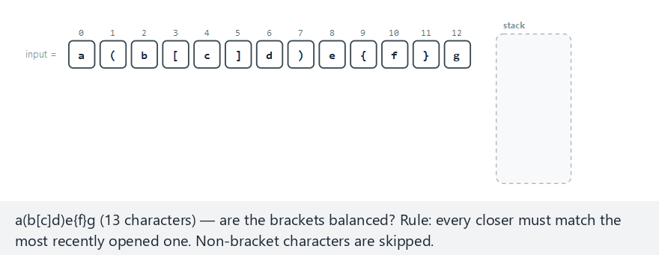
CEN207 Data Structures · Week 3
Checking brackets with a stack
RTEU Computer Engineering · Fall 2026–2027
42
Notes:
Watch the mismatch: a `]` arrives while `(` sits on top — no match, reject immediately.

Slide 43
CEN207 Data Structures · Week 3
Code — matches()
static bool matches(char open, char close) {
return (open == '(' && close == ')') ||
(open == '[' && close == ']') ||
(open == '{' && close == '}');
}
RTEU Computer Engineering · Fall 2026–2027
43
Notes:
A tiny helper: does this closing bracket pair with this opening bracket?

Slide 44
CEN207 Data Structures · Week 3
Code — balanced()
bool balanced(const char *s) {
char st[100]; int top = -1;
for (int i = 0; s[i] != '\0'; i++) {
char c = s[i];
if (c == '(' || c == '[' || c == '{') {
st[++top] = c;
} else if (c == ')' || c == ']' || c == '}') {
if (top == -1) return false;
char o = st[top--];
if (!matches(o, c)) return false;
}
}
return top == -1;
}
RTEU Computer Engineering · Fall 2026–2027
44
Notes:
The very last line is the one people forget: the string can end with unmatched openers still on the stack.

Slide 45
CEN207 Data Structures · Week 3
Complexity
Each character is looked at exactly once, each stack op is O(1) → balanced runs in O(n).
Worst-case space: O(n) — a string of all openers.
RTEU Computer Engineering · Fall 2026–2027
45
Notes:
One pass, one stack, done — this is the shape almost every stack algorithm today will take.

Slide 46
CEN207 Data Structures · Week 3
Pitfall — three ways to be unbalanced
1. Closer arrives, top does not match — (]
2. Closer arrives, stack already empty — )
3. String ends, stack not empty — (()
RTEU Computer Engineering · Fall 2026–2027
46
Notes:
A common bug: checking only case 1 and forgetting the final `return top == -1;`.

Slide 47
CEN207 Data Structures · Week 3
Quick question
Is ((A+B) accepted by balanced? Why or why not?
RTEU Computer Engineering · Fall 2026–2027
47
Notes:
One unmatched opening parenthesis — walk through what the stack looks like at the very end.

Slide 48
CEN207 Data Structures · Week 3
Answer
No. Every ( is pushed, and the string ends with the stack still holding one — top == -1 is false, so balanced correctly returns false.
RTEU Computer Engineering · Fall 2026–2027
48
Notes:
This is exactly failure case 3 from the previous slide.

Slide 49
CEN207 Data Structures · Week 3
Postfix evaluation — the question
5 3 + 8 2 - * 6 + 12 - should evaluate to (5+3)*(8-2) = 48, 48+6 = 54, 54-12 = 42.
No precedence rules needed at all — just a scan.
RTEU Computer Engineering · Fall 2026–2027
49
Notes:
Ask the class to predict the result before the animation runs.

Slide 50
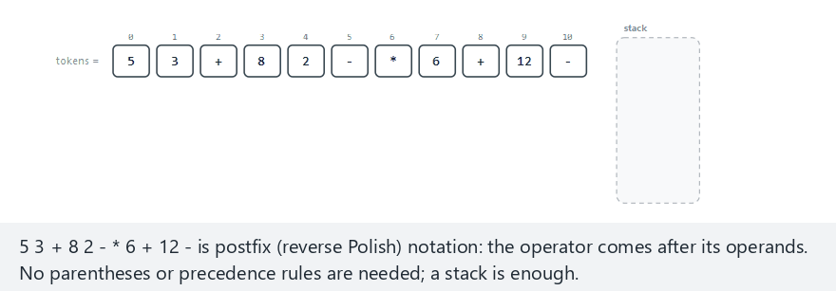
CEN207 Data Structures · Week 3
Evaluating a postfix expression
RTEU Computer Engineering · Fall 2026–2027
50
Notes:
Every number is pushed; every operator pops two values, applies itself, and pushes the result back.

Slide 51
CEN207 Data Structures · Week 3
Code — apply()
static int apply(char op, int a, int b) {
switch (op) {
case '+': return a + b;
case '-': return a - b;
case '*': return a * b;
case '/': return a / b;
default: return 0;
}
}
RTEU Computer Engineering · Fall 2026–2027
51
Notes:
A small dispatcher — nothing surprising, just the four arithmetic operators.

Slide 52
CEN207 Data Structures · Week 3
Code — eval_postfix()
int eval_postfix(char *tok[], int n) {
int st[100]; int top = -1;
for (int i = 0; i < n; i++) {
char *t = tok[i];
if (isdigit(t[0])) {
st[++top] = atoi(t);
} else {
int b = st[top--];
int a = st[top--];
st[++top] = apply(t[0], a, b);
}
}
return st[top];
}
RTEU Computer Engineering · Fall 2026–2027
52
Notes:
b comes off first (right operand), a second (left operand) — order matters for minus and divide.

Slide 53
CEN207 Data Structures · Week 3
Complexity
O(n) in the number of tokens: each token is pushed at most once and popped at most once.
RTEU Computer Engineering · Fall 2026–2027
53
Notes:
Calculators and compilers evaluate expressions exactly this way, in real time, on huge inputs.

Slide 54
CEN207 Data Structures · Week 3
Pitfall — operand order matters
8 2 - means 8 - 2. First popped (b) is the right operand; second popped (a) is the left. Swap them and you compute 2 - 8 instead.
RTEU Computer Engineering · Fall 2026–2027
54
Notes:
This is the single most common bug students write in this algorithm.

Slide 55
CEN207 Data Structures · Week 3
Quick question
Why does eval_postfix need only one stack, while to_postfix (coming next) needs a second output area too?
RTEU Computer Engineering · Fall 2026–2027
55
Notes:
Think about what each algorithm is actually producing at the end.

Slide 56
CEN207 Data Structures · Week 3
Answer
Evaluation collapses two operands and an operator into one number immediately — nothing extra to remember. Conversion only reorders symbols, so it needs a place to collect them.
RTEU Computer Engineering · Fall 2026–2027
56
Notes:
This distinction — collapsing values vs. reordering symbols — is worth restating slowly.

Slide 57
CEN207 Data Structures · Week 3
Evaluating a prefix expression
• Operator comes before its operands: + A B
• Same idea as postfix, scanned right to left
• First value popped is now the left operand
RTEU Computer Engineering · Fall 2026–2027
57
Notes:
Prefix is the mirror image of postfix in every respect — direction of scan, and which operand comes off first.

Slide 58
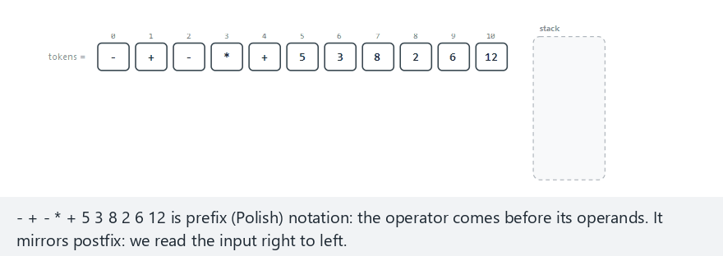
CEN207 Data Structures · Week 3
Evaluating a prefix expression
RTEU Computer Engineering · Fall 2026–2027
58
Notes:
Normal example: 11 tokens, no errors. The "hard" example actually errors out — more tokens is not automatically a valid expression.

Slide 59
CEN207 Data Structures · Week 3
Prefix vs. postfix — the mirror
• Scan right to left, not left to right
• Pop the left operand first, then the right one
• Same O(n) complexity, same error checks (division by zero, too few/many operands)
RTEU Computer Engineering · Fall 2026–2027
59
Notes:
Getting the pop order backwards silently breaks every non-commutative operator: minus and divide.

Slide 60
CEN207 Data Structures · Week 3
Infix to postfix — the idea
• Humans write infix; our evaluator needs postfix
• Shunting-yard algorithm (Dijkstra) — after railway
yards that reorder freight cars
• A second stack, holding operators, resolves
precedence once, up front
RTEU Computer Engineering · Fall 2026–2027
60
Notes:
This is the classic first "compiler-shaped" algorithm most students ever write.

Slide 61
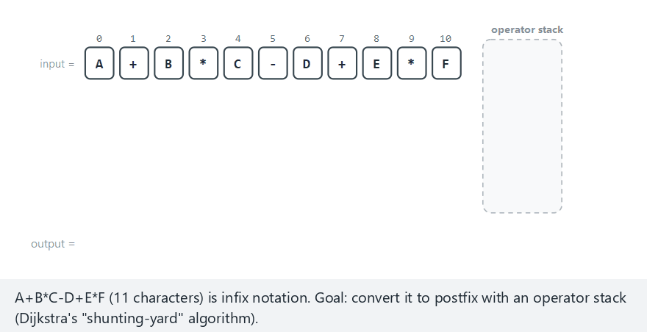
CEN207 Data Structures · Week 3
Converting infix to postfix
RTEU Computer Engineering · Fall 2026–2027
61
Notes:
Every operand goes straight to output; every operator first flushes stronger waiting operators, then is pushed.

Slide 62
CEN207 Data Structures · Week 3
Code — prec()
static int prec(char op) {
if (op == '+' || op == '-') return 1;
if (op == '*' || op == '/') return 2;
return 0;
}
RTEU Computer Engineering · Fall 2026–2027
62
Notes:
A tiny precedence table — multiply/divide bind tighter than plus/minus.

Slide 63
CEN207 Data Structures · Week 3
Code — to_postfix()
void to_postfix(const char *in, char *out) {
char ops[100]; int top = -1, k = 0;
for (int i = 0; in[i]; i++) {
char c = in[i];
if (isalnum(c)) { out[k++] = c; }
else {
while (top >= 0 && prec(ops[top]) >= prec(c))
out[k++] = ops[top--];
ops[++top] = c;
}
}
while (top >= 0) out[k++] = ops[top--];
out[k] = '\0';
}
RTEU Computer Engineering · Fall 2026–2027
63
Notes:
The final while-loop is the "flush" step: whatever is left on the stack still has to reach the output.

Slide 64
CEN207 Data Structures · Week 3
Complexity
O(n): every character is pushed onto the operator stack at most once, popped at most once.
RTEU Computer Engineering · Fall 2026–2027
64
Notes:
Same shape, same bound, as every other stack algorithm we have seen today.

Slide 65
CEN207 Data Structures · Week 3
Pitfall — three bugs here
• Using > instead of >= breaks left-associativity
• Forgetting the final flush loses trailing operators
• No parentheses support (left as a natural extension)
RTEU Computer Engineering · Fall 2026–2027
65
Notes:
A-B-C must become (A-B)-C, which needs equal-precedence operators to also be popped first.

Slide 66
CEN207 Data Structures · Week 3
Quick question
Convert A*B+C to postfix by hand.
RTEU Computer Engineering · Fall 2026–2027
66
Notes:
Give the class thirty seconds, then reveal and compare to the algorithm's own trace.

Slide 67
CEN207 Data Structures · Week 3
Answer
AB*C+. A→out. *→push. B→out. + sees * (prec 2 ≥ 1): pop *→out, push +. C→out. Flush +. Result: A B * C +.
RTEU Computer Engineering · Fall 2026–2027
67
Notes:
Walk through this trace line by line if the class looks unsure.

Slide 68
CEN207 Data Structures · Week 3
Converting infix to prefix
• Reverse the input, swapping ( ↔ )
• Run shunting-yard again, but pop only when
a waiting operator is strictly stronger (>, not >=)
• Reverse the result
RTEU Computer Engineering · Fall 2026–2027
68
Notes:
Three already-familiar steps instead of a brand-new algorithm — that is the whole trick.

Slide 69
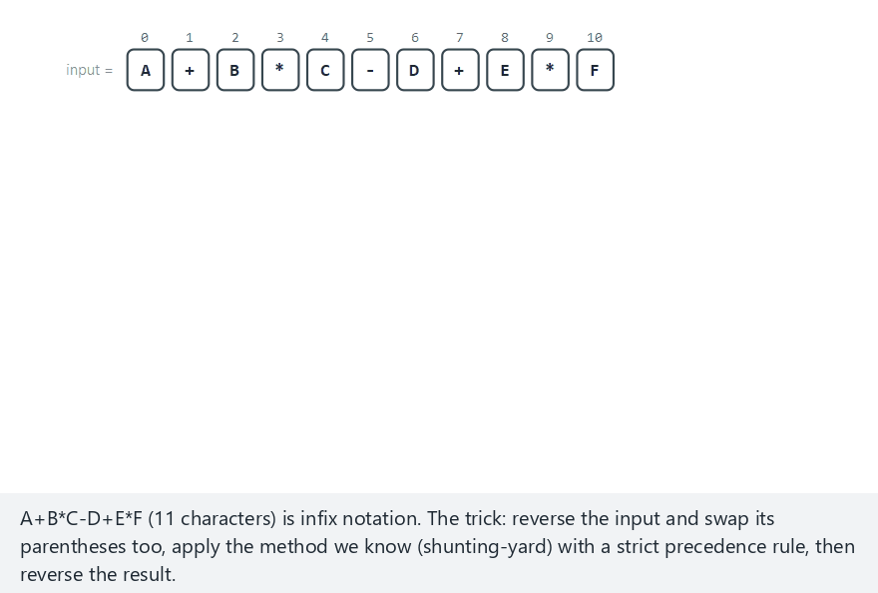
CEN207 Data Structures · Week 3
Converting infix to prefix
RTEU Computer Engineering · Fall 2026–2027
69
Notes:
Same normal example as infix-to-postfix, A+B*C-D+E*F, so the two outputs can be compared side by side.

Slide 70
CEN207 Data Structures · Week 3
Pitfall — strict >, not >=
• Prefix conversion pops only a strictly stronger
waiting operator — using >= breaks the final reversal
• Forgetting to swap (/) while reversing breaks grouping
RTEU Computer Engineering · Fall 2026–2027
70
Notes:
Compare the postfix and prefix outputs for a same-precedence chain like A+B+C+... to see the rule in action.

Slide 71
CEN207 Data Structures · Week 3
3. Recursion and the Call Stack
RTEU Computer Engineering · Fall 2026–2027
71
Notes:
The connection that makes recursion click: every function call, recursive or not, pushes a real stack frame.

Slide 72
CEN207 Data Structures · Week 3
What is recursion — a question
fact(n) = n * fact(n - 1), base case fact(0) = 1.
fact(3) = 3 * (2 * (1 * fact(0))) = 6
RTEU Computer Engineering · Fall 2026–2027
72
Notes:
A function that calls itself on a smaller version of the same problem, until a case simple enough to answer directly.

Slide 73
CEN207 Data Structures · Week 3
The base case is mandatory
• Not optional — it is what stops the recursion
• Without one: the function calls itself forever
• "Forever" really means: until memory runs out
RTEU Computer Engineering · Fall 2026–2027
73
Notes:
We are about to meet exactly the memory structure that runs out — the call stack.

Slide 74
CEN207 Data Structures · Week 3
The simplest recursion: countdown
• Print n, recurse on n - 1, until the base case
• Base case must be n <= 0, not n == 0
• n = 0 or negative n must stop on the very first call
RTEU Computer Engineering · Fall 2026–2027
74
Notes:
This is the smallest possible recursive function — everything about base cases shows up here first.

Slide 75
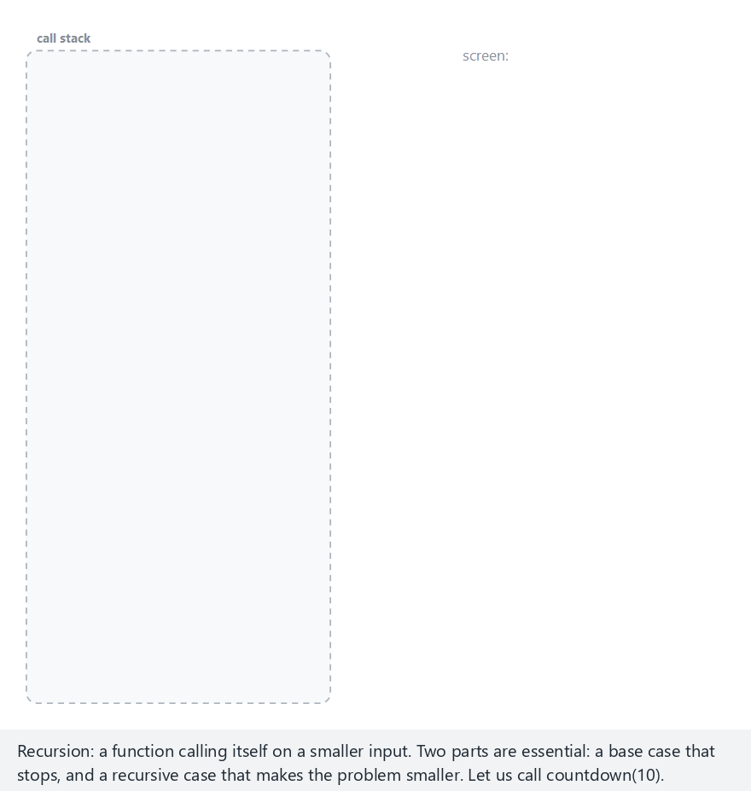
CEN207 Data Structures · Week 3
Recursion: countdown
RTEU Computer Engineering · Fall 2026–2027
75
Notes:
Normal example: countdown from 10. Edge cases n=0 and n=-4 both hit the base case immediately.

Slide 76
CEN207 Data Structures · Week 3
Pitfall — the wrong base case
n == 0 only: a negative starting value never satisfies it — infinite recursion. n <= 0 fixes it: negative input stops on the very first call.
RTEU Computer Engineering · Fall 2026–2027
76
Notes:
This is the exact bug that turned "countdown from -4" into an infinite loop before the fix.

Slide 77
CEN207 Data Structures · Week 3
The call stack: recursion is a stack
• Every function call pushes a frame:
local variables + the return address
• Returning from a function pops that frame
• This is a genuine LIFO stack, built into every
running program, whether you write one or not
RTEU Computer Engineering · Fall 2026–2027
77
Notes:
You have been using a stack every time you called a function — you just could not see it until today.

Slide 78
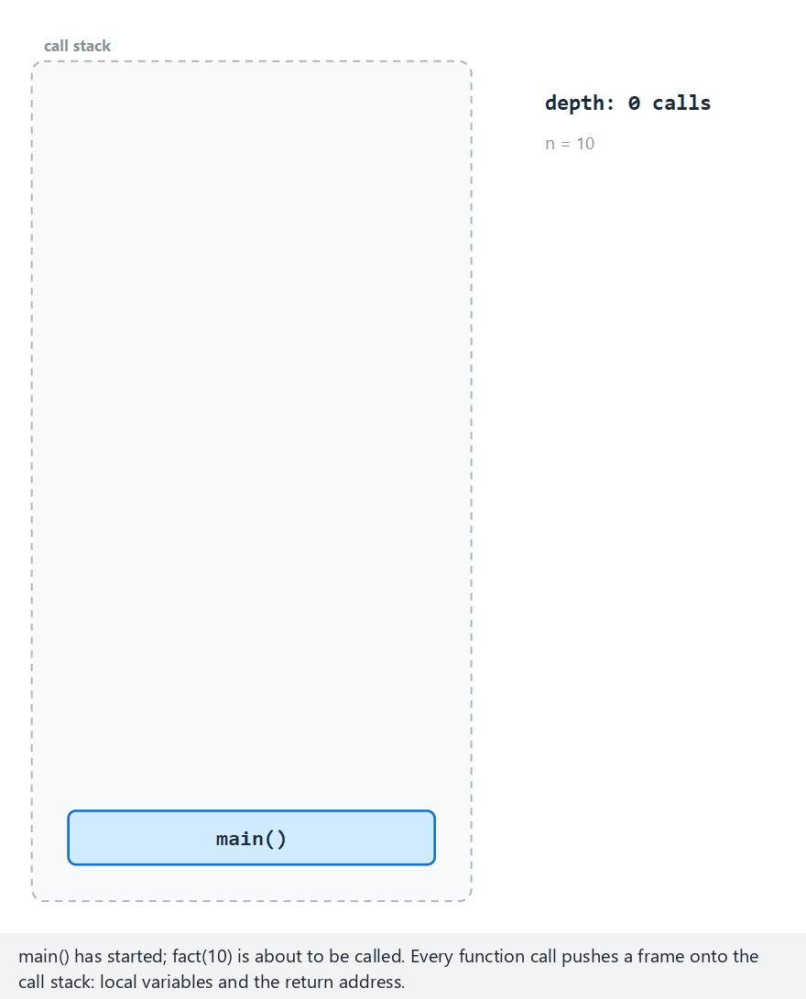
CEN207 Data Structures · Week 3
Recursion and the call stack: fact(n)
RTEU Computer Engineering · Fall 2026–2027
78
Notes:
Normal example: fact(10), 10 frames deep — each waits on the next, then frames unwind in reverse order.

Slide 79
CEN207 Data Structures · Week 3
Code — fact()
int fact(int n) {
if (n == 0) return 1;
/* unsigned multiply: defined wraparound, not signed-overflow UB */
return (int) ((unsigned) n * (unsigned) fact(n - 1));
}
RTEU Computer Engineering · Fall 2026–2027
79
Notes:
Two lines: a base case that stops the recursion, and a recursive call on a strictly smaller problem.

Slide 80
CEN207 Data Structures · Week 3
Expected output
fact(10) = 3628800
RTEU Computer Engineering · Fall 2026–2027
80
Notes:
Small output, but the call-stack machinery behind it is the real subject of this section.

Slide 81
CEN207 Data Structures · Week 3
Complexity
fact(n) makes n recursive calls: O(n) time, and — easy to forget — O(n) stack space, one frame per pending call.
A loop computing the same product uses O(1) space.
RTEU Computer Engineering · Fall 2026–2027
81
Notes:
Recursion often reads more clearly than a loop, but it is never free of memory cost.

Slide 82
CEN207 Data Structures · Week 3
Pitfall — silent int overflow
13! = 6227020800 — too big for a 32-bit int (max 2147483647). The program does not crash; it silently wraps to 1932053504.
RTEU Computer Engineering · Fall 2026–2027
82
Notes:
This is why the "hard" example in the picker stops at 12 — one call short of the overflow.

Slide 83
CEN207 Data Structures · Week 3
Pitfall — missing base case
Without a reachable base case, a recursive function pushes a new frame every call, forever — until the call stack itself overflows.
RTEU Computer Engineering · Fall 2026–2027
83
Notes:
This crash has a name you already know from Section 1: stack overflow — just applied to the call stack instead.

Slide 84
CEN207 Data Structures · Week 3
Pitfall — a problem that doesn't shrink
fact(n) calls itself with n - 1, strictly smaller. Every recursive call must move measurably closer to the base case.
RTEU Computer Engineering · Fall 2026–2027
84
Notes:
Decrementing by 2 from an odd starting n that expects to hit 0 is a classic version of this bug.

Slide 85
CEN207 Data Structures · Week 3
Quick question
fact(3) is the original call. How many frames sit on the call stack the instant fact(0) starts?
RTEU Computer Engineering · Fall 2026–2027
85
Notes:
Count them together: fact(3), fact(2), fact(1), fact(0).

Slide 86
CEN207 Data Structures · Week 3
Answer
Four: fact(3), fact(2), fact(1), fact(0), each still waiting for the one below it to return.
RTEU Computer Engineering · Fall 2026–2027
86
Notes:
None of these frames have returned yet — that is exactly why they are still on the stack.

Slide 87
CEN207 Data Structures · Week 3
Quick question
If the base case were if (n == 1) return 1; and someone called fact(-1), what happens?
RTEU Computer Engineering · Fall 2026–2027
87
Notes:
-1 never equals 1 on the way down through -2, -3, -4...

Slide 88
CEN207 Data Structures · Week 3
Answer
-1 never equals 1; the function recurses on -2, -3, -4, ... forever, eventually overflowing the call stack.
RTEU Computer Engineering · Fall 2026–2027
88
Notes:
A wrong base-case condition is just as dangerous as a missing one.

Slide 89
CEN207 Data Structures · Week 3
4. The Tower of Hanoi
RTEU Computer Engineering · Fall 2026–2027
89
Notes:
The standard first example of a problem that is easy to solve recursively yet fundamentally exponential.

Slide 90
CEN207 Data Structures · Week 3
The puzzle
• Three rods; disks stacked large-to-small on rod A
• Move the whole stack to rod C, one disk at a time
• Never place a larger disk on a smaller one
• Invented by Édouard Lucas, 1883 (monks legend)
RTEU Computer Engineering · Fall 2026–2027
90
Notes:
The legend: monks moving 64 golden disks, and the world ends when they finish. Not a bad time estimate, as we'll see.

Slide 91
CEN207 Data Structures · Week 3
The recursive idea
To move n disks from from to to, via via:
1. Move top n - 1 disks to via
2. Move the largest disk to to
3. Move the n - 1 disks from via onto it
RTEU Computer Engineering · Fall 2026–2027
91
Notes:
Steps 1 and 3 are the same problem, just smaller, with the rods relabeled — a perfect recursion.

Slide 92
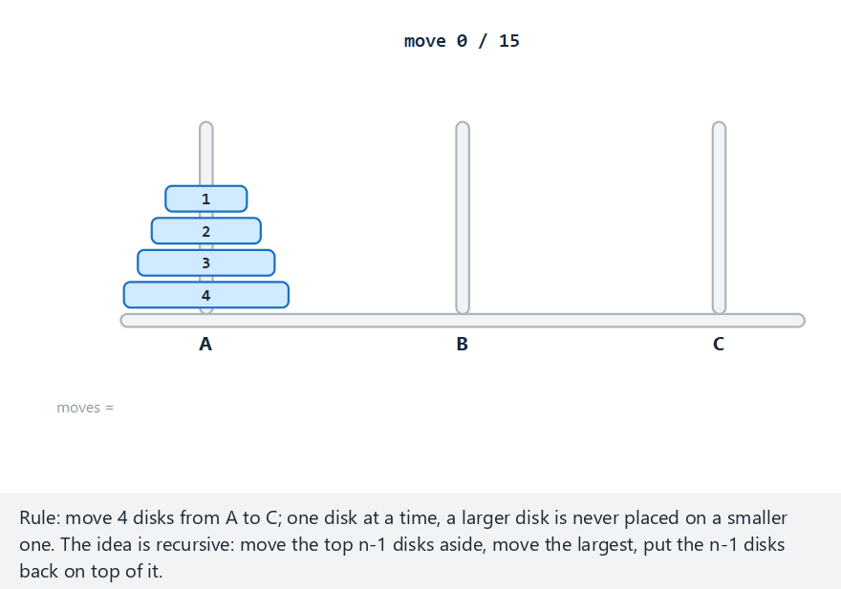
CEN207 Data Structures · Week 3
Tower of Hanoi
RTEU Computer Engineering · Fall 2026–2027
92
Notes:
Normal example: 4 disks, 15 moves. No explicit stack needed in the code — the call stack itself remembers "from, to, via".

Slide 93
CEN207 Data Structures · Week 3
Code — hanoi()
void hanoi(int n, char from, char to, char via) {
if (n == 0) return;
hanoi(n - 1, from, via, to);
move_disk(n, from, to);
hanoi(n - 1, via, to, from);
}
RTEU Computer Engineering · Fall 2026–2027
93
Notes:
Four lines, and the recursion structure is identical in spirit to fact() — smaller problem, act, smaller problem.

Slide 94
CEN207 Data Structures · Week 3
Expected output
move 1: disk 1 from A to B
move 2: disk 2 from A to C
move 3: disk 1 from B to C
move 4: disk 3 from A to B
...
total moves = 15
RTEU Computer Engineering · Fall 2026–2027
94
Notes:
Fifteen moves for four disks — we will see exactly why that number in a moment.

Slide 95
CEN207 Data Structures · Week 3
Complexity
T(n) = 2*T(n-1) + 1, T(0) = 0 → T(n) = 2ⁿ - 1 — exponential growth.
n = 4: 2⁴ - 1 = 15, matching the program above.
RTEU Computer Engineering · Fall 2026–2027
95
Notes:
No implementation trick fixes exponential growth — only a smaller n does.

Slide 96
CEN207 Data Structures · Week 3
The legend's 64 disks
2⁶⁴ - 1 ≈ 1.8 × 10¹⁹ moves.
At one move per second: ~585 billion years — tens of times the current age of the universe.
RTEU Computer Engineering · Fall 2026–2027
96
Notes:
The monks' prophecy about the world ending was, in a sense, a reasonable time estimate.

Slide 97
CEN207 Data Structures · Week 3
Looking further ahead
"Solve a smaller version, then combine" is exactly how depth-first search (DFS) explores a tree or graph, coming in the next two weeks.
RTEU Computer Engineering · Fall 2026–2027
97
Notes:
The call stack that tracked "from, to, via" here is the same call stack DFS will use to track "where to backtrack".

Slide 98
CEN207 Data Structures · Week 3
Quick question
How many moves does a 5-disk Tower of Hanoi need?
RTEU Computer Engineering · Fall 2026–2027
98
Notes:
Apply the formula from two slides ago.

Slide 99
CEN207 Data Structures · Week 3
Answer
2⁵ - 1 = 31 moves.
RTEU Computer Engineering · Fall 2026–2027
99
Notes:
Doubling the disks by one adds roughly double the moves, minus one.

Slide 100
CEN207 Data Structures · Week 3
Quick question
In hanoi(n - 1, from, via, to), why are the last two arguments swapped vs. the outer call?
RTEU Computer Engineering · Fall 2026–2027
100
Notes:
Think about what the "destination" and "spare" are for the smaller sub-problem.

Slide 101
CEN207 Data Structures · Week 3
Answer
For moving the top n - 1 disks out of the way, the destination is the spare rod, and the spare is the original destination — roles rotate at every level of recursion.
RTEU Computer Engineering · Fall 2026–2027
101
Notes:
This rotation is the part students find hardest to trace by hand — the animation makes it visible.

Slide 102
CEN207 Data Structures · Week 3
5. The Queue: First In, First Out
RTEU Computer Engineering · Fall 2026–2027
102
Notes:
The mirror image of the stack: same two operations, opposite ends, different name — FIFO instead of LIFO.

Slide 103
CEN207 Data Structures · Week 3
Intuition — a waiting line
• A checkout line, a print queue, a web request queue
• New arrivals join at the back
• The longest-waiting item leaves from the front
RTEU Computer Engineering · Fall 2026–2027
103
Notes:
Ask: who leaves the supermarket line first — the newest arrival, or the one who has waited longest?

Slide 104
CEN207 Data Structures · Week 3
FIFO — the mirror of LIFO
First In, First Out. Same two underlying operations as a stack, different names, and now they touch different ends.
RTEU Computer Engineering · Fall 2026–2027
104
Notes:
Stack: one end. Queue: two ends, one for each operation — that is the entire conceptual jump.

Slide 105
CEN207 Data Structures · Week 3
The Queue ADT
Operation | What it does | Precondition | Complexity
enqueue(x) | Add at the back | not full (array) | O(1)
dequeue() | Remove/return front | not empty | O(1)
peek() | Return front, keep it | not empty | O(1)
isEmpty() | zero elements? | none | O(1)
RTEU Computer Engineering · Fall 2026–2027
105
Notes:
We will build this ADT three different ways, each with its own trade-off.

Slide 106
CEN207 Data Structures · Week 3
Array queue — the idea
• Keep two indices: front (oldest) and rear (newest)
• enqueue: advance rear, write there
• dequeue: read at front, advance front
• No elements shifted — but watch the space at index 0
RTEU Computer Engineering · Fall 2026–2027
106
Notes:
Something goes wrong with the unused space at the front as elements are dequeued — the animation shows it.

Slide 107
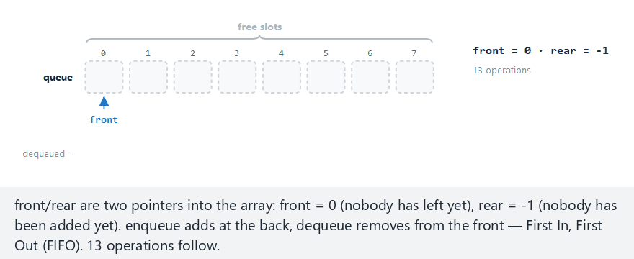
CEN207 Data Structures · Week 3
Queue in a plain array
RTEU Computer Engineering · Fall 2026–2027
107
Notes:
Normal example: fill 8 cells, remove 3, then two more enqueues still fail — front never reuses the cells dequeue frees.

Slide 108
CEN207 Data Structures · Week 3
Code — enqueue()/dequeue() (naive)
bool enqueue(int x) {
if (rear == CAP - 1) return false;
q[++rear] = x;
return true;
}
bool dequeue(int *out) {
if (front > rear) return false;
*out = q[front++];
return true;
}
RTEU Computer Engineering · Fall 2026–2027
108
Notes:
Simple and O(1), but rear never comes back, no matter how many cells dequeue frees near the front.

Slide 109
CEN207 Data Structures · Week 3
Expected output
enqueue(5,12,7,19,3,27,14,8): front=0, rear=7
dequeue() x3: front=3, rear=7
enqueue(99) -> false
enqueue(42) -> false
RTEU Computer Engineering · Fall 2026–2027
109
Notes:
Cells 0, 1, 2 are empty, yet the queue insists it is full — that is the drift problem.

Slide 110
CEN207 Data Structures · Week 3
Pitfall — the drift problem
rear only ever moves forward. The queue reports "full" while cells sit empty at the front — it has drifted off the array.
RTEU Computer Engineering · Fall 2026–2027
110
Notes:
Shifting every element after each dequeue would fix it, but turns O(1) dequeues into O(n) — not acceptable.

Slide 111
CEN207 Data Structures · Week 3
Quick question
Why does this queue say "full" even with three empty cells at the beginning?
RTEU Computer Engineering · Fall 2026–2027
111
Notes:
Look again at what enqueue actually checks.

Slide 112
CEN207 Data Structures · Week 3
Answer
enqueue only checks rear == CAP - 1; it never looks at whether cells before front are free. The real fix is next: think of the array as a ring.
RTEU Computer Engineering · Fall 2026–2027
112
Notes:
This sets up the circular queue perfectly.

Slide 113
CEN207 Data Structures · Week 3
The circular queue — think ring
• After the last index comes the first one again
• (index + 1) % CAP walks forward, wraps around
• front == (rear + 1) % CAP is now ambiguous (empty? full?)
• Keep one more field, count, to resolve it
RTEU Computer Engineering · Fall 2026–2027
113
Notes:
The wasted space was only wasted because we were thinking of the array as a straight line.

Slide 114
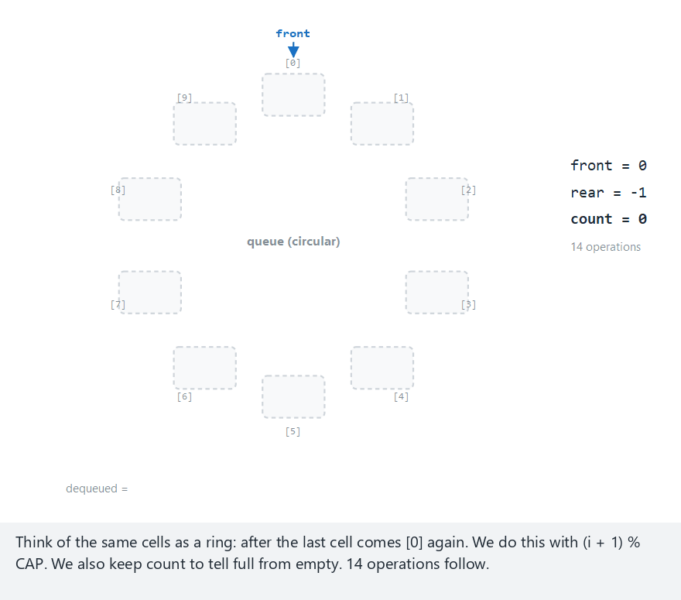
CEN207 Data Structures · Week 3
Circular queue
RTEU Computer Engineering · Fall 2026–2027
114
Notes:
Normal example: 10-cell ring, moderate mixing, one wrap-around — watch rear reuse the cells dequeue freed at the front.

Slide 115
CEN207 Data Structures · Week 3
Code — enqueue() (circular)
bool enqueue(int x) {
if (count == CAP) return false;
rear = (rear + 1) % CAP;
q[rear] = x;
count++;
return true;
}
RTEU Computer Engineering · Fall 2026–2027
115
Notes:
The only change from the naive version: rear wraps with modulo, and count tracks true fullness.

Slide 116
CEN207 Data Structures · Week 3
Code — dequeue() (circular)
bool dequeue(int *out) {
if (count == 0) return false;
*out = q[front];
front = (front + 1) % CAP;
count--;
return true;
}
RTEU Computer Engineering · Fall 2026–2027
116
Notes:
Same mirror shape as enqueue — front also wraps with modulo now.

Slide 117
CEN207 Data Structures · Week 3
Why we also need count
front == (rear + 1) % CAP is true both when the queue is empty and when it is completely full — a plain index comparison can no longer tell the two states apart.
RTEU Computer Engineering · Fall 2026–2027
117
Notes:
count resolves the ambiguity directly instead of relying on clever index tricks.

Slide 118
CEN207 Data Structures · Week 3
Complexity — still O(1), no drift
All five cells are used before the queue reports "full". The drift problem is completely gone, and every operation is still O(1).
RTEU Computer Engineering · Fall 2026–2027
118
Notes:
This is the queue implementation you would actually use in a real bounded buffer.

Slide 119
CEN207 Data Structures · Week 3
Common mistakes (circular queue)
• Using an index comparison instead of count for "empty"/"full"
• Forgetting the modulo on one of the two indices
• Either mistake corrupts the ring after one wrap
RTEU Computer Engineering · Fall 2026–2027
119
Notes:
If only rear wraps and not front, the ring breaks silently after the first wrap-around.

Slide 120
CEN207 Data Structures · Week 3
Quick question
What index relationship holds both right after the queue empties AND right after it fills — and why can't the indices alone tell which?
RTEU Computer Engineering · Fall 2026–2027
120
Notes:
Both "just became empty" and "just became full" show front == (rear + 1) % CAP.

Slide 121
CEN207 Data Structures · Week 3
Answer
Both states show front == (rear + 1) % CAP; `count` is exactly what tells them apart, since the index relationship alone is identical in both states.
RTEU Computer Engineering · Fall 2026–2027
121
Notes:
This is why count is not optional bookkeeping — it is the only thing resolving the ambiguity.

Slide 122
CEN207 Data Structures · Week 3
A queue that never overflows
• Linked-list queue: one node per element, no CAP
• Needs two pointers: front (remove),
rear (add) — so both stay O(1)
• Without rear, enqueue would walk the whole list
RTEU Computer Engineering · Fall 2026–2027
122
Notes:
Same overflow-removal trade as the linked stack, but this time we need a pointer to each end.

Slide 123
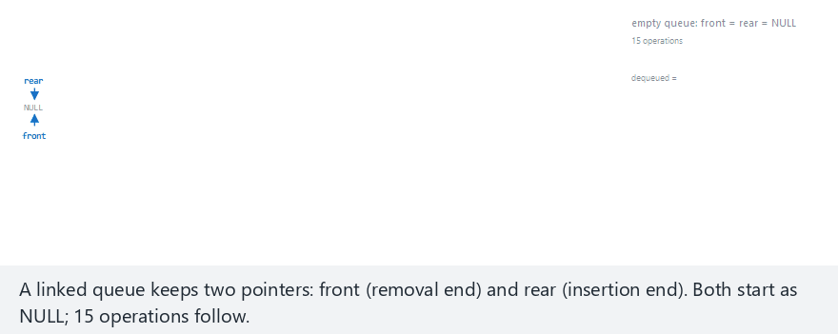
CEN207 Data Structures · Week 3
Linked-list queue
RTEU Computer Engineering · Fall 2026–2027
123
Notes:
With one node, front and rear point to the same node — watch that special case at the very start.

Slide 124
CEN207 Data Structures · Week 3
Code — enqueue() (linked)
void enqueue(int x) {
QNode *n = malloc(sizeof(QNode));
n->data = x; n->next = NULL;
if (rear == NULL) {
front = rear = n;
} else {
rear->next = n;
rear = n;
}
}
RTEU Computer Engineering · Fall 2026–2027
124
Notes:
The empty-queue case sets both pointers to the new node; otherwise only rear moves.

Slide 125
CEN207 Data Structures · Week 3
Code — dequeue() (linked)
bool dequeue(int *out) {
if (front == NULL) return false;
QNode *tmp = front;
*out = tmp->data;
front = front->next;
if (front == NULL) rear = NULL;
free(tmp);
return true;
}
RTEU Computer Engineering · Fall 2026–2027
125
Notes:
If the queue just became empty, rear must also be reset to NULL, or the next enqueue writes through garbage.

Slide 126
CEN207 Data Structures · Week 3
Common mistakes (linked queue)
• Forgetting to reset rear to NULL when empty
• Updating only one of front/rear with one node
• Both lead to a dangling pointer on the next enqueue
RTEU Computer Engineering · Fall 2026–2027
126
Notes:
A single node is both the front and the rear — both pointers must point to it.

Slide 127
CEN207 Data Structures · Week 3
Quick question
Why does the linked queue need a rear pointer, while the linked stack does not?
RTEU Computer Engineering · Fall 2026–2027
127
Notes:
Compare where each structure adds and where it removes.

Slide 128
CEN207 Data Structures · Week 3
Answer
The stack adds/removes at the same end (top) — one pointer suffices. The queue adds at one end, removes at the other — it needs a pointer to each end to stay O(1).
RTEU Computer Engineering · Fall 2026–2027
128
Notes:
Without rear, enqueue would need to walk the entire list to find the last node — O(n), not O(1).

Slide 129
CEN207 Data Structures · Week 3
The deque — both ends
A deque (double-ended queue) drops the "one end only" rule: it allows push/pop at both the front and the back.
RTEU Computer Engineering · Fall 2026–2027
129
Notes:
A deque behaves like a stack and a queue at the same time, depending only on which operations you call.

Slide 130
CEN207 Data Structures · Week 3
The Deque ADT
Operation | What it does | Complexity
push_back(x) | Add at the back | O(1)
push_front(x) | Add at the front | O(1)
pop_back() | Remove the back | O(1)
pop_front() | Remove the front | O(1)
RTEU Computer Engineering · Fall 2026–2027
130
Notes:
Built here on a doubly linked list, each end getting its own pair of pointer rewrites.

Slide 131
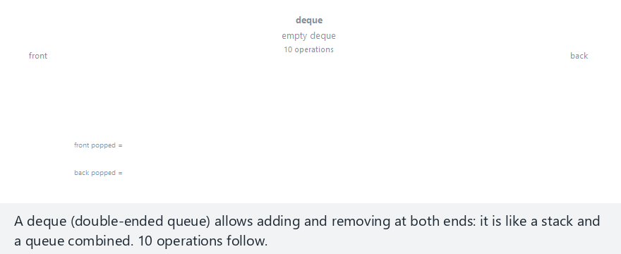
CEN207 Data Structures · Week 3
Double-ended queue (deque)
RTEU Computer Engineering · Fall 2026–2027
131
Notes:
Watch push_front insert at the opposite end from push_back — something a plain queue could never do.

Slide 132
CEN207 Data Structures · Week 3
Code — push_back()
void push_back(Deque *d, int x) {
DNode *n = malloc(sizeof(DNode));
n->data = x;
n->next = NULL;
n->prev = d->back;
if (d->back != NULL)
d->back->next = n;
else
d->front = n;
d->back = n;
}
RTEU Computer Engineering · Fall 2026–2027
132
Notes:
push_front is the mirror image of this function, touching front/prev instead of back/next.

Slide 133
CEN207 Data Structures · Week 3
Code — pop_back()
bool pop_back(Deque *d) {
if (d->back == NULL) return false;
DNode *tmp = d->back;
d->back = tmp->prev;
if (d->back != NULL)
d->back->next = NULL;
else
d->front = NULL;
free(tmp);
return true;
}
RTEU Computer Engineering · Fall 2026–2027
133
Notes:
pop_front mirrors this exactly, touching front/next instead of back/prev.

Slide 134
CEN207 Data Structures · Week 3
Note — a deque can be a stack or a queue
• Only push_back/pop_back → behaves like a stack
• Only push_back/pop_front → behaves like a queue
• Java's ArrayDeque is recommended as a faster
general replacement for both
RTEU Computer Engineering · Fall 2026–2027
134
Notes:
In C there is no standard deque, so we build one; in Java, java.util.ArrayDeque already gives us this.

Slide 135
CEN207 Data Structures · Week 3
Quick question
Empty deque: push_front(1), push_back(2), push_front(3). Front to back — what is it?
RTEU Computer Engineering · Fall 2026–2027
135
Notes:
Trace one call at a time.

Slide 136
CEN207 Data Structures · Week 3
Answer
3 1 2. push_front(1) → [1]. push_back(2) → [1, 2]. push_front(3) → [3, 1, 2].
RTEU Computer Engineering · Fall 2026–2027
136
Notes:
Front-inserts build backwards from the left; back-inserts build forwards on the right.

Slide 137
CEN207 Data Structures · Week 3
The multilevel queue
• Real schedulers rarely treat all work equally
• OS scheduler: keeps several FIFO queues at once
• Interactive first, then background, then batch
• Each level is an ordinary queue; a policy picks one
RTEU Computer Engineering · Fall 2026–2027
137
Notes:
This needs no new code today — just several of the queues we already built, plus a small selection rule.

Slide 138
CEN207 Data Structures · Week 3
Multilevel queue — levels
Level | Kind of work | Priority
Queue 1 | Interactive | Highest
Queue 2 | Background | Medium
Queue 3 | Batch | Lowest
RTEU Computer Engineering · Fall 2026–2027
138
Notes:
The scheduler serves higher queues first, falling through to lower ones only when higher ones are empty.

Slide 139
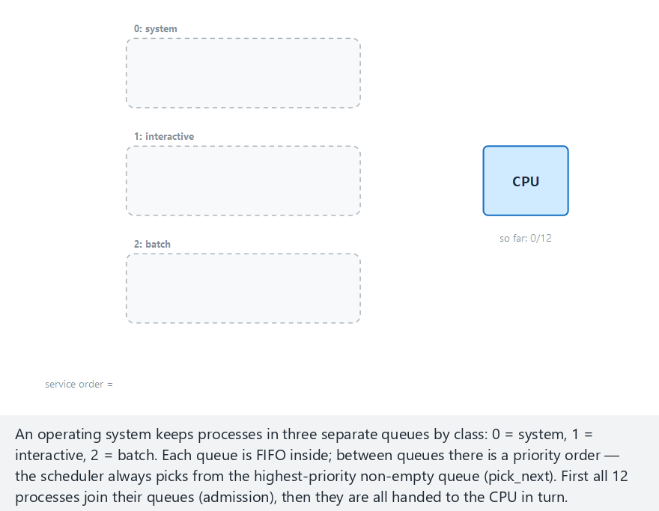
CEN207 Data Structures · Week 3
Multilevel queue scheduling
RTEU Computer Engineering · Fall 2026–2027
139
Notes:
Normal example: 12 processes evenly spread across three classes. admit() enqueues by level; pick_next() always tries level 0 first.

Slide 140
CEN207 Data Structures · Week 3
Pitfall — starvation risk
One early batch process among nine system/interactive ones is served last — plain priority order alone cannot prevent starvation.
RTEU Computer Engineering · Fall 2026–2027
140
Notes:
Real schedulers add aging or time-slicing so a lower level is never starved forever.

Slide 141
CEN207 Data Structures · Week 3
Quick question
Why is a multilevel queue not, strictly speaking, a new data structure?
RTEU Computer Engineering · Fall 2026–2027
141
Notes:
Look at what each individual level actually is.

Slide 142
CEN207 Data Structures · Week 3
Answer
Each level is an ordinary queue; "multilevel" describes a scheduling policy for choosing among several existing queues — not a new way to store data.
RTEU Computer Engineering · Fall 2026–2027
142
Notes:
You will meet its close relative, the priority queue, built on a heap, next week.

Slide 143
CEN207 Data Structures · Week 3
Summary — stack-based structures
Structure | Rule | Add/remove | Typical use
Array stack | LIFO | O(1), fixed cap. | Small, bounded stacks
Linked stack | LIFO | O(1), unbounded | Unpredictable size
Call stack | LIFO | Automatic | Every running program
RTEU Computer Engineering · Fall 2026–2027
143
Notes:
All three obey the exact same LIFO rule — only the storage and the capacity limit differ.

Slide 144
CEN207 Data Structures · Week 3
Summary — queue-based structures (I)
Structure | Rule | Add/remove
Array queue (naive) | FIFO | O(1), but drifts
Circular queue | FIFO | O(1), no drift
Linked-list queue | FIFO | O(1), unbounded
RTEU Computer Engineering · Fall 2026–2027
144
Notes:
The circular queue is the one you would actually ship; the naive array queue is a teaching stepping stone.

Slide 145
CEN207 Data Structures · Week 3
Summary — queue-based structures (II)
Structure | Rule | Typical use
Deque | Both ends | Sliding window, undo/redo
Multilevel queue | Several FIFOs + policy | OS scheduling
RTEU Computer Engineering · Fall 2026–2027
145
Notes:
Both generalize the plain queue — one by relaxing which end you touch, one by adding priority.

Slide 146
CEN207 Data Structures · Week 3
Summary — stack applications
Application | Structure | Key idea
Balanced brackets | Stack | Most recent, first closed
Postfix evaluation | Stack | Pop two, apply, push result
Infix → postfix | Operator stack + output | Resolve precedence once
Tower of Hanoi | Call stack | Solve n-1, act, solve n-1
RTEU Computer Engineering · Fall 2026–2027
146
Notes:
Four very different-looking problems, all solved by the exact same tiny stack interface.

Slide 147
CEN207 Data Structures · Week 3
The big picture
One rule — which end(s) you may touch — separates every structure in this lecture: one end (stack), two ends (queue/deque), or several parallel queues (multilevel).
RTEU Computer Engineering · Fall 2026–2027
147
Notes:
If a student remembers only one sentence from today, this is the one worth remembering.

Slide 148
CEN207 Data Structures · Week 3
Practice
• Exercises for all of today's topics are in the
week notes: docs/week-3/cen207-week-3.en.md
• Peek, pinpointing where an unbalanced-parens
error is, prefix-free infix-to-prefix, count-free circular queue, palindrome check, fairer scheduling
RTEU Computer Engineering · Fall 2026–2027
148
Notes:
These are the same six exercises listed at the end of the written notes, with worked answer sketches.

Slide 149
CEN207 Data Structures · Week 3
Self-check round
Ten short questions. Think before the answer appears on the next slide.
RTEU Computer Engineering · Fall 2026–2027
149
Notes:
These mirror the self-check quiz at the end of the week notes, one question per slide.

Slide 150
CEN207 Data Structures · Week 3
1. What does LIFO stand for?
RTEU Computer Engineering · Fall 2026–2027
150
Notes:
Ask, wait, then advance.

Slide 151
CEN207 Data Structures · Week 3
Last In, First Out — the stack.
RTEU Computer Engineering · Fall 2026–2027
151
Notes:
The plate-stack picture from Section 1 is the whole idea.

Slide 152
CEN207 Data Structures · Week 3
2. What does FIFO stand for?
RTEU Computer Engineering · Fall 2026–2027
152
Notes:
Ask, wait, then advance.

Slide 153
CEN207 Data Structures · Week 3
First In, First Out — the queue.
RTEU Computer Engineering · Fall 2026–2027
153
Notes:
The waiting-line picture from Section 5 is the whole idea.

Slide 154
CEN207 Data Structures · Week 3
3. Why does array push check top == CAP - 1, not top == CAP?
RTEU Computer Engineering · Fall 2026–2027
154
Notes:
Think about the valid index range.

Slide 155
CEN207 Data Structures · Week 3
Valid indices run 0..CAP-1; the stack is full the moment top reaches CAP-1.
RTEU Computer Engineering · Fall 2026–2027
155
Notes:
Waiting for top == CAP would already be one slot past the array's end.

Slide 156
CEN207 Data Structures · Week 3
4. In postfix evaluation, which operand is popped first?
RTEU Computer Engineering · Fall 2026–2027
156
Notes:
Recall the "right operand first" rule.

Slide 157
CEN207 Data Structures · Week 3
The right-hand operand — it was pushed most recently.
RTEU Computer Engineering · Fall 2026–2027
157
Notes:
This is exactly why 8 2 - means 8 - 2, not 2 - 8.

Slide 158
CEN207 Data Structures · Week 3
5. Why does a plain array queue eventually report "full" even with empty cells at the front?
RTEU Computer Engineering · Fall 2026–2027
158
Notes:
This is the drift problem, restated as a question.

Slide 159
CEN207 Data Structures · Week 3
rear only increases and never reuses cells dequeue frees near the front.
RTEU Computer Engineering · Fall 2026–2027
159
Notes:
The queue "drifts" right until it hits the end of the array.

Slide 160
CEN207 Data Structures · Week 3
6. What extra state does a circular queue need beyond front/rear?
RTEU Computer Engineering · Fall 2026–2027
160
Notes:
Think about the front == (rear + 1) % CAP ambiguity.

Slide 161
CEN207 Data Structures · Week 3
A count of current elements — indices alone cannot tell empty from full.
RTEU Computer Engineering · Fall 2026–2027
161
Notes:
After a wraparound, front == (rear + 1) % CAP no longer decides the question by itself.

Slide 162
CEN207 Data Structures · Week 3
7. What is the base case of fact(n) = n * fact(n - 1)?
RTEU Computer Engineering · Fall 2026–2027
162
Notes:
Recall the very first code slide of Section 3.

Slide 163
CEN207 Data Structures · Week 3
fact(0) = 1. Without it, calls never stop and the call stack overflows.
RTEU Computer Engineering · Fall 2026–2027
163
Notes:
Every recursive function needs at least one reachable base case.

Slide 164
CEN207 Data Structures · Week 3
8. Why does the call stack qualify as a genuine stack?
RTEU Computer Engineering · Fall 2026–2027
164
Notes:
Compare it to the LIFO rule from Section 1.

Slide 165
CEN207 Data Structures · Week 3
It obeys LIFO exactly: the most recent call is always the next one to finish.
RTEU Computer Engineering · Fall 2026–2027
165
Notes:
Just like the most recently pushed element of any stack is the next one popped.

Slide 166
CEN207 Data Structures · Week 3
9. For n disks, how many Hanoi moves are needed?
RTEU Computer Engineering · Fall 2026–2027
166
Notes:
Recall the recurrence from Section 4.

Slide 167
CEN207 Data Structures · Week 3
2ⁿ - 1 moves — exponential growth in n.
RTEU Computer Engineering · Fall 2026–2027
167
Notes:
For n = 64, that is about 585 billion years at one move per second.

Slide 168
CEN207 Data Structures · Week 3
10. Name one thing a deque can do that a plain stack or queue cannot.
RTEU Computer Engineering · Fall 2026–2027
168
Notes:
Think about which ends each structure is allowed to touch.

Slide 169
CEN207 Data Structures · Week 3
Add or remove at both the front and the back, each in O(1).
RTEU Computer Engineering · Fall 2026–2027
169
Notes:
A plain stack only ever touches its top; a plain queue only adds at one end and removes at the other.

Slide 170
CEN207 Data Structures · Week 3
Next week
Week 4 — Trees: Binary Trees, Traversals, Heaps
Every stack and queue today stored elements in a strict, unbranching sequence. Trees let a node have several children — traversed with the very same recursive pattern used for the Tower of Hanoi.
RTEU Computer Engineering · Fall 2026–2027
170
Notes:
Solve the left subtree, visit the node, solve the right subtree — exactly Hanoi's recursion shape, on a new shape of data.

Slide 171
CEN207 Data Structures · Week 3
References (1/2)
• Course syllabus, Week 3: docs/syllabus/syllabus.en.md
• Cormen, Leiserson, Rivest, Stein. *Introduction to
Algorithms*, 3rd ed. MIT Press
• Sedgewick, Wayne. Algorithms, 4th ed.
Addison-Wesley, 2011
RTEU Computer Engineering · Fall 2026–2027
171
Notes:
These are the same references listed at the end of the week's written notes.

Slide 172
CEN207 Data Structures · Week 3
References (2/2)
• Deitel & Deitel. C How to Program, 7th ed.
• Y. D. Liang. Introduction to Java Programming, 10th ed.
• É. Lucas, Récréations mathématiques, 1883
• J. Łukasiewicz, Polish/Reverse Polish notation, 1920s
RTEU Computer Engineering · Fall 2026–2027
172
Notes:
The historical references (Lucas, Łukasiewicz) are what today's "short history" slides drew on.

