Slide 1

CEN207 Data Structures · Week 5
Graphs and Traversals
CEN207 Data Structures — Week 5
Asst. Prof. Dr. Uğur CORUH · Fall 2026–2027
RTEU Computer Engineering · Fall 2026–2027
Notes:
A tree let one node point at several children, but never back up and never sideways. Drop both of those restrictions — let any node point at any node — and a tree becomes a graph, the most general shape in this course.

Slide 2
CEN207 Data Structures · Week 5
Today's plan (3 hours)
Hour | Topic
1 | Why graphs, vocabulary Anim 1 · matrix vs. list Anim 2–3
2 | BFS Anim 4 · DFS recursive Anim 5 · DFS iterative Anim 6
3 | Connected components Anim 7 · shortest path Anim 8
Learning outcomes: LO.1 (explain fundamental data structures) · LO.2 (analyze complexity) · LO.7 (choose the right structure)
RTEU Computer Engineering · Fall 2026–2027
2
Notes:
Eight short animations carry the whole lecture; each appears once, exactly where its idea is introduced, and every one gets a second look at a harder or edge-case input.

Slide 3
CEN207 Data Structures · Week 5
This week's concepts — where
Concept | Where
Why graphs, vocabulary | Sections 1–2
Adjacency matrix vs. adjacency list | Section 3
BFS, DFS (recursive and iterative) | Sections 4–6
Connected components, shortest path | Sections 7–8
RTEU Computer Engineering · Fall 2026–2027
3
Notes:
Every term gets a full definition the first time it appears; this table just says where to find it again.

Slide 4
CEN207 Data Structures · Week 5
How the code examples work
• Every idea has a complete C and Java program
• C: gcc -std=c11 -Wall -Wextra -o /tmp/x file.c && /tmp/x
• Java: javac -d /tmp/j File.java && java -cp /tmp/j File
• Sources: code/week-05/c/ and code/week-05/java/
• Each program's expected output is in the week notes
RTEU Computer Engineering · Fall 2026–2027
4
Notes:
Open a terminal now if you want to run these live; every snippet on today's slides compiles and runs exactly as shown.

Slide 5
CEN207 Data Structures · Week 5
Recap — stacks, queues, recursion (Week 3)
• A stack (LIFO): last pushed, first popped
• A queue (FIFO): first enqueued, first dequeued
• Recursion is a stack: a call pushes, a return pops
• Today: the very same stack and queue, holding graph vertices
RTEU Computer Engineering · Fall 2026–2027
5
Notes:
Nothing about the machinery is new this week — only a new shape for the data these two structures will hold.

Slide 6
CEN207 Data Structures · Week 5
Recap — trees are special graphs (Week 4)
• A tree: one root, no cycles, exactly one path to any node
• A graph: no root required, cycles allowed, many paths allowed
• Every tree is a graph; not every graph is a tree
• Traversals (pre/in/post/level) generalize to graph search today
RTEU Computer Engineering · Fall 2026–2027
6
Notes:
Last week's "n nodes, n-1 edges, no cycle" rule was a special case; today that restriction is lifted entirely.

Slide 7
CEN207 Data Structures · Week 5
Map of the week — at a glance
Foundations | Traversal & applications
Why graphs, vocabulary | BFS, DFS (recursive, iterative)
Matrix vs. list | Connected components
— | Shortest path (unweighted)
RTEU Computer Engineering · Fall 2026–2027
7
Notes:
Every box on this map gets its own slides below, most with a short animation and a complete C/Java program.

Slide 8
CEN207 Data Structures · Week 5
1. Why Graphs? From Bridges to Networks
RTEU Computer Engineering · Fall 2026–2027
8
Notes:
Section 1 motivates the whole week with the single oldest problem in graph theory, then shows the same shape hiding in maps, friendships, and the web.

Slide 9
CEN207 Data Structures · Week 5
A question to start
A city has four landmasses joined by seven bridges. Can you walk through the city crossing every bridge exactly once, and return home?
RTEU Computer Engineering · Fall 2026–2027
9
Notes:
This is the actual question a small city asked itself in the 1700s — and it produced an entirely new branch of mathematics.

Slide 10
CEN207 Data Structures · Week 5
A short history
• 1736 — Leonhard Euler solves the Königsberg bridge puzzle
• Königsberg (today Kaliningrad): 4 landmasses, 7 bridges
• Euler's paper is the first graph-theory paper ever written
• He answered "no" — and explained exactly why, for any city
RTEU Computer Engineering · Fall 2026–2027
10
Notes:
Euler never drew a single bridge in his paper — he threw away everything except which landmasses connect to which, which is precisely the idea of a graph.

Slide 11
CEN207 Data Structures · Week 5
The bridges, restated
• Each landmass becomes a vertex (4 of them)
• Each bridge becomes an edge (7 of them)
• The walk becomes: trace every edge once, never lifting your pen
• This is an Eulerian path — named after Euler himself
RTEU Computer Engineering · Fall 2026–2027
11
Notes:
Stripping away the map and keeping only "what connects to what" is the single most important move in this entire course.

Slide 12
CEN207 Data Structures · Week 5
Euler's insight: degree parity
• Every time you pass through a vertex, you use 2 edges
• Only your start and end vertex may use an odd number
• An Eulerian walk needs 0 or 2 odd-degree vertices, no more
• Königsberg has 4 odd-degree vertices — so no walk exists
RTEU Computer Engineering · Fall 2026–2027
12
Notes:
This single counting argument, degree parity, is why the answer is "no" for any city shaped like Königsberg, not just that one.

Slide 13
CEN207 Data Structures · Week 5
Why it matters
• One puzzle, solved by counting, founded graph theory
• The same vertex/edge idea now models almost any relationship
• Modern uses: maps, social networks, the web, and much more
• The next three slides show three of them
RTEU Computer Engineering · Fall 2026–2027
13
Notes:
"Vertices and edges" turned out to be one of the most reusable ideas in all of computer science.

Slide 14
CEN207 Data Structures · Week 5
Graphs are everywhere — road maps
• Vertices: intersections, cities, addresses
• Edges: roads, with a weight — distance or drive time
• GPS routing asks: shortest weighted path from A to B
• Week 9's Dijkstra's algorithm answers exactly that question
RTEU Computer Engineering · Fall 2026–2027
14
Notes:
Every "get directions" button you have ever tapped ran some form of a graph shortest-path algorithm underneath.

Slide 15
CEN207 Data Structures · Week 5
Graphs are everywhere — social networks
• Vertices: people or accounts
• Edges: "follows" (directed) or "is friends with" (undirected)
• "Friends of friends" — reachable in exactly 2 edges
• Section 4's BFS answers that question, one level at a time
RTEU Computer Engineering · Fall 2026–2027
15
Notes:
A friend suggestion feature is, underneath, almost always a short breadth-first search from your own vertex.

Slide 16
CEN207 Data Structures · Week 5
Graphs are everywhere — the web
• Vertices: web pages; edges: hyperlinks (directed)
• A>B means page A links to page B
• A crawler visits every reachable page exactly once
• Section 6's DFS is a classic way to write a web crawler
RTEU Computer Engineering · Fall 2026–2027
16
Notes:
PageRank, the original Google ranking idea, is fundamentally a computation performed on this exact directed graph of links.

Slide 17
CEN207 Data Structures · Week 5
Graph vs. tree, revisited
Tree (Week 4) | Graph (this week)
One root | No required root
No cycles allowed | Cycles allowed
Exactly one path between any two nodes | Zero, one, or many paths
RTEU Computer Engineering · Fall 2026–2027
17
Notes:
Keep this table in mind for the rest of the week — every traversal idea below is a tree idea with these three restrictions removed.

Slide 18
CEN207 Data Structures · Week 5
Common mistakes
• Assuming a graph must be connected — it may not be
• Assuming an edge always goes both ways — only if undirected
• Forgetting a single vertex with no edges is still a valid graph
RTEU Computer Engineering · Fall 2026–2027
18
Notes:
Every one of today's algorithms must work correctly even on the awkward cases this slide lists — that is exactly what the "edge case" animations below test.

Slide 19
CEN207 Data Structures · Week 5
Mini-quiz
A city has exactly two odd-degree landmasses, the rest even. Can a walk crossing every bridge once exist? Where would it have to start?
RTEU Computer Engineering · Fall 2026–2027
19
Notes:
Apply the parity rule from a few slides back.

Slide 20
CEN207 Data Structures · Week 5
Answer
Yes. With exactly two odd-degree vertices, an Eulerian path (not a full round trip) exists, starting at one odd vertex and ending at the other.
RTEU Computer Engineering · Fall 2026–2027
20
Notes:
Zero odd vertices gives a round trip back to the start; exactly two gives a one-way walk — anything else, no walk at all.

Slide 21
CEN207 Data Structures · Week 5
2. Graph Vocabulary
RTEU Computer Engineering · Fall 2026–2027
21
Notes:
Section 2 builds the vocabulary every later section leans on — vertex, edge, degree, path, cycle — all on one worked example.

Slide 22
CEN207 Data Structures · Week 5
A question to start
A graph is just two sets: V, the vertices, and E, the edges. How much structure can really come from an idea that small?
RTEU Computer Engineering · Fall 2026–2027
22
Notes:
Almost everything this week — surprisingly, this two-set definition is the entire foundation.

Slide 23
CEN207 Data Structures · Week 5
A graph, formally
• A graph G = (V, E): a set of vertices, a set of edges
• Each edge connects two vertices (possibly the same one)
• |V| vertices, |E| edges — common shorthand: V and E
• Everything below is built from just these two sets
RTEU Computer Engineering · Fall 2026–2027
23
Notes:
This formal definition looks sparse on purpose — its power is exactly how few assumptions it makes.

Slide 24
CEN207 Data Structures · Week 5
Vocabulary (1/4)
Term | Meaning
Vertex (node) | A single point in the graph
Edge | A connection between two vertices
Undirected | Edge A-B usable in either direction
Directed | Edge A>B usable only A to B
RTEU Computer Engineering · Fall 2026–2027
24
Notes:
Every one of these is pointed at, one at a time, in the animation right after this table.

Slide 25
CEN207 Data Structures · Week 5
Vocabulary (2/4)
Term | Meaning
Weighted | Every edge carries a number, its weight
Unweighted | Edges only say "connected", no number
Degree (undirected) | Edges touching a vertex
RTEU Computer Engineering · Fall 2026–2027
25
Notes:
An unweighted edge is really just a weighted edge whose weight always happens to be 1.

Slide 26
CEN207 Data Structures · Week 5
Vocabulary (3/4)
Term | Meaning
In-degree | Edges pointing into a vertex (directed)
Out-degree | Edges pointing out of a vertex (directed)
Path | An edge sequence, no repeated vertex
Cycle | A path that returns to its start
RTEU Computer Engineering · Fall 2026–2027
26
Notes:
Degree splits into two only once direction exists — an undirected graph never needs "in" or "out" at all.

Slide 27
CEN207 Data Structures · Week 5
Vocabulary (4/4)
Term | Meaning
Connected | Every vertex reachable from every other
Self-loop | An edge from a vertex to itself
Multi-edge | More than one edge between the same pair
RTEU Computer Engineering · Fall 2026–2027
27
Notes:
A graph that allows self-loops and multi-edges is sometimes specifically called a multigraph.

Slide 28
CEN207 Data Structures · Week 5
Sparse vs. dense
• Sparse: E close to V — few edges per vertex
• Dense: E close to V² — most pairs connected
• A road map: sparse (a city has few roads per intersection)
• A "who follows whom" graph on a small team: often dense
RTEU Computer Engineering · Fall 2026–2027
28
Notes:
This distinction matters a great deal in Section 3, when choosing how to store a graph.

Slide 29
CEN207 Data Structures · Week 5
What can we ask a graph?
Operation | What it answers
has_edge(a, b) | Are a and b directly connected?
neighbors(v) | Which vertices does v connect to?
degree(v) | How many edges touch v?
RTEU Computer Engineering · Fall 2026–2027
29
Notes:
Every algorithm this week is built entirely out of these three small questions, asked over and over.

Slide 30
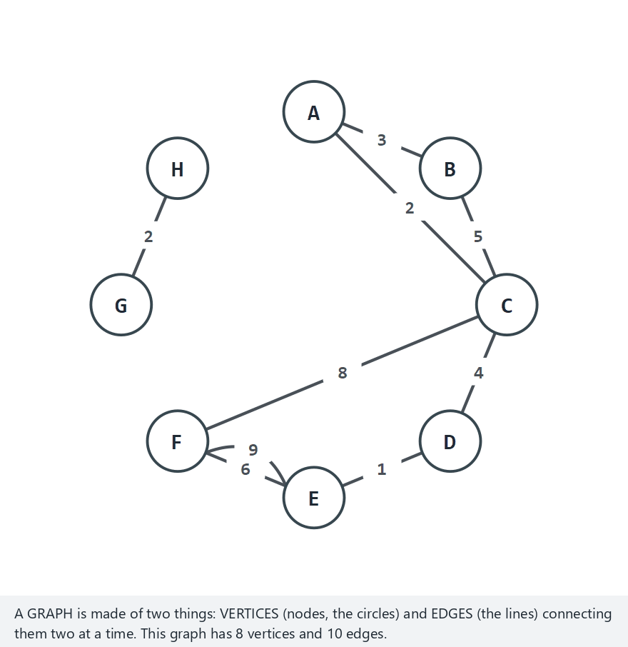
CEN207 Data Structures · Week 5
Graph vocabulary, one term at a time
RTEU Computer Engineering · Fall 2026–2027
30
Notes:
Normal example: 8 vertices, weighted, with a cycle, a self-loop, a multi-edge, and 2 components — every term from this section, on one graph.

Slide 31
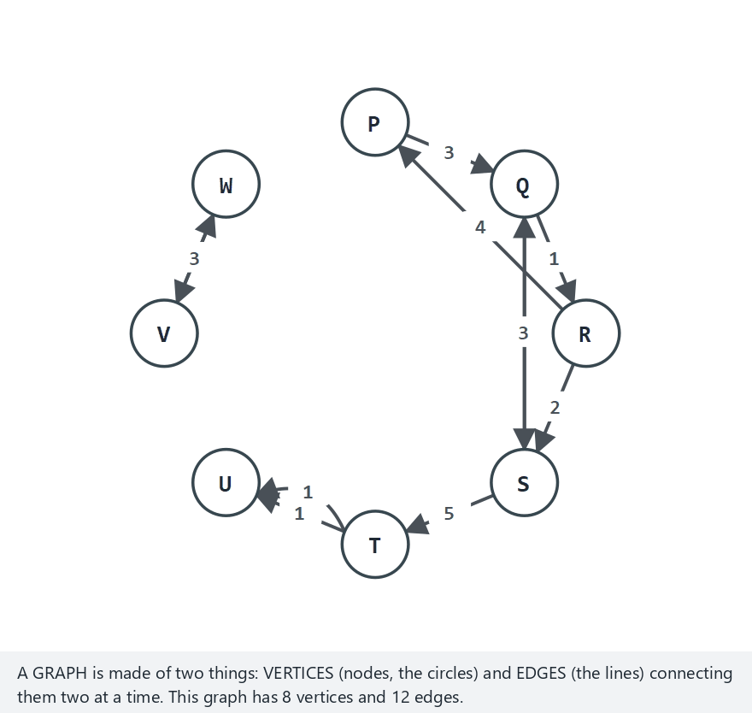
CEN207 Data Structures · Week 5
Edge case — directed, multiple cycles, a self-loop
RTEU Computer Engineering · Fall 2026–2027
31
Notes:
8 vertices, directed, with two separate cycles, a self-loop, a multi-edge and 2 weak components — in-degree and out-degree now genuinely differ per vertex.

Slide 32
CEN207 Data Structures · Week 5
Code — the Edge and Graph structs
typedef struct Edge {
int to; /* other endpoint */
int weight; /* 1 if unweighted */
struct Edge *next;
} Edge;
typedef struct Graph {
Edge *adj[MAX_V]; /* one list per vertex */
int vertex_count;
int directed; /* 0 or 1 */
} Graph;
RTEU Computer Engineering · Fall 2026–2027
32
Notes:
One struct for an edge, one for the whole graph — every algorithm this week is built on exactly these two shapes.

Slide 33
CEN207 Data Structures · Week 5
Code — out_degree()
int out_degree(Graph *g, int v) {
int d = 0;
for (Edge *e = g->adj[v]; e; e = e->next)
d++;
return d;
}
RTEU Computer Engineering · Fall 2026–2027
33
Notes:
In an undirected graph this single function already counts everything a vertex needs — no separate "in" version required.

Slide 34
CEN207 Data Structures · Week 5
Code — in_degree() (directed only)
int in_degree(Graph *g, int v) {
int d = 0;
for (int u = 0; u < g->vertex_count; u++)
for (Edge *e = g->adj[u]; e; e = e->next)
if (e->to == v) d++;
return d;
}
RTEU Computer Engineering · Fall 2026–2027
34
Notes:
Finding who points AT v means scanning every OTHER vertex's list — there is no shortcut without extra bookkeeping.

Slide 35
CEN207 Data Structures · Week 5
Complexity
• out_degree: walk one list — O(degree of v)
• in_degree: scan every vertex's list — O(V + E)
• Directed graphs make "in" strictly more expensive than "out"
RTEU Computer Engineering · Fall 2026–2027
35
Notes:
This asymmetry is a direct consequence of storing only outgoing edges, the adjacency-list choice Section 3 explains.

Slide 36
CEN207 Data Structures · Week 5
Common mistakes
• Confusing degree with number of neighbors on a multigraph
• Forgetting a self-loop counts twice toward degree
• Assuming in-degree and out-degree are always equal — only in special cases
RTEU Computer Engineering · Fall 2026–2027
36
Notes:
The hard-preset animation above was built specifically to make in-degree and out-degree disagree on most vertices.

Slide 37
CEN207 Data Structures · Week 5
Mini-quiz
A directed graph has a self-loop at vertex X. By how much does that self-loop raise X's in-degree? Its out-degree?
RTEU Computer Engineering · Fall 2026–2027
37
Notes:
Think about which direction a self-loop's single edge "points" in.

Slide 38
CEN207 Data Structures · Week 5
Answer
By 1 each. A self-loop X>X counts once as an edge into X and once as an edge out of X — both in-degree and out-degree rise by 1.
RTEU Computer Engineering · Fall 2026–2027
38
Notes:
In an undirected graph, that same self-loop instead raises plain degree by 2, not 1 — direction changes the counting rule.

Slide 39
CEN207 Data Structures · Week 5
3. Representing a Graph: Matrix vs. List
RTEU Computer Engineering · Fall 2026–2027
39
Notes:
A graph is an idea; a program needs one concrete way to store it. This section builds the two standard choices, side by side, on the very same graphs.

Slide 40
CEN207 Data Structures · Week 5
A question to start
has_edge(a, b) and neighbors(v) are the two questions every algorithm this week will ask. What is the simplest structure that answers both?
RTEU Computer Engineering · Fall 2026–2027
40
Notes:
There is no single best answer — the two structures below trade one operation's speed for the other's memory.

Slide 41
CEN207 Data Structures · Week 5
Two representations at a glance
 | Adjacency matrix | Adjacency list
Stores | A V x V table | One list per vertex
Best for | Dense graphs | Sparse graphs
has_edge | O(1) | O(degree)
RTEU Computer Engineering · Fall 2026–2027
41
Notes:
Both sections below build these from the exact same edge lists, so the two representations can be compared directly.

Slide 42
CEN207 Data Structures · Week 5
Adjacency matrix — the idea
A V x V table. matrix[i][j] holds 1 (or the weight) if an edge runs from vertex i to vertex j, 0 otherwise. Undirected graphs fill both matrix[i][j] and matrix[j][i].
RTEU Computer Engineering · Fall 2026–2027
42
Notes:
An undirected graph's matrix is always symmetric across its diagonal — that symmetry is what "either direction" means, written as numbers.

Slide 43
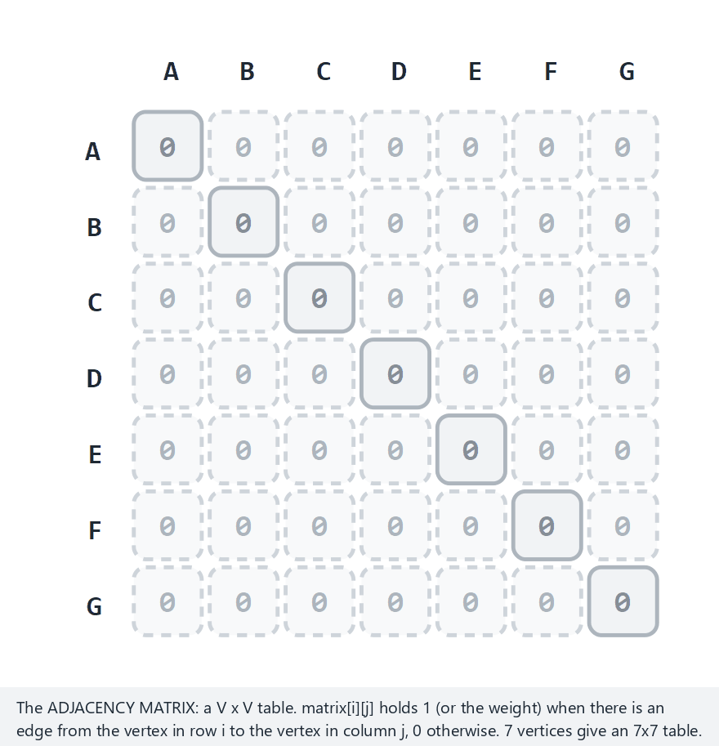
CEN207 Data Structures · Week 5
Adjacency matrix, step by step
RTEU Computer Engineering · Fall 2026–2027
43
Notes:
Normal example: 7 vertices, undirected, unweighted, 10 edges — watch the matrix fill in, one symmetric pair of cells at a time.

Slide 44
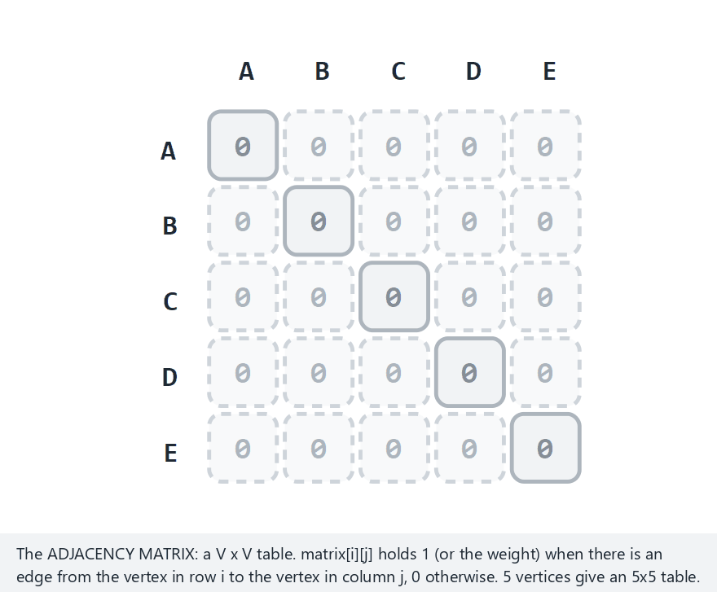
CEN207 Data Structures · Week 5
Edge case — a complete graph
RTEU Computer Engineering · Fall 2026–2027
44
Notes:
5 vertices, every pair connected, 10 edges — the maximum possible for 5 vertices, and the matrix ends up completely full off the diagonal.

Slide 45
CEN207 Data Structures · Week 5
Code — add_edge() (matrix)
void add_edge(int a, int b, int w, int dir) {
matrix[a][b] = w;
if (!dir)
matrix[b][a] = w; /* mirror the diagonal */
}
RTEU Computer Engineering · Fall 2026–2027
45
Notes:
One assignment for a directed edge, two — mirrored — for an undirected one; that single "if" is the whole difference.

Slide 46
CEN207 Data Structures · Week 5
Code — build_adjacency_matrix()
void build_adjacency_matrix(Edge *edges, int n,
int directed) {
for (int i = 0; i < MAX_V; i++)
for (int j = 0; j < MAX_V; j++)
matrix[i][j] = 0;
for (int k = 0; k < n; k++)
add_edge(edges[k].a, edges[k].b,
edges[k].weight, directed);
}
RTEU Computer Engineering · Fall 2026–2027
46
Notes:
Zero the whole table first, then add one edge at a time — order does not matter, since each edge only touches its own two cells.

Slide 47
CEN207 Data Structures · Week 5
Complexity — matrix
• has_edge(a, b): one lookup — O(1)
• Space: always O(V²) cells, dense or sparse alike
• neighbors(v): scan a whole row — O(V), even if v has 1 edge
RTEU Computer Engineering · Fall 2026–2027
47
Notes:
The matrix's cost never depends on how many edges actually exist — only on how many vertices could possibly exist.

Slide 48
CEN207 Data Structures · Week 5
Adjacency list — the idea
One linked list per vertex, holding only its actual neighbors. An undirected edge A-B appends B to A's list and A to B's list — two nodes, two lists.
RTEU Computer Engineering · Fall 2026–2027
48
Notes:
This is the exact same linked-list node from Week 2, just reused: one field for the neighbor's id, one for "next".

Slide 49
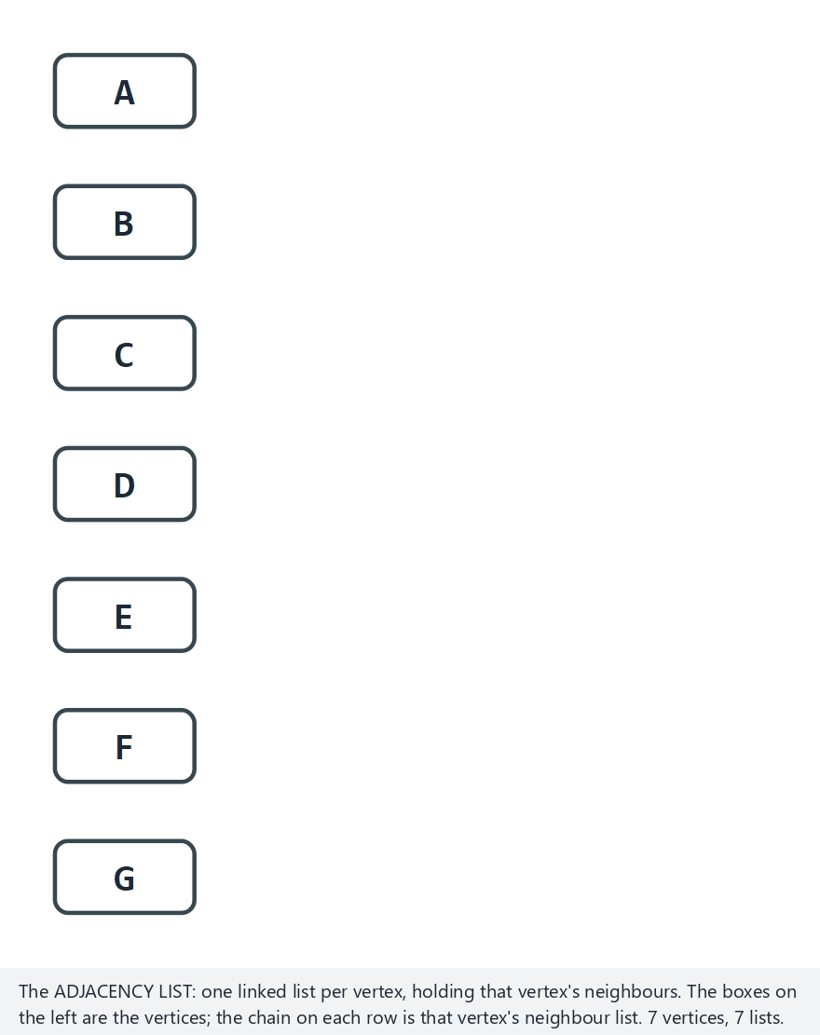
CEN207 Data Structures · Week 5
Adjacency list, step by step
RTEU Computer Engineering · Fall 2026–2027
49
Notes:
Same normal example as the matrix: 7 vertices, undirected, unweighted, 10 edges — watch each edge append to one or two lists.

Slide 50
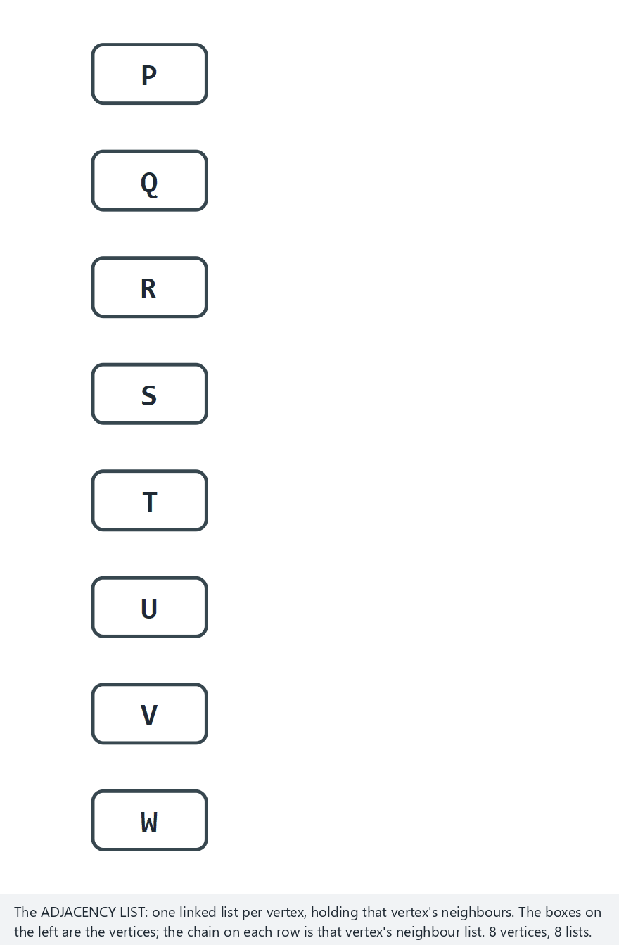
CEN207 Data Structures · Week 5
Edge case — directed, an empty list
RTEU Computer Engineering · Fall 2026–2027
50
Notes:
8 vertices, directed, weighted, 10 edges including a reversed pair `P>R` and `R>P` — some vertices end up with an empty list, having no outgoing edge at all.

Slide 51
CEN207 Data Structures · Week 5
Code — append() (list)
void append(int v, int neighbour) {
AdjNode *n = malloc(sizeof(AdjNode));
n->to = neighbour;
n->next = NULL;
if (adj[v] == NULL) { adj[v] = n; return; }
AdjNode *cur = adj[v];
while (cur->next) cur = cur->next;
cur->next = n;
}
RTEU Computer Engineering · Fall 2026–2027
51
Notes:
Exactly Week 2's singly linked list append: walk to the tail, then attach — nothing about graphs changes this pattern at all.

Slide 52
CEN207 Data Structures · Week 5
Code — add_edge() (list)
void add_edge(int a, int b, int directed) {
append(a, b);
if (!directed && a != b)
append(b, a);
}
RTEU Computer Engineering · Fall 2026–2027
52
Notes:
The self-loop check, `a != b`, exists so an undirected self-loop is not appended twice to the very same list.

Slide 53
CEN207 Data Structures · Week 5
Complexity — list
• Space: O(V + E) — only real edges take room
• neighbors(v): walk its own list — O(degree of v)
• has_edge(a, b): walk a's list looking for b — O(degree)
RTEU Computer Engineering · Fall 2026–2027
53
Notes:
has_edge is the one operation where the matrix strictly wins — the list must search, the matrix never does.

Slide 54
CEN207 Data Structures · Week 5
Memory & time, side by side
 | Matrix | List
Space | O(V²) | O(V + E)
has_edge | O(1) | O(degree)
neighbors | O(V) | O(degree)
RTEU Computer Engineering · Fall 2026–2027
54
Notes:
Three rows, and every later algorithm's complexity traces straight back to this one small table.

Slide 55
CEN207 Data Structures · Week 5
Sparse graphs: pick the list
• A road map, the web, a friendship graph: all sparse
• E is close to V, far below V²
• The list's O(V + E) space stays small; the matrix wastes O(V²)
• Every algorithm from Section 4 onward uses the list
RTEU Computer Engineering · Fall 2026–2027
55
Notes:
This is not a close call for the graphs this course actually cares about — the list wins by a wide margin.

Slide 56
CEN207 Data Structures · Week 5
Dense graphs: matrix can win
• A small, densely connected graph: E close to V²
• The matrix's "wasted" O(V²) space is barely wasted at all
• has_edge at O(1) can matter more than saving memory
• Rule of thumb: dense and small → matrix; sparse or large → list
RTEU Computer Engineering · Fall 2026–2027
56
Notes:
Both structures store the exact same information — this choice is purely an engineering trade-off, never a correctness one.

Slide 57
CEN207 Data Structures · Week 5
Common mistakes
• Using a matrix for a large, sparse graph — wastes huge memory
• Forgetting the list needs two appends for one undirected edge
• Reading matrix[a][b] as symmetric on a directed graph
RTEU Computer Engineering · Fall 2026–2027
57
Notes:
A directed matrix's two "mirror" cells, matrix[a][b] and matrix[b][a], can legitimately hold two completely different values.

Slide 58
CEN207 Data Structures · Week 5
Mini-quiz
A graph has 1,000 vertices and only 2,000 edges. Roughly how many cells would its adjacency matrix need? Is that graph sparse?
RTEU Computer Engineering · Fall 2026–2027
58
Notes:
Square the vertex count, then compare that to the edge count.

Slide 59
CEN207 Data Structures · Week 5
Answer
About 1,000,000 cells (1000²), for only 2,000 real edges — almost all of it wasted. Yes, very sparse: an adjacency list is the clear choice here.
RTEU Computer Engineering · Fall 2026–2027
59
Notes:
This is exactly the situation Section 3's "sparse vs. dense" rule of thumb was written for.

Slide 60
CEN207 Data Structures · Week 5
4. Breadth-First Search (BFS)
RTEU Computer Engineering · Fall 2026–2027
60
Notes:
BFS is level order, from Week 4, generalized from a tree to any graph — a queue, and nothing else, drives the whole algorithm.

Slide 61
CEN207 Data Structures · Week 5
A question to start
Starting from one person, who are their direct friends? Their friends-of-friends? Visit everyone, nearest first — how?
RTEU Computer Engineering · Fall 2026–2027
61
Notes:
"Nearest first" is the whole idea; the algorithm below is built to guarantee exactly that order.

Slide 62
CEN207 Data Structures · Week 5
A short history
• 1959 — Edward F. Moore publishes "The shortest path through a maze"
• Independently rediscovered soon after, in different fields
• The queue-based method here is essentially Moore's algorithm
• Now one of the most widely used graph algorithms in practice
RTEU Computer Engineering · Fall 2026–2027
62
Notes:
Moore was solving a physical maze-wiring problem — the same queue-based idea turned out to generalize to any graph at all.

Slide 63
CEN207 Data Structures · Week 5
Intuition — ripples on a pond
• Drop a stone: the first ripple reaches the nearest points
• The next ripple reaches everything one step further out
• BFS visits a graph the same way — ring by ring, outward
• Each "ring" here is called a level
RTEU Computer Engineering · Fall 2026–2027
63
Notes:
No ripple ever overtakes an earlier one — that ordering guarantee is exactly what makes BFS find shortest paths.

Slide 64
CEN207 Data Structures · Week 5
The BFS idea
• Use a queue (FIFO) — Week 3's structure, holding vertices
• Start vertex: enqueue it, mark visited, level 0
• Dequeue a vertex, enqueue its unvisited neighbors, level + 1
• The visited edges form a BFS tree, rooted at the start
RTEU Computer Engineering · Fall 2026–2027
64
Notes:
The BFS tree records, for every vertex, exactly one edge that first reached it — that is the parent pointer Section 8 reuses.

Slide 65
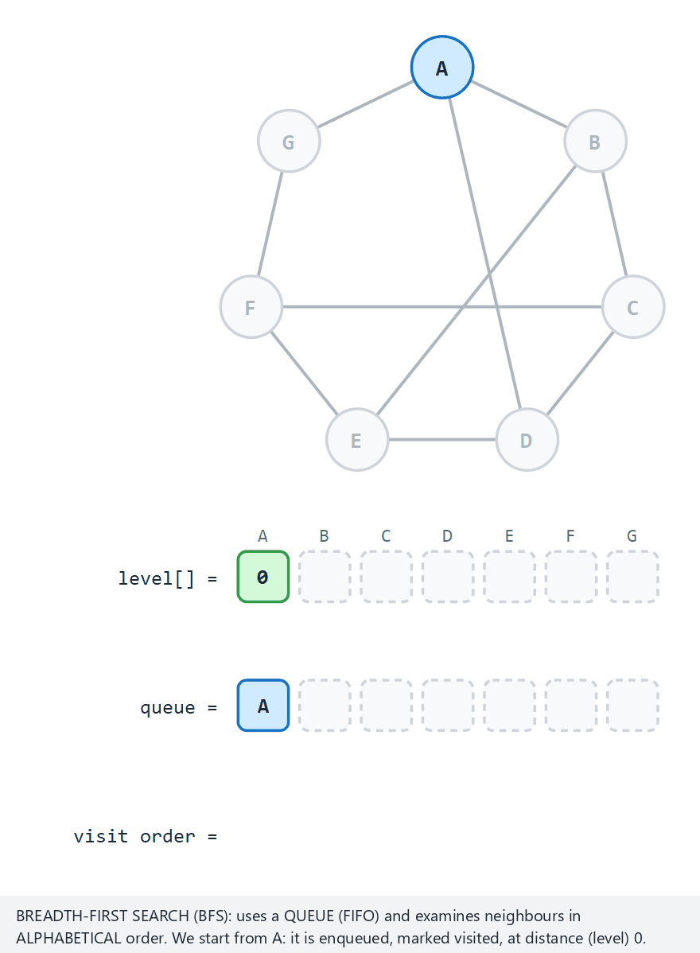
CEN207 Data Structures · Week 5
BFS, step by step
RTEU Computer Engineering · Fall 2026–2027
65
Notes:
Normal example: 7 vertices, undirected, starting at A, 10 edges — watch the queue and the level[] row fill in together.

Slide 66
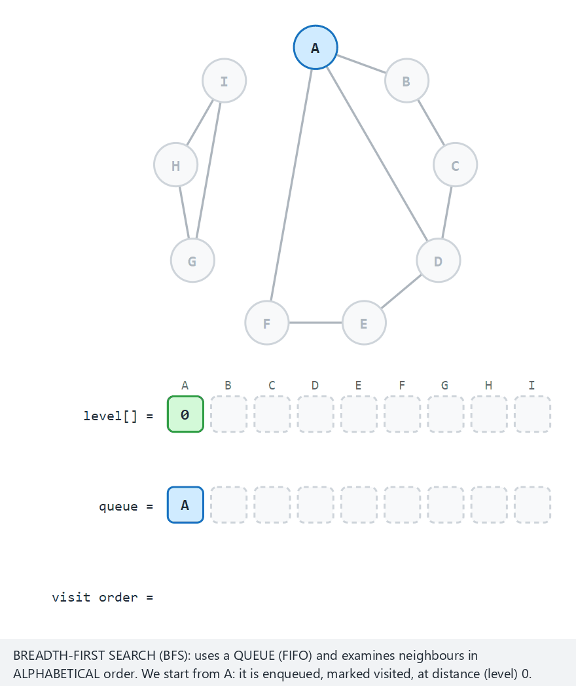
CEN207 Data Structures · Week 5
Edge case — a disconnected graph
RTEU Computer Engineering · Fall 2026–2027
66
Notes:
9 vertices, 2 components — G, H, I are simply unreachable from A, the starting vertex, and stay grey for the whole run.

Slide 67
CEN207 Data Structures · Week 5
Code — enqueue / dequeue
void enqueue(int v) {
queue_data[rear] = v;
rear = (rear + 1) % MAX_V;
count++;
}
int dequeue(void) {
int v = queue_data[front];
front = (front + 1) % MAX_V;
count--;
return v;
}
RTEU Computer Engineering · Fall 2026–2027
67
Notes:
The exact circular queue from Week 3 — only the element type changed, from int scores to graph vertex ids.

Slide 68
CEN207 Data Structures · Week 5
Code — bfs() main loop
visited[start] = 1;
level_of[start] = 0;
enqueue(start);
while (count > 0) {
int u = dequeue();
for (Edge *e = g->adj[u]; e; e = e->next) {
if (!visited[e->to]) {
visited[e->to] = 1;
level_of[e->to] = level_of[u] + 1;
parent_of[e->to] = u;
enqueue(e->to);
}
}
}
RTEU Computer Engineering · Fall 2026–2027
68
Notes:
Every unvisited neighbor gets marked, leveled, and given a parent pointer, all in the same instant it is first enqueued.

Slide 69
CEN207 Data Structures · Week 5
Complexity
• Every vertex enqueued once, dequeued once — O(V)
• Every edge examined at most twice (once per endpoint) — O(E)
• Total: O(V + E) — the same bound as every list operation
RTEU Computer Engineering · Fall 2026–2027
69
Notes:
This O(V + E) bound is the single most common complexity result in graph algorithms, and it recurs all through this week.

Slide 70
CEN207 Data Structures · Week 5
BFS tree and shortest paths
• The BFS tree's root-to-vertex path uses the fewest edges
• level_of[v] is exactly that shortest edge-count from the start
• This only holds for unweighted graphs — Section 8 uses it directly
• Weighted shortest paths need Dijkstra's algorithm, Week 9
RTEU Computer Engineering · Fall 2026–2027
70
Notes:
BFS is secretly already solving the unweighted shortest-path problem; Section 8 just makes that fact explicit.

Slide 71
CEN207 Data Structures · Week 5
Applications
• "Friends of friends" — Section 4's social-network motivation
• Web crawling level by level, nearest pages first
• Puzzle solvers: fewest moves to solve a maze or a sliding puzzle
• Network broadcast: reach every machine in the fewest hops
RTEU Computer Engineering · Fall 2026–2027
71
Notes:
Any time the question is "fewest steps", not "shortest weighted distance", BFS is usually the right first tool to reach for.

Slide 72
CEN207 Data Structures · Week 5
Common mistakes
• Using a stack instead of a queue — silently becomes depth-first
• Forgetting to mark a vertex visited at enqueue time, not dequeue
• Re-enqueuing an already-visited vertex — wastes work, may loop
RTEU Computer Engineering · Fall 2026–2027
72
Notes:
Marking "visited" too late is the single most common BFS bug — the same vertex can be enqueued more than once.

Slide 73
CEN207 Data Structures · Week 5
Mini-quiz
In an unweighted graph, BFS from A gives B level 2. How many edges are on the shortest path from A to B?
RTEU Computer Engineering · Fall 2026–2027
73
Notes:
Recall exactly what "level" was defined to mean, a few slides back.

Slide 74
CEN207 Data Structures · Week 5
Answer
Exactly 2 edges. BFS's level is defined as the fewest edges from the start — that is precisely the shortest-path edge count.
RTEU Computer Engineering · Fall 2026–2027
74
Notes:
This is the fact Section 8 turns into a full algorithm: level IS shortest-path length, for unweighted graphs.

Slide 75
CEN207 Data Structures · Week 5
5. Depth-First Search (DFS) — Recursive
RTEU Computer Engineering · Fall 2026–2027
75
Notes:
DFS is preorder, from Week 4, generalized from a tree to any graph — recursion, and nothing else, drives the whole algorithm.

Slide 76
CEN207 Data Structures · Week 5
A question to start
A maze has many branching paths. Instead of exploring every direction a little at a time, what if you committed to one path, all the way, before ever backtracking?
RTEU Computer Engineering · Fall 2026–2027
76
Notes:
"Commit, then backtrack" is depth-first search in one sentence — the opposite strategy from BFS's ring-by-ring approach.

Slide 77
CEN207 Data Structures · Week 5
Intuition — a maze, go deep first
• Pick a direction, walk it as far as it goes
• Dead end? Back up to the last choice, try the next direction
• "Back up" is exactly what a stack (or recursion) does for you
• Depth-first, not breadth-first — one branch, fully, before the next
RTEU Computer Engineering · Fall 2026–2027
77
Notes:
Recursion IS a stack, from Week 3 — every recursive dfs_visit call pushes a frame, and every return pops one.

Slide 78
CEN207 Data Structures · Week 5
Colors and times
• White (0): not yet discovered
• Gray (1): discovered, still exploring its neighbors
• Black (2): finished, every neighbor explored
• disc[v] / fin[v]: the clock tick each color change happens at
RTEU Computer Engineering · Fall 2026–2027
78
Notes:
A vertex is gray for exactly as long as it sits on the call stack — the moment it returns, it turns black.

Slide 79
CEN207 Data Structures · Week 5
Edge types
Type | Meaning
Tree edge | Leads to a new, white vertex
Back edge | Leads to a gray ancestor — a cycle!
Forward / cross | Leads to a finished, black vertex (directed only)
RTEU Computer Engineering · Fall 2026–2027
79
Notes:
Forward and cross edges cannot happen in an undirected graph — there, every non-tree edge you find is a back edge.

Slide 80
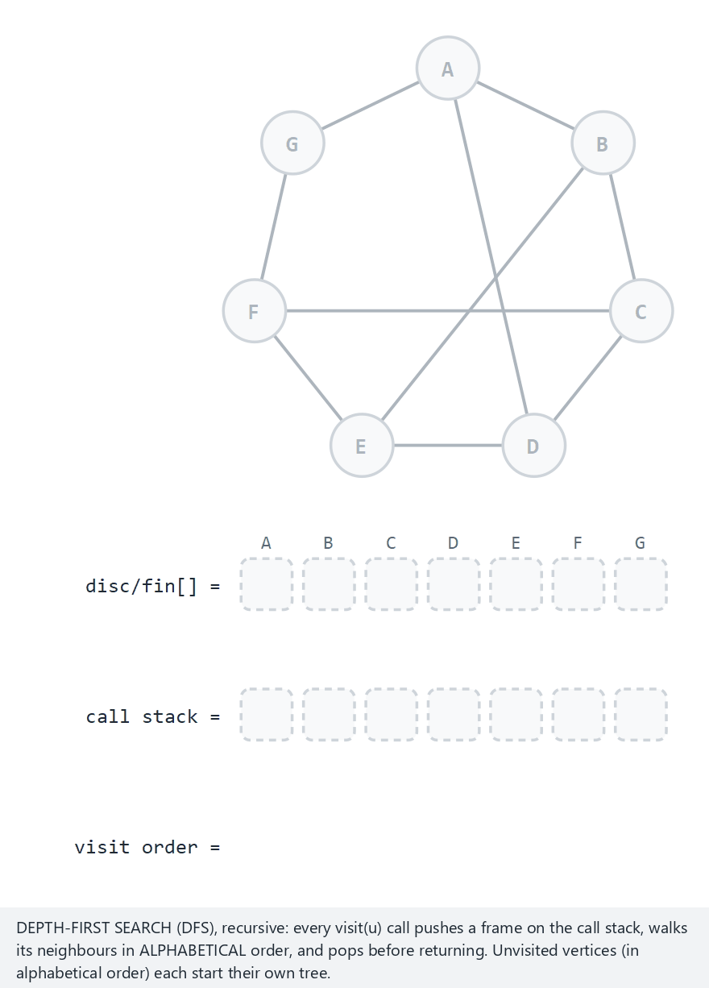
CEN207 Data Structures · Week 5
DFS recursive, step by step
RTEU Computer Engineering · Fall 2026–2027
80
Notes:
Normal example: 7 vertices, undirected, 4 back edges, 10 edges — watch the call stack column and disc/fin[] fill in together.

Slide 81
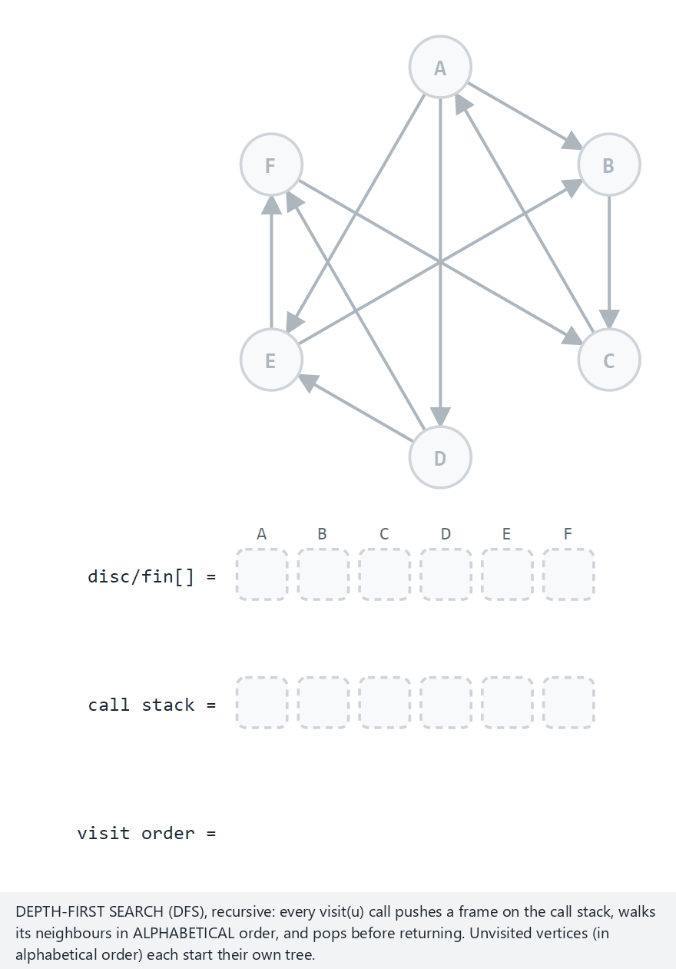
CEN207 Data Structures · Week 5
Edge case — all four edge types at once
RTEU Computer Engineering · Fall 2026–2027
81
Notes:
6 vertices, directed, built specifically so a tree, a back, a forward, and a cross edge all appear in one single run.

Slide 82
CEN207 Data Structures · Week 5
Code — dfs_visit(): discovery
void dfs_visit(Graph *g, int u) {
color_of[u] = 1; /* gray */
disc_time[u] = ++clock_;
for (Edge *e = g->adj[u]; e; e = e->next) {
int v = e->to;
/* ... classify the edge to v ... */
}
color_of[u] = 2; /* black */
fin_time[u] = ++clock_;
}
RTEU Computer Engineering · Fall 2026–2027
82
Notes:
One shared clock counts up on every discovery AND every finish — that is what makes disc/fin intervals nest correctly.

Slide 83
CEN207 Data Structures · Week 5
Code — classifying an edge
if (color_of[v] == 0) {
parent_of[v] = u;
dfs_visit(g, v); /* tree edge */
} else if (color_of[v] == 1) {
/* back edge: v is an ancestor */
} else {
/* v is black: forward or cross */
}
RTEU Computer Engineering · Fall 2026–2027
83
Notes:
Three colors, three branches — the entire edge-classification idea from a few slides back, written as one if/else chain.

Slide 84
CEN207 Data Structures · Week 5
Code — one tree per component
void dfs(Graph *g) {
for (int i = 0; i < g->vertex_count; i++)
color_of[i] = 0;
for (int i = 0; i < g->vertex_count; i++)
if (color_of[i] == 0)
dfs_visit(g, i);
}
RTEU Computer Engineering · Fall 2026–2027
84
Notes:
A disconnected graph's DFS produces not one tree but a DFS FOREST — one tree per component, exactly like Section 7's components.

Slide 85
CEN207 Data Structures · Week 5
Complexity
• Every vertex colored white → gray → black once — O(V)
• Every edge examined exactly once (twice if undirected) — O(E)
• Total: O(V + E) — identical to BFS's bound
RTEU Computer Engineering · Fall 2026–2027
85
Notes:
BFS and DFS visit the very same set of vertices and edges — only the ORDER differs, never the total work.

Slide 86
CEN207 Data Structures · Week 5
Recursion depth: a hidden risk
• Each dfs_visit call adds one frame to the call stack
• A long chain graph can recurse as deep as V calls
• A very large or very "stringy" graph can overflow that stack
• Section 6 rebuilds DFS with an explicit stack to avoid exactly this
RTEU Computer Engineering · Fall 2026–2027
86
Notes:
This is not a hypothetical: a million-vertex chain graph really can crash a naive recursive DFS in practice.

Slide 87
CEN207 Data Structures · Week 5
Common mistakes
• Forgetting to skip the edge straight back to your own parent
• Treating every non-tree edge as a "cycle" on a directed graph
• Reusing color_of across runs without resetting it to white
RTEU Computer Engineering · Fall 2026–2027
87
Notes:
On an undirected graph, the edge back to your immediate parent is not a real back edge — it is the same edge you just arrived on.

Slide 88
CEN207 Data Structures · Week 5
Mini-quiz
In an undirected graph, DFS finds an edge to a vertex that is currently gray. What does that tell you about the graph?
RTEU Computer Engineering · Fall 2026–2027
88
Notes:
Recall exactly what "gray" means, and where a gray vertex currently sits.

Slide 89
CEN207 Data Structures · Week 5
Answer
The graph has a cycle. A gray vertex is still on the call stack — it is an ancestor of the current vertex, so this edge is a back edge.
RTEU Computer Engineering · Fall 2026–2027
89
Notes:
This is exactly how graph-terminology.js detected the cycle it reported back in Section 2's animation.

Slide 90
CEN207 Data Structures · Week 5
6. DFS — Iterative (Explicit Stack)
RTEU Computer Engineering · Fall 2026–2027
90
Notes:
Section 5's recursion risk motivates this section directly: the same algorithm, the same visit order, but with our own array-based stack instead of the call stack.

Slide 91
CEN207 Data Structures · Week 5
A question to start
Section 5 ended on a warning: deep recursion can overflow the call stack. Can the exact same traversal be written without recursion?
RTEU Computer Engineering · Fall 2026–2027
91
Notes:
Yes — and the technique is one this course has already used once before, back in Week 4's iterative inorder traversal.

Slide 92
CEN207 Data Structures · Week 5
Why go iterative?
• Recursion's call stack has a fixed size, set by the OS
• Our own stack (Week 3's array-based one) can be sized as needed
• Same algorithm, same visit order — only the bookkeeping moves
• No memory saved overall, just moved somewhere safer
RTEU Computer Engineering · Fall 2026–2027
92
Notes:
This is the exact same motivation as Week 4's iterative inorder traversal, now applied to a graph instead of a tree.

Slide 93
CEN207 Data Structures · Week 5
The reverse-order trick
• Neighbors must be visited in alphabetical order, like recursion
• Pushing them alphabetically would pop them backwards
• Fix: push neighbors in reverse alphabetical order
• Popping a reversed-push order restores the original order
RTEU Computer Engineering · Fall 2026–2027
93
Notes:
This single trick is the whole difference between "an explicit stack" and "an explicit stack that matches recursion exactly".

Slide 94
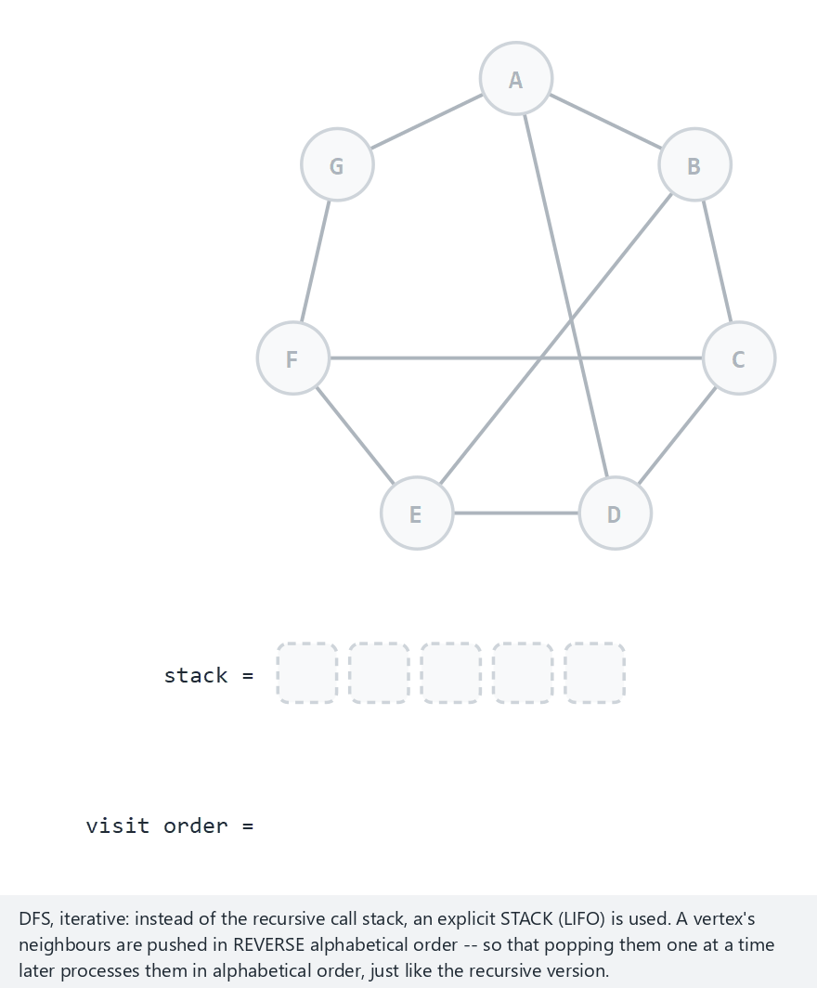
CEN207 Data Structures · Week 5
DFS iterative, step by step
RTEU Computer Engineering · Fall 2026–2027
94
Notes:
Same normal example as Section 5: 7 vertices, undirected, 4 back edges, 10 edges — the visit order comes out identical.

Slide 95
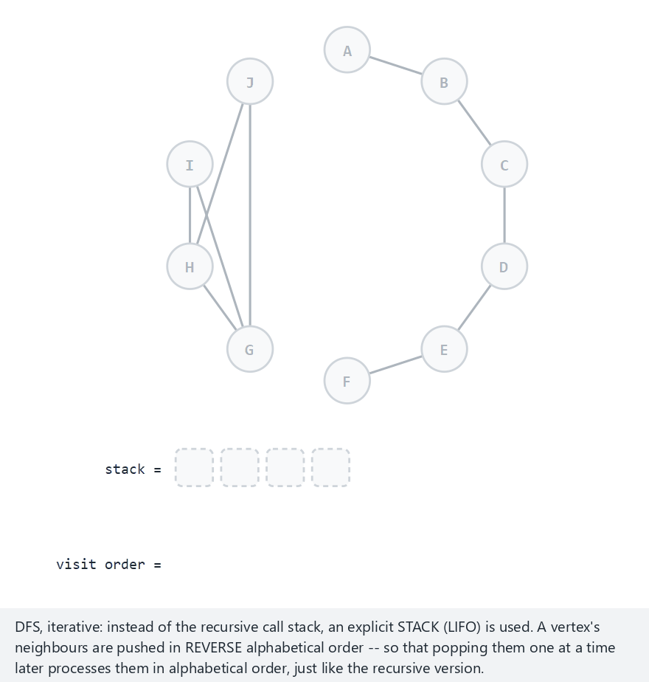
CEN207 Data Structures · Week 5
Edge case — a DFS forest
RTEU Computer Engineering · Fall 2026–2027
95
Notes:
10 vertices, 2 separate components — a fresh stack starts from each unvisited vertex, producing one tree per component, exactly as in Section 5.

Slide 96
CEN207 Data Structures · Week 5
Code — push / pop
void push(int v) { stack_data[++top] = v; }
int pop(void) { return stack_data[top--]; }
RTEU Computer Engineering · Fall 2026–2027
96
Notes:
The plainest possible array-based stack — one increment on push, one decrement on pop, nothing else.

Slide 97
CEN207 Data Structures · Week 5
Code — dfs_iterative() main loop
push(start);
while (top >= 0) {
int u = pop();
if (visited[u]) continue; /* stale entry */
visited[u] = 1;
for (int i = deg[u] - 1; i >= 0; i--)
if (!visited[adj[u][i]])
push(adj[u][i]);
}
RTEU Computer Engineering · Fall 2026–2027
97
Notes:
The "if (visited[u]) continue" line matters: a vertex can be pushed more than once, and only the FIRST pop should count.

Slide 98
CEN207 Data Structures · Week 5
Complexity
• Every vertex pushed and popped a bounded number of times — O(V)
• Every edge examined once (twice if undirected) — O(E)
• Total: O(V + E) — no better, no worse than the recursive version
RTEU Computer Engineering · Fall 2026–2027
98
Notes:
The whole point was never speed — it was avoiding a call-stack overflow that the recursive version risks on deep graphs.

Slide 99
CEN207 Data Structures · Week 5
Recursive vs. iterative, side by side
 | Recursive (Sec. 5) | Iterative (Sec. 6)
Stack | The call stack | Our own array
Visit order | Alphabetical | Alphabetical (reversed pushes)
Deep-graph risk | Can overflow | Bounded by array size
RTEU Computer Engineering · Fall 2026–2027
99
Notes:
Same order, same complexity, same output — this table is really about which stack does the remembering.

Slide 100
CEN207 Data Structures · Week 5
Common mistakes
• Pushing neighbors in forward, not reverse, alphabetical order
• Forgetting the stale-entry check — double-visits, wrong disc/fin
• Assuming a popped, unvisited vertex is always freshly discovered
RTEU Computer Engineering · Fall 2026–2027
100
Notes:
Skipping the stale-entry check is the single most common bug when converting recursion to an explicit stack by hand.

Slide 101
CEN207 Data Structures · Week 5
Mini-quiz
A vertex is pushed twice, from two different neighbors, before either pop happens. How many times is it actually visited?
RTEU Computer Engineering · Fall 2026–2027
101
Notes:
Recall what the stale-entry check on the previous code slide is specifically there to prevent.

Slide 102
CEN207 Data Structures · Week 5
Answer
Once. The first pop() visits it and marks it visited; the second pop() finds visited[u] already true and is discarded.
RTEU Computer Engineering · Fall 2026–2027
102
Notes:
That discard is exactly the "stale entry" case the code's `if (visited[u]) continue` line handles.

Slide 103
CEN207 Data Structures · Week 5
7. Connected Components
RTEU Computer Engineering · Fall 2026–2027
103
Notes:
Section 7 reuses BFS itself, unchanged, as a subroutine — the only new idea is calling it once per unvisited vertex and giving each run its own label.

Slide 104
CEN207 Data Structures · Week 5
A question to start
A graph may not be one connected piece — it can be several separate pieces. How many? Which vertices belong to which piece?
RTEU Computer Engineering · Fall 2026–2027
104
Notes:
Section 1 already warned that a graph need not be connected; this section answers "how disconnected, exactly?".

Slide 105
CEN207 Data Structures · Week 5
The idea
• Every unvisited vertex starts a new BFS, with a new id
• That BFS labels everything it can reach with that same id
• Once the queue empties, the next unvisited vertex starts the next
• Direction is ignored — this finds weak connectivity
RTEU Computer Engineering · Fall 2026–2027
105
Notes:
"Weak" connectivity means we treat every directed edge as if it were undirected, just for this one question.

Slide 106
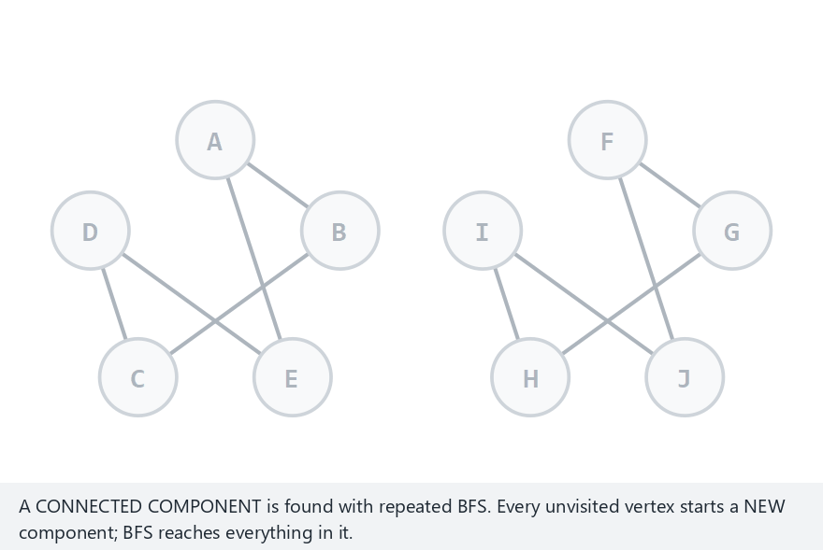
CEN207 Data Structures · Week 5
Connected components, step by step
RTEU Computer Engineering · Fall 2026–2027
106
Notes:
Normal example: 10 vertices, undirected, 2 components (two separate 5-cycles), 10 edges — watch each BFS claim its own circle.

Slide 107
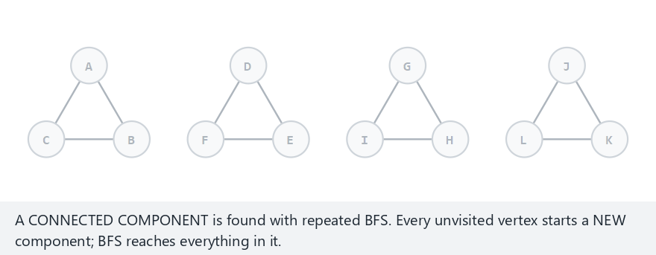
CEN207 Data Structures · Week 5
Edge case — many small components
RTEU Computer Engineering · Fall 2026–2027
107
Notes:
12 vertices, undirected, 4 separate triangle components, 12 edges — the most components this section's animation ever shows at once.

Slide 108
CEN207 Data Structures · Week 5
Code — bfs_label()
void bfs_label(Graph *g, int start, int id) {
int q[MAX_V], front = 0, rear = 0;
comp_of[start] = id;
q[rear++] = start;
while (front < rear) {
int u = q[front++];
for (Edge *e = g->adj[u]; e; e = e->next)
if (comp_of[e->to] == -1) {
comp_of[e->to] = id;
q[rear++] = e->to;
}
}
}
RTEU Computer Engineering · Fall 2026–2027
108
Notes:
This is Section 4's plain BFS, completely unchanged, except that "visited" is now "comp_of == -1" and the mark left behind is an id, not just true/false.

Slide 109
CEN207 Data Structures · Week 5
Code — count_components()
int count_components(Graph *g) {
int next_id = 0;
for (int i = 0; i < g->vertex_count; i++)
comp_of[i] = -1;
for (int i = 0; i < g->vertex_count; i++)
if (comp_of[i] == -1)
bfs_label(g, i, next_id++);
return next_id;
}
RTEU Computer Engineering · Fall 2026–2027
109
Notes:
next_id both counts the components AND becomes each new component's label — one variable, two jobs.

Slide 110
CEN207 Data Structures · Week 5
Complexity
• Every vertex enters exactly one bfs_label call — O(V)
• Every edge examined at most twice total, across all calls — O(E)
• Total: O(V + E) — the cost of one BFS, done once per component
RTEU Computer Engineering · Fall 2026–2027
110
Notes:
Running BFS several times, once per component, still adds up to the same O(V + E) as one single BFS over the whole graph.

Slide 111
CEN207 Data Structures · Week 5
Applications
• Social networks: which friend circles exist, and who is in each
• Image processing: which pixels form one connected region
• Networking: which machines can currently reach each other
• Puzzle games: "flood fill" — the paint-bucket tool, essentially
RTEU Computer Engineering · Fall 2026–2027
111
Notes:
Flood fill is worth naming specifically — it is exactly this algorithm, run on a grid of pixels instead of a graph of vertices.

Slide 112
CEN207 Data Structures · Week 5
Common mistakes
• Forgetting direction is ignored here — this is weak connectivity
• Reusing comp_of values across separate graphs without resetting
• Assuming a single-vertex graph has zero components — it has one
RTEU Computer Engineering · Fall 2026–2027
112
Notes:
Strong connectivity (respecting direction) is a genuinely harder problem, needing more than plain BFS — outside this week's scope.

Slide 113
CEN207 Data Structures · Week 5
Mini-quiz
A directed graph has an edge A>B but no edge B>A. Weakly, are A and B in the same component?
RTEU Computer Engineering · Fall 2026–2027
113
Notes:
Recall exactly what "direction is ignored" was said to mean, a few slides back.

Slide 114
CEN207 Data Structures · Week 5
Answer
Yes. Weak connectivity ignores direction entirely, so A>B alone is enough to place A and B in the same component.
RTEU Computer Engineering · Fall 2026–2027
114
Notes:
Strong connectivity would require BOTH A>B and a path back from B to A — a stricter, different question entirely.

Slide 115
CEN207 Data Structures · Week 5
8. Shortest Path in Unweighted Graphs
RTEU Computer Engineering · Fall 2026–2027
115
Notes:
Section 4 already computed every vertex's level; this section makes that fact fully explicit by reconstructing the actual shortest path, not just its length.

Slide 116
CEN207 Data Structures · Week 5
A question to start
BFS already knows the fewest edges from A to every vertex. Can it also report the exact route — not just the distance?
RTEU Computer Engineering · Fall 2026–2027
116
Notes:
Yes — and the mechanism is one already sitting inside BFS's output: the parent pointer, recorded the instant each vertex is first reached.

Slide 117
CEN207 Data Structures · Week 5
The idea
• Run BFS from s, recording each vertex's parent as usual
• To find the path to t: start at t, follow parent backward
• Stop when you reach s — then reverse the collected list
• The result is the shortest s-to-t path, by edge count
RTEU Computer Engineering · Fall 2026–2027
117
Notes:
Nothing here is new machinery — it is Section 4's BFS, plus one short walk backward through the parent pointers it already built.

Slide 118
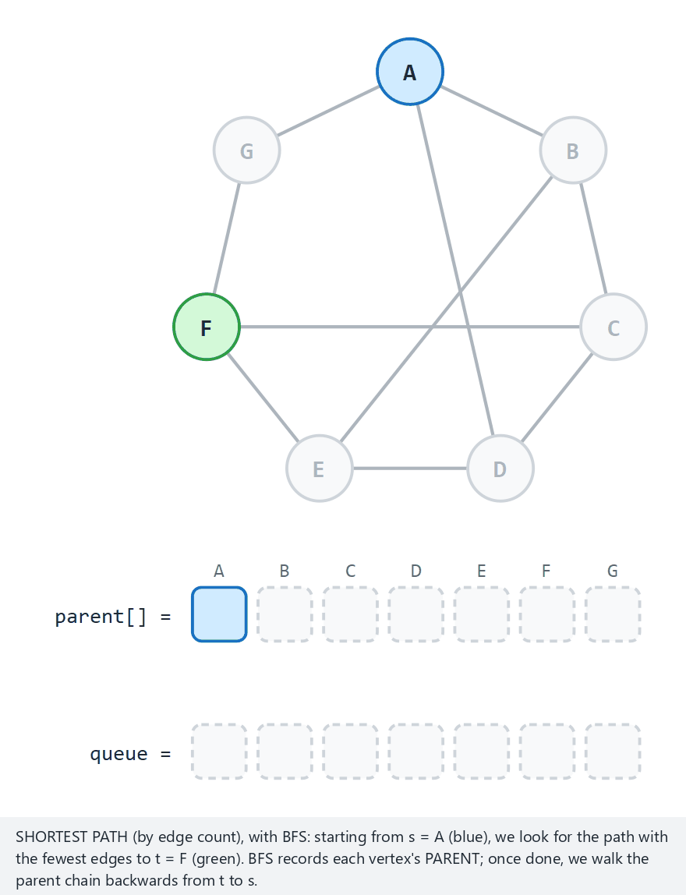
CEN207 Data Structures · Week 5
Path-finding BFS, step by step
RTEU Computer Engineering · Fall 2026–2027
118
Notes:
Normal example: 7 vertices, undirected, s=A, t=F, 10 edges — watch parent[] fill in during BFS, then get walked backward at the end.

Slide 119
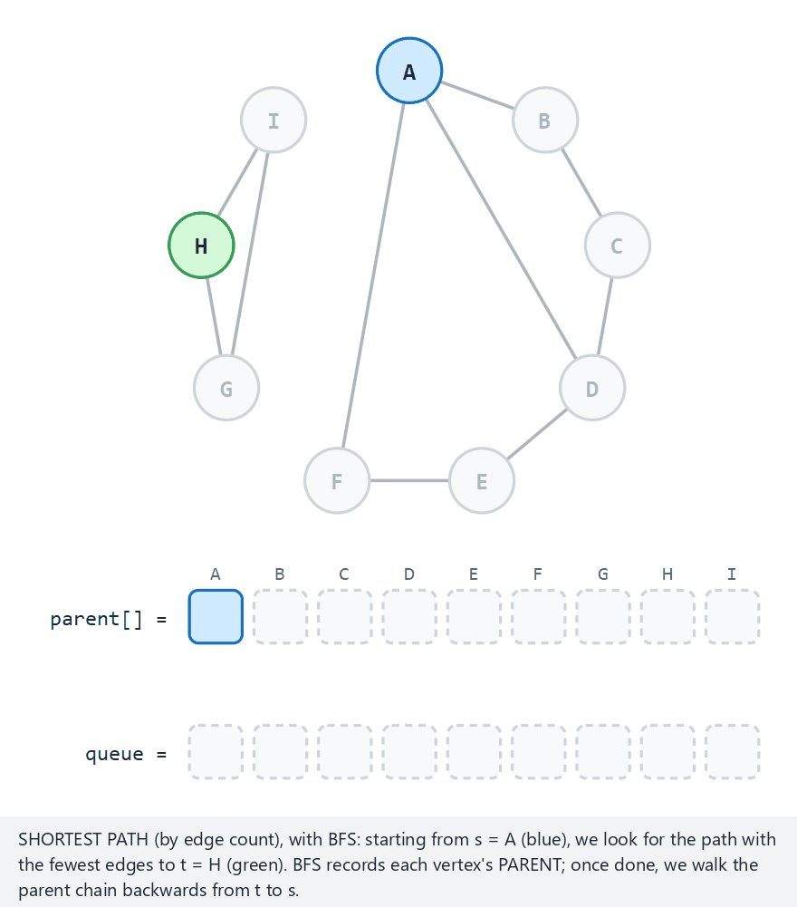
CEN207 Data Structures · Week 5
Edge case — no path exists
RTEU Computer Engineering · Fall 2026–2027
119
Notes:
9 vertices, s=A, t=H, in 2 separate components — the queue empties with t never visited, so no path can be reported at all.

Slide 120
CEN207 Data Structures · Week 5
Code — bfs_shortest_path(): the search
visited[s] = 1;
queue_data[rear++] = s;
while (front < rear) {
int u = queue_data[front++];
for (Edge *e = g->adj[u]; e; e = e->next)
if (!visited[e->to]) {
visited[e->to] = 1;
parent_of[e->to] = u;
queue_data[rear++] = e->to;
}
}
RTEU Computer Engineering · Fall 2026–2027
120
Notes:
Identical to Section 4's BFS loop, with one difference: this version's ONLY goal is filling in parent_of correctly.

Slide 121
CEN207 Data Structures · Week 5
Code — walking back the path
if (!visited[t]) return -1; /* no path */
int len = 0, v = t;
while (v != s) {
path_out[len++] = v;
v = parent_of[v];
}
path_out[len++] = s;
/* ... reverse path_out[0..len) in place ... */
return len - 1; /* edges */
RTEU Computer Engineering · Fall 2026–2027
121
Notes:
The walk builds the path backward, from t to s, purely because that is the only direction the parent pointers go — reversing at the end fixes the order.

Slide 122
CEN207 Data Structures · Week 5
Complexity
• The BFS itself: O(V + E), exactly as in Section 4
• Walking the path back: O(path length), at most O(V)
• Total: still O(V + E) — the walk-back never dominates
RTEU Computer Engineering · Fall 2026–2027
122
Notes:
Reconstructing the actual path is essentially free on top of a BFS you would often be running anyway.

Slide 123
CEN207 Data Structures · Week 5
Multiple shortest paths can exist
• BFS reports one shortest path, not necessarily the only one
• A different neighbor-visiting order can produce a different, equally short path
• All correct shortest paths share the same length, never necessarily the same route
RTEU Computer Engineering · Fall 2026–2027
123
Notes:
Only the LENGTH is guaranteed unique — the exact sequence of vertices depends on tie-breaking choices like alphabetical order.

Slide 124
CEN207 Data Structures · Week 5
Preview: weighted graphs need Dijkstra
• This section only works because every edge secretly has weight 1
• A weighted graph needs to compare actual distances, not edge counts
• Dijkstra's algorithm (Week 9) solves that, using a priority queue
• That priority queue is exactly the one Week 4 built from a heap
RTEU Computer Engineering · Fall 2026–2027
124
Notes:
BFS's plain queue always expands the nearest UNVISITED vertex by edge count; Dijkstra swaps in a priority queue so it expands by actual distance instead.

Slide 125
CEN207 Data Structures · Week 5
Common mistakes
• Forgetting to check visited[t] before walking the path back
• Walking parent forward instead of backward, from t to s
• Forgetting the final reversal — the path prints from t to s
RTEU Computer Engineering · Fall 2026–2027
125
Notes:
Every one of these three mistakes still runs without crashing — the bug only shows up in the printed path itself.

Slide 126
CEN207 Data Structures · Week 5
Mini-quiz
BFS from s never visits t at all. What should bfs_shortest_path return, and why?
RTEU Computer Engineering · Fall 2026–2027
126
Notes:
Recall the very first check the walk-back code makes, on the slide a few back.

Slide 127
CEN207 Data Structures · Week 5
Answer
`-1`. If t was never visited, no path exists at all — the visited[t] check catches exactly this case before any walk-back begins.
RTEU Computer Engineering · Fall 2026–2027
127
Notes:
This is precisely the situation the "no-path" edge-case animation above was built to demonstrate.

Slide 128
CEN207 Data Structures · Week 5
Summary — vocabulary and representations
Idea | Key fact
Graph | V vertices, E edges, directed or not
Degree | Undirected: 1 value; directed: in and out
Matrix | O(V²) space, O(1) has_edge
List | O(V + E) space, O(degree) has_edge
RTEU Computer Engineering · Fall 2026–2027
128
Notes:
Two representations, one table of trade-offs — every later algorithm's complexity traces back to this row.

Slide 129
CEN207 Data Structures · Week 5
Summary — traversals and applications
Idea | Key fact
BFS | Queue, level order, shortest unweighted path
DFS (recursive / iterative) | Stack, deep first, same visit order both ways
Components | Repeated BFS, one label per reachable set
Shortest path | BFS + parent pointers, walked backward
RTEU Computer Engineering · Fall 2026–2027
129
Notes:
Every one of these four rows is built from the same two moves: enqueue/dequeue, or push/pop.

Slide 130
CEN207 Data Structures · Week 5
The big picture
Drop a tree's "one root, no cycles" rule and you get a graph. Two structures store it; two traversals, BFS and DFS, explore it; both answer real questions — components, distance.
RTEU Computer Engineering · Fall 2026–2027
130
Notes:
If a student remembers only one sentence from today, this is the one worth remembering.

Slide 131
CEN207 Data Structures · Week 5
Self-check round
Four short questions. Think before the answer appears on the next slide. Full exercises and a ten-question quiz are in the week notes.
RTEU Computer Engineering · Fall 2026–2027
131
Notes:
These mirror the self-check quiz at the end of the written notes, one question per slide, with a shorter set here.

Slide 132
CEN207 Data Structures · Week 5
1. A graph has 6 vertices and is a complete graph (every pair connected). How many edges does it have?
RTEU Computer Engineering · Fall 2026–2027
132
Notes:
Ask, wait, then advance.

Slide 133
CEN207 Data Structures · Week 5
6 * 5 / 2 = 15 edges — every pair counted once, since the graph is undirected.
RTEU Computer Engineering · Fall 2026–2027
133
Notes:
For n vertices, a complete undirected graph always has n(n-1)/2 edges.

Slide 134
CEN207 Data Structures · Week 5
2. Why does BFS need a queue instead of a stack?
RTEU Computer Engineering · Fall 2026–2027
134
Notes:
Recall Section 4's ripples-on-a-pond intuition.

Slide 135
CEN207 Data Structures · Week 5
A queue's FIFO order visits the nearest vertices first; a stack would go deep immediately, becoming DFS instead.
RTEU Computer Engineering · Fall 2026–2027
135
Notes:
Swapping the data structure alone is the entire difference between these two traversal orders.

Slide 136
CEN207 Data Structures · Week 5
3. What does a "back edge" during DFS tell you about the graph?
RTEU Computer Engineering · Fall 2026–2027
136
Notes:
Recall Section 5's edge-type table.

Slide 137
CEN207 Data Structures · Week 5
The graph contains a cycle — a back edge always points to a gray ancestor still on the call stack.
RTEU Computer Engineering · Fall 2026–2027
137
Notes:
This is exactly the cycle-detection technique graph-terminology.js used back in Section 2.

Slide 138
CEN207 Data Structures · Week 5
4. Connected components treats a directed graph as if it were undirected. What is this called?
RTEU Computer Engineering · Fall 2026–2027
138
Notes:
Recall Section 7's terminology, a few slides back.

Slide 139
CEN207 Data Structures · Week 5
Weak connectivity — direction is ignored; strong connectivity, requiring a path back too, is a harder, different question.
RTEU Computer Engineering · Fall 2026–2027
139
Notes:
This distinction is worth remembering precisely, since the two give genuinely different answers on the same graph.

Slide 140
CEN207 Data Structures · Week 5
Next week
Week 6 — Search and Hashing
BFS and DFS both walk an entire graph to find something. What if you could look an item up directly, in close to O(1) time?
RTEU Computer Engineering · Fall 2026–2027
140
Notes:
Hashing trades the "explore everything" idea of this week for a completely different one: compute exactly where to look, in one step.

Slide 141
CEN207 Data Structures · Week 5
References (1/2)
• Course syllabus, Week 5: docs/syllabus/syllabus.en.md
• Cormen, Leiserson, Rivest, Stein. *Introduction to
Algorithms*, 4th ed. MIT Press
• Sedgewick, Wayne. Algorithms, 4th ed. Addison-Wesley
• Euler, L. (1736). *Solutio problematis ad geometriam
situs pertinentis*
RTEU Computer Engineering · Fall 2026–2027
141
Notes:
These are the same references listed at the end of the week's written notes.

Slide 142
CEN207 Data Structures · Week 5
References (2/2)
• Moore, E. F. (1959). "The shortest path through a maze"
• Hopcroft, J., Tarjan, R. (1973) — DFS edge classification
• Knuth. The Art of Computer Programming, Vol. 1, 3rd ed.
• williamfiset/Algorithms · Programiz DSA
RTEU Computer Engineering · Fall 2026–2027
142
Notes:
The historical references — Euler, Moore, Hopcroft and Tarjan — are what today's "short history" slides drew on.

